Slide 1


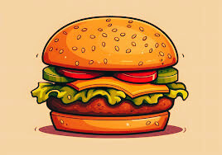

CAFE
STORY
2D ANIMATION CREATION

Slide 2
GROUP MEMBERS
W.A.D.Weerasingha - MMW/21/B1/31
A.D.R.A.Amandakoon - MMW/21/B1/33
W.A.H.A.Perera - MMW/21/B1/20
H.M.I.U.Deshapriya - MMW/21/B1/43
MODULE:
Multimedia and Product Development

Slide 3

INTRODUCTION
overview of the project.
Objective
Why a coffee shop theme was chosen

Slide 4

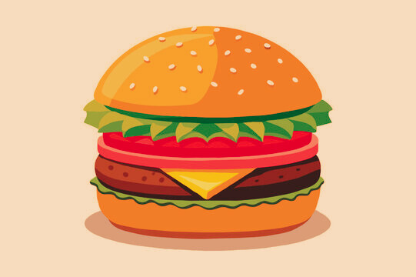
CONCEPT AND STORYLINE
Description of the storyline
creative inspiration

Slide 5


SOFTWARE AND TOOLS USED
Krita
Reasons for choosing Krita

Slide 6
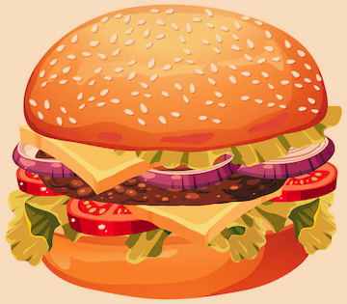
Workflow and Process
Steps in the project:
Storyboarding
Designing
Animating
Rendering

Slide 7

KEY SCENES
Highlight major scenes such as:
The café’s setup.
Visuals of the food and drink menu.
Animations of drinks being prepared
Food preparation animations

Slide 8

CHALLENGES
challenges faced:
Learning advanced animation techniques.
Managing rendering time for a 3-minute video.
Coordinating tasks among four group members.

Slide 9

SOLUTIONS
Team collaboration and task division.
Optimization of animation techniques to reduce render time.
Regular group meetings to ensure progress.

Slide 10
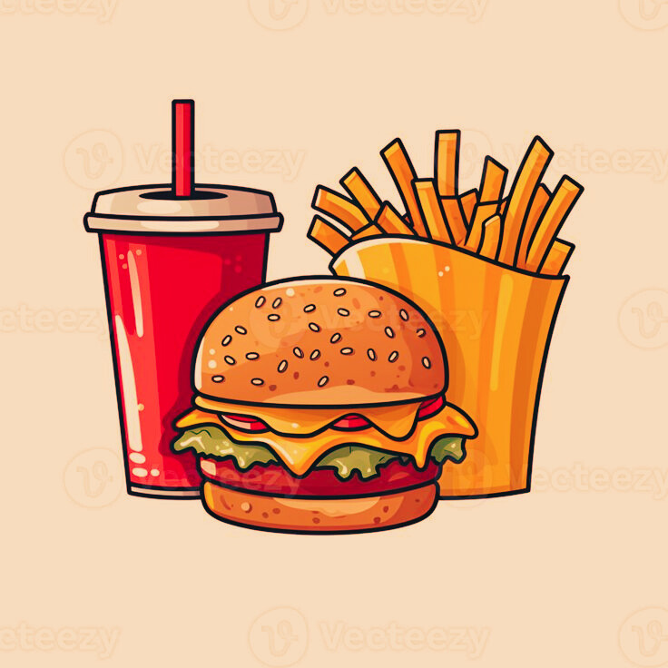
OUTCOME
A summary of the final product
Key features
Final runtime

Slide 11
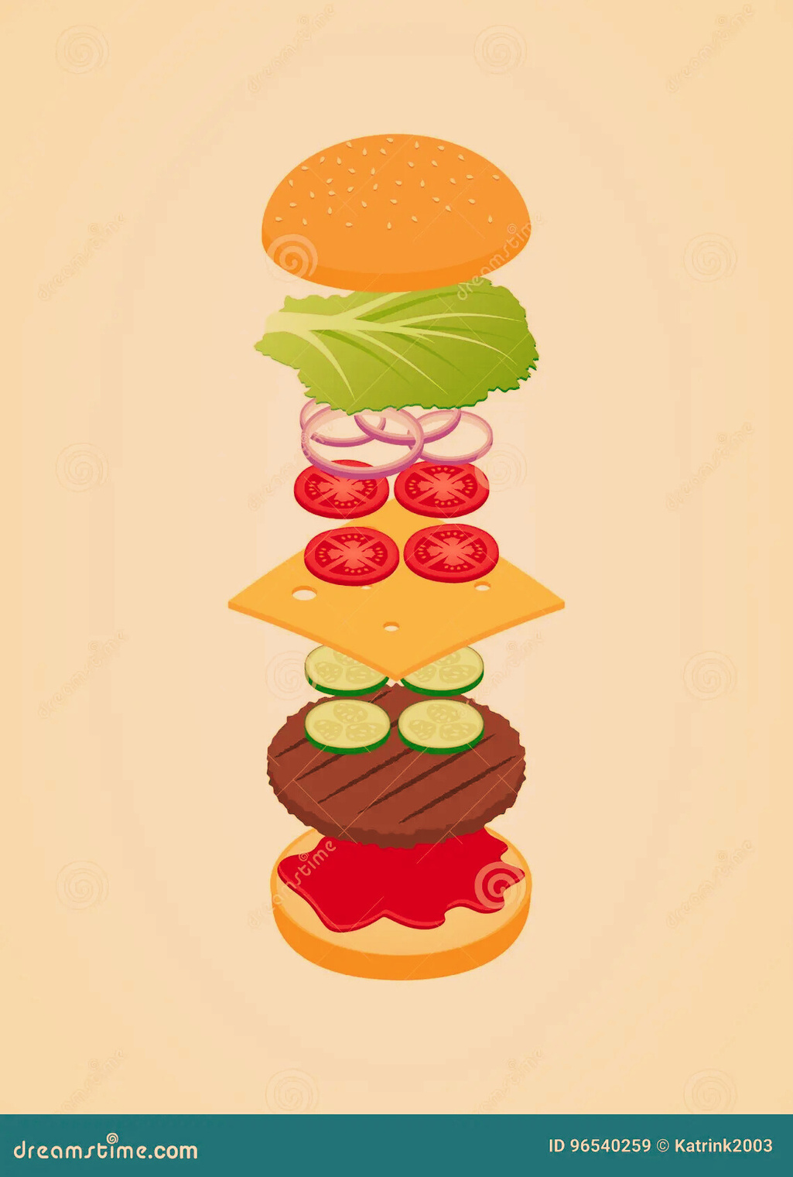
FUTURE IMPROVEMENTS
Ideas for improvement:
Add more detailed animations or customer interactions.
Improve rendering quality or animation techniques.
Gather and incorporate feedback from viewers.

Slide 12
CONCLUSION
Recap:
The project showcased the creation of a coffee shop and preparation of food and drinks through motion graphics, using Krita software."

Slide 13

THANK YOU!

