Slide 1
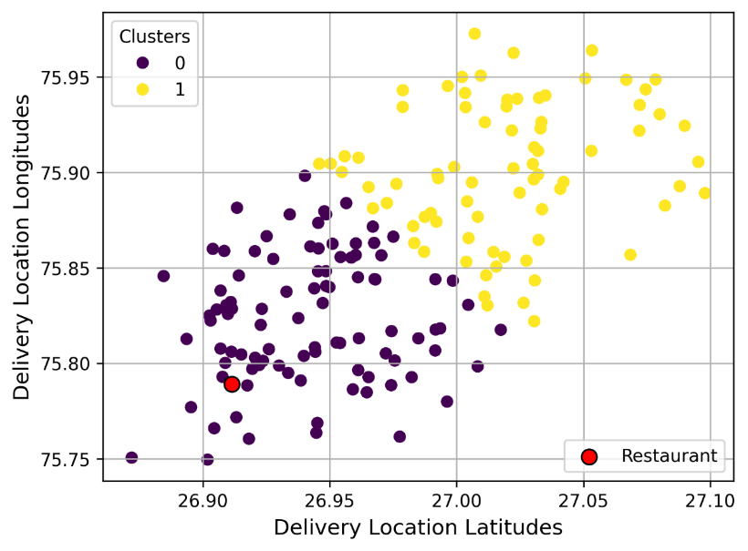
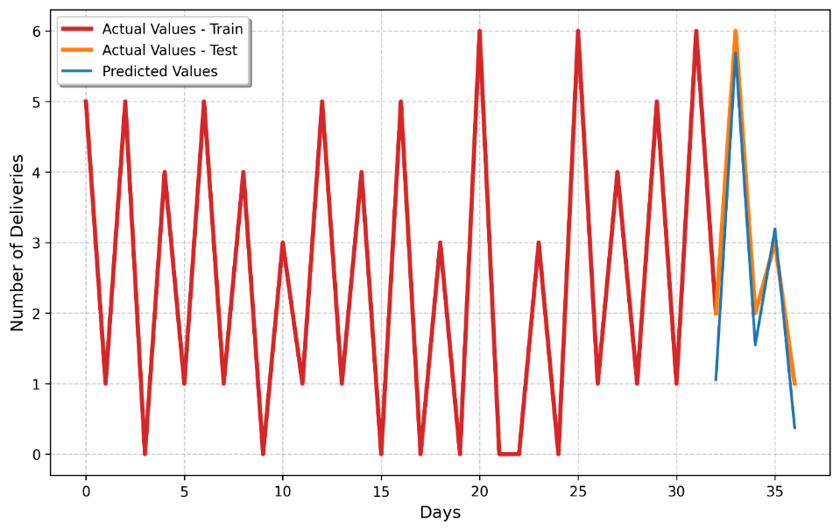
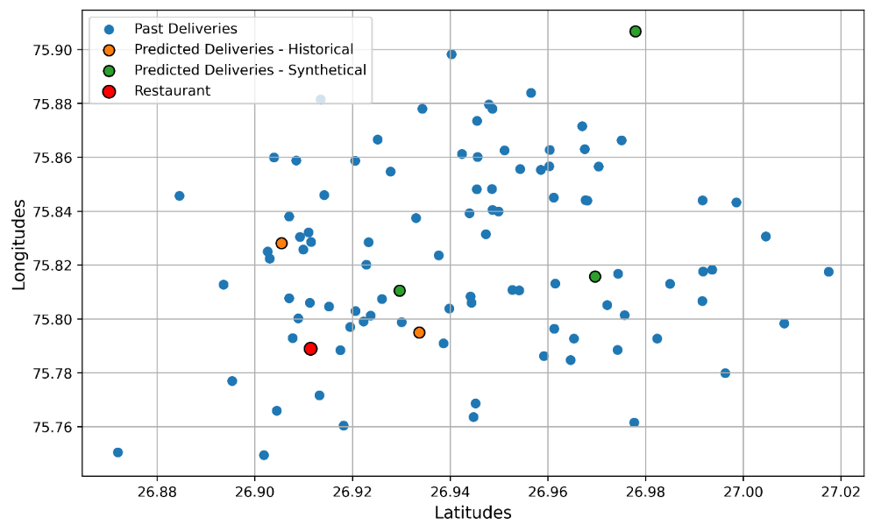
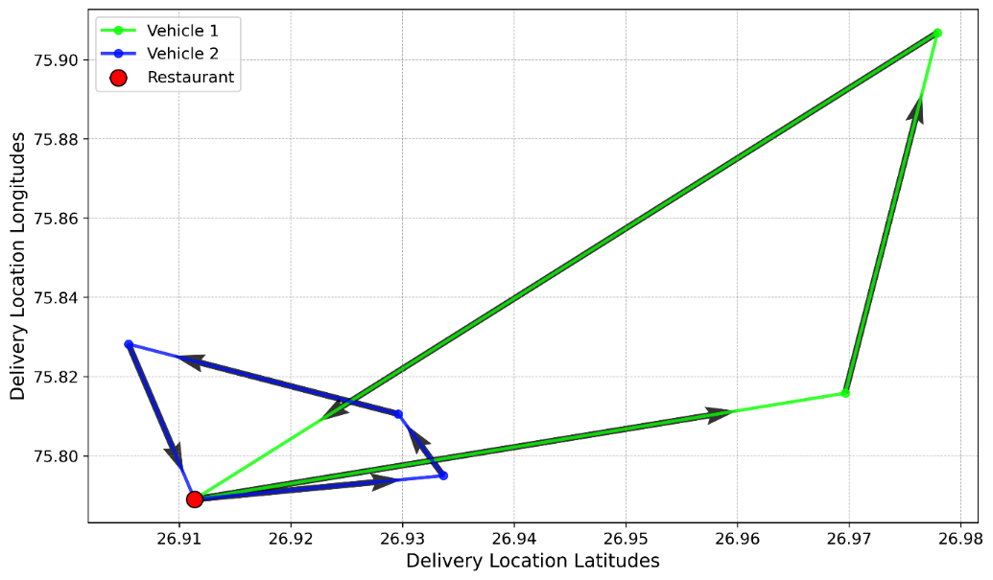
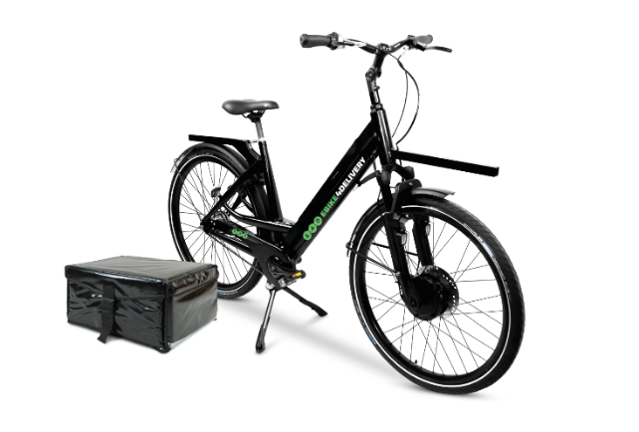
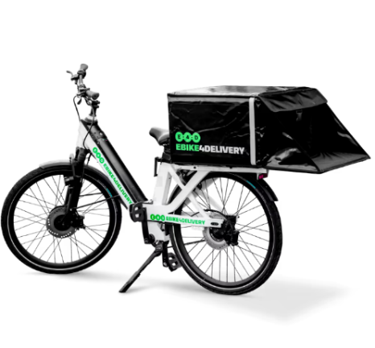
Enhancing Restaurant Delivery Through Predictive and Sustainable Practices
Cluster into zones
How are the past customers distributed among the delivery area?
What are the different zones of the delivery area?
How can the restaurant be expanded to other zones of the delivery?
For each zone
Forecast the deliveries
Generate new locations
Choose E-Bike model
Optimize delivery fleet
How much will be the demand for the next day?
How much E-Bikes will be needed as optimized fleet is required for the predicted demand?
What is the best E-Bike model from different providers?
How much Energy will be consumed, and CO2 Emissions will be saved by choosing the best E-Bike model?

