Slide 1

Demand Derived Sustainable Routing for Restaurant Deliveries
S. U. G. Senanayake
201462D
Prof. Amila Thibbotuwawa

Slide 2
Introduction
Background
Rise in Demand for Restaurant Deliveries
Pandemic Impact: COVID-19 lockdowns increased consumer demand for restaurant deliveries (Jia et al., 2020)
Third-Party Delivery Costs: Many restaurants partner with third-party services for scalability, but high fees (20%-30%) strain profitability (Khan, 2020).
Shift Toward In-House Solutions: Restaurants are exploring in-house delivery options to improve control and cost-effectiveness (Labib & Watfa, 2023).
Delivery Personnel Optimization
Efficient Staffing: Optimizing hiring and shift scheduling for delivery personnel is essential to manage costs and service quality.
Challenges: Balancing cost, demand fluctuations, and sustainable work shifts requires careful planning (Gur, 2020)
Sustainable Delivery Fleet
E-Bikes as an Eco-Friendly Solution: Cargo e-bikes equipped with IoT are effective in reducing urban noise and pollution, making them a sustainable delivery option (Tegeltija & Ostojić, 2020).
Route Optimization for Cost Efficiency
Efficient Routing: Optimal route planning reduces delivery times and costs, particularly with fluctuating demand. Routing should be tailored for cargo e-bikes to enhance efficiency and sustainability (Labib & Watfa, 2023).

Slide 3
Introduction
Gaps
Limited Studies have addressed and explored..
Integrated Delivery Optimization: A combined approach to optimize staffing, fleet size, and route selection based on predicted demand.
Shift-Based Staffing for Sustainability: Optimal shift scheduling for delivery personnel that considers both cost-efficiency and social sustainability.
Sustainable Evaluation of Delivery Modes: Evaluation of environmental and economical impact of cargo e-bikes versus traditional delivery bikes, specifically after optimizing staffing, fleet size, and routes based on predicted demand.
Simultaneous Optimization of Fleet, Staff, and Routes: Existing models often focus on one factor at a time.

Slide 4
Introduction
Research Question
"How can the optimal staffing, fleet size, and route configuration be determined for restaurant deliveries using cargo e-bikes, given predicted demand?“
Research Objective
“Predict demand for restaurant deliveries and identify high demand zones using AI to enhance forecasting accuracy”
“Optimize delivery staffing, fleet size, and routing configurations through operations research to meet demand efficiently and cost-effectively”
“Evaluate and compare the sustainable impact of cargo e-bikes versus traditional delivery bikes”

Slide 5
Research Method
Approach – Quantitative, Data-Driven Methodology
Dataset Pre-Processing - Preparing and calibrating data for accurate distance and demand modelling
Demand Prediction - Using LSTM to forecast delivery demand in dynamic settings like restaurants (Abbasimehr et al., 2020)
Distance Calculation - Google Distance Matrix API for calculating real-time, vehicle route distances
Sustainability Evaluation Comparing Social / Environmental / Econimical impacts of using Cargo E-Bikes vs Traditional Bikes
Vehicle Routing Problem (VRP) Scenario Analysis to simulate various routing constraints and demand scenarios, like time windows, pickups, deliveries, and capacity. (Giuffrida et al., 2022) and specifically run for different clusters of demand
Identifying Different Clusters of Locations of the predicted Demand - k-means Clustering (Rautela et al., 2019)

Slide 6
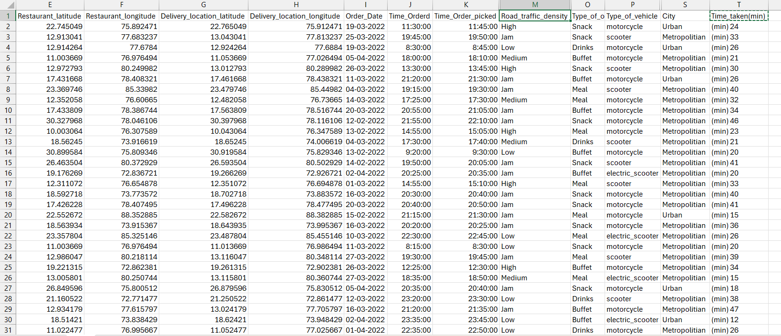
Data Collection
Malik, G. (2022). Food Delivery Dataset [Data set]. Kaggle. https://www.kaggle.com/datasets/gauravmalik26/food-delivery-dataset

Slide 7
Data Collection
Dataset holds aggregated real-world food delivery records of India.
Challenges
Data Quality Issues - Missing Values / Inconsistent Data
Data Bias - Geographic Bias / Time-Based Bias / Delivery Volume
Feature Selection
Handling Categorical Data - Encoding
Below columns that will be used for the Data Analysis in the Future
For Demand Prediction
Order_Date
For Route Optimization
Restaurant_latitude
Sustainability Evaluation
Road Traffic
Time_Orderd
Type_of_order
City
Restaurant_longitude
Delivery_location_latitude
Delivery_location_longitude
Time_Order_picked
Time_taken(min)
Type_of_Vehicle

Slide 8
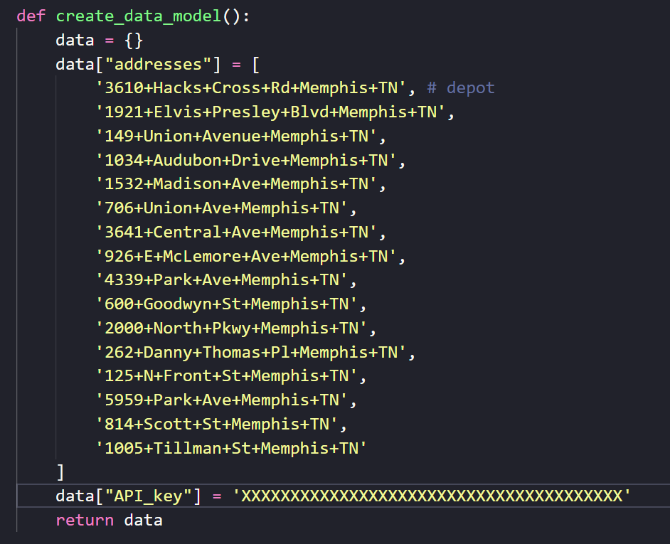
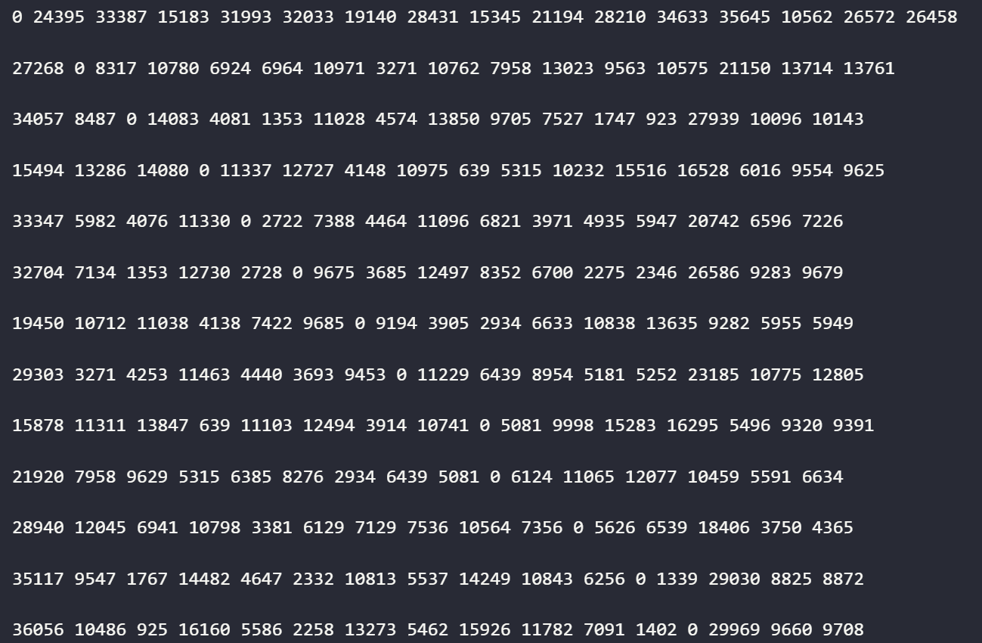
Data Analysis
Calculate the Distance Matrix using Google Maps Distance Matrix API for normal vehicle

Slide 9
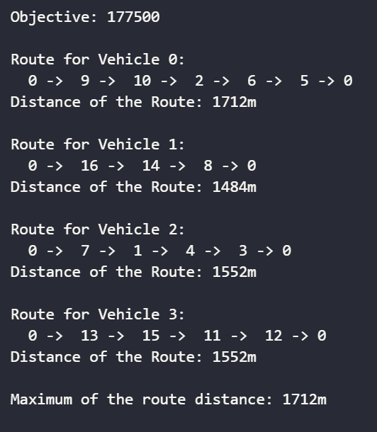
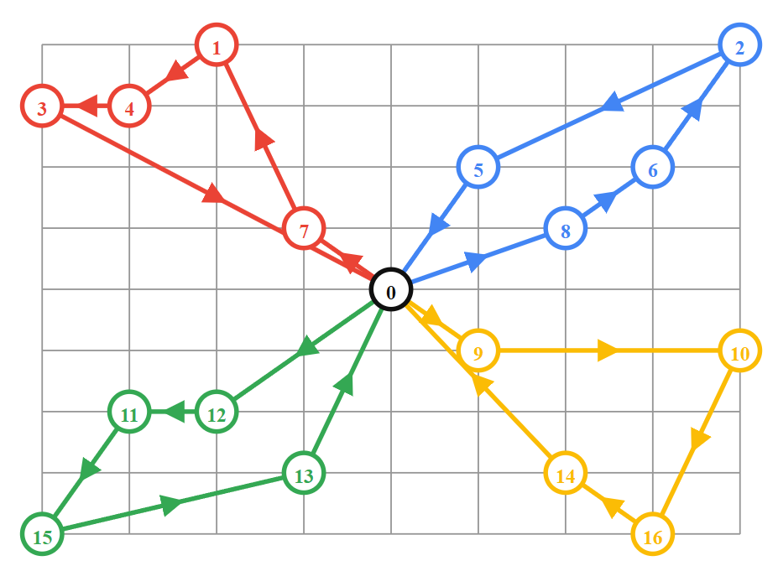
Data Analysis
Allocating Distances to Cargo E-Bikes (VRP)
Restaurant – 0 Node
Customers – 1, 2, 3, 4, 5, 6, 7, 8, 9, 10, 11, 12, 13, 14, 15, 16 Nodes
Distance per Cargo E-Bike = 3000km

Slide 10
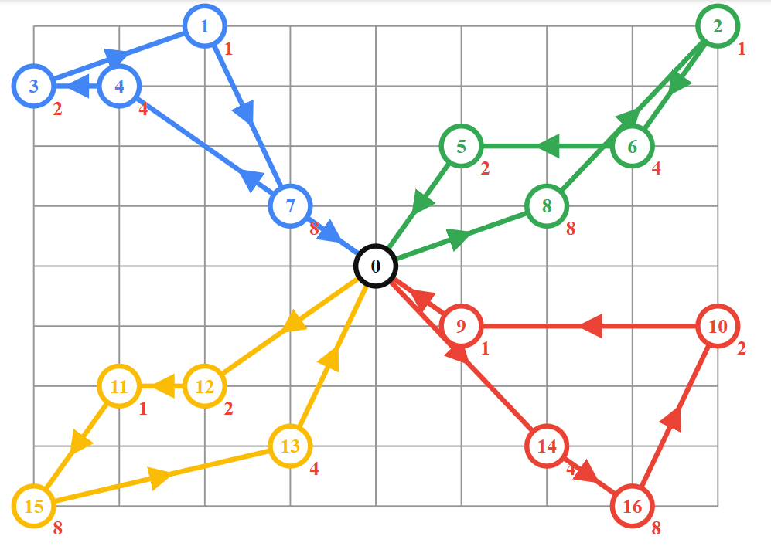
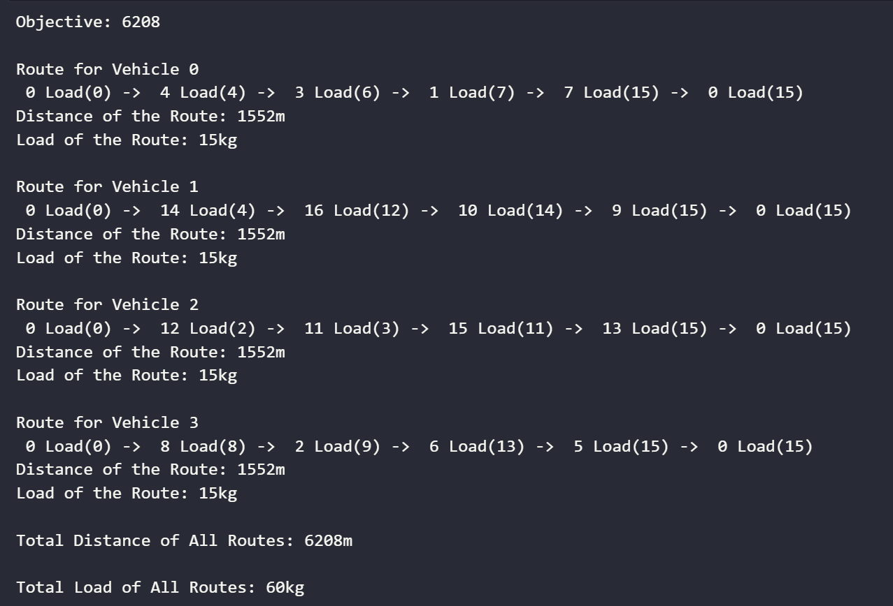
Data Analysis
Allocating Capacity to Cargo E-Bikes (CVRP)
Restaurant – 0 Node
Customers – 1, 2, 3, 4, 5, 6, 7, 8, 9, 10, 11, 12, 13, 14, 15, 16 Nodes
Capacity per Cargo E-Bike = 15kg

Slide 11
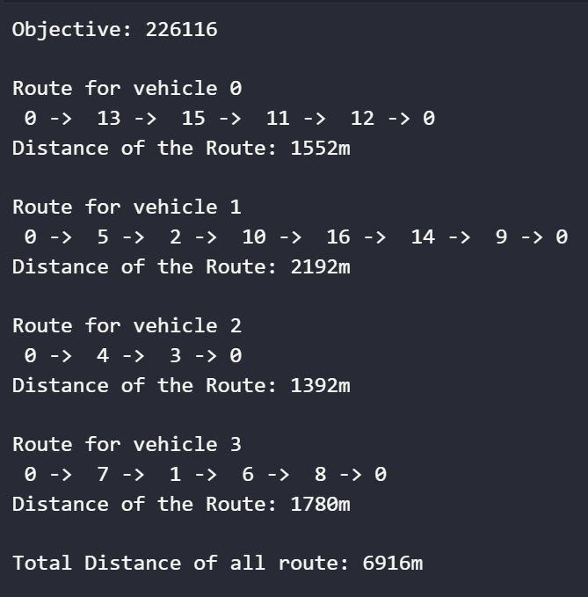
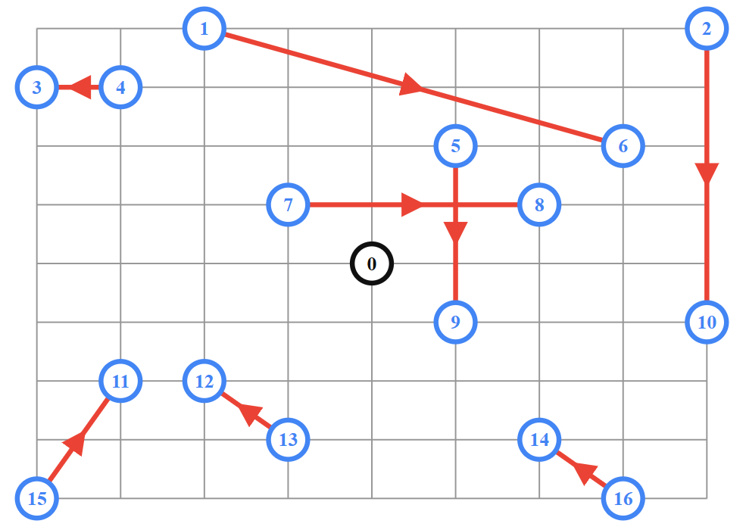
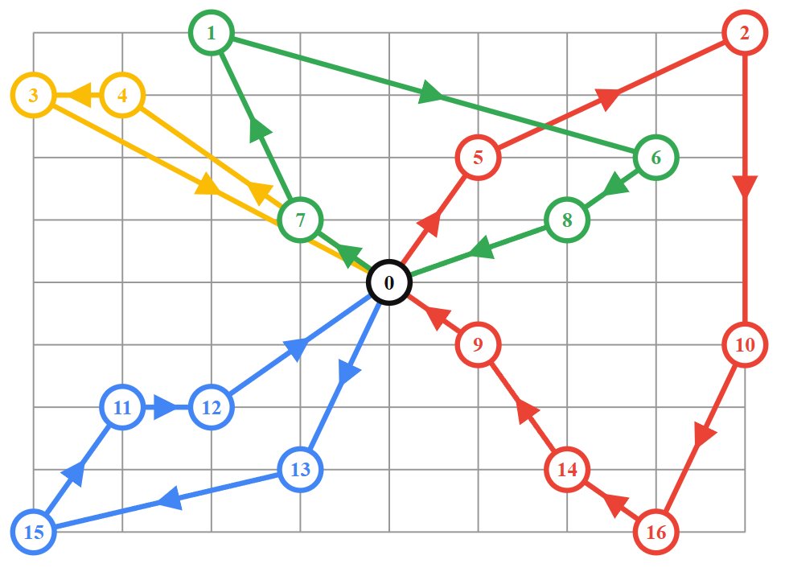
Data Analysis
Pickups and Deliveries using Cargo E-Bikes (PDVRP)
E-Bikes Depot – 0 Node
Restaurants – 1, 2, 4, 5, 7, 13, 15, 16 Nodes
Customers – 3, 6, 8, 9, 10, 11, 12, 14 Nodes
Range for Cargo E-Bike <= 3000m

Slide 12
Next Steps
Dataset -> Data Preprocessing (Cleansing, Calibration, Normalization)
Run LSTM to predict the demand using the “train data” of the dataset and check the accuracy them with the “test data”
Explore the Clusters of Locations of the Predicted Demand Locations using k-Means clustering
Run VRP for more various scenarios
Hard Time Windows
Combine dimensions
Various Demand Clusters
Finally, find the optimal delivery staff, optimal fleet & optimal route for a certain restaurant delivery
Evaluate and compare the Sustainability attributes such as Environmental, Economical and Social of solutions

Slide 13
References
Jia, H., Shen, S., García, J., & Shi, C. (2020). Partner with a Third-Party Delivery Service or Not? – a Prediction-and-Decision Tool for Restaurants Facing Takeout Demand Surges During a Pandemic. TransportRN: Other Urban Transportation (Topic). https://api.semanticscholar.org/CorpusID:229469154
Khan, M. A. (2020). Technological Disruptions in Restaurant Services: Impact of Innovations and Delivery Services. Journal of Hospitality and Tourism Research, 44(5), 715–732. https://doi.org/10.1177/1096348020908636
Labib, M. Y., & Watfa, M. K. (2023). Multi-method simulation approach: multiple restaurants to multiple customers on-demand food delivery services in Dubai. Journal of Foodservice Business Research, 26(2), 323–351. https://doi.org/10.1080/15378020.2022.2040284
Pinto, R., Zambetti, M., Lagorio, A., & Pirola, F. (2019). A network design model for a meal delivery service using drones. International Journal of Logistics Research and Applications, 23, 354–374. https://api.semanticscholar.org/CorpusID:213744736
Tegeltija Srdjan and Ostojić, G. and S. S. and K. D. and T. B. (2020). Food Delivery Using Cargo-Bikes with IoT. In B. and G. D. Anisic Zoran and Lalic (Ed.), Proceedings on 25th International Joint Conference on Industrial Engineering and Operations Management – IJCIEOM (pp. 483–491). Springer International Publishing.
Giuffrida, N., Fajardo-Calderin, J., Masegosa, A. D., Werner, F., Steudter, M., & Pilla, F. (2022). Optimization and Machine Learning Applied to Last-Mile Logistics: A Review. Sustainability (Switzerland), 14(9). https://doi.org/10.3390/su14095329
Rautela, A., Sharma, S. K., & Bhardwaj, P. (2019). Distribution planning using capacitated clustering and vehicle routing problem. Journal of Advances in Management Research. https://api.semanticscholar.org/CorpusID:195516656
Abbasimehr, H., Shabani, M., & Yousefi, M. (2020). An optimized model using LSTM network for demand forecasting. Computers & Industrial Engineering, 143, 106435. https://doi.org/https://doi.org/10.1016/j.cie.2020.106435

Slide 14
Thank You!

