Slide 1

Research proposal on “AI-Driven Predictive Logistics Optimization in Restaurant Supply Chains”
S. U. G. Senanayake
201462D

Slide 2
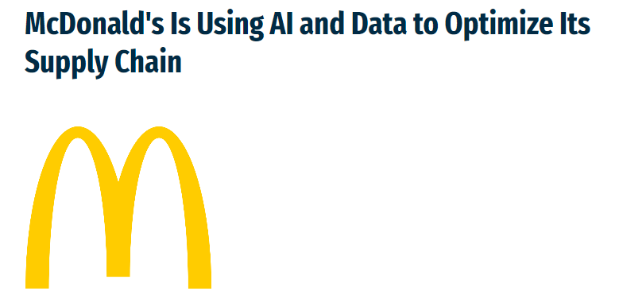

Introduction
Source: https://procureconsupplychain.wbresearch.com/blog/mcdonalds-ai-data-optimize-supply-chain
This research focuses on developing an AI-driven framework that integrates route optimization and demand forecasting and specifically tailored for restaurant supply chains.
Current Challenges in Restaurant Supply Chains
Route Optimization (Rajak et al., 2021)
Sustainability (Rajak et al., 2021) (Sutherland et al., 2016)
Complexity and Efficiency (Neal Analytics, 2022)
Consumer Expectations and Competitive Advantage (Neal Analytics, 2022) (Sutherland et al., 2016)

Slide 3
Introduction Cont.…
Research Gaps
Limited Applications of AI in Restaurant Supply Chains
Integration of Route Optimization and Demand Forecasting
Adaptation to Dynamic and Uncertain Environments
Objectives of the Study
Developing AI models that integrate route optimization and demand forecasting
Ensuring that these models can dynamically adjust to real-time changes in the environment
Tailoring these models specifically to meet the needs of restaurant supply chains, with an emphasis on sustainability and cost-efficiency
By addressing these unique logistical challenges of the restaurant industry, this study aims to enhance operational efficiency, reduce costs, and promote sustainability through advanced AI techniques.

Slide 4
Methodology
Data Collection
Geographical Data - Location and routing information
Sales Data - Historical sales data
External Data - weather, event calendars, and economic indicators to enhance prediction accuracy
Model Development - Route Optimization (Giuffrida et al., 2022)
Static Route Optimization
Dijkstra Algorithm
Vehicle Routing Problem (VRP) Solvers
Genetic Algorithms (GA) - to find near optimal solutions for routing problems with constraints like delivery windows and vehicle capacities
Simulated Annealing (SA) - explore the solution space using this probabilistic technique
Ant Colony Optimization (ACO) - to simulate the shortest path finding for delivery route optimization
Mixed-Integer Linear Programming (MILP) - solving routing problems with multiple constraints like time windows and vehicle capacities
Dynamic Route Optimization
Reinforcement Learning - Q-Learning and Deep Q-Networks (DQN) - an agent learns the best routes through trial and error, optimizing for rewards like minimized travel distance or fuel consumption, especially in dynamic and uncertain environments.

Slide 5
Methodology Cont.…
Model Development - Demand Forecasting (Smart Network Operator Platform Enabling Shared, Integrated and More Sustainable Urban Freight Logistics [D4.1] -Best Practice Catalogue, n.d.)
Time Series Analysis – ARIMA / SARIMA (Menculini et al., 2021)
Regression Models - Linear Regression / Random Forest
Deep Learning Models - LSTM (Long Short-Term Memory) (Menculini et al., 2021)
Models Evaluation
Route Optimization
Cross-Validation
Custom Scoring
Demand Forecasting (ARIMA vs Prophet vs LSTM for Time Series Prediction, 2022)
Mean Absolute Error (MAE)
Mean Squared Error (MSE)
R-squared (Coefficient of Determination)

Slide 6
Significance and Impact
Enhanced Efficiency and Cost Reduction (AI in Logistics: Streamlining Supply Chain Operations, 2022)
Optimized Resource Allocation
Improved Route Planning
Sustainability
Minimized Food Waste
Reduction in Carbon Footprint
Scalability and Competitive Advantage
Customer Satisfaction (AI in Logistics: Streamlining Supply Chain Operations, 2022)
Consistent Supply
Timely Deliveries
Contribution to Research and Industry
Innovative Application of AI
Framework for Future Studies

Slide 7
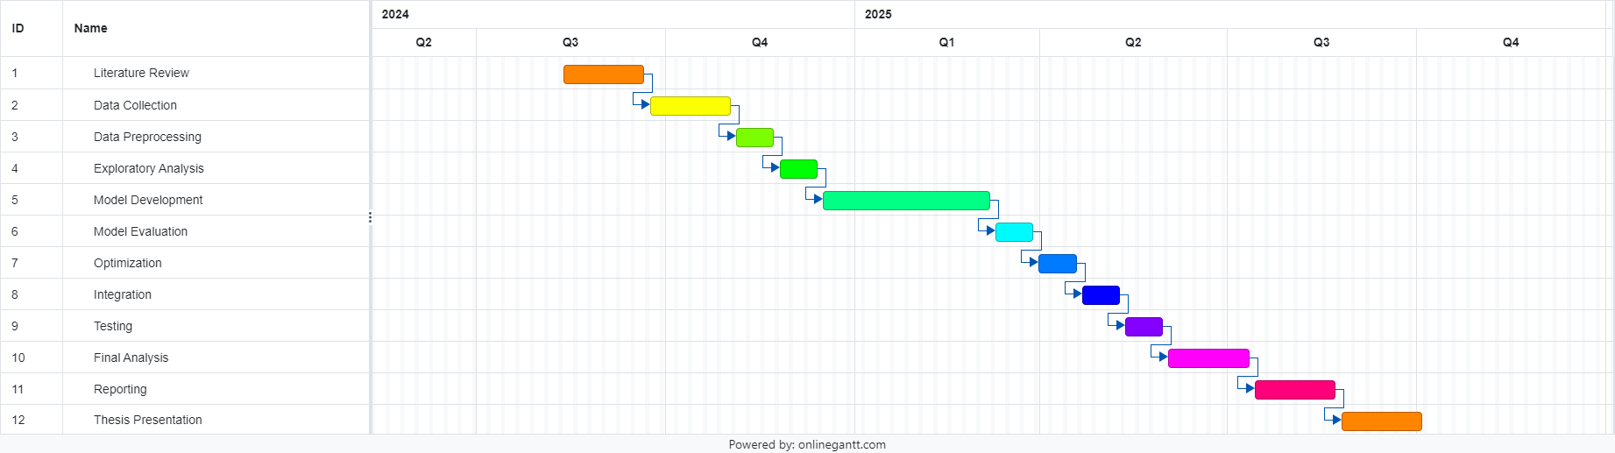
Research Plan

Slide 8
Progress of Work to Date
Reviewed over 10 research papers focusing on “AI-driven predictive logistics optimization in restaurant supply chains”.
Found a dataset on Kaggle on Restaurant Supply Chains.
Dataset Name - Fast Food Restaurant Chain (Click)
Source - Rishit Saraf
Learning essential mathematical concepts critical for predictive analytics, including statistical methods, time series analysis, and optimization techniques, to ensure the accurate application of AI models in logistics.
Essential Math for Data Science - Thomas Nield (Book)
Practical Statistics for Data Scientists - Peter Bruce, Andrew Bruce, Peter Gedeck (Book)
Learning and experimenting with leading machine learning libraries such as Scikit-learn and Keras.
Hands-On Machine Learning with Scikit-Learn, Keras, and TensorFlow - Aurelien Geron (Book)

Slide 9
Thank You!

