Slide 1

Employee Management System
Presented by :
Upendar Gavvala
Batch No : 470
Innomatics Research Labs Dilsukhnagar

Slide 2
ABOUT ME
My Name is Upendar Gavvala.
I have completed my graduation in Computer Science & Engineering
It enables me to transform raw data into actionable insights that support strategic decision-making and solve real-world business.
LinkedIn: linkedin.com/in/upendar-gavvala-2b2114227
GitHub: https://github.com/upendargavvala

Slide 3
AGENDA
Problem Statement
Objective of the Project
ER Diagram.
Database
Queries
Insights
Challenges
Future Enhancements
Conclusion

Slide 4
PROBLEM STATEMENT
Manual/fragmented employee data management → errors & inefficiency
Difficulty in retrieving/updating employee records quickly
Payroll processing errors due to manual calculations
Lack of transparency in leave and job role management
No centralized system for tracking qualifications, salaries, and departmental roles
Data inconsistency without relational integrity (PKs, FKs, cascading updates)
Develop a Structured Employee Management System (EMS) using SQL to:
Store & manage employee details securely
Ensure data accuracy and consistency
Generate insights through queries & reports
Streamline HR operations and decision-making

Slide 5
OBJECTIVE OF THE PROJECT
The Employee Management System (EMS) is designed to streamline the management of employee data, job roles, and departmental information within an organization. This system allows for efficient tracking of employee details
The system provides a centralized platform to store, retrieve, and update employee details such as employee information , job roles, departmental assignments, payroll, qualifications, and leave records.

Slide 6
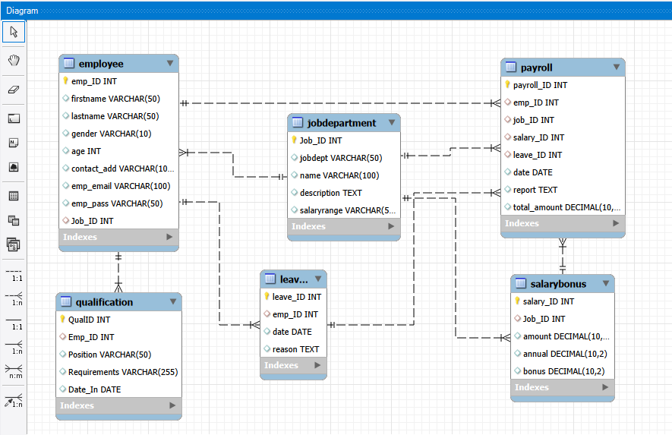
ENTITY RELATIONSHIP(ER) DIAGRAM

Slide 7
DATABASE TABLES
There are six tables in this database as follows:
Job Department
Salary/Bonus
Employee
Qualification
Leaves
Payroll

Slide 8
TABLE STRUCTURE(KEY COLUMNS)
Employee
emp_id (Primary Key)
firstname, lastname
gender, age
job_id (Foreign Key)
emp_email
JobDepartment
job_id (Primary Key)
jobdept
name (role)
salaryrange
SalaryBonus
salary_id (Primary Key)
job_id (Foreign Key)
Amount
bonus
Leaves
leave_id (Primary Key)
emp_id (Foreign Key)
date, reason
Payroll
payroll_id (Primary Key)
emp_id
job_id
total_amount

Slide 9
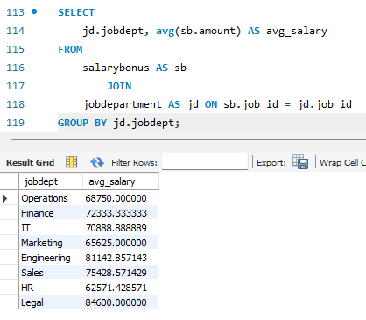
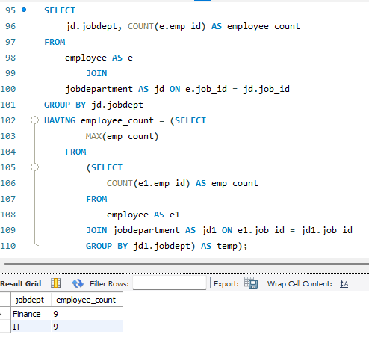
SQL QUERIES
1. EMPLOYEE INSIGHTS
1(a) What is the average salary per department?
1(b) Which departments have the highest number of employees?

Slide 10
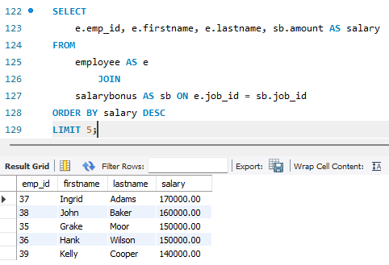
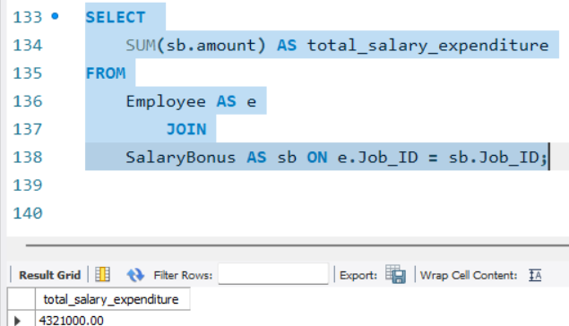
1(c) Who are the top 5 highest-paid employees?
1(d) What is the total salary expenditure across the company?

Slide 11
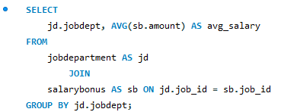
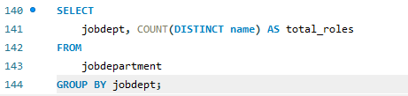
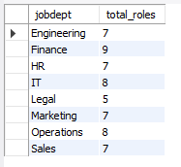
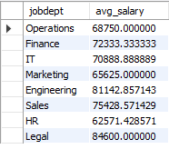
2. JOB ROLE AND DEPARTMENT ANALYSIS
2(a)How many different job roles exist in each department?
2(b)What is the average salary range per department?

Slide 12
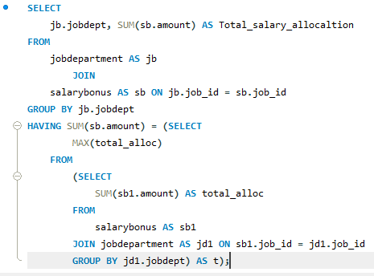
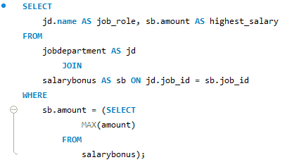


2(d)Which departments have the highest total salary allocation?
2(c)Which job roles offer the highest salary?

Slide 13
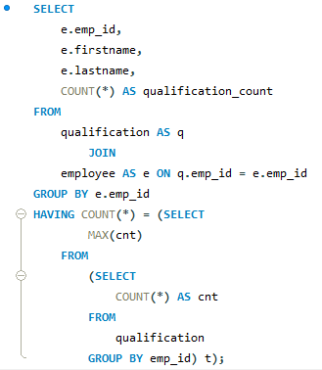
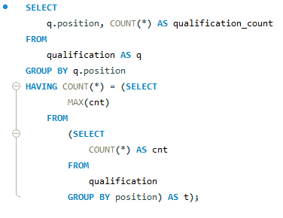
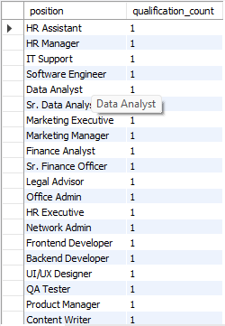
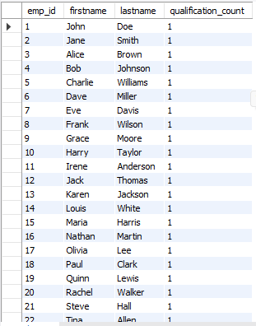
3. QUALIFICATION AND SKILLS ANALYSIS
3(a)Which employees have the highest number of qualifications?
3(b)Which positions require the most qualifications?

Slide 14
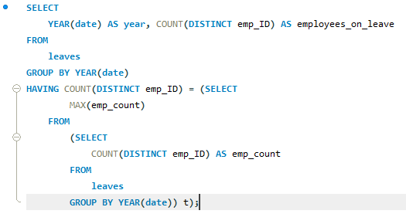
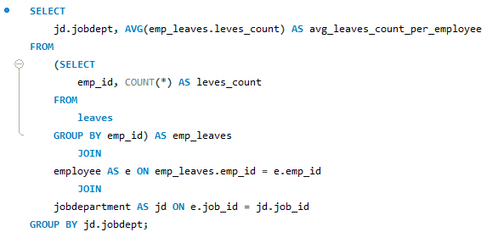
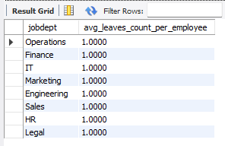

4. LEAVE AND ABSENCE PATTERNS
4(a) Which year had the most employees taking leaves?
4(b) What is the average number of leave days taken by its employees per department?

Slide 15
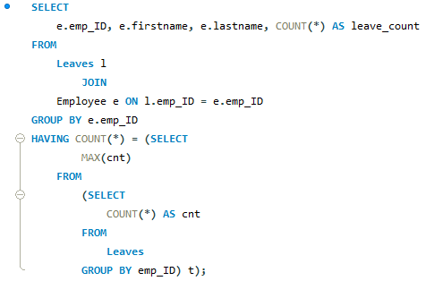
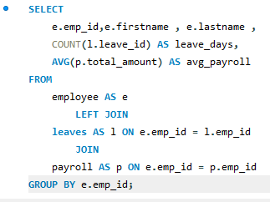
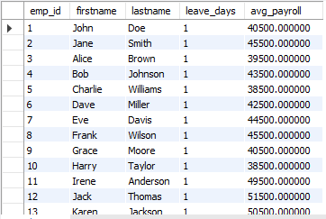
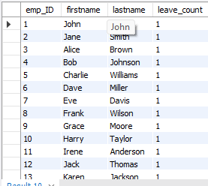
4(c) Which employees have taken the most leaves?
4(d) How do leave days correlate with payroll amounts?

Slide 16
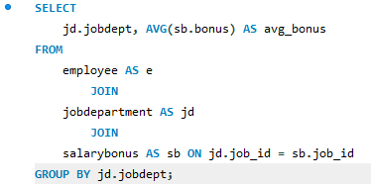
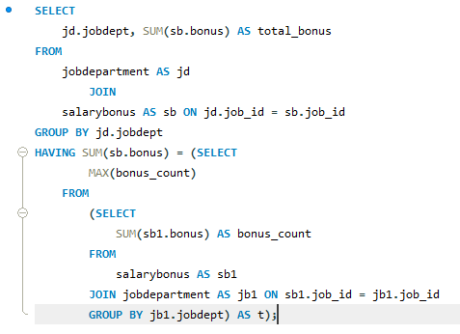
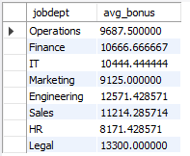

5.PAYROLL AND COMPENSATION ANALYSIS
5(a) Which department receives the highest total bonuses?
5(b) What is the average bonus given per department?

Slide 17
INSIGHTS
Certain departments have significantly higher employee counts
Salary distribution varies across departments.
Employees with more leaves show lower payroll trend.
Some roles require higher qualifications than others.
Payroll and bonus allocation varies by department.

Slide 18
CHALLENGES
Maintain relationship between tables with proper use of foreign keys so that we can perform operations.
Write proper Sql joins for generating reports across employees, roles, leaves, and payroll.
Check any duplicates in the data.
Writing Optimized SQL queries.

Slide 19
FUTURE ENHANCEMENTS
Integration with Power BI for dashboards.
Automation of payroll calculations
Real-time data updates.
Employee performance tracking system

Slide 20
CONCLUSION
The Employee Management System improves data organization, ensures accuracy, and enables meaningful insights through SQL-based analysis.
Ensure data accuracy and consistency
Generate insights through queries & reports
It helps organizations streamline HR operations and make data-driven decisions.

Slide 21

THANK YOU

