Slide 1
Tesla Stock Market
Performance Analysis
EDA & Unsupervised Learning
K-Means • Gaussian Mixture Model • DBSCAN
Prince Kumar Singh | Data Analyst
Tesla Stock Market Performance Analysis • Prince Kumar Singh 1

Slide 2
Agenda
From raw market data to interpretable historical regimes
• Project objective & dataset
• Data preparation and feature engineering
• EDA: distributions, trend, decomposition and rolling statistics
• Clustering: K-Means, GMM and DBSCAN
• Model evaluation and statistical validation
• Key findings, limitations and next steps
Tesla Stock Market Performance Analysis • Prince Kumar Singh 2

Slide 3
Project Objective
What the analysis is designed to uncover
• Identify daily periods with similar Tesla stock characteristics.
• Capture both price level and short-term market movement.
• Compare three unsupervised methods with different clustering assumptions.
• Use statistical and cluster-level evidence to understand whether the segments differ materially.
3,077
Daily observations
7
Original variables
6
Clustering features
Tesla Stock Market Performance Analysis • Prince Kumar Singh 3

Slide 4
Dataset & Data Quality
The supplied Tesla dataset is a daily OHLCV series
3,077
Rows
7
Columns
0
Missing values
0
Duplicates
• Date, Open, High, Low, Close, Adj Close and Volume.
• Date converted to datetime and records sorted chronologically.
• No missing values or duplicate rows were found in the raw file.
• Feature engineering creates expected leading missing values for differences and rolling calculations.
Tesla Stock Market Performance Analysis • Prince Kumar Singh 4

Slide 5
Feature Engineering
Representing short-term price dynamics for clustering
Price Change
Close − previous Close • Daily direction
Price Range
High − Low • Intraday movement
Pct Change
Daily % change • Relative movement
Volatility
30-day std. dev. • Recent variability
Tesla Stock Market Performance Analysis • Prince Kumar Singh 5

Slide 6
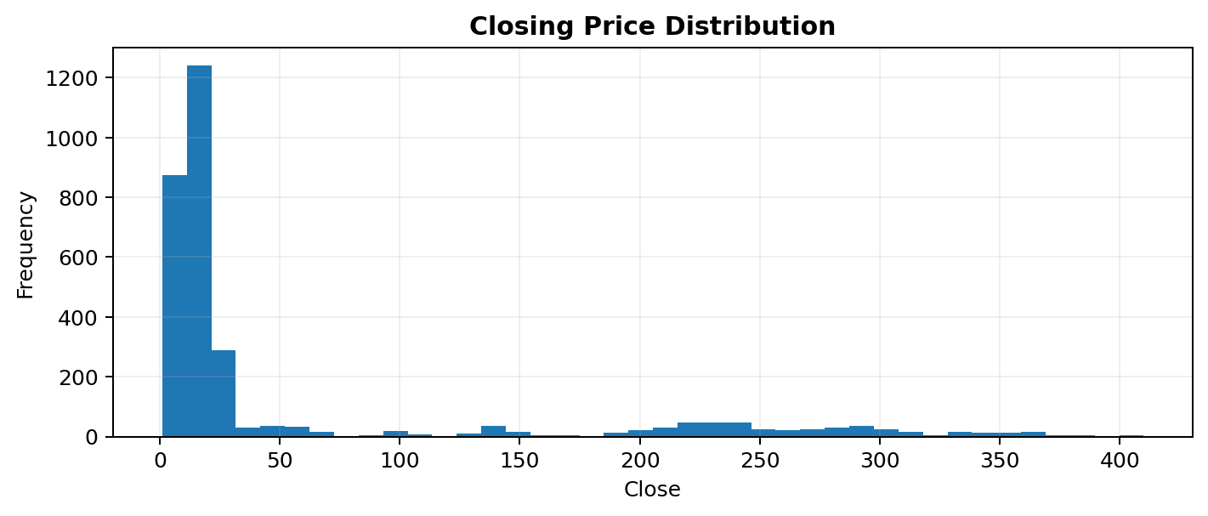
Distribution Analysis
Price and volume are not on a common scale
• Closing price is right-skewed across the full history.
• Volume also varies substantially across periods.
• Outliers in financial data may be genuine market observations and should not be removed automatically.
Tesla Stock Market Performance Analysis • Prince Kumar Singh 6

Slide 7
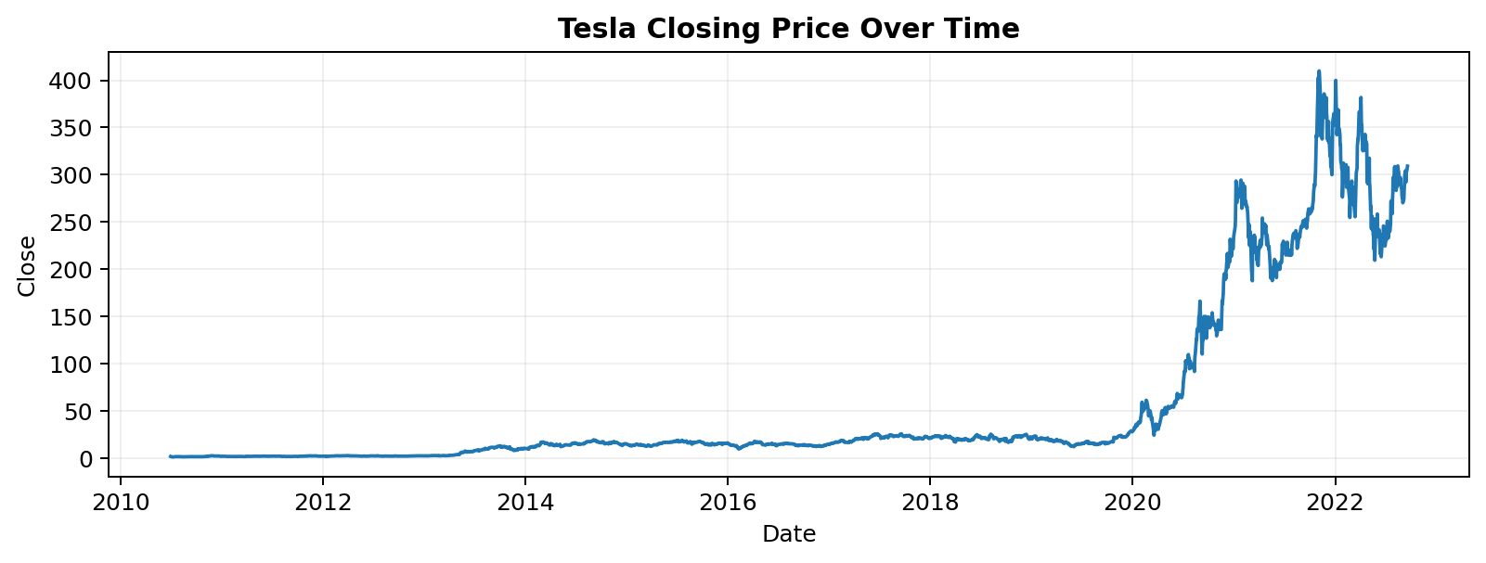
Closing Price Trend
Long-term price movement creates distinct historical regimes
Tesla Stock Market Performance Analysis • Prince Kumar Singh 7

Slide 8
Seasonal Decomposition
Separating trend, seasonal structure and residual movement
• An additive decomposition was applied to the Close series.
• A 252-business-day cycle was used as an approximate trading-year period.
• Trend captures long-term movement; seasonality represents repeating structure under the model assumption; residual captures remaining variation.
• Interpret seasonality cautiously: stock-price seasonality is exploratory, not guaranteed to persist.
Observed
Actual Close
Trend
Long-term movement
Seasonal
Annual-cycle component
Residual
Unexplained variation
Tesla Stock Market Performance Analysis • Prince Kumar Singh 8

Slide 9
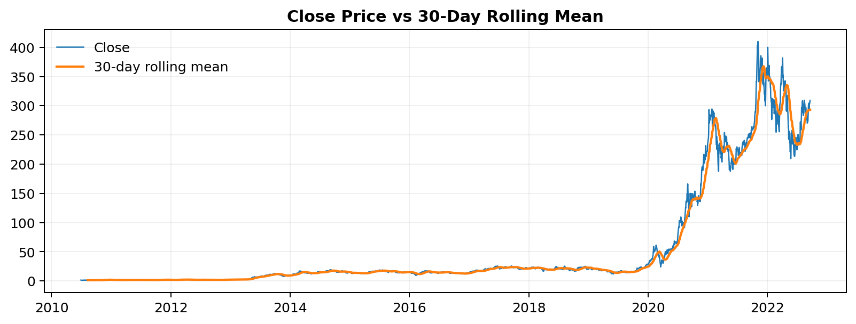
Rolling Statistics
30-day smoothing highlights changing volatility
• Rolling mean smooths short-term price noise.
• Rolling standard deviation measures recent dispersion and helps identify higher-volatility periods.
Tesla Stock Market Performance Analysis • Prince Kumar Singh 9

Slide 10
Feature Scaling
Making distance and density calculations comparable
• Six features were used: Close, Price Change, Price Range, Pct Change, Volatility and Volume.
• StandardScaler converts each feature to approximately mean 0 and standard deviation 1.
• Without scaling, high-magnitude variables such as Close or Volume could dominate distance calculations.
• The scaled matrix is the input for all three clustering methods.
StandardScaler
z = (x − μ) / σ
Tesla Stock Market Performance Analysis • Prince Kumar Singh 10

Slide 11
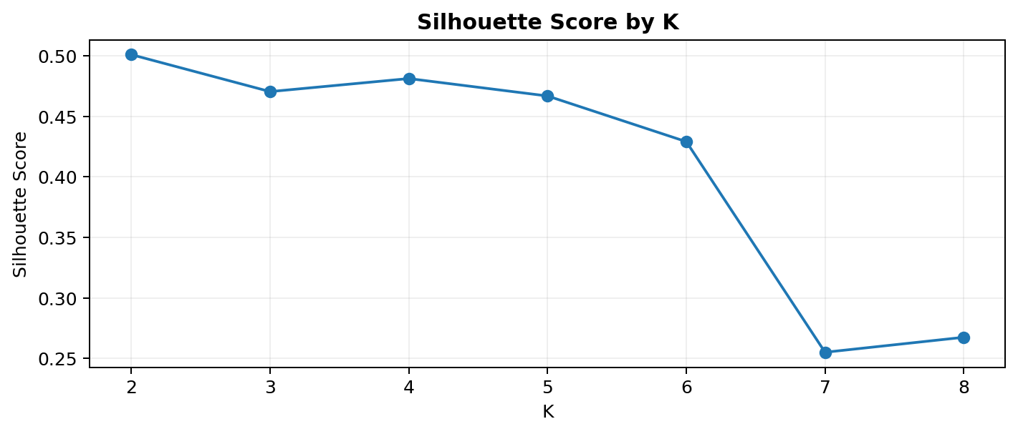
K-Means: Choosing K
Silhouette Score provides a data-driven cluster-count check
2
Selected K
0.501
Silhouette
• K=2 through K=8 were tested.
• K=2 produced the highest Silhouette Score on the selected feature set.
Tesla Stock Market Performance Analysis • Prince Kumar Singh 11

Slide 12
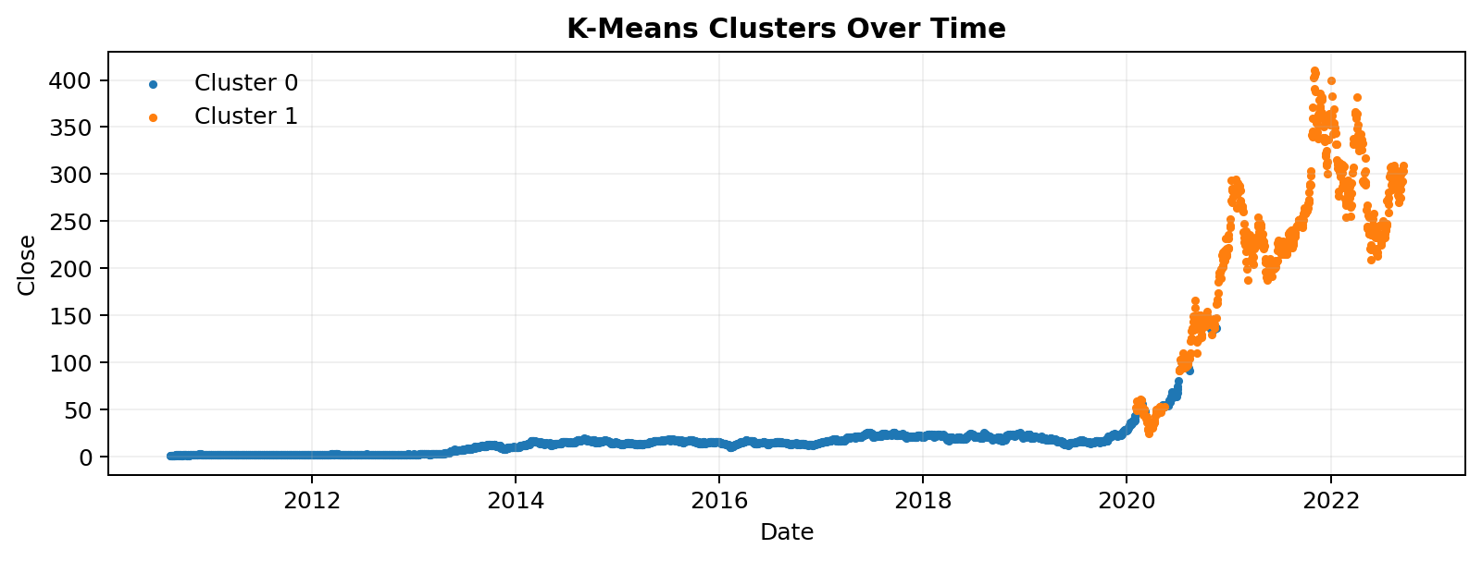
K-Means Cluster Behavior
Clusters mapped back to time reveal historical segments
• Each observation is assigned to the nearest centroid.
• The segments differ in their combined standardized profiles—not only in Close price.
• Cluster-wise means of Close, movement, range, volatility and volume provide the main interpretation.
Tesla Stock Market Performance Analysis • Prince Kumar Singh 12

Slide 13
Gaussian Mixture Model
Soft clustering for observations near regime boundaries
• GMM models the feature space as a mixture of Gaussian distributions.
• Unlike K-Means, GMM can express membership probabilities for each observation.
• This provides a different perspective when boundaries between market regimes are not perfectly sharp.
• Using 2 components, the GMM Silhouette Score was 0.465.
2
Components
0.465
Silhouette
Tesla Stock Market Performance Analysis • Prince Kumar Singh 13

Slide 14
DBSCAN: Density & Outliers
A density-based view that does not require K
1.5
eps
10
min_samples
2.8%
Noise rate
• DBSCAN identifies dense regions and labels low-density observations as noise (-1).
• 86 observations were labeled as noise under these parameter settings.
• Silhouette excluding noise = 0.576.
• Noise is a density-based designation; it does not automatically mean the observation is erroneous.
Tesla Stock Market Performance Analysis • Prince Kumar Singh 14

Slide 15
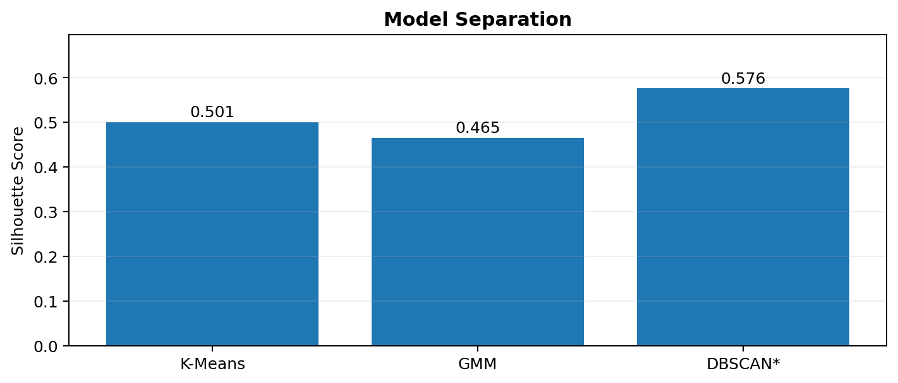
Model Comparison
Three algorithms, three different assumptions
• K-Means: centroid-based hard assignment.
• GMM: probabilistic / soft assignment.
• DBSCAN: density-based clusters + explicit noise.
• Silhouette Score is used for separation; DBSCAN score excludes noise observations.
Tesla Stock Market Performance Analysis • Prince Kumar Singh 15

Slide 16
Statistical Validation
Testing whether K-Means clusters differ in Close price
12947.66
ANOVA F-statistic
< 0.001
p-value
α = 0.05
Significance level
• H0: mean Close price is equal across K-Means clusters.
• H1: at least one cluster has a different mean Close price.
• The very small p-value provides evidence against H0 for this dataset.
• ANOVA identifies a difference in group means; it does not establish causality.
Tesla Stock Market Performance Analysis • Prince Kumar Singh 16

Slide 17
Key Findings & Next Steps
A concise interpretation of the completed analysis
• Tesla's price and volume scales change substantially over the historical sample, making feature scaling important.
• Engineered movement and volatility features add short-term context beyond raw OHLCV values.
• K-Means, GMM and DBSCAN produce complementary historical segmentation views.
• The clustering output should be treated as descriptive market regimes, not as guaranteed future trading signals.
• Next: test cluster stability across time windows and add market/technical features while preventing look-ahead leakage.
Thank You | Prince Kumar Singh | Data Analyst
Tesla Stock Market Performance Analysis • Prince Kumar Singh 17

