Slide 1
Customer Review Classification using NLP
BY
Upendhar Rapolu
Achyuth Rapolu
Ajay Kumar Kurapati
Chaitanya Dulipudi

Slide 2
Introduction
In the era of e-commerce, online reviews play a crucial role in influencing purchasing decisions. Analyzing and understanding customer sentiments expressed in reviews can provide valuable insights to businesses. This project focuses on classifying customer reviews and predicting ratings based on the sentiment conveyed in the text. The project utilizes state-of-the-art techniques in natural language processing (NLP) and machine learning to achieve this goal.

Slide 3
Dataset
The dataset is collected from Kaggle. The dataset has 34626 customer reviews in text. The label of the dataset is Rating. It has 5 classes – 1, 2, 3, 4, and 5.
This dataset consists of 21 columns/attributes. Only reviews.txt and reviews.rating is required so we extract these two columns only and dropped the other columns.
We also, removed the rows with missing values.

Slide 4
Methodology
Data Pre-Processing:
Extract useful features
Remove Missing Rows
Apply NLP Techniques:
BERT Tokenization:
Word Piece Tokenization
Vocabulary
Special Tokens
Token Embeddings
TF-IDF Vectorization
Apply Classification

Slide 5
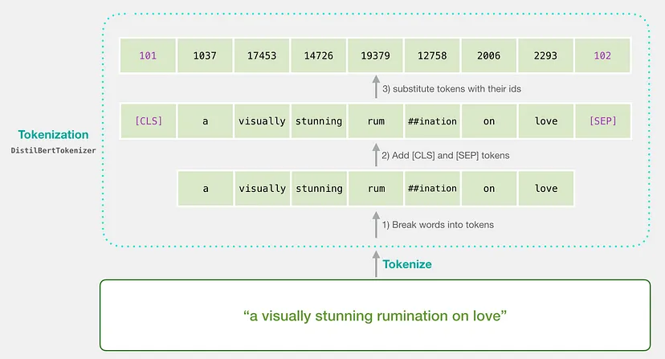
Methodology (Contd.)
Fig. BERT Tokenization

Slide 6
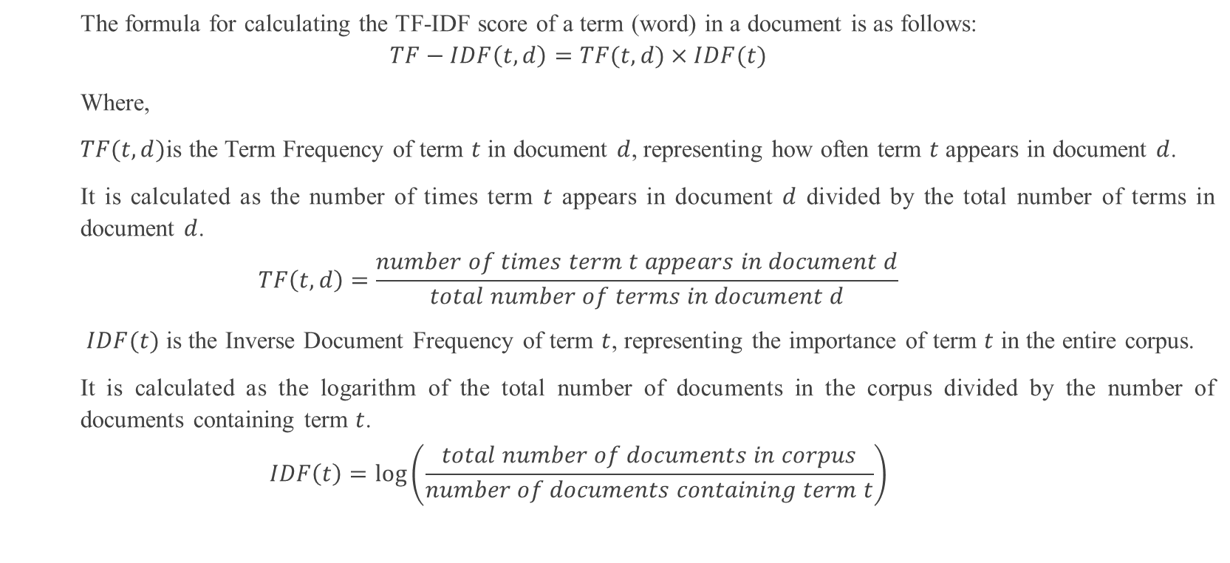
Methodology (Contd.)
The formula for calculating the TF-IDF score of a term (word) in a document is as follows:
$$TF−IDF\left(t,d\right)=TF(t,d)×IDF(t)$$
Where,
$TF(t,d)$is the Term Frequency of term $t$ in document $d$, representing how often term $t$ appears in document $d$.
It is calculated as the number of times term $t$ appears in document $d$ divided by the total number of terms in document $d$.
$$TF\left(t,d\right)=\frac{number of times term t appears in document d}{total number of terms in document d}$$
$IDF(t)$ is the Inverse Document Frequency of term $t$, representing the importance of term $t$ in the entire corpus.
It is calculated as the logarithm of the total number of documents in the corpus divided by the number of documents containing term $t$.
$$IDF\left(t\right)=\log\left(\frac{total number of documents in corpus}{number of documents containing term t}\right)$$

Slide 7

Methodology (Contd.)
Mathematically, the accuracy score of a classification model is calculated as:
$Accuracy= \frac{Number of correct predictions}{Total number of predictions}×100$%

Slide 8
Results
The top most significant term is depicted in the below table:
Terms | TF-IDF Score
promptly | 0.376349
amps | 0.295808
book | 0.278751
june | 0.278289
perfection | 0.26896

Slide 9
Result (Contd.)
The table below records the accuracy of each classifier model:
Classifier Models | Accuracy
KNN | 0.68
Gaussian Naïve Bayes | 0.73
Multinomial Naïve Bayes | 0.69
Decision Tree | 0.68
Random Forest | 0.67
Logistic Regression | 0.70
Support Vector machine | 0.72
Multi-layer Perceptron (MLP) | 0.75
Voting Classifier (Hard) | 0.74
Voting Classifier (Soft) | 0.77

Slide 10
Conclusion
Based on the evaluation of the classification models, the Voting Classifier with soft voting yielded the highest accuracy score. This indicates that combining the predictions of multiple individual classifiers using soft voting can lead to better overall performance compared to the individual classifiers on their own.
The higher accuracy of the Voting Classifier with soft voting suggests that the ensemble model is able to leverage the strengths of the individual classifiers and mitigate their weaknesses, resulting in more accurate predictions. This highlights the effectiveness of ensemble learning in improving classification performance.

Slide 11
Thank You

