Slide 1
CMR College of Engineering & Technology
(UGC Autonomous)
Accredited by NAAC with “A” Grade
Kandlakoya, Medchal Road, Hyderabad-501401
Department of Computer Science & Engineering
IRIS RECOGNITION USING MACHINE LEARNING TECHNIQUE
Guide Name: Mr .V.Venkataiah
(Associate Professor)
Batch Number 41
19H51A0592 : A. Akshith
19H51A05A7 : K. Bharath Raj
19H51A05A9 : L. Upendra
CMRCET - CSE

Slide 2
Contents
Abstract
Introduction
Literature Survey
-Existing System
-Problems in Existing System
Research Objective
Problem definition
Research Work
-Proposed System
-Methods
-Comparison of Proposed with Existing System
Performance Metrics
Results
Conclusion
Future Work
References
CMRCET - CSE

Slide 3
Abstract
It is indispensable to ensure security biometrically in the most authentication and identification scenario. Iris recognition regarded as the most reliable biometric recognition due to its stable and extraordinary variation in texture. The unique patterns are used in iris recognition to identify individuals in requiring a high level of security. This paper explores an efficient technique that uses convolutional neural network (CNN) and support vector machine (SVM) for feature extraction and classification respectively to increase the efficiency of recognition. The proposed technique has been successfully applied and also clearly demonstrates the performance of the experimental evaluation on iris images from the CASIA database.
CMRCET - CSE

Slide 4
Introduction
Iris recognition is a type of biometric technology that enables a person to be authenticated automatically via his criteria through machines. Compared to other biometric traits, iris possess lesser false acceptance and rejection rate due to its high in universality, uniqueness, permanence, permanency, and stability.
Informative features of iris are being extracted from the raw image and those features are classified based on criteria. Correct prediction on the label indicates successful iris recognition.
However, the growing interest of machine learning (ML) and computer vision in image processing indicate that feature extraction using Convolutional Neural Network (ConvNet) effectively extracting discriminative visual features iris images and eliminating the laborious feature-engineering task.
The limitation of traditional iris recognition system to process iris images that captured in unconstraint environments is breakthrough. Despite the power of ML in training machine to solve various tasks, the most important limitation lies in training dataset size and computational power in generating a powerful algorithm

Slide 5
Literature Review
S.No | Author | Name of the journal | Title of the paper | Year | Inference
1 | Jaspreet Kaur Anand Sharma | International Journal Of Computational Intelligence Research | PERFORMANCE ANALYSIS OF FACE DETECTION BY USING VIOLA-JONES ALGORITHM | 2017 | This paper describes the detection of human face using viola-jones algorithm.
2 | Zhuoshi Wei Xianchao Qiu Zhenan Sun Tieniu Tan | Center for Biometrics and Security Research | Counterfeit Iris Detection Based on Texture Analysis | 2019 | This Paper describes the detection of fake iris wore by human beings
CMRCET - CSE

Slide 6

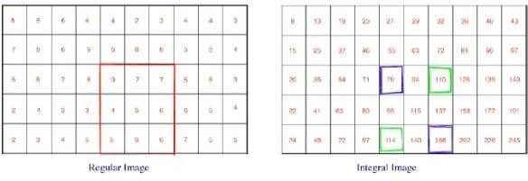
Existing Works
Face Detection using Viola-Jones Algorithm
The primary aim of face detection algorithms is to determine whether there is any face in an image or not.
In recent years, we have seen significant advancement of technologies that can detect and recognize faces.
Although there are quite advanced face detection algorithms, especially with the introduction of deep learning, the introduction of viola jones algorithm in 2001 was a breakthrough in this field. Now let us explore the viola jones algorithm in detail.
This Algorithm follows fours steps to identify a face
1.Haar Feature 2.Integral Image 3.Boosting with adaboost 4. Cascading
CMRCET - CSE

Slide 7
Result:
Five studies are analyzed and described the application of the Viola-Jones algorithm for facial recognition
The first study had a very good accuracy level of 85%-95% in detecting faces.
The second study had accuracy, precision, recall, and achievement times of 0.74, 0.73, 0.76, and 15 seconds in recognizing a person's emotions through facial expressions.
Meanwhile, the third study had a very good accuracy level of 94.5% in recognizing faces that are 1 meter away.
Limitations
It is not as effective detecting tilted or turned faces.
It is sensitive to lighting conditions.
There could possibly be different detections.
CMRCET - CSE

Slide 8
2. Counterfeit Iris Detection Based on Texture Analysis
This paper addresses the issue of counterfeit iris detection, which is a liveness detection problem in biometrics.
Fake iris mentioned here refers to iris wearing color contact lens with textures printed onto them.
We propose three measures to detect fake iris: measuring iris edge sharpness, applying Iris-Texton feature for characterizing the visual primitives of iris textures and using selected features based on co-occurrence matrix (CM).
Extensive testing is carried out on two datasets containing different types of contact lens with totally 640 fake iris images, which demonstrates that IrisTexton and CM features are effective and robust in anticounterfeit iris.
Detailed comparisons with two stateof-the-art methods in literatures are also presented, showing that the proposed iris edge sharpness measure acquires a comparable performance with these two methods, while Iris-Texton and CM features outperform the state-of-the-art.
CMRCET - CSE

Slide 9
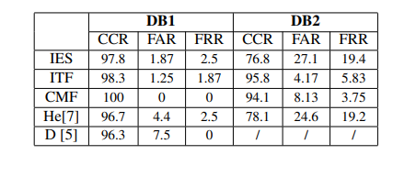
Result:
CCR -Correct Classification Rate
FAR-False Acceptance Rate
FRR-False Rejection Rate

Slide 10
Research Objective
First, this project manages to eliminate the iris segmentation phase since in conventional IRS, its’ failure can indirectly affect the recognition rate.
Second, transferability of pre-trained ConvNet model can be tested using support vector machine (SVM) classifier with transfer learning technique.
Third, a high-performance ConvNet model that able to run IRS task is developed using transfer learning technique.
Fourth, image augmentation, Bayesian optimisation and layer freezing techniques are being applied for better model performances.

Slide 11
Problem Definition
Conventionally passwords, secret codes and PINs are used for identification which can be easily splen observed or forgotten. In pattern recognition problems, the key issue is the relation between inter-class and intra-class variability. objects can be reliably classified only the variability among different instances of a given class is less than the variability between different classes. For example in face recognition difficulties arise from the fact that the face is a changeable social organ displaying a variety of expressions, as well as being an active 3D object whose mage varies with viewing angle, pose, illumination, accoutrements, and age. So as an alternative we propose to use biometrics (iris recognition) system to identify an individual.

Slide 12
Research Work
Proposed System
Our proposed system is iris recognition s using machine learning . In this system we are going to to use the Convolutional neural network(CNN) for feature extraction and classification to increase the efficiency of the recognition.
The proposed technique has been successfully applied and also clearly demonstrates the performance of the experimental evaluation on iris images from the CASIA database.
In this project there are few step to implement the system
1. Image Acquisition
2.Segmentation
3.normalization
4.Feature Extraction
5.Matching
6.Result

Slide 13
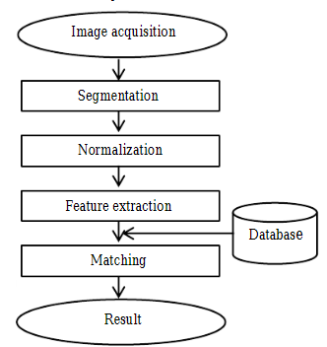
System Architecture

Slide 14
Methods
Algorithms used/ Techniques used:
Hough transformation is used for Iris segmentation.
Doughman rubber sheet model is used for Normalization.
Convolutional Neural Network is used for Feature extraction.
CMRCET - CSE

Slide 15
Implementation
Image Acquisition
The first step of iris recognition is image acquisition deals with capturing sequence of high quality iris images from the subject using cameras and sensors.
Instead of capturing images we use casia dataset.
Casia dataset contain 108 Irises and 7 images per iris
Iris Segmentation
The next step of iris recognition is iris segmentation, is a process to isolate the actual iris region in a digital eye image.
We use hough transform algorithm for this irs segmentation

Slide 16
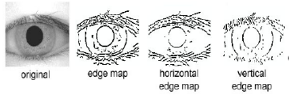

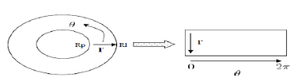
Segmentation using hough Transforms
Normalization
After successfully segmented the iris region from an eye image, the circular iris region is transformed into a fixed size rectangular block.
Daughman Rubber sheet model is used here to normalize iris image.
Daughman’s rubber- sheet model

Slide 17

Results

Slide 18


Slide 19


Slide 20


Slide 21


Slide 22
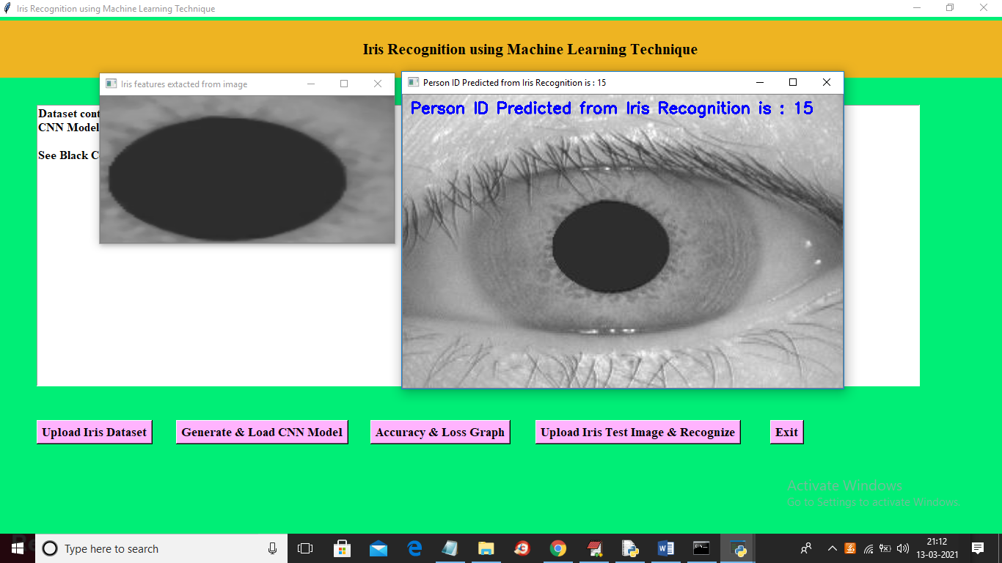

Slide 23
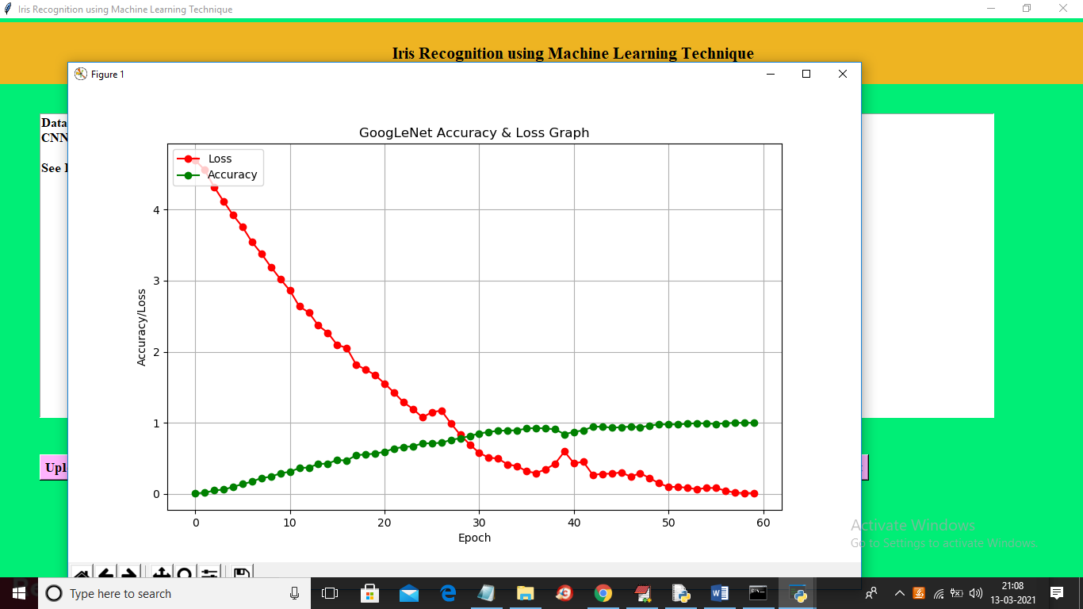

Slide 24
Conclusion
The template generated in the feature extraction stage needs a matching metric to measure the similarity between two iris templates. This metric gives one range of values when templates generated from the same eye are compared and another range of values when templates generated from Different person’s eye are compared; so that we can decide as to whether the two templates belong to the same or different persons.

Slide 25
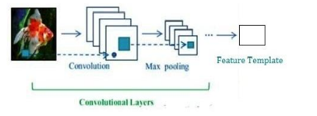
Feature Extraction
The most important step in iris recognition is feature extraction. Feature extraction is a process of finding the most discriminating information present in an iris pattern. The recognition rate and run time of matching of two iris templates mostly depends on feature extraction technique. In this paper, CNN is used for extracting feature of the normalized iris image.
Convolutional Neural Layers

Slide 26
References
Sabhanayagam, T., Venkatesan, V. P. & Senthamaraikannan, K. (2018). A comprehensive survey on various biometric systems. Int. J. App. Eng. Res., 13, 2276–2297.
Al Rifaee, M. (2014). Unconstrained iris recognition. PhD diss., De Montfort University.
Masek, L. (2003). Recognition of human iris patterns for biometric identification. BEng diss., University of Western Australia.
Cruz, F. R. G., Hortinela, C. C., Redosendo, B. E., Asuncion, B. K. P., Leoncio, C. J. S., Linsangan, N. B. & Chung, W. -Y. (2016). Iris recognition using Daugman algorithm on Raspberry Pi. 2016 IEEE region 10 conference (TENCON). New Jersey, USA: Institute of Electrical and Electronics (IEEE), 2126–2129, https://doi.org/10.1109/TENCON.2016.7848401.
Kunik, Z., Bykowski, A., Marciniak, T. & Dąbrowski, A. (2017). Raspberry Pi based complete embedded system for iris recognition. 2017 signal processing: algorithms, architectures, arrangements, and applications (SPA). New Jersey, USA: IEEE, 263–268, https://doi.org/10.23919/SPA.2017.8166876

Slide 27
THANK YOU
CMRCET - CSE

