Slide 1

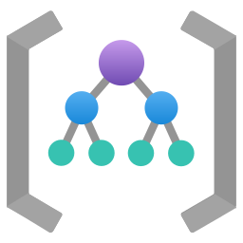
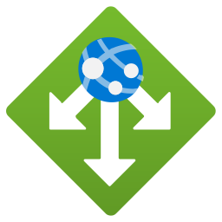
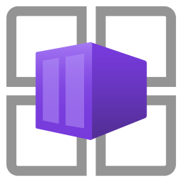




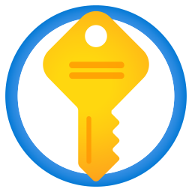


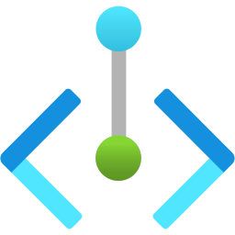
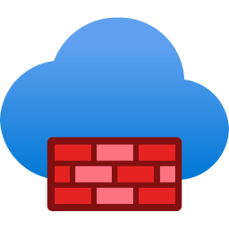

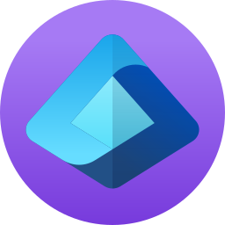

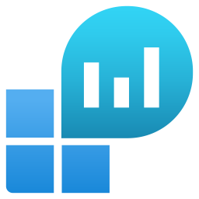


A shared platform keeps each AI workload private
EXECUTIVE SUMMARY · 6 OF 10
PROPOSED REFERENCE ARCHITECTURE
PLATFORM LANDING ZONE (SHARED)
PRODUCTION WORKLOAD SUBSCRIPTION
Management groups
policy and RBAC inheritance
DATA AND SECRETS
Azure Policy
guardrails and tags
App Gateway
WAF ingress
App host
Container Apps
Foundry project
agents
Model
deployment
AI Search
Storage account
Key Vault
Hub virtual network
peering to spokes
Private endpoints for Foundry, AI Search, Storage and Key Vault · managed identities, no shared keys
Azure Firewall
controlled egress
DNS Private Resolver
private DNS zones
NON-PRODUCTION SUBSCRIPTION (DEV, TEST)
Same pattern, separate subscription, policies and identities. Promotion only through the pipeline.
Entra PIM
privileged operator access
IaC pipelines
approvals, promotion
Log Analytics
platform logs
App Insights
agent traces
Budgets
cost alerts
Request / data flow
Data access
Double arrow: hub peering. Blue arrow: egress to hub firewall. Detail: appendix A5, A6.
Proposed reference architecture · CIS Infra custom design · not a Microsoft-published or Microsoft-endorsed architecture
CIS Infra · AI Platform / Landing Zone · v4.0 · 11 Oct 2026 · Working proposal, not approved terms
06
Notes:
TALK TRACK
Say: Read it in three steps. Users come in through a web firewall to the app. The app calls the Foundry project and model over private links, with data in AI Search and a Storage account. Everything outbound goes through the hub firewall, and every resource reports to shared monitoring and budgets. Shared platform on the left, separate production and non-production subscriptions on the right.
Likely question: Is this the Microsoft design?
Answer: It is our simplified adaptation of Microsoft’s AI Landing Zone reference, marked as proposed. Detailed network views are in the appendix.
DETAIL AND CAVEATS
Simplified, editable executive view. Adapted from the AI Landing Zone with platform landing zone diagram (04_AI-Landing-Zone-with-platform.png, source https://github.com/Azure/AI-Landing-Zones) and the Foundry baseline landing zone architecture. Not the original; detailed network and egress diagrams are in the appendix.
Reading order: (1) users reach the workload through Application Gateway with WAF; (2) the app host calls the Foundry project and model deployment through private endpoints; (3) retrieval and state use AI Search and a Storage account; secrets in Key Vault; (4) outbound traffic routes through the hub firewall; (5) all resources send telemetry to Log Analytics and Application Insights and are governed by management-group policy and budgets. Identity: managed identities for workloads, Entra PIM for privileged operators.
Storage label: the icon is the Azure Storage account; blob containers live inside it.
Sources (checked 11 Oct 2026):
Adapted from https://github.com/upendra25312/AI-Foundry-GTM-offering-/blob/main/architectures/04_AI-Landing-Zone-with-platform.png
https://github.com/Azure/AI-Landing-Zones
https://learn.microsoft.com/en-us/azure/architecture/ai-ml/architecture/baseline-microsoft-foundry-landing-zone
Azure Architecture Icons (V24): https://learn.microsoft.com/en-us/azure/architecture/icons/
Status: proposed offering for internal leadership review. No Cognizant approval, customer evidence, staffing commitment, rate card or verified quote is implied. Illustrative and synthetic figures are labelled as such. All money in USD. Font: Arial substituted for Gellix (not available). Azure icons: official Microsoft Azure Architecture Icons (V24 set, via az-icons.com and the icons embedded in the baseline decks), unmodified SVG with PNG fallback. Version 4.0 produced through PDCA cycles. Rendered and checked as PDF previews; not opened in desktop PowerPoint.

Slide 2
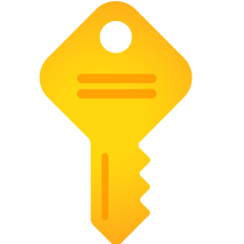
Management groups, subscriptions, policy and tags
APPENDIX A3
PROPOSED
Tenant root group
Control | Minimum baseline (proposed)
Azure Policy | Allowed regions and deployment types; deny public network access for AI, Search, Storage, Key Vault; require diagnostics
Tags | owner, workload, environment, cost-centre, data-classification, agent-id (where applicable)
Subscription vending | Request, approval, naming and budget set at creation
Cost ownership | Budget and alert per subscription and workload
Exceptions | Time-bound, approved by customer risk owner
Platform
Landing zones
Connectivity
Corp
Online
Identity, management
AI prod
AI non-prod
AI production and non-production are separate subscriptions under the Corp (or Online) group, inheriting platform policy.
CIS Infra · AI Platform / Landing Zone · v4.0 · 11 Oct 2026 · Working proposal, not approved terms
14
Notes:
TALK TRACK
Say: Use this slide to explain "Management groups, subscriptions, policy and tags". Editable reconstruction of the management group and subscription layout from the AI Landing Zone diagram (04_AI-Landing-Zone-with-platform.png). AI resources sit in governed application landing-zone subscriptions, separate for production and non-production. Policy assignment at management group scope is inherited.
Likely question: How firm is this, and who has agreed it?
Answer: It is a proposal for leadership review. The detail and sources below show what is verified, what is an estimate and who still needs to agree it.
DETAIL AND CAVEATS
Editable reconstruction of the management group and subscription layout from the AI Landing Zone diagram (04_AI-Landing-Zone-with-platform.png). AI resources sit in governed application landing-zone subscriptions, separate for production and non-production. Policy assignment at management group scope is inherited.
Sources (checked 11 Oct 2026):
https://github.com/upendra25312/AI-Foundry-GTM-offering-/blob/main/architectures/04_AI-Landing-Zone-with-platform.png
Cloud Adoption Framework: AI Ready: https://learn.microsoft.com/en-us/azure/cloud-adoption-framework/ai/ready
Status: proposed offering for internal leadership review. No Cognizant approval, customer evidence, staffing commitment, rate card or verified quote is implied. Illustrative and synthetic figures are labelled as such. All money in USD. Font: Arial substituted for Gellix (not available). Azure icons: official Microsoft Azure Architecture Icons (V24 set, via az-icons.com and the icons embedded in the baseline decks), unmodified SVG with PNG fallback. Version 4.0 produced through PDCA cycles. Rendered and checked as PDF previews; not opened in desktop PowerPoint.

Slide 3



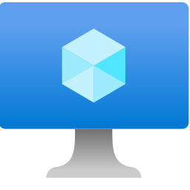


Hub connectivity, private endpoints and DNS
APPENDIX A5
ADAPTED FROM SOURCE
WORKLOAD LANDING ZONE SUBSCRIPTION: SPOKE VIRTUAL NETWORK
1
snet-appGateway
snet-appServicePlan
snet-agentsEgress
snet-privateEndpoints
App Gateway + WAF
App Service integration
Agent Service integration
End users
App Service
Storage account
Key Vault
2
snet-buildAgents, snet-jumpBoxes
All subnets: NSG and UDR 0.0.0.0/0 to hub firewall
Build agents and jump boxes (via Bastion)
Foundry
AI Search
Cosmos DB
VNet peering
5
egress via UDR
DNS from hub
4
PLATFORM LANDING ZONE: CONNECTIVITY SUBSCRIPTION
Hub virtual network
per region
Azure Firewall
egress inspection
DNS Private Resolver
linked rulesets
Private DNS zones
for Private Link
On-premises
VPN or ExpressRoute
Request / data flow
Data access
Telemetry or state read
Adapted from 11_baseline-landing-zone-networking.png
Adapted reference architecture · simplified from Microsoft source; validate subnets, DNS and routes per customer
CIS Infra · AI Platform / Landing Zone · v4.0 · 11 Oct 2026 · Working proposal, not approved terms
16
Notes:
TALK TRACK
Say: Use this slide to explain "Hub connectivity, private endpoints and DNS". Editable reconstruction of 11_baseline-landing-zone-networking.png (Microsoft Foundry chat baseline in an Azure landing zone). The original PNG clips several labels ("Workload landing zo", "Azure Firewa") in its rendering, so it is kept only as a traceability reference in the original references pack. Subnet names follow the source.
Likely question: How firm is this, and who has agreed it?
Answer: It is a proposal for leadership review. The detail and sources below show what is verified, what is an estimate and who still needs to agree it.
DETAIL AND CAVEATS
Editable reconstruction of 11_baseline-landing-zone-networking.png (Microsoft Foundry chat baseline in an Azure landing zone). The original PNG clips several labels ("Workload landing zo", "Azure Firewa") in its rendering, so it is kept only as a traceability reference in the original references pack. Subnet names follow the source. Changes: simplified to one spoke, labels completed, flows numbered.
Flows: (1) users reach Application Gateway with WAF in snet-appGateway; (2) App Service uses VNet integration (snet-appServicePlan) to reach private endpoints; (3) Foundry Agent Service egress uses snet-agentsEgress; (4) all private endpoints in snet-privateEndpoints resolve through hub-provided DNS (DNS Private Resolver and Private DNS zones for Private Link); (5) UDRs send workload egress to the hub firewall.
Sources (checked 11 Oct 2026):
https://github.com/upendra25312/AI-Foundry-GTM-offering-/blob/main/architectures/11_baseline-landing-zone-networking.png
https://github.com/upendra25312/AI-Foundry-GTM-offering-/blob/main/architectures/05_baseline-landing-zone-networking.vsdx
https://learn.microsoft.com/en-us/azure/architecture/ai-ml/architecture/baseline-microsoft-foundry-landing-zone
Status: proposed offering for internal leadership review. No Cognizant approval, customer evidence, staffing commitment, rate card or verified quote is implied. Illustrative and synthetic figures are labelled as such. All money in USD. Font: Arial substituted for Gellix (not available). Azure icons: official Microsoft Azure Architecture Icons (V24 set, via az-icons.com and the icons embedded in the baseline decks), unmodified SVG with PNG fallback. Version 4.0 produced through PDCA cycles. Rendered and checked as PDF previews; not opened in desktop PowerPoint.

Slide 4
Controlled egress through the hub firewall
APPENDIX A6
ADAPTED FROM SOURCE
SPOKE SUBNETS WITH UDR TO HUB
Private endpoints keep Azure PaaS traffic off the internet path; firewall handles the rest.
App Service integration
route 0.0.0.0/0 to firewall
HUB (CONNECTIVITY SUBSCRIPTION)
Agent Service integration
route 0.0.0.0/0 to firewall
Internet and partner endpoints
allow-listed FQDNs
Azure Firewall
application and network rules, logging
allowed only
Build agents
route 0.0.0.0/0 to firewall
Jump boxes
route 0.0.0.0/0 to firewall
Limit: Validate effective routes and each managed service’s egress support before enforcing forced tunnelling.
Adapted reference architecture · simplified from Microsoft source
CIS Infra · AI Platform / Landing Zone · v4.0 · 11 Oct 2026 · Working proposal, not approved terms
17
Notes:
TALK TRACK
Say: Use this slide to explain "Controlled egress through the hub firewall". Editable reconstruction of 12_baseline-landing-zone-networking-egress.png. Where possible, all workload-originated internet-bound traffic flows through the hub firewall because of the 0.0.0.0/0 UDR. The source does not prove every managed service honours the same route; validate effective routes and supported egress per service before enforcing forced tunnelling.
Likely question: How firm is this, and who has agreed it?
Answer: It is a proposal for leadership review. The detail and sources below show what is verified, what is an estimate and who still needs to agree it.
DETAIL AND CAVEATS
Editable reconstruction of 12_baseline-landing-zone-networking-egress.png. Where possible, all workload-originated internet-bound traffic flows through the hub firewall because of the 0.0.0.0/0 UDR. The source does not prove every managed service honours the same route; validate effective routes and supported egress per service before enforcing forced tunnelling.
Sources (checked 11 Oct 2026):
https://github.com/upendra25312/AI-Foundry-GTM-offering-/blob/main/architectures/12_baseline-landing-zone-networking-egress.png
https://github.com/upendra25312/AI-Foundry-GTM-offering-/blob/main/architectures/06_baseline-landing-zone-networking-egress.vsdx
Status: proposed offering for internal leadership review. No Cognizant approval, customer evidence, staffing commitment, rate card or verified quote is implied. Illustrative and synthetic figures are labelled as such. All money in USD. Font: Arial substituted for Gellix (not available). Azure icons: official Microsoft Azure Architecture Icons (V24 set, via az-icons.com and the icons embedded in the baseline decks), unmodified SVG with PNG fallback. Version 4.0 produced through PDCA cycles. Rendered and checked as PDF previews; not opened in desktop PowerPoint.

Slide 5

Foundry workload baseline: request flow
APPENDIX A8
ADAPTED FROM SOURCE
MICROSOFT FOUNDRY
AGENT DEPENDENCIES
1
2
AI Search
Cosmos DB
App Gateway
WAF
App Service
zone-redundant
Foundry project
Agent Service
Model deployment
User
3
6
7
Storage account
4
SPOKE VIRTUAL NETWORK
Private endpoints
Foundry, Search, Storage, Key Vault, Cosmos DB
Azure Firewall
outbound internet (5)
Key Vault
certificates, secrets
App Insights
monitoring
Request / data flow
Data access
Numbers follow the source diagram. Original: the original references pack.
Adapted reference architecture · simplified from Microsoft source; not a validated customer implementation
CIS Infra · AI Platform / Landing Zone · v4.0 · 11 Oct 2026 · Working proposal, not approved terms
18
Notes:
TALK TRACK
Say: Use this slide to explain "Foundry workload baseline: request flow". Simplified, editable adaptation of 07_baseline-microsoft-foundry.png (Microsoft Foundry baseline chat architecture). Original preserved in the original references pack. The source labels the model as "Azure OpenAI model"; here it is shown as a Foundry model deployment, which is the current product framing.
Likely question: How firm is this, and who has agreed it?
Answer: It is a proposal for leadership review. The detail and sources below show what is verified, what is an estimate and who still needs to agree it.
DETAIL AND CAVEATS
Simplified, editable adaptation of 07_baseline-microsoft-foundry.png (Microsoft Foundry baseline chat architecture). Original preserved in the original references pack. The source labels the model as "Azure OpenAI model"; here it is shown as a Foundry model deployment, which is the current product framing.
Steps: (1) user to Application Gateway with WAF; (2) App Service calls the Foundry agent through the Foundry private endpoint; (3) Foundry Agent Service runs in the Foundry project; (4) agent reaches dependencies through the agent integration subnet and private endpoints; (5) outbound internet calls go through Azure Firewall; (6) the agent calls the model deployment; (7) Foundry Agent Service dependencies (AI Search, Cosmos DB, Storage) hold threads and files.
Sources (checked 11 Oct 2026):
https://github.com/upendra25312/AI-Foundry-GTM-offering-/blob/main/architectures/07_baseline-microsoft-foundry.png
https://github.com/upendra25312/AI-Foundry-GTM-offering-/blob/main/architectures/03_baseline-microsoft-foundry.vsdx
https://learn.microsoft.com/en-us/azure/architecture/ai-ml/architecture/baseline-microsoft-foundry-chat
Status: proposed offering for internal leadership review. No Cognizant approval, customer evidence, staffing commitment, rate card or verified quote is implied. Illustrative and synthetic figures are labelled as such. All money in USD. Font: Arial substituted for Gellix (not available). Azure icons: official Microsoft Azure Architecture Icons (V24 set, via az-icons.com and the icons embedded in the baseline decks), unmodified SVG with PNG fallback. Version 4.0 produced through PDCA cycles. Rendered and checked as PDF previews; not opened in desktop PowerPoint.

Slide 6
Data paths and disaster recovery options
APPENDIX A20
PROPOSED OPTIONS
Data path | Azure services | CIS Infra role
Documents and files | Storage account, AI Search | Private endpoints, identity, lifecycle
Enterprise analytics data | Microsoft Fabric, OneLake (if used) | Network and identity integration only
Operational systems | Customer sources via connectors | Network path and DNS
DR option | How it works | Cost driver | Recovery
Single region, rebuild | Redeploy from code; restore data | Lowest | Hours to days
Warm standby | Second region pre-built, scaled down | Second region baseline, data replication | Hours
Active-active | Two regions serving traffic | Double capacity, global routing | Minutes, if capacity exists
Limit: Model capacity in a second region is not guaranteed on demand. Test failover before quoting a recovery time.
CIS Infra · AI Platform / Landing Zone · v4.0 · 11 Oct 2026 · Working proposal, not approved terms
29
Notes:
TALK TRACK
Say: Two questions customers always ask: where does the data come from, and what happens if a region fails. The data path is owned by the Data towers; we provide the private connectivity. For recovery there are three options, and the customer chooses based on cost and recovery time.
Likely question: Can we promise a recovery time?
Answer: Only after a tested failover. Model capacity in the second region is the usual constraint.
DETAIL AND CAVEATS
Data paths: documents in a Storage account, retrieval in AI Search, enterprise data through Microsoft Fabric and OneLake where the customer uses Fabric (Data tower owns design). DR options are customer choices with cost drivers; RTO and RPO must be tested per dependency. Model deployments may not have capacity in a second region on demand.
Sources: none cited on this slide. Content is a CIS Infra proposal, an estimate or arithmetic from figures sourced elsewhere in this deck (see S1).
Status: proposed offering for internal leadership review. No Cognizant approval, customer evidence, staffing commitment, rate card or verified quote is implied. Illustrative and synthetic figures are labelled as such. All money in USD. Font: Arial substituted for Gellix (not available). Azure icons: official Microsoft Azure Architecture Icons (V24 set, via az-icons.com and the icons embedded in the baseline decks), unmodified SVG with PNG fallback. Version 4.0 produced through PDCA cycles. Rendered and checked as PDF previews; not opened in desktop PowerPoint.

