Slide 1

CIS INFRA · INTERNAL OFFERING PROPOSAL · FOR SENIOR LEADERSHIP REVIEW
Original Microsoft reference diagrams
Unchanged source diagrams behind the editable architectures in decks 01 to 05
Moved out of the offering decks in v4.0 to reduce appendix length · kept for traceability
11 Oct 2026 · Version 4.0 · Reference pack for decks 01 to 05
01
Notes:
TALK TRACK
Say: This pack holds the original Microsoft diagrams we adapted. Use it when someone asks where a design came from.
Likely question: Are these current?
Answer: Some use older labels, which is why the decks use rebuilt versions. Each slide says so.
DETAIL AND CAVEATS
Reference pack. Each slide shows an original Microsoft Architecture Center diagram from the GTM repository, unchanged, with its source link. The editable, current-label versions are in the offering decks.
Status: proposed offering for internal leadership review. No Cognizant approval, customer evidence, staffing commitment, rate card or verified quote is implied. Illustrative and synthetic figures are labelled as such. All money in USD. Font: Arial substituted for Gellix (not available). Azure icons: official Microsoft Azure Architecture Icons (V24 set, via az-icons.com and the icons embedded in the baseline decks), unmodified SVG with PNG fallback. Version 4.0 produced through PDCA cycles. Rendered and checked as PDF previews; not opened in desktop PowerPoint.

Slide 2

REFERENCES
Original reference diagrams
Grouped by offering deck: 01 landing zone, 02 agent governance, 03 gateway, 05 operations.
02
Notes:
TALK TRACK
Say: We now move into the appendix. Everything from here supports the executive section and is for architecture, presales and commercial workshops. Use the index on the next slide to jump to a topic when a question comes up.
Likely question: Do we need to go through the appendix?
Answer: No. Use it to answer questions; the executive section stands on its own.
DETAIL AND CAVEATS
Reference divider.
Sources: see appendix S1.
Status: proposed offering for internal leadership review. No Cognizant approval, customer evidence, staffing commitment, rate card or verified quote is implied. Illustrative and synthetic figures are labelled as such. All money in USD. Font: Arial substituted for Gellix (not available). Azure icons: official Microsoft Azure Architecture Icons (V24 set, via az-icons.com and the icons embedded in the baseline decks), unmodified SVG with PNG fallback. Version 4.0 produced through PDCA cycles. Rendered and checked as PDF previews; not opened in desktop PowerPoint.

Slide 3
Appendix index
APPENDIX
04 01-O1 Original: AI landing zone with platform
11 02-O3 Original: Foundry baseline
05 01-O2 Original: Foundry baseline
12 03-O1 Original: gateway conceptual
06 01-O3 Original: landing zone networking
13 03-O2 Historical: legacy identity diagram
07 01-O4 Original: landing zone egress
14 03-O3 Original: single gateway, regional backends
08 01-O5 Original: CAF landing zone conceptual
15 03-O4 Original: multi-region gateway
09 02-O1 Original: multiple-agent workflow
16 05-O1 Original: Foundry baseline network flows
10 02-O2 Original: agentic RAG loop
CIS Infra · Original reference diagrams · v4.0 · 11 Oct 2026 · Working proposal, not approved terms
03
Notes:
TALK TRACK
Say: This index lists every appendix topic. Click a line to jump to it, and use the Appendix index link in the footer to come back.
Likely question: How firm is this, and who has agreed it?
Answer: It is a proposal for leadership review. The detail and sources below show what is verified, what is an estimate and who still needs to agree it.
DETAIL AND CAVEATS
Navigation slide. Each entry links to the appendix slide. Use the Index link in the footer of any appendix slide to return here.
Sources: none cited on this slide. Content is a CIS Infra proposal, an estimate or arithmetic from figures sourced elsewhere in this deck (see S1).
Status: proposed offering for internal leadership review. No Cognizant approval, customer evidence, staffing commitment, rate card or verified quote is implied. Illustrative and synthetic figures are labelled as such. All money in USD. Font: Arial substituted for Gellix (not available). Azure icons: official Microsoft Azure Architecture Icons (V24 set, via az-icons.com and the icons embedded in the baseline decks), unmodified SVG with PNG fallback. Version 4.0 produced through PDCA cycles. Rendered and checked as PDF previews; not opened in desktop PowerPoint.

Slide 4
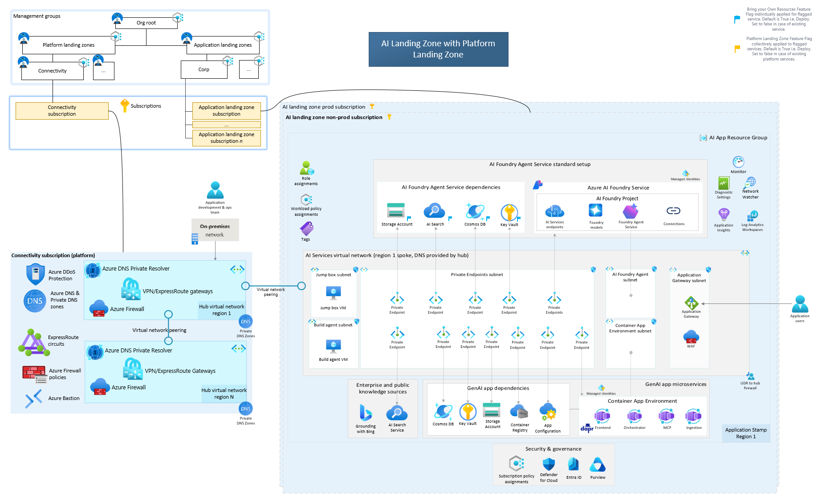
Original reference: AI landing zone with platform
APPENDIX 01-O1
ORIGINAL REFERENCE, UNCHANGED
Source: 04_AI-Landing-Zone-with-platform.png in the GTM repository · Microsoft page: link
Source labels use the earlier "AI Foundry" naming; the simplified executive view uses current Foundry names.
CIS Infra · Original reference diagrams · v4.0 · 11 Oct 2026 · Working proposal, not approved terms
Appendix index
04
Notes:
TALK TRACK
Say: This is the original Microsoft reference, kept unchanged for traceability. The simplified editable version is earlier in the appendix.
Likely question: How firm is this, and who has agreed it?
Answer: It is a proposal for leadership review. The detail and sources below show what is verified, what is an estimate and who still needs to agree it.
DETAIL AND CAVEATS
Original diagram from the user repository, embedded unchanged at source resolution and not stretched beyond its native size. Repository: https://github.com/upendra25312/AI-Foundry-GTM-offering-/blob/main/architectures/04_AI-Landing-Zone-with-platform.png
Editable Visio: https://github.com/upendra25312/AI-Foundry-GTM-offering-/blob/main/architectures/01_AI-Landing-Zones-Multi-Page.vsdx
Microsoft source: https://github.com/Azure/AI-Landing-Zones
Source labels use the earlier "AI Foundry" naming; the simplified executive view uses current Foundry names.
Sources: none cited on this slide. Content is a CIS Infra proposal, an estimate or arithmetic from figures sourced elsewhere in this deck (see S1).
Status: proposed offering for internal leadership review. No Cognizant approval, customer evidence, staffing commitment, rate card or verified quote is implied. Illustrative and synthetic figures are labelled as such. All money in USD. Font: Arial substituted for Gellix (not available). Azure icons: official Microsoft Azure Architecture Icons (V24 set, via az-icons.com and the icons embedded in the baseline decks), unmodified SVG with PNG fallback. Version 4.0 produced through PDCA cycles. Rendered and checked as PDF previews; not opened in desktop PowerPoint.

Slide 5

Original reference: Microsoft Foundry baseline
APPENDIX 01-O2
ORIGINAL REFERENCE, UNCHANGED
Source: 07_baseline-microsoft-foundry.png in the GTM repository · Microsoft page: link
Source shows "Azure OpenAI model"; adapted view (A8) uses Foundry model deployment.
CIS Infra · Original reference diagrams · v4.0 · 11 Oct 2026 · Working proposal, not approved terms
Appendix index
05
Notes:
TALK TRACK
Say: This is the original Microsoft reference, kept unchanged for traceability. The simplified editable version is earlier in the appendix.
Likely question: How firm is this, and who has agreed it?
Answer: It is a proposal for leadership review. The detail and sources below show what is verified, what is an estimate and who still needs to agree it.
DETAIL AND CAVEATS
Original diagram from the user repository, embedded unchanged at source resolution and not stretched beyond its native size. Repository: https://github.com/upendra25312/AI-Foundry-GTM-offering-/blob/main/architectures/07_baseline-microsoft-foundry.png
Editable Visio: https://github.com/upendra25312/AI-Foundry-GTM-offering-/blob/main/architectures/03_baseline-microsoft-foundry.vsdx
Microsoft source: https://learn.microsoft.com/en-us/azure/architecture/ai-ml/architecture/baseline-microsoft-foundry-chat
Source shows "Azure OpenAI model"; adapted view (A8) uses Foundry model deployment.
Sources: none cited on this slide. Content is a CIS Infra proposal, an estimate or arithmetic from figures sourced elsewhere in this deck (see S1).
Status: proposed offering for internal leadership review. No Cognizant approval, customer evidence, staffing commitment, rate card or verified quote is implied. Illustrative and synthetic figures are labelled as such. All money in USD. Font: Arial substituted for Gellix (not available). Azure icons: official Microsoft Azure Architecture Icons (V24 set, via az-icons.com and the icons embedded in the baseline decks), unmodified SVG with PNG fallback. Version 4.0 produced through PDCA cycles. Rendered and checked as PDF previews; not opened in desktop PowerPoint.

Slide 6
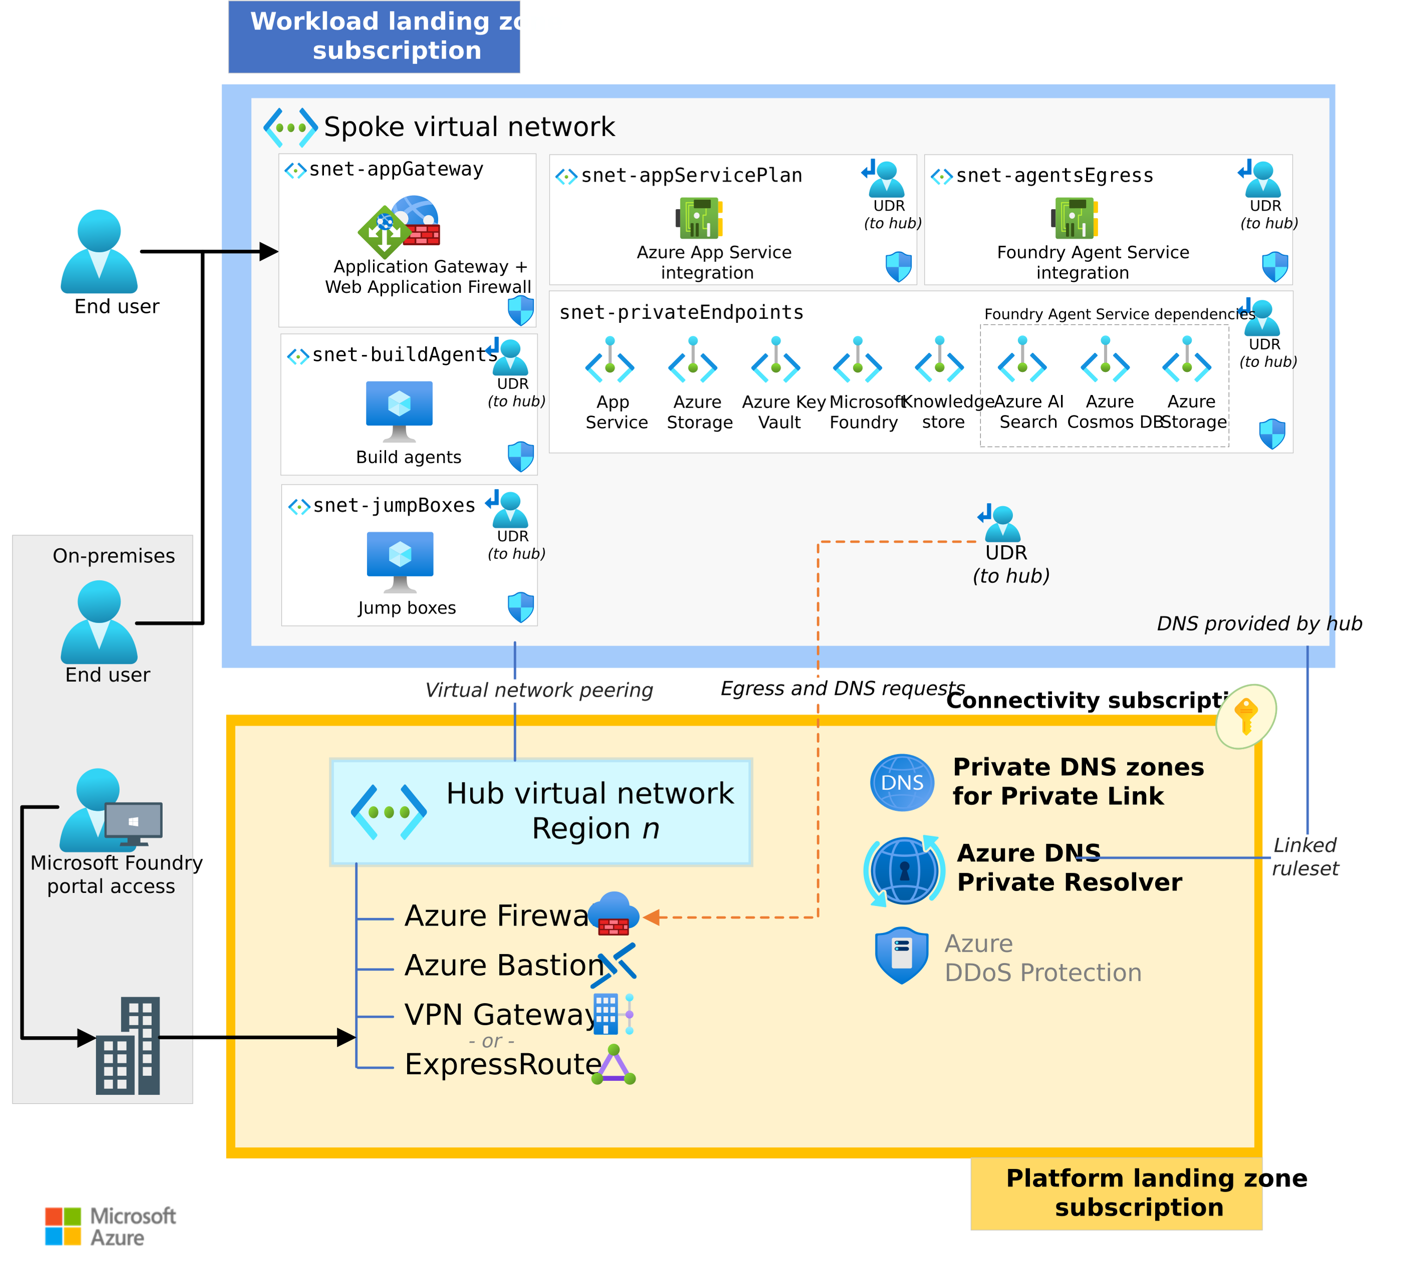
Original reference: landing zone networking
APPENDIX 01-O3
ORIGINAL REFERENCE, UNCHANGED
Source: 11_baseline-landing-zone-networking.png in the GTM repository · Microsoft page: link
The source PNG clips some labels in its own render; the editable reconstruction is appendix A5.
CIS Infra · Original reference diagrams · v4.0 · 11 Oct 2026 · Working proposal, not approved terms
Appendix index
06
Notes:
TALK TRACK
Say: This is the original Microsoft reference, kept unchanged for traceability. The simplified editable version is earlier in the appendix.
Likely question: How firm is this, and who has agreed it?
Answer: It is a proposal for leadership review. The detail and sources below show what is verified, what is an estimate and who still needs to agree it.
DETAIL AND CAVEATS
Original diagram from the user repository, embedded unchanged at source resolution and not stretched beyond its native size. Repository: https://github.com/upendra25312/AI-Foundry-GTM-offering-/blob/main/architectures/11_baseline-landing-zone-networking.png
Editable Visio: https://github.com/upendra25312/AI-Foundry-GTM-offering-/blob/main/architectures/05_baseline-landing-zone-networking.vsdx
Microsoft source: https://learn.microsoft.com/en-us/azure/architecture/ai-ml/architecture/baseline-microsoft-foundry-landing-zone
The source PNG clips some labels in its own render; the editable reconstruction is appendix A5.
Sources: none cited on this slide. Content is a CIS Infra proposal, an estimate or arithmetic from figures sourced elsewhere in this deck (see S1).
Status: proposed offering for internal leadership review. No Cognizant approval, customer evidence, staffing commitment, rate card or verified quote is implied. Illustrative and synthetic figures are labelled as such. All money in USD. Font: Arial substituted for Gellix (not available). Azure icons: official Microsoft Azure Architecture Icons (V24 set, via az-icons.com and the icons embedded in the baseline decks), unmodified SVG with PNG fallback. Version 4.0 produced through PDCA cycles. Rendered and checked as PDF previews; not opened in desktop PowerPoint.

Slide 7
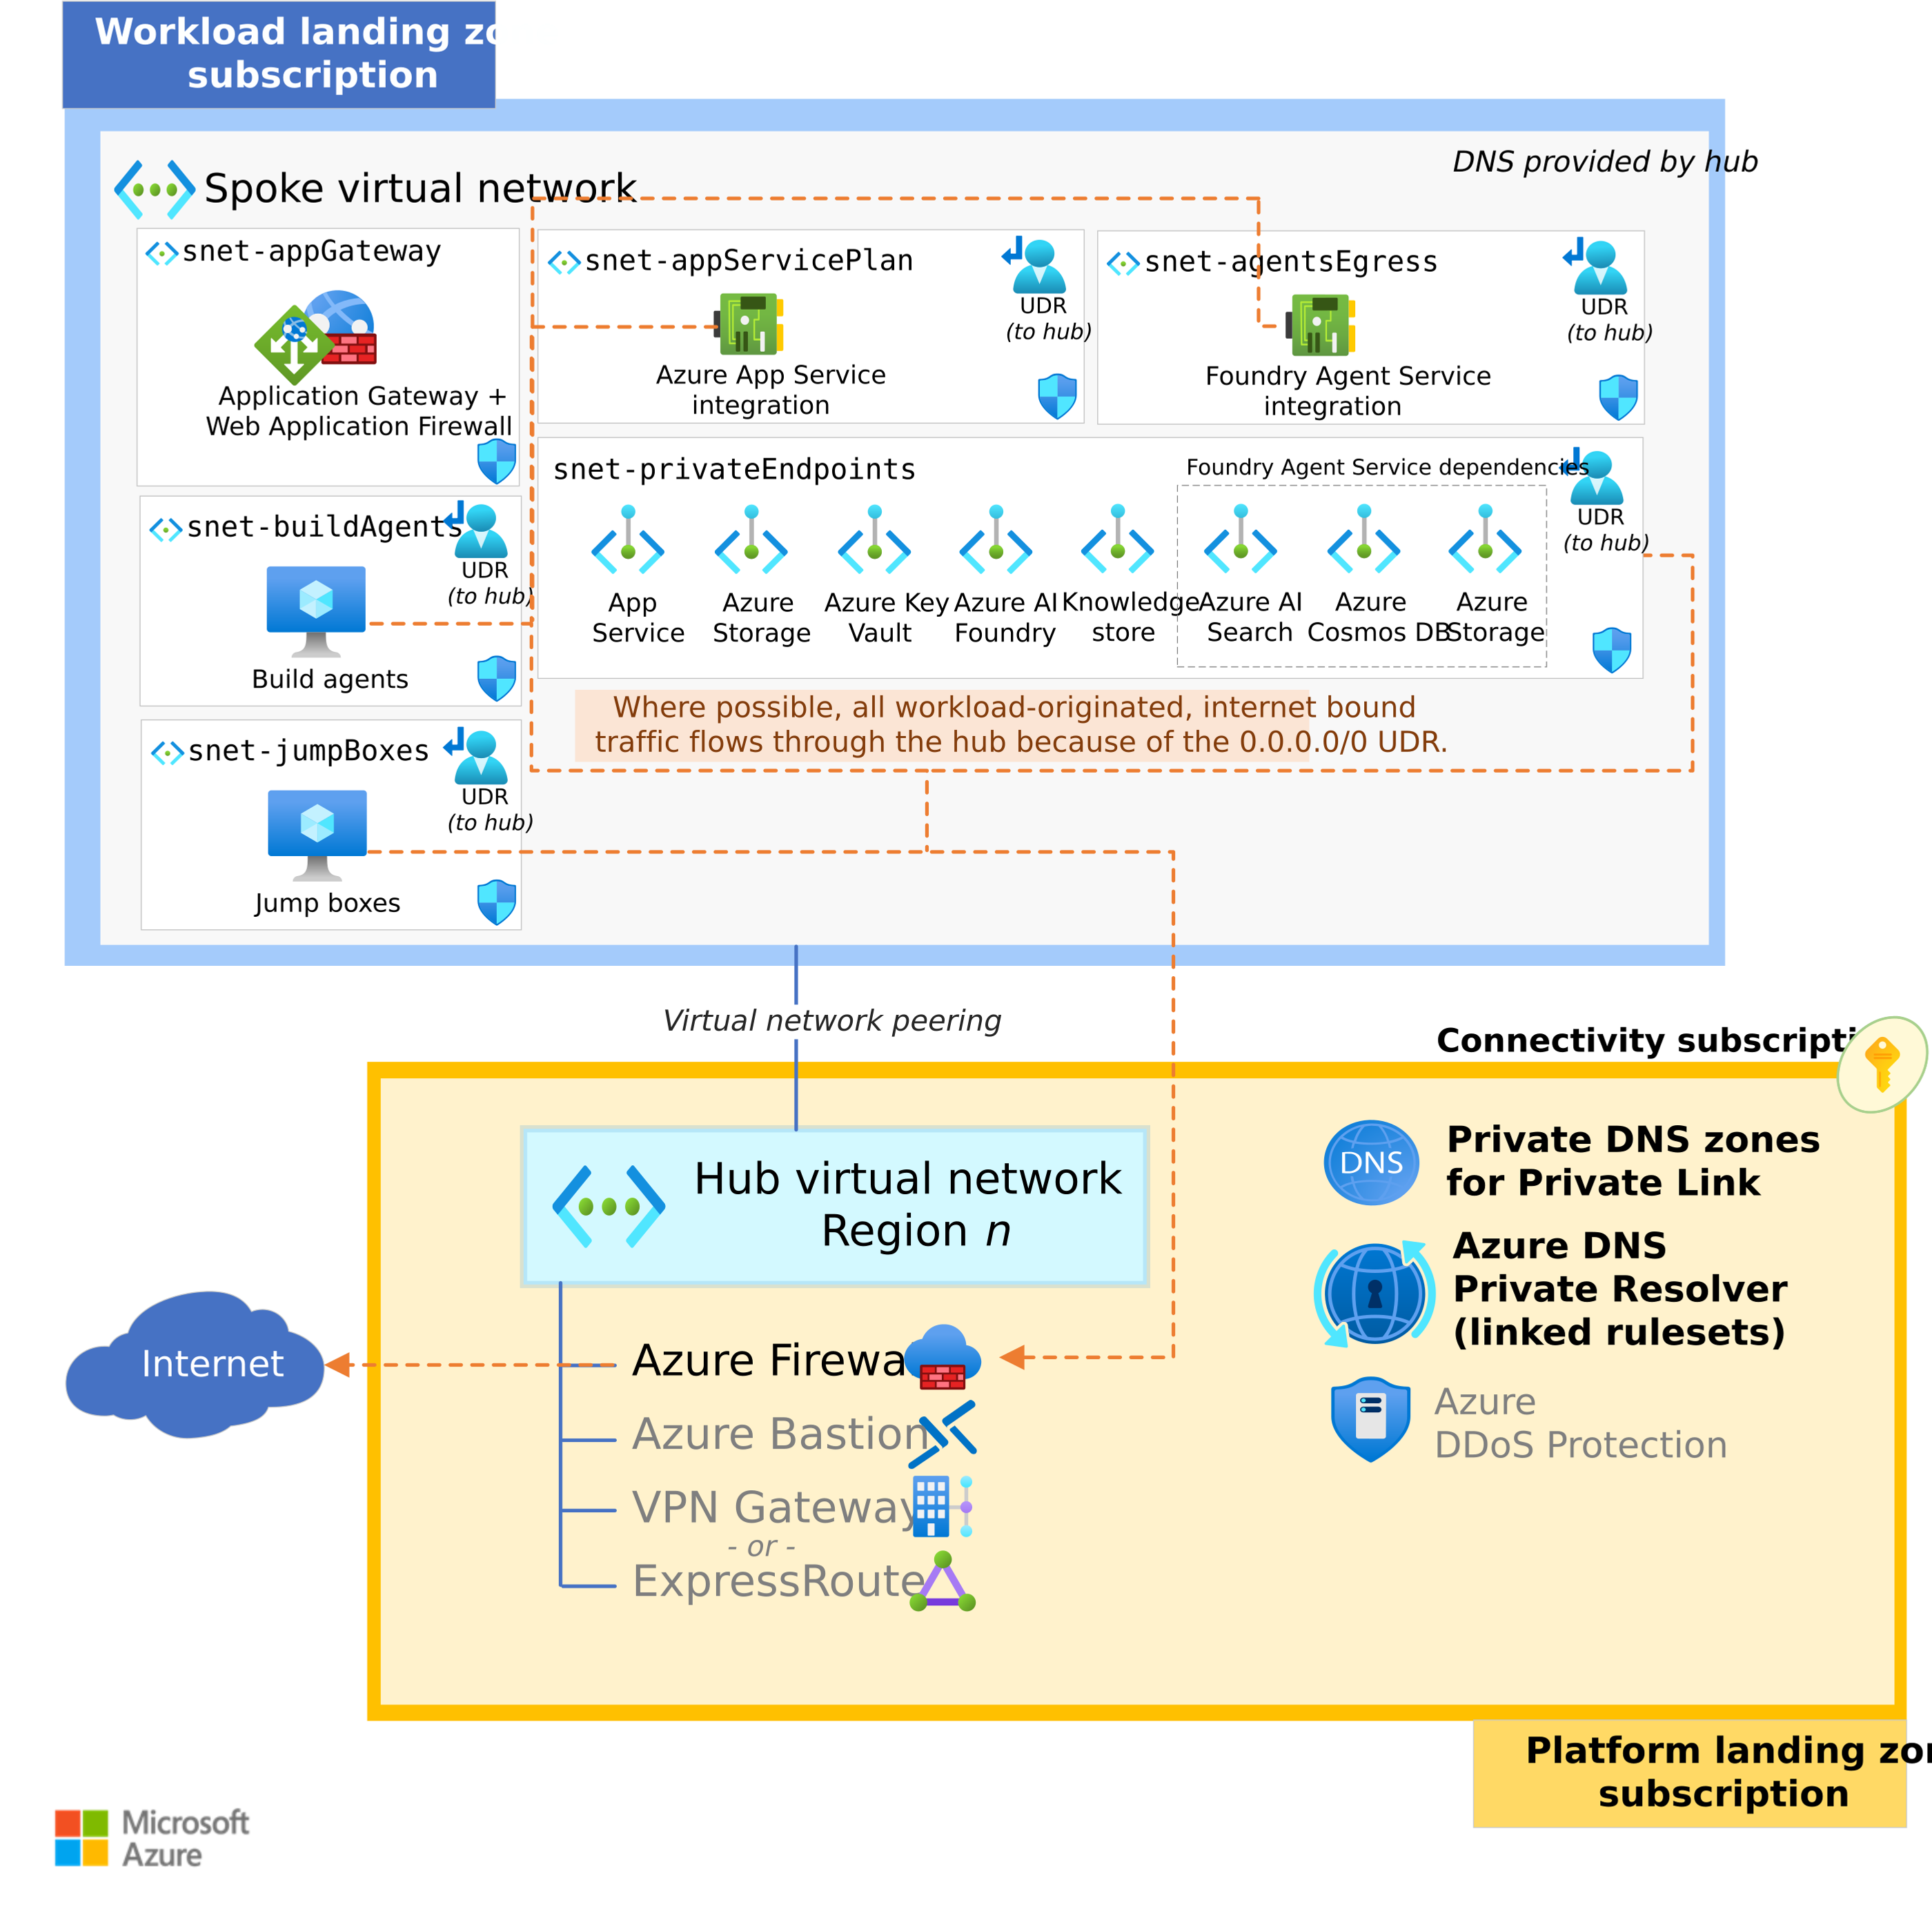
Original reference: landing zone egress
APPENDIX 01-O4
ORIGINAL REFERENCE, UNCHANGED
Source: 12_baseline-landing-zone-networking-egress.png in the GTM repository · Microsoft page: link
The source PNG clips some labels in its own render; the editable reconstruction is appendix A6.
CIS Infra · Original reference diagrams · v4.0 · 11 Oct 2026 · Working proposal, not approved terms
Appendix index
07
Notes:
TALK TRACK
Say: This is the original Microsoft reference, kept unchanged for traceability. The simplified editable version is earlier in the appendix.
Likely question: How firm is this, and who has agreed it?
Answer: It is a proposal for leadership review. The detail and sources below show what is verified, what is an estimate and who still needs to agree it.
DETAIL AND CAVEATS
Original diagram from the user repository, embedded unchanged at source resolution and not stretched beyond its native size. Repository: https://github.com/upendra25312/AI-Foundry-GTM-offering-/blob/main/architectures/12_baseline-landing-zone-networking-egress.png
Editable Visio: https://github.com/upendra25312/AI-Foundry-GTM-offering-/blob/main/architectures/06_baseline-landing-zone-networking-egress.vsdx
Microsoft source: https://learn.microsoft.com/en-us/azure/architecture/ai-ml/architecture/baseline-microsoft-foundry-landing-zone
The source PNG clips some labels in its own render; the editable reconstruction is appendix A6.
Sources: none cited on this slide. Content is a CIS Infra proposal, an estimate or arithmetic from figures sourced elsewhere in this deck (see S1).
Status: proposed offering for internal leadership review. No Cognizant approval, customer evidence, staffing commitment, rate card or verified quote is implied. Illustrative and synthetic figures are labelled as such. All money in USD. Font: Arial substituted for Gellix (not available). Azure icons: official Microsoft Azure Architecture Icons (V24 set, via az-icons.com and the icons embedded in the baseline decks), unmodified SVG with PNG fallback. Version 4.0 produced through PDCA cycles. Rendered and checked as PDF previews; not opened in desktop PowerPoint.

Slide 8
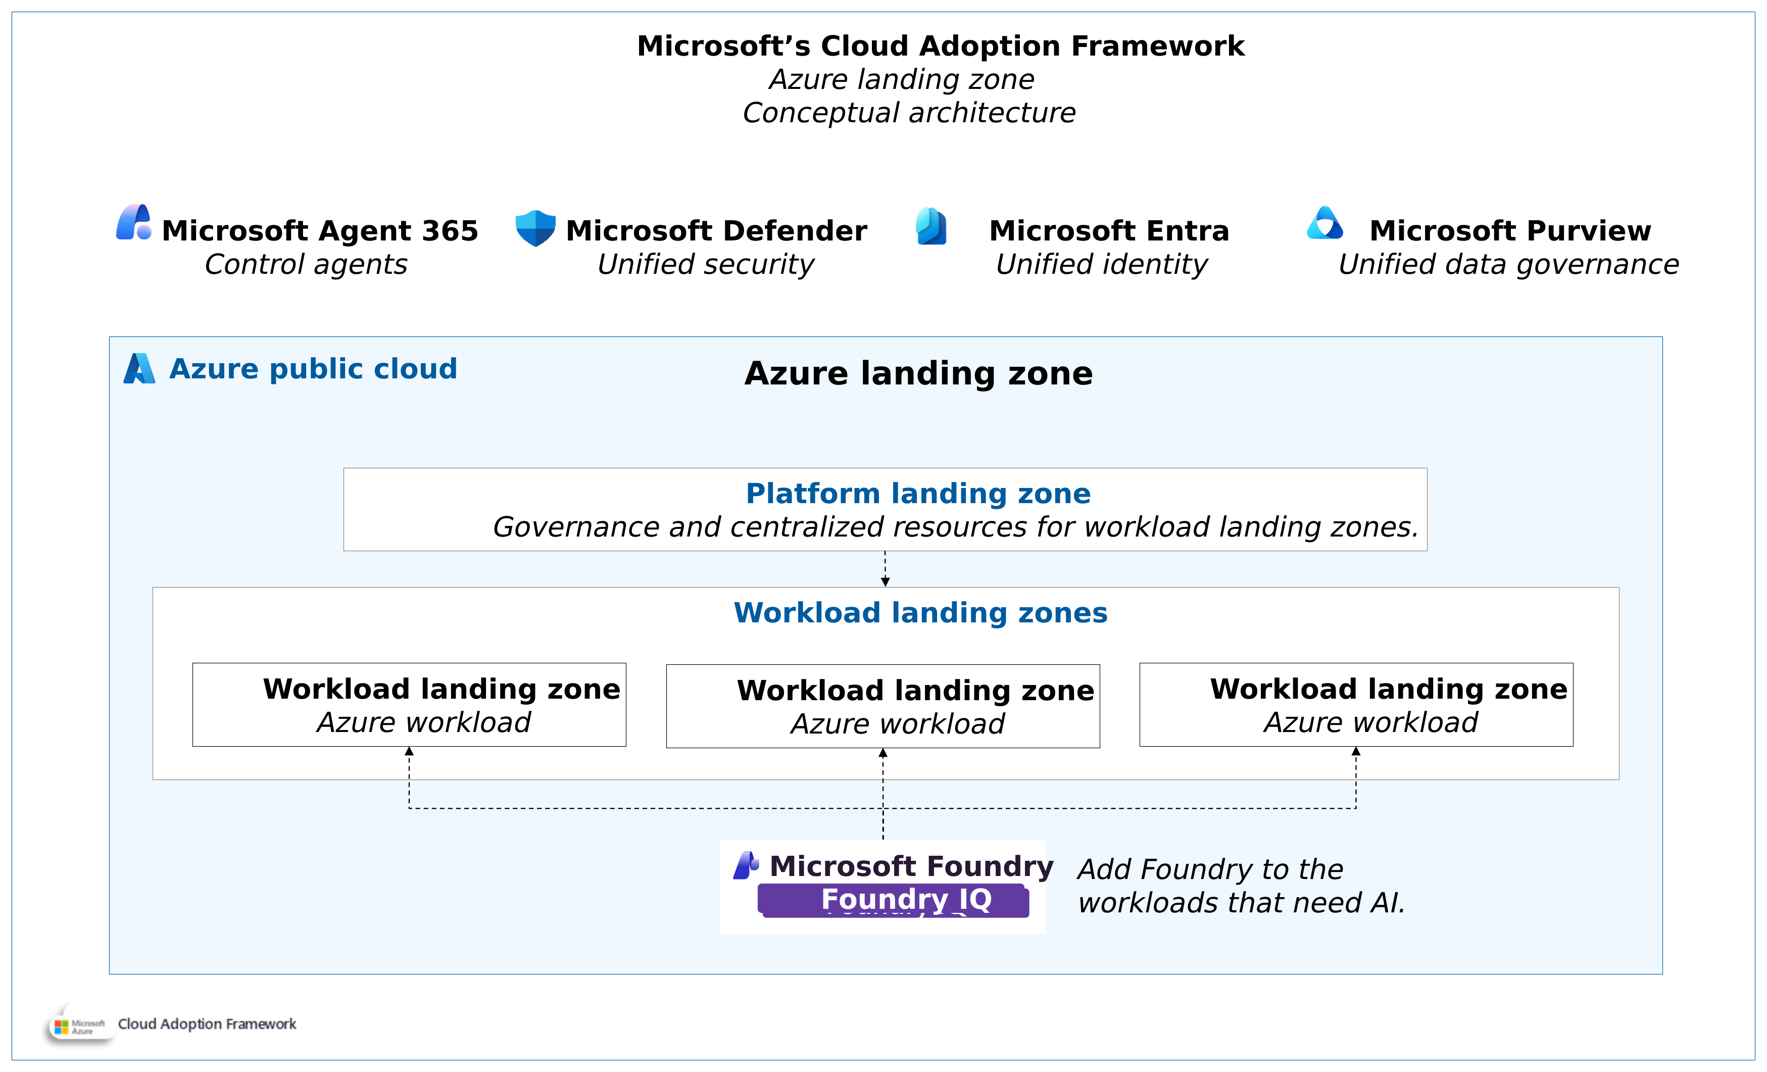
Original reference: Azure landing zone conceptual view
APPENDIX 01-O5
ORIGINAL REFERENCE, UNCHANGED
Source: 35_azure-landing-zone-conceptual-architecture.png in the GTM repository · Microsoft page: link
Microsoft CAF conceptual view showing Foundry added to workload landing zones that need AI.
CIS Infra · Original reference diagrams · v4.0 · 11 Oct 2026 · Working proposal, not approved terms
Appendix index
08
Notes:
TALK TRACK
Say: This is the original Microsoft reference, kept unchanged for traceability. The simplified editable version is earlier in the appendix.
Likely question: How firm is this, and who has agreed it?
Answer: It is a proposal for leadership review. The detail and sources below show what is verified, what is an estimate and who still needs to agree it.
DETAIL AND CAVEATS
Original diagram from the user repository, embedded unchanged at source resolution and not stretched beyond its native size. Repository: https://github.com/upendra25312/AI-Foundry-GTM-offering-/blob/main/architectures/35_azure-landing-zone-conceptual-architecture.png
Microsoft source: https://learn.microsoft.com/en-us/azure/cloud-adoption-framework/ready/landing-zone/
Microsoft CAF conceptual view showing Foundry added to workload landing zones that need AI.
Sources: none cited on this slide. Content is a CIS Infra proposal, an estimate or arithmetic from figures sourced elsewhere in this deck (see S1).
Status: proposed offering for internal leadership review. No Cognizant approval, customer evidence, staffing commitment, rate card or verified quote is implied. Illustrative and synthetic figures are labelled as such. All money in USD. Font: Arial substituted for Gellix (not available). Azure icons: official Microsoft Azure Architecture Icons (V24 set, via az-icons.com and the icons embedded in the baseline decks), unmodified SVG with PNG fallback. Version 4.0 produced through PDCA cycles. Rendered and checked as PDF previews; not opened in desktop PowerPoint.

Slide 9
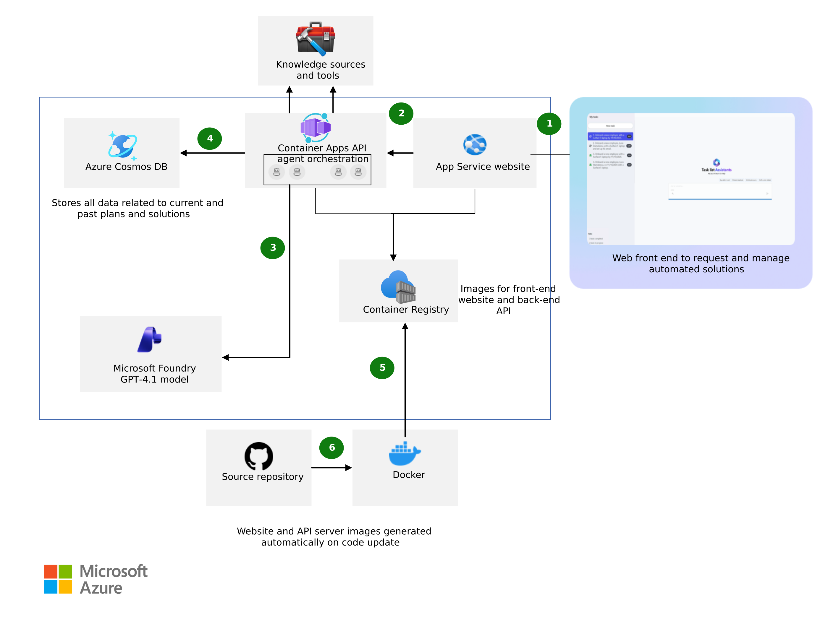
Original reference: multiple-agent workflow
APPENDIX 02-O1
ORIGINAL REFERENCE, UNCHANGED
Source: 15_multiple-agent-workflow-automation.png in the GTM repository · Microsoft page: link
Source labels the model GPT-4.1, which retires 2027-04-14; adapted view (A11) uses a generic model deployment.
CIS Infra · Original reference diagrams · v4.0 · 11 Oct 2026 · Working proposal, not approved terms
Appendix index
09
Notes:
TALK TRACK
Say: This is the original Microsoft reference, kept unchanged for traceability. The simplified editable version is earlier in the appendix.
Likely question: How firm is this, and who has agreed it?
Answer: It is a proposal for leadership review. The detail and sources below show what is verified, what is an estimate and who still needs to agree it.
DETAIL AND CAVEATS
Original diagram from the user repository, embedded unchanged at source resolution and not stretched beyond its native size. Repository: https://github.com/upendra25312/AI-Foundry-GTM-offering-/blob/main/architectures/15_multiple-agent-workflow-automation.png
Editable Visio: https://github.com/upendra25312/AI-Foundry-GTM-offering-/blob/main/architectures/08_multiple-agent-workflow-automation.vsdx
Microsoft source: https://learn.microsoft.com/en-us/azure/architecture/ai-ml/idea/multiple-agent-workflow-automation
Source labels the model GPT-4.1, which retires 2027-04-14; adapted view (A11) uses a generic model deployment.
Sources: none cited on this slide. Content is a CIS Infra proposal, an estimate or arithmetic from figures sourced elsewhere in this deck (see S1).
Status: proposed offering for internal leadership review. No Cognizant approval, customer evidence, staffing commitment, rate card or verified quote is implied. Illustrative and synthetic figures are labelled as such. All money in USD. Font: Arial substituted for Gellix (not available). Azure icons: official Microsoft Azure Architecture Icons (V24 set, via az-icons.com and the icons embedded in the baseline decks), unmodified SVG with PNG fallback. Version 4.0 produced through PDCA cycles. Rendered and checked as PDF previews; not opened in desktop PowerPoint.

Slide 10
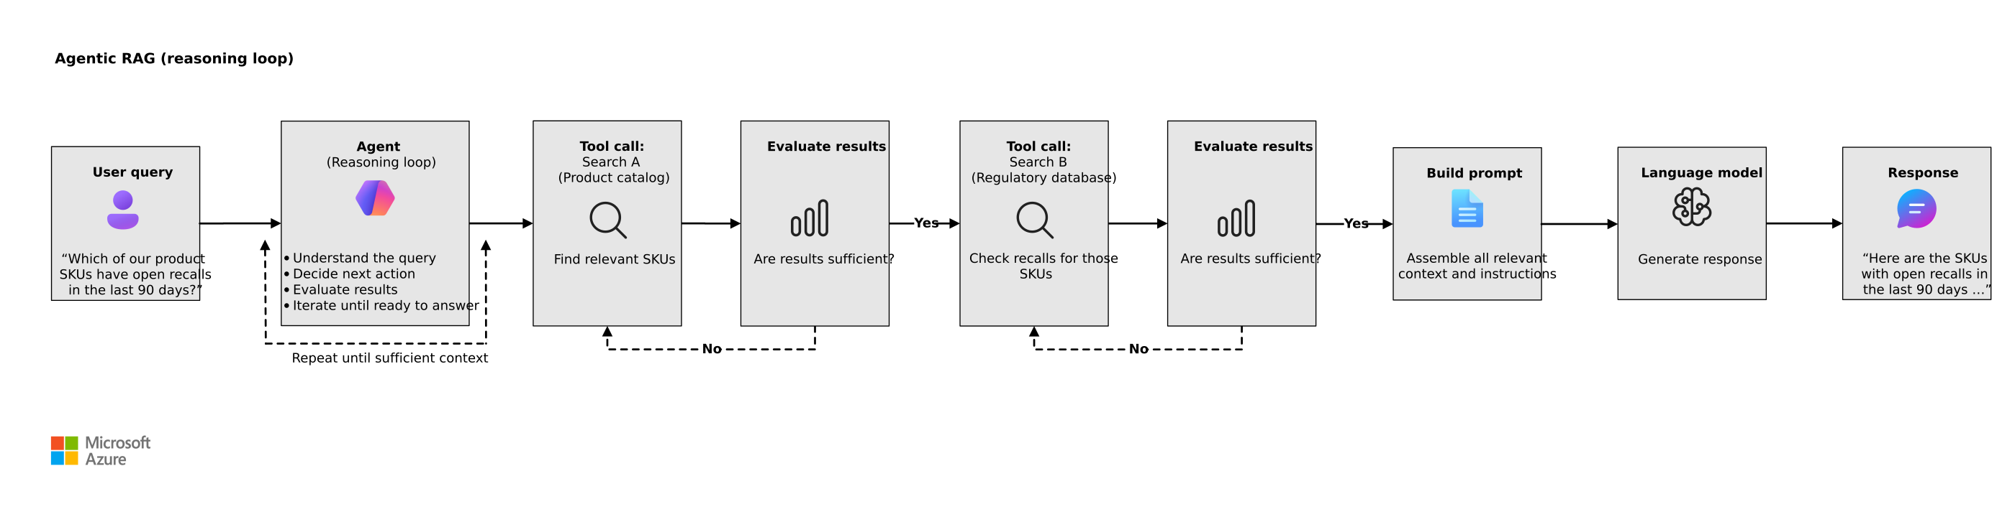
Original reference: agentic RAG loop
APPENDIX 02-O2
ORIGINAL REFERENCE, UNCHANGED
Source: 14_agentic-rag.png in the GTM repository · Microsoft page: link
Reasoning loop only; it does not show an implemented kill switch.
CIS Infra · Original reference diagrams · v4.0 · 11 Oct 2026 · Working proposal, not approved terms
Appendix index
10
Notes:
TALK TRACK
Say: This is the original Microsoft reference, kept unchanged for traceability. The simplified editable version is earlier in the appendix.
Likely question: How firm is this, and who has agreed it?
Answer: It is a proposal for leadership review. The detail and sources below show what is verified, what is an estimate and who still needs to agree it.
DETAIL AND CAVEATS
Original diagram from the user repository, embedded unchanged at source resolution and not stretched beyond its native size. Repository: https://github.com/upendra25312/AI-Foundry-GTM-offering-/blob/main/architectures/14_agentic-rag.png
Editable Visio: https://github.com/upendra25312/AI-Foundry-GTM-offering-/blob/main/architectures/07_agentic-rag.vsdx
Microsoft source: https://learn.microsoft.com/en-us/azure/architecture/ai-ml/guide/rag/rag-agentic
Reasoning loop only; it does not show an implemented kill switch.
Sources: none cited on this slide. Content is a CIS Infra proposal, an estimate or arithmetic from figures sourced elsewhere in this deck (see S1).
Status: proposed offering for internal leadership review. No Cognizant approval, customer evidence, staffing commitment, rate card or verified quote is implied. Illustrative and synthetic figures are labelled as such. All money in USD. Font: Arial substituted for Gellix (not available). Azure icons: official Microsoft Azure Architecture Icons (V24 set, via az-icons.com and the icons embedded in the baseline decks), unmodified SVG with PNG fallback. Version 4.0 produced through PDCA cycles. Rendered and checked as PDF previews; not opened in desktop PowerPoint.

Slide 11
Original reference: Foundry baseline monitoring scope
APPENDIX 02-O3
ORIGINAL REFERENCE, UNCHANGED
Source: 07_baseline-microsoft-foundry.png in the GTM repository · Microsoft page: link
Use to map agent registrations, runtime, search, storage and network to monitored assets.
CIS Infra · Original reference diagrams · v4.0 · 11 Oct 2026 · Working proposal, not approved terms
Appendix index
11
Notes:
TALK TRACK
Say: This is the original Microsoft reference, kept unchanged for traceability. The simplified editable version is earlier in the appendix.
Likely question: How firm is this, and who has agreed it?
Answer: It is a proposal for leadership review. The detail and sources below show what is verified, what is an estimate and who still needs to agree it.
DETAIL AND CAVEATS
Original diagram from the user repository, embedded unchanged at source resolution and not stretched beyond its native size. Repository: https://github.com/upendra25312/AI-Foundry-GTM-offering-/blob/main/architectures/07_baseline-microsoft-foundry.png
Editable Visio: https://github.com/upendra25312/AI-Foundry-GTM-offering-/blob/main/architectures/03_baseline-microsoft-foundry.vsdx
Microsoft source: https://learn.microsoft.com/en-us/azure/architecture/ai-ml/architecture/baseline-microsoft-foundry-chat
Use to map agent registrations, runtime, search, storage and network to monitored assets.
Sources: none cited on this slide. Content is a CIS Infra proposal, an estimate or arithmetic from figures sourced elsewhere in this deck (see S1).
Status: proposed offering for internal leadership review. No Cognizant approval, customer evidence, staffing commitment, rate card or verified quote is implied. Illustrative and synthetic figures are labelled as such. All money in USD. Font: Arial substituted for Gellix (not available). Azure icons: official Microsoft Azure Architecture Icons (V24 set, via az-icons.com and the icons embedded in the baseline decks), unmodified SVG with PNG fallback. Version 4.0 produced through PDCA cycles. Rendered and checked as PDF previews; not opened in desktop PowerPoint.

Slide 12
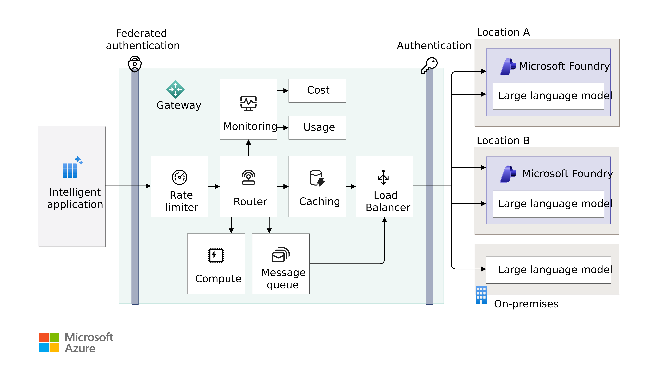
Original reference: gateway conceptual architecture
APPENDIX 03-O1
ORIGINAL REFERENCE, UNCHANGED
Source: 38_foundry-gateway-conceptual-architecture.png in the GTM repository · Microsoft page: link
Conceptual functions; queuing and compute may need services beyond one API Management tier.
CIS Infra · Original reference diagrams · v4.0 · 11 Oct 2026 · Working proposal, not approved terms
Appendix index
12
Notes:
TALK TRACK
Say: This is the original Microsoft reference, kept unchanged for traceability. The simplified editable version is earlier in the appendix.
Likely question: How firm is this, and who has agreed it?
Answer: It is a proposal for leadership review. The detail and sources below show what is verified, what is an estimate and who still needs to agree it.
DETAIL AND CAVEATS
Original diagram from the user repository, embedded unchanged at source resolution and not stretched beyond its native size. Repository: https://github.com/upendra25312/AI-Foundry-GTM-offering-/blob/main/architectures/38_foundry-gateway-conceptual-architecture.png
Editable Visio: https://github.com/upendra25312/AI-Foundry-GTM-offering-/blob/main/architectures/12_foundry-gateway-conceptual-architecture.vsdx
Microsoft source: https://learn.microsoft.com/en-us/azure/architecture/ai-ml/guide/azure-openai-gateway-guide
Conceptual functions; queuing and compute may need services beyond one API Management tier.
Sources: none cited on this slide. Content is a CIS Infra proposal, an estimate or arithmetic from figures sourced elsewhere in this deck (see S1).
Status: proposed offering for internal leadership review. No Cognizant approval, customer evidence, staffing commitment, rate card or verified quote is implied. Illustrative and synthetic figures are labelled as such. All money in USD. Font: Arial substituted for Gellix (not available). Azure icons: official Microsoft Azure Architecture Icons (V24 set, via az-icons.com and the icons embedded in the baseline decks), unmodified SVG with PNG fallback. Version 4.0 produced through PDCA cycles. Rendered and checked as PDF previews; not opened in desktop PowerPoint.

Slide 13
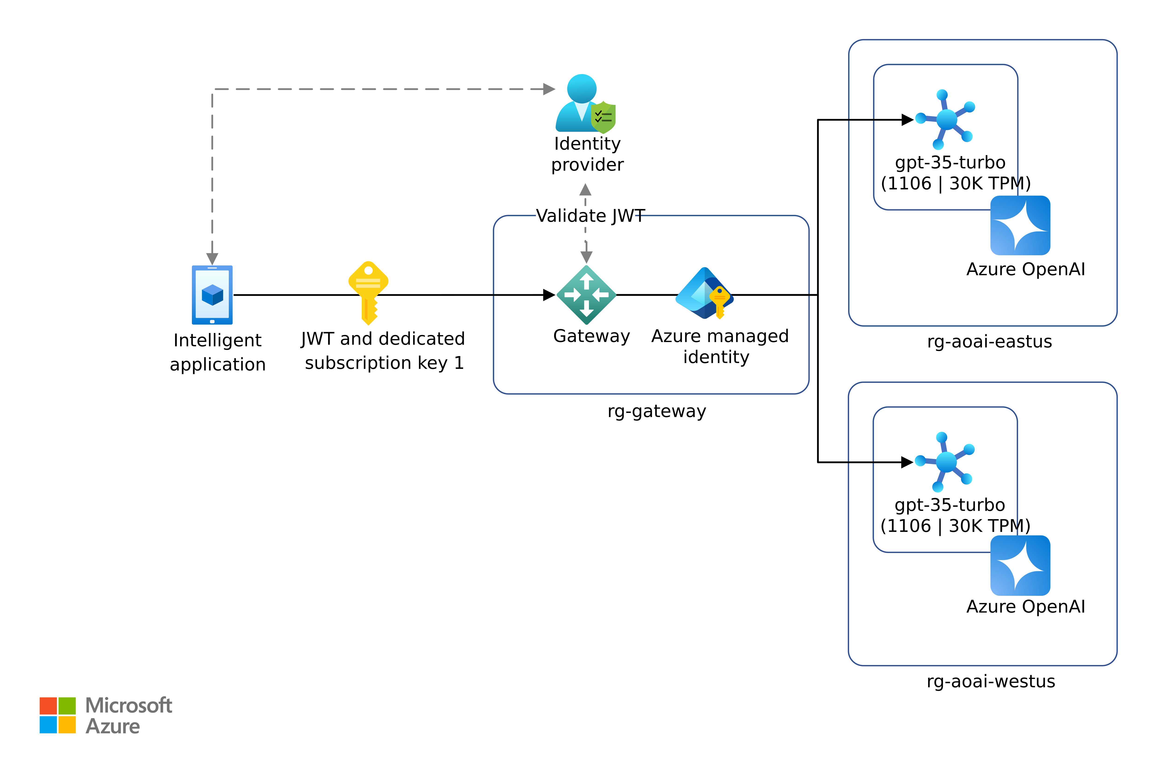
Historical reference: legacy identity diagram
APPENDIX 03-O2
HISTORICAL, LEGACY LABELS
Source: 44_azure-openai-gateway-identity-solution-combined.png in the GTM repository · Microsoft page: link
HISTORICAL: legacy gpt-35-turbo and Azure OpenAI labels. Do not use in proposals; use appendix A3.
CIS Infra · Original reference diagrams · v4.0 · 11 Oct 2026 · Working proposal, not approved terms
Appendix index
13
Notes:
TALK TRACK
Say: This is the original Microsoft reference, kept unchanged for traceability. The simplified editable version is earlier in the appendix. It carries legacy labels, so do not use it in proposals.
Likely question: How firm is this, and who has agreed it?
Answer: It is a proposal for leadership review. The detail and sources below show what is verified, what is an estimate and who still needs to agree it.
DETAIL AND CAVEATS
Original diagram from the user repository, embedded unchanged at source resolution and not stretched beyond its native size. Repository: https://github.com/upendra25312/AI-Foundry-GTM-offering-/blob/main/architectures/44_azure-openai-gateway-identity-solution-combined.png
Editable Visio: https://github.com/upendra25312/AI-Foundry-GTM-offering-/blob/main/architectures/14_azure-openai-authentication.vsdx
Microsoft source: https://learn.microsoft.com/en-us/azure/architecture/ai-ml/guide/azure-openai-gateway-custom-authentication
HISTORICAL: legacy gpt-35-turbo and Azure OpenAI labels. Do not use in proposals; use appendix A3.
Sources: none cited on this slide. Content is a CIS Infra proposal, an estimate or arithmetic from figures sourced elsewhere in this deck (see S1).
Status: proposed offering for internal leadership review. No Cognizant approval, customer evidence, staffing commitment, rate card or verified quote is implied. Illustrative and synthetic figures are labelled as such. All money in USD. Font: Arial substituted for Gellix (not available). Azure icons: official Microsoft Azure Architecture Icons (V24 set, via az-icons.com and the icons embedded in the baseline decks), unmodified SVG with PNG fallback. Version 4.0 produced through PDCA cycles. Rendered and checked as PDF previews; not opened in desktop PowerPoint.

Slide 14
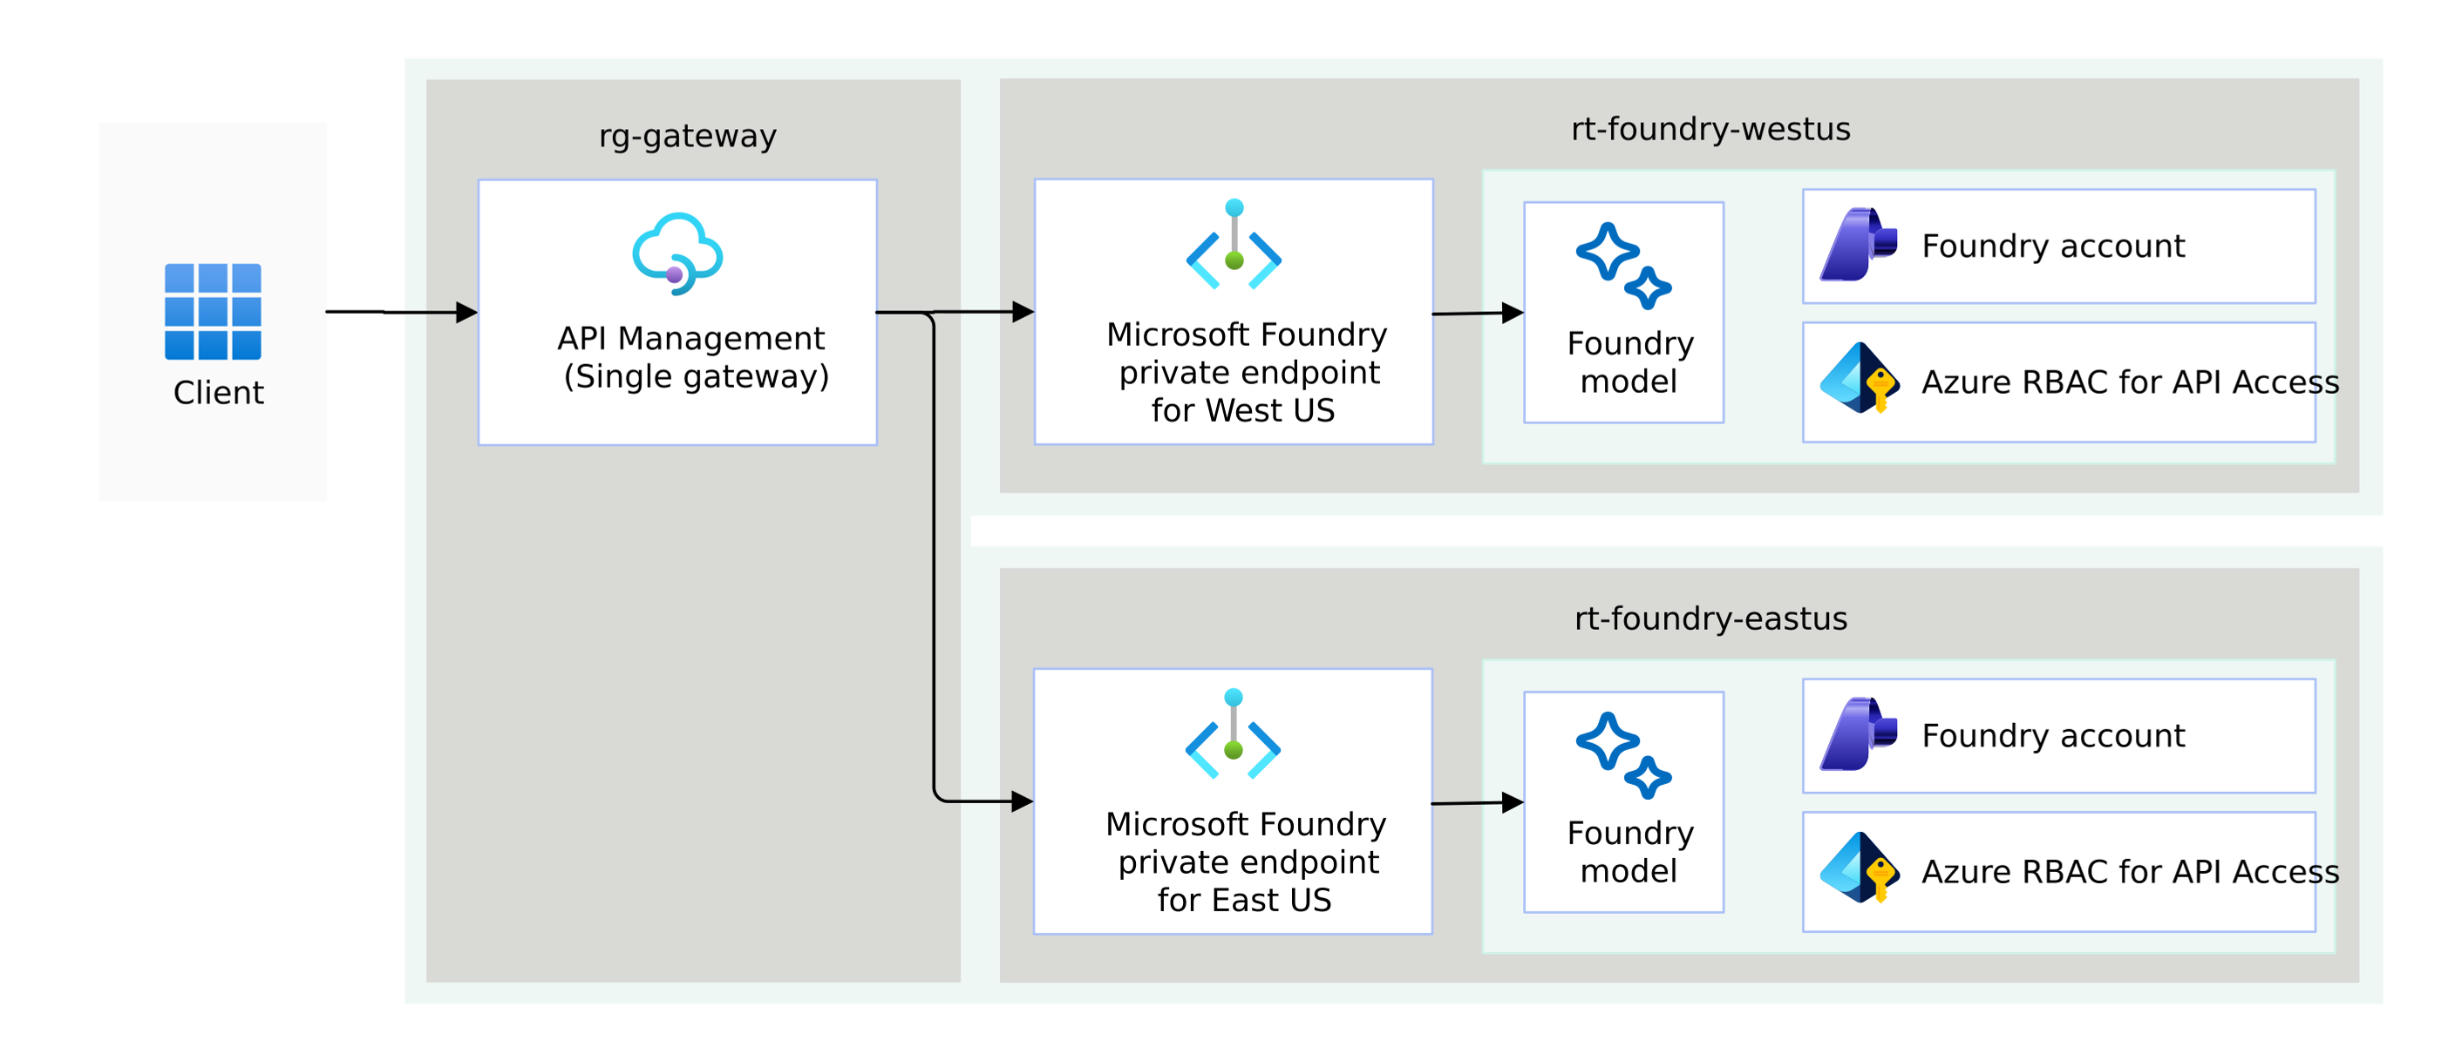
Original reference: one gateway, regional backends
APPENDIX 03-O3
ORIGINAL REFERENCE, UNCHANGED
Source: 20_multiple-regions-api-management-single-after.png in the GTM repository · Microsoft page: link
Source labels "rt-foundry-westus" appear to mean resource group; backend failover keeps one gateway failure domain.
CIS Infra · Original reference diagrams · v4.0 · 11 Oct 2026 · Working proposal, not approved terms
Appendix index
14
Notes:
TALK TRACK
Say: This is the original Microsoft reference, kept unchanged for traceability. The simplified editable version is earlier in the appendix.
Likely question: How firm is this, and who has agreed it?
Answer: It is a proposal for leadership review. The detail and sources below show what is verified, what is an estimate and who still needs to agree it.
DETAIL AND CAVEATS
Original diagram from the user repository, embedded unchanged at source resolution and not stretched beyond its native size. Repository: https://github.com/upendra25312/AI-Foundry-GTM-offering-/blob/main/architectures/20_multiple-regions-api-management-single-after.png
Microsoft source: https://learn.microsoft.com/en-us/azure/architecture/ai-ml/guide/azure-openai-gateway-guide
Source labels "rt-foundry-westus" appear to mean resource group; backend failover keeps one gateway failure domain.
Sources: none cited on this slide. Content is a CIS Infra proposal, an estimate or arithmetic from figures sourced elsewhere in this deck (see S1).
Status: proposed offering for internal leadership review. No Cognizant approval, customer evidence, staffing commitment, rate card or verified quote is implied. Illustrative and synthetic figures are labelled as such. All money in USD. Font: Arial substituted for Gellix (not available). Azure icons: official Microsoft Azure Architecture Icons (V24 set, via az-icons.com and the icons embedded in the baseline decks), unmodified SVG with PNG fallback. Version 4.0 produced through PDCA cycles. Rendered and checked as PDF previews; not opened in desktop PowerPoint.

Slide 15
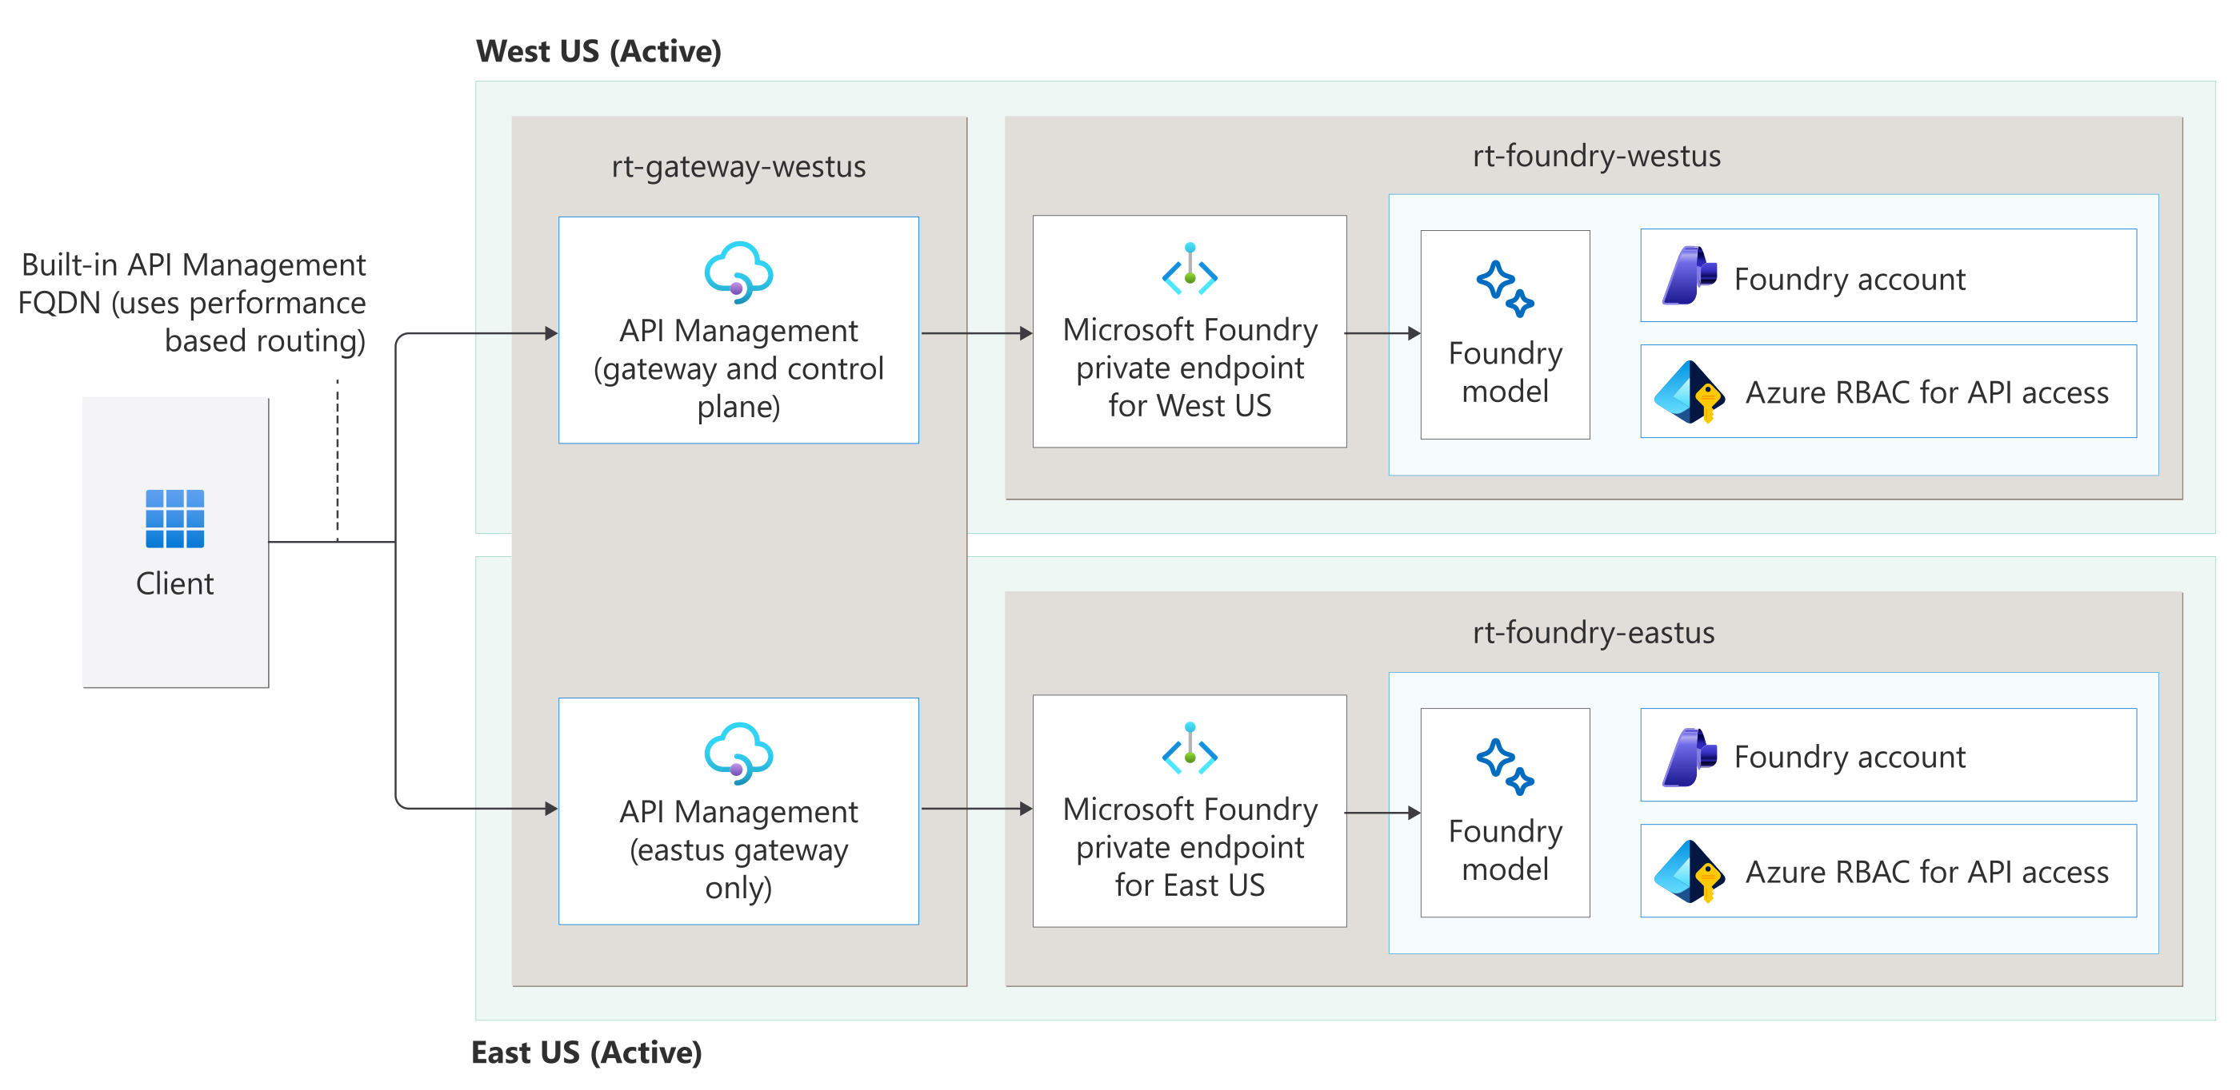
Original reference: multi-region gateway
APPENDIX 03-O4
ORIGINAL REFERENCE, UNCHANGED
Source: 21_multiple-regions-api-management-multiple-after.png in the GTM repository · Microsoft page: link
Built-in multi-region API Management needs Premium (classic).
CIS Infra · Original reference diagrams · v4.0 · 11 Oct 2026 · Working proposal, not approved terms
Appendix index
15
Notes:
TALK TRACK
Say: This is the original Microsoft reference, kept unchanged for traceability. The simplified editable version is earlier in the appendix.
Likely question: How firm is this, and who has agreed it?
Answer: It is a proposal for leadership review. The detail and sources below show what is verified, what is an estimate and who still needs to agree it.
DETAIL AND CAVEATS
Original diagram from the user repository, embedded unchanged at source resolution and not stretched beyond its native size. Repository: https://github.com/upendra25312/AI-Foundry-GTM-offering-/blob/main/architectures/21_multiple-regions-api-management-multiple-after.png
Microsoft source: https://learn.microsoft.com/en-us/azure/architecture/ai-ml/guide/azure-openai-gateway-guide
Built-in multi-region API Management needs Premium (classic).
Sources: none cited on this slide. Content is a CIS Infra proposal, an estimate or arithmetic from figures sourced elsewhere in this deck (see S1).
Status: proposed offering for internal leadership review. No Cognizant approval, customer evidence, staffing commitment, rate card or verified quote is implied. Illustrative and synthetic figures are labelled as such. All money in USD. Font: Arial substituted for Gellix (not available). Azure icons: official Microsoft Azure Architecture Icons (V24 set, via az-icons.com and the icons embedded in the baseline decks), unmodified SVG with PNG fallback. Version 4.0 produced through PDCA cycles. Rendered and checked as PDF previews; not opened in desktop PowerPoint.

Slide 16
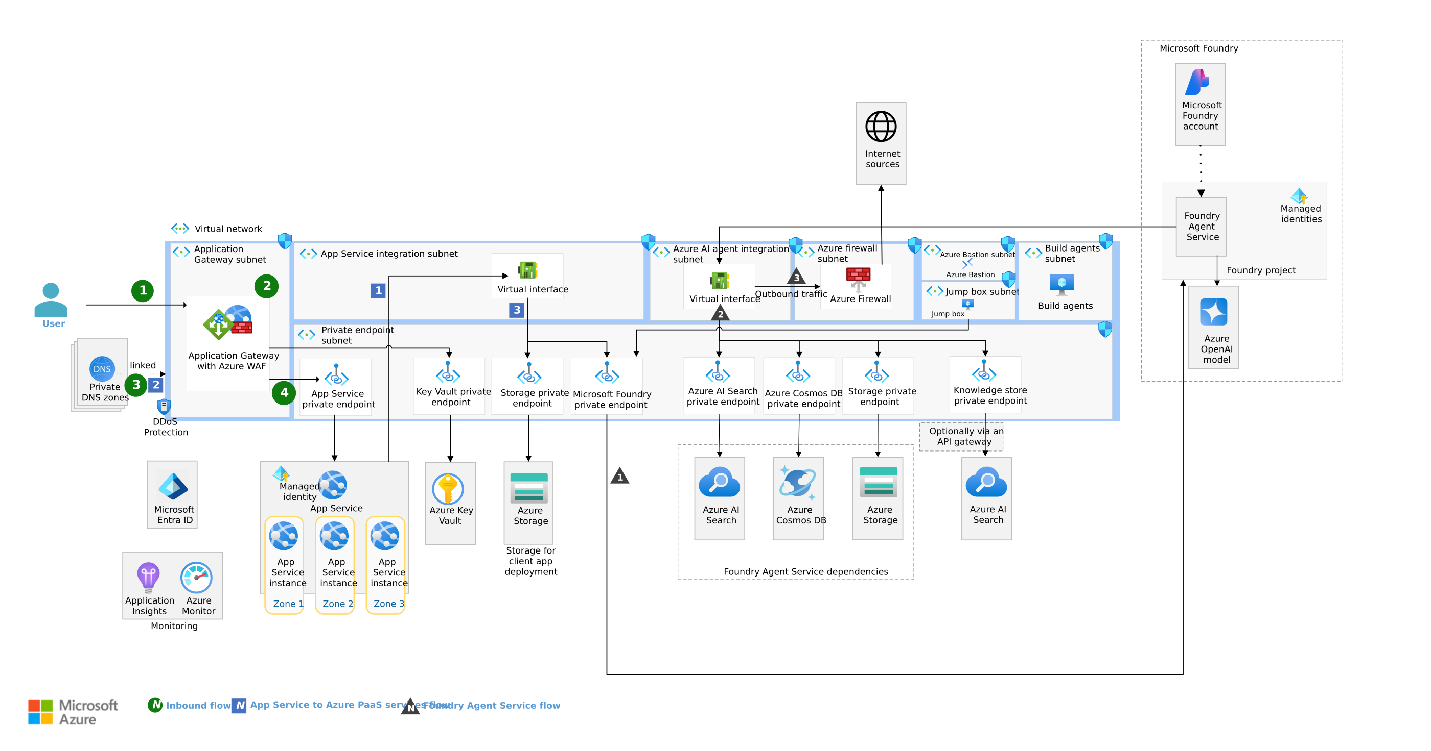
Original reference: Foundry baseline network flows
APPENDIX 05-O1
ORIGINAL REFERENCE, UNCHANGED
Source: 08_baseline-microsoft-foundry-network-flow.png in the GTM repository · Microsoft page: link
Use to derive the monitored dependency map (A3). Source labels the model "Azure OpenAI model".
CIS Infra · Original reference diagrams · v4.0 · 11 Oct 2026 · Working proposal, not approved terms
Appendix index
16
Notes:
TALK TRACK
Say: This is the original Microsoft reference, kept unchanged for traceability. The simplified editable version is earlier in the appendix.
Likely question: How firm is this, and who has agreed it?
Answer: It is a proposal for leadership review. The detail and sources below show what is verified, what is an estimate and who still needs to agree it.
DETAIL AND CAVEATS
Original diagram from the user repository, embedded unchanged at source resolution and not stretched beyond its native size. Repository: https://github.com/upendra25312/AI-Foundry-GTM-offering-/blob/main/architectures/08_baseline-microsoft-foundry-network-flow.png
Editable Visio: https://github.com/upendra25312/AI-Foundry-GTM-offering-/blob/main/architectures/03_baseline-microsoft-foundry.vsdx
Microsoft source: https://learn.microsoft.com/en-us/azure/architecture/ai-ml/architecture/baseline-microsoft-foundry-chat
Use to derive the monitored dependency map (A3). Source labels the model "Azure OpenAI model".
Sources: none cited on this slide. Content is a CIS Infra proposal, an estimate or arithmetic from figures sourced elsewhere in this deck (see S1).
Status: proposed offering for internal leadership review. No Cognizant approval, customer evidence, staffing commitment, rate card or verified quote is implied. Illustrative and synthetic figures are labelled as such. All money in USD. Font: Arial substituted for Gellix (not available). Azure icons: official Microsoft Azure Architecture Icons (V24 set, via az-icons.com and the icons embedded in the baseline decks), unmodified SVG with PNG fallback. Version 4.0 produced through PDCA cycles. Rendered and checked as PDF previews; not opened in desktop PowerPoint.

