Slide 1

Enterprise RAG
Solutioning Proposal
CIS Infra customer pursuit reference
Worked reference case / Revision 2
Candidate EU and US deployments / Illustrative USD budget
Upendra Kumar / Azure Presales Architect / 10 October 2026
Notes:
Source materials:
https://github.com/upendra25312/AI-Foundry-GTM-offering-/blob/ad3af1ef8701abbcf05ee926c2f9e09ca8d346f4/CIS_Infra_Azure_AI_Platform_GTM_Proposal_V3.docx
https://github.com/upendra25312/AI-Foundry-GTM-offering-/blob/ad3af1ef8701abbcf05ee926c2f9e09ca8d346f4/Microsoft_AI_Architect_Learning_Roadmap.xlsx
Brand reference: https://github.com/upendra25312/AI-Foundry-GTM-offering-/blob/ad3af1ef8701abbcf05ee926c2f9e09ca8d346f4/Cognizant_Branded_Presales_Template.pptx
Reviewed 10 October 2026. Estimates and RACI are proposed. Source diagrams may use names that differ from current Microsoft branding. Verify exact runtime, API and feature support at deal design. No approved internal product or rate card is asserted.

Slide 2

CIS Infra / Solutioning proposal
The reference case has a bounded business outcome
Business objective
Customer outcome
Help employees answer questions over one approved document collection, with citations.
A tested platform with access enforcement, repeatable releases and accepted operating ownership.
Reference population
Source assumption
5,000 eligible users. Base scenario assumes 1,000 active users and 20 monthly requests each.
Up to 10,000 text documents and 10M source tokens. 50 GB storage allowance. Approved ACL metadata. No OCR.
Scope
Decision status
One source collection and read-only answers. Development and production in separate workload subscriptions.
Customer identity, source rights, model capacity and approved geography remain prerequisites.
Synthetic customer case. Extra sources, OCR, actions and region recovery require a change estimate.
CIS Infra / Revision 2 / 10 Oct 2026
02
Notes:
Source materials:
https://github.com/upendra25312/AI-Foundry-GTM-offering-/blob/ad3af1ef8701abbcf05ee926c2f9e09ca8d346f4/CIS_Infra_Azure_AI_Platform_GTM_Proposal_V3.docx
https://github.com/upendra25312/AI-Foundry-GTM-offering-/blob/ad3af1ef8701abbcf05ee926c2f9e09ca8d346f4/Microsoft_AI_Architect_Learning_Roadmap.xlsx
Brand reference: https://github.com/upendra25312/AI-Foundry-GTM-offering-/blob/ad3af1ef8701abbcf05ee926c2f9e09ca8d346f4/Cognizant_Branded_Presales_Template.pptx
Reviewed 10 October 2026. Estimates and RACI are proposed. Source diagrams may use names that differ from current Microsoft branding. Verify exact runtime, API and feature support at deal design. No approved internal product or rate card is asserted.

Slide 3
CIS Infra / Solutioning proposal
A custom RAG application is the selected route
Application runtime
EU candidate
App Service hosts UI, API, ingestion job and the retrieval pipeline. No hosted agent runtime in this baseline.
Sweden Central resources. Candidate chat uses EU Data Zone Standard; embeddings use a supported regional deployment.
Model access
US candidate
Azure OpenAI in Foundry Models through the v1 GA API. Candidate GPT-4.1 and text-embedding-3-small.
East US 2 resources. Candidate chat uses US Data Zone Standard; embeddings use a supported regional deployment.
Data services
Approval boundary
Azure AI Search stores document chunks and access metadata. Blob holds the approved source copy.
Validate model version, deployment type, quota, private routes and lifecycle before ordering.
These are alternative customer patterns, not a two-region HA or DR commitment.
CIS Infra / Revision 2 / 10 Oct 2026
03
Notes:
Proposed custom application RAG pattern, not the current Microsoft Foundry Agent Service baseline. No Agent Service, Cosmos DB, APIM, tool actions or semantic cache in the baseline. Application generates embeddings, performs security-filtered retrieval, sends authorized context to the chat model and returns citations. HTTPS private endpoints for app, Search, Azure OpenAI, Blob and Key Vault. Existing VPN/ExpressRoute provides private app access. Sources: https://github.com/Azure-Samples/azure-search-openai-demo and https://github.com/Azure-Samples/azure-search-openai-demo/blob/main/docs/deploy_private.md . Document filtering is application-enforced and must be implemented and tested; source ACL synchronization is customer-specific. Authentication reference: https://github.com/Azure-Samples/azure-search-openai-demo/blob/main/docs/login_and_acl.md API: https://learn.microsoft.com/en-us/azure/foundry/openai/api-version-lifecycle . Candidate models are subject to availability and evaluation; pin the chosen version in the deployment register. Data Zone scope follows Microsoft definitions, not a single country. Chat and embedding deployment support must be validated separately. Do not infer that the embedding model supports Data Zone Standard.
Source materials:
https://github.com/upendra25312/AI-Foundry-GTM-offering-/blob/ad3af1ef8701abbcf05ee926c2f9e09ca8d346f4/CIS_Infra_Azure_AI_Platform_GTM_Proposal_V3.docx
https://github.com/upendra25312/AI-Foundry-GTM-offering-/blob/ad3af1ef8701abbcf05ee926c2f9e09ca8d346f4/Microsoft_AI_Architect_Learning_Roadmap.xlsx
Brand reference: https://github.com/upendra25312/AI-Foundry-GTM-offering-/blob/ad3af1ef8701abbcf05ee926c2f9e09ca8d346f4/Cognizant_Branded_Presales_Template.pptx
Technical/public sources: https://learn.microsoft.com/en-us/azure/foundry/foundry-models/concepts/deployment-types
Reviewed 10 October 2026. Estimates and RACI are proposed. Source diagrams may use names that differ from current Microsoft branding. Verify exact runtime, API and feature support at deal design. No approved internal product or rate card is asserted.

Slide 4
CIS Infra / Solutioning proposal
Authorized retrieval precedes answer generation
Employee client
Enterprise private access
App Service UI / API
RAG orchestration
Permission enforcement
2 filtered query
Azure AI Search
Chunks + ACL metadata
1 request
3 model calls
4 ingest
Microsoft Entra ID
User authentication
Azure OpenAI
Chat + embeddings
Scoped ingestion job
Approved Blob copy
Chunk, embed, index
4 embeddings
5 Redacted telemetry, request IDs and cost metrics to Azure Monitor
Proposed logical design. Numbered flows are explained on the next slide.
CIS Infra / Revision 2 / 10 Oct 2026
04
Notes:
Proposed custom application RAG pattern, not the current Microsoft Foundry Agent Service baseline. No Agent Service, Cosmos DB, APIM, tool actions or semantic cache in the baseline. Application generates embeddings, performs security-filtered retrieval, sends authorized context to the chat model and returns citations. HTTPS private endpoints for app, Search, Azure OpenAI, Blob and Key Vault. Existing VPN/ExpressRoute provides private app access. Sources: https://github.com/Azure-Samples/azure-search-openai-demo and https://github.com/Azure-Samples/azure-search-openai-demo/blob/main/docs/deploy_private.md . Document filtering is application-enforced and must be implemented and tested; source ACL synchronization is customer-specific. Authentication reference: https://github.com/Azure-Samples/azure-search-openai-demo/blob/main/docs/login_and_acl.md
Source materials:
https://github.com/upendra25312/AI-Foundry-GTM-offering-/blob/ad3af1ef8701abbcf05ee926c2f9e09ca8d346f4/CIS_Infra_Azure_AI_Platform_GTM_Proposal_V3.docx
https://github.com/upendra25312/AI-Foundry-GTM-offering-/blob/ad3af1ef8701abbcf05ee926c2f9e09ca8d346f4/Microsoft_AI_Architect_Learning_Roadmap.xlsx
Brand reference: https://github.com/upendra25312/AI-Foundry-GTM-offering-/blob/ad3af1ef8701abbcf05ee926c2f9e09ca8d346f4/Cognizant_Branded_Presales_Template.pptx
Reviewed 10 October 2026. Estimates and RACI are proposed. Source diagrams may use names that differ from current Microsoft branding. Verify exact runtime, API and feature support at deal design. No approved internal product or rate card is asserted.

Slide 5
CIS Infra / Solutioning proposal
Five flows define the solution boundary
1 / sign-in and request
4 / source ingestion
The client authenticates with Entra ID and reaches the private application through existing enterprise connectivity.
The ingestion identity reads approved Blob content and writes chunks, embeddings and ACL metadata to Search.
2 / authorized retrieval
5 / operational evidence
The API resolves the approved user/group scope, applies a mandatory document filter and requests permitted chunks.
Request IDs and redacted metrics flow to monitoring. Raw source content and prompts are off by default.
3 / model generation
Excluded flow
The API sends authorized context and the prompt to the model. It returns the answer and allowed citations.
No autonomous tool execution, MCP tools, shared semantic cache or unrestricted source browsing.
The app generates query embeddings before vector retrieval. Citation links must enforce source access.
CIS Infra / Revision 2 / 10 Oct 2026
05
Notes:
Proposed custom application RAG pattern, not the current Microsoft Foundry Agent Service baseline. No Agent Service, Cosmos DB, APIM, tool actions or semantic cache in the baseline. Application generates embeddings, performs security-filtered retrieval, sends authorized context to the chat model and returns citations. HTTPS private endpoints for app, Search, Azure OpenAI, Blob and Key Vault. Existing VPN/ExpressRoute provides private app access. Sources: https://github.com/Azure-Samples/azure-search-openai-demo and https://github.com/Azure-Samples/azure-search-openai-demo/blob/main/docs/deploy_private.md . Document filtering is application-enforced and must be implemented and tested; source ACL synchronization is customer-specific. Authentication reference: https://github.com/Azure-Samples/azure-search-openai-demo/blob/main/docs/login_and_acl.md
Source materials:
https://github.com/upendra25312/AI-Foundry-GTM-offering-/blob/ad3af1ef8701abbcf05ee926c2f9e09ca8d346f4/CIS_Infra_Azure_AI_Platform_GTM_Proposal_V3.docx
https://github.com/upendra25312/AI-Foundry-GTM-offering-/blob/ad3af1ef8701abbcf05ee926c2f9e09ca8d346f4/Microsoft_AI_Architect_Learning_Roadmap.xlsx
Brand reference: https://github.com/upendra25312/AI-Foundry-GTM-offering-/blob/ad3af1ef8701abbcf05ee926c2f9e09ca8d346f4/Cognizant_Branded_Presales_Template.pptx
Reviewed 10 October 2026. Estimates and RACI are proposed. Source diagrams may use names that differ from current Microsoft branding. Verify exact runtime, API and feature support at deal design. No approved internal product or rate card is asserted.

Slide 6
CIS Infra / Solutioning proposal
The workload reuses approved enterprise connectivity
Shared platform / existing
Workload / per environment
Private service endpoints
Hub VNet
VPN / ExpressRoute
Firewall + DNS resolver
Spoke VNet
App integration subnet
Private app endpoint
Azure OpenAI / Search
Blob / Key Vault
Private endpoints
Peering, private DNS links
and approved firewall routes
No public data endpoints
No new WAN in scope
Outbound paths tested
Private build VM
Separate dev / prod pools
Separate dev / prod subscriptions. Customer platform team owns the shared hub.
Private endpoints restrict inbound access. Approved routes and outbound dependencies require separate validation.
CIS Infra / Revision 2 / 10 Oct 2026
06
Notes:
Proposed custom application RAG pattern, not the current Microsoft Foundry Agent Service baseline. No Agent Service, Cosmos DB, APIM, tool actions or semantic cache in the baseline. Application generates embeddings, performs security-filtered retrieval, sends authorized context to the chat model and returns citations. HTTPS private endpoints for app, Search, Azure OpenAI, Blob and Key Vault. Existing VPN/ExpressRoute provides private app access. Sources: https://github.com/Azure-Samples/azure-search-openai-demo and https://github.com/Azure-Samples/azure-search-openai-demo/blob/main/docs/deploy_private.md . Document filtering is application-enforced and must be implemented and tested; source ACL synchronization is customer-specific. Authentication reference: https://github.com/Azure-Samples/azure-search-openai-demo/blob/main/docs/login_and_acl.md Build agents are separate by environment. Search replicas in the budget are a sizing hypothesis, not an HA or recovery guarantee.
Source materials:
https://github.com/upendra25312/AI-Foundry-GTM-offering-/blob/ad3af1ef8701abbcf05ee926c2f9e09ca8d346f4/CIS_Infra_Azure_AI_Platform_GTM_Proposal_V3.docx
https://github.com/upendra25312/AI-Foundry-GTM-offering-/blob/ad3af1ef8701abbcf05ee926c2f9e09ca8d346f4/Microsoft_AI_Architect_Learning_Roadmap.xlsx
Brand reference: https://github.com/upendra25312/AI-Foundry-GTM-offering-/blob/ad3af1ef8701abbcf05ee926c2f9e09ca8d346f4/Cognizant_Branded_Presales_Template.pptx
Reviewed 10 October 2026. Estimates and RACI are proposed. Source diagrams may use names that differ from current Microsoft branding. Verify exact runtime, API and feature support at deal design. No approved internal product or rate card is asserted.

Slide 7
CIS Infra / Solutioning proposal
Authorization fails closed at the application boundary
User access
Permission changes
Validate tenant, token audience and required claims. Missing or unresolvable permissions deny retrieval.
Deny content with unknown ACL freshness. Proposed revocation target: 15 minutes, subject to source feasibility.
Runtime identity
Ingestion access
Use a scoped managed identity for model and data access. Keep deployment permissions separate.
Separate source-read and index-write permissions from the query identity. Audit all administrative changes.
Document enforcement
Citation access
Attach source ACL metadata to chunks. Apply the mandatory security filter before any context reaches the model.
Recheck document authorization when returning or opening citations. Deny unauthenticated downloads.
Proposed control design. Security, AI and Data Engineering must implement and verify it.
CIS Infra / Revision 2 / 10 Oct 2026
07
Notes:
Proposed custom application RAG pattern, not the current Microsoft Foundry Agent Service baseline. No Agent Service, Cosmos DB, APIM, tool actions or semantic cache in the baseline. Application generates embeddings, performs security-filtered retrieval, sends authorized context to the chat model and returns citations. HTTPS private endpoints for app, Search, Azure OpenAI, Blob and Key Vault. Existing VPN/ExpressRoute provides private app access. Sources: https://github.com/Azure-Samples/azure-search-openai-demo and https://github.com/Azure-Samples/azure-search-openai-demo/blob/main/docs/deploy_private.md . Document filtering is application-enforced and must be implemented and tested; source ACL synchronization is customer-specific. Authentication reference: https://github.com/Azure-Samples/azure-search-openai-demo/blob/main/docs/login_and_acl.md Fifteen-minute revocation target is proposed and requires source change-event or polling feasibility. Do not promise it before proof. No automatic user-level security is asserted for managed identity retrieval.
Source materials:
https://github.com/upendra25312/AI-Foundry-GTM-offering-/blob/ad3af1ef8701abbcf05ee926c2f9e09ca8d346f4/CIS_Infra_Azure_AI_Platform_GTM_Proposal_V3.docx
https://github.com/upendra25312/AI-Foundry-GTM-offering-/blob/ad3af1ef8701abbcf05ee926c2f9e09ca8d346f4/Microsoft_AI_Architect_Learning_Roadmap.xlsx
Brand reference: https://github.com/upendra25312/AI-Foundry-GTM-offering-/blob/ad3af1ef8701abbcf05ee926c2f9e09ca8d346f4/Cognizant_Branded_Presales_Template.pptx
Reviewed 10 October 2026. Estimates and RACI are proposed. Source diagrams may use names that differ from current Microsoft branding. Verify exact runtime, API and feature support at deal design. No approved internal product or rate card is asserted.

Slide 8
CIS Infra / Solutioning proposal
Security controls have explicit test obligations
Network exposure
Release controls
Disable public data endpoints and test denied public paths. Record private DNS and firewall dependencies.
Scan code, dependencies, secrets and Terraform. Approve plans and test rollback.
Prompt and content safety
Key and data controls
Test malicious documents, instruction injection and sensitive-data prompts. Refuse unsupported questions.
Use platform encryption by default. Customer-managed keys require an explicit requirement and design package.
Sensitive telemetry
Risk decision
Redact logs and restrict readers. Set retention with the data owner. No raw prompt retention by default.
No unresolved critical finding at release. Named risk owner decides treatment of high findings.
Finite tests demonstrate agreed controls. They do not establish universal accuracy or legal compliance.
CIS Infra / Revision 2 / 10 Oct 2026
08
Notes:
Source materials:
https://github.com/upendra25312/AI-Foundry-GTM-offering-/blob/ad3af1ef8701abbcf05ee926c2f9e09ca8d346f4/CIS_Infra_Azure_AI_Platform_GTM_Proposal_V3.docx
https://github.com/upendra25312/AI-Foundry-GTM-offering-/blob/ad3af1ef8701abbcf05ee926c2f9e09ca8d346f4/Microsoft_AI_Architect_Learning_Roadmap.xlsx
Brand reference: https://github.com/upendra25312/AI-Foundry-GTM-offering-/blob/ad3af1ef8701abbcf05ee926c2f9e09ca8d346f4/Cognizant_Branded_Presales_Template.pptx
Reviewed 10 October 2026. Estimates and RACI are proposed. Source diagrams may use names that differ from current Microsoft branding. Verify exact runtime, API and feature support at deal design. No approved internal product or rate card is asserted.

Slide 9
CIS Infra / Solutioning proposal
Gateway and agent expansion require separate design
Baseline gateway
Agent expansion
No APIM cost or dependency in the selected baseline. The app calls approved private model endpoints.
Price agentic retrieval and autonomous actions separately. Add tool authorization and evaluation tests for actions.
Optional APIM
Hosted runtime
Use supported AI policies in an approved GA APIM tier after private routing, latency and failover tests.
Foundry Agent Service introduces setup-specific compute, data and networking dependencies.
Preview distinction
Change gate
The dedicated AI Gateway tier is preview. It does not enter this production baseline.
Reprice the BOM, threat model, acceptance and support schedule before adding a gateway or tool.
Preview feature adoption requires an explicit customer risk decision.
CIS Infra / Revision 2 / 10 Oct 2026
09
Notes:
https://learn.microsoft.com/en-us/azure/api-management/ai-gateway-overview documents preview status and no preview SLA. https://learn.microsoft.com/en-us/azure/foundry/agents/concepts/networking-options defines setup choices. Existing APIM AI capability support varies by tier. No selected optional tier is quoted here.
Source materials:
https://github.com/upendra25312/AI-Foundry-GTM-offering-/blob/ad3af1ef8701abbcf05ee926c2f9e09ca8d346f4/CIS_Infra_Azure_AI_Platform_GTM_Proposal_V3.docx
https://github.com/upendra25312/AI-Foundry-GTM-offering-/blob/ad3af1ef8701abbcf05ee926c2f9e09ca8d346f4/Microsoft_AI_Architect_Learning_Roadmap.xlsx
Brand reference: https://github.com/upendra25312/AI-Foundry-GTM-offering-/blob/ad3af1ef8701abbcf05ee926c2f9e09ca8d346f4/Cognizant_Branded_Presales_Template.pptx
Technical/public sources: https://learn.microsoft.com/en-us/azure/architecture/ai-ml/guide/azure-openai-gateway-guide
https://learn.microsoft.com/en-us/azure/api-management/genai-gateway-capabilities
Reviewed 10 October 2026. Estimates and RACI are proposed. Source diagrams may use names that differ from current Microsoft branding. Verify exact runtime, API and feature support at deal design. No approved internal product or rate card is asserted.

Slide 10
CIS Infra / Solutioning proposal
The USD quote separates implementation and run costs
Implementation fee
First-year total
$76,885.71 for 88 base days plus 15% cost reserve at a sample 30% margin.
$134,742.87 using 12 base months. Excludes assessment, licences, taxes and optional scope.
Azure base budget
Commercial inputs
$2,500/month for the two environments at 20,000 monthly requests.
Role costs, region-specific Azure prices, delivery mix and support capacity need approval.
Operations fee
Price validity
$2,321.43/month for a pooled, bounded business-hours service.
Attach a dated estimate and agreed quote expiry. Reprice when inputs or scope change.
ILLUSTRATIVE USD BUDGET. Not an approved quote or Microsoft price.
CIS Infra / Revision 2 / 10 Oct 2026
10
Notes:
Every dollar figure is a synthetic planning input, not an Azure list price or Cognizant rate card. Reprice using dated customer agreement prices, actual geography, role mix, support pool cost and Finance policy. No FX conversion is used. USD excludes taxes, licences, optional assessment and changes. Numbers deliberately demonstrate quote mechanics.
Source materials:
https://github.com/upendra25312/AI-Foundry-GTM-offering-/blob/ad3af1ef8701abbcf05ee926c2f9e09ca8d346f4/CIS_Infra_Azure_AI_Platform_GTM_Proposal_V3.docx
https://github.com/upendra25312/AI-Foundry-GTM-offering-/blob/ad3af1ef8701abbcf05ee926c2f9e09ca8d346f4/Microsoft_AI_Architect_Learning_Roadmap.xlsx
Brand reference: https://github.com/upendra25312/AI-Foundry-GTM-offering-/blob/ad3af1ef8701abbcf05ee926c2f9e09ca8d346f4/Cognizant_Branded_Presales_Template.pptx
Reviewed 10 October 2026. Estimates and RACI are proposed. Source diagrams may use names that differ from current Microsoft branding. Verify exact runtime, API and feature support at deal design. No approved internal product or rate card is asserted.

Slide 11
CIS Infra / Solutioning proposal
Token volume drives only part of the Azure budget
Monthly input | Low | Base | High
Active users | 500 | 1,000 | 2,000
Requests/user | 10 | 20 | 30
Total requests | 5,000 | 20,000 | 60,000
Input/output tokens, M | 10 / 2.5 | 60 / 15 | 240 / 60
Model budget | $87.50 | $525.00 | $2,100.00
Total Azure budget | $2,062.50 | $2,500.00 | $4,075.00
Planning rates, not Azure prices: $5/M input, $15/M output. Other Azure budget $1,975/month.
CIS Infra / Revision 2 / 10 Oct 2026
11
Notes:
Every dollar figure is a synthetic planning input, not an Azure list price or Cognizant rate card. Reprice using dated customer agreement prices, actual geography, role mix, support pool cost and Finance policy. No FX conversion is used. USD excludes taxes, licences, optional assessment and changes. Numbers deliberately demonstrate quote mechanics. Original workbook scenario retained. Output tokens/request=500/750/1000 and input=2000/3000/4000. Monthly volumes do not determine TPM, RPM or latency. Fixed/other budget includes embeddings and ingestion allowance; changes in their load need re-estimation.
Source materials:
https://github.com/upendra25312/AI-Foundry-GTM-offering-/blob/ad3af1ef8701abbcf05ee926c2f9e09ca8d346f4/CIS_Infra_Azure_AI_Platform_GTM_Proposal_V3.docx
https://github.com/upendra25312/AI-Foundry-GTM-offering-/blob/ad3af1ef8701abbcf05ee926c2f9e09ca8d346f4/Microsoft_AI_Architect_Learning_Roadmap.xlsx
Brand reference: https://github.com/upendra25312/AI-Foundry-GTM-offering-/blob/ad3af1ef8701abbcf05ee926c2f9e09ca8d346f4/Cognizant_Branded_Presales_Template.pptx
Reviewed 10 October 2026. Estimates and RACI are proposed. Source diagrams may use names that differ from current Microsoft branding. Verify exact runtime, API and feature support at deal design. No approved internal product or rate card is asserted.

Slide 12
CIS Infra / Solutioning proposal
Capacity and service targets need customer agreement
Initial load test
Quality target
Proposed 25 concurrent sessions and 20 requests/minute for 30 minutes. Record P95, errors and throttling.
At least 85% business-approved answers over 200 held-out questions, with valid citations.
Quota basis
Latency target
Base prompt sizes at 20 RPM imply about 60,000 input tokens/minute. Include output and retry headroom.
Proposed P95 complete answer within 15 seconds for agreed prompt and response sizes.
Scale decision
Availability boundary
Use measured throughput to confirm App Service replicas, Search units and model quota.
Agree an end-to-end SLO after dependency analysis. Component SLAs do not establish application availability.
All thresholds are proposal targets. Customer approval and measured results are pending.
CIS Infra / Revision 2 / 10 Oct 2026
12
Notes:
Targets are newly proposed, not Microsoft guarantees or source benchmarks. Query embeddings add calls. Capture actual tokens/minute, RPM, queueing, throttling, retry behaviour and retrieval latency. 200 questions are a starter evaluation set, not statistical proof for all workloads.
Source materials:
https://github.com/upendra25312/AI-Foundry-GTM-offering-/blob/ad3af1ef8701abbcf05ee926c2f9e09ca8d346f4/CIS_Infra_Azure_AI_Platform_GTM_Proposal_V3.docx
https://github.com/upendra25312/AI-Foundry-GTM-offering-/blob/ad3af1ef8701abbcf05ee926c2f9e09ca8d346f4/Microsoft_AI_Architect_Learning_Roadmap.xlsx
Brand reference: https://github.com/upendra25312/AI-Foundry-GTM-offering-/blob/ad3af1ef8701abbcf05ee926c2f9e09ca8d346f4/Cognizant_Branded_Presales_Template.pptx
Reviewed 10 October 2026. Estimates and RACI are proposed. Source diagrams may use names that differ from current Microsoft branding. Verify exact runtime, API and feature support at deal design. No approved internal product or rate card is asserted.

Slide 13
CIS Infra / Solutioning proposal
Eight weeks depend on accepted prerequisites
Weeks 1–2
Base staffing
Confirm source and access. Approve design, BOM, threat model and test targets.
88 role days across six towers. Peak week: 14 days, or 2.8 FTE at five days per week.
Weeks 3–6
Reserve handling
Build platform and application. Implement ingestion and access filtering. Test incrementally.
13.2 additional role days are unallocated risk reserve. Schedule them after the risk decision.
Weeks 7–8
Customer review gates
Complete integrated tests, recovery evidence, customer acceptance and service handover.
Allow agreed review windows, source-owner access and CAB dates. Delays trigger a schedule update.
Illustrative schedule begins after access, source, funding, capacity and tower staffing are accepted.
CIS Infra / Revision 2 / 10 Oct 2026
13
Notes:
Weekly base totals calculated from appendix: 12,14,12,14,12,11,10,3 =88. Peak14/5=2.8 FTE. Reserve is not committed capacity or automatic calendar float.
Source materials:
https://github.com/upendra25312/AI-Foundry-GTM-offering-/blob/ad3af1ef8701abbcf05ee926c2f9e09ca8d346f4/CIS_Infra_Azure_AI_Platform_GTM_Proposal_V3.docx
https://github.com/upendra25312/AI-Foundry-GTM-offering-/blob/ad3af1ef8701abbcf05ee926c2f9e09ca8d346f4/Microsoft_AI_Architect_Learning_Roadmap.xlsx
Brand reference: https://github.com/upendra25312/AI-Foundry-GTM-offering-/blob/ad3af1ef8701abbcf05ee926c2f9e09ca8d346f4/Cognizant_Branded_Presales_Template.pptx
Reviewed 10 October 2026. Estimates and RACI are proposed. Source diagrams may use names that differ from current Microsoft branding. Verify exact runtime, API and feature support at deal design. No approved internal product or rate card is asserted.

Slide 14
CIS Infra / Solutioning proposal
Recovery protects a bounded single-region service
Initial objectives
Regional outage
Proposed RTO: one business day. Proposed RPO: 24 hours for the approved source copy.
No alternate region or model capacity is included. Recovery objectives exclude a full-region outage.
Restoration method
Source availability
Redeploy Terraform and app versions, restore the source snapshot, then rebuild the search index.
Customer retains the authoritative source and accepts the snapshot, retention and restore method.
Recovery evidence
Extension option
Measure restore and re-index time for 10M source tokens and 10,000 documents. Test model dependencies.
Regional DR adds capacity, replicas, data-boundary review, network changes and another priced test package.
Targets require test evidence. No guaranteed recovery or automatic region failover.
CIS Infra / Revision 2 / 10 Oct 2026
14
Notes:
Source copy snapshot/versioning configuration and retention are subject to data approval. Search is rebuilt, not represented as having a native snapshot backup. Shared platform availability may block recovery. This limitation must be explicit in SOW.
Source materials:
https://github.com/upendra25312/AI-Foundry-GTM-offering-/blob/ad3af1ef8701abbcf05ee926c2f9e09ca8d346f4/CIS_Infra_Azure_AI_Platform_GTM_Proposal_V3.docx
https://github.com/upendra25312/AI-Foundry-GTM-offering-/blob/ad3af1ef8701abbcf05ee926c2f9e09ca8d346f4/Microsoft_AI_Architect_Learning_Roadmap.xlsx
Brand reference: https://github.com/upendra25312/AI-Foundry-GTM-offering-/blob/ad3af1ef8701abbcf05ee926c2f9e09ca8d346f4/Cognizant_Branded_Presales_Template.pptx
Reviewed 10 October 2026. Estimates and RACI are proposed. Source diagrams may use names that differ from current Microsoft branding. Verify exact runtime, API and feature support at deal design. No approved internal product or rate card is asserted.

Slide 15
CIS Infra / Solutioning proposal
Acceptance separates platform and workload evidence
Gate | Proposed pass condition | Approver
Platform | Repeat deploy, rollback and private-path tests pass | Platform owner
Authorization | Zero forbidden chunks/citations in agreed deny tests | Security and data owner
Quality | ≥85% accepted answers on 200 held-out questions | Business workload owner
Performance | P95 ≤15s at the agreed 20 RPM test | Workload owner
Recovery | Agreed source restore and re-index targets met | Service owner
Handover | Costs, runbooks, support and exceptions accepted | Service owner
Proposed thresholds. Name approvers and agree defects, retests and risk exceptions before signature.
CIS Infra / Revision 2 / 10 Oct 2026
15
Notes:
Source materials:
https://github.com/upendra25312/AI-Foundry-GTM-offering-/blob/ad3af1ef8701abbcf05ee926c2f9e09ca8d346f4/CIS_Infra_Azure_AI_Platform_GTM_Proposal_V3.docx
https://github.com/upendra25312/AI-Foundry-GTM-offering-/blob/ad3af1ef8701abbcf05ee926c2f9e09ca8d346f4/Microsoft_AI_Architect_Learning_Roadmap.xlsx
Brand reference: https://github.com/upendra25312/AI-Foundry-GTM-offering-/blob/ad3af1ef8701abbcf05ee926c2f9e09ca8d346f4/Cognizant_Branded_Presales_Template.pptx
Reviewed 10 October 2026. Estimates and RACI are proposed. Source diagrams may use names that differ from current Microsoft branding. Verify exact runtime, API and feature support at deal design. No approved internal product or rate card is asserted.

Slide 16
CIS Infra / Solutioning proposal
Operations use a priced shared service pool
Coverage proposal
Commercial basis
8×5 in one agreed customer time zone. Holidays and out-of-hours escalation are explicit exclusions.
Cost $1,625/month. Sample 30% margin produces a $2,321.43 fee. Existing support-pool capacity must be approved.
Included monthly effort
Specialist routing
Infra 2 days, Security 0.5 day and AI 0.5 day. Planned incidents, maintenance and FinOps use this allowance.
DevOps, Engineering and other resolvers need separate OLAs or priced call-off support.
Incident target
Overage and change
Proposed P1 acknowledgment within one covered hour. Resolution depends on the contracted resolver.
Track hours by incident and package. Obtain approval for allowance overrun or scope changes.
Three role days do not provide a dedicated 8×5 engineer or 24×7 specialist coverage.
CIS Infra / Revision 2 / 10 Oct 2026
16
Notes:
Every dollar figure is a synthetic planning input, not an Azure list price or Cognizant rate card. Reprice using dated customer agreement prices, actual geography, role mix, support pool cost and Finance policy. No FX conversion is used. USD excludes taxes, licences, optional assessment and changes. Numbers deliberately demonstrate quote mechanics. 2*500+.5*600+.5*650=1625; /0.7=2321.4285714. Illustrative allowance is24h at8h/day. Shared service staffing, on-call cover, P1 acknowledgment and specialist OLAs remain open approvals. No unlimited ticket entitlement or resolution SLA.
Source materials:
https://github.com/upendra25312/AI-Foundry-GTM-offering-/blob/ad3af1ef8701abbcf05ee926c2f9e09ca8d346f4/CIS_Infra_Azure_AI_Platform_GTM_Proposal_V3.docx
https://github.com/upendra25312/AI-Foundry-GTM-offering-/blob/ad3af1ef8701abbcf05ee926c2f9e09ca8d346f4/Microsoft_AI_Architect_Learning_Roadmap.xlsx
Brand reference: https://github.com/upendra25312/AI-Foundry-GTM-offering-/blob/ad3af1ef8701abbcf05ee926c2f9e09ca8d346f4/Cognizant_Branded_Presales_Template.pptx
Reviewed 10 October 2026. Estimates and RACI are proposed. Source diagrams may use names that differ from current Microsoft branding. Verify exact runtime, API and feature support at deal design. No approved internal product or rate card is asserted.

Slide 17
CIS Infra / Solutioning proposal
PDCA controls design, delivery and ongoing changes
Plan
Act
Agree requirements, architecture decisions, commercial inputs and acceptance thresholds.
Close defects, approve residual risks and release only when platform and workload gates pass.
Do
After release
Build the platform, application, ingestion and operational evidence through versioned releases.
Review cost and incidents monthly. Trigger re-evaluation on model, prompt, source or permission changes.
Check
Change record
Run security, quality, performance, cost and recovery tests against the approved baseline.
Every change updates design, BOM, WBS, acceptance, support terms and the quote where affected.
The detailed PDCA action plan maps each audit recommendation to an owner, evidence and release gate.
CIS Infra / Revision 2 / 10 Oct 2026
17
Notes:
Source materials:
https://github.com/upendra25312/AI-Foundry-GTM-offering-/blob/ad3af1ef8701abbcf05ee926c2f9e09ca8d346f4/CIS_Infra_Azure_AI_Platform_GTM_Proposal_V3.docx
https://github.com/upendra25312/AI-Foundry-GTM-offering-/blob/ad3af1ef8701abbcf05ee926c2f9e09ca8d346f4/Microsoft_AI_Architect_Learning_Roadmap.xlsx
Brand reference: https://github.com/upendra25312/AI-Foundry-GTM-offering-/blob/ad3af1ef8701abbcf05ee926c2f9e09ca8d346f4/Cognizant_Branded_Presales_Template.pptx
Reviewed 10 October 2026. Estimates and RACI are proposed. Source diagrams may use names that differ from current Microsoft branding. Verify exact runtime, API and feature support at deal design. No approved internal product or rate card is asserted.

Slide 18
CIS Infra / Solutioning proposal
The SOW needs six accepted decision records
Scope and architecture
Acceptance
Source collection, read-only boundary, product route, geography and selected runtime.
Signed quality, permission, load and recovery targets with approvers.
Commercials and schedule
Operations
Approved BOM, rate mix, staffing, reserve and quote validity.
Accepted service pool, specialist OLAs, coverage and overage rules.
Customer obligations
Release decision
Tenant authority, source rights, CAB access and review turnaround.
Evidence pack, exceptions and accountable sign-off for platform and workload.
Complete these records before presenting this reference case as a customer commitment.
CIS Infra / Revision 2 / 10 Oct 2026
18
Notes:
Source materials:
https://github.com/upendra25312/AI-Foundry-GTM-offering-/blob/ad3af1ef8701abbcf05ee926c2f9e09ca8d346f4/CIS_Infra_Azure_AI_Platform_GTM_Proposal_V3.docx
https://github.com/upendra25312/AI-Foundry-GTM-offering-/blob/ad3af1ef8701abbcf05ee926c2f9e09ca8d346f4/Microsoft_AI_Architect_Learning_Roadmap.xlsx
Brand reference: https://github.com/upendra25312/AI-Foundry-GTM-offering-/blob/ad3af1ef8701abbcf05ee926c2f9e09ca8d346f4/Cognizant_Branded_Presales_Template.pptx
Reviewed 10 October 2026. Estimates and RACI are proposed. Source diagrams may use names that differ from current Microsoft branding. Verify exact runtime, API and feature support at deal design. No approved internal product or rate card is asserted.

Slide 19
Reference appendix / Solutioning proposal
Appendix / selected resource budget, part 1
Resource / proposed SKU | Quantity basis | Sample monthly input | USD total
App Service P1v3 Linux | Prod 2 + dev 1 | 3 × $150 | $450
AI Search S1 | Prod 3 SU + dev 1 | 4 × $250 | $1,000
Blob source copy | 2 × 50 GB allowance | 2 × $20 | $40
Key Vault Standard | 2 operation allowances | 2 × $5 | $10
Private endpoints | 5 services × 2 env | 10 × $8 | $80
Monthly planning inputs, not Azure prices. SKU and scale require availability and load validation.
CIS Infra / Revision 2 / 10 Oct 2026
19
Notes:
Every dollar figure is a synthetic planning input, not an Azure list price or Cognizant rate card. Reprice using dated customer agreement prices, actual geography, role mix, support pool cost and Finance policy. No FX conversion is used. USD excludes taxes, licences, optional assessment and changes. Numbers deliberately demonstrate quote mechanics. App, Azure OpenAI, Search, Blob and Key Vault each have one private endpoint per environment. Separate App Service Plans per environment. Search S1:1partition×3replicas prod,1×1dev. Search unit count does not prove full solution SLA.
Source materials:
https://github.com/upendra25312/AI-Foundry-GTM-offering-/blob/ad3af1ef8701abbcf05ee926c2f9e09ca8d346f4/CIS_Infra_Azure_AI_Platform_GTM_Proposal_V3.docx
https://github.com/upendra25312/AI-Foundry-GTM-offering-/blob/ad3af1ef8701abbcf05ee926c2f9e09ca8d346f4/Microsoft_AI_Architect_Learning_Roadmap.xlsx
Brand reference: https://github.com/upendra25312/AI-Foundry-GTM-offering-/blob/ad3af1ef8701abbcf05ee926c2f9e09ca8d346f4/Cognizant_Branded_Presales_Template.pptx
Reviewed 10 October 2026. Estimates and RACI are proposed. Source diagrams may use names that differ from current Microsoft branding. Verify exact runtime, API and feature support at deal design. No approved internal product or rate card is asserted.

Slide 20
Reference appendix / Solutioning proposal
Appendix / selected resource budget, part 2
Resource / proposed SKU | Quantity basis | Sample monthly input | USD total
Private DNS | 5 shared-zone allocations | 5 × $1 | $5
Azure Monitor | 30 GB ingestion allowance | 30 × $3 | $90
Build VM D2s_v5 Linux | One per environment | 2 × $90 | $180
Shared hub services | Firewall/resolver allocation | Monthly allocation | $100
Embedding/ingestion | Bounded monthly allowance | Token/job budget | $20
Parts 1–2 total $1,975. Chat model adds $525 base budget. Total $2,500/month.
CIS Infra / Revision 2 / 10 Oct 2026
20
Notes:
Every dollar figure is a synthetic planning input, not an Azure list price or Cognizant rate card. Reprice using dated customer agreement prices, actual geography, role mix, support pool cost and Finance policy. No FX conversion is used. USD excludes taxes, licences, optional assessment and changes. Numbers deliberately demonstrate quote mechanics. Region: Sweden Central for EU candidate or East US2 for US candidate. Actual log retention, snapshots, storage transactions, network transfer and peak scaling must be priced within/replacing allowances. Shared hub costs must not be double-counted. Five zones are app, model, search, blob and vault; existing hub authority resolves conditional forwarding. No Cosmos DB, Agent Service, APIM, OCR, licence or regional DR resource in baseline.
Source materials:
https://github.com/upendra25312/AI-Foundry-GTM-offering-/blob/ad3af1ef8701abbcf05ee926c2f9e09ca8d346f4/CIS_Infra_Azure_AI_Platform_GTM_Proposal_V3.docx
https://github.com/upendra25312/AI-Foundry-GTM-offering-/blob/ad3af1ef8701abbcf05ee926c2f9e09ca8d346f4/Microsoft_AI_Architect_Learning_Roadmap.xlsx
Brand reference: https://github.com/upendra25312/AI-Foundry-GTM-offering-/blob/ad3af1ef8701abbcf05ee926c2f9e09ca8d346f4/Cognizant_Branded_Presales_Template.pptx
Reviewed 10 October 2026. Estimates and RACI are proposed. Source diagrams may use names that differ from current Microsoft branding. Verify exact runtime, API and feature support at deal design. No approved internal product or rate card is asserted.

Slide 21
Reference appendix / Solutioning proposal
Appendix / implementation cost and commercial controls
Tower | Days | Sample USD/day | Base cost
Infra | 40 | $500.00 | $20,000.00
Security | 8 | $600.00 | $4,800.00
DevOps | 12 | $500.00 | $6,000.00
Data | 4 | $550.00 | $2,200.00
Data Engineering | 12 | $500.00 | $6,000.00
AI | 12 | $650.00 | $7,800.00
Base $46,800 + reserve $7,020 = cost $53,820. At 30% margin, fee $76,885.71.
CIS Infra / Revision 2 / 10 Oct 2026
21
Notes:
Every dollar figure is a synthetic planning input, not an Azure list price or Cognizant rate card. Reprice using dated customer agreement prices, actual geography, role mix, support pool cost and Finance policy. No FX conversion is used. USD excludes taxes, licences, optional assessment and changes. Numbers deliberately demonstrate quote mechanics.
Source materials:
https://github.com/upendra25312/AI-Foundry-GTM-offering-/blob/ad3af1ef8701abbcf05ee926c2f9e09ca8d346f4/CIS_Infra_Azure_AI_Platform_GTM_Proposal_V3.docx
https://github.com/upendra25312/AI-Foundry-GTM-offering-/blob/ad3af1ef8701abbcf05ee926c2f9e09ca8d346f4/Microsoft_AI_Architect_Learning_Roadmap.xlsx
Brand reference: https://github.com/upendra25312/AI-Foundry-GTM-offering-/blob/ad3af1ef8701abbcf05ee926c2f9e09ca8d346f4/Cognizant_Branded_Presales_Template.pptx
Reviewed 10 October 2026. Estimates and RACI are proposed. Source diagrams may use names that differ from current Microsoft branding. Verify exact runtime, API and feature support at deal design. No approved internal product or rate card is asserted.

Slide 22
Reference appendix / Solutioning proposal
Appendix / weekly staffing in base role days
Tower | W1 | W2 | W3 | W4 | W5 | W6 | W7 | W8
Infra | 6 | 7 | 6 | 6 | 5 | 4 | 4 | 2
Security | 2 | 2 | 0 | 0 | 1 | 1 | 2 | 0
DevOps | 1 | 2 | 3 | 3 | 1 | 1 | 1 | 0
Data | 2 | 1 | 0 | 0 | 0 | 1 | 0 | 0
Data Engineering | 0 | 1 | 2 | 3 | 3 | 2 | 1 | 0
AI | 1 | 1 | 1 | 2 | 2 | 2 | 2 | 1
Weekly totals: 12, 14, 12, 14, 12, 11, 10, 3. Base 88 days. Reserve 13.2 days is unscheduled.
CIS Infra / Revision 2 / 10 Oct 2026
22
Notes:
5dayweeks and8h/role-day are planning conventions. Fractional specialist involvement requires agreed allocations. Customer elapsed review windows and holidays are outside role-day arithmetic.
Source materials:
https://github.com/upendra25312/AI-Foundry-GTM-offering-/blob/ad3af1ef8701abbcf05ee926c2f9e09ca8d346f4/CIS_Infra_Azure_AI_Platform_GTM_Proposal_V3.docx
https://github.com/upendra25312/AI-Foundry-GTM-offering-/blob/ad3af1ef8701abbcf05ee926c2f9e09ca8d346f4/Microsoft_AI_Architect_Learning_Roadmap.xlsx
Brand reference: https://github.com/upendra25312/AI-Foundry-GTM-offering-/blob/ad3af1ef8701abbcf05ee926c2f9e09ca8d346f4/Cognizant_Branded_Presales_Template.pptx
Reviewed 10 October 2026. Estimates and RACI are proposed. Source diagrams may use names that differ from current Microsoft branding. Verify exact runtime, API and feature support at deal design. No approved internal product or rate card is asserted.

Slide 23
Reference appendix / Solutioning proposal
Appendix / delivery accountability
Deliverable | INF | SEC | DEV | DAT | ENG | AI
Network and platform | A/R | C | C | I | C | C
Security verification | R | A/R | C | C | C | C
IaC and deployment | R | C | A/R | I | I | C
Source governance | C | C | I | A/R | R | C
Ingestion and indexing | C | C | C | C | A/R | C
Workload and evaluation | C | C | C | C | R | A/R
Platform handover | A/R | R | R | C | R | R
A/R accountable/responsible, C consulted, I informed. INF Infra, SEC Security, DEV DevOps, DAT Data, ENG Data Engineering.
CIS Infra / Revision 2 / 10 Oct 2026
23
Notes:
Baseline V3 RACI. M365 or Power Platform options add their own accountable practice and tenant owner. One accountable tower per deliverable. Customer obligations remain explicit in the SOW.
Source materials:
https://github.com/upendra25312/AI-Foundry-GTM-offering-/blob/ad3af1ef8701abbcf05ee926c2f9e09ca8d346f4/CIS_Infra_Azure_AI_Platform_GTM_Proposal_V3.docx
https://github.com/upendra25312/AI-Foundry-GTM-offering-/blob/ad3af1ef8701abbcf05ee926c2f9e09ca8d346f4/Microsoft_AI_Architect_Learning_Roadmap.xlsx
Brand reference: https://github.com/upendra25312/AI-Foundry-GTM-offering-/blob/ad3af1ef8701abbcf05ee926c2f9e09ca8d346f4/Cognizant_Branded_Presales_Template.pptx
Reviewed 10 October 2026. Estimates and RACI are proposed. Source diagrams may use names that differ from current Microsoft branding. Verify exact runtime, API and feature support at deal design. No approved internal product or rate card is asserted.

Slide 24
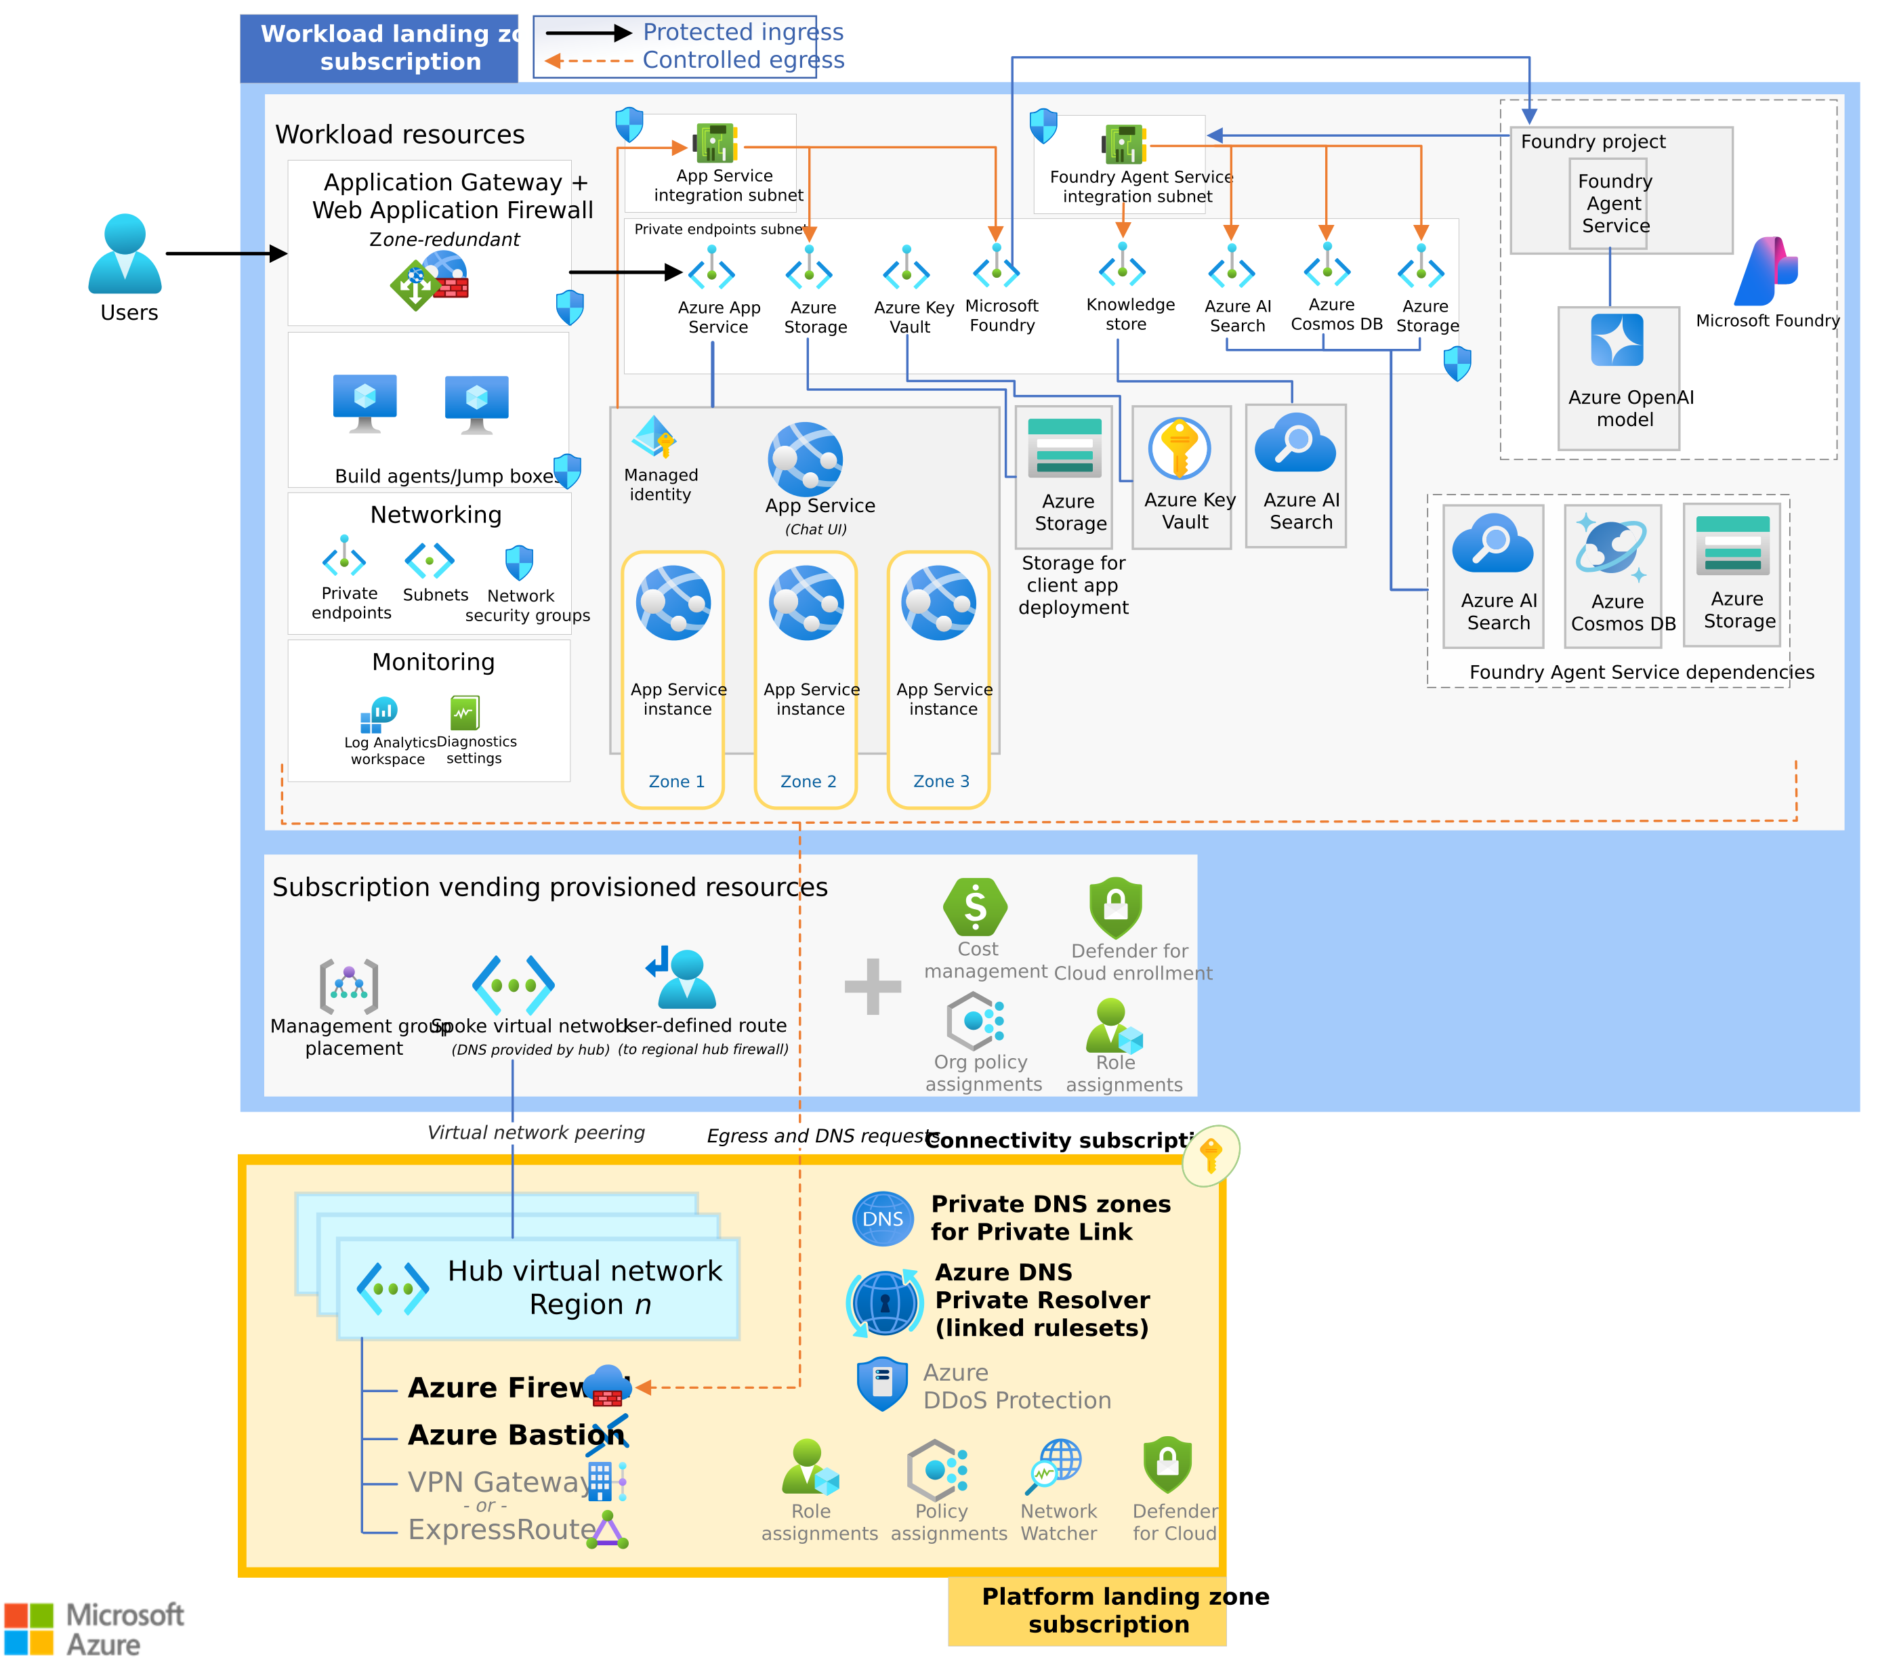
Reference appendix / Solutioning proposal
Appendix / Microsoft landing zone reference
Existing platform
Reuse approved connectivity, policy and identity foundations.
Environments
Define subscriptions; separate development from production.
Quote boundary
New platform or WAN work requires a separate package.
Microsoft Agent Service landing zone reference. The selected custom RAG runtime differs from this reference.
CIS Infra / Revision 2 / 10 Oct 2026
24
Notes:
Source materials:
https://github.com/upendra25312/AI-Foundry-GTM-offering-/blob/ad3af1ef8701abbcf05ee926c2f9e09ca8d346f4/CIS_Infra_Azure_AI_Platform_GTM_Proposal_V3.docx
https://github.com/upendra25312/AI-Foundry-GTM-offering-/blob/ad3af1ef8701abbcf05ee926c2f9e09ca8d346f4/Microsoft_AI_Architect_Learning_Roadmap.xlsx
Brand reference: https://github.com/upendra25312/AI-Foundry-GTM-offering-/blob/ad3af1ef8701abbcf05ee926c2f9e09ca8d346f4/Cognizant_Branded_Presales_Template.pptx
Technical/public sources: https://learn.microsoft.com/en-us/azure/architecture/ai-ml/architecture/baseline-microsoft-foundry-landing-zone
Diagram source: https://github.com/upendra25312/AI-Foundry-GTM-offering-/blob/ad3af1ef8701abbcf05ee926c2f9e09ca8d346f4/architectures/10_baseline-microsoft-foundry-landing-zone.png
Original Microsoft diagram retained as an image. Editable Visio sources, where published, are in the repository architectures folder.
Reviewed 10 October 2026. Estimates and RACI are proposed. Source diagrams may use names that differ from current Microsoft branding. Verify exact runtime, API and feature support at deal design. No approved internal product or rate card is asserted.

Slide 25
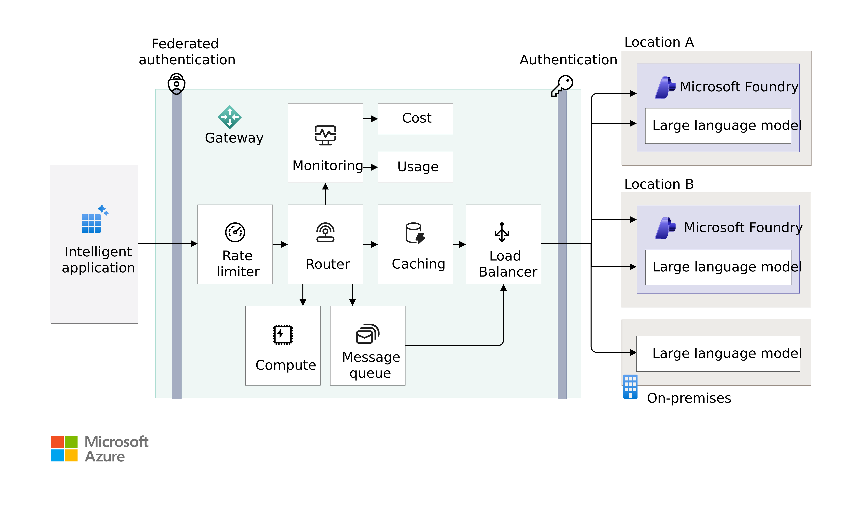
Reference appendix / Solutioning proposal
Appendix / Microsoft gateway reference
Shared governance
Use APIM for shared access, usage controls and routing.
Tier decision
Validate policy and networking in the chosen tier.
Scope decision
Gateway cost and support enter a separate approved work package.
Microsoft reference only. Optional capabilities require a separate design, estimate and acceptance.
CIS Infra / Revision 2 / 10 Oct 2026
25
Notes:
AI gateway extends Azure API Management. It is not a separate Azure product. Source diagram is conceptual. Validate workload benefit against operational complexity.
Source materials:
https://github.com/upendra25312/AI-Foundry-GTM-offering-/blob/ad3af1ef8701abbcf05ee926c2f9e09ca8d346f4/CIS_Infra_Azure_AI_Platform_GTM_Proposal_V3.docx
https://github.com/upendra25312/AI-Foundry-GTM-offering-/blob/ad3af1ef8701abbcf05ee926c2f9e09ca8d346f4/Microsoft_AI_Architect_Learning_Roadmap.xlsx
Brand reference: https://github.com/upendra25312/AI-Foundry-GTM-offering-/blob/ad3af1ef8701abbcf05ee926c2f9e09ca8d346f4/Cognizant_Branded_Presales_Template.pptx
Technical/public sources: https://learn.microsoft.com/en-us/azure/architecture/ai-ml/guide/azure-openai-gateway-guide
https://learn.microsoft.com/en-us/azure/api-management/genai-gateway-capabilities
Diagram source: https://github.com/upendra25312/AI-Foundry-GTM-offering-/blob/ad3af1ef8701abbcf05ee926c2f9e09ca8d346f4/architectures/38_foundry-gateway-conceptual-architecture.png
Original Microsoft diagram retained as an image. Editable Visio sources, where published, are in the repository architectures folder.
Reviewed 10 October 2026. Estimates and RACI are proposed. Source diagrams may use names that differ from current Microsoft branding. Verify exact runtime, API and feature support at deal design. No approved internal product or rate card is asserted.

Slide 26
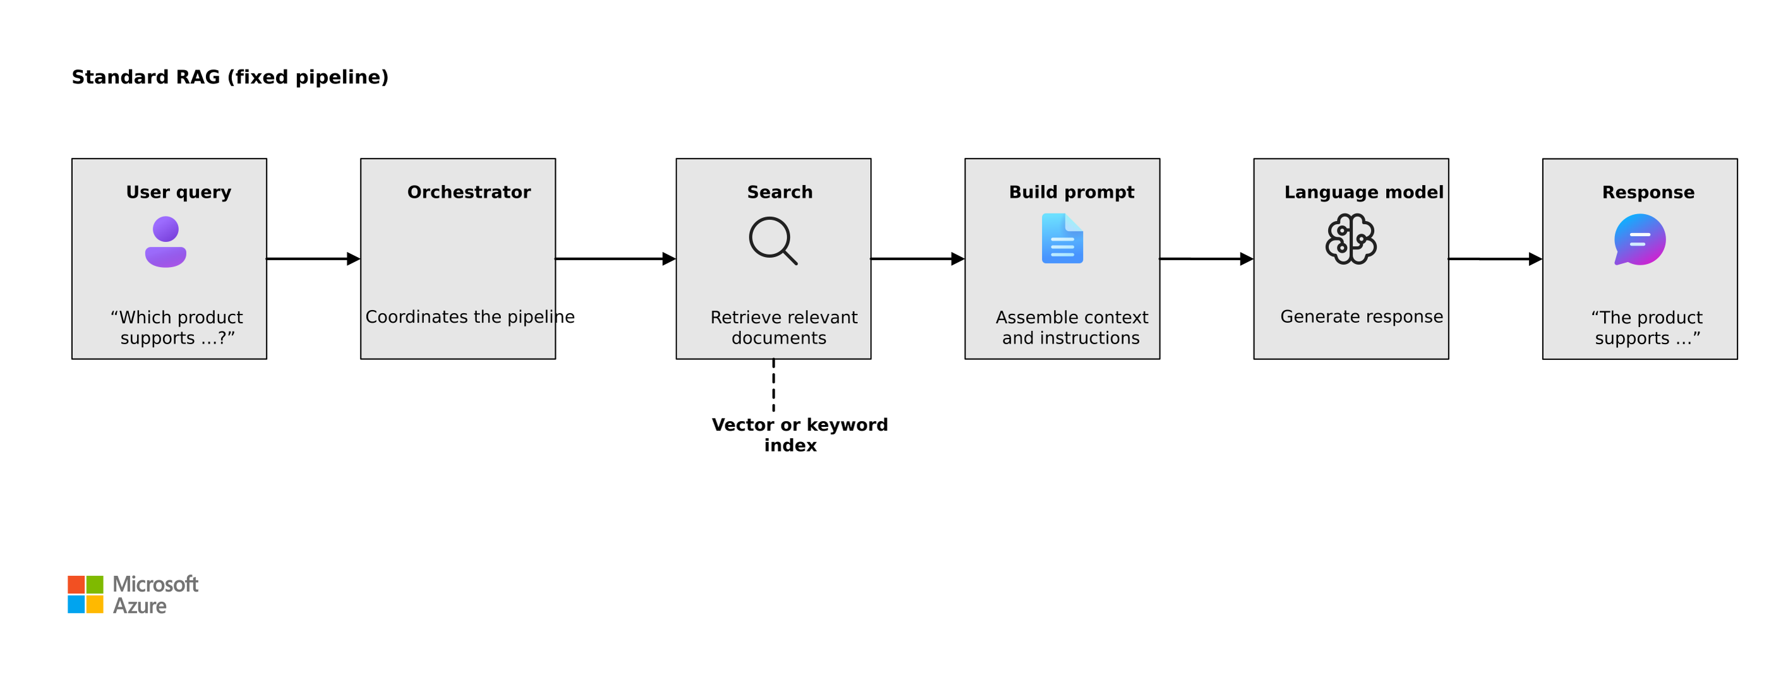
Reference appendix / Solutioning proposal
Appendix / Microsoft standard RAG reference
Retrieval boundary
Use one approved source with permitted content and citations.
Quality evidence
Agree the evaluation set, answer threshold and escalation rule.
Data ownership
Engineering proves ingestion, freshness and permission behaviour.
Microsoft reference only. Validate selected retrieval design, source access and permissions.
CIS Infra / Revision 2 / 10 Oct 2026
26
Notes:
Recommendation for the illustrative baseline, not a promise that a specific retrieval method meets the business target. Test no-answer handling, stale source behaviour and access revocation.
Source materials:
https://github.com/upendra25312/AI-Foundry-GTM-offering-/blob/ad3af1ef8701abbcf05ee926c2f9e09ca8d346f4/CIS_Infra_Azure_AI_Platform_GTM_Proposal_V3.docx
https://github.com/upendra25312/AI-Foundry-GTM-offering-/blob/ad3af1ef8701abbcf05ee926c2f9e09ca8d346f4/Microsoft_AI_Architect_Learning_Roadmap.xlsx
Brand reference: https://github.com/upendra25312/AI-Foundry-GTM-offering-/blob/ad3af1ef8701abbcf05ee926c2f9e09ca8d346f4/Cognizant_Branded_Presales_Template.pptx
Technical/public sources: https://learn.microsoft.com/en-us/azure/architecture/ai-ml/guide/rag/rag-agentic
Diagram source: https://github.com/upendra25312/AI-Foundry-GTM-offering-/blob/ad3af1ef8701abbcf05ee926c2f9e09ca8d346f4/architectures/13_standard-rag.png
Original Microsoft diagram retained as an image. Editable Visio sources, where published, are in the repository architectures folder.
Reviewed 10 October 2026. Estimates and RACI are proposed. Source diagrams may use names that differ from current Microsoft branding. Verify exact runtime, API and feature support at deal design. No approved internal product or rate card is asserted.

Slide 27
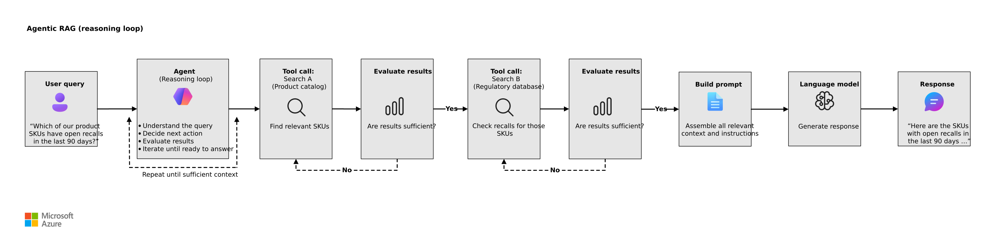
Reference appendix / Solutioning proposal
Appendix / Microsoft agentic retrieval reference
Expansion trigger
Use agentic retrieval when a measured search task needs iterative reasoning.
Cost and safety
Re-estimate model calls, tool loops, latency and misuse tests.
Acceptance scope
Approve retrieval permissions and quality gates. Actions need separate design.
Microsoft reference only. Optional capabilities require a separate design, estimate and acceptance.
CIS Infra / Revision 2 / 10 Oct 2026
27
Notes:
Future option outside the baseline. Source image describes agentic retrieval. It does not authorize autonomous write actions. Scope action tools and their security separately.
Source materials:
https://github.com/upendra25312/AI-Foundry-GTM-offering-/blob/ad3af1ef8701abbcf05ee926c2f9e09ca8d346f4/CIS_Infra_Azure_AI_Platform_GTM_Proposal_V3.docx
https://github.com/upendra25312/AI-Foundry-GTM-offering-/blob/ad3af1ef8701abbcf05ee926c2f9e09ca8d346f4/Microsoft_AI_Architect_Learning_Roadmap.xlsx
Brand reference: https://github.com/upendra25312/AI-Foundry-GTM-offering-/blob/ad3af1ef8701abbcf05ee926c2f9e09ca8d346f4/Cognizant_Branded_Presales_Template.pptx
Technical/public sources: https://learn.microsoft.com/en-us/azure/architecture/ai-ml/guide/rag/rag-agentic
Diagram source: https://github.com/upendra25312/AI-Foundry-GTM-offering-/blob/ad3af1ef8701abbcf05ee926c2f9e09ca8d346f4/architectures/14_agentic-rag.png
Original Microsoft diagram retained as an image. Editable Visio sources, where published, are in the repository architectures folder.
Reviewed 10 October 2026. Estimates and RACI are proposed. Source diagrams may use names that differ from current Microsoft branding. Verify exact runtime, API and feature support at deal design. No approved internal product or rate card is asserted.

Slide 28
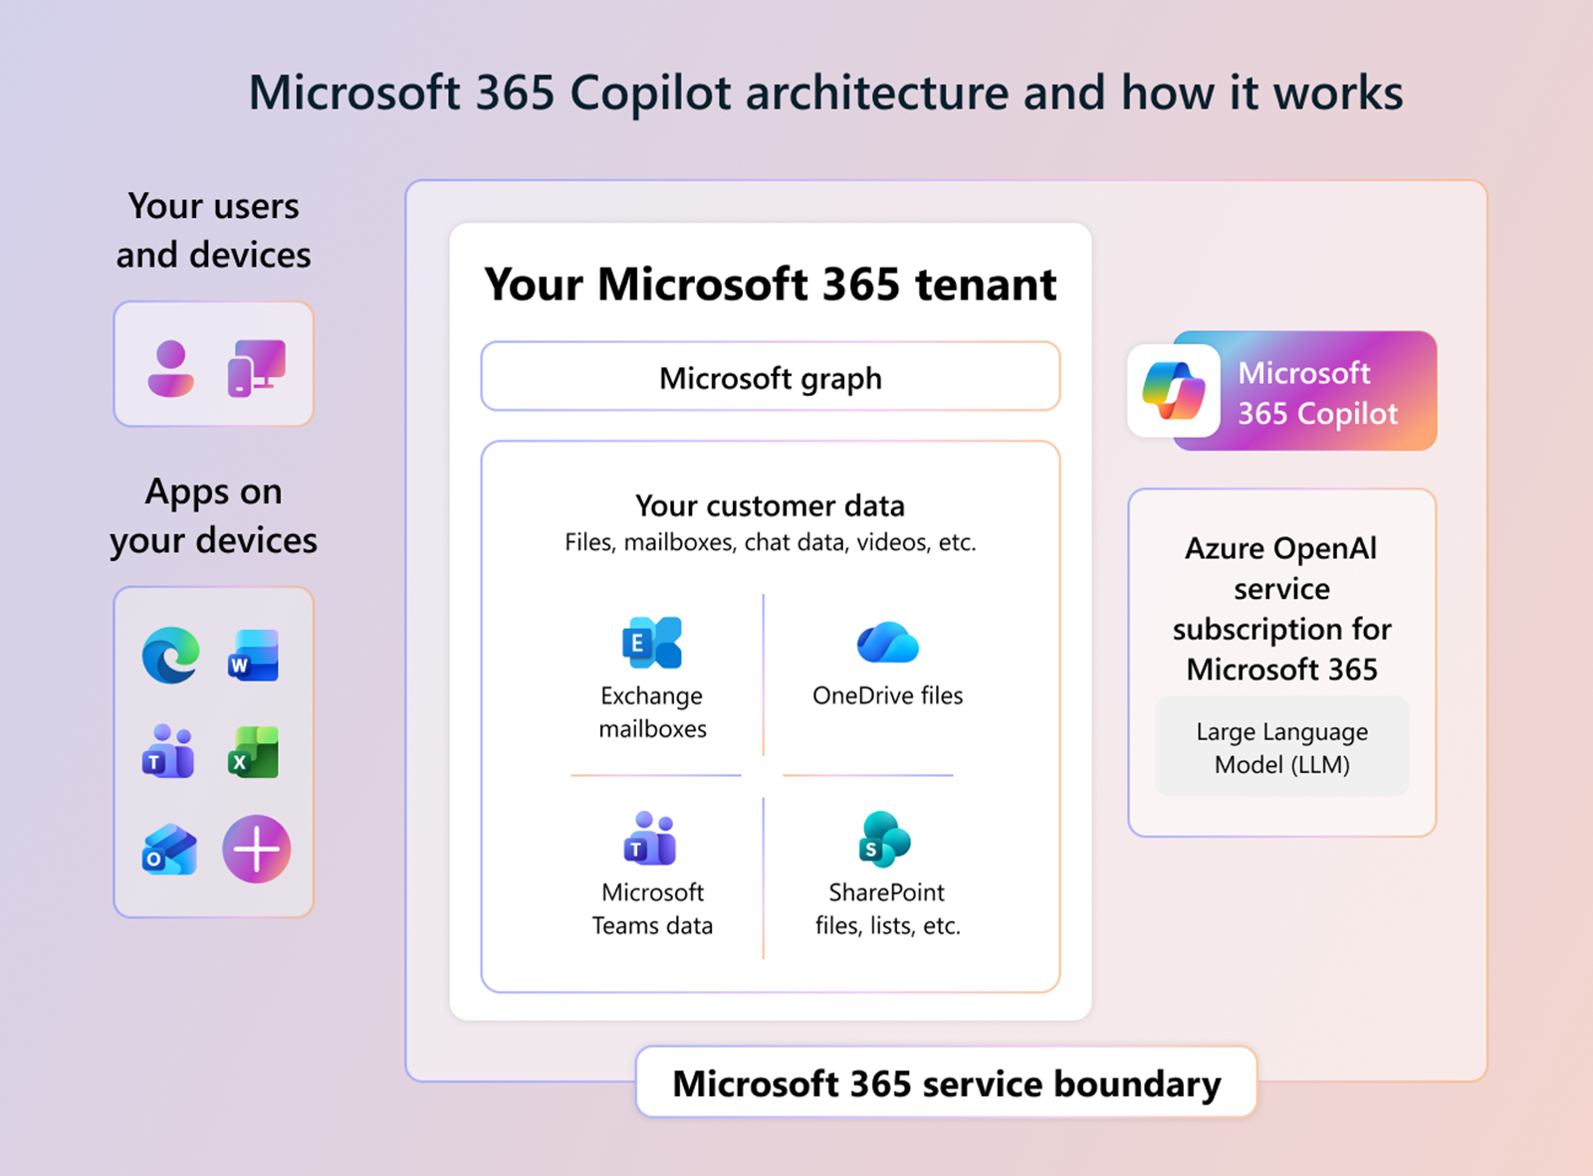
Reference appendix / Solutioning proposal
Appendix / Microsoft 365 Copilot service boundary
SaaS architecture
Microsoft operates the Copilot service within Microsoft 365.
Practice ownership
M365 administrators and Security own tenant readiness.
Infra work package
Custom Azure endpoints and integrations remain separately scoped.
Optional M365 reference. Separate practice, tenant readiness, licensing and service scope apply.
CIS Infra / Revision 2 / 10 Oct 2026
28
Notes:
Current Microsoft Learn image, not the legacy 2023 Visio poster. Do not place customer APIM in the core Microsoft 365 Copilot service path. Custom extensions need their own architecture and authorizations.
Source materials:
https://github.com/upendra25312/AI-Foundry-GTM-offering-/blob/ad3af1ef8701abbcf05ee926c2f9e09ca8d346f4/CIS_Infra_Azure_AI_Platform_GTM_Proposal_V3.docx
https://github.com/upendra25312/AI-Foundry-GTM-offering-/blob/ad3af1ef8701abbcf05ee926c2f9e09ca8d346f4/Microsoft_AI_Architect_Learning_Roadmap.xlsx
Brand reference: https://github.com/upendra25312/AI-Foundry-GTM-offering-/blob/ad3af1ef8701abbcf05ee926c2f9e09ca8d346f4/Cognizant_Branded_Presales_Template.pptx
Technical/public sources: https://learn.microsoft.com/en-us/microsoft-365/copilot/microsoft-365-copilot-architecture
Diagram source: https://github.com/upendra25312/AI-Foundry-GTM-offering-/blob/ad3af1ef8701abbcf05ee926c2f9e09ca8d346f4/architectures/24_copilot-tenant-architecture.png
Original Microsoft diagram retained as an image. Editable Visio sources, where published, are in the repository architectures folder.
Reviewed 10 October 2026. Estimates and RACI are proposed. Source diagrams may use names that differ from current Microsoft branding. Verify exact runtime, API and feature support at deal design. No approved internal product or rate card is asserted.

Slide 29
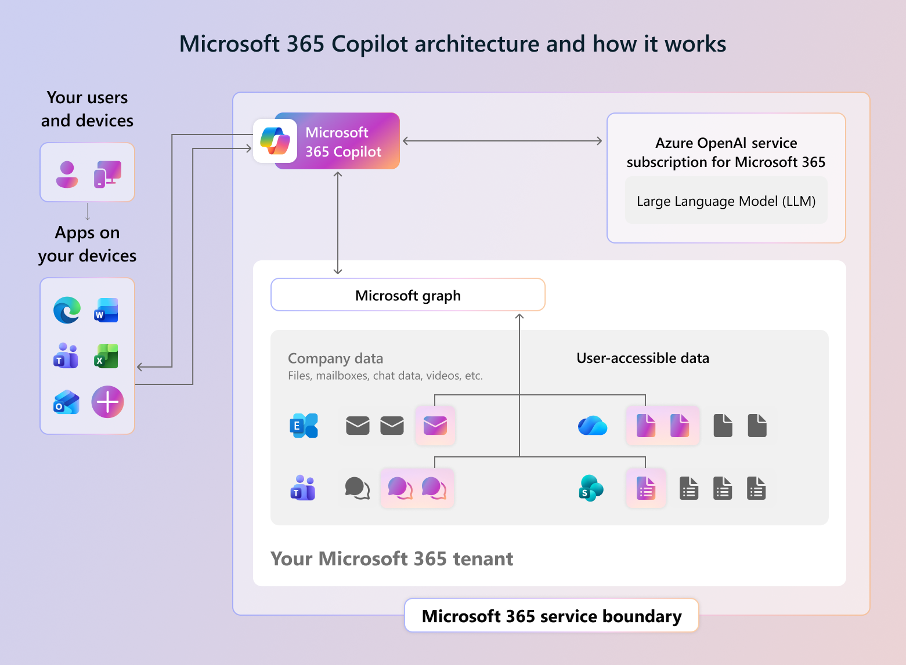
Reference appendix / Solutioning proposal
Appendix / Microsoft 365 permissions reference
User permissions
Copilot access follows the signed-in user’s permissions.
Readiness work
Review sharing, access and policies with tenant owners.
Release decision
M365 and business owners approve rollout and licensing.
Optional M365 reference. Separate practice, tenant readiness, licensing and service scope apply.
CIS Infra / Revision 2 / 10 Oct 2026
29
Notes:
Current Microsoft architecture. Existing permissions can be overly broad, so tenant readiness must inspect them. Infra does not own enterprise content remediation or SaaS licensing by default.
Source materials:
https://github.com/upendra25312/AI-Foundry-GTM-offering-/blob/ad3af1ef8701abbcf05ee926c2f9e09ca8d346f4/CIS_Infra_Azure_AI_Platform_GTM_Proposal_V3.docx
https://github.com/upendra25312/AI-Foundry-GTM-offering-/blob/ad3af1ef8701abbcf05ee926c2f9e09ca8d346f4/Microsoft_AI_Architect_Learning_Roadmap.xlsx
Brand reference: https://github.com/upendra25312/AI-Foundry-GTM-offering-/blob/ad3af1ef8701abbcf05ee926c2f9e09ca8d346f4/Cognizant_Branded_Presales_Template.pptx
Technical/public sources: https://learn.microsoft.com/en-us/microsoft-365/copilot/microsoft-365-copilot-architecture
Diagram source: https://github.com/upendra25312/AI-Foundry-GTM-offering-/blob/ad3af1ef8701abbcf05ee926c2f9e09ca8d346f4/architectures/26_copilot-user-access.png
Original Microsoft diagram retained as an image. Editable Visio sources, where published, are in the repository architectures folder.
Reviewed 10 October 2026. Estimates and RACI are proposed. Source diagrams may use names that differ from current Microsoft branding. Verify exact runtime, API and feature support at deal design. No approved internal product or rate card is asserted.

