Slide 1

CIS INFRA · INTERNAL OFFERING PROPOSAL · FOR SENIOR LEADERSHIP REVIEW
AI Platform / Landing Zone
A governed Azure foundation for one funded AI workload, then the next
Assess, extend an existing landing zone, or establish a new foundation · US, Europe, UK and Middle East pursuits
11 Oct 2026 · Version 2.0 · Working proposal for leadership review
01
Notes:
Presenter purpose: open the leadership review of the CIS Infra AI Platform / Landing Zone offering.
Status: proposed offering for internal leadership review. No Cognizant approval, customer evidence, staffing commitment, rate card or verified quote is implied. Illustrative and synthetic figures are labelled as such. All money in USD. Font: Arial substituted for Gellix (not available). Azure icons: official Microsoft Azure Architecture Icons (V24 set, via az-icons.com and the icons embedded in the baseline decks), unmodified SVG with PNG fallback. Rendered and checked as PDF previews; not opened in desktop PowerPoint.

Slide 2

Executive summary: sell an accepted platform, not hours
EXECUTIVE SUMMARY · 2 OF 10
PROPOSED OFFERING
Problem
AI pilots stall at the platform: network, identity, environments, capacity and support ownership are unresolved.
Decision requested
Nominate an Infra sponsor and tower leads for a 30-day validation
Approve the three delivery routes and scope boundaries
Ask Finance to approve attribution and margin rules before any quote
Offer
CIS Infra assesses, extends or establishes the Azure foundation for one approved workload, with specialist towers in one plan.
Outcome
An accepted, repeatable environment with tested controls, cost visibility and a named operating owner.
Note: Proposed offering. No approved rate card, staffing commitment or customer evidence yet.
CIS Infra · AI Platform / Landing Zone · 11 Oct 2026 · Working proposal, not approved terms
02
Notes:
Answers: what problem creates demand, what the customer receives, what decision is needed. Source: CIS Infra Azure AI Platform GTM Proposal V3 (8 Oct 2026), repository root.
Status: proposed offering for internal leadership review. No Cognizant approval, customer evidence, staffing commitment, rate card or verified quote is implied. Illustrative and synthetic figures are labelled as such. All money in USD. Font: Arial substituted for Gellix (not available). Azure icons: official Microsoft Azure Architecture Icons (V24 set, via az-icons.com and the icons embedded in the baseline decks), unmodified SVG with PNG fallback. Rendered and checked as PDF previews; not opened in desktop PowerPoint.

Slide 3
Who buys, and what triggers the purchase
EXECUTIVE SUMMARY · 3 OF 10
Buyer role | What they need | Purchase trigger
Platform or infrastructure leader | A controlled place to run AI workloads | Pilot blocked by network, identity or environment gaps
CIO or transformation sponsor | Funded path from pilot to production | Repeated manual setup; no production route
Business workload owner | A date the workload can go live | Approved use case waiting on platform readiness
CISO delegate | Evidence that controls are tested | Unresolved private connectivity or ownership
Decision: No funded workload, no platform authority or unresolved region and capacity: sell the assessment, not an implementation.
CIS Infra · AI Platform / Landing Zone · 11 Oct 2026 · Working proposal, not approved terms
03
Notes:
Buyer roles and triggers from the V3 proposal qualification section. Qualify funding, deployment authority and a named workload before quoting implementation.
Status: proposed offering for internal leadership review. No Cognizant approval, customer evidence, staffing commitment, rate card or verified quote is implied. Illustrative and synthetic figures are labelled as such. All money in USD. Font: Arial substituted for Gellix (not available). Azure icons: official Microsoft Azure Architecture Icons (V24 set, via az-icons.com and the icons embedded in the baseline decks), unmodified SVG with PNG fallback. Rendered and checked as PDF previews; not opened in desktop PowerPoint.

Slide 4
Where this offering sits in the portfolio
EXECUTIVE SUMMARY · 4 OF 10
PROPOSED PORTFOLIO
04
AI Capacity and
FinOps Assessment
Measure demand, choose
capacity model
01
AI Platform /
Landing Zone
Governed foundation for
AI workloads
03
AI Gateway
Implementation
Control model and
tool traffic
02
Agent Governance
and Operations
Know, observe and
contain agents
05
Managed AI
Platform Operations
Run, report and
optimise the platform
THIS OFFERING
Monthly operations evidence feeds the next capacity and cost decision
Handoffs for this offering
Receives from 04 Capacity and FinOps
Deployment type, processing boundary, quota and capacity plan
Hands to 03 Gateway and 02 Governance
Private network, identities, hosting and telemetry for enforcement
Hands to 05 Managed Operations
Accepted platform, runbooks, alerts and cost baseline
Note: Each handoff has a named owner, acceptance evidence and a date. No offering assumes another is sold.
CIS Infra · AI Platform / Landing Zone · 11 Oct 2026 · Working proposal, not approved terms
04
Notes:
Portfolio view of the five proposed CIS Infra offerings. The landing zone is the foundation the gateway, agent governance and managed operations depend on. Each handoff needs a named owner and acceptance evidence.
Status: proposed offering for internal leadership review. No Cognizant approval, customer evidence, staffing commitment, rate card or verified quote is implied. Illustrative and synthetic figures are labelled as such. All money in USD. Font: Arial substituted for Gellix (not available). Azure icons: official Microsoft Azure Architecture Icons (V24 set, via az-icons.com and the icons embedded in the baseline decks), unmodified SVG with PNG fallback. Rendered and checked as PDF previews; not opened in desktop PowerPoint.

Slide 5
What CIS Infra provides, and what it does not
EXECUTIVE SUMMARY · 5 OF 10
PROPOSED SCOPE
Included: CIS Infra delivers
Optional: priced separately
Other owners
Subscriptions, environments, policy and tags
Hub integration, private endpoints, DNS, egress
Foundry project, model endpoint, approved agent hosting
Monitoring, budgets, recovery runbook
Integrated plan and platform handover
More workloads, environments or regions
Regional disaster recovery
AI Gateway (offering 03)
Agent governance (offering 02)
Managed operations (offering 05)
Security: control design and verification
DevOps: Terraform modules and pipelines
AI: models, agents, quality tests
Data and Data Eng.: governance, ingestion
Customer: data rights, risk acceptance
Limit: CIS Infra does not own model quality, application behaviour, data quality or security operations.
CIS Infra · AI Platform / Landing Zone · 11 Oct 2026 · Working proposal, not approved terms
05
Notes:
Scope boundaries from V3 proposal. CIS Infra does not own model quality, application behaviour, data quality or security operations unless a separately agreed service includes them. Terraform accountability sits with DevOps in this baseline unless Infra staffs and maintains it.
Status: proposed offering for internal leadership review. No Cognizant approval, customer evidence, staffing commitment, rate card or verified quote is implied. Illustrative and synthetic figures are labelled as such. All money in USD. Font: Arial substituted for Gellix (not available). Azure icons: official Microsoft Azure Architecture Icons (V24 set, via az-icons.com and the icons embedded in the baseline decks), unmodified SVG with PNG fallback. Rendered and checked as PDF previews; not opened in desktop PowerPoint.

Slide 6
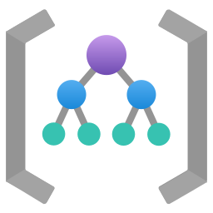

















Architecture: shared platform, separate workloads
EXECUTIVE SUMMARY · 6 OF 10
PROPOSED REFERENCE ARCHITECTURE
PLATFORM LANDING ZONE (SHARED)
PRODUCTION WORKLOAD SUBSCRIPTION
Management groups
policy and RBAC inheritance
DATA AND SECRETS
Azure Policy
guardrails and tags
App Gateway
WAF ingress
App host
Container Apps
Foundry project
agents
Model
deployment
AI Search
Storage account
Key Vault
Hub virtual network
peering to spokes
Private endpoints for Foundry, AI Search, Storage and Key Vault · managed identities, no shared keys
Azure Firewall
controlled egress
DNS Private Resolver
private DNS zones
NON-PRODUCTION SUBSCRIPTION (DEV, TEST)
Same pattern, separate subscription, policies and identities. Promotion only through the pipeline.
Entra PIM
privileged operator access
IaC pipelines
approvals, promotion
Log Analytics
platform logs
App Insights
agent traces
Budgets
cost alerts
Request / data flow
Data access
Double arrow: hub peering. Blue arrow: egress to hub firewall. Detail: appendix A5, A6.
Proposed reference architecture · CIS Infra custom design · not a Microsoft-published or Microsoft-endorsed architecture
CIS Infra · AI Platform / Landing Zone · 11 Oct 2026 · Working proposal, not approved terms
06
Notes:
Simplified, editable executive view. Adapted from the AI Landing Zone with platform landing zone diagram (04_AI-Landing-Zone-with-platform.png, source https://github.com/Azure/AI-Landing-Zones) and the Foundry baseline landing zone architecture. Not the original; detailed network and egress diagrams are in the appendix.
Reading order: (1) users reach the workload through Application Gateway with WAF; (2) the app host calls the Foundry project and model deployment through private endpoints; (3) retrieval and state use AI Search and a Storage account; secrets in Key Vault; (4) outbound traffic routes through the hub firewall; (5) all resources send telemetry to Log Analytics and Application Insights and are governed by management-group policy and budgets. Identity: managed identities for workloads, Entra PIM for privileged operators.
Storage label: the icon is the Azure Storage account; blob containers live inside it.
Sources (checked 11 Oct 2026):
Adapted from https://github.com/upendra25312/AI-Foundry-GTM-offering-/blob/main/architectures/04_AI-Landing-Zone-with-platform.png
https://github.com/Azure/AI-Landing-Zones
https://learn.microsoft.com/en-us/azure/architecture/ai-ml/architecture/baseline-microsoft-foundry-landing-zone
Azure Architecture Icons (V24): https://learn.microsoft.com/en-us/azure/architecture/icons/
Status: proposed offering for internal leadership review. No Cognizant approval, customer evidence, staffing commitment, rate card or verified quote is implied. Illustrative and synthetic figures are labelled as such. All money in USD. Font: Arial substituted for Gellix (not available). Azure icons: official Microsoft Azure Architecture Icons (V24 set, via az-icons.com and the icons embedded in the baseline decks), unmodified SVG with PNG fallback. Rendered and checked as PDF previews; not opened in desktop PowerPoint.

Slide 7
Three routes, each priced as a separate package
EXECUTIVE SUMMARY · 7 OF 10
PROPOSED PACKAGES
NO APPROVED RATES
Proposition: a fixed-fee assessment converts platform uncertainty into a bounded, accepted implementation.
Route | Starting point | What the customer receives | Pricing unit
Assess first | Unknown access, connectivity, capacity | Gap register, decisions, priced resource list | Fixed fee, bounded scope
Extend | Mature Azure landing zone in place | AI workload environments and controls on it | Role days x approved rate, per work package
Establish | Platform gaps or a new tenant scope | Platform baseline plus AI environments | Separate platform and AI work packages
Transition | Accepted build | Runbooks, hypercare, operating handover | Fixed fee with capped hypercare
Note: Azure consumption and model tokens are customer spend, not CIS Infra revenue. Recurring operations are priced in offering 05.
CIS Infra · AI Platform / Landing Zone · 11 Oct 2026 · Working proposal, not approved terms
07
Notes:
Strengthens the baseline commercial proposition (old slide 17). Extending a mature landing zone adds AI workload resources and controls to an existing platform. Establishing a new foundation also builds the platform layer (management groups, subscription vending, hub connectivity, identity integration, policy baseline). The two have different scope, risk and price and must not share one estimate. Reference effort: the V3 proposal worked example estimates about 88 role days across six towers for a bounded extension, before contingency. That is effort, not elapsed time, and is illustrative only.
Status: proposed offering for internal leadership review. No Cognizant approval, customer evidence, staffing commitment, rate card or verified quote is implied. Illustrative and synthetic figures are labelled as such. All money in USD. Font: Arial substituted for Gellix (not available). Azure icons: official Microsoft Azure Architecture Icons (V24 set, via az-icons.com and the icons embedded in the baseline decks), unmodified SVG with PNG fallback. Rendered and checked as PDF previews; not opened in desktop PowerPoint.

Slide 8
Dependencies and risks that decide success
EXECUTIVE SUMMARY · 8 OF 10
Risk or dependency | Effect if unmanaged | Mitigation | Owner
No funded workload | Empty platform, weak value | Qualify; sell assessment only | Account lead
Model, region or capacity unavailable | Redesign or delay | Verify deployment type and quota in assessment | AI with CIS Infra
Tower capacity not committed | Critical path slips | Signed dependency register before quote | Integrated service owner
Hub, DNS or firewall gaps | Scope grows mid-build | Price the establish route explicitly | CIS Infra
Slow customer access or approvals | Schedule slips | Customer duties and dates in the SOW | Customer platform owner
CIS Infra · AI Platform / Landing Zone · 11 Oct 2026 · Working proposal, not approved terms
08
Notes:
Top dependencies and risks. A critical dependency without a signed commitment blocks the implementation quote (V3 proposal dependency register rule).
Status: proposed offering for internal leadership review. No Cognizant approval, customer evidence, staffing commitment, rate card or verified quote is implied. Illustrative and synthetic figures are labelled as such. All money in USD. Font: Arial substituted for Gellix (not available). Azure icons: official Microsoft Azure Architecture Icons (V24 set, via az-icons.com and the icons embedded in the baseline decks), unmodified SVG with PNG fallback. Rendered and checked as PDF previews; not opened in desktop PowerPoint.

Slide 9
How success will be measured
EXECUTIVE SUMMARY · 9 OF 10
TARGETS TO AGREE IN SOW
Measure | Definition | Owner
Reproducible build | Environment redeployed from versioned IaC; rollback test passes | DevOps with CIS Infra
Network controls | All agreed allowed paths pass and all denied paths fail | CIS Infra, Security verifies
Cost visibility | Share of in-scope resources with owner and cost-centre tags | CIS Infra
Operational readiness | Restore and containment drills recorded; runbooks accepted | Integrated service owner
Workload acceptance | Business-approved evaluation set passes (separate milestone) | Customer workload owner
CIS Infra · AI Platform / Landing Zone · 11 Oct 2026 · Working proposal, not approved terms
09
Notes:
Measures are proposed definitions. Numeric targets and test populations are agreed in the SOW. Platform acceptance and workload acceptance are separate milestones with different owners.
Status: proposed offering for internal leadership review. No Cognizant approval, customer evidence, staffing commitment, rate card or verified quote is implied. Illustrative and synthetic figures are labelled as such. All money in USD. Font: Arial substituted for Gellix (not available). Azure icons: official Microsoft Azure Architecture Icons (V24 set, via az-icons.com and the icons embedded in the baseline decks), unmodified SVG with PNG fallback. Rendered and checked as PDF previews; not opened in desktop PowerPoint.

Slide 10
Decide now, and what waits for evidence
EXECUTIVE SUMMARY · 10 OF 10
Leadership can decide now
Depends on evidence or approval
Sponsor and named tower leads for a 30-day validation
Three routes and scope boundaries as the sales baseline
Assessment as the default entry offer
Who owns Terraform: DevOps unless Infra staffs it
Sell rates and margin rules Finance
Tower effort and availability Tower leads
Reference estimate for extension Pilot evidence
Approved demo environment and IaC assets Pilot evidence
External launch and branding Leadership after pilot
Decision: Next step: approve the validation, then review offer card, cost model and signed tower commitments.
CIS Infra · AI Platform / Landing Zone · 11 Oct 2026 · Working proposal, not approved terms
10
Notes:
Separates decisions leadership can take at this review from those that depend on pilot evidence, Finance approval or specialist tower agreement. Full register in appendix D1 and in the decision register workbook.
Status: proposed offering for internal leadership review. No Cognizant approval, customer evidence, staffing commitment, rate card or verified quote is implied. Illustrative and synthetic figures are labelled as such. All money in USD. Font: Arial substituted for Gellix (not available). Azure icons: official Microsoft Azure Architecture Icons (V24 set, via az-icons.com and the icons embedded in the baseline decks), unmodified SVG with PNG fallback. Rendered and checked as PDF previews; not opened in desktop PowerPoint.

Slide 11
APPENDIX
Technical and commercial appendix
Detailed architecture, networking, regional decisions, delivery readiness, RACI, revenue attribution, cost layers, original reference diagrams and sources.
11
Notes:
Appendix divider. All useful baseline content is retained here. Use the appendix index (next slide) to navigate.

Slide 12
Appendix index
APPENDIX
13 A1 Extend versus establish: what changes
29 A17 Acceptance gates and evidence
14 A2 Proposed package structure
30 A18 Effort drivers and change control
15 A3 Governance: management groups, policy, tags
31 A19 BOM checklist
16 A4 Identity, RBAC, managed identity, PIM
32 C1 Cost layers and pricing formula
17 A5 Network: hub, spoke, private endpoints, DNS
33 K Kill-switch cross-reference
18 A6 Controlled egress
34 R1 RACI matrix
19 A7 Inbound, runtime and outbound paths
35 R2 Revenue attribution framework
20 A8 Foundry workload baseline (simplified)
36 R3 Delivery and commercial readiness
21 A9 Foundry projects and agent hosting options
37 D1 Decision and approval register
22 A10 Search, storage and data dependencies
38 O1 Original: AI landing zone with platform
23 A11 IaC, CI/CD and promotion
39 O2 Original: Foundry baseline
24 A12 Environment separation
40 O3 Original: landing zone networking
25 A13 Monitoring, budgets, containment, recovery
41 O4 Original: landing zone egress
26 A14 Deployment types and processing boundary
42 O5 Original: CAF landing zone conceptual
27 A15 Model availability snapshot by region
43 S1 Sources and verification dates
28 A16 Included baseline and separately scoped work
CIS Infra · AI Platform / Landing Zone · 11 Oct 2026 · Working proposal, not approved terms
12
Notes:
Navigation slide. Each entry links to the appendix slide. Use the Index link in the footer of any appendix slide to return here.
Status: proposed offering for internal leadership review. No Cognizant approval, customer evidence, staffing commitment, rate card or verified quote is implied. Illustrative and synthetic figures are labelled as such. All money in USD. Font: Arial substituted for Gellix (not available). Azure icons: official Microsoft Azure Architecture Icons (V24 set, via az-icons.com and the icons embedded in the baseline decks), unmodified SVG with PNG fallback. Rendered and checked as PDF previews; not opened in desktop PowerPoint.

Slide 13
Extending a landing zone versus building a new one
APPENDIX A1
Topic | Extend an existing landing zone | Establish a new foundation
Starting evidence | Accepted management groups, hub, DNS, policy and identity | Gaps, no platform, or a new tenant or region
CIS Infra builds | Workload subscriptions, spoke, private endpoints, AI resources, AI-specific policy | All of extend plus management groups, subscription vending, hub, DNS, firewall, identity integration
Main risk | Hidden gaps in the existing platform | Larger change surface and customer decisions
Customer decisions | Approve workload placement and AI policies | Platform design authority, connectivity, naming, policy baseline
Commercial basis | AI work packages only | Separate platform and AI work packages
Entry evidence | Validation checklist passes in assessment | Assessment gap register approved
Limit: New foundations are not included in an extension price. Existing shared hubs are reused only after validation.
CIS Infra · AI Platform / Landing Zone · 11 Oct 2026 · Working proposal, not approved terms
Appendix index
13
Notes:
Audit finding: explain the difference between extending an existing landing zone and establishing a new foundation. Extending reuses an accepted platform after validation. Establishing builds the platform layer first. New foundations are never included in the extension price.
Status: proposed offering for internal leadership review. No Cognizant approval, customer evidence, staffing commitment, rate card or verified quote is implied. Illustrative and synthetic figures are labelled as such. All money in USD. Font: Arial substituted for Gellix (not available). Azure icons: official Microsoft Azure Architecture Icons (V24 set, via az-icons.com and the icons embedded in the baseline decks), unmodified SVG with PNG fallback. Rendered and checked as PDF previews; not opened in desktop PowerPoint.

Slide 14
Proposed package structure
APPENDIX A2
PROPOSED
ESTIMATES, NOT COMMITMENTS
1 Assessment
Fixed fee
2 Implementation
Extend or establish
3 Operational transition
Fixed fee, capped
Access and estate review
Workload, region and capacity check
Gap register and decisions
Priced resource list and route
Platform or AI work packages
IaC, pipelines and promotion
Network, DNS, identity, policy
Test evidence per gate
Runbooks and alert routing
Restore and containment drills
Hypercare window
Handover to operations
Exit: Gap register and estimate accepted
Exit: Platform gates passed
Exit: Named owners accept
Note: Reference effort for a bounded extension: about 88 role days across six towers before contingency (V3 proposal, illustrative).
CIS Infra · AI Platform / Landing Zone · 11 Oct 2026 · Working proposal, not approved terms
Appendix index
14
Notes:
Proposed packaging. Durations are not given because they depend on access, approvals and named tower staff. The V3 worked example (about 88 role days for a bounded extension: Infra 40, Security 8, DevOps 12, Data 4, Data Engineering 12, AI 12) is effort before contingency and is illustrative only.
Status: proposed offering for internal leadership review. No Cognizant approval, customer evidence, staffing commitment, rate card or verified quote is implied. Illustrative and synthetic figures are labelled as such. All money in USD. Font: Arial substituted for Gellix (not available). Azure icons: official Microsoft Azure Architecture Icons (V24 set, via az-icons.com and the icons embedded in the baseline decks), unmodified SVG with PNG fallback. Rendered and checked as PDF previews; not opened in desktop PowerPoint.

Slide 15

Management groups, subscriptions, policy and tags
APPENDIX A3
PROPOSED
Tenant root group
Control | Minimum baseline (proposed)
Azure Policy | Allowed regions and deployment types; deny public network access for AI, Search, Storage, Key Vault; require diagnostics
Tags | owner, workload, environment, cost-centre, data-classification, agent-id (where applicable)
Subscription vending | Request, approval, naming and budget set at creation
Cost ownership | Budget and alert per subscription and workload
Exceptions | Time-bound, approved by customer risk owner
Platform
Landing zones
Connectivity
Corp
Online
Identity, management
AI prod
AI non-prod
AI production and non-production are separate subscriptions under the Corp (or Online) group, inheriting platform policy.
CIS Infra · AI Platform / Landing Zone · 11 Oct 2026 · Working proposal, not approved terms
Appendix index
15
Notes:
Editable reconstruction of the management group and subscription layout from the AI Landing Zone diagram (04_AI-Landing-Zone-with-platform.png). AI resources sit in governed application landing-zone subscriptions, separate for production and non-production. Policy assignment at management group scope is inherited.
Sources (checked 11 Oct 2026):
https://github.com/upendra25312/AI-Foundry-GTM-offering-/blob/main/architectures/04_AI-Landing-Zone-with-platform.png
Cloud Adoption Framework: AI Ready: https://learn.microsoft.com/en-us/azure/cloud-adoption-framework/ai/ready
Status: proposed offering for internal leadership review. No Cognizant approval, customer evidence, staffing commitment, rate card or verified quote is implied. Illustrative and synthetic figures are labelled as such. All money in USD. Font: Arial substituted for Gellix (not available). Azure icons: official Microsoft Azure Architecture Icons (V24 set, via az-icons.com and the icons embedded in the baseline decks), unmodified SVG with PNG fallback. Rendered and checked as PDF previews; not opened in desktop PowerPoint.

Slide 16

Identity, RBAC and privileged access
APPENDIX A4
PROPOSED BASELINE
Identity type | Used for | Control | Implemented by
Workload managed identity | App host to Foundry, Search, Storage, Key Vault | Least-privilege data-plane roles; local auth disabled where supported | CIS Infra
Agent identity | Agent calls to models, tools and data | Scoped per agent and version; mapped server-side | AI with Security
Deployment identity | Pipelines that create resources | Federated credentials; no long-lived secrets; scoped per environment | DevOps
Privileged operators | Platform administration and containment | Entra PIM, just-in-time, approval for production | Security designs, CIS Infra operates
Break-glass accounts | Emergency access | Monitored, tested, excluded from automation | Customer with Security
Managed Identities, Entra Privileged Identity Management and Key Vault are the core Azure services for this layer.
CIS Infra · AI Platform / Landing Zone · 11 Oct 2026 · Working proposal, not approved terms
Appendix index
16
Notes:
Identity baseline. Security designs and verifies identity controls; CIS Infra implements its allocated platform controls. Keys for Foundry, Search and Storage are disabled where the service supports it, so that identity is the only access path.
Status: proposed offering for internal leadership review. No Cognizant approval, customer evidence, staffing commitment, rate card or verified quote is implied. Illustrative and synthetic figures are labelled as such. All money in USD. Font: Arial substituted for Gellix (not available). Azure icons: official Microsoft Azure Architecture Icons (V24 set, via az-icons.com and the icons embedded in the baseline decks), unmodified SVG with PNG fallback. Rendered and checked as PDF previews; not opened in desktop PowerPoint.

Slide 17






Hub connectivity, private endpoints and DNS
APPENDIX A5
ADAPTED FROM SOURCE
WORKLOAD LANDING ZONE SUBSCRIPTION: SPOKE VIRTUAL NETWORK
1
snet-appGateway
snet-appServicePlan
snet-agentsEgress
snet-privateEndpoints
App Gateway + WAF
App Service integration
Agent Service integration
End users
App Service
Storage account
Key Vault
2
snet-buildAgents, snet-jumpBoxes
All subnets: NSG and UDR 0.0.0.0/0 to hub firewall
Build agents and jump boxes (via Bastion)
Foundry
AI Search
Cosmos DB
VNet peering
5
egress via UDR
DNS from hub
4
PLATFORM LANDING ZONE: CONNECTIVITY SUBSCRIPTION
Hub virtual network
per region
Azure Firewall
egress inspection
DNS Private Resolver
linked rulesets
Private DNS zones
for Private Link
On-premises
VPN or ExpressRoute
Request / data flow
Data access
Telemetry or state read
Adapted from 11_baseline-landing-zone-networking.png
Adapted reference architecture · simplified from Microsoft source; validate subnets, DNS and routes per customer
CIS Infra · AI Platform / Landing Zone · 11 Oct 2026 · Working proposal, not approved terms
Appendix index
17
Notes:
Editable reconstruction of 11_baseline-landing-zone-networking.png (Microsoft Foundry chat baseline in an Azure landing zone). The original PNG clips several labels ("Workload landing zo", "Azure Firewa") in its rendering, so it is kept only as a traceability reference in appendix O3. Subnet names follow the source. Changes: simplified to one spoke, labels completed, flows numbered.
Flows: (1) users reach Application Gateway with WAF in snet-appGateway; (2) App Service uses VNet integration (snet-appServicePlan) to reach private endpoints; (3) Foundry Agent Service egress uses snet-agentsEgress; (4) all private endpoints in snet-privateEndpoints resolve through hub-provided DNS (DNS Private Resolver and Private DNS zones for Private Link); (5) UDRs send workload egress to the hub firewall.
Sources (checked 11 Oct 2026):
https://github.com/upendra25312/AI-Foundry-GTM-offering-/blob/main/architectures/11_baseline-landing-zone-networking.png
https://github.com/upendra25312/AI-Foundry-GTM-offering-/blob/main/architectures/05_baseline-landing-zone-networking.vsdx
https://learn.microsoft.com/en-us/azure/architecture/ai-ml/architecture/baseline-microsoft-foundry-landing-zone
Status: proposed offering for internal leadership review. No Cognizant approval, customer evidence, staffing commitment, rate card or verified quote is implied. Illustrative and synthetic figures are labelled as such. All money in USD. Font: Arial substituted for Gellix (not available). Azure icons: official Microsoft Azure Architecture Icons (V24 set, via az-icons.com and the icons embedded in the baseline decks), unmodified SVG with PNG fallback. Rendered and checked as PDF previews; not opened in desktop PowerPoint.

Slide 18
Controlled egress through the hub firewall
APPENDIX A6
ADAPTED FROM SOURCE
SPOKE SUBNETS WITH UDR TO HUB
Private endpoints keep Azure PaaS traffic off the internet path; firewall handles the rest.
App Service integration
route 0.0.0.0/0 to firewall
HUB (CONNECTIVITY SUBSCRIPTION)
Agent Service integration
route 0.0.0.0/0 to firewall
Internet and partner endpoints
allow-listed FQDNs
Azure Firewall
application and network rules, logging
allowed only
Build agents
route 0.0.0.0/0 to firewall
Jump boxes
route 0.0.0.0/0 to firewall
Limit: Validate effective routes and each managed service’s egress support before enforcing forced tunnelling.
Adapted reference architecture · simplified from Microsoft source
CIS Infra · AI Platform / Landing Zone · 11 Oct 2026 · Working proposal, not approved terms
Appendix index
18
Notes:
Editable reconstruction of 12_baseline-landing-zone-networking-egress.png. Where possible, all workload-originated internet-bound traffic flows through the hub firewall because of the 0.0.0.0/0 UDR. The source does not prove every managed service honours the same route; validate effective routes and supported egress per service before enforcing forced tunnelling.
Sources (checked 11 Oct 2026):
https://github.com/upendra25312/AI-Foundry-GTM-offering-/blob/main/architectures/12_baseline-landing-zone-networking-egress.png
https://github.com/upendra25312/AI-Foundry-GTM-offering-/blob/main/architectures/06_baseline-landing-zone-networking-egress.vsdx
Status: proposed offering for internal leadership review. No Cognizant approval, customer evidence, staffing commitment, rate card or verified quote is implied. Illustrative and synthetic figures are labelled as such. All money in USD. Font: Arial substituted for Gellix (not available). Azure icons: official Microsoft Azure Architecture Icons (V24 set, via az-icons.com and the icons embedded in the baseline decks), unmodified SVG with PNG fallback. Rendered and checked as PDF previews; not opened in desktop PowerPoint.

Slide 19
Private ingress is distinct from outbound connectivity
APPENDIX A7
Inbound
Runtime
Outbound
Approved client to App Gateway WAF, then to the app’s private endpoint
App host runs with a workload managed identity
VNet integration to private endpoints for Foundry, Search, Storage, Key Vault
Limit: No universal private-network guarantee. Validate each selected service and API, including deployment access.
CIS Infra · AI Platform / Landing Zone · 11 Oct 2026 · Working proposal, not approved terms
Appendix index
19
Notes:
Inbound App Service private endpoint does not provide outbound integration. Use separate subnets and validate private DNS, deployment (SCM) access and permitted outbound dependencies. Other runtimes have different network patterns.
Sources (checked 11 Oct 2026):
https://learn.microsoft.com/en-us/azure/app-service/overview-private-endpoint
https://learn.microsoft.com/en-us/azure/app-service/overview-vnet-integration
Status: proposed offering for internal leadership review. No Cognizant approval, customer evidence, staffing commitment, rate card or verified quote is implied. Illustrative and synthetic figures are labelled as such. All money in USD. Font: Arial substituted for Gellix (not available). Azure icons: official Microsoft Azure Architecture Icons (V24 set, via az-icons.com and the icons embedded in the baseline decks), unmodified SVG with PNG fallback. Rendered and checked as PDF previews; not opened in desktop PowerPoint.

Slide 20

Foundry workload baseline: request flow
APPENDIX A8
ADAPTED FROM SOURCE
MICROSOFT FOUNDRY
AGENT DEPENDENCIES
1
2
AI Search
Cosmos DB
App Gateway
WAF
App Service
zone-redundant
Foundry project
Agent Service
Model deployment
User
3
6
7
Storage account
4
SPOKE VIRTUAL NETWORK
Private endpoints
Foundry, Search, Storage, Key Vault, Cosmos DB
Azure Firewall
outbound internet (5)
Key Vault
certificates, secrets
App Insights
monitoring
Request / data flow
Data access
Numbers follow the source diagram. Original: appendix O2.
Adapted reference architecture · simplified from Microsoft source; not a validated customer implementation
CIS Infra · AI Platform / Landing Zone · 11 Oct 2026 · Working proposal, not approved terms
Appendix index
20
Notes:
Simplified, editable adaptation of 07_baseline-microsoft-foundry.png (Microsoft Foundry baseline chat architecture). Original preserved in appendix O2. The source labels the model as "Azure OpenAI model"; here it is shown as a Foundry model deployment, which is the current product framing.
Steps: (1) user to Application Gateway with WAF; (2) App Service calls the Foundry agent through the Foundry private endpoint; (3) Foundry Agent Service runs in the Foundry project; (4) agent reaches dependencies through the agent integration subnet and private endpoints; (5) outbound internet calls go through Azure Firewall; (6) the agent calls the model deployment; (7) Foundry Agent Service dependencies (AI Search, Cosmos DB, Storage) hold threads and files.
Sources (checked 11 Oct 2026):
https://github.com/upendra25312/AI-Foundry-GTM-offering-/blob/main/architectures/07_baseline-microsoft-foundry.png
https://github.com/upendra25312/AI-Foundry-GTM-offering-/blob/main/architectures/03_baseline-microsoft-foundry.vsdx
https://learn.microsoft.com/en-us/azure/architecture/ai-ml/architecture/baseline-microsoft-foundry-chat
Status: proposed offering for internal leadership review. No Cognizant approval, customer evidence, staffing commitment, rate card or verified quote is implied. Illustrative and synthetic figures are labelled as such. All money in USD. Font: Arial substituted for Gellix (not available). Azure icons: official Microsoft Azure Architecture Icons (V24 set, via az-icons.com and the icons embedded in the baseline decks), unmodified SVG with PNG fallback. Rendered and checked as PDF previews; not opened in desktop PowerPoint.

Slide 21
Foundry projects, model endpoints and agent hosting
APPENDIX A9
VERIFY PER ENGAGEMENT
Hosting route | Platform pattern CIS Infra provides | Lifecycle control (verified) | Watch-outs
Foundry prompt agents and workflows | Foundry project, private endpoints, agent subnet | Stop when published; unpublished must be deleted to stop | Stop does not end existing runs
Foundry hosted agents | As above, plus compute quota | Start and stop; stop deallocates compute | Check region support
Customer-hosted (Container Apps, AKS) | Spoke subnet, identity, registry, ingress | Register as custom agent: Block or Unblock | Block covers proxy path, not host
Logic Apps agent loops | Logic Apps with VNet integration | Stop the Logic Apps resource | Stops every workflow in it; no traces
Item | Rule
Model endpoint | Approved deployment type and model version per environment; quota checked; processing boundary approved (appendix A14)
CIS Infra · AI Platform / Landing Zone · 11 Oct 2026 · Working proposal, not approved terms
Appendix index
21
Notes:
Hosting choices affect containment, observability and network design. Lifecycle actions per agent type are summarised from Microsoft Learn (Foundry Control Plane, updated 2026-07-15). The AI tower selects the runtime; CIS Infra provides the platform pattern.
Sources (checked 11 Oct 2026):
Foundry Control Plane: manage agents: https://learn.microsoft.com/en-us/azure/foundry/control-plane/how-to-manage-agents
Foundry Models deployment types: https://learn.microsoft.com/en-us/azure/foundry/foundry-models/concepts/deployment-types
Status: proposed offering for internal leadership review. No Cognizant approval, customer evidence, staffing commitment, rate card or verified quote is implied. Illustrative and synthetic figures are labelled as such. All money in USD. Font: Arial substituted for Gellix (not available). Azure icons: official Microsoft Azure Architecture Icons (V24 set, via az-icons.com and the icons embedded in the baseline decks), unmodified SVG with PNG fallback. Rendered and checked as PDF previews; not opened in desktop PowerPoint.

Slide 22
Search, storage and workload data dependencies
APPENDIX A10
Dependency | Azure service | CIS Infra provides | Owned elsewhere
Retrieval index | Azure AI Search | Service, private endpoint, identity, diagnostics | Index design (Data); indexing pipelines (Data Eng.)
Documents and files | Storage account (blob containers) | Account, private endpoint, network rules, lifecycle policy | Classification and retention (Data); loads (Data Eng.)
Agent threads and state | Azure Cosmos DB | Account for Agent Service standard setup, backup policy | Data model (AI)
Secrets and certificates | Key Vault | Vault, RBAC, rotation alerts | Secret content (workload team)
Source systems | Customer systems | Network path and DNS only | Data rights and access (customer source owner)
Platform readiness does not imply data quality or permission propagation; those are separate acceptance gates.
CIS Infra · AI Platform / Landing Zone · 11 Oct 2026 · Working proposal, not approved terms
Appendix index
22
Notes:
Separates platform endpoints (CIS Infra) from data architecture (Data), pipelines (Data Engineering) and data rights (customer). Storage label correction: the Azure resource is a Storage account; blob containers are inside it.
Status: proposed offering for internal leadership review. No Cognizant approval, customer evidence, staffing commitment, rate card or verified quote is implied. Illustrative and synthetic figures are labelled as such. All money in USD. Font: Arial substituted for Gellix (not available). Azure icons: official Microsoft Azure Architecture Icons (V24 set, via az-icons.com and the icons embedded in the baseline decks), unmodified SVG with PNG fallback. Rendered and checked as PDF previews; not opened in desktop PowerPoint.

Slide 23
Terraform, CI/CD, approvals and environment promotion
APPENDIX A11
PROPOSED
Pull request
plan, policy and security scans
Dev
auto-apply after review
Test
integration and network tests
Approval
customer change authority
Production
apply; drift check; rollback ready
Control | Rule
State | Remote state per environment; locked; access by deployment identity only
Identity | Federated pipeline identity per environment; no stored secrets
Evidence | Plan output, test results and approval stored with each release
Rollback | Previous version redeployable; tested before acceptance
CIS Infra · AI Platform / Landing Zone · 11 Oct 2026 · Working proposal, not approved terms
Appendix index
23
Notes:
DevOps owns Terraform modules and pipelines in this baseline (V3 proposal). If CIS Infra staffs and maintains them, move accountability to CIS Infra. Promotion is the only change path to production.
Status: proposed offering for internal leadership review. No Cognizant approval, customer evidence, staffing commitment, rate card or verified quote is implied. Illustrative and synthetic figures are labelled as such. All money in USD. Font: Arial substituted for Gellix (not available). Azure icons: official Microsoft Azure Architecture Icons (V24 set, via az-icons.com and the icons embedded in the baseline decks), unmodified SVG with PNG fallback. Rendered and checked as PDF previews; not opened in desktop PowerPoint.

Slide 24
Development, test and production separation
APPENDIX A12
Aspect | Development | Test (optional) | Production
Subscription | Non-production | Non-production | Production, separate
Data | Synthetic or masked | Approved test data | Live, per data owner approval
Model deployment | Standard, low quota | Same type as production | Approved type and processing boundary
Access | Engineers, PIM optional | Engineers via pipeline | Pipeline only; PIM for operators
Network | Private endpoints | Private endpoints | Private endpoints, WAF, egress firewall
Telemetry | Short retention | As production | Agreed retention; alerts routed
CIS Infra · AI Platform / Landing Zone · 11 Oct 2026 · Working proposal, not approved terms
Appendix index
24
Notes:
Baseline: one workload with development and production (V3 proposal). A test environment is an option that adds policy, release, test and support effort. Each extra environment is a change-control trigger.
Status: proposed offering for internal leadership review. No Cognizant approval, customer evidence, staffing commitment, rate card or verified quote is implied. Illustrative and synthetic figures are labelled as such. All money in USD. Font: Arial substituted for Gellix (not available). Azure icons: official Microsoft Azure Architecture Icons (V24 set, via az-icons.com and the icons embedded in the baseline decks), unmodified SVG with PNG fallback. Rendered and checked as PDF previews; not opened in desktop PowerPoint.

Slide 25



Monitoring, budgets, containment and recovery
APPENDIX A13
Monitoring
Budgets
Diagnostics to Log Analytics; Application Insights per Foundry project; alert rules with named owners
Budget and alert per subscription and workload; model usage reported separately from platform cost
Containment hooks
Recovery
Network and identity design that lets offering 02 block, cancel and deny (see appendix K)
IaC redeploy, backups for stateful stores, restore drill recorded; RTO and RPO agreed per dependency
Limit: Log Analytics ingestion is a material consumption cost (East US 2 list: $2.76 per GB after the free allowance). Agree retention.
CIS Infra · AI Platform / Landing Zone · 11 Oct 2026 · Working proposal, not approved terms
Appendix index
25
Notes:
Operational controls built during implementation and handed to managed operations (offering 05). Recovery scope is per dependency; single-region restoration is not regional disaster recovery.
Sources (checked 11 Oct 2026):
Azure Retail Prices API: Log Analytics, East US 2: https://prices.azure.com/api/retail/prices?$filter=serviceName eq 'Log Analytics' and armRegionName eq 'eastus2'
Status: proposed offering for internal leadership review. No Cognizant approval, customer evidence, staffing commitment, rate card or verified quote is implied. Illustrative and synthetic figures are labelled as such. All money in USD. Font: Arial substituted for Gellix (not available). Azure icons: official Microsoft Azure Architecture Icons (V24 set, via az-icons.com and the icons embedded in the baseline decks), unmodified SVG with PNG fallback. Rendered and checked as PDF previews; not opened in desktop PowerPoint.

Slide 26
Processing location and residency are customer decisions
APPENDIX A14
VERIFIED 11 OCT 2026
Deployment type | Where prompts and responses are processed | Billing
Global Standard / Global Provisioned | Any Azure region where the model is deployed | Per token / reserved PTU
Data Zone Standard / Provisioned | Within the Microsoft data zone: US, EU or APAC | Per token / reserved PTU
Standard (regional) / Regional Provisioned | Within the customer-selected Azure geography | Per token / reserved PTU
Global or Data Zone Batch | As Global or Data Zone; 24-hour target, no real-time SLA | 50% discount on tokens
Decision: No UK or Middle East data zone is published. Those pursuits need regional deployments or an approved Global boundary.
Approve both the resource region and the model processing boundary. Then verify model support, subscription quota and deployable capacity, which are three different things.
CIS Infra · AI Platform / Landing Zone · 11 Oct 2026 · Working proposal, not approved terms
Appendix index
26
Notes:
Distinguish the resource region from the model processing geography. Data at rest stays in the designated geography; inferencing location depends on deployment type. Data zones published: US, EU, APAC. No UK or Middle East data zone is published, so UK and Middle East pursuits use Standard (regional) or Regional Provisioned deployments, or an approved Global deployment.
Sources (checked 11 Oct 2026):
Foundry Models deployment types: https://learn.microsoft.com/en-us/azure/foundry/foundry-models/concepts/deployment-types
Status: proposed offering for internal leadership review. No Cognizant approval, customer evidence, staffing commitment, rate card or verified quote is implied. Illustrative and synthetic figures are labelled as such. All money in USD. Font: Arial substituted for Gellix (not available). Azure icons: official Microsoft Azure Architecture Icons (V24 set, via az-icons.com and the icons embedded in the baseline decks), unmodified SVG with PNG fallback. Rendered and checked as PDF previews; not opened in desktop PowerPoint.

Slide 27
Model availability snapshot: gpt-4.1, selected regions
APPENDIX A15
SNAPSHOT 11 OCT 2026
NOT EXHAUSTIVE
Deployment type | East US 2 | Sweden Central | West Europe | Germany W. Central | France Central | UK South | UAE North
Global Standard | Listed | Listed | Listed | Listed | Listed | Listed | Listed
Data Zone Standard | Listed | Listed | Listed | Listed | Listed | Not listed | Not listed
Standard (regional) | Listed | Listed | Not listed | Not listed | Not listed | Not listed | Not listed
Global Provisioned | Listed | Listed | Listed | Listed | Listed | Listed | Listed
Data Zone Provisioned | Listed | Listed | Listed | Listed | Listed | Not listed | Not listed
Regional Provisioned | Listed | Listed | Not listed | Listed | Not listed | Listed | Listed
Limit: Published support is not quota or capacity. gpt-4.1 retires 2027-04-14; repeat this check for the model actually selected.
Region selection: East US 2 for US; Sweden Central, West Europe, Germany West Central and France Central for EU; UK South for UK; UAE North for Middle East (Qatar Central not listed).
CIS Infra · AI Platform / Landing Zone · 11 Oct 2026 · Working proposal, not approved terms
Appendix index
27
Notes:
Snapshot read on 11 Oct 2026 from the Microsoft Learn region availability page (updated 2026-09-04), Americas, Europe and Middle East tabs, for gpt-4.1 version 2025-04-14. Selected regions only: commonly used US East region plus the main EU, UK and Middle East regions in Cognizant US and EMEA pursuits. "Listed" means published support only; it does not confirm subscription quota or deployable capacity. Not listed means not shown in the table on that date. gpt-4.1 is Deprecated and retires 2027-04-14, so newer models should be checked the same way before design.
Sources (checked 11 Oct 2026):
Foundry Models region availability (Europe and MEA tabs read in browser): https://learn.microsoft.com/en-us/azure/foundry/foundry-models/concepts/models-sold-directly-by-azure-region-availability
Foundry Models retirement schedule: https://learn.microsoft.com/en-us/azure/foundry/openai/concepts/model-retirement-schedule
Status: proposed offering for internal leadership review. No Cognizant approval, customer evidence, staffing commitment, rate card or verified quote is implied. Illustrative and synthetic figures are labelled as such. All money in USD. Font: Arial substituted for Gellix (not available). Azure icons: official Microsoft Azure Architecture Icons (V24 set, via az-icons.com and the icons embedded in the baseline decks), unmodified SVG with PNG fallback. Rendered and checked as PDF previews; not opened in desktop PowerPoint.

Slide 28
Define scope before selecting the resource list
APPENDIX A16
Included reference baseline | Separately scoped
One workload; development and production | Extra workloads and environments
One region and approved processing boundary | Regional disaster recovery and extra geographies
Agreed platform controls and IaC | Enterprise-wide security remediation
One onboarding and data integration pattern | Broad data clean-up or application redevelopment
Existing hybrid connectivity | New WAN or DNS remediation
Business-hours project support and stabilisation | SOC services, Copilot Studio or M365 administration
CIS Infra · AI Platform / Landing Zone · 11 Oct 2026 · Working proposal, not approved terms
Appendix index
28
Notes:
Customer-specific quantities and resource list supersede these reference bounds. Source connectors, data volumes, network changes, migration and SaaS scope must be enumerated.
Status: proposed offering for internal leadership review. No Cognizant approval, customer evidence, staffing commitment, rate card or verified quote is implied. Illustrative and synthetic figures are labelled as such. All money in USD. Font: Arial substituted for Gellix (not available). Azure icons: official Microsoft Azure Architecture Icons (V24 set, via az-icons.com and the icons embedded in the baseline decks), unmodified SVG with PNG fallback. Rendered and checked as PDF previews; not opened in desktop PowerPoint.

Slide 29
Acceptance requires demonstrable evidence
APPENDIX A17
PROPOSED
Gate | Pass evidence | Approver
Reproducible build | Deployed from versioned IaC; drift explained; rollback passes | Customer platform owner
Connectivity | Approved paths pass; prohibited paths fail; DNS and egress recorded | Security with CIS Infra
Access controls | Agreed positive and negative permission tests pass | Security
Recovery | Scoped restore demonstrated; limitations documented | Integrated service owner
Costs and handover | Allocation and budget alerts tested; runbooks accepted by named owners | Customer service owner
Workload quality (separate) | Business-approved evaluation set meets thresholds | Customer workload owner
CIS Infra · AI Platform / Landing Zone · 11 Oct 2026 · Working proposal, not approved terms
Appendix index
29
Notes:
Proposed acceptance gates from the V3 proposal. Passing a finite test set does not prove universal security or model accuracy. Agree test cases, thresholds and exception authority in the SOW.
Status: proposed offering for internal leadership review. No Cognizant approval, customer evidence, staffing commitment, rate card or verified quote is implied. Illustrative and synthetic figures are labelled as such. All money in USD. Font: Arial substituted for Gellix (not available). Azure icons: official Microsoft Azure Architecture Icons (V24 set, via az-icons.com and the icons embedded in the baseline decks), unmodified SVG with PNG fallback. Rendered and checked as PDF previews; not opened in desktop PowerPoint.

Slide 30
Effort drivers and change-control triggers
APPENDIX A18
Driver | Why it changes effort | Change-control trigger
Environment count | Each adds policy, release, test and support work | Any environment beyond dev and prod
Connectivity | New WAN or DNS remediation changes the critical path | Hub, DNS or firewall not validated
Resilience | Extra regions add capacity, replication and recovery tests | DR or a second region requested
Data integrations | Each source adds access, network and test work | Sources beyond the agreed pattern
Region or model change | Quota, policy and residency rework | Processing boundary or model change
Customer availability | Approvals and access gate each phase | Agreed review dates missed
CIS Infra · AI Platform / Landing Zone · 11 Oct 2026 · Working proposal, not approved terms
Appendix index
30
Notes:
Build the estimate by discovery, architecture, network, identity, IaC, security, workload integration, project management, testing and stabilisation. Separate customer effort. A risk reserve is not calendar compression.
Status: proposed offering for internal leadership review. No Cognizant approval, customer evidence, staffing commitment, rate card or verified quote is implied. Illustrative and synthetic figures are labelled as such. All money in USD. Font: Arial substituted for Gellix (not available). Azure icons: official Microsoft Azure Architecture Icons (V24 set, via az-icons.com and the icons embedded in the baseline decks), unmodified SVG with PNG fallback. Rendered and checked as PDF previews; not opened in desktop PowerPoint.

Slide 31
Bill of materials checklist for a defensible quote
APPENDIX A19
Resource group | Required pricing fields
Connectivity | Firewall and gateway SKU, data processed, DNS resolver, private endpoints, egress
AI and data | Model, version, deployment type, token volumes or PTU; AI Search tier and replicas; storage and retention
Hosting and release | App or container compute SKU, replicas, registry, build agents
Operations | Log ingestion and retention, alerts, backup, Defender plans in scope
Every line | Region, quantity, environment, USD unit rate, meter, pricing date, monthly total
CIS Infra · AI Platform / Landing Zone · 11 Oct 2026 · Working proposal, not approved terms
Appendix index
31
Notes:
Every row needs region, quantity, environment, USD unit rate, meter source, pricing date and monthly total. Distinguish shared allocations from incremental spend.
Status: proposed offering for internal leadership review. No Cognizant approval, customer evidence, staffing commitment, rate card or verified quote is implied. Illustrative and synthetic figures are labelled as such. All money in USD. Font: Arial substituted for Gellix (not available). Azure icons: official Microsoft Azure Architecture Icons (V24 set, via az-icons.com and the icons embedded in the baseline decks), unmodified SVG with PNG fallback. Rendered and checked as PDF previews; not opened in desktop PowerPoint.

Slide 32
Six cost layers are priced and owned separately
APPENDIX C1
NO APPROVED QUOTE
Layer | Applies to this offering | Pricing formula or unit | Missing input (owner)
1 CIS Infra services | Assessment, implementation, transition | Fixed fee; role days x approved sell rate | Sell rates (Finance)
2 Specialist towers | Security, DevOps, AI, Data, Data Eng. work packages | Tower role days x tower rate | Tower estimates (tower leads)
3 Recurring managed service | Optional, offering 05 | Base + assets x rate + coverage | Service rates (Finance)
4 Azure platform consumption | Network, hosting, Search, Storage, logs | Azure meters x quantity, dated | Customer agreement prices (customer)
5 Model consumption | Tokens or PTU for the workload | Tokens x price, or PTU x hours or reservation | Volumes (AI tower); PTU rates (Microsoft)
6 GPU hosting | Not in baseline | Only if self-hosted inference is chosen (offering 04) | n/a unless selected
Limit: Layers 4 to 6 are customer Azure spend unless a resale agreement says otherwise. They are not CIS Infra services revenue.
CIS Infra · AI Platform / Landing Zone · 11 Oct 2026 · Working proposal, not approved terms
Appendix index
32
Notes:
Separates Cognizant services revenue from customer-paid Azure consumption. Where internal sell rates or enterprise Azure rates are unavailable, the formula and the missing input owner are shown instead of a number.
Status: proposed offering for internal leadership review. No Cognizant approval, customer evidence, staffing commitment, rate card or verified quote is implied. Illustrative and synthetic figures are labelled as such. All money in USD. Font: Arial substituted for Gellix (not available). Azure icons: official Microsoft Azure Architecture Icons (V24 set, via az-icons.com and the icons embedded in the baseline decks), unmodified SVG with PNG fallback. Rendered and checked as PDF previews; not opened in desktop PowerPoint.

Slide 33
Agent containment: how this offering contributes
APPENDIX K
CROSS-REFERENCE
Block new requests
API Management ingress
Cancel or isolate
runtime adapter
Deny actions
outbound gateway, tool guard
1
2
3
What this offering provides
Private endpoints and disabled local auth so agents cannot bypass the gateway
Separate subnets and identities so a runtime can be isolated without affecting the hub
Telemetry plumbing (Log Analytics, Application Insights) that containment verification depends on
A restricted management boundary for the containment control plane
Note: No universal instant stop. Full architecture, limits and tests: deck 02 (Agent Governance) and deck 05 (Managed Operations).
CIS Infra · AI Platform / Landing Zone · 11 Oct 2026 · Working proposal, not approved terms
Appendix index
33
Notes:
Concise cross-reference. The full rogue-agent kill-switch reference architecture, limits and test scenarios are in the Agent Governance and Operations deck (02) and the Managed AI Platform Operations deck (05).
Proposed reference architecture, custom CIS Infra design built from Azure services; not a Microsoft-published reference or a built-in Azure kill-switch service.
Execution path: the caller identity is validated and mapped server-side to tenant, agent ID and version (never trust a caller-supplied agent header). Enforcement point 1 (API Management ingress) rejects new requests for quarantined scopes. Enforcement point 2 (runtime guard or adapter) checks state at each loop checkpoint and cancels or isolates running work where the runtime supports it. Enforcement point 3 (outbound gateway and tool-side authorisation) denies further model, tool and data actions. Model, tool and data endpoints are drawn separately because each needs its own authorisation and network control.
Control plane: an authorised operator (Entra PIM, approval) or an approved Azure Monitor alert rule starts the Durable Functions orchestrator. It writes quarantine state with a monotonic state version to Cosmos DB, signals enforcement points, records evidence in a Storage account (immutability is a configured policy, not a default), and verifies containment through Application Insights traces. Restart is human-approved, after root-cause review and a bounded canary. Containment is never undone automatically when an alert clears.
Limits: Foundry Stop prevents new runs but does not terminate existing runs (Microsoft Learn, Foundry Control Plane manage agents, updated 2026-07-15). Custom-agent Block stops proxy requests, not the underlying host. Token or RBAC revocation can propagate asynchronously. Direct endpoint access bypasses a proxy-only control. A backend circuit breaker protects a dependency; it is not an agent kill switch. Cosmos DB consistency, caches and polling intervals set the worst-case enforcement time. Fail-closed behaviour trades availability for safety. No numeric stop-time SLA is promised.
Icons: official Azure icons. Container Apps is shown as one example of a customer-hosted runtime; AKS is equivalent. Function App represents an example tool host.
Status: proposed offering for internal leadership review. No Cognizant approval, customer evidence, staffing commitment, rate card or verified quote is implied. Illustrative and synthetic figures are labelled as such. All money in USD. Font: Arial substituted for Gellix (not available). Azure icons: official Microsoft Azure Architecture Icons (V24 set, via az-icons.com and the icons embedded in the baseline decks), unmodified SVG with PNG fallback. Rendered and checked as PDF previews; not opened in desktop PowerPoint.

Slide 34
Delivery RACI: one accountable role per activity
APPENDIX R1
PROPOSED, VALIDATE WITH TOWERS
Activity (proposed, validate with towers) | CIS Infra | Secu- rity | Dev- Ops | AI | Data | Data Eng. | Integr. service owner | Cust. work- load owner | Comm. / fin.
Platform design and integrated plan | A/R | C | C | C | C | C | R | C | I
Subscriptions, network, DNS, egress | A/R | C | C | I | I | I | I | C | I
Security control design and verification | R | A/R | C | C | C | I | I | C | I
Terraform modules and pipelines | R | C | A/R | I | I | I | I | I | I
Foundry project, model endpoint hosting | A/R | C | R | C | I | I | I | I | I
Data architecture and ingestion | C | C | I | C | A/R | R | I | C | I
Platform testing (build, network, access) | A/R | R | R | I | I | I | C | I | I
Platform service acceptance | R | C | C | I | I | I | R | A | I
Workload acceptance (quality) | I | C | I | R | C | C | C | A | I
Operational handover and runbooks | R | R | R | R | C | R | A | C | I
Containment hooks and recovery drill | R | C | C | R | I | I | A | C | I
Pricing, attribution and quote | C | C | C | C | C | C | R | I | A
A accountable (one per row) R responsible C consulted I informed. Integrated service owner = named Cognizant delivery lead for the end-to-end outcome.
CIS Infra · AI Platform / Landing Zone · 11 Oct 2026 · Working proposal, not approved terms
Appendix index
34
Notes:
Proposed RACI for validation with tower leads, the integrated service owner and Finance. Exactly one A per row (A/R = accountable and responsible). Roles: CIS Infra; Security; DevOps; AI; Data (architecture and governance); Data Engineering (pipelines); Integrated service owner (named Cognizant delivery lead accountable for the integrated outcome); Customer workload owner; Commercial or finance owner (account commercial lead with Finance).
Platform service acceptance is accountable to the customer; Cognizant roles are responsible for evidence.
Status: proposed offering for internal leadership review. No Cognizant approval, customer evidence, staffing commitment, rate card or verified quote is implied. Illustrative and synthetic figures are labelled as such. All money in USD. Font: Arial substituted for Gellix (not available). Azure icons: official Microsoft Azure Architecture Icons (V24 set, via az-icons.com and the icons embedded in the baseline decks), unmodified SVG with PNG fallback. Rendered and checked as PDF previews; not opened in desktop PowerPoint.

Slide 35
Revenue attribution follows contracted work packages
APPENDIX R2
PROPOSED FRAMEWORK
HYPOTHETICAL EXAMPLE
Four separate views
Hypothetical worked example
View | Basis | Owner of the rule
Sales credit | Origination and pursuit role, per internal sales policy | Sales leadership
Booked revenue | Priced work package in the signed SOW, credited to the delivering tower | Finance
Delivery cost | Actual role days at approved loaded cost, per work package | Delivering tower
Margin | Work package revenue minus its delivery cost; shared costs allocated once | Finance with integrated service owner
Work package | Delivering tower | Hypothetical fee
Platform foundation and integration | CIS Infra | $180,000
Security design and verification | Security | $40,000
Terraform and pipelines | DevOps | $50,000
Data architecture | Data | $20,000
Ingestion and indexing | Data Eng. | $60,000
Workload onboarding and evaluation | AI | $50,000
Services total |  | $400,000
Approval mechanism
Tower leads agree the work package ledger before pricing
Finance approves attribution, shared-cost and pass-through treatment
Changes in scope rebaseline the ledger through change control
Round numbers to show mechanics only. Not a rate card, quote or tower split. Azure consumption excluded.
Decision: No fixed tower percentages. Attribution is derived from priced work packages and approved by Finance.
CIS Infra · AI Platform / Landing Zone · 11 Oct 2026 · Working proposal, not approved terms
Appendix index
35
Notes:
Framework for Finance approval. No fixed tower percentages are proposed. Attribution follows priced work packages and the tower that delivers and carries the cost. Sales credit, booked revenue, delivery cost and margin ownership are separate views and must not be double counted. Azure consumption resold or passed through is recorded separately from services revenue. The worked example uses round hypothetical numbers only to show the mechanics; it is not a quote, rate or split.
Status: proposed offering for internal leadership review. No Cognizant approval, customer evidence, staffing commitment, rate card or verified quote is implied. Illustrative and synthetic figures are labelled as such. All money in USD. Font: Arial substituted for Gellix (not available). Azure icons: official Microsoft Azure Architecture Icons (V24 set, via az-icons.com and the icons embedded in the baseline decks), unmodified SVG with PNG fallback. Rendered and checked as PDF previews; not opened in desktop PowerPoint.

Slide 36
Delivery and commercial readiness checklist
APPENDIX R3
PROPOSED
Item | This offering
Entry criteria | Funded workload, platform sponsor, data owner, deployment authority, tower commitments
Discovery inputs | Landing zone design, subscriptions, hub, DNS, identity, policy, region and model needs
Deliverables | Design, IaC, configured environments, test evidence, runbooks, handover pack
Scope boundaries | One workload, dev and prod, one region, one data pattern (reference)
Dependencies | Security, DevOps, AI, Data, Data Eng. work packages; customer approvals
Delivery phases | Assess, design, build, prove, transition (estimate per engagement)
Item | This offering
Acceptance criteria | Gates in appendix A17, agreed in the SOW
Customer responsibilities | Access, approvals, data rights, risk acceptance, named owners
Pricing units | Fixed assessment fee; role days per work package; capped transition fee
Change-control triggers | Environments, regions, connectivity, data sources, model or boundary change
Support handoff | Offering 05 or customer operations; runbooks and alert routing accepted
Success indicators | Gates passed first time; time to accepted environment; tag coverage
CIS Infra · AI Platform / Landing Zone · 11 Oct 2026 · Working proposal, not approved terms
Appendix index
36
Notes:
Readiness criteria for this offering. Timelines and staffing are estimates only and require named tower commitments. Use this as the qualification and SOW checklist.
Status: proposed offering for internal leadership review. No Cognizant approval, customer evidence, staffing commitment, rate card or verified quote is implied. Illustrative and synthetic figures are labelled as such. All money in USD. Font: Arial substituted for Gellix (not available). Azure icons: official Microsoft Azure Architecture Icons (V24 set, via az-icons.com and the icons embedded in the baseline decks), unmodified SVG with PNG fallback. Rendered and checked as PDF previews; not opened in desktop PowerPoint.

Slide 37
Decisions that need an owner and a date
APPENDIX D1
OPEN DECISIONS
Decision | Decide when | Proposed owner | Evidence needed
Nominate Infra sponsor and tower leads | Now | CIS Infra leadership | Named people and effort
Adopt three routes and scope boundaries | Now | Offering owner | This deck
Terraform ownership: DevOps or CIS Infra | Now | CIS Infra and DevOps leads | Who staffs and maintains modules
Sell rates, margin and attribution rules | Finance approval | Finance | Internal costing model
Reference estimate for extension | After pilot | Integrated service owner | Actual effort from validation
Approved demo environment and IaC assets | After pilot | CIS Infra | Working deployment
External launch and Microsoft alliance positioning | After pilot | Leadership | Offer card, evidence pack
CIS Infra · AI Platform / Landing Zone · 11 Oct 2026 · Working proposal, not approved terms
Appendix index
37
Notes:
Unresolved decisions for this offering. "Now" means leadership can decide at this review. Other items depend on pilot evidence, Finance approval or specialist tower agreement. The consolidated register is delivered as a separate workbook.
Status: proposed offering for internal leadership review. No Cognizant approval, customer evidence, staffing commitment, rate card or verified quote is implied. Illustrative and synthetic figures are labelled as such. All money in USD. Font: Arial substituted for Gellix (not available). Azure icons: official Microsoft Azure Architecture Icons (V24 set, via az-icons.com and the icons embedded in the baseline decks), unmodified SVG with PNG fallback. Rendered and checked as PDF previews; not opened in desktop PowerPoint.

Slide 38
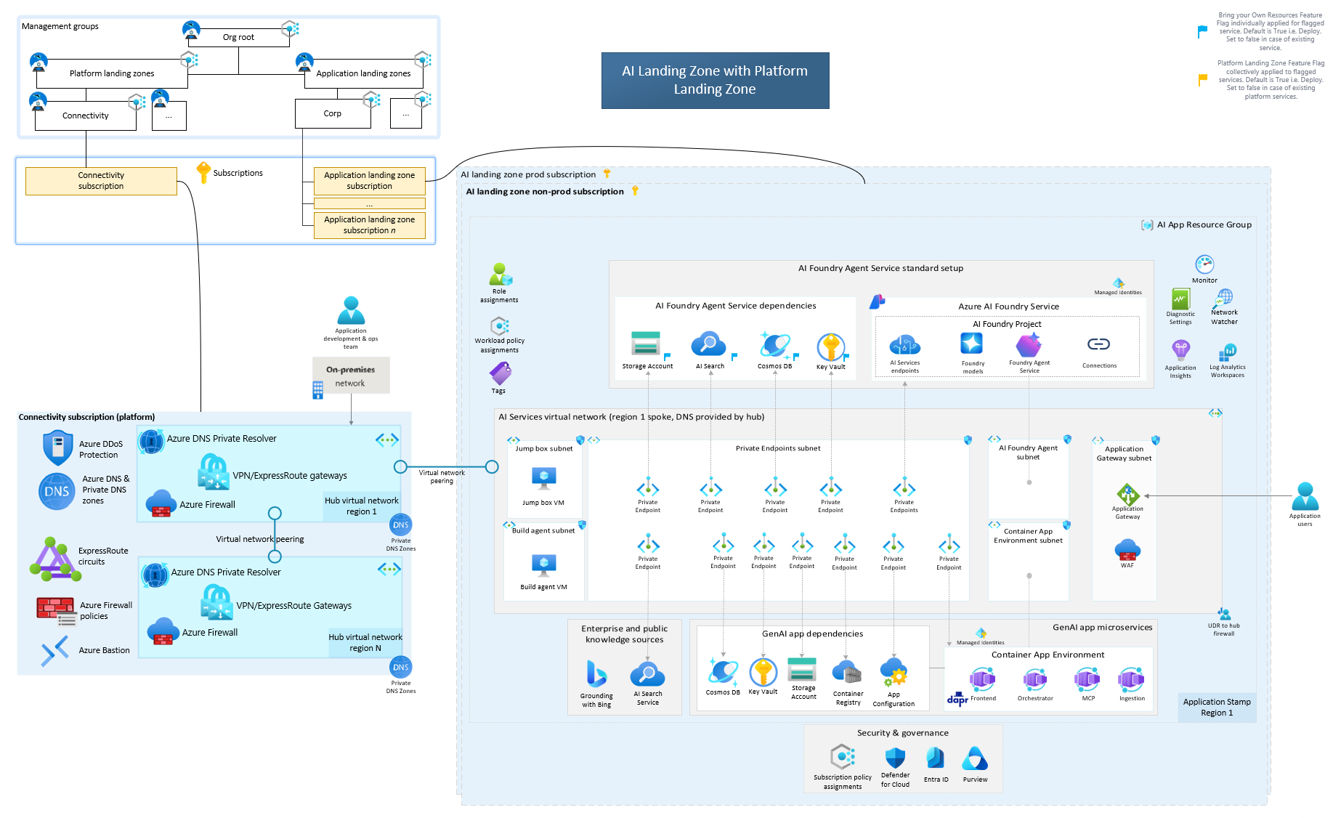
Original reference: AI landing zone with platform
APPENDIX O1
ORIGINAL REFERENCE, UNCHANGED
Source: 04_AI-Landing-Zone-with-platform.png in the GTM repository · Microsoft page: link
Source labels use the earlier "AI Foundry" naming; the simplified executive view uses current Foundry names.
CIS Infra · AI Platform / Landing Zone · 11 Oct 2026 · Working proposal, not approved terms
Appendix index
38
Notes:
Original diagram from the user repository, embedded unchanged at source resolution and not stretched beyond its native size. Repository: https://github.com/upendra25312/AI-Foundry-GTM-offering-/blob/main/architectures/04_AI-Landing-Zone-with-platform.png
Editable Visio: https://github.com/upendra25312/AI-Foundry-GTM-offering-/blob/main/architectures/01_AI-Landing-Zones-Multi-Page.vsdx
Microsoft source: https://github.com/Azure/AI-Landing-Zones
Source labels use the earlier "AI Foundry" naming; the simplified executive view uses current Foundry names.
Status: proposed offering for internal leadership review. No Cognizant approval, customer evidence, staffing commitment, rate card or verified quote is implied. Illustrative and synthetic figures are labelled as such. All money in USD. Font: Arial substituted for Gellix (not available). Azure icons: official Microsoft Azure Architecture Icons (V24 set, via az-icons.com and the icons embedded in the baseline decks), unmodified SVG with PNG fallback. Rendered and checked as PDF previews; not opened in desktop PowerPoint.

Slide 39

Original reference: Microsoft Foundry baseline
APPENDIX O2
ORIGINAL REFERENCE, UNCHANGED
Source: 07_baseline-microsoft-foundry.png in the GTM repository · Microsoft page: link
Source shows "Azure OpenAI model"; adapted view (A8) uses Foundry model deployment.
CIS Infra · AI Platform / Landing Zone · 11 Oct 2026 · Working proposal, not approved terms
Appendix index
39
Notes:
Original diagram from the user repository, embedded unchanged at source resolution and not stretched beyond its native size. Repository: https://github.com/upendra25312/AI-Foundry-GTM-offering-/blob/main/architectures/07_baseline-microsoft-foundry.png
Editable Visio: https://github.com/upendra25312/AI-Foundry-GTM-offering-/blob/main/architectures/03_baseline-microsoft-foundry.vsdx
Microsoft source: https://learn.microsoft.com/en-us/azure/architecture/ai-ml/architecture/baseline-microsoft-foundry-chat
Source shows "Azure OpenAI model"; adapted view (A8) uses Foundry model deployment.
Status: proposed offering for internal leadership review. No Cognizant approval, customer evidence, staffing commitment, rate card or verified quote is implied. Illustrative and synthetic figures are labelled as such. All money in USD. Font: Arial substituted for Gellix (not available). Azure icons: official Microsoft Azure Architecture Icons (V24 set, via az-icons.com and the icons embedded in the baseline decks), unmodified SVG with PNG fallback. Rendered and checked as PDF previews; not opened in desktop PowerPoint.

Slide 40
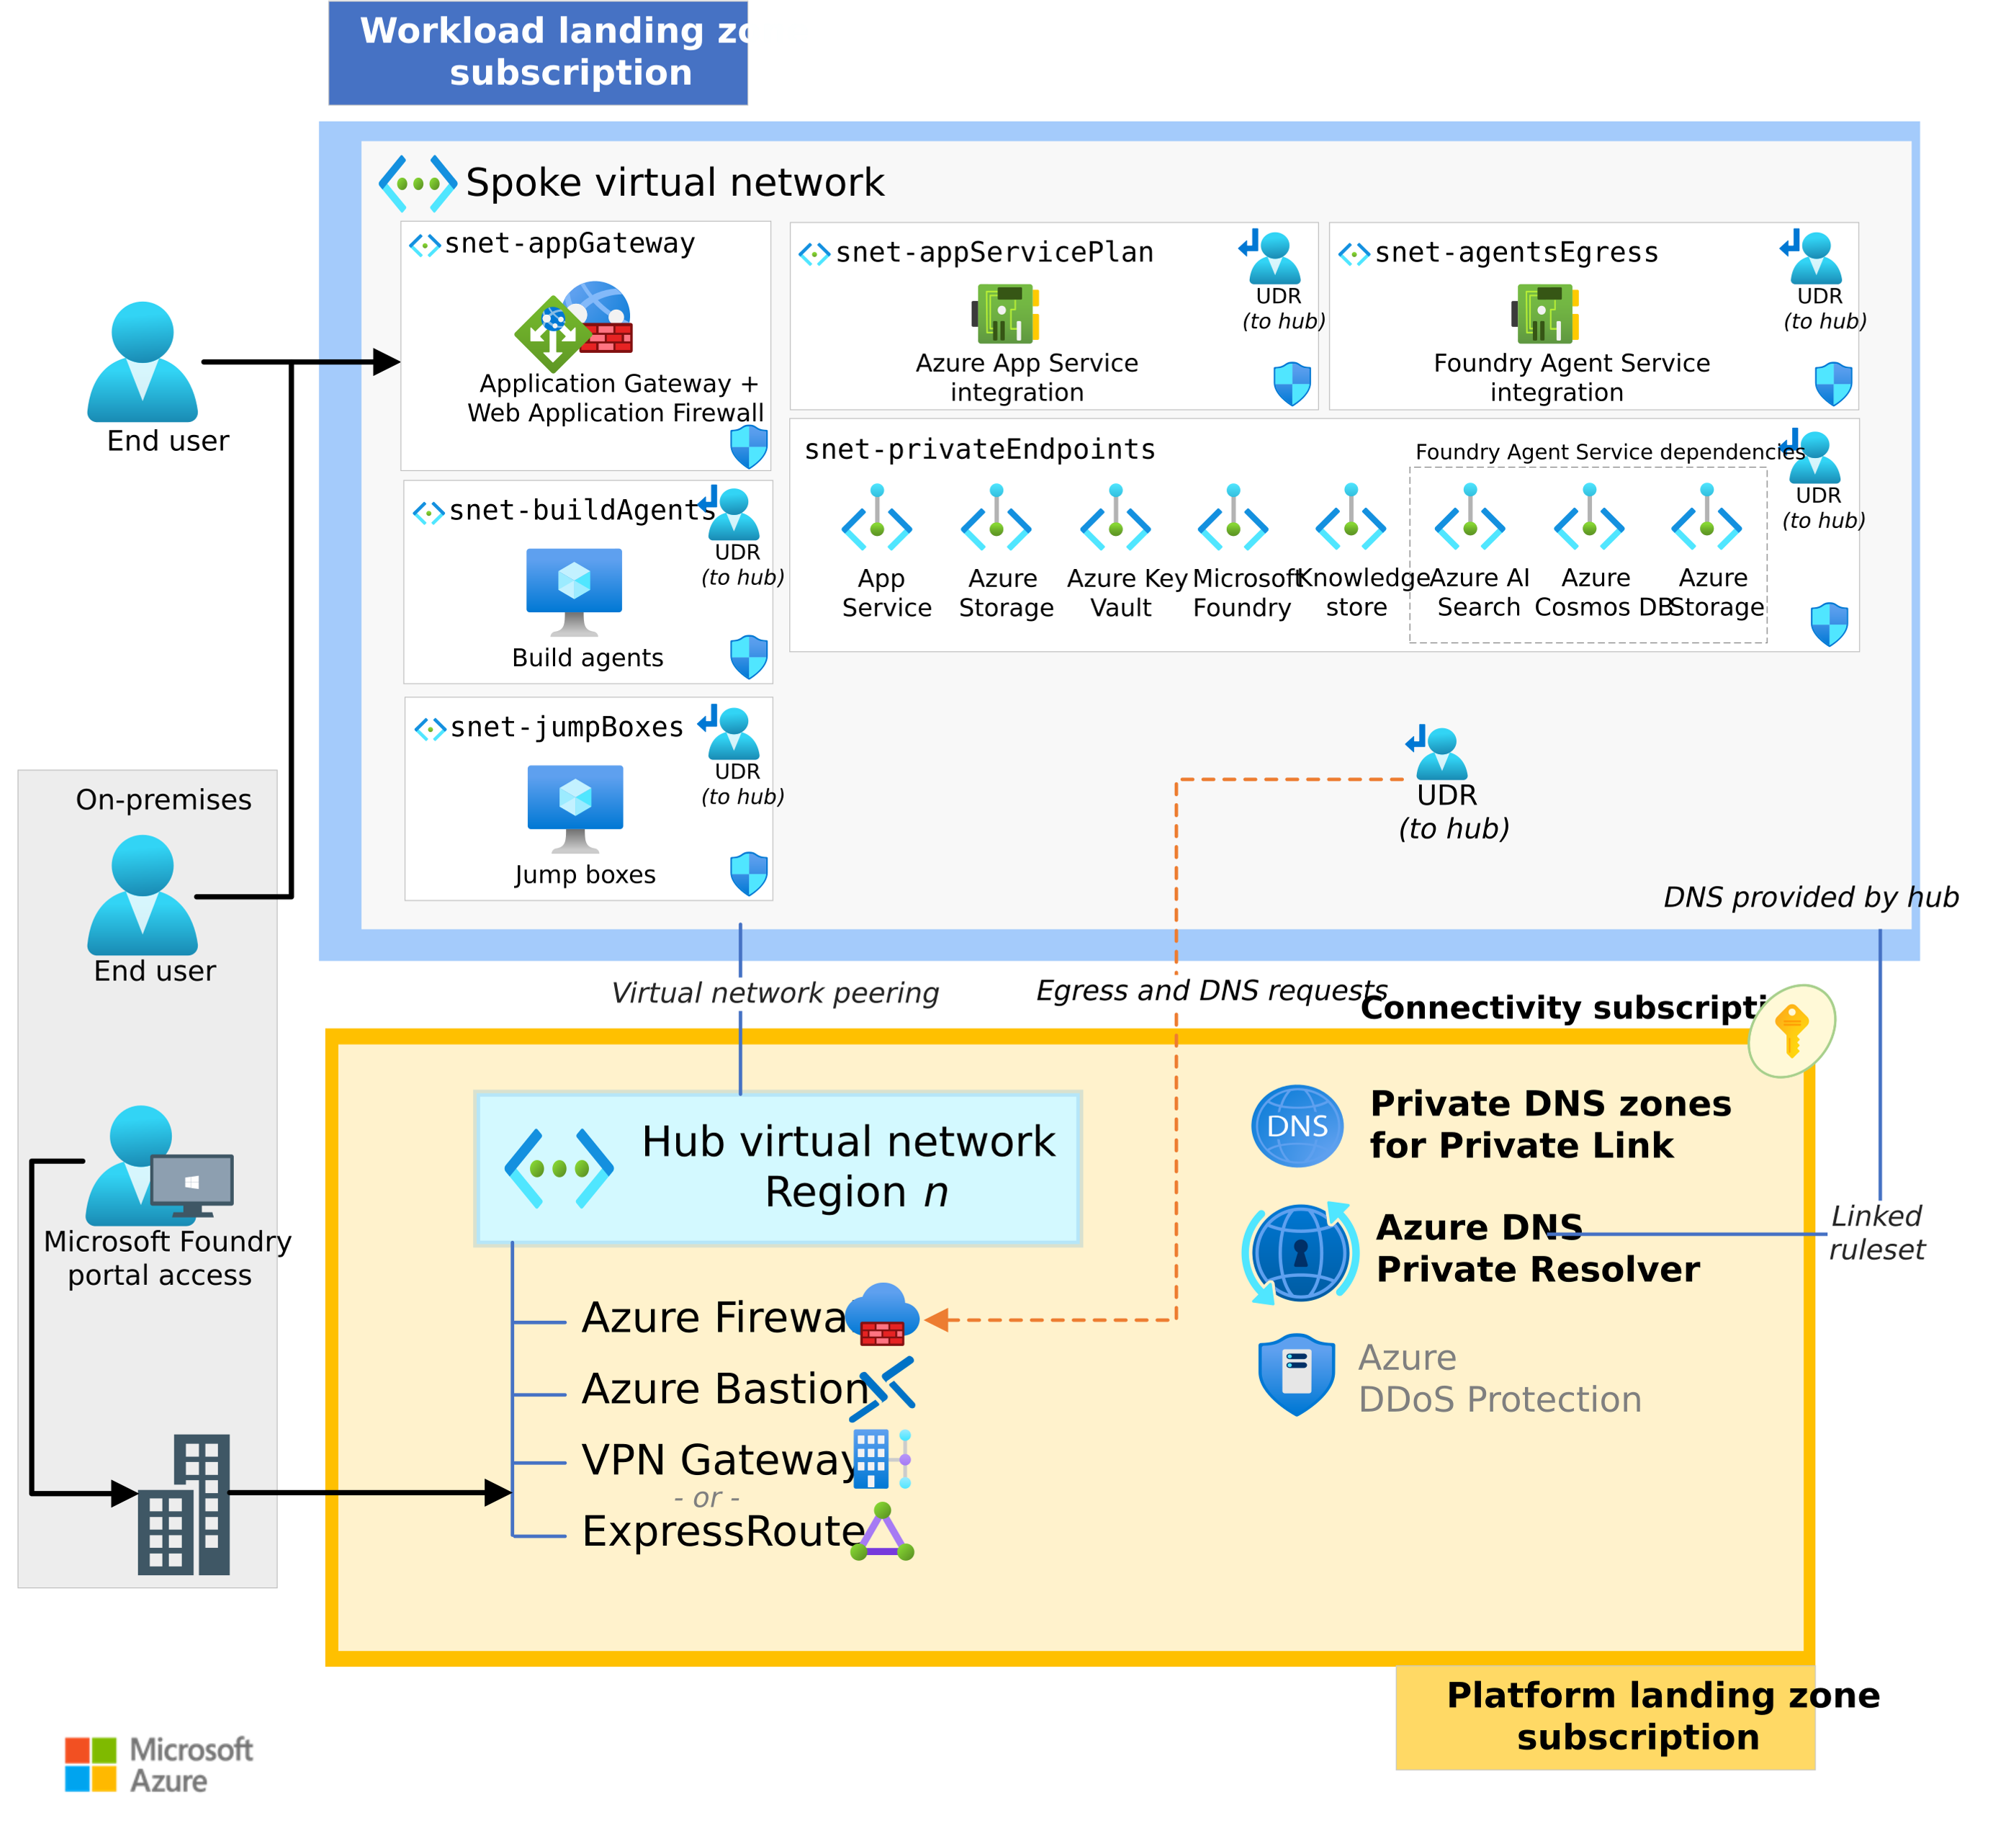
Original reference: landing zone networking
APPENDIX O3
ORIGINAL REFERENCE, UNCHANGED
Source: 11_baseline-landing-zone-networking.png in the GTM repository · Microsoft page: link
The source PNG clips some labels in its own render; the editable reconstruction is appendix A5.
CIS Infra · AI Platform / Landing Zone · 11 Oct 2026 · Working proposal, not approved terms
Appendix index
40
Notes:
Original diagram from the user repository, embedded unchanged at source resolution and not stretched beyond its native size. Repository: https://github.com/upendra25312/AI-Foundry-GTM-offering-/blob/main/architectures/11_baseline-landing-zone-networking.png
Editable Visio: https://github.com/upendra25312/AI-Foundry-GTM-offering-/blob/main/architectures/05_baseline-landing-zone-networking.vsdx
Microsoft source: https://learn.microsoft.com/en-us/azure/architecture/ai-ml/architecture/baseline-microsoft-foundry-landing-zone
The source PNG clips some labels in its own render; the editable reconstruction is appendix A5.
Status: proposed offering for internal leadership review. No Cognizant approval, customer evidence, staffing commitment, rate card or verified quote is implied. Illustrative and synthetic figures are labelled as such. All money in USD. Font: Arial substituted for Gellix (not available). Azure icons: official Microsoft Azure Architecture Icons (V24 set, via az-icons.com and the icons embedded in the baseline decks), unmodified SVG with PNG fallback. Rendered and checked as PDF previews; not opened in desktop PowerPoint.

Slide 41
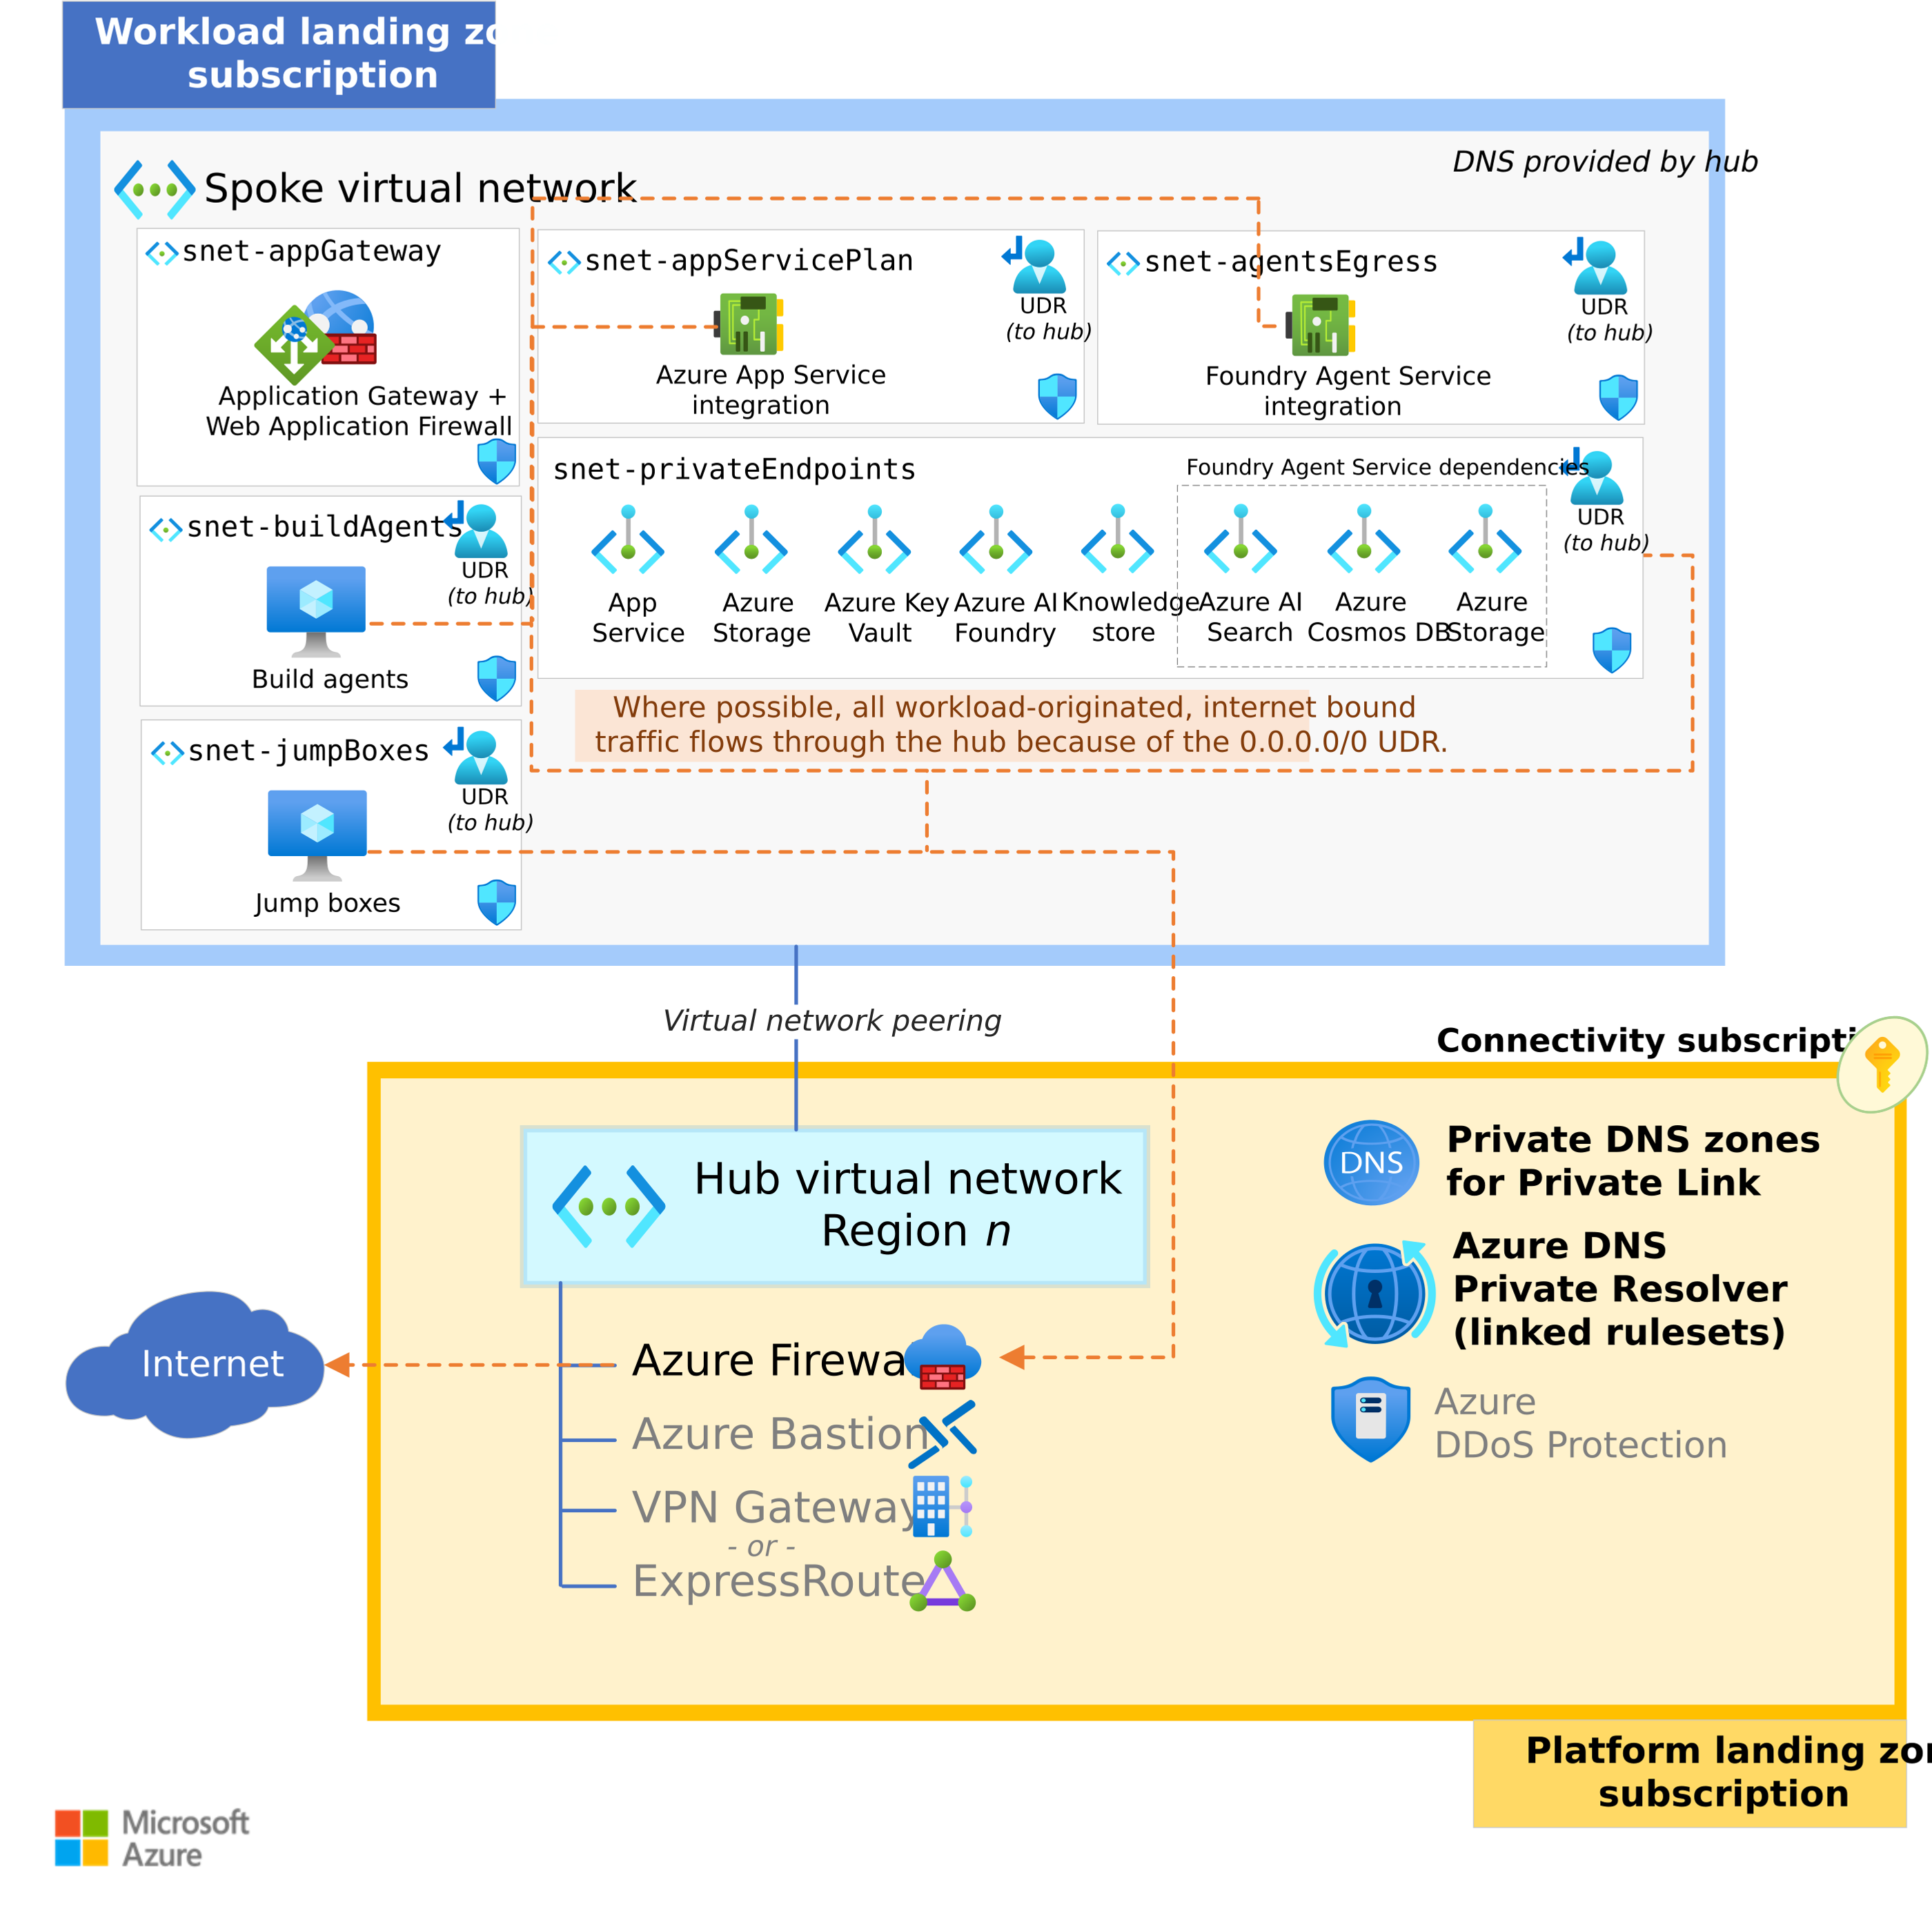
Original reference: landing zone egress
APPENDIX O4
ORIGINAL REFERENCE, UNCHANGED
Source: 12_baseline-landing-zone-networking-egress.png in the GTM repository · Microsoft page: link
The source PNG clips some labels in its own render; the editable reconstruction is appendix A6.
CIS Infra · AI Platform / Landing Zone · 11 Oct 2026 · Working proposal, not approved terms
Appendix index
41
Notes:
Original diagram from the user repository, embedded unchanged at source resolution and not stretched beyond its native size. Repository: https://github.com/upendra25312/AI-Foundry-GTM-offering-/blob/main/architectures/12_baseline-landing-zone-networking-egress.png
Editable Visio: https://github.com/upendra25312/AI-Foundry-GTM-offering-/blob/main/architectures/06_baseline-landing-zone-networking-egress.vsdx
Microsoft source: https://learn.microsoft.com/en-us/azure/architecture/ai-ml/architecture/baseline-microsoft-foundry-landing-zone
The source PNG clips some labels in its own render; the editable reconstruction is appendix A6.
Status: proposed offering for internal leadership review. No Cognizant approval, customer evidence, staffing commitment, rate card or verified quote is implied. Illustrative and synthetic figures are labelled as such. All money in USD. Font: Arial substituted for Gellix (not available). Azure icons: official Microsoft Azure Architecture Icons (V24 set, via az-icons.com and the icons embedded in the baseline decks), unmodified SVG with PNG fallback. Rendered and checked as PDF previews; not opened in desktop PowerPoint.

Slide 42
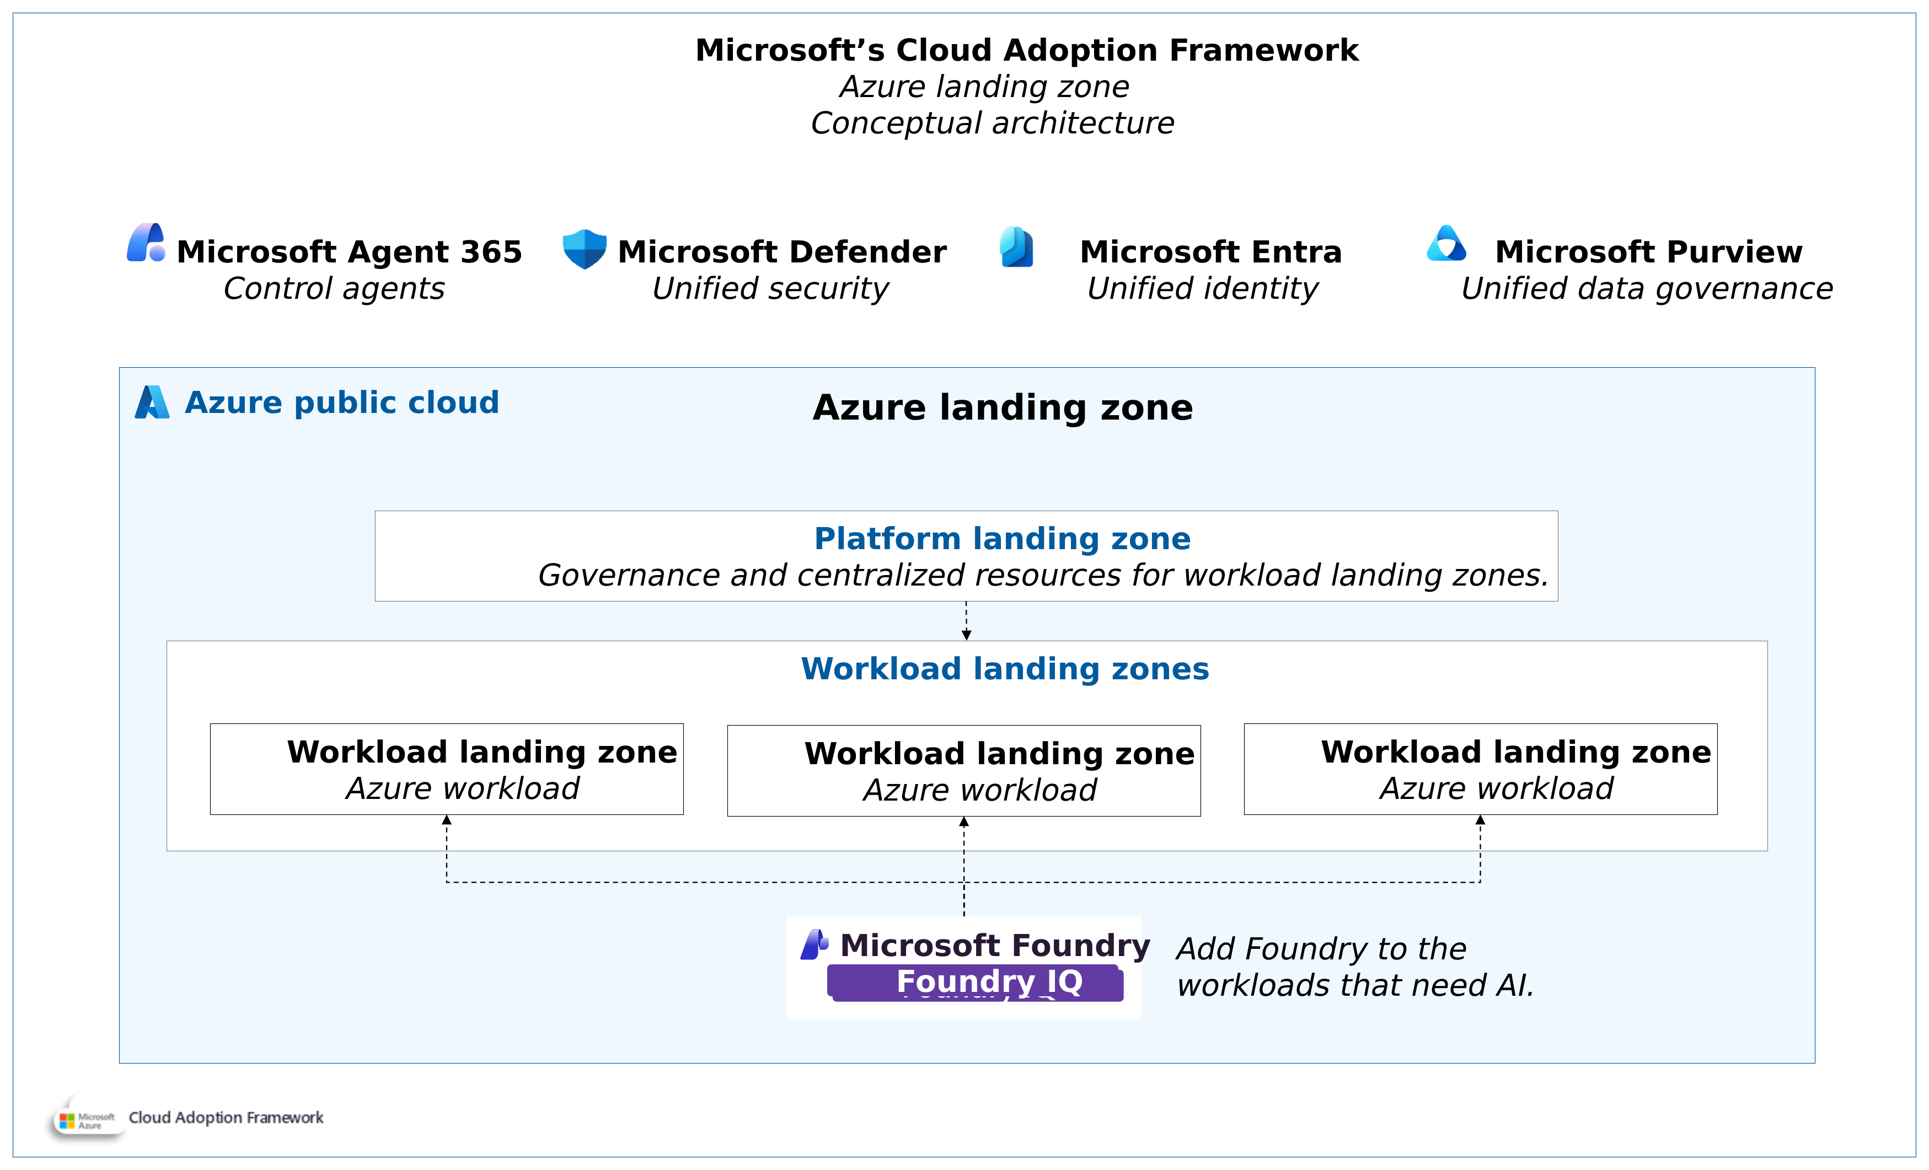
Original reference: Azure landing zone conceptual view
APPENDIX O5
ORIGINAL REFERENCE, UNCHANGED
Source: 35_azure-landing-zone-conceptual-architecture.png in the GTM repository · Microsoft page: link
Microsoft CAF conceptual view showing Foundry added to workload landing zones that need AI.
CIS Infra · AI Platform / Landing Zone · 11 Oct 2026 · Working proposal, not approved terms
Appendix index
42
Notes:
Original diagram from the user repository, embedded unchanged at source resolution and not stretched beyond its native size. Repository: https://github.com/upendra25312/AI-Foundry-GTM-offering-/blob/main/architectures/35_azure-landing-zone-conceptual-architecture.png
Microsoft source: https://learn.microsoft.com/en-us/azure/cloud-adoption-framework/ready/landing-zone/
Microsoft CAF conceptual view showing Foundry added to workload landing zones that need AI.
Status: proposed offering for internal leadership review. No Cognizant approval, customer evidence, staffing commitment, rate card or verified quote is implied. Illustrative and synthetic figures are labelled as such. All money in USD. Font: Arial substituted for Gellix (not available). Azure icons: official Microsoft Azure Architecture Icons (V24 set, via az-icons.com and the icons embedded in the baseline decks), unmodified SVG with PNG fallback. Rendered and checked as PDF previews; not opened in desktop PowerPoint.

Slide 43
Sources and verification
APPENDIX S1
CHECKED 11 OCT 2026
Cloud Adoption Framework: AI Ready: https://learn.microsoft.com/en-us/azure/cloud-adoption-framework/ai/ready
Foundry Models deployment types: https://learn.microsoft.com/en-us/azure/foundry/foundry-models/concepts/deployment-types
Foundry Models region availability (Europe and MEA tabs read in browser): https://learn.microsoft.com/en-us/azure/foundry/foundry-models/concepts/models-sold-directly-by-azure-region-availability
Foundry Models retirement schedule: https://learn.microsoft.com/en-us/azure/foundry/openai/concepts/model-retirement-schedule
Foundry Control Plane: manage agents: https://learn.microsoft.com/en-us/azure/foundry/control-plane/how-to-manage-agents
Azure Retail Prices API: Log Analytics, East US 2: https://prices.azure.com/api/retail/prices?$filter=serviceName eq 'Log Analytics' and armRegionName eq 'eastus2'
Azure Architecture Icons (V24): https://learn.microsoft.com/en-us/azure/architecture/icons/
az-icons.com catalogue of official Azure icons (July 2026 set): https://az-icons.com/
Azure Architecture Center browse: https://learn.microsoft.com/en-us/azure/architecture/browse/
GTM proposal V3: https://github.com/upendra25312/AI-Foundry-GTM-offering-/blob/main/CIS_Infra_Azure_AI_Platform_GTM_Proposal_V3.docx
Azure AI Landing Zones: https://github.com/Azure/AI-Landing-Zones
Foundry baseline in a landing zone: https://learn.microsoft.com/en-us/azure/architecture/ai-ml/architecture/baseline-microsoft-foundry-landing-zone
App Service private endpoint: https://learn.microsoft.com/en-us/azure/app-service/overview-private-endpoint
CIS Infra · AI Platform / Landing Zone · 11 Oct 2026 · Working proposal, not approved terms
Appendix index
43
Notes:
Full source register (URL, date checked, product, deployment type, region, SKU, GA or preview status, limitations) is provided as a separate workbook. Links below are clickable in slideshow mode.
Status: proposed offering for internal leadership review. No Cognizant approval, customer evidence, staffing commitment, rate card or verified quote is implied. Illustrative and synthetic figures are labelled as such. All money in USD. Font: Arial substituted for Gellix (not available). Azure icons: official Microsoft Azure Architecture Icons (V24 set, via az-icons.com and the icons embedded in the baseline decks), unmodified SVG with PNG fallback. Rendered and checked as PDF previews; not opened in desktop PowerPoint.

