Slide 1

CIS INFRA · INTERNAL OFFERING PROPOSAL · FOR SENIOR LEADERSHIP REVIEW
AI Gateway Implementation
Govern model and tool traffic through one controlled, observable path
Azure API Management AI gateway: identity, token budgets, routing, safety, telemetry · US, Europe, UK and Middle East pursuits
11 Oct 2026 · Version 2.0 · Working proposal for leadership review
01
Notes:
Presenter purpose: open the leadership review of the CIS Infra AI Gateway Implementation offering.
Status: proposed offering for internal leadership review. No Cognizant approval, customer evidence, staffing commitment, rate card or verified quote is implied. Illustrative and synthetic figures are labelled as such. All money in USD. Font: Arial substituted for Gellix (not available). Azure icons: official Microsoft Azure Architecture Icons (V24 set, via az-icons.com and the icons embedded in the baseline decks), unmodified SVG with PNG fallback. Rendered and checked as PDF previews; not opened in desktop PowerPoint.

Slide 2

Summary: one governed path for model and tool calls
EXECUTIVE SUMMARY · 2 OF 10
PROPOSED OFFERING
Problem
Apps and agents call models and tools directly, often with keys. There are no shared limits, routing, cost allocation or safety checks.
Decision requested
Production on GA API Management tiers; AI Gateway tier only as a pilot
Approve the policy scope and owners
Accept that token caps are not exact currency caps
Offer
CIS Infra designs and builds an API Management AI gateway, its policies and its private network, and closes bypass routes.
Outcome
Every governed call is authenticated, metered, attributable and routable. Ungoverned paths are closed or listed.
Limit: A gateway cannot govern calls it never receives. Bypass prevention is part of the scope.
CIS Infra · AI Gateway Implementation · 11 Oct 2026 · Working proposal, not approved terms
02
Notes:
Sell when several consumers, identity controls, cost allocation or routing justify a shared gateway. A single low-risk application may not justify a new service. The gateway controls only traffic routed through it.
Status: proposed offering for internal leadership review. No Cognizant approval, customer evidence, staffing commitment, rate card or verified quote is implied. Illustrative and synthetic figures are labelled as such. All money in USD. Font: Arial substituted for Gellix (not available). Azure icons: official Microsoft Azure Architecture Icons (V24 set, via az-icons.com and the icons embedded in the baseline decks), unmodified SVG with PNG fallback. Rendered and checked as PDF previews; not opened in desktop PowerPoint.

Slide 3
Who buys, and what triggers the purchase
EXECUTIVE SUMMARY · 3 OF 10
Buyer role | What they need | Purchase trigger
Platform or API owner | One controlled entry for AI traffic | Several teams calling models directly
FinOps or budget owner | Usage attributed to teams and agents | Unexplained model spend
CISO delegate | Identity, safety and logging on every call | Keys in apps; no prompt-attack controls
AI platform leader | Routing across PTU, PAYG and regions | Throttling, quota limits or capacity events
Decision: One low-risk app with one model may not need a shared gateway. Qualify on consumers, controls and routing need.
CIS Infra · AI Gateway Implementation · 11 Oct 2026 · Working proposal, not approved terms
03
Notes:
Buyer roles and triggers for the gateway offering.
Status: proposed offering for internal leadership review. No Cognizant approval, customer evidence, staffing commitment, rate card or verified quote is implied. Illustrative and synthetic figures are labelled as such. All money in USD. Font: Arial substituted for Gellix (not available). Azure icons: official Microsoft Azure Architecture Icons (V24 set, via az-icons.com and the icons embedded in the baseline decks), unmodified SVG with PNG fallback. Rendered and checked as PDF previews; not opened in desktop PowerPoint.

Slide 4
Where this offering sits in the portfolio
EXECUTIVE SUMMARY · 4 OF 10
PROPOSED PORTFOLIO
04
AI Capacity and
FinOps Assessment
Measure demand, choose
capacity model
01
AI Platform /
Landing Zone
Governed foundation for
AI workloads
03
AI Gateway
Implementation
Control model and
tool traffic
02
Agent Governance
and Operations
Know, observe and
contain agents
05
Managed AI
Platform Operations
Run, report and
optimise the platform
THIS OFFERING
Monthly operations evidence feeds the next capacity and cost decision
Handoffs for this offering
Receives from 01 and 04
Private network and identities; capacity plan for PTU and PAYG routing
Hands to 02 Agent Governance
Ingress and outbound enforcement points, per-agent token metrics
Hands to 05 Managed Operations
Policy register, dashboards, runbooks and alert routing
Note: Each handoff has a named owner, acceptance evidence and a date. No offering assumes another is sold.
CIS Infra · AI Gateway Implementation · 11 Oct 2026 · Working proposal, not approved terms
04
Notes:
The gateway depends on the landing zone network and identity, uses the capacity plan from offering 04 for routing, and is an enforcement point for agent containment in offering 02.
Status: proposed offering for internal leadership review. No Cognizant approval, customer evidence, staffing commitment, rate card or verified quote is implied. Illustrative and synthetic figures are labelled as such. All money in USD. Font: Arial substituted for Gellix (not available). Azure icons: official Microsoft Azure Architecture Icons (V24 set, via az-icons.com and the icons embedded in the baseline decks), unmodified SVG with PNG fallback. Rendered and checked as PDF previews; not opened in desktop PowerPoint.

Slide 5
What CIS Infra provides, and what it does not
EXECUTIVE SUMMARY · 5 OF 10
PROPOSED SCOPE
Included: CIS Infra delivers
Optional: priced separately
Other owners
APIM instance, network and DNS
Identity and managed identity setup
Token, request and concurrency policies
Backend pools, retries, circuit breakers
Token metrics, logs and dashboards
Multi-region gateway resilience
Semantic caching (needs Redis)
MCP and tool API onboarding
Chargeback reporting
AI Gateway tier pilot (preview)
Security: identity design, safety policy
AI: API contracts, routing choice, tests
DevOps: policy CI/CD and rollback
Finance: budget and allocation rules
Tool owners: tool-side authorisation
Limit: CIS Infra does not own model quality, application behaviour or security operations.
CIS Infra · AI Gateway Implementation · 11 Oct 2026 · Working proposal, not approved terms
05
Notes:
CIS Infra owns the gateway platform, network and service health. Security owns identity design and safety policy requirements. AI owns API contracts, model routing choices and behaviour tests. DevOps owns policy deployment pipelines. Finance and the customer own budgets and cost allocation rules.
Status: proposed offering for internal leadership review. No Cognizant approval, customer evidence, staffing commitment, rate card or verified quote is implied. Illustrative and synthetic figures are labelled as such. All money in USD. Font: Arial substituted for Gellix (not available). Azure icons: official Microsoft Azure Architecture Icons (V24 set, via az-icons.com and the icons embedded in the baseline decks), unmodified SVG with PNG fallback. Rendered and checked as PDF previews; not opened in desktop PowerPoint.

Slide 6







Architecture: the gateway in the request path
EXECUTIVE SUMMARY · 6 OF 10
PROPOSED REFERENCE ARCHITECTURE
API MANAGEMENT (AI GATEWAY)
BACKENDS AND POLICY SERVICES (PRIVATE)
1
Authenticate validate token, map caller
PTU deployment
primary, priority 1
PAYG deployment
approved overflow
4
2
Limit tokens, requests, concurrency
Apps and agents
Entra token
Content Safety
called by policy
Key Vault
certificates
3
Protect content safety, prompt shield
Route priority backends, retry, breaker
5
TOOLS AND TELEMETRY
Observe token metrics, logs
Tool APIs
own policies
App Insights
token metrics
6
Direct call to model endpoint: blocked by network and identity
Request / data flow
Telemetry or state read
Path that must be blocked
Proposed reference architecture · CIS Infra custom design · not a Microsoft-published or Microsoft-endorsed architecture
CIS Infra · AI Gateway Implementation · 11 Oct 2026 · Working proposal, not approved terms
06
Notes:
Executive view replacing the legacy identity diagram (old slide 8). No legacy model labels are used; backends are shown as deployment types, not model names.
Steps: (1) app or agent obtains an Entra token; (2) API Management validates the token and maps the caller to a counter key; (3) inbound policies apply token and request limits and the content-safety check; (4) the backend policy routes to the PTU deployment first and to an approved PAYG deployment on 429, using managed identity; (5) tool calls go to tool APIs under their own policies and tool-side authorisation; (6) outbound policies check completions and emit token metrics to Application Insights. Direct calls from apps to model endpoints are blocked by private endpoints and disabled local auth.
Sources (checked 11 Oct 2026):
AI gateway capabilities in API Management: https://learn.microsoft.com/en-us/azure/api-management/genai-gateway-capabilities
APIM llm-token-limit policy: https://learn.microsoft.com/en-us/azure/api-management/llm-token-limit-policy
APIM llm-content-safety policy: https://learn.microsoft.com/en-us/azure/api-management/llm-content-safety-policy
Provisioned throughput concepts: https://learn.microsoft.com/en-us/azure/foundry/openai/concepts/provisioned-throughput
Azure Architecture Icons (V24): https://learn.microsoft.com/en-us/azure/architecture/icons/
Status: proposed offering for internal leadership review. No Cognizant approval, customer evidence, staffing commitment, rate card or verified quote is implied. Illustrative and synthetic figures are labelled as such. All money in USD. Font: Arial substituted for Gellix (not available). Azure icons: official Microsoft Azure Architecture Icons (V24 set, via az-icons.com and the icons embedded in the baseline decks), unmodified SVG with PNG fallback. Rendered and checked as PDF previews; not opened in desktop PowerPoint.

Slide 7
What the gateway controls, and what it cannot
EXECUTIVE SUMMARY · 7 OF 10
VERIFIED 11 OCT 2026
Controls for routed traffic
Limits leaders must accept
Caller identity and managed identity to backends
Token rate limits and quotas per caller
Content safety and prompt-attack checks
Priority routing, retries and circuit breakers
Token metrics per caller, app or agent
No control over calls that bypass it
Counters are per gateway, not global
Concurrent calls can overshoot a limit
Streaming usage is estimated
Token caps are not exact currency caps
Decision: For a hard financial cap, add a budget service designed for bounded overshoot.
CIS Infra · AI Gateway Implementation · 11 Oct 2026 · Working proposal, not approved terms
07
Notes:
Verified against Microsoft Learn on 11 Oct 2026. llm-token-limit "tracks token usage independently at each gateway ... It doesn't aggregate token counts across the entire instance." Concurrent requests "can temporarily exceed the configured token limit". With streaming, prompt and completion tokens are estimated. The policy counts prompt and completion tokens only. Content safety returns 403; with streaming it stops forwarding without a 403.
Sources (checked 11 Oct 2026):
APIM llm-token-limit policy: https://learn.microsoft.com/en-us/azure/api-management/llm-token-limit-policy
APIM llm-content-safety policy: https://learn.microsoft.com/en-us/azure/api-management/llm-content-safety-policy
AI gateway capabilities in API Management: https://learn.microsoft.com/en-us/azure/api-management/genai-gateway-capabilities
Status: proposed offering for internal leadership review. No Cognizant approval, customer evidence, staffing commitment, rate card or verified quote is implied. Illustrative and synthetic figures are labelled as such. All money in USD. Font: Arial substituted for Gellix (not available). Azure icons: official Microsoft Azure Architecture Icons (V24 set, via az-icons.com and the icons embedded in the baseline decks), unmodified SVG with PNG fallback. Rendered and checked as PDF previews; not opened in desktop PowerPoint.

Slide 8
Three things are priced separately
EXECUTIVE SUMMARY · 8 OF 10
VERIFIED LIST PRICES
NO APPROVED FEES
1 Gateway platform
Customer Azure spend, recurring
2 Model consumption
Customer Azure spend, per use
3 Implementation
CIS Infra services, one-time
Standard v2: $0.9589 per unit-hour, about $700 a month
Premium v2: $3.8356 per unit-hour, about $2,800 a month
Also: logs, private endpoints, Content Safety calls
gpt-4.1 Global: $2.00 input, $8.00 output per 1M tokens
Provisioned: $1.00 per PTU-hour Global, list
Driver: traffic the gateway routes, not the gateway
Unit: role days x approved sell rate
Drivers: consumers, policies, regions, tests
Status: no approved rate yet (Finance)
Note: East US 2 retail list prices, USD, checked 11 Oct 2026. Synthetic budget example is kept apart in appendix A20.
CIS Infra · AI Gateway Implementation · 11 Oct 2026 · Working proposal, not approved terms
08
Notes:
Improves the distinction between platform cost, model consumption and implementation fees (audit finding). Platform and model prices are Azure Retail Prices API list prices for East US 2 in USD, retrieved 11 Oct 2026, at 730 hours per month; enterprise agreements differ. The AI Gateway tier meter shows $0.00 but Microsoft states pricing will be announced later in the preview; do not treat it as free. Implementation fees have no approved rate; the formula is shown.
Sources (checked 11 Oct 2026):
Azure Retail Prices API: API Management, East US 2: https://prices.azure.com/api/retail/prices?$filter=serviceName eq 'API Management' and armRegionName eq 'eastus2'
Azure Retail Prices API: Azure OpenAI gpt-4.1, East US 2: https://prices.azure.com/api/retail/prices?$filter=productName eq 'Azure OpenAI' and armRegionName eq 'eastus2'
AI Gateway tier (preview) overview: https://learn.microsoft.com/en-us/azure/api-management/ai-gateway-overview
Status: proposed offering for internal leadership review. No Cognizant approval, customer evidence, staffing commitment, rate card or verified quote is implied. Illustrative and synthetic figures are labelled as such. All money in USD. Font: Arial substituted for Gellix (not available). Azure icons: official Microsoft Azure Architecture Icons (V24 set, via az-icons.com and the icons embedded in the baseline decks), unmodified SVG with PNG fallback. Rendered and checked as PDF previews; not opened in desktop PowerPoint.

Slide 9
Dependencies and risks that decide success
EXECUTIVE SUMMARY · 9 OF 10
Risk or dependency | Effect if unmanaged | Mitigation | Owner
Direct endpoints left open | Controls bypassed | Private endpoints; local auth off | CIS Infra with Security
Preview tier used in production | No SLA; changing limits | GA tiers for production | Architecture owner
Region capacity notices | Tier cannot be created | Recheck region table before quote | CIS Infra
Spoofable counter key | Budgets evaded | Counter key from validated token | Security
Overflow to PAYG unbudgeted | Spend spikes | Approved overflow, alerts, quota | Budget owner
CIS Infra · AI Gateway Implementation · 11 Oct 2026 · Working proposal, not approved terms
09
Notes:
Top dependencies and risks for the gateway offering.
Status: proposed offering for internal leadership review. No Cognizant approval, customer evidence, staffing commitment, rate card or verified quote is implied. Illustrative and synthetic figures are labelled as such. All money in USD. Font: Arial substituted for Gellix (not available). Azure icons: official Microsoft Azure Architecture Icons (V24 set, via az-icons.com and the icons embedded in the baseline decks), unmodified SVG with PNG fallback. Rendered and checked as PDF previews; not opened in desktop PowerPoint.

Slide 10
How success is measured, and what to decide now
EXECUTIVE SUMMARY · 10 OF 10
TARGETS TO AGREE
Measure | Definition
Coverage | Share of AI calls routed through the gateway
Bypass | Direct-call tests denied
Budget accuracy | Measured overshoot under load
Resilience | Fallback stays inside approved boundary
Attribution | Tokens attributed to caller and agent
Decide now
GA tier for production; preview for pilot
Counter key from validated identity
After evidence or approval
Region and tier (capacity check)
Overflow budget (budget owner)
Sell rates (Finance)
CIS Infra · AI Gateway Implementation · 11 Oct 2026 · Working proposal, not approved terms
10
Notes:
Measures are definitions; thresholds agreed in the SOW after load tests. Full decision register in appendix D1.
Status: proposed offering for internal leadership review. No Cognizant approval, customer evidence, staffing commitment, rate card or verified quote is implied. Illustrative and synthetic figures are labelled as such. All money in USD. Font: Arial substituted for Gellix (not available). Azure icons: official Microsoft Azure Architecture Icons (V24 set, via az-icons.com and the icons embedded in the baseline decks), unmodified SVG with PNG fallback. Rendered and checked as PDF previews; not opened in desktop PowerPoint.

Slide 11
APPENDIX
Technical and commercial appendix
Request flow, identity, token limits, routing, safety, telemetry, resilience, SKU and regional detail, pricing, original references, RACI and sources.
11
Notes:
Appendix divider.

Slide 12
Appendix index
APPENDIX
13 A1 Request and response flow
30 A18 Regional availability snapshot
14 A2 Model API and tool API governance
31 A19 Verified API Management list prices
15 A3 Identity pattern (rebuilt)
32 A20 Synthetic budget example
16 A4 Token rate limits and quotas
33 A21 Policy register
17 A5 Token-limit policy flow (rebuilt)
34 A22 Acceptance gates
18 A6 Counters, streaming and overshoot
35 K Kill-switch cross-reference
19 A7 Request, concurrency and budget controls
36 C1 Cost layers and pricing formula
20 A8 Backend pools and routing (rebuilt)
37 R1 RACI matrix
21 A9 Circuit breaker (rebuilt)
38 R2 Revenue attribution framework
22 A10 PTU primary, PAYG overflow options
39 R3 Delivery and commercial readiness
23 A11 Content safety (rebuilt)
40 D1 Decision and approval register
24 A12 Tool authorisation and approval
41 O1 Original: gateway conceptual
25 A13 Token metrics and cost allocation (rebuilt)
42 O2 Historical: legacy identity diagram
26 A14 Private connectivity and regional resilience
43 O3 Original: single gateway, regional backends
27 A15 Bypass prevention
44 O4 Original: multi-region gateway
28 A16 GA versus preview register
45 O5 Low-resolution originals
29 A17 Tier feature matrix
46 S1 Sources and verification dates
CIS Infra · AI Gateway Implementation · 11 Oct 2026 · Working proposal, not approved terms
12
Notes:
Navigation slide. Each entry links to the appendix slide. Use the Index link in the footer of any appendix slide to return here.
Status: proposed offering for internal leadership review. No Cognizant approval, customer evidence, staffing commitment, rate card or verified quote is implied. Illustrative and synthetic figures are labelled as such. All money in USD. Font: Arial substituted for Gellix (not available). Azure icons: official Microsoft Azure Architecture Icons (V24 set, via az-icons.com and the icons embedded in the baseline decks), unmodified SVG with PNG fallback. Rendered and checked as PDF previews; not opened in desktop PowerPoint.

Slide 13
Request and response flow, step by step
APPENDIX A1
Step | Section | What happens | Policy or service
1 Authenticate | Inbound | Validate Entra token; map caller, app and agent to a counter key | validate-azure-ad-token or validate-jwt
2 Limit | Inbound | Token rate and quota; request rate; concurrency | llm-token-limit, rate-limit-by-key, limit-concurrency
3 Protect | Inbound | Harm categories and prompt shield on the prompt | llm-content-safety (shield-prompt)
4 Route | Backend | Priority pool PTU then PAYG; retry; circuit breaker; managed identity | set-backend-service, retry, backend pool
5 Respond | Outbound | Completion safety check; usage headers | llm-content-safety (outbound)
6 Observe | Outbound | Token metrics with caller dimensions; logs | llm-emit-token-metric, diagnostics
CIS Infra · AI Gateway Implementation · 11 Oct 2026 · Working proposal, not approved terms
Appendix index
13
Notes:
Policy placement follows API Management inbound, backend and outbound sections. Exact policies vary by tier and API type; verify per deployment.
Sources (checked 11 Oct 2026):
AI gateway capabilities in API Management: https://learn.microsoft.com/en-us/azure/api-management/genai-gateway-capabilities
APIM llm-token-limit policy: https://learn.microsoft.com/en-us/azure/api-management/llm-token-limit-policy
APIM llm-content-safety policy: https://learn.microsoft.com/en-us/azure/api-management/llm-content-safety-policy
Status: proposed offering for internal leadership review. No Cognizant approval, customer evidence, staffing commitment, rate card or verified quote is implied. Illustrative and synthetic figures are labelled as such. All money in USD. Font: Arial substituted for Gellix (not available). Azure icons: official Microsoft Azure Architecture Icons (V24 set, via az-icons.com and the icons embedded in the baseline decks), unmodified SVG with PNG fallback. Rendered and checked as PDF previews; not opened in desktop PowerPoint.

Slide 14
Model APIs and tool APIs need separate governance
APPENDIX A2
Concern | Model APIs | Tool APIs (REST, MCP)
What a call does | Generates text or embeddings | Reads or changes business systems
Main limit | Tokens per minute and quota | Requests, transaction value, allowed operations
Authorisation | Caller may use this model deployment | Caller may do this operation on this target
Safety | Content safety, prompt shield | Input validation, approval for high-impact actions
Containment | Deny further model calls | Deny at gateway and at tool side
Owner | AI with CIS Infra | Tool owner with Security
CIS Infra · AI Gateway Implementation · 11 Oct 2026 · Working proposal, not approved terms
Appendix index
14
Notes:
API Management can expose REST APIs as MCP servers, pass through to existing MCP servers, and import A2A agent APIs. Tool calls change systems, so they need authorisation on the tool side as well as at the gateway.
Sources (checked 11 Oct 2026):
AI gateway capabilities in API Management: https://learn.microsoft.com/en-us/azure/api-management/genai-gateway-capabilities
Status: proposed offering for internal leadership review. No Cognizant approval, customer evidence, staffing commitment, rate card or verified quote is implied. Illustrative and synthetic figures are labelled as such. All money in USD. Font: Arial substituted for Gellix (not available). Azure icons: official Microsoft Azure Architecture Icons (V24 set, via az-icons.com and the icons embedded in the baseline decks), unmodified SVG with PNG fallback. Rendered and checked as PDF previews; not opened in desktop PowerPoint.

Slide 15



Gateway identity pattern with current labels
APPENDIX A3
ADAPTED, LEGACY LABELS REPLACED
obtain token
Identity provider
Microsoft Entra ID or external IdP
REGION A RESOURCE GROUP
validate
Microsoft Foundry
resource
Model deployment
customer-selected model
JWT, optional key
GATEWAY RESOURCE GROUP
Intelligent application
client
API Management
validates JWT
Managed identity
to backends
REGION B RESOURCE GROUP
Microsoft Foundry
resource
Model deployment
customer-selected model
Request / data flow
Telemetry or state read
Adapted reference architecture · rebuilt from Microsoft source with current labels; original kept as historical reference
CIS Infra · AI Gateway Implementation · 11 Oct 2026 · Working proposal, not approved terms
Appendix index
15
Notes:
Editable reconstruction of 44_azure-openai-gateway-identity-solution-combined.png (Microsoft Azure OpenAI gateway custom authentication guide). The source labels two backends "gpt-35-turbo (1106 | 30K TPM)" and "Azure OpenAI"; those legacy labels are replaced with "model deployment" and "Microsoft Foundry", and the TPM example is removed. The original is kept only as a historical reference (appendix O2).
Pattern: the client obtains a JWT from the identity provider and calls the gateway with the JWT and, optionally, a subscription key for product mapping. The gateway validates the JWT, then calls regional Foundry resources with its managed identity. Subscription keys alone are not user identity.
Sources (checked 11 Oct 2026):
https://github.com/upendra25312/AI-Foundry-GTM-offering-/blob/main/architectures/44_azure-openai-gateway-identity-solution-combined.png
https://github.com/upendra25312/AI-Foundry-GTM-offering-/blob/main/architectures/14_azure-openai-authentication.vsdx
https://learn.microsoft.com/en-us/azure/architecture/ai-ml/guide/azure-openai-gateway-custom-authentication
Status: proposed offering for internal leadership review. No Cognizant approval, customer evidence, staffing commitment, rate card or verified quote is implied. Illustrative and synthetic figures are labelled as such. All money in USD. Font: Arial substituted for Gellix (not available). Azure icons: official Microsoft Azure Architecture Icons (V24 set, via az-icons.com and the icons embedded in the baseline decks), unmodified SVG with PNG fallback. Rendered and checked as PDF previews; not opened in desktop PowerPoint.

Slide 16
Token rate limits and quotas need a trusted counter key
APPENDIX A4
VERIFIED 11 OCT 2026
Control | Scope | Response when exceeded | Use for
tokens-per-minute | Per counter key, per gateway | 429 with Retry-After | Smoothing bursts
token-quota (hourly to yearly) | Per counter key, per gateway | 403 | Allowance per team or agent
estimate-prompt-tokens | Per policy | Rejects earlier using estimates | Reducing wasted backend calls
Counter key | Expression on validated identity | n/a | Who the limit applies to
Limit: Token caps are not currency caps: price differs by model and by input, cached and output tokens.
Illustrative design only: 20,000 tokens per minute and 2 million tokens per day per application. Set real values from measured demand (offering 04).
CIS Infra · AI Gateway Implementation · 11 Oct 2026 · Working proposal, not approved terms
Appendix index
16
Notes:
Verified: llm-token-limit supports tokens-per-minute and token-quota with Hourly, Daily, Weekly, Monthly or Yearly periods; exceeding a rate limit returns 429, exceeding a quota returns 403. The counter key accepts policy expressions; use a claim from the validated token, not a caller-supplied header. Example values are illustrative: 20,000 TPM and 2M daily tokens per application.
Sources (checked 11 Oct 2026):
APIM llm-token-limit policy: https://learn.microsoft.com/en-us/azure/api-management/llm-token-limit-policy
Status: proposed offering for internal leadership review. No Cognizant approval, customer evidence, staffing commitment, rate card or verified quote is implied. Illustrative and synthetic figures are labelled as such. All money in USD. Font: Arial substituted for Gellix (not available). Azure icons: official Microsoft Azure Architecture Icons (V24 set, via az-icons.com and the icons embedded in the baseline decks), unmodified SVG with PNG fallback. Rendered and checked as PDF previews; not opened in desktop PowerPoint.

Slide 17
Token-limit policy flow
APPENDIX A5
REBUILT FROM LOW-RES SOURCE
API MANAGEMENT
Identify caller counter key from token claim
Model deployment
Foundry Models
Callers
apps and agents
llm-token-limit TPM and quota per key
yes
Within limit? yes: forward no: reject
429 rate exceeded, Retry-After
403 quota exceeded
no
Limit: Counters are per gateway and in-flight requests can overshoot before the limit takes effect (appendix A6).
Rebuilt reference flow · official Azure icons; source image kept in appendix O5
CIS Infra · AI Gateway Implementation · 11 Oct 2026 · Working proposal, not approved terms
Appendix index
17
Notes:
Editable reconstruction of 29_token-rate-limiting.png (609 x 297 px, dark background, OpenAI logo). The source shows requests funnelling through API Management rate-limiting policies to a model backend. Rebuilt with the official API Management and Foundry Models icons and the verified response codes. Original kept in appendix O5 for traceability.
Sources (checked 11 Oct 2026):
https://github.com/upendra25312/AI-Foundry-GTM-offering-/blob/main/architectures/29_token-rate-limiting.png
APIM llm-token-limit policy: https://learn.microsoft.com/en-us/azure/api-management/llm-token-limit-policy
Status: proposed offering for internal leadership review. No Cognizant approval, customer evidence, staffing commitment, rate card or verified quote is implied. Illustrative and synthetic figures are labelled as such. All money in USD. Font: Arial substituted for Gellix (not available). Azure icons: official Microsoft Azure Architecture Icons (V24 set, via az-icons.com and the icons embedded in the baseline decks), unmodified SVG with PNG fallback. Rendered and checked as PDF previews; not opened in desktop PowerPoint.

Slide 18
Distributed counters, streaming and overshoot
APPENDIX A6
VERIFIED 11 OCT 2026
Regions
Each regional gateway counts on its own. Two regions can each admit a full allowance.
Concurrency
Usage is known only after responses return, so parallel calls can overshoot.
Streaming
Prompt and completion tokens are estimated when stream is true.
Algorithm
v2 tiers use a token bucket; classic tiers a sliding window. Keep values consistent.
Limit: Do not promise zero overspend from API Management alone. Load-test parallel calls, large prompts and stream cancellation.
CIS Infra · AI Gateway Implementation · 11 Oct 2026 · Working proposal, not approved terms
Appendix index
18
Notes:
Quoted from Microsoft Learn llm-token-limit policy: "tracks token usage independently at each gateway where it is applied, including workspace gateways and regional gateways in a multi-region deployment. It doesn't aggregate token counts across the entire instance." "concurrent or near-concurrent requests can temporarily exceed the configured token limit." "When streaming is enabled ... prompt tokens are always estimated ... Completion tokens are also estimated." v2 tiers use a token bucket algorithm; classic tiers a sliding window. The policy counts prompt and completion tokens only.
Sources (checked 11 Oct 2026):
APIM llm-token-limit policy: https://learn.microsoft.com/en-us/azure/api-management/llm-token-limit-policy
Status: proposed offering for internal leadership review. No Cognizant approval, customer evidence, staffing commitment, rate card or verified quote is implied. Illustrative and synthetic figures are labelled as such. All money in USD. Font: Arial substituted for Gellix (not available). Azure icons: official Microsoft Azure Architecture Icons (V24 set, via az-icons.com and the icons embedded in the baseline decks), unmodified SVG with PNG fallback. Rendered and checked as PDF previews; not opened in desktop PowerPoint.

Slide 19
Request limits, concurrency and budget controls
APPENDIX A7
Control | Mechanism | Limit
Request rate | rate-limit-by-key on validated identity | Counts calls, not cost
Request quota | quota-by-key per period | Per gateway counters
Concurrency | limit-concurrency per key or backend | Queues or rejects; tune timeouts
Token allowance | llm-token-limit quota | Tokens, not currency
Currency budget | Custom budget service: price table x metered tokens, reservation before call | Custom build; bounded, not zero, overshoot
Azure budgets | Cost Management budget alerts | Alerts after spend; not a gate
CIS Infra · AI Gateway Implementation · 11 Oct 2026 · Working proposal, not approved terms
Appendix index
19
Notes:
Request and concurrency policies complement token limits. A budget control in currency needs price per model and token type and a service designed for bounded overshoot; API Management token limits alone are not a currency cap.
Sources (checked 11 Oct 2026):
AI gateway capabilities in API Management: https://learn.microsoft.com/en-us/azure/api-management/genai-gateway-capabilities
Status: proposed offering for internal leadership review. No Cognizant approval, customer evidence, staffing commitment, rate card or verified quote is implied. Illustrative and synthetic figures are labelled as such. All money in USD. Font: Arial substituted for Gellix (not available). Azure icons: official Microsoft Azure Architecture Icons (V24 set, via az-icons.com and the icons embedded in the baseline decks), unmodified SVG with PNG fallback. Rendered and checked as PDF previews; not opened in desktop PowerPoint.

Slide 20
Backend pools and routing
APPENDIX A8
REBUILT FROM LOW-RES SOURCE
API MANAGEMENT BACKEND POOL
Mode: priority, weighted, round-robin or session-aware
Health and circuit breaker remove an unavailable backend; traffic moves to the next priority inside the approved boundary.
Backend 1 priority 1, PTU, region A
Requests
PTU deployment
primary
Backend 2 priority 2, PAYG, region A or B
PAYG deployment
approved overflow
Limit: Overflow and retries can raise PAYG spend. Fallback must stay inside the approved processing boundary.
CIS Infra · AI Gateway Implementation · 11 Oct 2026 · Working proposal, not approved terms
Appendix index
20
Notes:
Editable reconstruction of 32_backend-load-balancing.png (708 x 422 px). The source shows a backend pool with one unavailable backend and requests flowing to another region or instance. API Management load-balancer modes (verified): round-robin, weighted, priority-based and session-aware. Priorities can favour PTU endpoints. Route only to approved models, regions and deployments with available capacity; retries, failover and PTU overflow can increase PAYG spend.
Sources (checked 11 Oct 2026):
https://github.com/upendra25312/AI-Foundry-GTM-offering-/blob/main/architectures/32_backend-load-balancing.png
AI gateway capabilities in API Management: https://learn.microsoft.com/en-us/azure/api-management/genai-gateway-capabilities
Status: proposed offering for internal leadership review. No Cognizant approval, customer evidence, staffing commitment, rate card or verified quote is implied. Illustrative and synthetic figures are labelled as such. All money in USD. Font: Arial substituted for Gellix (not available). Azure icons: official Microsoft Azure Architecture Icons (V24 set, via az-icons.com and the icons embedded in the baseline decks), unmodified SVG with PNG fallback. Rendered and checked as PDF previews; not opened in desktop PowerPoint.

Slide 21
Backend circuit breaker protects a dependency
APPENDIX A9
REBUILT FROM LOW-RES SOURCE
Closed
Open
Half-open
Calls flow to backend
Trip on 429 or 5xx rule; calls fail fast or go to next backend
After trip duration (can follow Retry-After), test calls allowed
test calls succeed: close
Configured on the API Management backend; pairs with the backend pool for fallback.
Limit: Not an agent kill switch: it does not stop running work or revoke tool access. See appendix K.
CIS Infra · AI Gateway Implementation · 11 Oct 2026 · Working proposal, not approved terms
Appendix index
21
Notes:
Editable reconstruction of 33_backend-circuit-breaker.png (715 x 253 px). Verified: the circuit breaker features dynamic trip duration using the backend Retry-After header. Configure trip conditions (for example 429 and 5xx counts in an interval) and recovery. A circuit breaker does not cancel work already running or revoke an agent tool permission; it is not an agent kill switch.
Sources (checked 11 Oct 2026):
https://github.com/upendra25312/AI-Foundry-GTM-offering-/blob/main/architectures/33_backend-circuit-breaker.png
AI gateway capabilities in API Management: https://learn.microsoft.com/en-us/azure/api-management/genai-gateway-capabilities
Status: proposed offering for internal leadership review. No Cognizant approval, customer evidence, staffing commitment, rate card or verified quote is implied. Illustrative and synthetic figures are labelled as such. All money in USD. Font: Arial substituted for Gellix (not available). Azure icons: official Microsoft Azure Architecture Icons (V24 set, via az-icons.com and the icons embedded in the baseline decks), unmodified SVG with PNG fallback. Rendered and checked as PDF previews; not opened in desktop PowerPoint.

Slide 22
PTU primary with approved PAYG overflow: two ways
APPENDIX A10
VERIFIED 11 OCT 2026
Aspect | Foundry spillover | API Management priority backends
Where it decides | Inside the Foundry resource | At the gateway
Scope | Same resource, standard deployment | Any approved backend, any region
Trigger | Provisioned deployment returns non-200, such as 429 | Circuit breaker or health rule
Model support | Azure OpenAI models; not DeepSeek or Llama today | Any backend the gateway can call
Cost control | Overflow billed at standard rates | Overflow billed at standard rates; per-key limits apply
Choose when | Single resource, simple overflow | Several resources, regions or policies
Limit: Overflow is conditional capacity, not unlimited. Budget the PAYG share and alert on it.
CIS Infra · AI Gateway Implementation · 11 Oct 2026 · Working proposal, not approved terms
Appendix index
22
Notes:
Foundry spillover (verified): optional configuration that routes overflow requests from a fully utilised provisioned deployment (non-200 such as 429) to a corresponding standard deployment in the same Foundry resource; set per deployment or per request with the x-ms-spillover-deployment header; Azure OpenAI models support it, Azure DeepSeek and Meta Llama do not currently. API Management priority routing works across resources and regions but must be kept within the approved processing boundary.
Sources (checked 11 Oct 2026):
Provisioned throughput concepts: https://learn.microsoft.com/en-us/azure/foundry/openai/concepts/provisioned-throughput
AI gateway capabilities in API Management: https://learn.microsoft.com/en-us/azure/api-management/genai-gateway-capabilities
Status: proposed offering for internal leadership review. No Cognizant approval, customer evidence, staffing commitment, rate card or verified quote is implied. Illustrative and synthetic figures are labelled as such. All money in USD. Font: Arial substituted for Gellix (not available). Azure icons: official Microsoft Azure Architecture Icons (V24 set, via az-icons.com and the icons embedded in the baseline decks), unmodified SVG with PNG fallback. Rendered and checked as PDF previews; not opened in desktop PowerPoint.

Slide 23

Content safety in the gateway flow
APPENDIX A11
REBUILT FROM LOW-RES SOURCE
VERIFIED 11 OCT 2026
API MANAGEMENT POLICIES
Inbound check
categories, blocklists, prompt shield
Azure AI Content Safety
managed identity
Model deployment
Foundry Models
Prompt
from app or agent
Outbound check
completion validation
403
on violation
Azure Monitor
logs and metrics
Limit: Streaming: forwarding stops on violation without a 403. Test thresholds, false positives, latency and service failure.
Rebuilt reference flow · official Azure icons; source image kept in appendix O5
CIS Infra · AI Gateway Implementation · 11 Oct 2026 · Working proposal, not approved terms
Appendix index
23
Notes:
Editable reconstruction of 31_content-safety.png (622 x 332 px). The source labels the safety service "Content Safety in Foundry Control Plane"; the verified implementation is the API Management llm-content-safety policy calling a configured Azure AI Content Safety resource through a backend with managed identity (Cognitive Services User role). Verified behaviour: categories Hate, SelfHarm, Sexual, Violence with thresholds; shield-prompt checks user attacks; blocklists supported; inbound checks requests, outbound checks responses; violation returns 403; with streaming, forwarding stops without a 403. Not a universal DLP, transaction approval or agent authorisation engine.
Sources (checked 11 Oct 2026):
https://github.com/upendra25312/AI-Foundry-GTM-offering-/blob/main/architectures/31_content-safety.png
APIM llm-content-safety policy: https://learn.microsoft.com/en-us/azure/api-management/llm-content-safety-policy
Status: proposed offering for internal leadership review. No Cognizant approval, customer evidence, staffing commitment, rate card or verified quote is implied. Illustrative and synthetic figures are labelled as such. All money in USD. Font: Arial substituted for Gellix (not available). Azure icons: official Microsoft Azure Architecture Icons (V24 set, via az-icons.com and the icons embedded in the baseline decks), unmodified SVG with PNG fallback. Rendered and checked as PDF previews; not opened in desktop PowerPoint.

Slide 24

Tool authorisation and human approval
APPENDIX A12
PROPOSED
Moderate
Authorise
Approve
Harm categories and prompt attacks on prompts and completions
Allowed tool, target and operation per agent identity, enforced at gateway and tool side
Human approval before high-impact actions, recorded with the request
Limit: Test fail-open versus fail-closed for each control. Approval services are custom and owned by the AI tower.
CIS Infra · AI Gateway Implementation · 11 Oct 2026 · Working proposal, not approved terms
Appendix index
24
Notes:
Content safety moderates content; it does not authorise actions. Tool authorisation decides whether this caller may do this operation on this target. Human approval gates high-impact or irreversible actions. API Management can front MCP servers and use the credential manager for OAuth to downstream tools.
Sources (checked 11 Oct 2026):
AI gateway capabilities in API Management: https://learn.microsoft.com/en-us/azure/api-management/genai-gateway-capabilities
Status: proposed offering for internal leadership review. No Cognizant approval, customer evidence, staffing commitment, rate card or verified quote is implied. Illustrative and synthetic figures are labelled as such. All money in USD. Font: Arial substituted for Gellix (not available). Azure icons: official Microsoft Azure Architecture Icons (V24 set, via az-icons.com and the icons embedded in the baseline decks), unmodified SVG with PNG fallback. Rendered and checked as PDF previews; not opened in desktop PowerPoint.

Slide 25


Token metrics, logs and cost allocation
APPENDIX A13
REBUILT FROM LOW-RES SOURCE
API Management
llm-emit-token-metric
Application Insights
custom metrics
Log Analytics
gateway logs, retention
Allocation workbook
tokens by team and agent
Dimension | Source | Used for
Application or agent ID | Validated token claim | Allocation and containment scope
Team or cost centre | Product or subscription mapping | Showback
Model and deployment type | Backend selected | Price per token type
Region | Gateway and backend | Residency evidence
CIS Infra · AI Gateway Implementation · 11 Oct 2026 · Working proposal, not approved terms
Appendix index
25
Notes:
Editable reconstruction of 34_emit-token-metrics.png (709 x 318 px). Verified: llm-emit-token-metric emits token counts with custom dimensions (for example client IP, API ID, user ID) to Application Insights; prompts, completions and token usage can be logged to Azure Monitor and Application Insights. Use identity-derived dimensions (app, agent, team) for allocation; avoid sensitive payloads in logs and agree retention.
Sources (checked 11 Oct 2026):
https://github.com/upendra25312/AI-Foundry-GTM-offering-/blob/main/architectures/34_emit-token-metrics.png
AI gateway capabilities in API Management: https://learn.microsoft.com/en-us/azure/api-management/genai-gateway-capabilities
Azure Retail Prices API: Log Analytics, East US 2: https://prices.azure.com/api/retail/prices?$filter=serviceName eq 'Log Analytics' and armRegionName eq 'eastus2'
Status: proposed offering for internal leadership review. No Cognizant approval, customer evidence, staffing commitment, rate card or verified quote is implied. Illustrative and synthetic figures are labelled as such. All money in USD. Font: Arial substituted for Gellix (not available). Azure icons: official Microsoft Azure Architecture Icons (V24 set, via az-icons.com and the icons embedded in the baseline decks), unmodified SVG with PNG fallback. Rendered and checked as PDF previews; not opened in desktop PowerPoint.

Slide 26
Private connectivity and regional resilience options
APPENDIX A14
VERIFIED 11 OCT 2026
Pattern | Gateway failure domain | Network | Tier fit
One gateway, regional backends | Single gateway region | Private endpoints to each backend | Standard v2 or Premium v2
Multi-region gateway (built in) | Regional gateways, one control plane | VNet injection | Premium (classic) only
Two independent gateways | Separate instances, separate counters | Per-region private network | Any production tier
Zone-redundant gateway | Zones within one region | VNet injection | Premium v2 or Premium (classic)
Limit: Backend failover across regions leaves a single-gateway failure domain in place. Counters do not aggregate across gateways.
CIS Infra · AI Gateway Implementation · 11 Oct 2026 · Working proposal, not approved terms
Appendix index
26
Notes:
Multi-region deployment is available only in Premium (classic) per the feature comparison (updated 2026-06-18). Standard v2 supports inbound private endpoint and outbound VNet integration; Premium v2 adds VNet injection and availability zones. Original references 20 and 21 show one gateway with regional backends and a multi-region gateway (appendix O3, O4).
Sources (checked 11 Oct 2026):
API Management feature comparison by tier: https://learn.microsoft.com/en-us/azure/api-management/api-management-features
Status: proposed offering for internal leadership review. No Cognizant approval, customer evidence, staffing commitment, rate card or verified quote is implied. Illustrative and synthetic figures are labelled as such. All money in USD. Font: Arial substituted for Gellix (not available). Azure icons: official Microsoft Azure Architecture Icons (V24 set, via az-icons.com and the icons embedded in the baseline decks), unmodified SVG with PNG fallback. Rendered and checked as PDF previews; not opened in desktop PowerPoint.

Slide 27
Bypass prevention checklist
APPENDIX A15
PROPOSED CONTROLS
Control | How | Negative test
No public model endpoints | Public network access disabled; private endpoints only | Call from internet fails
No keys in apps | Local auth disabled where supported; managed identity at gateway only | Key-based call fails
Data-plane RBAC only for gateway | Apps have no role on the Foundry resource | App identity call fails
Network path | NSG and UDR allow model endpoints only from gateway subnet | Direct call from app subnet fails
Detect drift | Azure Policy deny or audit; Resource Graph query for public endpoints | Policy flags a test resource
CIS Infra · AI Gateway Implementation · 11 Oct 2026 · Working proposal, not approved terms
Appendix index
27
Notes:
The gateway controls only traffic routed through it. These controls close or detect ungoverned direct paths. Each must be tested with a negative test.
Status: proposed offering for internal leadership review. No Cognizant approval, customer evidence, staffing commitment, rate card or verified quote is implied. Illustrative and synthetic figures are labelled as such. All money in USD. Font: Arial substituted for Gellix (not available). Azure icons: official Microsoft Azure Architecture Icons (V24 set, via az-icons.com and the icons embedded in the baseline decks), unmodified SVG with PNG fallback. Rendered and checked as PDF previews; not opened in desktop PowerPoint.

Slide 28
Generally available versus preview capabilities
APPENDIX A16
VERIFIED 11 OCT 2026
Capability | Status on Microsoft Learn | Production use
llm-token-limit, llm-emit-token-metric | No preview label; all tiers incl. v2 | Yes, with tests
llm-content-safety (incl. shield-prompt) | No preview label (updated 2026-08-19) | Yes, with tests
Backend pools, circuit breaker | No preview label; varies by tier | Yes
Semantic caching | No preview label; needs RediSearch cache | Optional; isolation design
Unified model API | Preview | Pilot only
AI gateway in Microsoft Foundry | Preview | Pilot only
AI Gateway tier (dedicated) | Public preview, no SLA, pricing TBA | Pilot only
CIS Infra · AI Gateway Implementation · 11 Oct 2026 · Working proposal, not approved terms
Appendix index
28
Notes:
Status as stated on Microsoft Learn on 11 Oct 2026. "No label" means the page does not mark the feature as preview; confirm GA status for the exact tier and region before contract.
Sources (checked 11 Oct 2026):
AI Gateway tier (preview) overview: https://learn.microsoft.com/en-us/azure/api-management/ai-gateway-overview
AI gateway capabilities in API Management: https://learn.microsoft.com/en-us/azure/api-management/genai-gateway-capabilities
APIM llm-token-limit policy: https://learn.microsoft.com/en-us/azure/api-management/llm-token-limit-policy
APIM llm-content-safety policy: https://learn.microsoft.com/en-us/azure/api-management/llm-content-safety-policy
Status: proposed offering for internal leadership review. No Cognizant approval, customer evidence, staffing commitment, rate card or verified quote is implied. Illustrative and synthetic figures are labelled as such. All money in USD. Font: Arial substituted for Gellix (not available). Azure icons: official Microsoft Azure Architecture Icons (V24 set, via az-icons.com and the icons embedded in the baseline decks), unmodified SVG with PNG fallback. Rendered and checked as PDF previews; not opened in desktop PowerPoint.

Slide 29
API Management tier capabilities that drive SKU choice
APPENDIX A17
VERIFIED 11 OCT 2026
SELECTED FEATURES
Capability | Developer | Basic v2 | Standard v2 | Premium v2 | Premium (classic)
Inbound private endpoint | Yes | No | Yes | Yes | Yes
Outbound to VNet backends | Yes | No | Yes | Yes | Yes
VNet injection | Yes | No | No | Yes | Yes
Availability zones | No | No | No | Yes | Yes
Built-in multi-region | No | No | No | No | Yes
Self-hosted gateway | Yes | No | No | No | Yes
Production SLA | No | Check SLA | Check SLA | Check SLA | Check SLA
Limit: SLA terms are tier-specific and not stated on the feature page. Confirm on the Azure SLA page before contract.
CIS Infra · AI Gateway Implementation · 11 Oct 2026 · Working proposal, not approved terms
Appendix index
29
Notes:
Selected capabilities from the API Management feature comparison (updated 2026-06-18), not a complete comparison. Developer tier has no SLA. SKU selection is not a capacity guarantee; see the region snapshot.
Sources (checked 11 Oct 2026):
API Management feature comparison by tier: https://learn.microsoft.com/en-us/azure/api-management/api-management-features
Status: proposed offering for internal leadership review. No Cognizant approval, customer evidence, staffing commitment, rate card or verified quote is implied. Illustrative and synthetic figures are labelled as such. All money in USD. Font: Arial substituted for Gellix (not available). Azure icons: official Microsoft Azure Architecture Icons (V24 set, via az-icons.com and the icons embedded in the baseline decks), unmodified SVG with PNG fallback. Rendered and checked as PDF previews; not opened in desktop PowerPoint.

Slide 30
Regional availability snapshot for v2 tiers
APPENDIX A18
SNAPSHOT 11 OCT 2026
SELECTED REGIONS
Region | Basic v2 | Standard v2 | Premium v2 | AI Gateway tier (preview)
East US 2 | Listed | Listed | Creation blocked | Listed
East US | Listed | Listed | Not listed | Not listed
Sweden Central | Listed | Listed | Creation blocked | Listed
West Europe | Listed | Listed | Not listed | Not listed
Germany West Central | Listed | Listed | Creation blocked | Not listed
France Central | Listed | Listed | Not listed | Not listed
Norway East | Listed | Listed | Listed | Not listed
UK South | Creation blocked | Creation blocked | Creation blocked | Not listed
UK West | Listed | Listed | Not listed | Not listed
UAE North | Listed | Listed | Not listed | Not listed
Limit: UK South has temporary creation blocks on all v2 tiers. Recheck before any quote or design commitment.
CIS Infra · AI Gateway Implementation · 11 Oct 2026 · Working proposal, not approved terms
Appendix index
30
Notes:
Snapshot from the API Management v2 region availability page (updated 2026-09-28). Creation blocked = Microsoft notice that new instance creation is temporarily unavailable; existing instances are not affected. Not listed = not shown as supported on that date; it is not a prediction. This is a selected-region view for US, EU, UK and Middle East pursuits, not a global list. Qatar Central and Saudi Arabia regions are not in the table. AI Gateway tier (preview) regions: East US 2 and Sweden Central only. Published availability is not subscription quota or deployable capacity.
Sources (checked 11 Oct 2026):
API Management v2 tier region availability: https://learn.microsoft.com/en-us/azure/api-management/api-management-region-availability
AI Gateway tier (preview) overview: https://learn.microsoft.com/en-us/azure/api-management/ai-gateway-overview
Status: proposed offering for internal leadership review. No Cognizant approval, customer evidence, staffing commitment, rate card or verified quote is implied. Illustrative and synthetic figures are labelled as such. All money in USD. Font: Arial substituted for Gellix (not available). Azure icons: official Microsoft Azure Architecture Icons (V24 set, via az-icons.com and the icons embedded in the baseline decks), unmodified SVG with PNG fallback. Rendered and checked as PDF previews; not opened in desktop PowerPoint.

Slide 31
API Management list prices used in estimates
APPENDIX A19
VERIFIED 11 OCT 2026
Meter (East US 2, USD list) | Unit price | About per month | Note
Basic v2 unit | $0.20548 per hour | $150 | No inbound private endpoint
Standard v2 unit | $0.9589 per hour | $700 | Calls: $0.025 per 10K after included tier
Standard v2 secondary unit | $0.68493 per hour | $500 | Scale-out unit
Premium v2 unit | $3.83562 per hour | $2,800 | VNet injection, zones
Premium (classic) unit | $3.829 per hour | $2,795 | Built-in multi-region
AI Gateway tier requests | $0.00 per 10K (listed) | Unknown | Pricing to be announced; not free
CIS Infra · AI Gateway Implementation · 11 Oct 2026 · Working proposal, not approved terms
Appendix index
31
Notes:
Azure Retail Prices API, region eastus2, USD, consumption list prices, retrieved 11 Oct 2026. Monthly = hourly x 730. Call meters show $0 up to the included tier, then the listed price per 10,000 calls. AI Gateway tier meter shows $0.00 per 10K requests effective 2026-09-01, while Microsoft states pricing will be announced; treat as unknown. Enterprise agreement prices differ.
Sources (checked 11 Oct 2026):
Azure Retail Prices API: API Management, East US 2: https://prices.azure.com/api/retail/prices?$filter=serviceName eq 'API Management' and armRegionName eq 'eastus2'
Status: proposed offering for internal leadership review. No Cognizant approval, customer evidence, staffing commitment, rate card or verified quote is implied. Illustrative and synthetic figures are labelled as such. All money in USD. Font: Arial substituted for Gellix (not available). Azure icons: official Microsoft Azure Architecture Icons (V24 set, via az-icons.com and the icons embedded in the baseline decks), unmodified SVG with PNG fallback. Rendered and checked as PDF previews; not opened in desktop PowerPoint.

Slide 32
Synthetic budget mechanics, kept apart from prices
APPENDIX A20
SYNTHETIC EXAMPLE
SYNTHETIC · round planning inputs · not Azure prices, not a quote, not a customer forecast
$4,000
synthetic monthly total
What it shows: model consumption can outweigh the gateway itself. Gateway cost is fixed; model cost moves with traffic.
CIS Infra · AI Gateway Implementation · 11 Oct 2026 · Working proposal, not approved terms
Appendix index
32
Notes:
SYNTHETIC example carried from the baseline deck (old slides 20 and 21) and kept separate from verified prices. Round planning inputs in USD per month: gateway allowance 1,200; telemetry and network 300; safety 100; model 2,400; total 4,000. These are not observed Azure rates, SKU prices or customer estimates. Implementation services are excluded. Replace every input with dated meter-based quantities.
Status: proposed offering for internal leadership review. No Cognizant approval, customer evidence, staffing commitment, rate card or verified quote is implied. Illustrative and synthetic figures are labelled as such. All money in USD. Font: Arial substituted for Gellix (not available). Azure icons: official Microsoft Azure Architecture Icons (V24 set, via az-icons.com and the icons embedded in the baseline decks), unmodified SVG with PNG fallback. Rendered and checked as PDF previews; not opened in desktop PowerPoint.

Slide 33
Policy register is a delivery artefact
APPENDIX A21
Policy record | Required evidence
Identity and counter key | Trusted claim mapping and negative tests
Token and request limits | Thresholds, scope and concurrency tests
Content safety | Categories, thresholds, API support and failure behaviour
Routing and cache | Residency, isolation and invalidation tests
Logging | Redaction, retention and access checks
CIS Infra · AI Gateway Implementation · 11 Oct 2026 · Working proposal, not approved terms
Appendix index
33
Notes:
Caching is optional and must preserve tenant and document permission isolation. Do not reuse protected answers across users without an approved permission-aware key and invalidation design.
Status: proposed offering for internal leadership review. No Cognizant approval, customer evidence, staffing commitment, rate card or verified quote is implied. Illustrative and synthetic figures are labelled as such. All money in USD. Font: Arial substituted for Gellix (not available). Azure icons: official Microsoft Azure Architecture Icons (V24 set, via az-icons.com and the icons embedded in the baseline decks), unmodified SVG with PNG fallback. Rendered and checked as PDF previews; not opened in desktop PowerPoint.

Slide 34
Acceptance requires demonstrable evidence
APPENDIX A22
PROPOSED
Gate | Pass evidence | Approver
Access | Unauthorised and bypass calls denied | Customer security owner
Budgets | Rate and quota tests pass; overshoot measured and accepted | Customer platform owner
Resilience | Fallback stays inside approved boundary | Customer architecture owner
Safety | Thresholds tested; failure behaviour agreed | Customer security owner
Operations | Telemetry, rollback and runbooks accepted | Integrated service owner
CIS Infra · AI Gateway Implementation · 11 Oct 2026 · Working proposal, not approved terms
Appendix index
34
Notes:
Proposed acceptance criteria. Agree test cases, thresholds and exception authority in the SOW.
Status: proposed offering for internal leadership review. No Cognizant approval, customer evidence, staffing commitment, rate card or verified quote is implied. Illustrative and synthetic figures are labelled as such. All money in USD. Font: Arial substituted for Gellix (not available). Azure icons: official Microsoft Azure Architecture Icons (V24 set, via az-icons.com and the icons embedded in the baseline decks), unmodified SVG with PNG fallback. Rendered and checked as PDF previews; not opened in desktop PowerPoint.

Slide 35
Agent containment: how this offering contributes
APPENDIX K
CROSS-REFERENCE
Block new requests
API Management ingress
Cancel or isolate
runtime adapter
Deny actions
outbound gateway, tool guard
1
2
3
What this offering provides
Ingress enforcement point: reject quarantined agent IDs before work starts
Outbound enforcement point: deny model and tool calls for quarantined scopes
Per-agent token metrics that show whether containment worked
A circuit breaker is not a kill switch: it protects backends, not the agent scope
Note: No universal instant stop. Full architecture, limits and tests: deck 02 (Agent Governance) and deck 05 (Managed Operations).
CIS Infra · AI Gateway Implementation · 11 Oct 2026 · Working proposal, not approved terms
Appendix index
35
Notes:
Concise cross-reference. The full rogue-agent kill-switch reference architecture, limits and test scenarios are in the Agent Governance and Operations deck (02) and the Managed AI Platform Operations deck (05).
Proposed reference architecture, custom CIS Infra design built from Azure services; not a Microsoft-published reference or a built-in Azure kill-switch service.
Execution path: the caller identity is validated and mapped server-side to tenant, agent ID and version (never trust a caller-supplied agent header). Enforcement point 1 (API Management ingress) rejects new requests for quarantined scopes. Enforcement point 2 (runtime guard or adapter) checks state at each loop checkpoint and cancels or isolates running work where the runtime supports it. Enforcement point 3 (outbound gateway and tool-side authorisation) denies further model, tool and data actions. Model, tool and data endpoints are drawn separately because each needs its own authorisation and network control.
Control plane: an authorised operator (Entra PIM, approval) or an approved Azure Monitor alert rule starts the Durable Functions orchestrator. It writes quarantine state with a monotonic state version to Cosmos DB, signals enforcement points, records evidence in a Storage account (immutability is a configured policy, not a default), and verifies containment through Application Insights traces. Restart is human-approved, after root-cause review and a bounded canary. Containment is never undone automatically when an alert clears.
Limits: Foundry Stop prevents new runs but does not terminate existing runs (Microsoft Learn, Foundry Control Plane manage agents, updated 2026-07-15). Custom-agent Block stops proxy requests, not the underlying host. Token or RBAC revocation can propagate asynchronously. Direct endpoint access bypasses a proxy-only control. A backend circuit breaker protects a dependency; it is not an agent kill switch. Cosmos DB consistency, caches and polling intervals set the worst-case enforcement time. Fail-closed behaviour trades availability for safety. No numeric stop-time SLA is promised.
Icons: official Azure icons. Container Apps is shown as one example of a customer-hosted runtime; AKS is equivalent. Function App represents an example tool host.
Status: proposed offering for internal leadership review. No Cognizant approval, customer evidence, staffing commitment, rate card or verified quote is implied. Illustrative and synthetic figures are labelled as such. All money in USD. Font: Arial substituted for Gellix (not available). Azure icons: official Microsoft Azure Architecture Icons (V24 set, via az-icons.com and the icons embedded in the baseline decks), unmodified SVG with PNG fallback. Rendered and checked as PDF previews; not opened in desktop PowerPoint.

Slide 36
Six cost layers are priced and owned separately
APPENDIX C1
NO APPROVED QUOTE
Layer | Applies to this offering | Pricing formula or unit | Missing input (owner)
1 CIS Infra services | Gateway design, build, policies, tests | Role days x approved sell rate | Sell rates (Finance)
2 Specialist towers | Security identity and safety; AI routing; DevOps CI/CD | Tower role days x tower rate | Tower estimates (tower leads)
3 Recurring managed service | Gateway operation (offering 05) | Base + APIs x rate + coverage | Service rates (Finance)
4 Azure platform consumption | APIM units, logs, private endpoints, Content Safety | Units x hours; GB; calls (appendix A19) | Customer agreement prices (customer)
5 Model consumption | Traffic routed through the gateway | Tokens x price or PTU x hours | Volumes (AI); PTU reservation price (Microsoft)
6 GPU hosting | Only for self-hosted backends | See offering 04 | n/a unless selected
Limit: Layers 4 to 6 are customer Azure spend unless a resale agreement says otherwise. They are not CIS Infra services revenue.
CIS Infra · AI Gateway Implementation · 11 Oct 2026 · Working proposal, not approved terms
Appendix index
36
Notes:
Separates Cognizant services revenue from customer-paid Azure consumption. Where internal sell rates or enterprise Azure rates are unavailable, the formula and the missing input owner are shown instead of a number.
Status: proposed offering for internal leadership review. No Cognizant approval, customer evidence, staffing commitment, rate card or verified quote is implied. Illustrative and synthetic figures are labelled as such. All money in USD. Font: Arial substituted for Gellix (not available). Azure icons: official Microsoft Azure Architecture Icons (V24 set, via az-icons.com and the icons embedded in the baseline decks), unmodified SVG with PNG fallback. Rendered and checked as PDF previews; not opened in desktop PowerPoint.

Slide 37
Delivery RACI: one accountable role per activity
APPENDIX R1
PROPOSED, VALIDATE WITH TOWERS
Activity (proposed, validate with towers) | CIS Infra | Secu- rity | Dev- Ops | AI | Data | Data Eng. | Integr. service owner | Cust. work- load owner | Comm. / fin.
Gateway design and integrated plan | A/R | C | C | C | I | I | R | C | I
Identity and safety policy requirements | C | A/R | I | C | I | I | I | C | I
API contracts and model routing choice | C | C | I | A/R | I | I | I | C | I
APIM build, network, private endpoints | A/R | C | C | I | I | I | I | I | I
Policy CI/CD and rollback | R | C | A/R | C | I | I | I | I | I
Load, bypass and failover testing | A/R | R | R | R | I | I | C | C | I
Service acceptance | R | R | I | R | I | I | R | A | I
Gateway operations and health | A/R | C | C | C | I | I | R | I | I
Agent containment via gateway | R | R | I | R | I | I | A | C | I
Recovery of gateway service | A/R | C | R | I | I | I | C | C | I
Budget and cost allocation rules | R | I | I | C | I | I | C | C | A
Pricing, attribution and quote | C | C | C | C | I | I | R | I | A
A accountable (one per row) R responsible C consulted I informed. Integrated service owner = named Cognizant delivery lead for the end-to-end outcome.
CIS Infra · AI Gateway Implementation · 11 Oct 2026 · Working proposal, not approved terms
Appendix index
37
Notes:
Proposed RACI for validation with tower leads, the integrated service owner and Finance. Exactly one A per row (A/R = accountable and responsible). Roles: CIS Infra; Security; DevOps; AI; Data (architecture and governance); Data Engineering (pipelines); Integrated service owner (named Cognizant delivery lead accountable for the integrated outcome); Customer workload owner; Commercial or finance owner (account commercial lead with Finance).
Budget and allocation rules: the commercial or finance owner is accountable, with the customer budget owner consulted through the customer workload owner column.
Status: proposed offering for internal leadership review. No Cognizant approval, customer evidence, staffing commitment, rate card or verified quote is implied. Illustrative and synthetic figures are labelled as such. All money in USD. Font: Arial substituted for Gellix (not available). Azure icons: official Microsoft Azure Architecture Icons (V24 set, via az-icons.com and the icons embedded in the baseline decks), unmodified SVG with PNG fallback. Rendered and checked as PDF previews; not opened in desktop PowerPoint.

Slide 38
Revenue attribution follows contracted work packages
APPENDIX R2
PROPOSED FRAMEWORK
HYPOTHETICAL EXAMPLE
Four separate views
Hypothetical worked example
View | Basis | Owner of the rule
Sales credit | Origination and pursuit role, per internal sales policy | Sales leadership
Booked revenue | Priced work package in the signed SOW, credited to the delivering tower | Finance
Delivery cost | Actual role days at approved loaded cost, per work package | Delivering tower
Margin | Work package revenue minus its delivery cost; shared costs allocated once | Finance with integrated service owner
Work package | Delivering tower | Hypothetical fee
Gateway platform, network and policies | CIS Infra | $110,000
Identity and safety design review | Security | $25,000
API contracts and routing tests | AI | $30,000
Policy pipelines | DevOps | $20,000
Services total |  | $185,000
Approval mechanism
Round numbers to show mechanics only. Not a rate card, quote or tower split. Azure consumption excluded.
Tower leads agree the work package ledger before pricing
Finance approves attribution, shared-cost and pass-through treatment
Changes in scope rebaseline the ledger through change control
Decision: No fixed tower percentages. Attribution is derived from priced work packages and approved by Finance.
CIS Infra · AI Gateway Implementation · 11 Oct 2026 · Working proposal, not approved terms
Appendix index
38
Notes:
Framework for Finance approval. No fixed tower percentages are proposed. Attribution follows priced work packages and the tower that delivers and carries the cost. Sales credit, booked revenue, delivery cost and margin ownership are separate views and must not be double counted. Azure consumption resold or passed through is recorded separately from services revenue. The worked example uses round hypothetical numbers only to show the mechanics; it is not a quote, rate or split.
Status: proposed offering for internal leadership review. No Cognizant approval, customer evidence, staffing commitment, rate card or verified quote is implied. Illustrative and synthetic figures are labelled as such. All money in USD. Font: Arial substituted for Gellix (not available). Azure icons: official Microsoft Azure Architecture Icons (V24 set, via az-icons.com and the icons embedded in the baseline decks), unmodified SVG with PNG fallback. Rendered and checked as PDF previews; not opened in desktop PowerPoint.

Slide 39
Delivery and commercial readiness checklist
APPENDIX R3
PROPOSED
Item | This offering
Entry criteria | Several consumers or agents, named API owner, approved models and regions, landing zone network
Discovery inputs | Consumers, models, tools, identities, traffic shape, regions, existing APIM
Deliverables | Gateway, network, policies, policy register, dashboards, tests, runbooks
Scope boundaries | Agreed APIs, policies and regions; tool-side authorisation by tool owners
Dependencies | Offering 01 network, Security identity design, AI routing, DevOps CI/CD
Delivery phases | Discover, design, build, prove (estimate per engagement)
Item | This offering
Acceptance criteria | Appendix A22 gates
Customer responsibilities | API ownership, budget rules, approval of overflow and regions
Pricing units | Role days per work package; Azure meters separate
Change-control triggers | New region, tier change, new API classes, caching, multi-region gateway
Support handoff | Offering 05 or customer API platform team
Success indicators | Gateway coverage, bypass tests, measured overshoot, attribution
CIS Infra · AI Gateway Implementation · 11 Oct 2026 · Working proposal, not approved terms
Appendix index
39
Notes:
Readiness criteria for this offering. Timelines and staffing are estimates only and require named tower commitments. Use this as the qualification and SOW checklist.
Status: proposed offering for internal leadership review. No Cognizant approval, customer evidence, staffing commitment, rate card or verified quote is implied. Illustrative and synthetic figures are labelled as such. All money in USD. Font: Arial substituted for Gellix (not available). Azure icons: official Microsoft Azure Architecture Icons (V24 set, via az-icons.com and the icons embedded in the baseline decks), unmodified SVG with PNG fallback. Rendered and checked as PDF previews; not opened in desktop PowerPoint.

Slide 40
Decisions that need an owner and a date
APPENDIX D1
OPEN DECISIONS
Decision | Decide when | Proposed owner | Evidence needed
Production on GA tiers; AI Gateway tier as pilot only | Now | Architecture owner | Preview status (A16)
Counter key derived from validated identity | Now | Security | Identity design
Tier and region per pursuit | Before quote | CIS Infra | Region snapshot recheck
Overflow budget and alerts | Customer approval | Customer budget owner | PAYG share forecast
Hard currency cap needed or not | Customer approval | Customer budget owner | Overshoot test results
Sell rates and attribution | Finance approval | Finance | Costing model
CIS Infra · AI Gateway Implementation · 11 Oct 2026 · Working proposal, not approved terms
Appendix index
40
Notes:
Unresolved decisions for this offering. "Now" means leadership can decide at this review. Other items depend on pilot evidence, Finance approval or specialist tower agreement. The consolidated register is delivered as a separate workbook.
Status: proposed offering for internal leadership review. No Cognizant approval, customer evidence, staffing commitment, rate card or verified quote is implied. Illustrative and synthetic figures are labelled as such. All money in USD. Font: Arial substituted for Gellix (not available). Azure icons: official Microsoft Azure Architecture Icons (V24 set, via az-icons.com and the icons embedded in the baseline decks), unmodified SVG with PNG fallback. Rendered and checked as PDF previews; not opened in desktop PowerPoint.

Slide 41
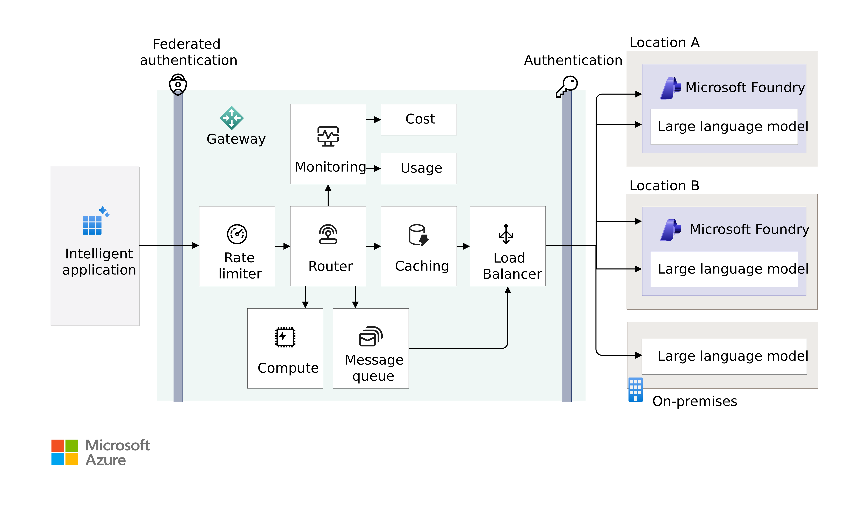
Original reference: gateway conceptual architecture
APPENDIX O1
ORIGINAL REFERENCE, UNCHANGED
Source: 38_foundry-gateway-conceptual-architecture.png in the GTM repository · Microsoft page: link
Conceptual functions; queuing and compute may need services beyond one API Management tier.
CIS Infra · AI Gateway Implementation · 11 Oct 2026 · Working proposal, not approved terms
Appendix index
41
Notes:
Original diagram from the user repository, embedded unchanged at source resolution and not stretched beyond its native size. Repository: https://github.com/upendra25312/AI-Foundry-GTM-offering-/blob/main/architectures/38_foundry-gateway-conceptual-architecture.png
Editable Visio: https://github.com/upendra25312/AI-Foundry-GTM-offering-/blob/main/architectures/12_foundry-gateway-conceptual-architecture.vsdx
Microsoft source: https://learn.microsoft.com/en-us/azure/architecture/ai-ml/guide/azure-openai-gateway-guide
Conceptual functions; queuing and compute may need services beyond one API Management tier.
Status: proposed offering for internal leadership review. No Cognizant approval, customer evidence, staffing commitment, rate card or verified quote is implied. Illustrative and synthetic figures are labelled as such. All money in USD. Font: Arial substituted for Gellix (not available). Azure icons: official Microsoft Azure Architecture Icons (V24 set, via az-icons.com and the icons embedded in the baseline decks), unmodified SVG with PNG fallback. Rendered and checked as PDF previews; not opened in desktop PowerPoint.

Slide 42
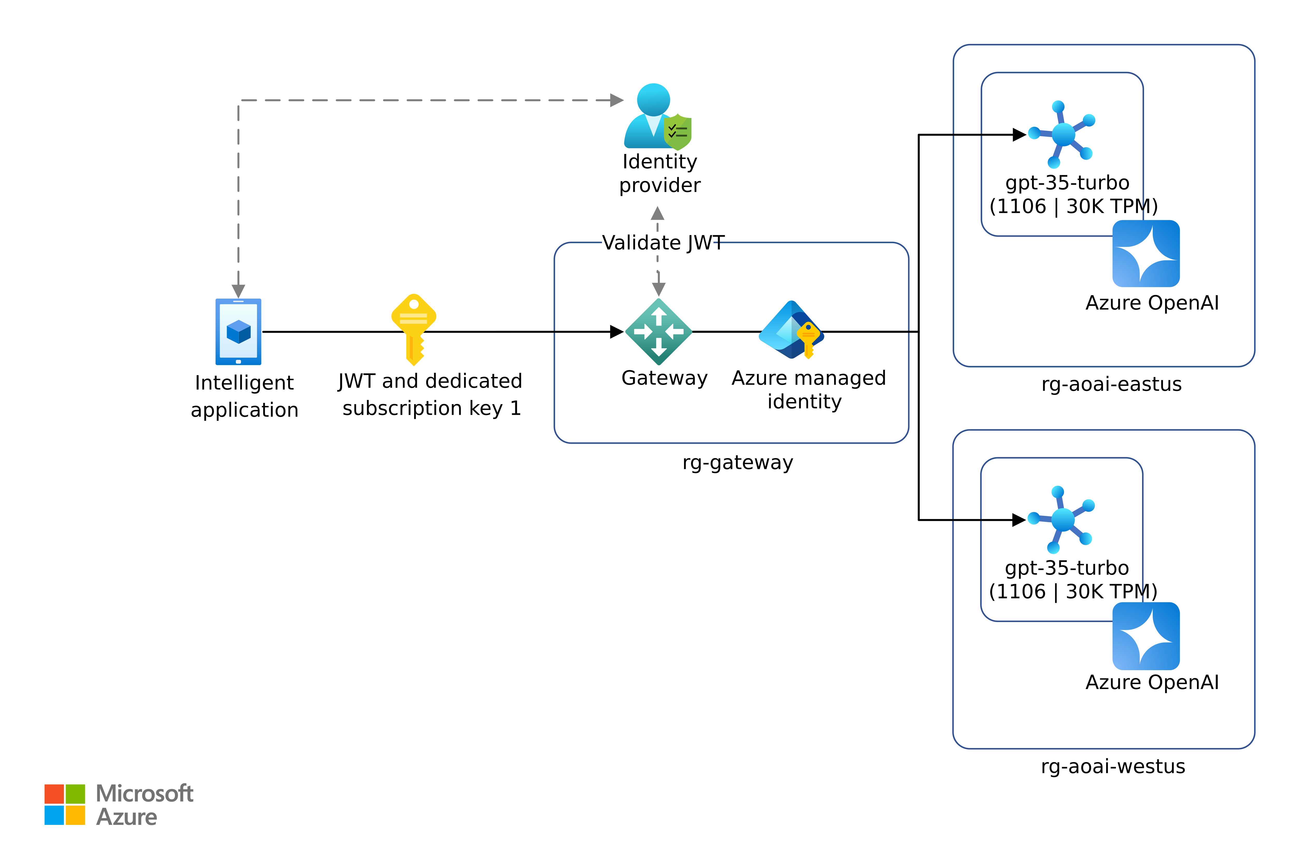
Historical reference: legacy identity diagram
APPENDIX O2
HISTORICAL, LEGACY LABELS
Source: 44_azure-openai-gateway-identity-solution-combined.png in the GTM repository · Microsoft page: link
HISTORICAL: legacy gpt-35-turbo and Azure OpenAI labels. Do not use in proposals; use appendix A3.
CIS Infra · AI Gateway Implementation · 11 Oct 2026 · Working proposal, not approved terms
Appendix index
42
Notes:
Original diagram from the user repository, embedded unchanged at source resolution and not stretched beyond its native size. Repository: https://github.com/upendra25312/AI-Foundry-GTM-offering-/blob/main/architectures/44_azure-openai-gateway-identity-solution-combined.png
Editable Visio: https://github.com/upendra25312/AI-Foundry-GTM-offering-/blob/main/architectures/14_azure-openai-authentication.vsdx
Microsoft source: https://learn.microsoft.com/en-us/azure/architecture/ai-ml/guide/azure-openai-gateway-custom-authentication
HISTORICAL: legacy gpt-35-turbo and Azure OpenAI labels. Do not use in proposals; use appendix A3.
Status: proposed offering for internal leadership review. No Cognizant approval, customer evidence, staffing commitment, rate card or verified quote is implied. Illustrative and synthetic figures are labelled as such. All money in USD. Font: Arial substituted for Gellix (not available). Azure icons: official Microsoft Azure Architecture Icons (V24 set, via az-icons.com and the icons embedded in the baseline decks), unmodified SVG with PNG fallback. Rendered and checked as PDF previews; not opened in desktop PowerPoint.

Slide 43
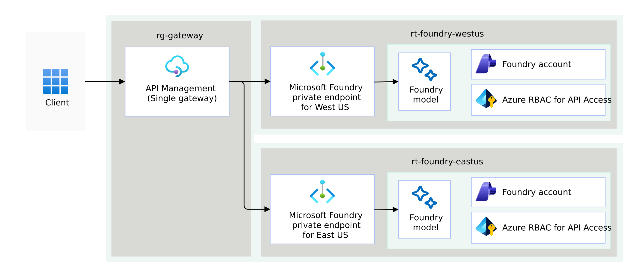
Original reference: one gateway, regional backends
APPENDIX O3
ORIGINAL REFERENCE, UNCHANGED
Source: 20_multiple-regions-api-management-single-after.png in the GTM repository · Microsoft page: link
Source labels "rt-foundry-westus" appear to mean resource group; backend failover keeps one gateway failure domain.
CIS Infra · AI Gateway Implementation · 11 Oct 2026 · Working proposal, not approved terms
Appendix index
43
Notes:
Original diagram from the user repository, embedded unchanged at source resolution and not stretched beyond its native size. Repository: https://github.com/upendra25312/AI-Foundry-GTM-offering-/blob/main/architectures/20_multiple-regions-api-management-single-after.png
Microsoft source: https://learn.microsoft.com/en-us/azure/architecture/ai-ml/guide/azure-openai-gateway-guide
Source labels "rt-foundry-westus" appear to mean resource group; backend failover keeps one gateway failure domain.
Status: proposed offering for internal leadership review. No Cognizant approval, customer evidence, staffing commitment, rate card or verified quote is implied. Illustrative and synthetic figures are labelled as such. All money in USD. Font: Arial substituted for Gellix (not available). Azure icons: official Microsoft Azure Architecture Icons (V24 set, via az-icons.com and the icons embedded in the baseline decks), unmodified SVG with PNG fallback. Rendered and checked as PDF previews; not opened in desktop PowerPoint.

Slide 44
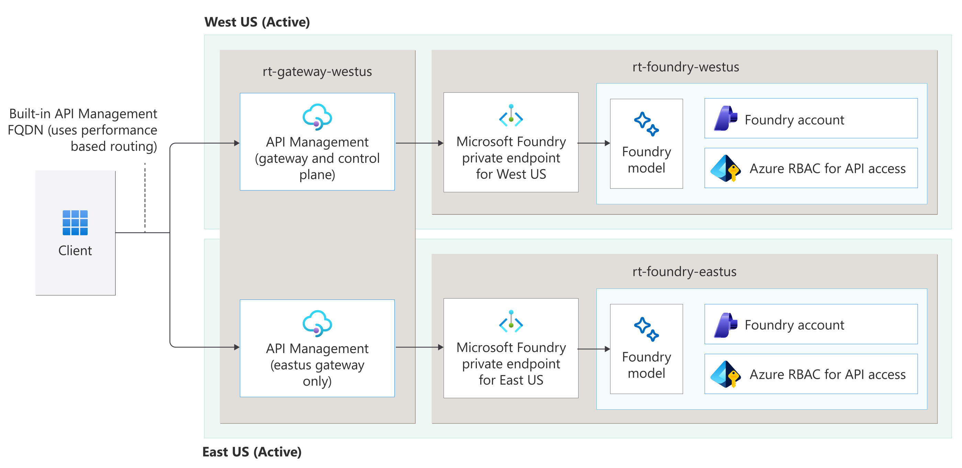
Original reference: multi-region gateway
APPENDIX O4
ORIGINAL REFERENCE, UNCHANGED
Source: 21_multiple-regions-api-management-multiple-after.png in the GTM repository · Microsoft page: link
Built-in multi-region API Management needs Premium (classic).
CIS Infra · AI Gateway Implementation · 11 Oct 2026 · Working proposal, not approved terms
Appendix index
44
Notes:
Original diagram from the user repository, embedded unchanged at source resolution and not stretched beyond its native size. Repository: https://github.com/upendra25312/AI-Foundry-GTM-offering-/blob/main/architectures/21_multiple-regions-api-management-multiple-after.png
Microsoft source: https://learn.microsoft.com/en-us/azure/architecture/ai-ml/guide/azure-openai-gateway-guide
Built-in multi-region API Management needs Premium (classic).
Status: proposed offering for internal leadership review. No Cognizant approval, customer evidence, staffing commitment, rate card or verified quote is implied. Illustrative and synthetic figures are labelled as such. All money in USD. Font: Arial substituted for Gellix (not available). Azure icons: official Microsoft Azure Architecture Icons (V24 set, via az-icons.com and the icons embedded in the baseline decks), unmodified SVG with PNG fallback. Rendered and checked as PDF previews; not opened in desktop PowerPoint.

Slide 45
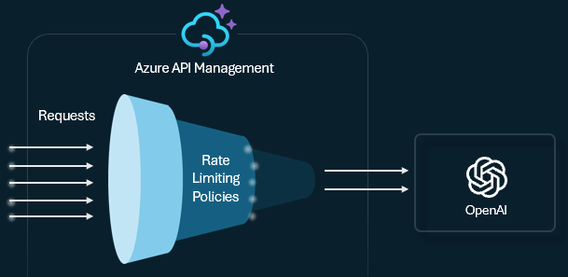
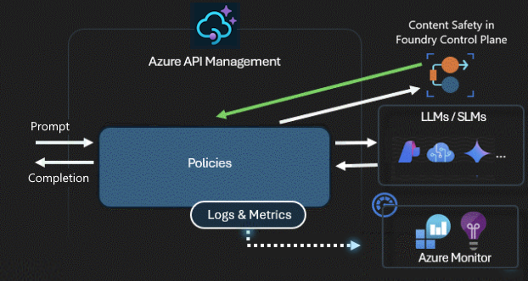
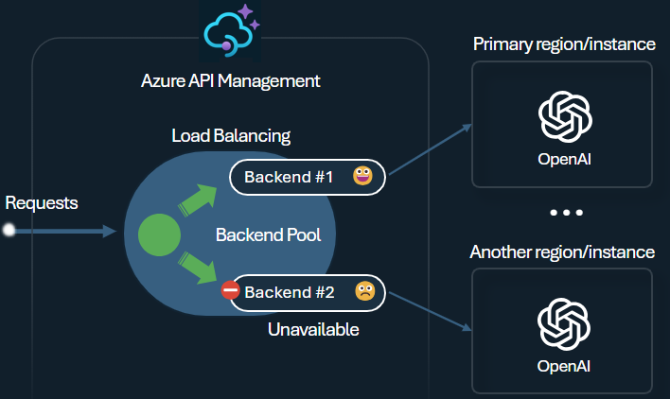
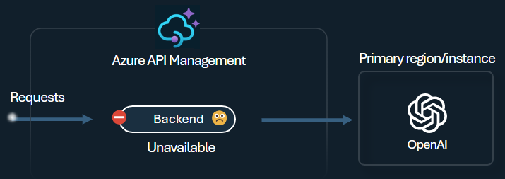
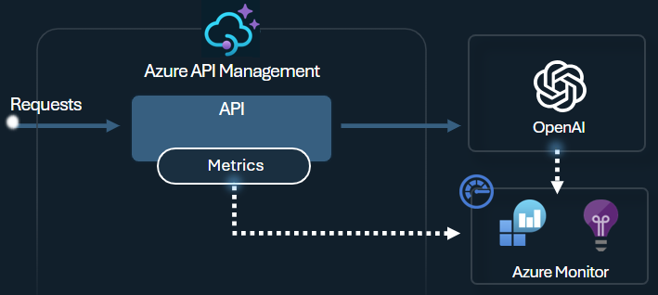
Low-resolution source images kept for traceability
APPENDIX O5
ORIGINALS, NOT FOR PRESENTATION
29_token-rate-limiting.png
31_content-safety.png
32_backend-load-balancing.png
Rebuilt as editable diagrams with official Azure icons: A5, A8, A9, A11, A13.
33_backend-circuit-breaker.png
34_emit-token-metrics.png
CIS Infra · AI Gateway Implementation · 11 Oct 2026 · Working proposal, not approved terms
Appendix index
45
Notes:
Five source PNGs (609 to 715 px wide, dark theme, third-party OpenAI logo) are kept only for traceability and shown at or below native size. Rebuilt editable versions: A5 (29), A11 (31), A8 (32), A9 (33), A13 (34). Sources: https://github.com/upendra25312/AI-Foundry-GTM-offering-/blob/main/architectures/29_token-rate-limiting.png, https://github.com/upendra25312/AI-Foundry-GTM-offering-/blob/main/architectures/31_content-safety.png, https://github.com/upendra25312/AI-Foundry-GTM-offering-/blob/main/architectures/32_backend-load-balancing.png, https://github.com/upendra25312/AI-Foundry-GTM-offering-/blob/main/architectures/33_backend-circuit-breaker.png, https://github.com/upendra25312/AI-Foundry-GTM-offering-/blob/main/architectures/34_emit-token-metrics.png
Status: proposed offering for internal leadership review. No Cognizant approval, customer evidence, staffing commitment, rate card or verified quote is implied. Illustrative and synthetic figures are labelled as such. All money in USD. Font: Arial substituted for Gellix (not available). Azure icons: official Microsoft Azure Architecture Icons (V24 set, via az-icons.com and the icons embedded in the baseline decks), unmodified SVG with PNG fallback. Rendered and checked as PDF previews; not opened in desktop PowerPoint.

Slide 46
Sources and verification
APPENDIX S1
CHECKED 11 OCT 2026
AI gateway capabilities in API Management: https://learn.microsoft.com/en-us/azure/api-management/genai-gateway-capabilities
APIM llm-token-limit policy: https://learn.microsoft.com/en-us/azure/api-management/llm-token-limit-policy
APIM llm-content-safety policy: https://learn.microsoft.com/en-us/azure/api-management/llm-content-safety-policy
AI Gateway tier (preview) overview: https://learn.microsoft.com/en-us/azure/api-management/ai-gateway-overview
API Management feature comparison by tier: https://learn.microsoft.com/en-us/azure/api-management/api-management-features
API Management v2 tier region availability: https://learn.microsoft.com/en-us/azure/api-management/api-management-region-availability
Azure Retail Prices API: API Management, East US 2: https://prices.azure.com/api/retail/prices?$filter=serviceName eq 'API Management' and armRegionName eq 'eastus2'
Azure Retail Prices API: Azure OpenAI gpt-4.1, East US 2: https://prices.azure.com/api/retail/prices?$filter=productName eq 'Azure OpenAI' and armRegionName eq 'eastus2'
Provisioned throughput concepts: https://learn.microsoft.com/en-us/azure/foundry/openai/concepts/provisioned-throughput
Azure Retail Prices API: Log Analytics, East US 2: https://prices.azure.com/api/retail/prices?$filter=serviceName eq 'Log Analytics' and armRegionName eq 'eastus2'
Azure Architecture Icons (V24): https://learn.microsoft.com/en-us/azure/architecture/icons/
az-icons.com catalogue of official Azure icons (July 2026 set): https://az-icons.com/
Azure OpenAI gateway guide: https://learn.microsoft.com/en-us/azure/architecture/ai-ml/guide/azure-openai-gateway-guide
Gateway custom authentication: https://learn.microsoft.com/en-us/azure/architecture/ai-ml/guide/azure-openai-gateway-custom-authentication
CIS Infra · AI Gateway Implementation · 11 Oct 2026 · Working proposal, not approved terms
Appendix index
46
Notes:
Full source register (URL, date checked, product, deployment type, region, SKU, GA or preview status, limitations) is provided as a separate workbook. Links below are clickable in slideshow mode.
Status: proposed offering for internal leadership review. No Cognizant approval, customer evidence, staffing commitment, rate card or verified quote is implied. Illustrative and synthetic figures are labelled as such. All money in USD. Font: Arial substituted for Gellix (not available). Azure icons: official Microsoft Azure Architecture Icons (V24 set, via az-icons.com and the icons embedded in the baseline decks), unmodified SVG with PNG fallback. Rendered and checked as PDF previews; not opened in desktop PowerPoint.

