Slide 1

Azure Review Assistant: Accelerating Architecture Governance

Slide 2
The Architecture Review Challenge
60%
Average first Azure Landing Zone compliance gap requiring remediation
3-6 months
$1.2M+
Typical remediation cycle for unplanned architecture issues
Average annual cost of cloud misconfigurations per enterprise
Architecture decisions made without structured review create technical debt that becomes exponentially more expensive to remediate after production deployment

Slide 3
What Azure Review Assistant Delivers
Standard Mode (No sign-in)
1,300+ Best Practices
Browse 100+ Azure services and select stack components for immediate best-practice findings and regional availability signals
Export per-service checks as CSV or HTML for quick design-time risk assessment without authentication overhead
Validated checks across 15+ workload types and platforms
0-100 Scorecard
Weighted assessment with framework coverage
ARB Grade Mode (Sign-in required)
Upload SOW documents, design diagrams, IaC scripts, and spreadsheets for automated assessment across 11 frameworks including WAF, CAF, and ALZ Governance
Receive weighted scorecard with findings grounded in uploaded documents, Microsoft Learn remediation links, and human sign-off checkpoint before executive summary export
Board-Ready Exports
CSV, HTML, Markdown formats

Slide 4
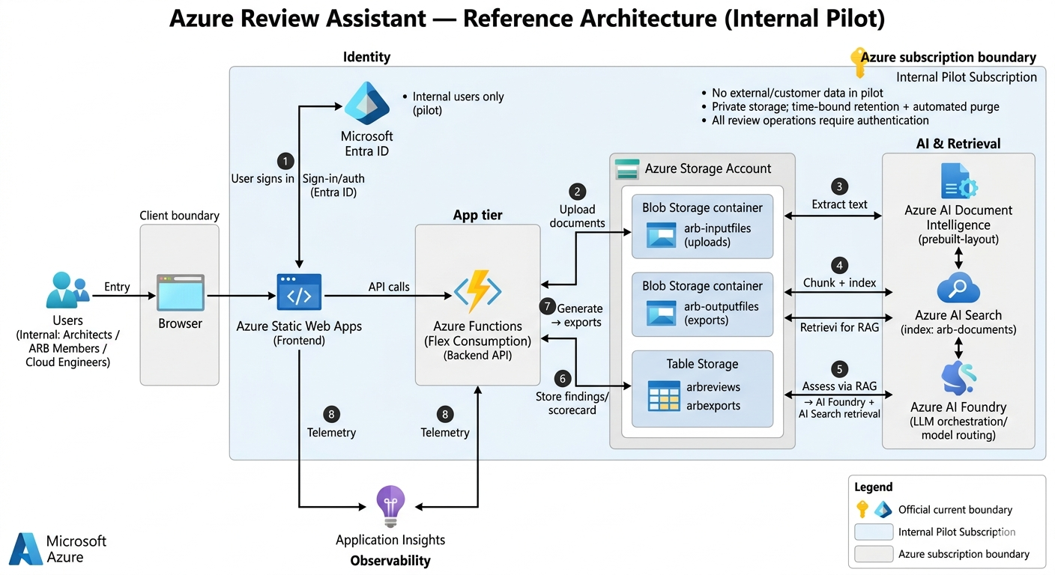

Slide 5
Proven Organizational Value
Early detection of architecture gaps prevents costly production incidents by finding security vulnerabilities, reliability weaknesses, and compliance violations before workload deployment
Standardized review processes accelerate delivery by reducing back-and-forth iterations, providing clear acceptance criteria, and enabling parallel workstream execution across teams
Continuous compliance monitoring through automated policy checks reduces audit burden and ensures ongoing adherence to organizational standards without manual intervention overhead

Slide 6

Executive Sponsorship
Identify sponsor, define vision, confirm budget and policy support
Organizational Adoption Framework
Adoption Team
Create cross-functional team and champion network
Strong leadership support sets up sharp vision and confirms budget for adoption
Cross-functional team and champions provide ongoing support beyond pilot
Embedding tool into daily workflow through process updates drives sustained usage
Feedback loop tracking usage metrics enables continuous refinement
Training & Support
Deliver comprehensive onboarding and ongoing enablement
Workflow Integration
Update processes and templates to prompt usage
Continuous Improvement
Monitor usage, measure impact, refine program

Slide 7
Recommended Rollout Strategy
Month 1-2
Conduct baseline assessment and create prioritized remediation roadmap
Month 3-4
Begin with Azure Landing Zone Review assessment to set up baseline readiness and find foundational gaps
Prioritize security and compliance findings first to set up minimum practical governance before cost optimization
Establish architecture review checkpoints at key decision gates including landing zone deployment and production promotion
Transition from manual reviews to automated Azure Resource Graph queries as organization matures and increases adoption
Pilot with 2-3 engagements and implement critical security and compliance fixes
Month 5-6
Deploy automated monitoring and integrate into architecture approval workflow
Ongoing
Execute quarterly maturity assessments and refine governance controls

Slide 8
Supporting Resources & References
Microsoft Learn and Microsoft Blog documentation supporting the claims and frameworks referenced in this presentation
Frameworks & Architecture
Azure Well-Architected Framework
learn.microsoft.com/en-us/azure/well-architected/
Well-Architected Review Assessment Tool
learn.microsoft.com/en-us/assessments/azure-architecture-review/
Microsoft Cloud Adoption Framework (CAF)
learn.microsoft.com/en-us/azure/cloud-adoption-framework/overview
Azure Landing Zones
learn.microsoft.com/en-us/azure/cloud-adoption-framework/ready/landing-zone/
Azure Architecture Best Practices
learn.microsoft.com/en-us/azure/architecture/best-practices/index-best-practices
Governance, Security & Operations
Azure Governance Design Area
learn.microsoft.com/en-us/azure/cloud-adoption-framework/ready/landing-zone/design-area/governance
Azure Resource Graph Overview
learn.microsoft.com/en-us/azure/governance/resource-graph/overview
Security Monitoring & Management in Azure
learn.microsoft.com/en-us/azure/security/fundamentals/management-monitoring-overview
Monitor Cloud Governance
learn.microsoft.com/en-us/azure/cloud-adoption-framework/govern/monitor-cloud-governance
Introducing Azure Well-Architected Framework (Blog)
azure.microsoft.com/en-us/blog/introducing-the-microsoft-azure-wellarchitected-framework/

