Slide 1
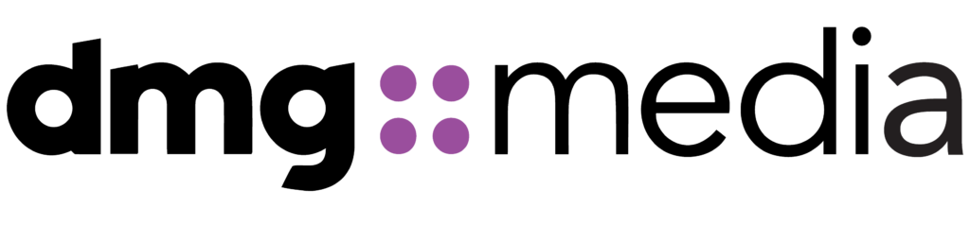
Cloud Readiness Assessment – Part 1
Platform Direction & Path Forward
April 2026
Scott Beckford
Senior Consulting Cloud Architect

Slide 2
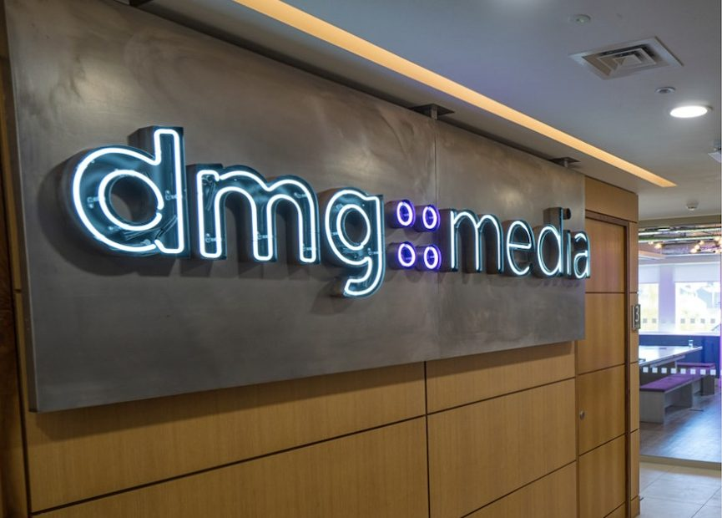
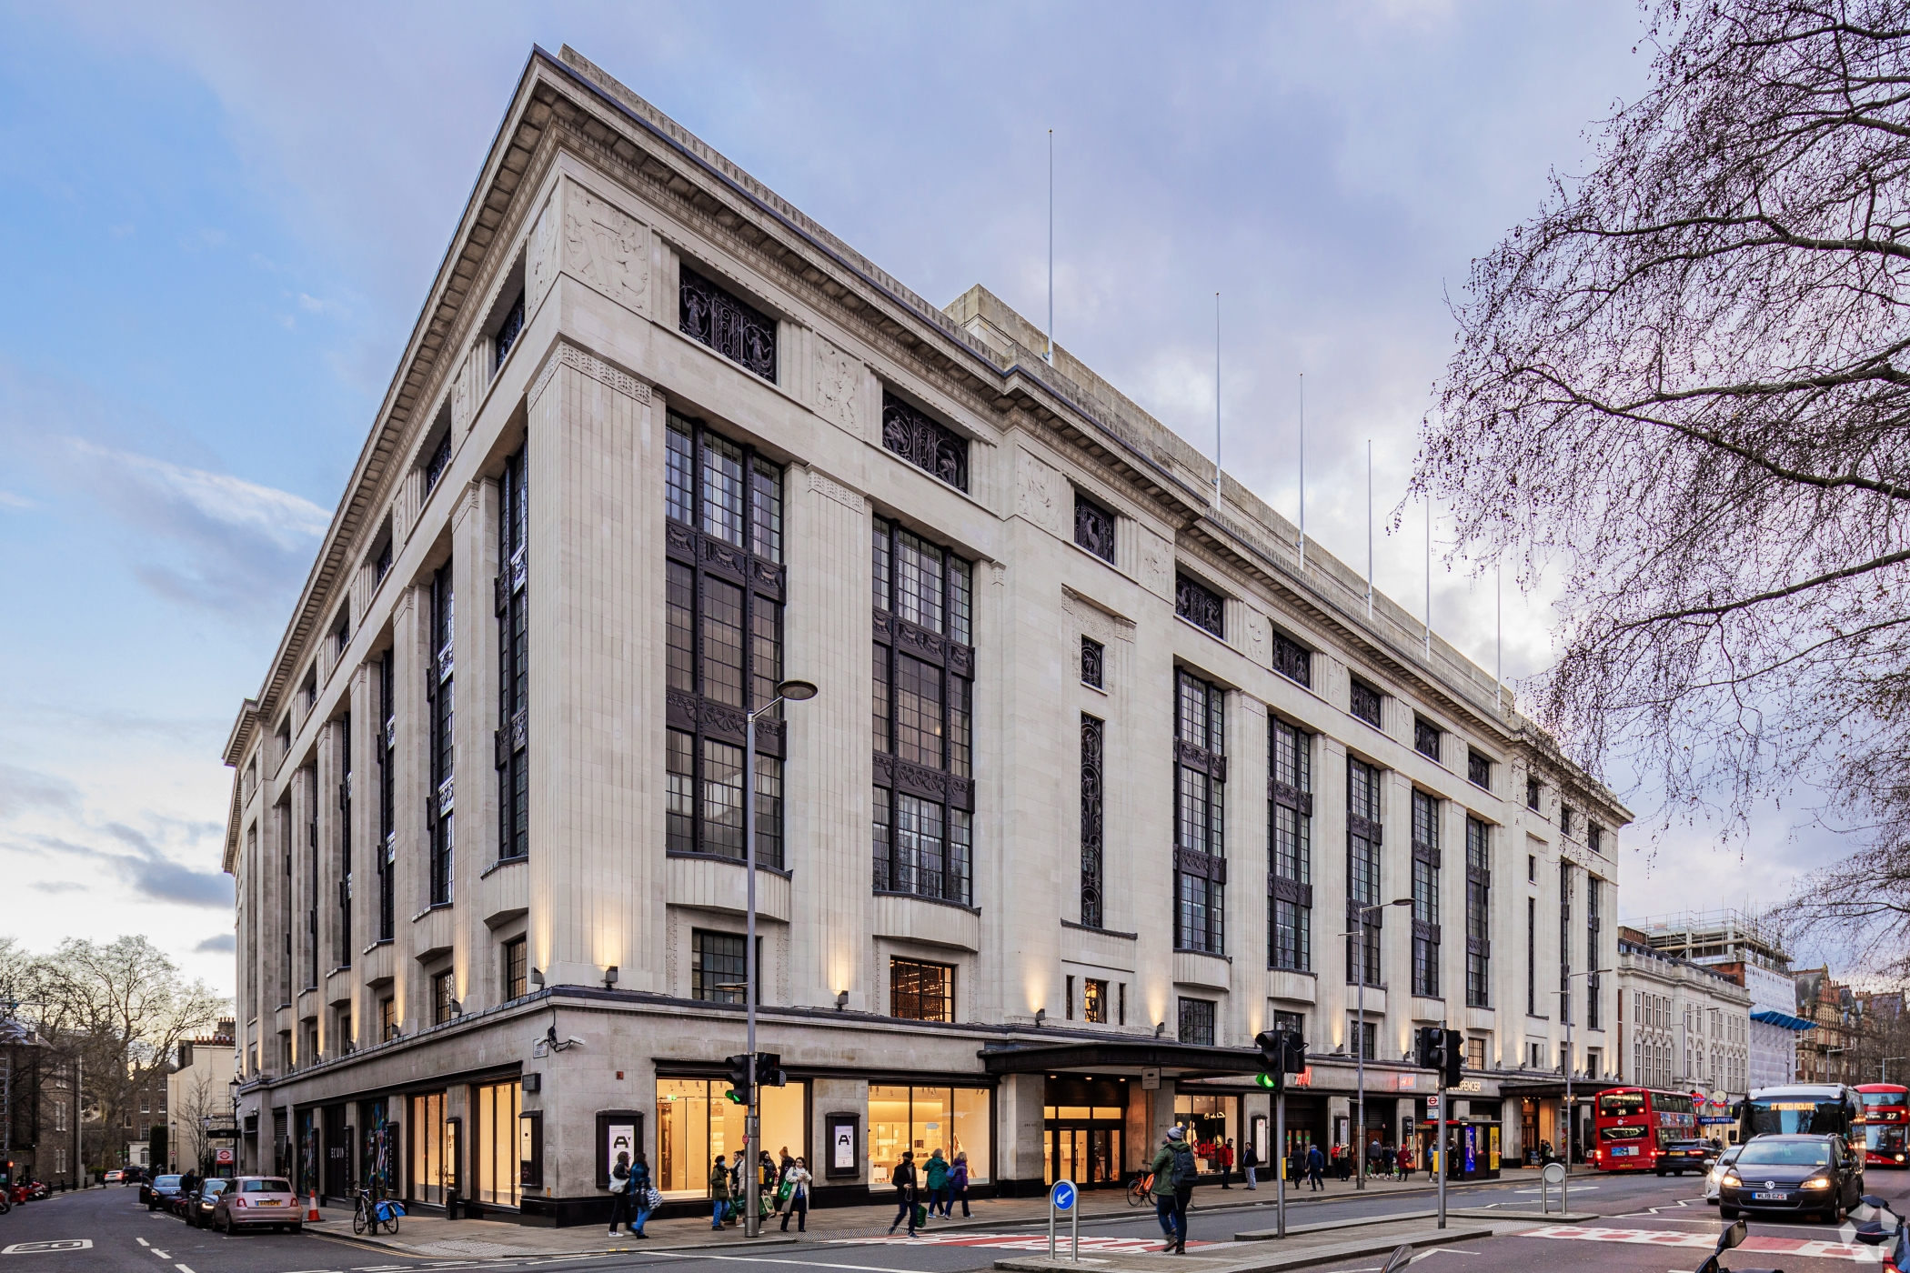
# | Agenda Item | Detail | Duration | Start | Finish
1 | Executive Summary | Key findings Scope and recommendation up front | 15 min | 0930 | 0945
2 | Why Cloud? Why Now? | Business drivers and case for acting now | 30 min | 0945 | 1015
3 | Your Estate | Discovery applications databases Workshops and gaps | 30 min | 1015 | 1045
4 | Cost Comparison | Methodology comparison Oracle paths and Complete View | 30 min | 1045 | 1115
5 | BREAK |  | 15 min | 1115 | 1130
6 | Business & Application Fit | Technical constraints cohorts and co-migration groups | 15 min | 1130 | 1145
7 | Hyperscaler Recommendation | Scoring Why AWS platform comparison and decision discussion | 30 min | 1145 | 1215
8 | Customer Readiness | Readiness scores and closing the gap | 10 min | 1215 | 1225
9 | Challenges & Opportunities | Paired challenges and quantified and strategic opportunities | 15 min | 1225 | 1240
10 | Moving Forward and Part 2 | Decisions needed Phase 2 scope timeline and hyperscaler guidance | 20 min | 1240 | 1300
11 | Working Discussion | Agree platform direction Oracle path and Phase 2 go/no-go | 30 min | 1300 | 1330

Slide 3
Executive Summary

Slide 4

What this assessment covers
What this assessment does
Provides an evidence‑based view of cloud suitability for the in‑scope estate
Compares AWS, Azure, and GCP using the same source data and live pricing
Identifies material technical constraints, cost drivers, and readiness gaps
Reaches a primary platform recommendation
What this assessment deliberately does not do
Estimate migration execution cost or a Year‑1 financial outcome
Produce a final application‑by‑application migration plan
Design a landing zone or target security architecture
Decide long‑term Oracle modernisation
Why those boundaries matter
These boundaries let us give you a clear platform direction today without forcing design, cost, or database decisions that belong later.
Detailed sequencing, design, and planning follow once platform direction is agreed.

Slide 5
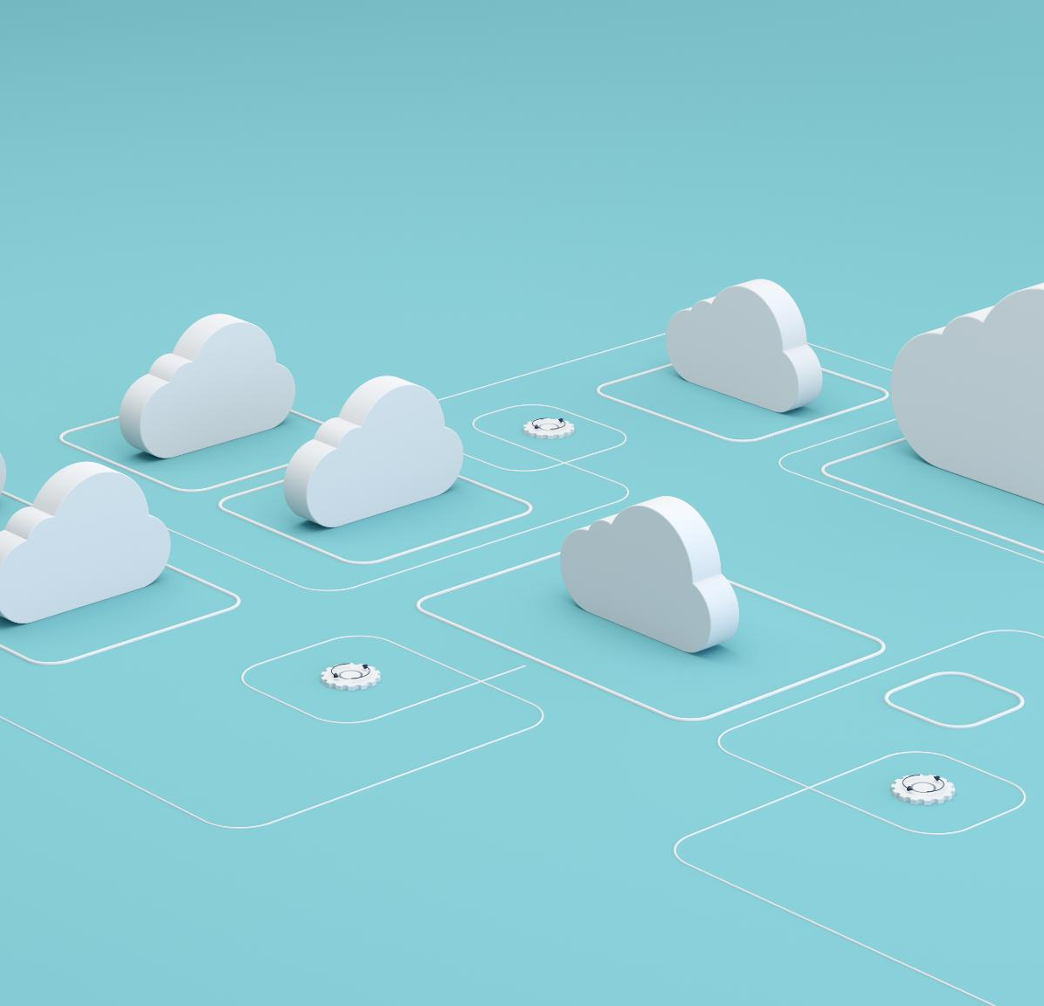
Scope Summary
3 datacentres Reading, Slough, Sydney
3,038 servers discovered and independently priced
39 applications profiled across 9 workshops
88 databases Oracle and SQL Server assessed
3 clouds compared using live pricing APIs
5 infrastructure types VMware, Proxmox, physical, appliance, cloud

Slide 6
Key Findings
Doing nothing is no longer a safe or cheap option
Datacentre leases, VMware licensing changes, and the Microsoft EA all come up for renewal within the next two years. If decisions are delayed, you still end up making commitments - just through renewals rather than by choice.
The evidence points to a clear primary cloud direction
When cost, technical constraints, and operating realities are considered together, AWS is the platform that best fits the estate. GCP is retained where it already delivers clear value, and Azure carries a material cost premium without a matching benefit.
Oracle is a major complexity, but not a blocker to deciding the platform
Oracle behaves broadly the same across all three clouds. It affects migration sequencing and risk, but it does not change which cloud makes sense. That work is deliberately handled in Part 2 rather than being forced now.
A defined next step is needed to remove the remaining uncertainty
Part 2 is the point where application groupings, landing zone design, and a realistic datacentre exit plan are confirmed. It turns assessment findings into a plan you can act on.

Slide 7
Why Cloud?
Why Now?

Slide 8
Cloud Migration Business Drivers - Summary
1. Standardisation + Simplification
Reduce complexity to scale operations and delivery speed
2. Productivity + Cost Optimisation
Remove low value work and create credible savings
3. Automation + Workflow Optimisation
Reduce toil and improve customer experience
NB: Enhanced Security & Data/AI analytical insights are an expected outcome of transformation, not necessarily a pure business driver.

Slide 9
Standardisation + Simplification
Driver # 1
Goal
Standardisation of Core Technology products across [Client] Business
Meet North Star growth targets across all brands
MOL – 1M Subscribers
Eliminate Shadow IT
Strategic Intent
Standardisation is a prerequisite for scalable growth
Platform sprawl increases cost, risk, and execution friction
Converge on a limited set of approved platforms and architectural patterns
Enforce security, compliance, and governance by design
Preserve innovation while eliminating unnecessary variation
Outcome
Simplified Target Operating Model (TOM)
Lower execution and operational risk
Faster, more predictable delivery of change
A scalable foundation that supports growth without proportional complexity
Reduce complexity to scale operations and delivery speed

Slide 10
Productivity + Cost Optimisation
Driver # 2
Goal
Removal of custom systems and processes providing low value
Replacement with pre-approved blueprints/templates
Reduce total cost of ownership while improving delivery velocity
Shift from fixed, capacity‑based cost models to demand‑aligned consumption
Strategic Intent
Translate cloud adoption into financial performance
Cloud only delivers value with active cost discipline
Inefficiency compounds rapidly at scale
Embed financial accountability into technology decision‑making
Outcome
Measurable cost optimisation and improved margin predictability
Clear visibility of spend by platform, product, and environment
Financial governance (FinOps) embedded into the operating model
Remove low value work and create credible savings

Slide 11
Automation + Workflow Optimisation
Driver # 3
Goal
Automate repeatable, high‑volume operational workflows
Adopt Self-service delivery model to improve customer service levels
Strategic intent
Manual processes limit growth and degrade customer experience
Automation is essential for enterprise‑scale cloud operations
Improve service consistency, resilience, and customer experience
Default to cloud‑native and managed services where appropriate
Outcome
Reduced operational and key‑person risk
Ability to scale revenue without linear cost growth
Business teams focused on value creation rather than administration
Reduce toil and improve customer experience

Slide 12
The case for acting now
Contracts converging DC leases, EA, Broadcom, Oracle all landing inside two years. Each renewal re-locks capital.
VMware position has changed Perpetual licences, expired support. No patches, no new hosts. VCF subscription is the only path forward.
Operational fragmentation limits growth 170 staff, 7 areas, different tooling and processes. No consistent control plane.
1M subscribers needs elastic infrastructure Fixed-capacity on-prem cannot scale for elections, breaking news, or subscriber growth without capital outlay.
What happens if you don't

Slide 13
Your Estate

Slide 14
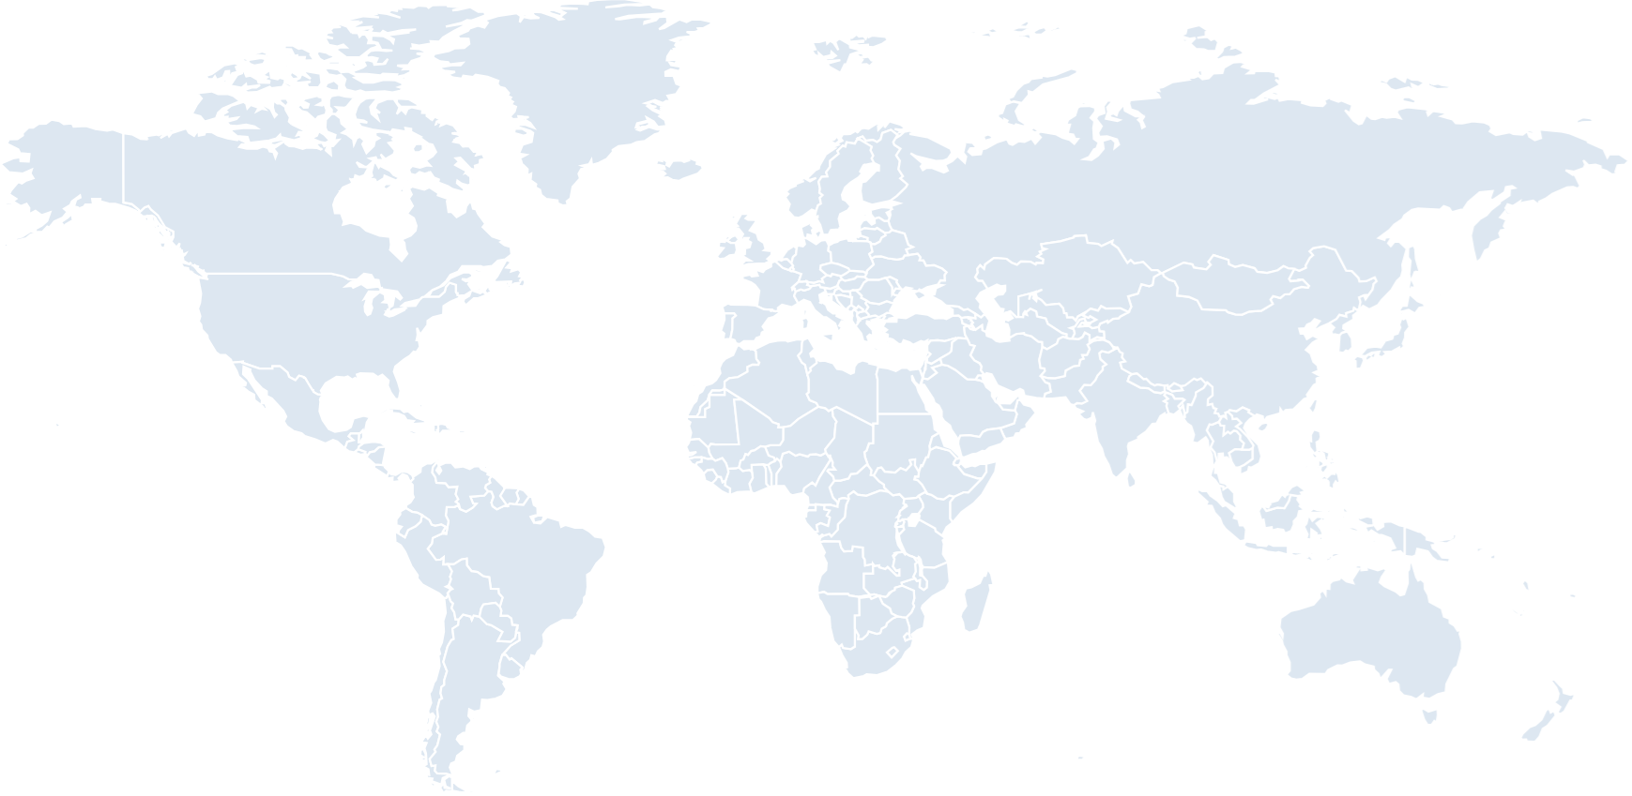
[Client] Global Presence
In Scope for this Assessment:
Reading, Slough, Sydney
Remainder Out of Scope
Carn, Glasgow
Dublin
Leicester, Manchester
London - Reading
London - Slough
Los Angeles
New York
Sydney
Notes:
Leceister, Manchester

Slide 15
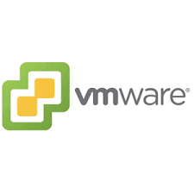
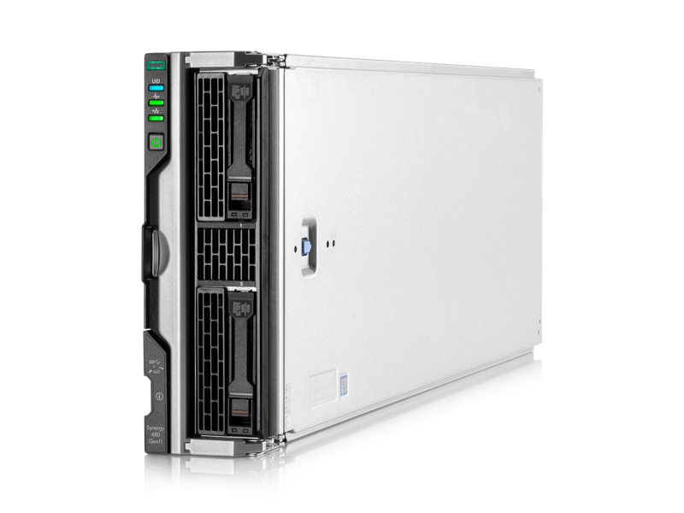
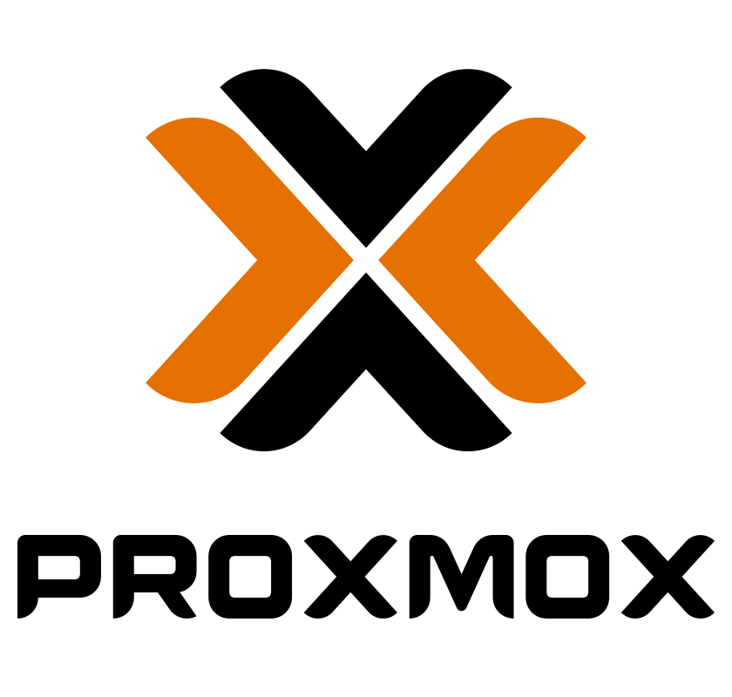

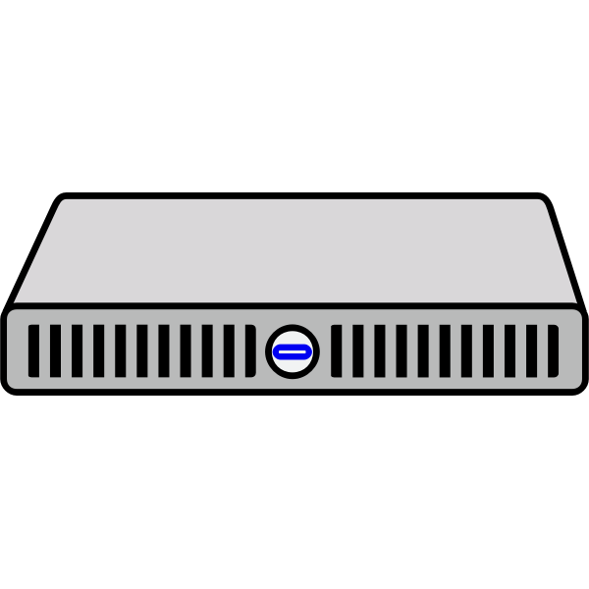

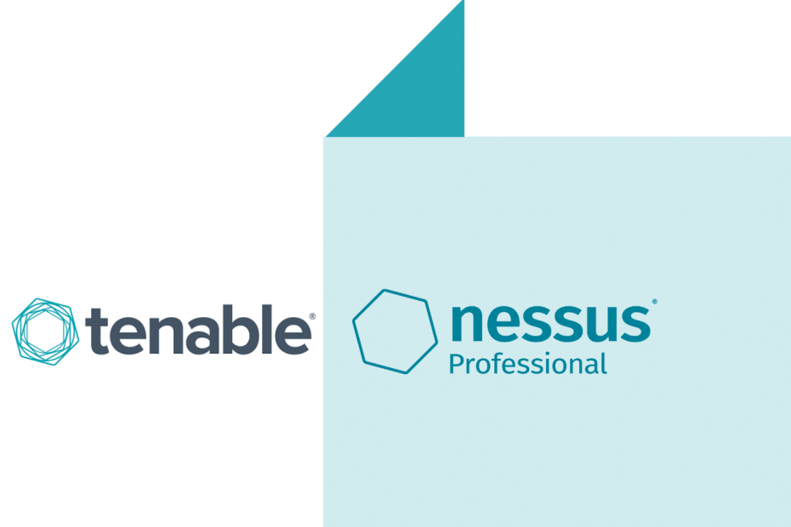
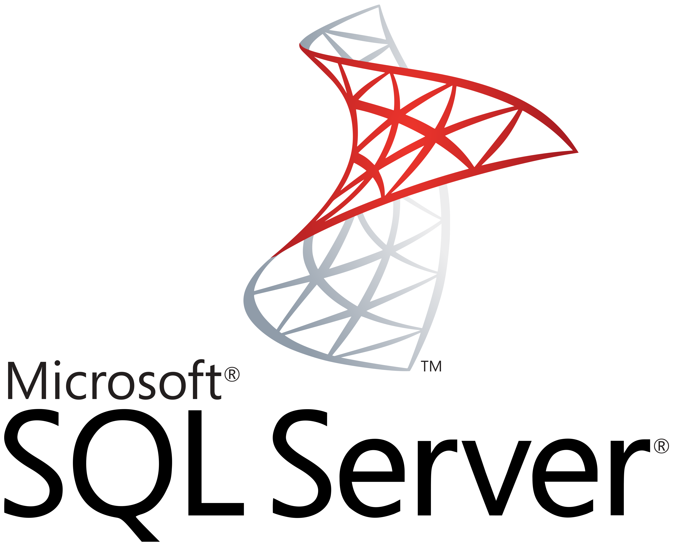

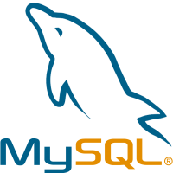







[Client] Inventory Scope – At a Glance
Virtual Appliances
Virtual DBServers
DBs on Physicals
Reading
MOL - Prod
6 x DL360
6 x 3par
6 x HPE 480 G11
No MOL proxmox
In Reading
4x
3x
5x
CHP – Prod
1 x DL360
1 x Primera
ANL proxmox
Reading – TEST ONLY
???
2x
9x
6 x Reading - prod
4x
Atex – Prod
1 x DL380
1 x Primera
Slough
51x
MOL - Prod + Int
8 x DL360
8 x 3par
6x
3x
MOL INT
CHP - Prod + Int
2 x DL360
2 x Primera
8x
???
12x
Atex – Prod
2 x DL380
2 x Primera
3 x Slough - non-prod
3 x Slough - prod
4x
Sydney
29x
4x
38x
3x
2x
38x
=========
3076 Assets

Slide 16
Application landscape
Mail Online: 2,206 servers (72.6%) 91 sub-components | Oracle at the centre | Dual ownership (CPO + CTO)
CHP: 146 servers (Oracle-backed, publishing operations)
WPS: 136 servers (tightly coupled to Mail Online, must co-migrate)
Atex: 109 servers (multicast constraint, business decision required)
RTA: 41 servers (significantly overprovisioned)
Remaining 29 applications: 400 servers combined (editorial tooling, shared services, retirement candidates)

Slide 17
Workshop findings
Mail Online is a distributed monolith Many sub-services, many dependencies, not independently releasable
Oracle is the centre of gravity MOL, Atex, CHP, Circnet all depend on Oracle. £650K/yr support.
Atex has a hard multicast constraint Cloud networks do not natively support multicast (except AWS Transit Gateway)
WPS and Mail Online must co-migrate Sustained Oracle connections to the B-cluster. Cannot be separated.
Sydney is independent 4 servers, flexible contract, natural early candidate and proof point

Slide 18
Discovery and data gaps
100% of in-scope servers discovered
97% TCO-grade data captured
9 of 9 application workshops completed
Custom automation built for 5 infrastructure types
No common credential mechanism, worked through it
MOL B-cluster: no Oracle DMA data (production primary, highest priority)
Network dependency mapping: 27.7% coverage (guest-level collection was the bottleneck)
Software inventory: 51.5% coverage
1,227 servers without VMware Tools (sized from provisioned spec, slightly conservative)

Slide 19
Cost Comparison

Slide 20
How we built the numbers
Same source data fed to all three clouds. No cloud got a different version of the estate.
Each cloud's own tool sized the workloads (Migration Center, Transform, Azure Migrate)
SKU audit of what each tool recommended and why
Re-priced against live APIs to neutralise tool-specific bias
Two pricing pillars: on-demand baseline and 3-year committed
Oracle modelled separately (three distinct paths, different mechanics per cloud)
Commercial layer separate (partner discounts and credits, not mixed into the baseline)
Methodology / Assumptions

Slide 21
Cost Comparison
TBC:
Backup
DB Costs
- Operations Costs?
- Migration Costs?
London Region | On Premise | AWS | Azure | GCP
PAYG (Monthly, GBP)
Compute |  | £ 228,907 | £ 228,410 | £ 196,025
Storage |  | £ 63,587 | £ 159,446 | £ 91,005
Licenses |  | £ 21,105 | £ 17,582 | £ 9,883
Network (5%) |  | £ 14,625 | £ 19,393 | £ 14,351
Total Monthly |  | £ 328,223 | £ 424,831 | £ 311,264
Total Annual - PAYG |  | £ 3,938,677 | £ 5,097,970 | £ 3,735,172
Credits |  | £ (984,669) | £ (41,000) | £ (1,120,575)
Total Annual (after credits) |  | £ 2,954,008 | £ 5.056.970 | £ 2,614,597
3 Year Committed (Monthly, GBP)
Total - Monthly |  | £ 190,285 | £ 274,881 | £ 186,974
Total - Annual | £ 3,636,342 | £ 2,283,419 | £ 3,298,566 | £ 2,243,685
Total - 3 Year Cumulative |  | £ 6,850,257 | £ 9,895,699 | £ 6,731,054

Slide 22
[Client] – On-Premise Costs
Category | Subcategory | Cost Item | Description / Scope | Vendor | Portability / Entitlements | Cost Type | Input Basis | Input Amount (GBP) | Dep. (yrs) | Annualized Cost (GBP)
Compute & Storage | Server Hardware | Server hardware costs (purchase/lease) | Purchase/lease costs; include depreciation schedule and refresh cycle | TBD | TBD | Capex | Capex | £1.262.234 | 5 | £252.447
Compute & Storage | Hardware Maintenance | Hardware maintenance | Annual maintenance/support for server hardware | TBD | N/A | Opex | Annual | £5.000 |  | £5.000
Compute & Storage | Storage | Storage (SAN/NAS + backup) | SAN/NAS + backup infrastructure (capex + support) | TBD | TBD | Capex | Capex | £1.451.571 | 5 | £290.314
Compute & Storage | Virtualization | VMware licensing (vSphere/vCenter/vSAN) | Include vSphere, vCenter, vSAN (if applicable) | VMware | TBD | Opex | Annual | £0 |  | £0
Software Licensing | Operating System | Windows Server licenses | Windows Server licensing for on-prem infrastructure | Microsoft | Software Assurance / BYOL TBD | Opex | Annual | £136.825 |  | £136.825
Software Licensing | Operating System | Linux (RHEL/SUSE) licenses | If applicable: RHEL/SUSE subscriptions | Red Hat/SUSE | BYOL not typical | Opex | Annual | £71.000 |  | £71.000
Software Licensing | Operating System | Ubuntu patching / support | Landscape/Ubuntu support and patching tools | Canonical/TBD | TBD | Opex | Annual | £20.000 |  | £20.000
Software Licensing | Database | SQL Server licenses | SQL Server licensing (core/CAL as applicable) | Microsoft | SA / BYOL TBD | Opex | Annual | £118.968 |  | £118.968
Software Licensing | Database | Oracle Support/Maintenance | Per-core/per-socket details help | Oracle | BYOL terms TBD | Opex | Annual | £650.000 |  | £650.000
Operations | Database | Database SUpport | NCS SUPPORT | NCS | N/A | Opex | Annual | £568.000 |  | £568.000
Software Licensing | Database | MySQL Enterprise / support | MySQL enterprise subscription/support if used | MySQL | BYOL TBD | Opex | Annual | £0 |  | £0
Software Licensing | Security / Other | Tenable / Guardicore (if applicable) | Any other commercial software tied to infrastructure - Per Server! | Tenable/Guardicore | Portability TBD | Opex | Annual | £443.888 |  | £443.888
Software Licensing | Other | Other commercial infra software (none yet) | Placeholder for any additional commercial infra software | N/A | N/A | Opex | Annual |  |  | £0
Facilities & Network | Colocation / Facility | Colocation / facility costs - Reading | Power, cooling, rack space; per site if different (MOL vs ANL) | Centre Square | N/A | Opex | Annual | £386.400 |  | £386.400
Facilities & Network | Colocation / Facility | Colocation / facility costs - Slough | Power, cooling, rack space; per site if different (MOL vs ANL) | Digital Realty | N/A | Opex | Annual | £338.300 |  | £338.300
Facilities & Network | Colocation / Facility | Colocation / facility costs - Sydney | Power, cooling, rack space; per site if different (MOL vs ANL) | Equinix | N/A | Opex | Annual | £40.000 |  | £40.000
Facilities & Network | Network | Interconnect between sites | Bandwidth / interconnect costs between sites | TBD | N/A | Opex | Monthly | £1.600 |  | £19.200
Facilities & Network | Internet | WAN/Internet egress costs | Internet connectivity (egress) costs | ISP/TBD | N/A | Opex | Monthly | £8.000 |  | £96.000
Operations | Vendor Support | Vendor support contracts | All vendor support contracts for infra | TBD | N/A | Opex | Annual | £20.000 |  | £20.000
Operations | People | Infra management FTE | IT staff dedicated to physical infra management (approx FTE) | Internal | N/A | Opex | Annual | £100.000 |  | £100.000
Contracts & Commitments | Lock-ins | Existing contract lock-ins | VMware EA, hardware leases, colo agreements and end dates | TBD | N/A | Opex | Annual | £0 |  | £0
Contracts & Commitments | Refresh | Planned hardware refreshes (next 12-24 months) | Planned capex refreshes in next 12-24 months | TBD | N/A | Capex | Capex | £200.000
Contracts & Commitments | Support | Microsoft Support (MS Family) | Support that may need replacing if moving from MS EA | Bluesource (Accredited Partner) | TBD | Opex | Annual | £80.000 |  | £80.000
Total |  |  |  |  |  |  |  | £ 5.901.786 |  | £ 3.636.342
Notes:
As you shared with us

Slide 23
Cloud Infra Cost Comparison – PAYG vs. 3 Year Commitment
Key Points:
AWS + GCP pricing are very closely matched (2%)
We priced independent of the Hyperscaler offerings
Same source data was fed to all three hyperscaler tools
3038 servers
14,165 vCPUs
53,758 GB Memory
1,261,841 Gb storage
We focused on agnostic “apples-to-apples” comparison
GCP tooling can create custom sizing (mem)
Our numbers provide a strong baseline for a Phase 1 independent comparison
Generated: 15 April 2026 19:51
Servers in scope: 3,038 | Currency: GBP | FX Rate: 1 USD = 0.755 GBP
All pricing API-verified: AWS Price List API | GCP Billing Catalog API | Azure Retail Prices API
PAYG Component Breakdown (Monthly, GBP)
 |  | London
 | AWS | GCP | Azure
Compute | 228.907 | 196.025 | 228.410
Storage | 63.587 | 91.005 | 159.446
OS License | 21.105 | 9.883 | 17.582
Network (5%) | 14.625 | 14.351 | 19.393
Total - Monthly | 328.223 | 311.264 | 424.831
Annual (GBP) | 3.938.677 | 3.735.172 | 5.097.970
3yr Commitment Pricing Breakdown (GBP)
 |  | London
 | AWS | GCP | Azure
Total - Monthly | 190.285 | 186.974 | 274.881
Annual | 2.283.419 | 2.243.685 | 3.298.566
Savings % | 42,0% | 39,9% | 35,3%
Methodology:
All pricing verified via official cloud APIs (GCP Billing Catalog, AWS Price List, Azure Retail Prices)
GCP and Azure rates in native GBP from API. AWS rates in USD, converted at corporate FX rate above.
PAYG = on-demand. 3yr = GCP CUD / AWS 3yr Standard NURI (per-instance from API) / Azure 3yr RI
Storage: GCP Balanced PD/Hyperdisk (SSD), AWS gp3 (per-region from API), Azure Premium SSD
Network: 5% of (compute + storage) - standard cloud estimate estimate
OS licensing: Windows/RHEL at PAYG surcharge rates. SQL Server and Oracle licensing in separate workbook.
Instance mapping: GCP Migration Center, AWS Transform, Azure Migrate - all architect-assigned
All 3 clouds sized from the same source dataset (GCP Migration Center export, 3,038 servers in scope)
Not included: backup/DR, management tooling, migration execution, double-run overlap, egress, headcount, VMware savings
Notes:
On a 3-year committed basis in London, GCP is the cheapest by approximately 2% over AWS.
What does “apples-to-apples” mean?
The same source data (server specifications, memory, storage, operating system) was fed to all three hyperscalers .
Block storage (SSD class, IOPS-matched across clouds at 80,000 IOPS per disk where needed) – Explaining Large Azure Storage Variance
Ensured that burstable VM families were excluded across all three clouds by team agreement as not suitable for production workloads.
Consistent “Comfort factor” and “Utilisation percentile” applied
Even then, the tooling has differences. The cost spread reflects how each cloud's own assessment tool sized the same source workload.
GCP Migration Center produced the smallest vCPU allocation at 32% of source, using custom instance shapes down to 1 vCPU. This drives their licensing costs down as cores are licensed.
AWS Transform sat at 49% vCPU allocation.
Azure Migrate sat at 53%, typically assigning F2s_v2 (2 vCPU minimum) across most of the estate because its sizing algorithm did not generate 1-vCPU SKUs for production workloads and F-series SKU availability with 3-year Reserved Instance coverage in London shapes the options available.
Methodology
Data normalisation. The same source data (server specifications, memory, storage, operating system) was fed to all three hyperscalers .
Architectural benchmarking. Each cloud's own sizing tool (GCP Migration Center, AWS Transform, Azure Migrate) produced right-sized target configurations. The native tools did the sizing. Their outputs are the starting point, not the final answer.
AI logic audit. We audited the SKU mappings each tool produced. Different tools use different optimisation logic. We checked what each tool assumed and why.
Bias mitigation. To remove tool-specific bias, we re-priced every recommended SKU against the official cloud pricing APIs (AWS Price List API, Azure Retail Prices API, GCP Billing Catalog API). This produced a validated, normalised view. The provider-native outputs are kept for internal validation only.
Two pricing pillars. We report on-demand (the clean baseline) and 3-year committed (the realistic commitment for an organization of your scale). One-year commitments are deprioritised as a less attractive option.
Partner and commercial pricing is a separate layer. This sits on top of the normalised baseline. Where commercial offers are not yet received, the layer is flagged [PENDING ] rather than inferred.
Oracle scenarios are modelled separately. Oracle has three fundamentally different migration paths, each with different pricing mechanics. These are separated rather than averaged into compute cost.
This methodology is what gives the figures credibility when each cloud provider presents their own view directly. Your technical panel can verify any number against a specific API response and data normalisation step.

Slide 24
Cost Comparison - TCO
 | GCP (GBP/mo) | AWS (GBP/mo) | Azure (GBP/mo)
BASELINE (3yr Committed, London, Monthly)
Compute + Storage + OS + Network | 186.974 | 190.285 | 274.881
WINDOWS BYOL (234 servers, requires SA)
Net saving | -7.220 | -8.605 | -17.529
Net of Sole Tenant (GCP) and Dedicated Host (AWS) overhead. Azure AHB has no infrastructure overhead.
SQL SERVER (33 instances, 132 cores)
License surcharge (included in total below) | 15.284 | 14.286 | 14.286
BYOL saving (nets to zero if SA confirmed) | -15.284 | -14.286 | -14.286
Surcharge included in total. BYOL offset requires client SA confirmation.
ORACLE DATABASE (6 servers, 24 proc licenses, support GBP 650K/yr)
Option A: Oracle Exadata@Cloud (keep RAC, keep Oracle) | 42.909 | 42.909 | 42.909
All three clouds offer Exadata@Cloud in London (GA).
STORAGE TIERING (336 TiB non-prod, SSD to HDD)
Non-prod storage saving | -18.603 | -10.261 | -9.964
COMPLETE VIEW (Baseline + Oracle Exadata + Savings)
Includes: compute, storage, OS, 5% network placeholder (inter-zone/region), Oracle (Option A Exadata@Cloud), Oracle support retained under BYOL, Windows + SQL Server BYOL (SA assumed). SQL surcharge is not added because SA is assumed in place.
Baseline 3yr | 186.974 | 190.285 | 274.881
- Windows BYOL (SA assumed) | -7.220 | -8.605 | -17.529
- Storage tiering (non-prod to HDD) | -18.603 | -10.261 | -9.964
+ Oracle Option A (Exadata@Cloud) | 42.909 | 42.909 | 42.909
+ Oracle support (GBP 650K/yr, retained under BYOL) | 54.167 | 54.167 | 54.167
COMPLETE VIEW TOTAL (Monthly) | 258.227 | 268.495 | 344.464
COMPLETE VIEW TOTAL (Annual) | 3.098.724 | 3.221.940 | 4.133.568
WITH INDICATIVE EGRESS (100TB/mo) - illustrative, Phase 2 to quantify actual volume
+ Internet egress at 100TB/mo | 6.274 | 5.889 | 4.832
COMPLETE VIEW + EGRESS (Monthly) | 264.501 | 274.384 | 349.296
COMPLETE VIEW + EGRESS (Annual) | 3.174.012 | 3.292.608 | 4.191.552
Key Points:
Windows BYOL – 2019 Only vs AHB
SQL ???
Notes:
Egress - API-verified rates: AWS 0-10/10-50/50-150TB = $0.09/$0.085/$0.07 per GB | Azure (Internet) = $0.08/$0.065/$0.06 per GB | GCP Premium = $0.12 first 1TB, $0.11 to 10TB, $0.08 above

Slide 25

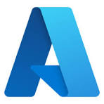

Hyperscaler Funding Summary
Total cloud spend (PAYG yearly) | $ 3,024,396 | $ 4,368,962 | $ 2,243,685
Total Partner Payment (A) (discount against Rackspace Fees) | $ 1,757,600 | - | $ 1,080,498
Total Cloud Credits (B) (discount against [Client]’s consumption) | $ 756,099 | - | $ 745,192
Total funding in USD (A+B) | $ 2,513,699 | - | $ 1,825,690
Total funding in GBP* | GBP 1,897,842 |  | GBP 1,378,396
AZURE NUMBERS TBD
*FX Rate 1 USD = 0.755 GBP

Slide 26
Business and Application Fit

Slide 27
Technical constraints
Atex multicast Prestige clustering requires multicast for node discovery. AWS supports natively via Transit Gateway. GCP and Azure do not. Vendor engagement on unicast is a Phase 2 action.
Oracle RAC Shared storage, cluster interconnect. Exadata@Cloud available on all three platforms in London. Same OCI pricing. This is not a differentiator between clouds.
SQL Server Datacenter BYOL with Software Assurance. Azure AHB is simplest. AWS and GCP require Dedicated Hosts or Sole Tenant. Windows Server 2022 BYOL blocked on AWS and GCP (Listed Provider rules).
Three constraints that shape the approach

Slide 28
Migration cohorts
Cohort 0: Foundation | 5 apps, 95 servers AD, monitoring, security, config management. Must exist before anything migrates.
Cohort 1: Quick wins | 13 apps, 63 servers Independent, well-discovered, clear cloud fit. Early value and operational experience.
Cohort 2: Planned | 17 apps, 425 servers Some database dependencies, mixed infrastructure. Manageable complexity.
Cohort 3: Complex | 2 apps, 2,342 servers (77%) Customer_App1 + WPS. Oracle dependency. 91 sub-components. This is the programme.
Cohort 4: Decision required | 2 apps, 113 servers Atex + InstantPress. Multicast constraint. Cannot progress until unicast decision is made.
Five cohorts, one critical path

Slide 29
Co-migration groups
Customer_App1 + WPS WPS maintains sustained Oracle connections to the B-cluster. Splitting them breaks the publishing pipeline.
ECO3 + OneVision OneVision reads from ECO3's courier database via SMB (port 445, network-confirmed).
Atex + InstantPress InstantPress produces PDF output from Atex content. Coupled by data flow.
What this means These groups are scheduling constraints. Phase 2 builds the release plan around them. You cannot pick applications for convenience. You pick them by coupling.
Applications that must move together

Slide 30
Hyperscaler Recommendation

Slide 31
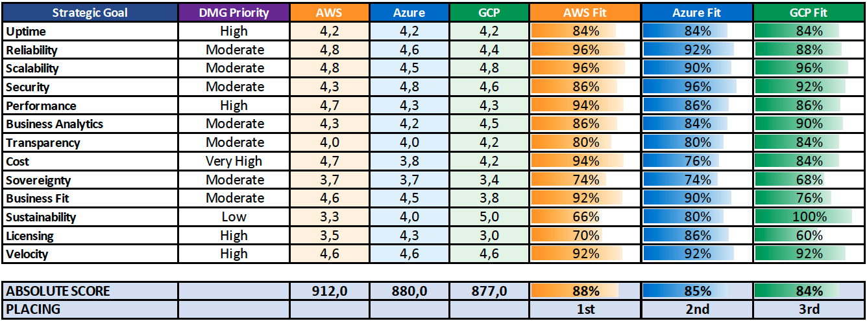
Hyperscaler Weighted Scoring
Very High

Slide 32
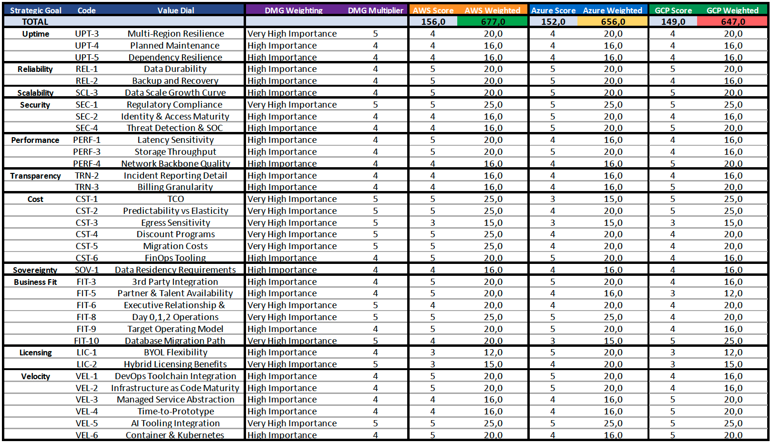
Weighted Scoring – [Client] Key Value Dials

Slide 33
Overall Recommendation
1st
2nd
3rd
Cost – 3 year
Weighted Scoring
Business Fit

Slide 34
1st
2nd
3rd
Least engagement during process
Best up-front 3 year pricing
good discounts offered
% (TBC)
GCP 3rd overall in weighted scoring assessment
Strong native container solution
Expected synergy with google related to Telegraph bid removed
Not able to run multicast (Atex) without major architecture refactor to unicast.
Strong engagement from account team
Competitive (< 5% difference) 3 year pricing.
Best credits/discounts/MAP funding means long-term (3yr) cheapest partner
ARR: NN% (TBC)
AWS best overall in weighted scoring assessment
mixed/mostly linux workloads well suited to AWS
on-premise connectivity (direct-connect) already configured
Video streaming already on AWS
Able to run multicast without refactoring (Atex)
In-House knowledge of AWS within business teams (MIMIR,Airtable,[Client] iQ - Social Media & MSN Gallery Creator)
Basic entry level understanding within current platform team
Largest partner ecosystem and skills market across all segments – media
Good engagement from account team
Least attractive 3 year pricing
unclear position on credits/discounts
AHB makes a negligable difference (windows VMs = 234/3038 = 7.7%)
Microsoft came 2nd overall in weighted scoring assessment
Not able to run multicast (Atex) without major architecture refactor to unicast.
UK South struggling for capacity
Rephrase to fit business objectives
Table format might be better
Rephrase engagement to quality of response.
quality sets expectation around further
Notes:
Overall Recommendation comes down to:
TCO
Weighted Scoring
Business Fit

Slide 35

[Client] Readiness

Slide 36
Readiness today
Your team has deep expertise in VMware, Oracle, and networking. This score measures cloud readiness only.
Business: 2.5 Objectives clear. Operating model definition is the gap.
Governance: 3.0 Strongest area. CMDB maintained, supplier management mature.
Operations: 1.8 DR planning and cross-brand monitoring consistency are the gaps.
People: 1.2 Cloud-specific skills at earliest stage. No formal training plan yet.
Security: 2.0 CISO engaged. Shared responsibility model and cloud-native GRC early-stage.
Bottom line: Overall: 2.1 of 5. Consistent with an organisation at the start of its cloud journey.
Cloud-specific, not overall capability

Slide 37
Closing the gap
Current
Business: 2.5
Governance: 3.0
Operations: 1.8
People: 1.2
Security: 2.0
Overall: 2.1
12 Month target
Business: 4.0
Governance: 4.0
Operations: 3.0
People: 3.0
Security: 4.0
Overall: 3.6
Current state to 12-month target
How it closes:
Landing zone build establishes governance, security baselines, and IaC from day one
Partner-assisted delivery carries the specialist load during transition
Your team works alongside, absorbing capability cohort by cohort
End state: Customer-led cloud operation with internal capability built in-flight

Slide 38
Challenges

Slide 39
Challenges
Skills Gap
Vmware Tools
Appliances
Cloud Skills required
Suggest partner to aid during transition phase
Build fully featured LZ
Assist with migrations
Develop core security practices
Build foundational FinOps concept
Develop DevOps automation processes
Upskill in-house team
Where possible having vmware tools enabled gives a better perspective of performance inside the VM
Update where possible
challenge
response
Standardised Access
Legacy OS
Naming Conventions
Consistent logins required for administrator access
Old unsupported OS types will take longer to move to Cloud
Risk of duplication or accidentally leaving out of migration
Standardised login methods for Linux/Windows
Standardised accounts across MOL/ANL
Ability to make changes
Some customers prefer to use a tool to manage PAM. (eg: Cyberark)
Replatforming is possible but must be factored into timeline.
Same hostnames with .int and .hsk

Slide 40
Opportunities

Slide 41
Quantified opportunities
Oracle modernisation to PostgreSQL | £45-65K/mo saving (£540-780K/yr) Eliminates £650K/yr support contract. Requires Phase 2 assessment. Conversion cost not yet estimated.
Windows BYOL | £7-18K/mo saving depending on cloud Requires active SA. Cost-effective on Azure (AHB). On AWS/GCP only while EA is active (expires May 2027).
SQL Server BYOL | £14-15K/mo saving across all clouds Requires SA confirmation from Bluesource. Cost-effective on all three platforms.
Storage tiering | £10-19K/mo saving depending on cloud 336 TiB non-production moved from SSD to HDD class. No application impact.
RTA rightsizing | Saving TBD (Phase 2 to quantify) Many instances significantly overprovisioned. Right-size during migration for immediate saving.
Modelled in Part 1

Slide 42
Strategic opportunities
Sydney datacentre exit 4 servers, flexible contract, £40K/yr cost offset. Low-risk proof point. Migrate early.
Application rationalisation Lotus Notes (SaaS replacement), Atex 5.5 (32-bit, retire when Atex 6 complete), SolarWinds and Zabbix (replace with cloud-native monitoring). Every app retired is servers removed from migration scope.
Load balancer modernisation F5 (corporate) and Zeus/Ivanti vTM (Customer_App1) replaced by cloud-native. No hardware lifecycle, auto-scaling, native integration.
Observability consolidation Replace SolarWinds and Zabbix with a single cloud-native or cloud-agnostic monitoring platform. Consistent across brands.
Infrastructure as Code from day one All cloud provisioning via Terraform or cloud-native equivalent. Reproducible, auditable, eliminates manual configuration errors.
Phase 2 to validate

Slide 43
Moving Forward and Part 2

Slide 44
What you need to do now
Data to provide
SA confirmation from Bluesource (unblocks BYOL modelling)
Broadcom VCF subscription quote (completes cost of doing nothing)
MOL B-cluster DMA access (largest database, currently sized from hardware spec only)
Decisions to make
Primary platform (this assessment recommends AWS)
Atex vendor engagement on unicast support
Oracle path: Exadata@Cloud now, PostgreSQL timing for Phase 2
Day 2 operating model (partner-assisted with upskilling)
CPO and CTO joint sponsorship for Mail Online
Data and decisions

Slide 45
Phase 2 entry point
Discovery and profiling Extend to full 4,500+ estate. MOL B-cluster DMA. Deep performance profiling. Per-application 7R classification.
Architecture and design Landing zone design. Security posture assessment. Network and load balancer modernisation. Guardicore policy migration.
Data and modernisation Oracle modernisation assessment (highest-value workstream). SQL Server per-instance assessment. PostgreSQL feasibility.
Planning and governance Cohort sequencing with timeline. Co-migration group scheduling. Dual-run cost modelling. Cloud Platform Team formation. Staff training roadmap.
Bottom line: Phase 2 is a separately proposed engagement. It turns this report into a concrete migration plan. It does not execute migration.
From assessment to migration plan

Slide 46
Indicative timeline
Phase 2 (planning and design): 15 weeks, Q3 2026
Migration execution: Q4 2026 to Q3 2027 (13 months)
DC lease expiry: November 2027 (achievable if Phase 2 starts Q3 and critical decisions are made during planning)

Slide 47
Hyperscaler guidance
Warning signs
All-5 self-ratings without Customer-specific justification
Cost figures that do not include Oracle, SQL licensing, or support
Sizing using only their own tool without independent validation
Year 1 savings claims without acknowledging dual-run cost
Proposals that ignore your Software Assurance status
Questions to ask each cloud
What is your answer for Oracle? (the whole path, not just the price)
How have you sized our workloads? (does their methodology match?)
What does BYOL look like for Server 2022? (only Azure AHB works without restrictions)
What is your commercial offer? (private pricing, credits, funded resources)
Who owns Day 2 operations?

Slide 48
