Slide 1








Solution Assessments M

Slide 2
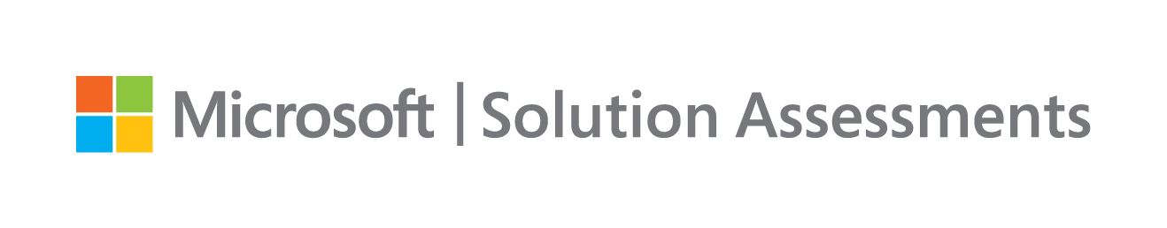
Content
Assessment Summary
Azure Savings
Overall Analysis
Considerations/Opportunities
Appendix

Slide 3

Azure Journey
Accelerate your journey to the cloud
Next Steps
Plan & DECIDE
ASSESS & DISCOVER
PLAN & DECIDE
MIGRATE
OPTIMIZE
Notes:
Our typical delivery model

Slide 4
Assessment Summary
Azure Migrate tool used to discover
Customer Name | Customer
No. of Sites | 1
Site Location | UAE
No. of Machines | 77
Environment Groups | 1
Windows Machines | 67
Linux Machines | 10
Entity Logo

Slide 5
Overall Analysis
Operating System Analysis
Windows Support Analysis
Readiness Information
Performance Analysis

Slide 6
Operating System Analysis
87% of the machines are running with different version of Windows OS and the rest are running Linux Distribution

Slide 7
Windows Support Analysis
89 % of the machines running with extended support operating Systems
OS Name | End of Life | Extended Support
Windows server 2008 R2 Standard |  | January 14, 2020
Windows Server 2012 R2 Standard | October 9, 2018 | October 10, 2023
Windows Server 2016 | January 11, 2022 | January 11, 2027

Slide 8
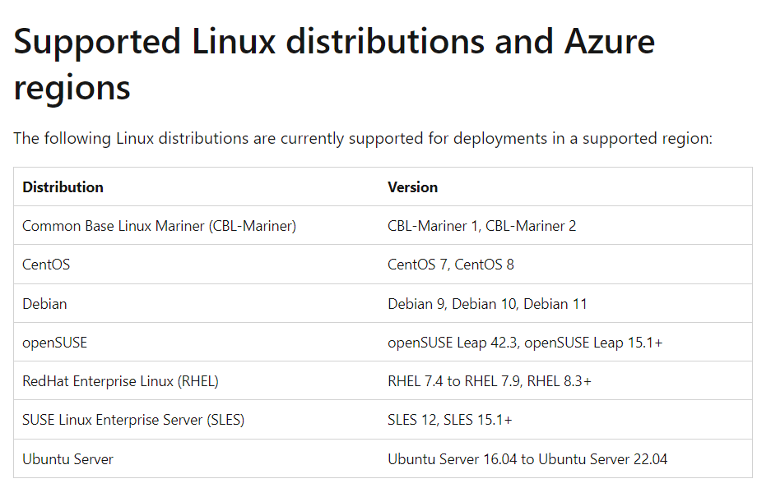
Linux Readiness Conditions Conditionally endorsed Linux OS
Supported distributions and versions
Readiness issues | Count of Azure readiness issues
Conditionally endorsed Linux | 3
Conditionally endorsed linux OS | Operating system
XXX | CentOS 4/5/6/7 (64-bit)
YYY | SUSE openSUSE (64-bit)
ZZZ | Ubuntu Linux (64-bit)

Slide 9
Overall Readiness
Migrate Windows and Linux Servers, Databases, Data, Web Applications and Virtual Desktops
Readiness issues | Count of Azure readiness issues
Ready | 74
Ready with condition | 3

Slide 10
CPU and RAM Performance and Optimization analysis
v
Up to 50% Optimization
v

Slide 11
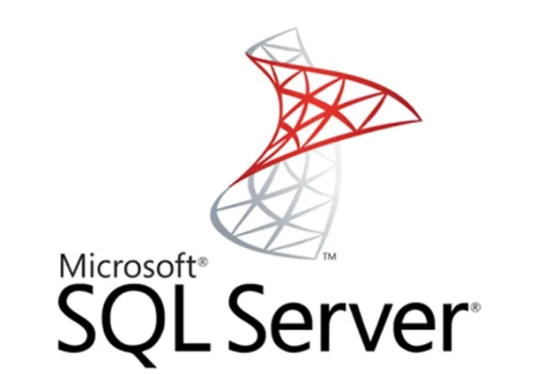
Modernization Assessment

Slide 12



Which Azure SQL offering is right for you?
Migration
Do you need
OS level access?
SQL Server versions 2008 - 2019?
Distributed Transaction Coordinator?
PolyBase/Filestream?
Capabilities at the VM level?
SSRS/SSAS?
Yes
SQL Server on Azure VMs
No
SQL Modernization
Do you need
An instance model?
Linked Server?
Cross-DB transactions?
SQL Agent?
Capabilities at the instance level?
SSIS?
Yes
Azure SQL Managed Instance
App Innovation
No
Do you need
No
Yes
Azure SQL Database
A database model?
Up to 100TB of database storage?
Ability to automatically pause/restart a workload?
Notes:
We understand that it’s not always easy to know where to start, so we’ve created this simplified flow chart with some key features of each database offering to help you choose the best destination for your needs.
If you know you’ll need OS level access and don’t want to make changes to your existing codebase, then SQL Server on Azure VM is the right option for you.
If your goal is to modernize an existing application, and want to take advantage of all the features of Azure PaaS, then Azure SQL MI may be the right fit. With a few tweaks to your existing application, you should be able to run on MI and take advantage of your instance easily.
If you’re looking to begin building cloud-native applications on Azure, or are looking for the flexibility to automatically pause and resume intermittent workloads, then Azure SQL Database is the perfect choice.
And finally, if you are looking to process data on the edge and need a small-footprint database to stream, store, and perform analytics, then Azure SQL Edge is the solution.
Once on Azure, take advantage of all Azure SQL has to offer. (suggest strike this)

Slide 13
Scanned SQL DB servers
DB Server Name | Ram | Core | SQL Server | No. of DBs | Storage size
XXX | 24 | 12 | SQL Server 2016 | 2 | 393
XXX | 24 | 4 | SQL Server 2016 | 1 | 273
XXX | 8 | 4 | SQL Server 2016 | 5 | 173
XXX | 8 | 4 | SQL Server 2016 | 2 | 153
XXX | 16 | 4 | SQL Server 2014 | 8 | 1453
XXX | 12 | 4 | SQL Server 2016 | 3 | 373
XXX | 8 | 4 | SQL Server 2014 | 1 | 151
XXX | 6 | 4 | SQL Server 2014 | 10 | 140
XXX | 16 | 8 | SQL Server 2014 | 2 | 841
XXX | 16 | 4 | SQL Server 2012 | 55 | 452
XXX | 24 | 4 | SQL Server 2016 | 37 | 500
XXX | 16 | 4 | SQL Server 2012 | 12 | 150
XXX | 16 | 4 | SQL Server 2012 | 3 | 150
XXX | 16 | 4 | SQL Server 2016 | 18 | 470
XXX | 16 | 4 | SQL Server 2014 | 23 | 470
Notes:
For Azure SQL Edge the operating system is that of the container holding the database software not of the edge device.

Slide 14

Managed Instance Compatibility
Managed Instances
Upon gathering the information for the 15 SQL servers within the scoped environment,
10 SQL servers are fully compatible with the SQL Managed Instance platform.
5 SQL servers require further and in-depth analysis to determine the migration approach, which is done typically during the migration planning.
Server name | Breaking Change | MigrationBlocker | Grand Total
XXX |  | 7 | 7
XXX | 14 | 21 | 35
XXX | 426 |  | 426
XXX | 180 |  | 180
XXX | 371 | 14 | 635
Grand Total | 991 | 42 | 1283
Server name | Unsupported Feature
XXX | 3
XXX | 1
XXX | 2
Grand Total | 6
Notes:
For Azure SQL Edge the operating system is that of the container holding the database software not of the edge device.

Slide 15
Azure SQL DB Compatibility
Azure SQL
Upon gathering the information for the 15 SQL servers within the scoped environment, below is the analysis of the compatibility to move the DBs to an Azure SQL DB as a service option.
This option requires another look at the DB level to determine the migration approach, which usually recommended in Phase 2 (DB modernization)
Count of Server Name | Column Labels
Server name | Partially Supported Feature | Unsupported Feature | Grand Total
XXX | 2 | 9 | 11
XXX |  | 2 | 2
XXX | 2 | 11 | 13
XXX | 9 | 3 | 12
XXX |  | 1 | 1
XXX | 6 | 49 | 55
XXX | 4 | 40 | 44
XXX | 11 | 21 | 32
XXX | 16 | 31 | 47
Grand Total | 50 | 167 | 217
Count of Server Name | Column Labels
Server name | BreakingChange | MigrationBlocker | Grand Total
XXX | 77 | 68 | 145
XXX | 8 |  | 8
XXX | 440 |  | 440
XXX | 73008 | 12 | 73020
XXX | 628 | 99 | 727
XXX | 601 | 13 | 614
XXX | 4094 | 16 | 4110
XXX | 51022 | 119 | 51141
Grand Total | 129878 | 327 | 130205
Notes:
For Azure SQL Edge the operating system is that of the container holding the database software not of the edge device.

Slide 16

Azure Costing Terminology
Cost Considerations:
When recommending the 1 and 3-year options across pay-as-you-go, Azure Hybrid Use Benefit (AHUB), and Reserved Instances (RI) explain what each option is and the terms and conditions for each option.
Pay-As-You-Go
Azure Hybrid Benefit
Reserved Instances
Extended Support
This offer is billed at the standard Pay-As-You-Go rates
Bring Windows Server and SQL Server on-premises licenses with Software Assurance to Azure
This pricing mechanism from Microsoft offers great discounts compared to the Pay As You Go (PAYG) model
Get Windows Server and SQL Server Extended Security Updates for 3 more years at no additional charge, only in Azure.

Slide 17
Lift & Re-size Approach – Azure TCO
AHUB Applied | PAYG | 1 Year SP | 3 Years SP
Compute | 7,328 | 4,734 | 2,915
Storage | 5,065 | 5,065 | 5,065
Total | 17,713 | 15,119 | 13,300

Slide 18
Appendix
Troubleshoot assessments in Azure Migrate - Azure Migrate | Microsoft Docs Azure Monitor overview - Azure Monitor | Microsoft Docs
Microsoft Azure Marketplace
Backup and Disaster Recovery | Microsoft Azure
Azure Sentinel – Cloud-native SIEM Solution | Microsoft Azure
Azure files | Microsoft Azure
Azure Virtual Desktop | Microsoft Azure
SQL Managed Instance | Microsoft Azure Azure Arc - Hybrid and Multicloud Management | Microsoft Azure

Slide 19
Thank You

