Slide 1








Solution Assessments M

Slide 2

Content
Assessment Summary
Azure Savings
Overall Analysis
Considerations/Opportunities
High level Migration Plan
Appendix

Slide 3
Azure Journey
Accelerate your journey to the cloud
Next Steps
Plan & DECIDE
ASSESS & DISCOVER
PLAN & DECIDE
MIGRATE
OPTIMIZE
Notes:
Our typical delivery model

Slide 4

Assessment Summary
Azure Migrate tool used to discover
Customer Name | Abu Dhabi Fund for Development
No. of Sites | 1
Site Location | UAE
No. of Machines | 53
Environment Groups | 1
Windows Machines | 47
Linux Machines | 6
SQL Servers | 4
* Not part of migration | 133
* Windows 10, Servers planned for Decommission and not part of Cloud migration

Slide 5
Overall Analysis
Operating System Analysis
Windows Support Analysis
Readiness Information
Performance Analysis

Slide 6
VM Operating System Analysis
89% of the machines are running with different versions of MWS OS (Microsoft Windows Server) and the rest are running Linux (Centos/Oracle/Ubuntu) Distribution.

Slide 7
VM Windows Support Analysis
98 % of the machines running with extended support operating Systems
OS Name | End of Life | Extended Support | Azure Extended Support
* Microsoft Windows Server 2012 | October 9, 2018 | October 10, 2023 | October 13, 2026
Windows Server 2019 | January 09, 2024 | January 09, 2029 | NA
* jumpsrv-3.19(accopsrv)

Slide 8
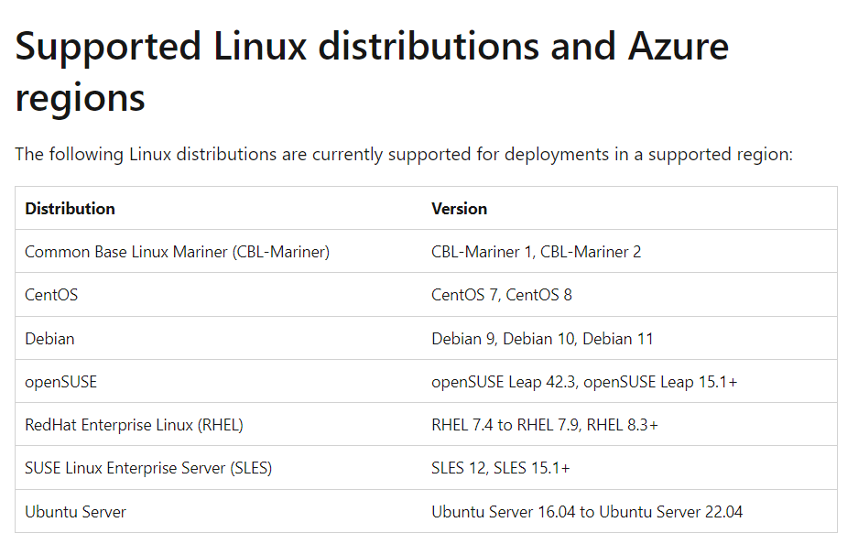
VM Linux Readiness Conditions Conditionally endorsed Linux OS
Supported distributions and versions
Readiness issues | Count of Azure readiness issues
Conditionally endorsed Linux | 1
Conditionally endorsed linux OS | Operating system
1 | Ubuntu Linux (64-bit)

Slide 9
VM Overall Readiness
Migrate Windows and Linux Servers, Databases, Data, Web Applications and Virtual Desktops
Readiness issues | Count of Azure readiness issues
Ready | 52
Ready with condition | 1

Slide 10
VM Servers CPU and RAM Performance and Optimization analysis
Up to 50% Optimization
Up o 68% Optimization
Up to 68% Optimization

Slide 11
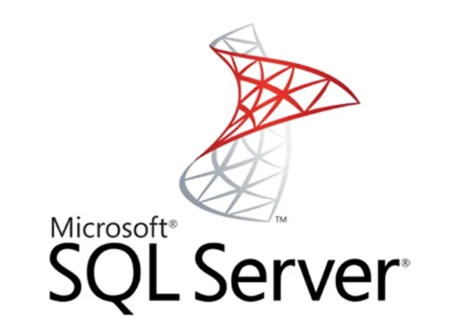
Modernization Assessment

Slide 12
Which Azure SQL offering is right for you?
Update
Migration
Do you need
OS level access?
SQL Server versions 2008 - 2019?
Distributed Transaction Coordinator?
PolyBase/Filestream?
Capabilities at the VM level?
SSRS/SSAS?
Yes
SQL Server on Azure VMs
No
SQL Modernization
Do you need
An instance model?
Linked Server?
Cross-DB transactions?
SQL Agent?
Capabilities at the instance level?
SSIS?
Yes
Azure SQL Managed Instance
App Innovation
No
Do you need
No
Yes
Azure SQL Database
A database model?
Up to 100TB of database storage?
Ability to automatically pause/restart a workload?
Notes:
We understand that it’s not always easy to know where to start, so we’ve created this simplified flow chart with some key features of each database offering to help you choose the best destination for your needs.
If you know you’ll need OS level access and don’t want to make changes to your existing codebase, then SQL Server on Azure VM is the right option for you.
If your goal is to modernize an existing application, and want to take advantage of all the features of Azure PaaS, then Azure SQL MI may be the right fit. With a few tweaks to your existing application, you should be able to run on MI and take advantage of your instance easily.
If you’re looking to begin building cloud-native applications on Azure, or are looking for the flexibility to automatically pause and resume intermittent workloads, then Azure SQL Database is the perfect choice.
And finally, if you are looking to process data on the edge and need a small-footprint database to stream, store, and perform analytics, then Azure SQL Edge is the solution.
Once on Azure, take advantage of all Azure SQL has to offer. (suggest strike this)

Slide 13
Scanned SQL DB servers on VM servers
DB Server Name | MEM(GB) | Core | SQL Server | Storage Size(GB)
ADDCPRSQL16S1 | 102 | 8 | SQL Server 2016 | 1440
ADDCPRSQL16S2 | 102 | 8 | SQL Server 2016 | 1380
ADDCPRSQL19S1 | 51 | 4 | SQL Server 2019 | 1310
ADDCPRSQL19S2 | 40 | 4 | SQL Server 2019 | 1310
Recommendation on Azure
DB Server Name | MEM(GB) | Core | SQL Server | Storage Size(GB) | Recommendation
ADDCPRSQL16S1 | 128 | 16 | SQL Server 2016 | 1536 | Azure SQL MI
ADDCPRSQL16S2 | 128 | 16 | SQL Server 2016 | 1536 | Azure SQL MI
ADDCPRSQL19S1 | 64 | 8 | SQL Server 2019 | 1536 | Azure SQL VM
ADDCPRSQL19S2 | 64 | 8 | SQL Server 2019 | 1536 | Azure SQL VM

Slide 14
SQL Servers CPU and RAM Performance and Optimization analysis
Increase CPU and Memory
Increase CPU and Memory

Slide 15

Managed Instance Compatibility
Managed Instances
Upon gathering the information for the 4 SQL servers within the scoped environment,
4 SQL servers are compatible with the Azure SQL Managed Instance platform
67 DBs of SQL19 are compatible with Azure SQL MI, 1 DB on SQL 19 needs further analysis to make it compatible with Azure SQL MI.
All 4 SQL DBs are 100% utilized, so recommendations made to increase CPU and Memory in Azure.
Premium SSD is chosen to support higher IOPs.

Slide 16
Azure Costing Terminology
Cost Considerations:
When recommending the 1 and 3-year options across pay-as-you-go, Azure Hybrid Use Benefit (AHUB), and Reserved Instances (RI) explain what each option is and the terms and conditions for each option.
Pay-As-You-Go
Azure Hybrid Benefit
Reserved Instances
Extended Support
This offer is billed at the standard Pay-As-You-Go rates
Bring Windows Server and SQL Server on-premises licenses with Software Assurance to Azure
This pricing mechanism from Microsoft offers great discounts compared to the Pay As You Go (PAYG) model
Get Windows Server and SQL Server Extended Security Updates for 3 more years at no additional charge, only in Azure.

Slide 17
Lift & Re-size Approach – Azure TCO for VM’s
 | PAYG | 1 Year SP | 3 Years SP
Compute | 5,854 | 3,373 | 2,129
Storage | 3,177 | 3,177 | 3,177
Total | 9,031 | 6,550 | 5,360

Slide 18
Lift & Re-size Approach – Azure TCO for SQL DBs
 | PAYG | 1 Year SP | 3 Years SP |  |  | PAYG | 1 Year SP | 3 Years SP
Compute (SQL 19) | 1,080 | 746 | 464 |  | Compute (SQL 16) | 2,160 | 1,492 | 930
Storage | 240 | 240 | 240 |  | Storage | 240 | 240 | 240
Total | 1,320 | 986 | 704 |  | Total | 2,400 | 1,732 | 1,170

Slide 19
Modernize Approach – Azure TCO for Azure SQL Managed Instances
 | PAYG | 1 Year SP | 3 Years SP |  |  | PAYG | 1 Year SP | 3 Years SP
Azure SQL MI (SQL 19) | 2,346 | 1,525 | 1,055 |  | Azure SQL MI (SQL 16) | 4,766 | 3,123 | 2,184
Storage | 73 | 73 | 73 |  | Storage | 73 | 73 | 73
Total | 2,419 | 1,598 | 1,128 |  | Total | 4,839 | 3,196 | 2,257
* SQL Server licenses are not required for standby replicas, resulting in discounted rates for your geo-secondary replicated instances used for disaster recovery only.

Slide 20

High Level Migration Plan Timelines
Mar 1 - Mar 15
Mar 15 - Apr 1
Apr 1 - May 1
May 1 - Jun 1
Jun 1 - Jul 1
Jul 1 - Aug 1
Aug 1 - Sep 1
Sep 1 - Oct 1
May 1 - Nov 1
133 days
11 days
12 days
23 days
23 days
21 days
24 days
22 days
22 days
2024
2024
Today
Wave 1 Complete
Wave 3 Complete
Project Kickoff
LZ Compelete
Wave 2 Complete
Wave 4 Complete
2024
May
Jun
Jul
Aug
Sep
Oct
Nov
Dec
Landing Zone
LZ Design
LZ Build
Azure Target Environment Readiness
Wave 1
Wave 2
Migration
Wave 3
Wave 4
HyperCare
Hyper Care Support
*15 VMs per Wave
Notes:
``` ` ```

Slide 21
Additional Information
Hardware Refresh Cycle | 5 to 6 years (4 prod, 1 development and 1 DR Intel servers in the environment and out of which 4 servers were purchased last years)
Are there any license commitment for more than 1 year that might delay the migration (Vmware, Citrix, Backup, FW). | All licenses are with 1-year commitment
Is NCM doing or planning any migration in the coming 4 months? | Intranet and a website are planned to go to Azure within 3 months and File Server by end of year
Is a DR required on Azure from day one? | DR is required for website
Are there any projects in the pipeline that NCM want us to include in the Azure sizing | Digital Media Server (within 5 months) and File Server by end of year
Putting the Azure hosting cost and migration aside, when can NCM start the migration | 3 months

Slide 22
Appendix
Troubleshoot assessments in Azure Migrate - Azure Migrate | Microsoft Docs Azure Monitor overview - Azure Monitor | Microsoft Docs
Microsoft Azure Marketplace
Backup and Disaster Recovery | Microsoft Azure
Azure Sentinel – Cloud-native SIEM Solution | Microsoft Azure
Azure files | Microsoft Azure
Azure Virtual Desktop | Microsoft Azure
SQL Managed Instance | Microsoft Azure Azure Arc - Hybrid and Multicloud Management | Microsoft Azure

Slide 23
Thank You

