Slide 1
Cloud Strategy Workshops
Keiran Holloway
Senior Technical Lead - Professional Services - EMEA

Slide 2
What we heard…
“We need a roadmap to public cloud”
“How do we manage a hybrid cloud?”
“Cloud provides attractive economics”
“we need to improve our operational effectiveness”
“We need to reduce risk when using cloud… ”

Slide 3
Operating in the cloud is a lifestyle change…
Aspect | Traditional
Infrastructure | Dedicated
Deployment mechanism | Manual/Config management
Architecture patterns | Monolithic
Complexity | Low
Provisioning lead times | Weeks / Months
Change lead time | Days / Weeks
Change failure rate | 60%+
Business Relevance | Supporting
Operation Model | Infrastructure / centralized
Starter
Cloud (VMs + some PaaS)
Infrastructure as code, config management, CI/CD pipelines
Monolithic / Domain-based
Low
Days / Weeks
Days / Weeks
40-60%
Supporting / digital twin
Centralized IT / Ticket Driven, Cloud Management Office
Mid
Cloud (VMs, PaaS, SaaS)
Infrastructure as code, config management, CI/CD pipelines
Domain-based, Service Based
Medium
Days / Weeks
Days
20-40%
Core
Cloud Management Office / Centralized
Experienced
Cloud (VMs, PaaS, SaaS, Cloud native)
Infrastructure as code, config management, CI/CD pipelines, immutable
Domain, Service, Microservice
Medium / High
Hours / Days
Hours
<10%
Critical
CCoE / Distributed Ops
Elite
All (Bias to Cloud native)
Platform as a Service, CI/CD pipelines, immutable
Microservice, event driven, cloud native
High
On-demand
On-demand
<5%
Critical
Distributed Ops / Platform Engineering
Operational Maturity
Notes:
Where does your current level of maturity sit within your organization?

Slide 4
What are the key influences factors for going to the cloud?
What key business outcomes are you targeting in the next 12 months?
How does your IT strategy support those business goals?
Where are the skills strong versus where do you rely on external help?
What goals or changes are planned for your technology and operations teams?
What delivery and governance processes are in place today (e.g., agile, ITIL, DevOps)
What challenges exist in your current structure or ways of working?
What commercial drivers are influencing cloud adoption (e.g., hardware refresh, licensing pressure, vendor contracts)?
How do you currently manage risk and compliance?

Slide 5
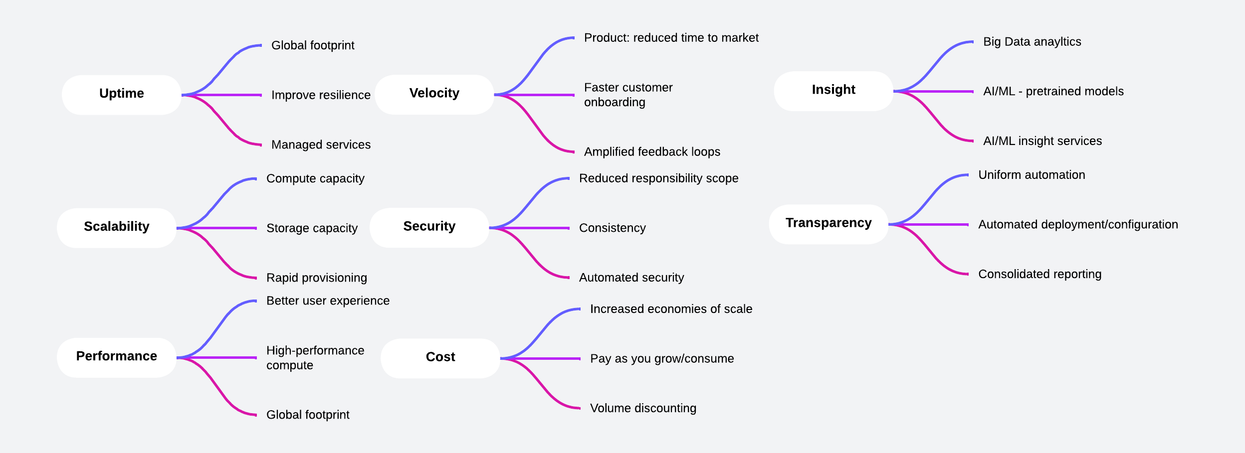
Why are you going to the cloud again? Prioritization Matters!
Notes:
Need to prioritize what comes first. Without deciding what the business priorities are – we can invest time, money and effort on things which do not move the needle.

Slide 6
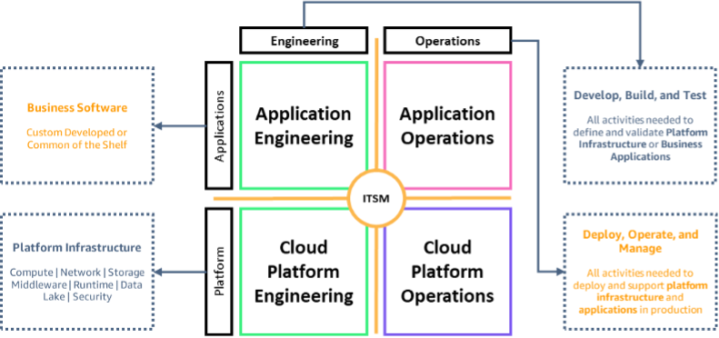
Traditional Operating Model with Dedicated Infrastructure…

Slide 7
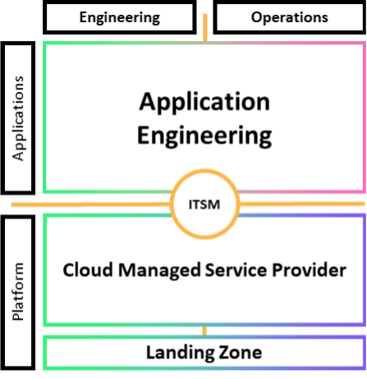
Cloud Operating Model…

Slide 8
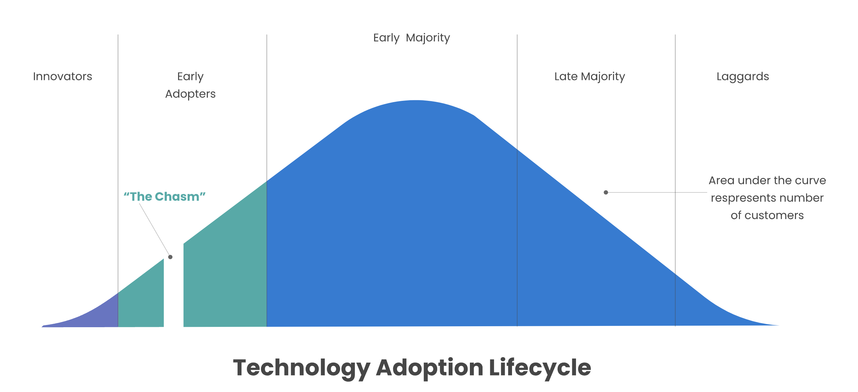
The Chasm and Cloud Adoption….

Slide 9
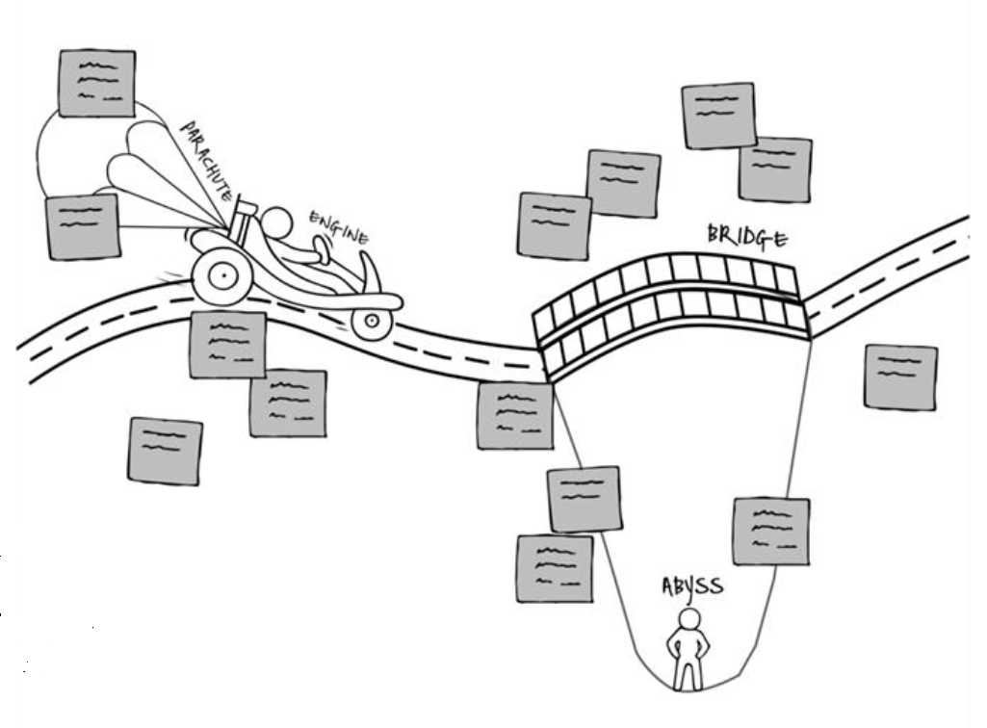
Bridging The Chasm….
What is your Engine to propel you across the chasm? What is working well within your migration today? What strengths do you have within the team? What capabilities do you have in abundance?
What can you leverage or capitalize on to increase probability of success?

Slide 10
Bridging The Chasm….
What are your parachutes?
Backups and/or safety needs to avoid failure?
Potential quick fixes or fallback strategies?

Slide 11
Bridging The Chasm….
Abyss…
What are the big risks which need to be mitigated?
What are the unknowns that need qualification?
What are the threats (internal/external) that could disrupt crossing the chasm?

Slide 12
Bridging The Chasm….
The Bridge
What is the strategy to approach the chasm?
Are there potential solutions or approaches which have been considered?
What do you still need to create solutions?

Slide 13
Rackspace Public Cloud Solutions We offer a wide array of solutions and continue to expand our portfolio
Advise
Transform
Manage and Optimize
Application Modernization Roadmap
Application Migrations
Cloud Native Application Development
IoT Platform Design & Development
Multicloud Engineering & Optimization
Cloud
apps
Data & AI Strategy & Roadmap
Cloud Data Migrations
Analytics &
Applied AI
Cloud Data Platform
Cloud
data
Cloud Strategy, Architecture Roadmap
Platform Migrations
Cloud Platform Architecture & Engineering
Modern Operations
Cloud
platform
Cloud Security Advisory & Assurance
Identity & Access Management
Application Security & DevSecOps
Zero Trust & Next Gen Networking
Detection & Response
Cloud
security
SERVICE LINES
PROFESSIONAL SERVICES
MANAGED SERVICES AND ELASTIC ENGINEERING
Notes:
Advise:
Cloud Strategy, Architecture Roadmap
Develop a cloud strategy and architecture roadmap using a structured Cloud Adoption Framework and expert guidance
Application Modernization Roadmap
Develop a fit-for-purpose continuous modernization roadmap for your application portfolio working with our application experts and cloud partners
Data & AI Strategy and Roadmap
Develop a strategy, conceptual architecture and roadmap for data & AI, using ideation workshops, assessments and reviewing use cases and business priorities
Transform:
Cloud Center of Excellence
Design and establish a Cloud Center of Excellence aimed to incubate and scale cloud architecture and operational processes needed for cloud adoption and transformation
Cloud Application Migrations
Execute a fit for purpose migration of client application workloads by lifting, shifting and optimizing VM based workloads to the cloud
Cloud Data Migration
Evaluate transactional (OLTP) and analytical (OLAP) workloads and migrate data workloads to cloud databases and data warehouses
Manage:
Cloud Native Application Development
Create innovative applications built using cloud native architectures, services and design principles
Applied AI, Machine Learning & MLOps
Leverage AI & ML to jumpstart projects in anomaly and pattern detection, forecasting and predictions, language processing and more
Cloud Data Platform & Analytics
Design and implement a cloud native data analytics architecture, improving usage and effectiveness of data for the business
Cloud Platform Optimization
Build resilient cloud platforms using cloud services for autoscaling, containers, serverless using industry best practices
Optimize:
Cloud Security & GRC
Architect, design and embed a declarative and automated model for cloud security, governance, risk and compliance based on zero trust architecture principles
Multicloud Engineering & Management
End-to-end cloud engineering and operations (platform, data, applications, cost optimization, 24x7 incident response)

Slide 14
Cloud Continual Service Improvement Flywheel
Identify Goals/Define Return on Investment
Create execution plan
Measure Results
Implementation
Business Priority

Slide 15
Our cloud strategy solution offerings can be tailored to your needs
AT A GLANCE
Cloud Advisory workshop
2. Cloud Readiness Assessment
3. Cloud Maturity Assessment
When to use it
Learn how leading organizations are making shifts across technology, process, and people to drive business solutions using the Public Cloud
You require a comprehensive assessment to find the right cloud platforms for your unique needs
Become Cloud Fluent so that your business can properly leverage cloud as an enabler of innovation
Main audience
Executive Stakeholders
Business & Technical stakeholders
Business & Technical stakeholders
Key benefits
Current state assessments
Strategic forward-looking plan
Cloud designs and cost estimates
Business case and TCO
A complete and objective people, process, and technology assessment against Cloud best practices
Achieve the target maturity levels based on the specific needs of your business.
Actionable roadmap for that will set your organization on a path to maximize the value of cloud.
A complementary 60-minute session to get you started
You are here

Slide 16
Our cloud strategy solution offerings can be tailored to your needs
AT A GLANCE
4. FinOps Assessment Workshop
5. DevOps Assessment
6. Service Management Assessment
When to use it
Refine and optimize your financial operation practices.
You want to review your DevOps readiness, ranging from architecture and coding to team and culture.
You require a assessment to find the operating model in the Cloud using ITIL methods
Main audience
Finance & Technical stakeholders
Business & Technical stakeholders
Business & Technical stakeholders
Key benefits
Deep research specific to your organization to select the right DevOps approach.
Training from our DevOps specialists on gaining organizational alignment around your DevOps go forward plan.
Tangible roadmaps of how to implement desired DevOps end state in your organization.
Co-creation of value stream mapping for your company
Conduct an IT Service Management Maturity Assessment of key ITIL processes
Gap analysis from your current state to the targeted best practices recommendations, proposed actions, and benefits
Perform a people, process, and technology analysis of your service management landscape capturing your Current Operating Model
Develop/Review financial governance framework and best-practices
Automate reporting at scale to deliver cost insights in real time
Align financial and technical teams on cloud consumption and strategic business goals
Future Opportunities
FinOps Engagement
Platform Migration
Cloud Architecture / DevOps Engagement
Platform Migration
DevOps Engagement
Service Management Engagement
CCoE Engagement
Service Management Engagement
CCoE Engagement

Slide 17
Consultancy: Rackspace to Deliver Cloud Transformation …
People and Skills Assessment
People upskilling program
Cloud Centre of excellence design
Automated Implement security and governance controls
ITSM Assessment
Establish service objectives and KPIs
FinOps
DevOps Assessment
Automated development environment
Increased Velocity (faster innovation cycles)
BUSINESS DRIVERS
Increased Developer Productivity (happier engineers)
BUSINESS OUTCOMES
Increased Utilization of Cloud Spend (better ROI)
Increased Cloud Security, Performance and Operational Excellence
Developer environment
design
Implement standard ‘route-to-live’ processes
Shared Services platform implementation
Cloud Management Office Design
Landing Zone Design
Cloud Native Platform Frameworks and Automation
Managed Services
Security and governance framework
Cloud Centre of Excellence implementation
Identity and access management review
Reference architectures for PaaS / Containers
Platform Engineering
Notes:
Growth focus meanings of thinking of the entire picture. Considering how we can chain engagements together into an extended piece of work.

Slide 18
Source
Build
Test
Deploy
Monitor
Code Repo
Pipeline Initiation
Static Code Review
Compiling & Executable format
Build artifact
Unit
Integration
System
Acceptance
Release strategy
Rollback mechanisms
Monitoring and logging
Versioning
Vulnerability testing
DevOps workflow discovery….

