Slide 1

Fraud Investigator Tool
An AI-first case review for insurance fraud investigators
The AI prepares. The investigator decides.
50
10
140
referrals assessed before the investigator opens the queue
flagged for first review, holding $337K of $569K claimed
automated evaluation checks passing
Take-home assignment · Working prototype walkthrough
Notes:
Open with the promise from the brief: when the investigator opens the tool, the queue is already triaged, with reasoning, evidence and a next step for every case. Everything shown is a working prototype on the supplied 50 cases.

Slide 2




From a reactive tool to a prepared queue
Who it is for and the job it does
Today
With AI-first triage
Paste a claim number, pull the data by hand
Read dozens of signals per case to decide what matters
Inconsistent calls between investigators
Most time spent on referrals that turn out benign
Every referral assessed and ordered before work starts
Evidence, counter-evidence and a next step per case
The same transparent rules for every investigator
Low-priority cases cleared fast; time goes where it matters
User: a fraud investigator working a daily referral queue. Job to be done: decide quickly and defensibly which referrals deserve investigation time.
Notes:
The brief describes a reactive tool: paste a claim number, read the signals, repeat. The pain is time spent on benign cases and inconsistency. The product flips this: the AI does the preparation work first, the human stays responsible for the decision.

Slide 3

The dashboard: the morning queue at a glance
Live numbers from the supplied 50 cases
Paste a dashboard screenshot here
$337K
17
Overview tab, full browser window. Insert the picture, size it over this frame, then delete the frame.
of $569K claimed sits in high-priority cases (59%)
cases carry at least one fraud flag
2
1
second-opinion disagreements
data-quality issue: a claim number used twice
Notes:
Replace the frame with a screenshot of the Overview tab: insert the picture, drag it over the dashed frame, then delete the frame. The numbers on the right are computed from the supplied file: 10 high priority, 7 needs attention, 32 lower priority, 1 data review. High-priority cases hold $337K of the $569K claimed.

Slide 4
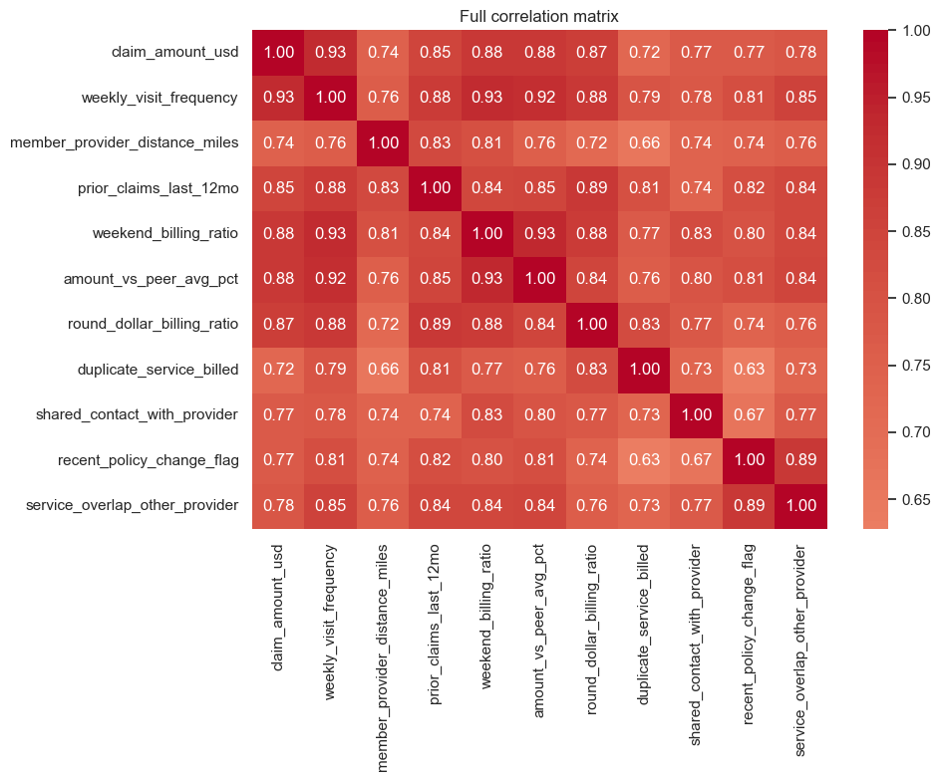
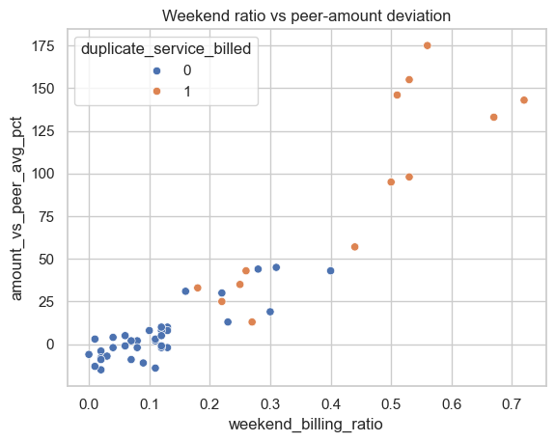
What the data shows (1/2): signals move together
Exploratory analysis of the 50 supplied cases
All signals correlate 0.63 to 0.93 (median 0.81). One pattern can look like ten pieces of evidence, so the scoring caps related signals.
Duplicate-billed cases form their own cluster: weekend billing 50% vs 11%, amount +95% vs +2% against peers (medians).
Charts: exploratory analysis notebook from an independent data-science review. Figures recomputed from the supplied file.
Notes:
The heatmap is the reason for group caps: every signal is strongly correlated with every other. If we simply added up points, a single underlying pattern would be counted many times. The scatter shows flagged cases separating clearly on billing behaviour.

Slide 5
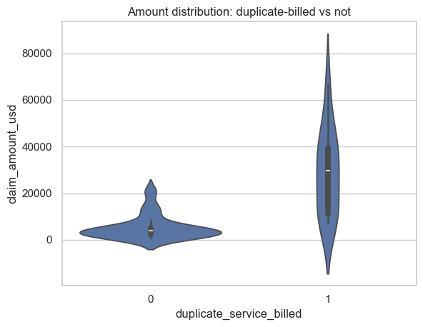
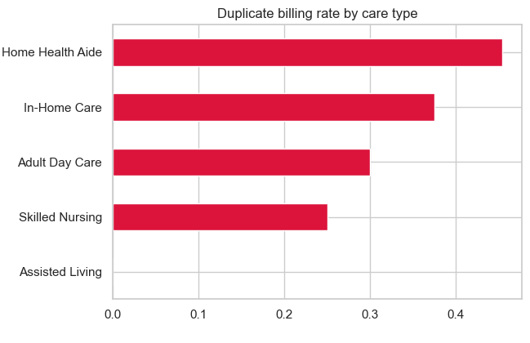
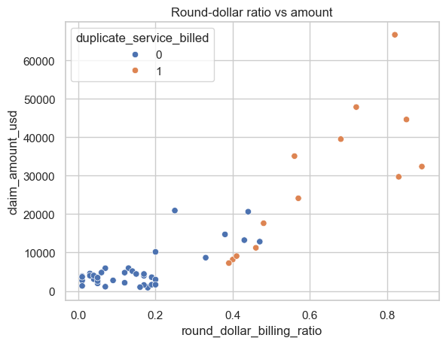

What the data shows (2/2): where risk concentrates
13 duplicate-billed cases hold 66% of claimed dollars (median $29.7K vs $3.9K).
Duplicate billing: 45% of Home Health Aide, 0% of Assisted Living. Compare cases within their care type.
Round-dollar billing tracks duplicate billing (r = 0.83): estimated rather than recorded billing.
Data quality: claim number LTC-2034786 appears on C1001 and C1031. The tool routes this to Data review and never scores it as fraud.
Notes:
Money concentrates in duplicate-billed cases, which is why claim amount is shown as exposure but not used as evidence: large claims are not suspicious by themselves. Care type matters, so peer comparisons are within care type. The repeated claim number is a data-quality issue for claims operations, not a fraud signal.

Slide 6
The scoring model: thresholds learned from the queue
No hand-set threshold per column: every numeric signal is scored against the loaded queue's own distribution
Points thresholds the data produced (supplied queue)
Robust z-score
z = (value − median) ÷ (1.4826 × MAD)
Signal | Median | Start | Full | Max
Visits per week | 5 | 7.2 | 13.9 | 10
Distance | 22 mi | 37.6 mi | 84.3 mi | 10
Prior claims (12 mo) | 2 | 3.1 | 6.5 | 6
Amount vs peer | +8% | +24% | +72% | 10
Weekend billing | 12% | 23% | 54% | 7
Round-dollar billing | 18% | 34% | 80% | 7
Points ramp
points = weight × clip((z − 0.75) ÷ 2.25, 0, 1)
Case score
Σ min(cap, group points) + min(14, bonus)
Flags score fixed points: duplicate billing 20, service overlap 18, shared contact 14, policy change 6.
Recomputed on every import: a different queue produces different thresholds. MAD (median absolute deviation) ignores outliers.
Notes:
This is the answer to 'isn't a threshold per column odd?'. There is none: two global numbers, 0.75 and 3.0, say where points start and where they are full, measured in robust spreads above the queue median. The table shows the actual cut-offs those produce on this queue, for example distance scores nothing up to 37.6 miles and full points from 84.3 miles. With a different queue they move automatically.

Slide 7



Caps, levels and confidence: a worked example
Why C1023 is high priority, and how sure the model is
Group caps (sum to 100)
Billing integrity 30 · Relationship 16 · Utilization 20 · Billing pattern 20 · Combinations 14. Correlated signals cannot stack.
Priority levels
High priority at 60+ or a strong indicator (duplicate billing with overlap). Needs attention at 20+. Data review when the record itself has an issue.
Confidence, separate from priority
Starts at 1.0: −0.30 data-quality issue, −0.20 missing values, −0.15 under 8 peers, −0.25 rules/anomaly disagreement, −0.20 if the level flips in over 15% of 200 runs with weights ±20%. High ≥ 0.85. Queue: 47 High, 3 Medium.
Service overlap 18 · shared contact 11.2 · combinations 11 · distance, billing pattern and policy change add the rest
Notes:
Group caps exist because the signals are highly correlated (slide 4). C1023 has no duplicate billing, but service overlap, shared contact and the new shared contact + overlap combination take it to 62.9, above the high-priority line. Confidence is a separate number: it drops for data issues, thin peer groups, disagreement with the anomaly check, or when small weight changes would flip the level.

Slide 8



Unsupervised second opinion: three methods, one vote
Runs on the real cases to detect disagreement with the rules. It never sets a priority by itself.
Isolation Forest
8
Local Outlier Factor
3
PCA reconstruction
8
flagged
flagged
flagged
Isolates unusual cases with random splits. Averaged over 10 forests × 100 trees; top 15% flagged.
Compares each case's density with its 10 nearest neighbours.
3 principal components; cases they cannot reconstruct are unusual (top 15%).
The vote
A case is unusual when at least 2 of 3 methods agree
and it is unusual in a suspicious direction (a flag is set or a signal is above the norm)
Features are robust-scaled (median and IQR); claim amount is excluded
Outcome on the supplied queue: 4 cases unusual
Case | IF pct | IF | LOF | PCA | Outcome
C1023 | 98 | Yes | – | Yes | Agrees: high priority
C1050 | 96 | Yes | – | Yes | Agrees: high priority
C1011 | 92 | Yes | – | Yes | Second opinion shown: rules say Needs attention
C1019 | 72 | – | Yes | Yes | Raised to Needs attention (rules 18.9, below 20)
Notes:
Three unsupervised techniques on robust-scaled signals. Isolation Forest is averaged across 10 forests because single forests disagreed by up to 30 percentile points on some cases. A case counts as unusual only when two methods agree and the oddness points in a suspicious direction; Isolation Forest alone would also flag unusually small, quiet claims. On this queue the vote changed one priority (C1019) and produced one visible disagreement (C1011).

Slide 9
Two independent methods, one queue
Transparent rules lead; an unsupervised Isolation Forest gives a visible second opinion
0.86
rank correlation with the independent Isolation Forest analysis
8/10
same cases in both top-10 lists
2
disagreements shown as a Second opinion: C1011, C1019
29 lower-priority cases score 0 on the rules, whatever their anomaly rank
Adopted from the review
Shared contact + overlap rule (C1023 to high priority)
Isolation Forest averaged over 10 forests
Anomalies only count in a suspicious direction
Notes:
An independent data scientist scored the same cases with Isolation Forest. The two methods agree strongly. Where they disagree, the app says so explicitly. I adopted three things from that review and deliberately kept the transparent score as primary, because without labels investigators need to be able to challenge each point. Isolation Forest also flags unusually small claims, which is why anomalies only count when a case is unusual in a suspicious direction.

Slide 10



LLM layer: any model, the same guardrails
One provider interface over REST; no vendor SDK. The LLM explains, it never scores.
Provider | Default model | Connect with
Google Gemini (spec default) | gemini-2.5-flash | GEMINI_API_KEY
Anthropic Claude | claude-sonnet-5 | ANTHROPIC_API_KEY
OpenAI | gpt-4o-mini | OPENAI_API_KEY
OpenAI-compatible (Ollama, vLLM, LM Studio) | any model ID | LLM_BASE_URL (local or private)
None | deterministic | no key: everything still works
Assessment agent
Writes summary, key points, counter-points, next step and uncertainty from a structured evidence pack; output schema-checked.
Copilot agent
Answers questions using 19 allowlisted tools, at most 6 calls per question. Write actions become proposals.
Switch in .env or in the app's Model connection panel (test, then connect). A pasted key stays private to that browser session. Optional Google ADK runtime for the copilot.
Grounding validator
Checks every number, case ID and field; blocks fraud claims. One retry, then a deterministic fallback.
Notes:
Any of these models plugs in with one setting, and the copilot and narratives behave the same because the guardrails live outside the model. The model never sees or sets a score; it receives an evidence pack and tool results, and its output is checked before anyone sees it.

Slide 11
Technical architecture
Python end to end, layered so production is an evolution rather than a rewrite
Presentation
Streamlit app: SQL-paged queue · Overview (Altair, Plotly) · Analysis · AI evaluation · Data & rules · copilot panel · per-session model connection
Stack
Python 3.12 · pandas · NumPy · SciPy · scikit-learn · Streamlit · Altair · Plotly · SQLite · requests
Operations
Docker (non-root) · GitHub Actions CI · overnight batch job · optional MCP server
Measured
1.2 s cold start · 5 ms per page at 100,000 cases · 13 ms reject and re-score
Application service
CockpitService: import and validation · assessment cache and versioning · workflow (accept, reject, notes, status) · SQL aggregates for charts
Analytics
Rules engine (ruleset v1.1, JSON) · anomaly cross-check (IF, LOF, PCA) · peer cohorts · similarity index · evaluation suite (140 checks)
AI layer
Assessment and copilot agents · grounding validator · playbook retrieval (BM25, 9 playbooks) · provider adapters
Persistence
SQLite, schema ready for PostgreSQL: cases · assessments (versioned) · queue index and signals · decisions · notes · status history · agent runs and tool calls · knowledge · evaluations
Notes:
Five layers. The UI only talks to the service; the service owns all numbers; analytics are deterministic Python; the AI layer reads tool results and is validated; persistence is SQLite with a schema that maps to PostgreSQL. The measured figures come from the benchmark on 100,000 synthetic cases.

Slide 12






Keeping the investigator in control
How investigators trust, validate and override the AI
Grounded answers
Proposals, not actions
Challenge any finding
Every number, case ID and field in an AI answer is checked against the data first.
The copilot can draft a note or status; only the investigator's click applies it.
Reject with a reason and the score recalculates; every version is kept.
Honest uncertainty
Full audit trail
Measured, not assumed
Confidence is separate from priority, and the AI says when data is missing.
Assessments, decisions, notes, status changes, agent runs and tool calls.
140-check evaluation suite; no accuracy claimed without outcome labels.
Notes:
Trust comes from verification and control. Nothing the AI writes reaches the investigator unchecked; the AI cannot change a case; every finding can be challenged and the effect is visible; and every step is logged.

Slide 13
Trade-offs and the road to production
What was chosen for the prototype, and what changes for production
Area | Prototype choice | Production direction
Interface | Streamlit: fastest path to a working slice | FastAPI service; Streamlit for internal use or a React front end
Data | SQLite, schema designed for PostgreSQL | PostgreSQL, keyset paging, direct feed from the fraud engine
Security | Authentication out of scope, per the brief | SSO, role-based access, secrets manager, PII masking before any LLM call
Models | Transparent rules; no supervised model without labels | Train on investigator outcomes; a model must beat the rules before use
LLM | Any provider; grounding checks; deterministic fallback | LLM gateway, zero-retention terms, cost limits, monitoring
Key risks
Accuracy: no labels yet; weights are expert-set
Trust: wrong confident answers; mitigated by grounding
Cost & latency: LLM calls per case; batch overnight
Abuse: prompt injection; tools allowlisted, writes need a click
Privacy: health data; mask before the model
Left out on purpose: authentication and multi-tenancy (per the brief), claims-system integration, any supervised model (no labels).
With more time: calibrate on real outcomes, retrieval over past decisions, a rule builder with approval, network analysis.
Notes:
Security is a property of the architecture, not the web framework. The prototype keeps the service layer independent of the UI, so production is an evolution: put it behind an API and SSO, move to PostgreSQL, and route LLM calls through a gateway with PII masking.

Slide 14
The AI prepares. The investigator decides.
Next steps
1
Collect real outcomes
2
Harden for production
3
Earn automation
Every final decision is stored as a label from day one.
PostgreSQL, SSO, an LLM gateway with PII masking.
A supervised model trained on real outcomes must beat the rules first.
Code, README, deployment guide and model comparison: github.com/upendradeshpande/Agentic_AI_Insurance_Fraud_Investigator
Notes:
Close on the product promise. The next steps show the path from a trustworthy prototype to production: real labels first, then hardening, and automation only when it has earned its place against the transparent rules.

