Slide 1
Consumer Expenditure varying by age
Created by –
Team 1
Aditya Sharma
Apoorva Agarwal
Upendra Karki

Slide 2
Agenda
1.
Business Understanding
2.
Data Understanding
3.
Data preparation
4.
Business inferences

Slide 3
Is study of ‘consumer expenditures varying by age’ of any importance?

Slide 4




Business Understanding
“The aging of the baby-boom generation will influence the overall level and composition of consumer spending in the years to come”
- Ann C. Foster
Government
Private agencies
Policymakers
Researchers
Entities who can make use of this study
https://digitalcommons.ilr.cornell.edu/cgi/viewcontent.cgi?article=2491&context=key_workplace
Notes:
Government
Private agencies
Economic policymakers
Market researchers
Department of Commerce

Slide 5
Data Understanding
Consumer Expenditure
What is the data about?
Interview & dairy survey
How did we collect data?
Bureau of Labour Statistics
Who collected the data?
Annually or semi annually
When data was collected?
Income & expenditure behavior
Why data was collected?

Slide 6



Data Preparation
Using Table, Text file, One screen data search from www.bls.gov/data
Rows into categories and subcategories
Extract
Combine
Clean
Remove null values
Remove ambiguities
Remove duplicity

Slide 7
Inference for Business Targeting

Slide 8
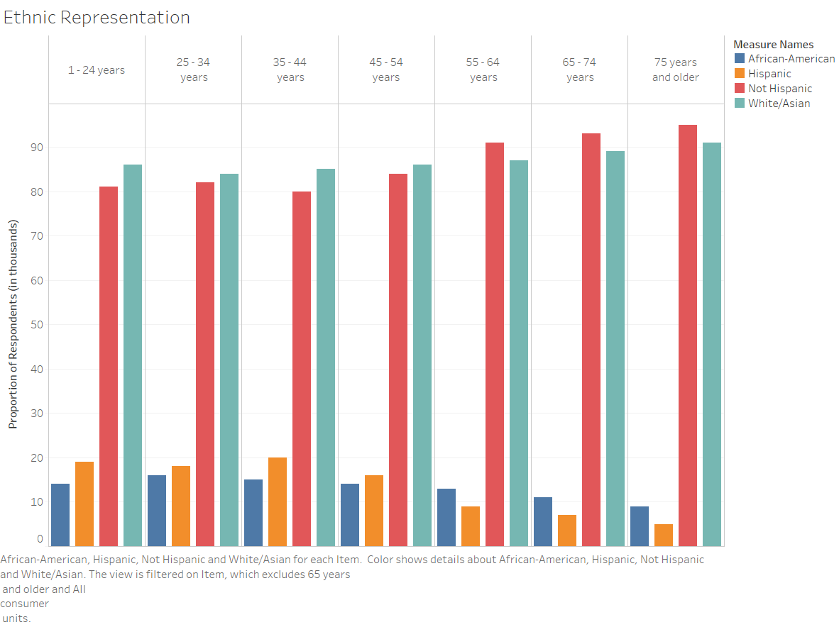
Participation of different ethnic race
Majority:
Non Hispanic
White/Asian

Slide 9
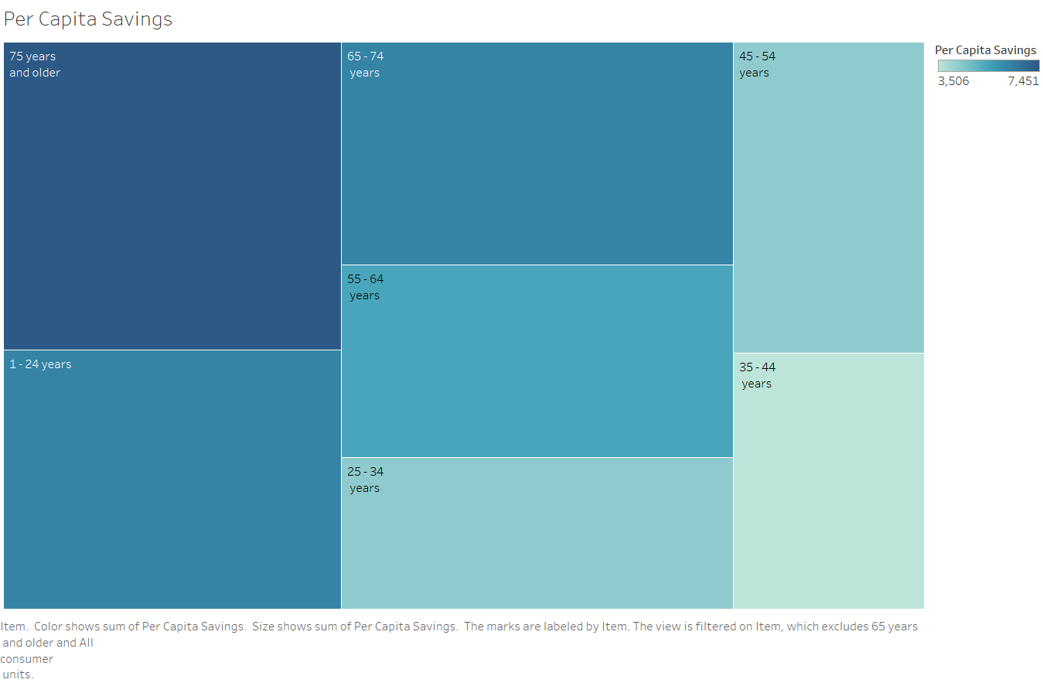
Per Capita Saving

Slide 10
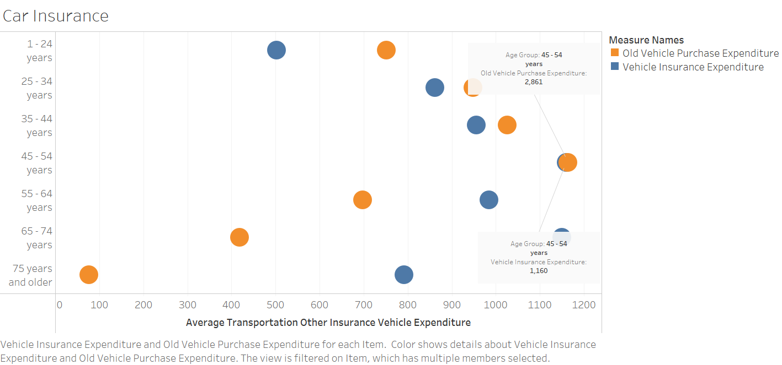

Slide 11



Inference for Business Targeting
Increasing trend of buying
vehicle insurance
Decreasing trend of buying
old vehicle
At age of 45-54 year we could
see vehicle insurance and
purchase at peak

Slide 12
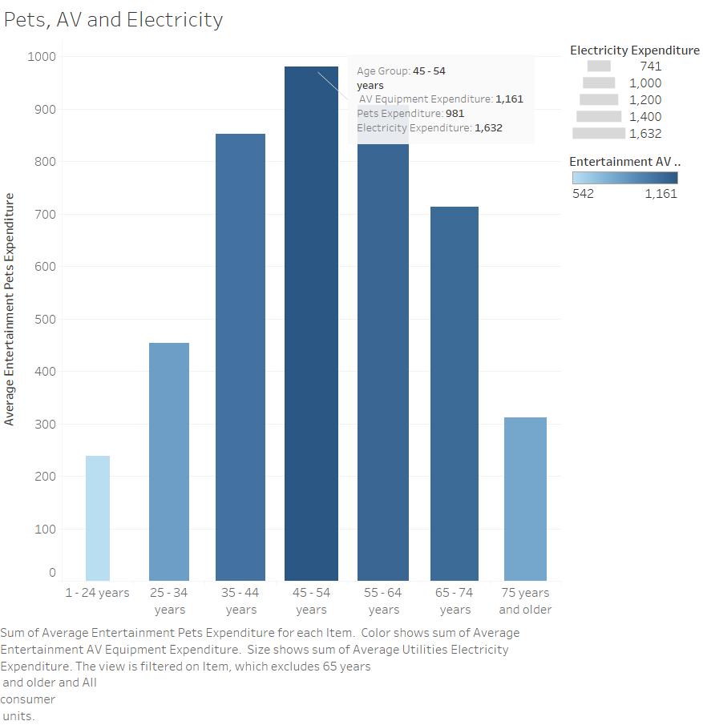
Inference for Business Targeting
Maximum Average pet owned by group age 45-50 years
Maximum electricity spent is by age group
45-54 years
1
2
Conclude : All these factors point that people with this age group spend more time at home.
4
3
Even most AV is expenditure is done by age group 45-54 years

Slide 13
Thank you

