Slide 1

MBA Topic Modeling
Jatin Chanana
Upendra Karki
Erin O’Brien
David Torgerson
Notes:
Intro: Erin

Slide 2
What We’ve accomplished since...
Gathered and cleaned the data
Integrated data into NodeXL
Built network graph to identify influencers and participants
Took comments and performed topic modeling using LDA

Slide 3
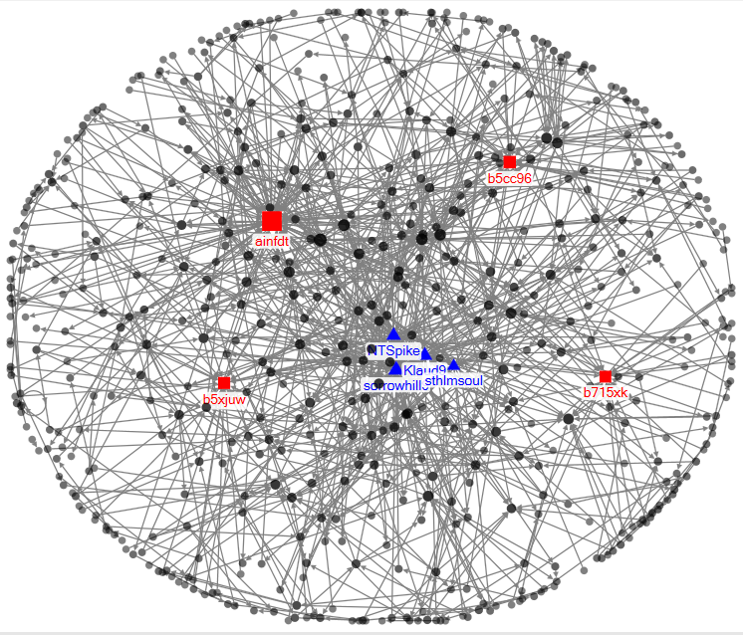
NodeXL Network Analysis
We’ve used people making comments as vertex one and those receiving the comments as vertex two.
Red Squares: Individuals receiving the most attention
Blue Triangles: Individuals exerting the most effort/energy
Notes:
David

Slide 4
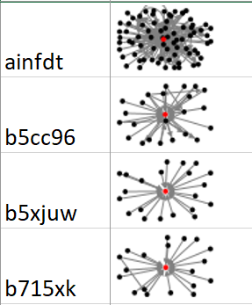
Key Influencers
Subgraphs of 1-degree network for attention receivers
Those who are receiving the most attention:
We looked at in-degree to determine who is receiving the most attention since they are receiving the most comments
These are the accounts we would give information to spread since they generate the most response
Notes:
David

Slide 5
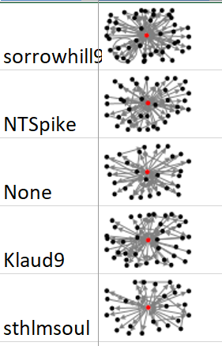
Key Participants
Sub graphs of 1-degree networks for attention givers.
Individuals were identified by looking at their out degree.
They are exerting the most effort; they’re good candidates to be administrators since they’re frequently active on the thread.
Note: “None” is shown which could be due to a deleted account or comment by someone without an account.
Notes:
David

Slide 6

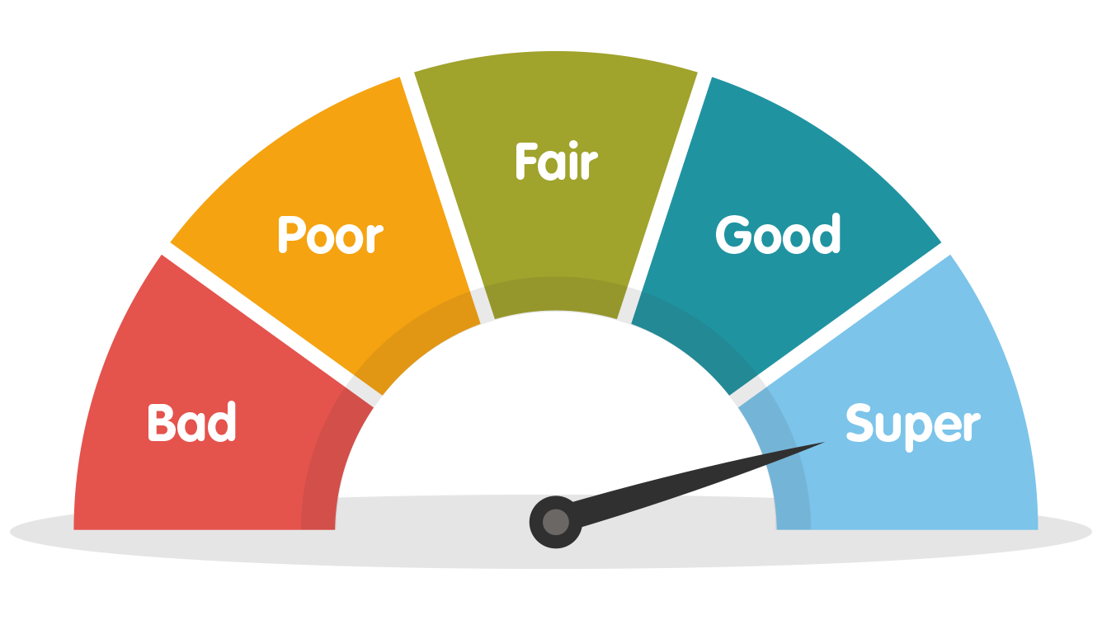


Topic Modeling
Topic modeling is a type of statistical modeling for discovering the abstract “topics” that occur in a collection of documents
Latent Dirichlet Allocation:
Unsupervised learning algorithm to create cluster of topics automatically that the given data set of sentence contains.
Assumption: Documents talking similar topics would use similar group of words
Preprocessing
Training
Score
Evaluate
Notes:
Upen/Jatin

Slide 7

Pre-processing
WORDS
WORDS
WORDS
WORDS
WORDS
WORDS
WORDS
WORDS
WORDS
WORDS
WORDS
WORDS
WORDS
WORDS
Minimum number of words to be present in an posts/comments
Word length
Stop word list
Lemmatization
Parts of speech
Remove words if words appear more than 10% of the article
Remove words if the words appear in less than 20 articles
X
X

Slide 8
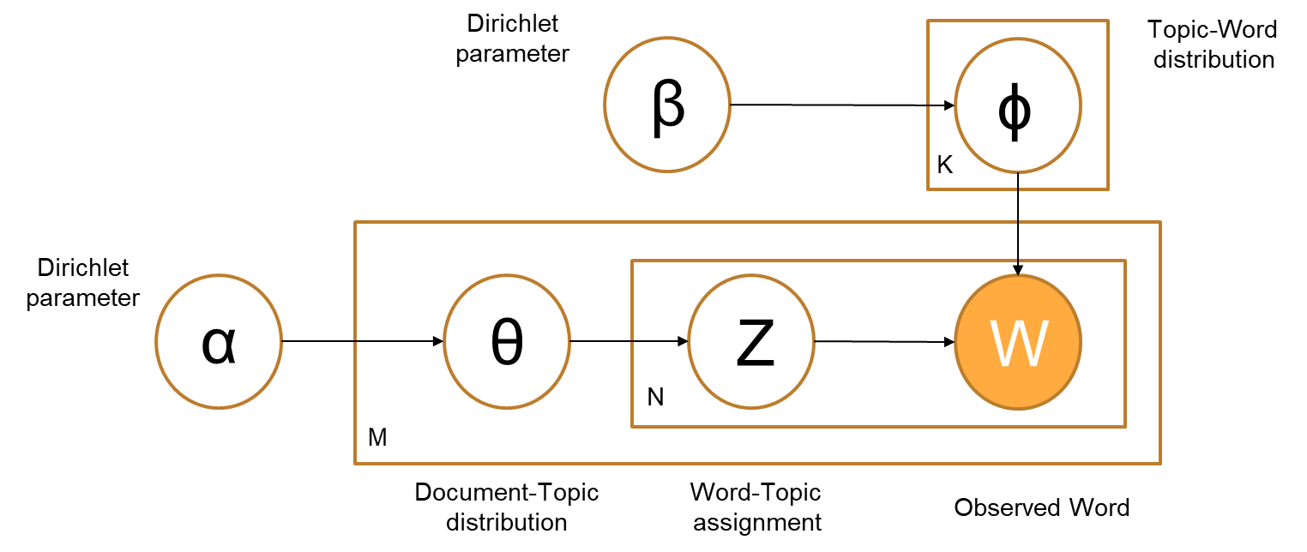
Graphical Model
Θ - topic distribution for document M
Z - topic for the N-th word in the document M
W - is the specific word
Document concentration –α (Per document topic distribution)
A high alpha-value means that each document is likely to contain a mixture of most of the topics.
Topic concentration – β (Per topic word distribution)
A high beta-value means that each topic is likely to contain a mixture of most of the words.

Slide 9
Simple Explanation
Recipe:
Topic1 Topic2 Topic 3
50% 30% 45%
Topic1 Topic2 Topic 3
P*w P*w P*w
P*w P*w P*w
P*w P*w P*w
P*w P*w P*w
P*w P*w P*w
P*w P*w P*w
Generate document according to the recipe
w w w w w w
w w w w w w
w w w w w w
w w w w w w
w w w w w w
Topic1 Topic2 Topic 3
P*w P*w P*w
P*w P*w P*w
P*w P*w P*w
P*w P*w P*w
P*w P*w P*w
P*w P*w P*w
w w w w w w
w w w w w w
w w w w w w
w w w w w w
w w w w w w
Figure out what the document describe it best
https://www.youtube.com/watch?v=3mHy4OSyRf0

Slide 10
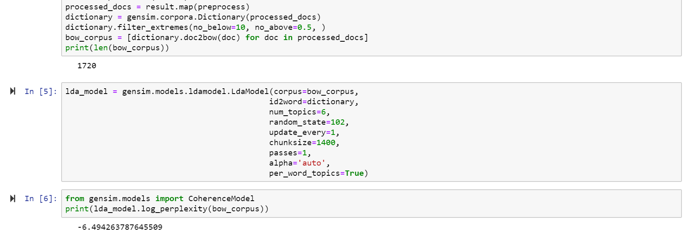
Training the Model

Slide 11
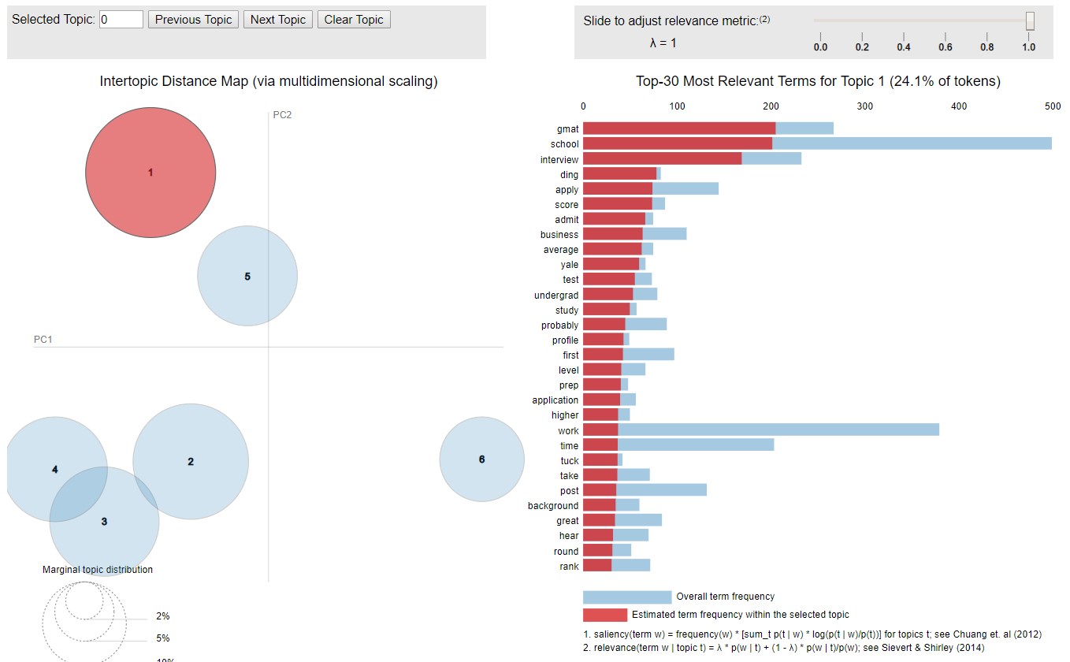

Slide 12
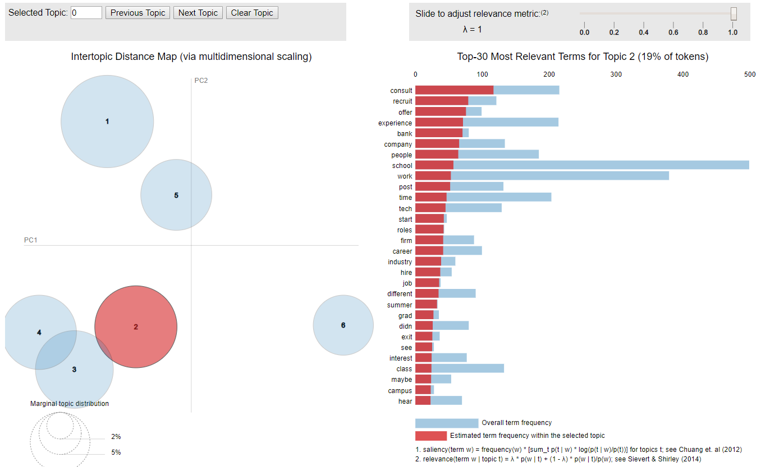

Slide 13
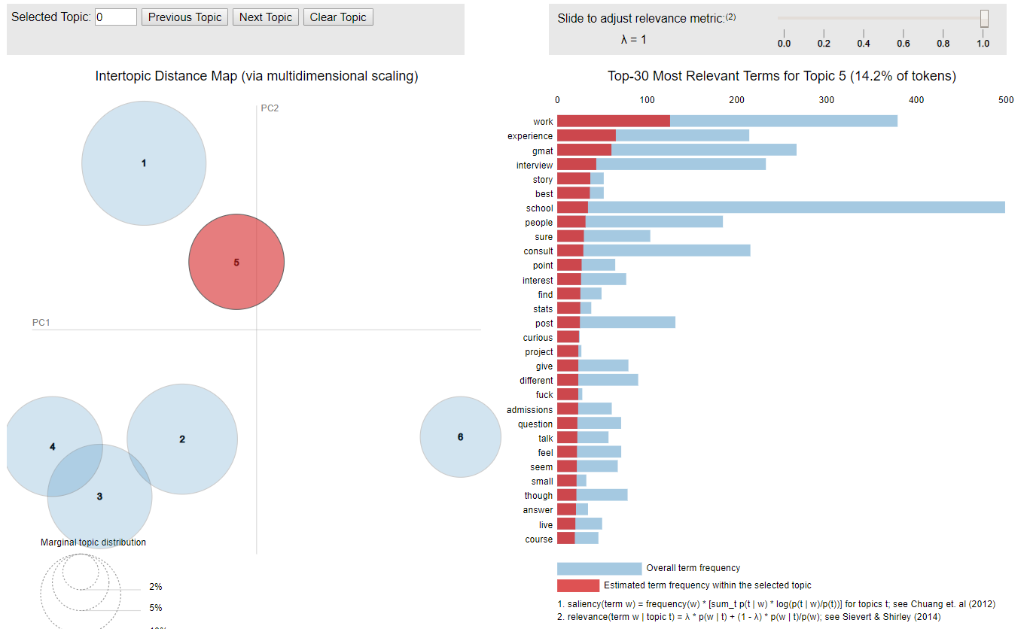

Slide 14
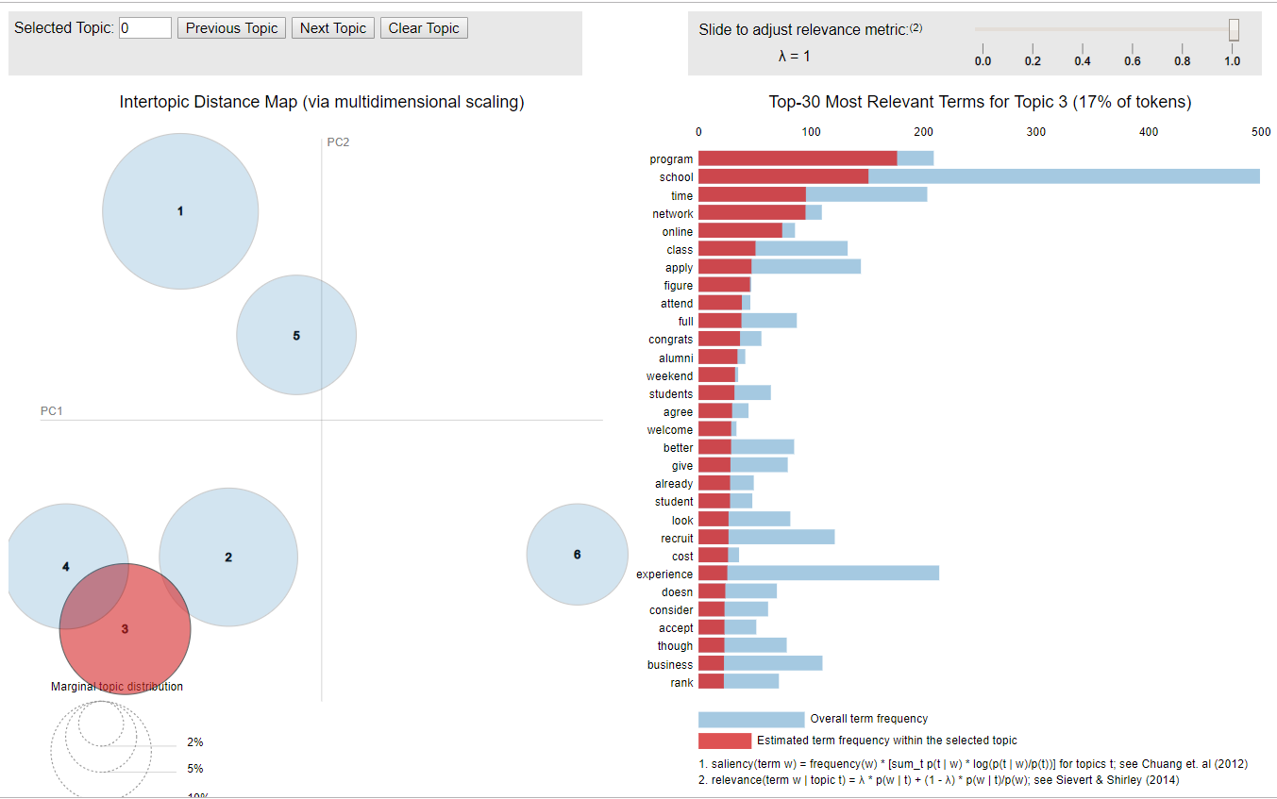

Slide 15
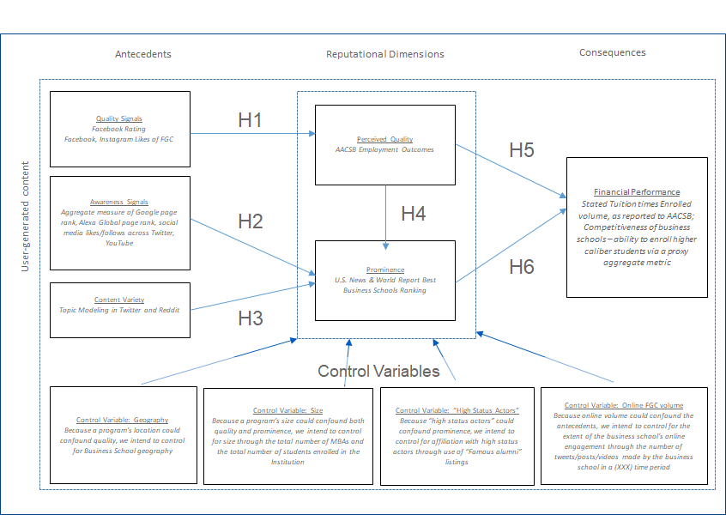
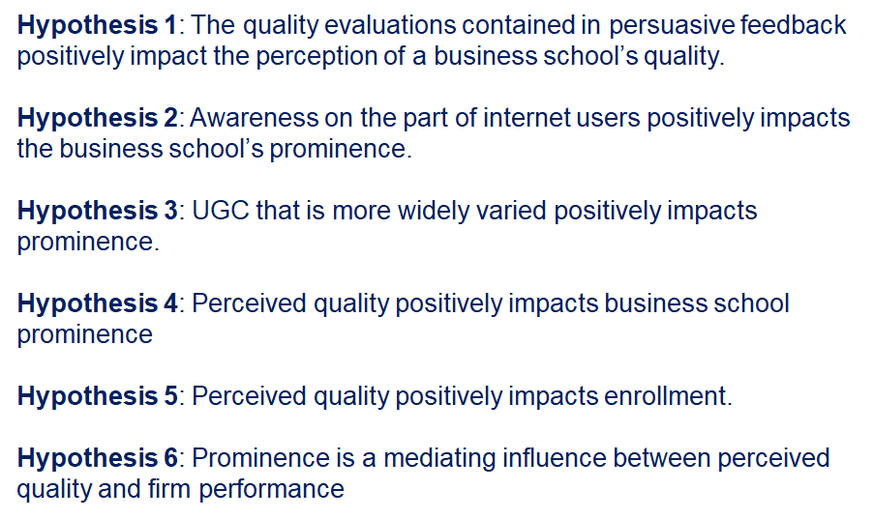
Why examine r/MBA data and relationships?
Reputation can create or destroy competitive advantage for a firm
UGC has higher impact on subsequent consumer choice than traditional marketing activities of the firm (Trusov et al., 2009).
Notes:
Erin

Slide 16
r/MBA Relationships and Topic Modeling
Who are the most active UGC voices in r/MBA?
For future research, we are interested in the “influencer” voices because they carry the most conversational UGC weight
What are they talking about?
One-, Three-, Ten-topic models
Themes of “work experience,” “consult,” a very limited number of schools - Wharton, Anderson, Kellogg, Booth
Questions to consider?
Limits of these UGC voices? Large? Small?
If they are admissions consultants, are they paid to direct interest in forums to particular schools?
Notes:
Erin

