Slide 1
A* algorithm
Atharva Dixit c38
Aditya Holkar c57
Upendra kadre c69
Swapnil katti c72

Slide 2
introduction
A* is one of the many search algorithm that take an input, evaluates a number of possible paths and returns a solution.
A* combines features of uniform-cost search and pure heuristic search to effectively compute optimal solutions
A* evaluates nodes by combining g(n) and h(n) f(n) = g(n) + h(n)
f(n) is called evaluation function
A* is both complete and optimal.

Slide 3
Evaluation Function
f(n) = g(n) + h(n)
f(n) is the estimated total cost of the cheapest solution through n
g(n) gives the path cost from the start node to node n
h(n) named as heuristic function is the estimated cost of the cheapest path
from n to the goal node.

Slide 4
Algorithm Process
Given: A graph of nodes, start, node, goal node
Aim: To find out the path from to with the minimum cost
Procedure
1. Create a search graph G, consisting solely of the start node s. Put s on a list called OPEN.
2. Create a list called CLOSED that is initially empty.
3. LOOP: if OPEN is empty, exit with failure
4. Select the first node on OPEN, remove it from OPEN and put it into CLOSED. Call this node n.

Slide 5
5. If n is a goal node, exit successfully with the solution obtained by tracing a path along the pointers from n to s in G.
6. Expand node n, generating the set M of its successors and install them as successors of n in G.
7. Establish a pointer to n from those members of M that were not already in G(i.e not already on either OPEN or CLOSED). Add these members of M to
OPEN. For each member of M that was already on OPEN or CLOSED, decide whether or not to redircet its pointer to n. For each member of M already
on CLOSED, decide for each its descendents in G whether or not to redirect its pointer.
8. Recorder the list OPEN, eitheraccording to some scheme or some heuristic merit
9. Goto LOOP

Slide 6
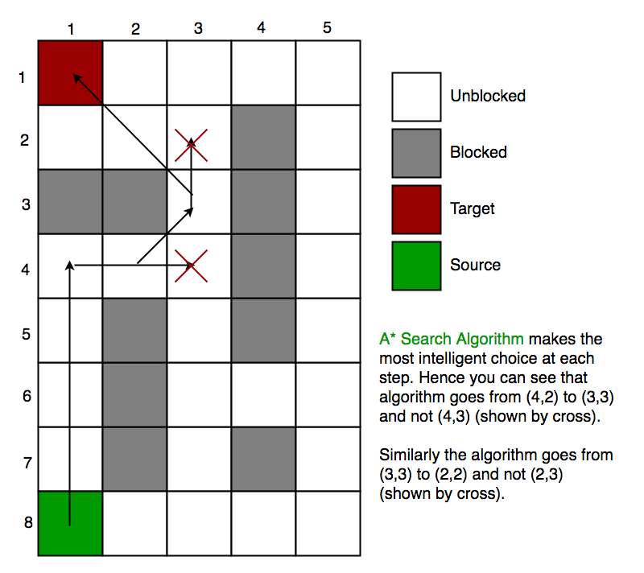

Slide 7
Conditions for Optimality
Admissibility
Consistency

Slide 8
Admissible Heuristics
A heuristic h(n) is admissible if for every node n, h(n) ≤ h*(n), where h*(n) is the true cost to reach the goal from n.
An admissible heuristics never overestimates the cost to reach the goal
Property: The tree-search version of A* is optimal if h(n) is admissible

Slide 9
Consistent Heuristics
A heuristic is consistent if for every node n, every successor n’ of n generated by any action a,
h(n) ≤ c(n, a, n’) + h(n’)
If h is consistent, we have
f(n’) = g(n’) + h(n’)
= g(n) + c(n, a, n’) + h(n’)
f(n’) ≥ g(n) + h(n) ➔ f(n’) ≥ f(n)
Property: The graph-search version of A* is optimal if h(n) is consistent.

Slide 10
Time Complexity
The time complexity depends on heuristic function
In worst case of an unbound search space: O(bd)
The time complexity is polynomial when
Search space is tree
There is a single goal state
Heuristic function meets: | h(x) – h*(x)| = O(logh*(x)), where h* is the optimal heuristic, the exact cost to get from x to the goal

Slide 11
Conclusion
Advantage:
The A* algorithm is complete, optimal, and optimally efficient among all such algorithms.
Disadvantage:
A* is not practical for many large-scale problems, due to space time complexity is O(bd). That means A*
usually runs out of space long before it runs out of time.
Applications
Network routing
Image processing
A.I path finding

Slide 12
Reference
Artificial Intelligence: A Modern Approach, third edition by Stuart Russell & Peter Norvig
https://en.wikipedia.org/wiki/A*_search_algorithm
https://www.ics.uci.edu/~welling/teaching/ICS175winter12/A-starSearch.ppt
http://theory.stanford.edu/~amitp/GameProgramming/AStarComparison.html
http://web.mit.edu/eranki/www/tutorials/search/

