Slide 1
The New SDBM Data Model
The SDBM captures manuscript descriptions as described in various sources, and connects descriptions about the same manuscript together to create a history of that manuscript’s transmission across time

Slide 2
The SDBM isn’t really a database of manuscripts, it’s a database of sources about manuscripts, e.g.: catalogs from auctions, booksellers, and private collections; census and inventory data; personal observations from users

Slide 3
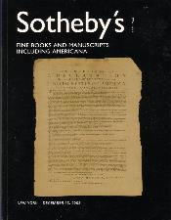
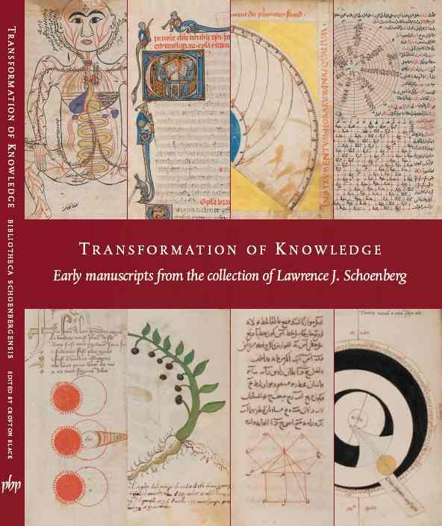

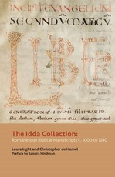
The SDBM gathers data from various sources that describe manuscripts
SDBM

Slide 4
The SDBM DOES NOT own any manuscripts. The SDBM DOES NOT make any objective claims about the reality of a manuscript’s descriptive characteristics or provenance history. The SDBM reflects what its Sources record about the manuscripts.

Slide 5
SDBM Data Model
The SDBM is composed of three main entities: Sources, Entries, and Manuscript Records.
Entries are descriptions of manuscripts derived from Sources
Entries that describe the same manuscript are linked together via a Manuscript Record

Slide 6
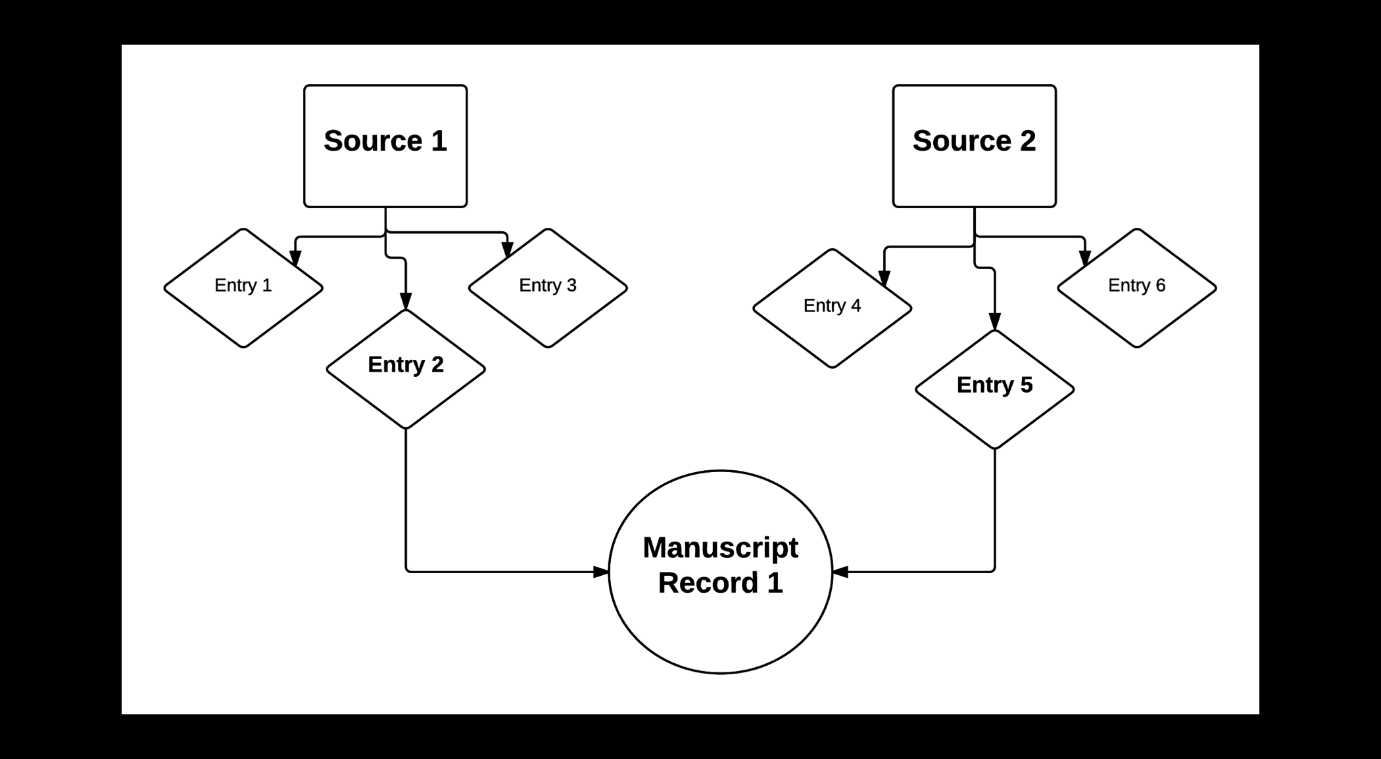
Basic SDBM Data Model

Slide 7
Source
Information resource about manuscripts:
Auction/Sale Catalogs
Private Collection Catalogs
Online-only Auction and Bookseller Websites
Other Published Sources
Unpublished Sources
Personal Observations

Slide 8
Sources, cont.
Each Source in the SDBM has its own ID number.
Each Source has an About page that includes its description and links to every entry derived from it in the database.
Click on any SDBM_SOURCE_ID number while in the database to go to that source’s About page.

Slide 9
Entry
An entry is a description about a single manuscript as described in a Source
An entry repeats verbatim the information recorded in its Source
Each entry has its own SDBM_ID number
Entries about the same manuscript can be linked together. These links are what make up a Manuscript Record

Slide 10
Manuscript Record
Represents a physical manuscript
Entries that describe the same manuscript are linked together via the Manuscript Record
Each Manuscript Record has its own About that includes its description, a composite provenance list, and links to every entry it includes
Click on an SDBM_MS_ID number in the database to go to that Manuscript Record’s About page

Slide 11
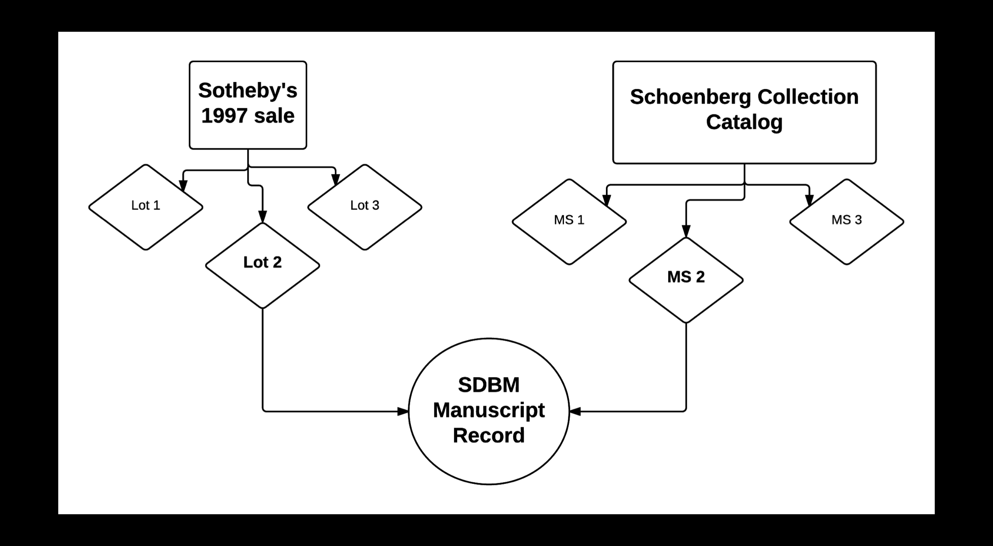
Example:

Slide 12
Additional Resources
From the Help menu in your Dashboard:
User Manual PDF
Data Definitions PDF
Video Tutorials
Questions or comments, email us at sdbm@upenn.edu

