Slide 1


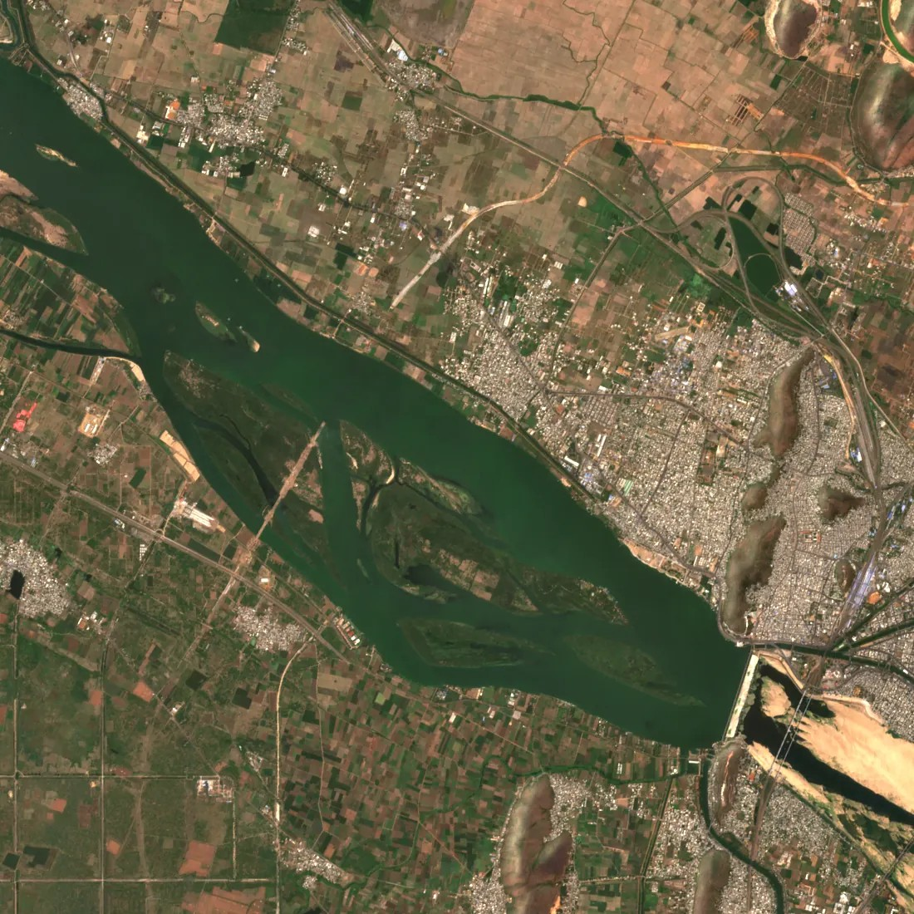
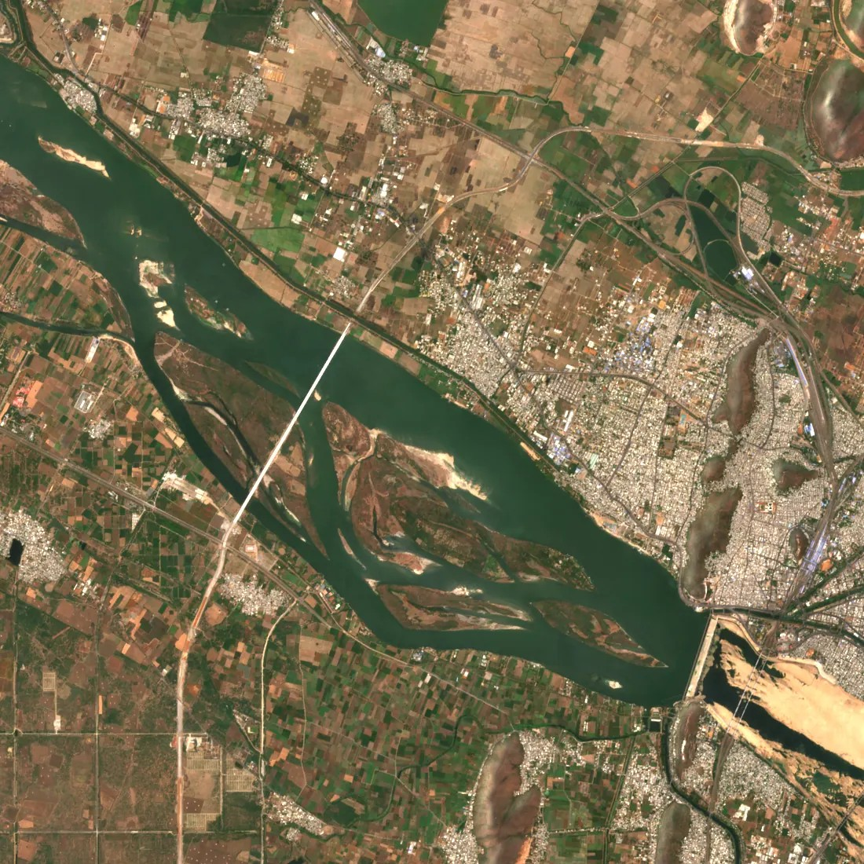




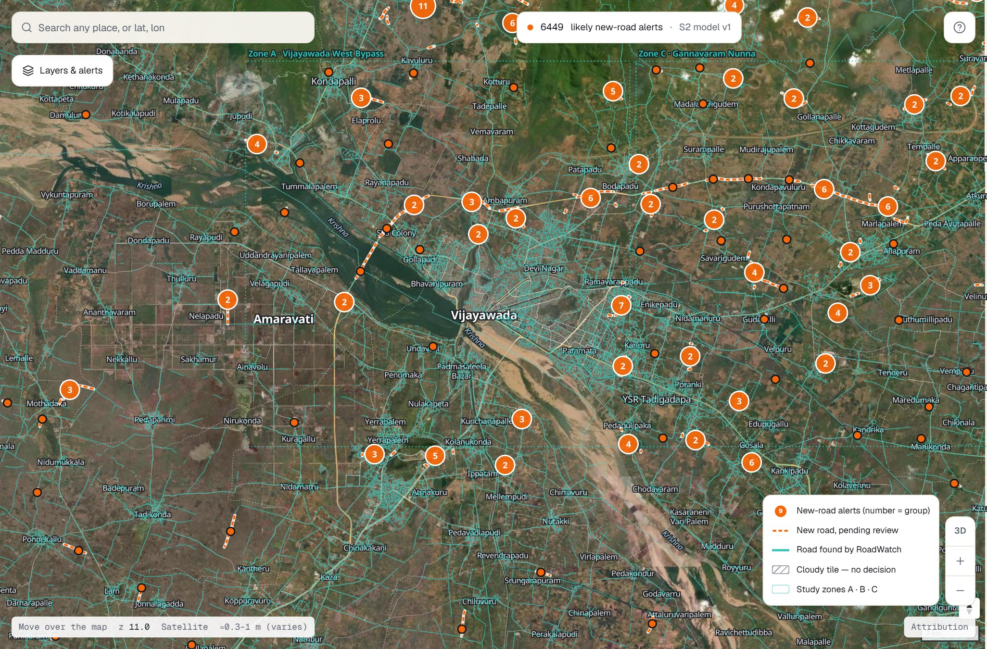


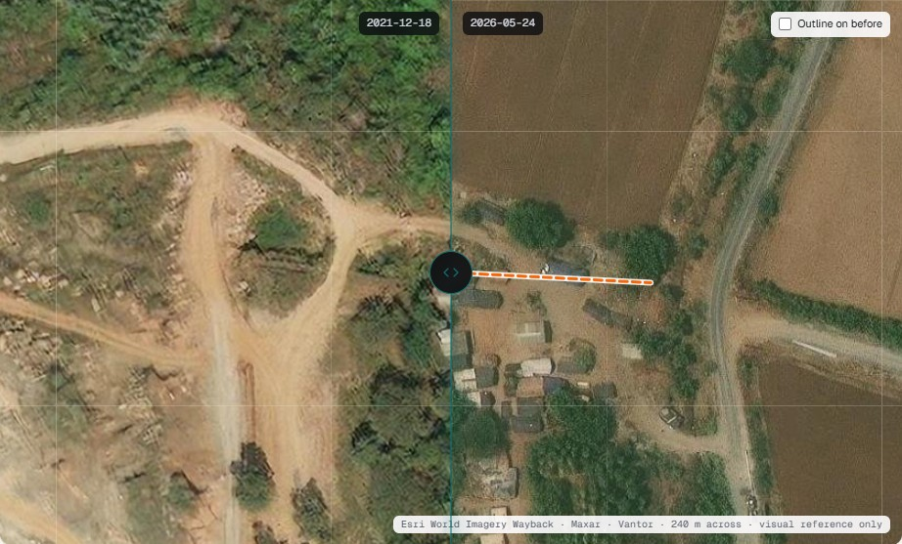


RoadWatch AP
Automatic Road Extraction and New-Road Change Alerting from Multi-Temporal Satellite Images
[Student name(s)] · [Register number(s)] · Guide: [Guide name], [Designation]
Scan: live demo
Department of CSE · KONERU LAKSHMAIAH EDUCATION FOUNDATION
SIH1564 (NTRO) · CLIMATE-06
The problem
Roads change every season, but maps are updated by hand — slowly and incompletely, so planning and monitoring work from out-of-date evidence.
Our goal
2022
2024
Read free satellite images, map every road and raise trustworthy alerts for genuinely new roads — each with before/after proof.
Sentinel-2 (10 m), Vijayawada: the new NH16 West Bypass bridge across the Krishna appears between the two seasons.
How it works
1
Composite
2
Segment
3
Vectorise
4
Compare
5
Confirm
6
Alert
Median of the 8 least-cloudy passes per season
U-Net (ResNet) road probability, ONNX
Skeleton → road graph per season
2022 baseline vs every later season
Seen ≥ 3 later dates; cloudy = abstain
Score, stable id, flags, evidence
Alert score = model confidence × persistence × connectivity × data quality
Results at scale — live at roadwatch-ap.onrender.com
11,920
alerts published
AP · Tamil Nadu · Hyderabad · Bengaluru
6,449
likely new roads
5,471 flagged as probably not new
2.9 lakh km
roads extracted
served as map vector tiles
98.7 %
of South India mapped
all-India map in progress
Teal = roads extracted by RoadWatch · orange = new-road alerts
Change detection vs baselines (zones A–C)
Road extraction models
Conclusion
Future scope
Deployed end to end; 16× fewer alerts than pixel difference
KPIs measured honestly; 14/14 negative tests pass
Updates itself twice a year — no manual step
All-India map; multi-year training
Sentinel-1 radar for monsoon months
Field validation; reviews feed retraining
Every alert has proof: before | after

