Slide 1

REVIEW-II
RoadWatch AP — Automatic Road Extraction and New-Road Change Alerting from Multi-Temporal Satellite Images
Smart India Hackathon SIH1564 (NTRO) · KL Capstone CLIMATE-06
[Student name(s)]
[Register number(s)]
Under the Guidance of
[Guide name]
[Designation]
Department of Computer Science & Engineering
KONERU LAKSHMAIAH EDUCATION FOUNDATION
Notes:
Title slide. Fill in the student names, register numbers and guide before the review.

Slide 2
OUTLINE
1
Introduction
7
Detailed Design & Data Flow
2
Problem Statement & Objectives
8
Implementation & Unit-Level Progress
3
Functional & Non-Functional Requirements
9
The Live System
4
Alternative Solutions & Trade-off Analysis
10
Testing & Results
5
Complete System Architecture
11
Conclusion & Future Scope
6
Technology Stack & Design Rationale
Notes:
Eleven sections, following the Review-II format.

Slide 3
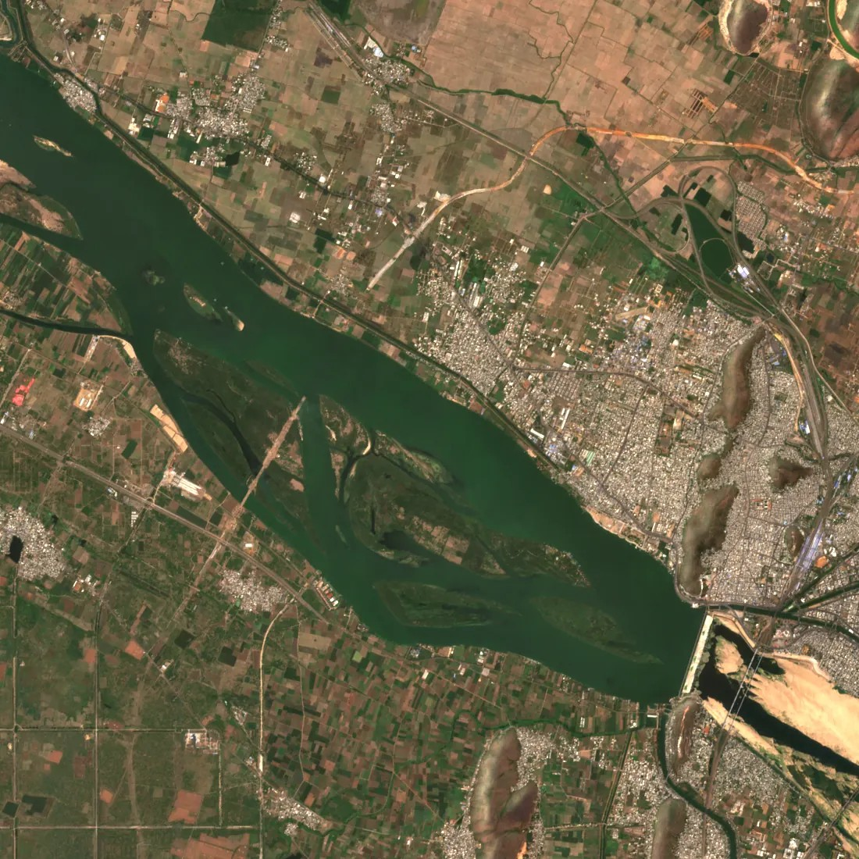
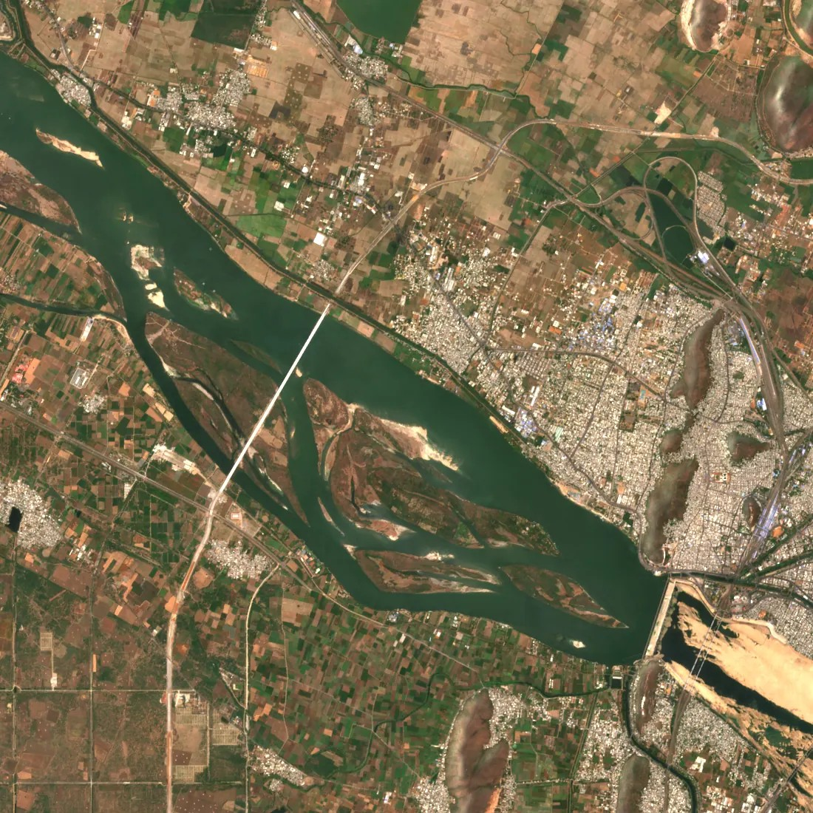
INTRODUCTION
Roads change every season; maps are updated by hand, slowly and incompletely
Unseen new roads mean planning, logistics and monitoring work from out-of-date evidence
RoadWatch reads free Sentinel-2 satellite images (10 m, every 5 days), maps every road and alerts on genuinely new ones — with before/after proof
Built for SIH1564 (NTRO); runs for Andhra Pradesh, Tamil Nadu, Hyderabad, Bengaluru and is being extended to all of India
Pre-monsoon 2022
Pre-monsoon 2024
Same place, two years apart
Vijayawada West Bypass (NH16): the new bridge across the Krishna appears between the two Sentinel-2 seasons — the kind of change RoadWatch alerts on.
Notes:
Real Sentinel-2 L2A composites from the project (zone A). The bridge is the new West Bypass across the Krishna.

Slide 4






PROBLEM STATEMENT & OBJECTIVES
Road networks change constantly and keeping maps current by hand is slow and incomplete, so spatial decisions are made from misaligned, incomplete or weakly validated evidence. Goal: extract roads automatically from satellite images and raise trustworthy alerts for new ones.
O1
O2
O3
O4
O5
Validate the problem
Robust road extraction
Change over time
Alerts with proof
Independent validation
Charter, requirements, risk register, source-to-claim map
U-Net on Sentinel-2; frozen spatial holdout; 95 % CIs
Graph comparison across 9 seasons, persistence, abstain
Scored alerts, evidence chips, flags, live web app
KPIs vs OSM history, negative tests, all-India check
Done
Done
Done
Done
In progress
Notes:
Five objectives from the KL charter; O5 (independent validation) continues in CP2.

Slide 5
FUNCTIONAL & NON-FUNCTIONAL REQUIREMENTS
Functional
Non-functional
FR-1
Ingest Sentinel-2 L2A + OSM labels with provenance and quality gates
Met
NFR-1
Performance: KPIs with 95 % CIs, resource cost recorded
Partly
FR-2
One-command reproducible training runs (config hash per run)
Met
NFR-2
Reliability: all negative tests pass (14/14)
Met
FR-3
Change detection as a separate, tested subsystem
Met
NFR-3
CRS, registration, cloud cover explicit and checked
Met
FR-4
Alert layer: score, evidence, input/output contracts
Met
NFR-4
Frozen spatial holdout — no train/test leakage
Met
FR-5
CLI pipeline: s2-build · infer · detect · serve
Met
NFR-5
Git, CI, automated tests, Docker build
Met
FR-6
Complete, deployed system — not a notebook
Met
NFR-6
Operability: health, degraded mode (abstain), guides
Partly
Notes:
Status from docs/charter/02_requirements.md. NFR-1 and NFR-6 are partly met: KPI-4/5 and a verified recovery drill are CP2 work.

Slide 6
ALTERNATIVE SOLUTIONS & TRADE-OFF ANALYSIS
Approach | Data | Measured | Decision
Pixel difference (classical) | Same model, 2 dates | 6,826 alerts, precision 0.20 | Baseline only
U-Net ResNet-34 (Baseline A) | DeepGlobe 0.5 m RGB | Test IoU 0.501 | Reference; 0.5 m data not free statewide
Frozen DINOv3-sat ViT-L (Ref. B) | DeepGlobe 0.5 m RGB | Test IoU 0.356 | Rejected (below A)
U-Net on Sentinel-2 10 m | Andhra Pradesh, 4 bands | Test IoU 0.320 → 0.344 | Chosen: free, 5-day revisit, statewide
Graph comparison over 9 seasons cuts reviewer load 16× vs pixel difference; pixel difference with 30 m tolerance stays a strong baseline (see Results).
Notes:
All Sentinel-2 comparisons are paired on the same images with bootstrap CIs (ADR-029). ResNet-50 ImageNet is best (+0.028 over v2); SSL4EO pretraining was rejected on validation.

Slide 7





COMPLETE SYSTEM ARCHITECTURE
Sources
Kaggle (free CPU / GPU)
Merge & publish
Serve (Render)
Sentinel-2 L2A (Planetary Computer)
OpenStreetMap (Geofabrik, ohsome)
Esri Wayback (sharp reference)
Seasonal composites
Model training (U-Net)
Statewide screening runs
Merge, stable ids, flags
Road vector tiles, bundle
GitHub release + commit
FastAPI: alerts, evidence, tiles
React + MapLibre web app
Reviews → training labels
GitHub Actions scheduler
Twice a year (5 Jun, 5 Jan) it builds the new season on Kaggle, re-screens, merges, flags and republishes the site with no manual step. CI runs lint, tests, holdout check and a Docker smoke test on every push.
Notes:
Heavy work runs on Kaggle; the 512 MB web server only serves pre-built files. ADR-021 (deploy) and ADR-031 (automatic seasons).

Slide 8



TECHNOLOGY STACK & DESIGN RATIONALE
Geospatial data
Machine learning
Free, repeatable imagery with recorded provenance
CPU inference anywhere; paired evaluation with CIs
Sentinel-2 L2A via STAC
rasterio / GDAL, GeoPandas, Shapely
Deterministic UTM tile grid
PyTorch + segmentation-models
U-Net, ResNet-34 / 50 encoders
ONNX Runtime for inference
Web & API
Ops & quality
Fast map of ~1 M road lines on a 512 MB server
Every claim reproducible from a config hash
FastAPI (Python 3.11)
React, TypeScript, Vite
MapLibre GL vector tiles, three.js
Docker on Render
Kaggle runs, GitHub Actions
pytest (88 tests), ruff, CI
Notes:
Design rationale is recorded as ADRs in DECISIONS.md.

Slide 9


DETAILED DESIGN & DATA FLOW
1
2
3
4
5
6
Composite
Segment
Vectorise
Compare
Confirm
Alert
Median of the 8 least-cloudy passes per season, 10 m, 4 bands
U-Net road probability per 5.12 km tile (ONNX)
Threshold → skeleton → road graph per season
2022 baseline (25 m buffer) vs every later season
Seen on ≥ 3 later dates, stability ≥ 0.75; cloudy = abstain
Score, stable id, flags, before/after evidence
Alert score = model confidence × persistence × connectivity × data quality
Stable ids
An alert overlapping an earlier one keeps its id, so reviews stay on the same road
Flags
On a road OSM already had in 2022, or a short line inside dense buildings → listed apart
Quality gates
Mixed CRS or out-of-order seasons are refused; registration error ≤ 1 px
Notes:
src/roadwatch/change/detect.py (ADR-020), change/ids.py (stable ids), scripts/alert_flags.py (ADR-026).

Slide 10
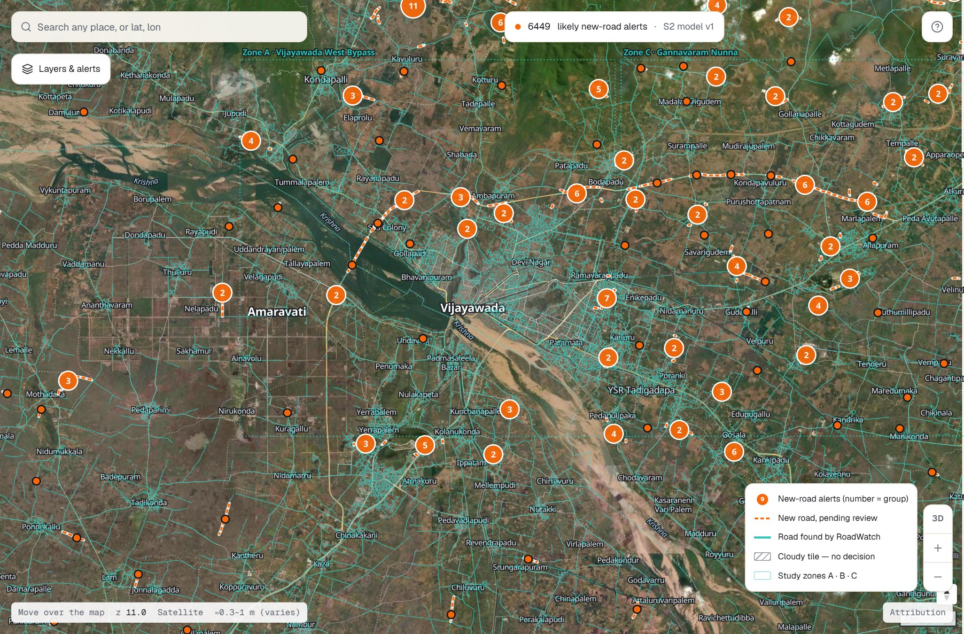
IMPLEMENTATION & UNIT-LEVEL PROGRESS
11,920
alerts published
AP, Tamil Nadu, Hyderabad, Bengaluru
6,449
likely new roads
5,471 flagged as probably not new
2.9 lakh km
roads extracted
served as map vector tiles
98.7 %
of South India mapped
64,327 of 65,166 tiles; North running
Live map, Vijayawada: teal = roads extracted by RoadWatch, orange = new-road alerts (numbers = clusters)
Notes:
Numbers from the published data bundle (2026-10-27) and reports/india_map_check.md (2026-10-29).

Slide 11
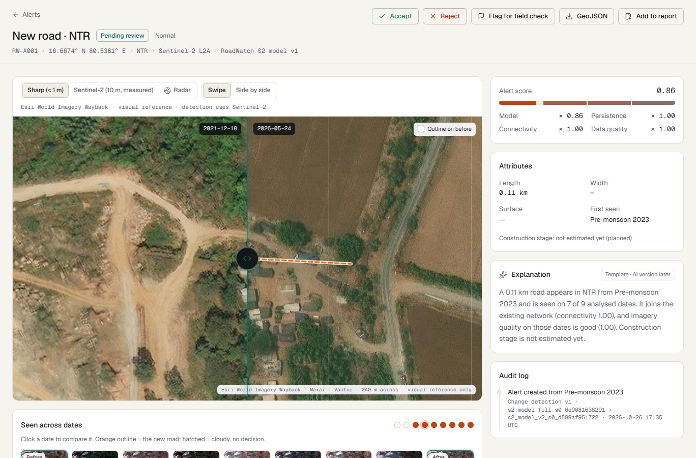


THE LIVE SYSTEM — EVERY ALERT WITH PROOF
Before / after
Sharp Esri Wayback imagery for reference; detection itself uses Sentinel-2
Seen across dates
Filmstrip of all 9 seasons: seen, absent or cloudy
Accept / reject / flag
Decisions are exported as training labels
Try it
roadwatch-ap.onrender.com
Notes:
Screenshot of the deployed site (alert RW-A001). The site is public and read-only; decisions stay in the browser.

Slide 12
TESTING & RESULTS
Check | What was measured | Result
KPI-1 Road extraction | Pixel IoU, AP spatial holdout, 95 % bootstrap CI | 0.344 (ResNet-50); v1 0.320 [0.300, 0.338]
KPI-2 New-road precision | Alerts vs OSM history 2022 → 2026, zones A–C | 0.364 [0.305, 0.427]
KPI-3 False alerts | Alerts on roads OSM already had in 2022 | 0.368 vs 0.444 pixel difference (−17 %)
KPI-6 Registration | Shift between seasons, 522 tile pairs | median 0.071 px; 100 % ≤ 1 px
Negative tests NT-1…NT-5 | Occlusion, seasonal tracks, CRS, cloud, shift | 14 / 14 pass
Engineering | Automated tests + CI (lint, holdout, Docker) | 88 tests pass; site API 3–4 s → 0.34 s
Honest reading: extraction is measured with confidence intervals and every engineering check passes; change detection beats raw pixel difference, but about 1 in 3 alerts still lies on an old road — those are now flagged and listed apart.
Notes:
Sources: reports/kpi1_cp1.md, kpi23_change_eval.md, kpi6_registration.md, negative_tests.md; ADR-029.

Slide 13
CHANGE DETECTION VS BASELINES
413
alerts to review
vs 6,826 from pixel difference — 16× less work
0.364
precision
above pixel difference (0.201); below the 30 m-tolerant variant (0.481)
5,471
alerts flagged
lie on 2022 OSM roads or are short lines in built-up areas
Notes:
reports/kpi23_change_eval.md. Root cause of the false alerts: models trained on 2025–26 imagery under-extract old roads in 2022 composites (ADR-024/027); multi-year training with dated labels addresses it.

Slide 14

CONCLUSION & FUTURE SCOPE
Conclusion
Future scope
A complete, deployed system: satellite images in, new-road alerts with proof out
Extraction measured honestly on a frozen holdout (best test IoU 0.344)
Change detection cuts reviewer load 16× and every alert carries evidence
Updates itself twice a year — no laptop, no manual step
Finish the all-India map (North half running) and close the remaining gaps
Multi-year training to cut alerts on old roads (root cause found)
Sentinel-1 radar for the cloudy monsoon months
Field validation with district officials; reviews feed retraining
0.344
best test IoU (extraction)
16×
fewer alerts than pixel difference
11,920
alerts live, updated twice a year
Notes:
Next steps follow ADR-024/027 and the all-India plan (ADR-025).

Slide 15
THANK YOU
Questions?
roadwatch-ap.onrender.com

