Slide 1
C-1 LEADERSHIP BRIEFING
Should we proceed with the acquisition?
What the evidence supports, what remains unproven, and what must be validated before the Executive Committee commits
Healthcare acquisition decision
Version 1.1 | 31 October 2026
Confidential
Based on simulated (fictional) stakeholder interviews prepared for the hackathon; not real client evidence.
Level 2 of 3: reasoning behind the C-suite paper (PDF), backed by the working-group document (DOCX).

Slide 2
EXECUTIVE DECISION PACK 1 / 5
Executive recommendation: PAUSE pending validation. Do not commit capital yet.
PAUSE
Why not proceed
Every one of eight stakeholders conditions support; four set explicit pause or red-flag rules.
No statement describes the target; all 95 say what to test.
Not proceed. Not reconsider. Test the deal on five gates in 12 weeks, then decide.
Why not reconsider
0
5
12
Nothing says the target is poor either: absence of evidence is not evidence of a bad deal.
The strategic upside is real but unproven, and a partner or rival may move: keep the option, time-box the test.
verified facts about the target
gates to pass
weeks to a decision
Healthcare acquisition decision | C-1 leadership | Version 1.1 | Based on simulated (fictional) stakeholder interviews prepared for the hackathon; not real client evidence.
2

Slide 3
EXECUTIVE DECISION PACK 2 / 5
Key evidence: eight stakeholders, one message. Prove it before you pay for it.
Stakeholder (8 of 8) | Asks for verification beyond management claims
CSO | "We should show what we know, what management claims, and what remains untested."
Commercial | "We should validate claims with customer references and independent sources rather than relying only on the target's pitch deck."
CMO | "I would ask how quality is measured, over what period, against which comparator, and who independently verified the data."
Regulatory | "We should reconcile management's answers with original records."
CIO | "A policy document alone does not prove controls work."
CFO | "Reconcile reported revenue to contracts, invoices, cash collections and underlying activity."
COO | "A market forecast does not tell us whether the target can safely deliver the extra demand."
Regional | "The team should show where the target has a credible route to adoption, what local barriers remain, and which assumptions are supported by customer evidence rather than management optimism."
Four set stop rules
CSO, CMO, Regulatory, CFO each state when to pause, escalate or treat as a red flag.
External check
Buyers cite high valuations, target-performance uncertainty and competition for scarce targets as top obstacles (KPMG, Jan 2026): the same gaps the stakeholders name.
Source: Trainer's simulated interviews; 95 sentences machine-checked; classification by us. Based on simulated (fictional) stakeholder interviews prepared for the hackathon; not real client evidence.
3

Slide 4
EXECUTIVE DECISION PACK 3 / 5
Strategic implications: five insights shape what must be true before we proceed
# | Insight (details and evidence IDs in the working-group document, section 7)
1 | The deal thesis is a hypothesis: nobody has shown the target owns the advantages, or that a partnership could not deliver them.
2 | A large market is not an accessible market: access, adoption and cash conversion must be proven country by country.
3 | Permission to operate and clinical quality sit upstream of value: one licence, safety or conduct red flag can end the deal at any price.
4 | The headline price is not the cost: remediation, cyber, working capital, retention and integration are unquantified, so no valuation is defensible yet.
5 | Integration can create the risk it is meant to remove: continuity of care, supply and data integrity must be protected from Day 1.
Each insight is backed by exact quotes and, where available, an external source with date and credibility rating.
Healthcare acquisition decision | C-1 leadership | Version 1.1 | Based on simulated (fictional) stakeholder interviews prepared for the hackathon; not real client evidence.
4

Slide 5
EXECUTIVE DECISION PACK 4 / 5
Major risks and uncertainties: the biggest one is that we do not yet know what is being bought
Risk or uncertainty | Why it matters | What we do
Cost of pausing: a rival acquires the target | KPMG survey lists competition for limited targets among top obstacles (EC-04); Indian deal volumes are at a series high (EC-06) | Time-box to 12 weeks; ask counsel whether limited exclusivity is appropriate; keep walk-away discipline
Target data may not exist or may not be shared | All stakeholders rely on data not yet seen | Make data access a Gate 1 condition; treat refusal as information
Findings are all hypothetical until target data arrive | 0 of 95 statements verifies anything about the target | Do not publish recommendations to proceed before gates pass
Regulatory facts change | Several Indian rules moved in 2024-26 (DPDP, FDI, MDR drafts) | Counsel confirms against the Gazette at each gate
Gun-jumping or information-sharing breach | Standstill and penalties (RC-04) | Clean-team protocol approved by counsel
Bias toward the deal ("management optimism", INT-08-A5-S2) | Strategy sponsor may favour proceeding | Independent reviewers; evidence classes labelled throughout
Also open: tax, legal contracts, people, ESG, IP and litigation are not covered by any interview and are added to the plan.
Healthcare acquisition decision | C-1 leadership | Version 1.1 | Based on simulated (fictional) stakeholder interviews prepared for the hackathon; not real client evidence.
5

Slide 6
EXECUTIVE DECISION PACK 5 / 5
Prioritised next steps: five actions, decision at week 12
Step | What | Owner | By
Confirm what is being bought | Target business model, countries and thesis owner; fix the scope of every other test. | CSO | Week 2
Issue the diligence data requests | Commercial, regulatory, quality, financial, technology and operations records; reconcile with original documents. | Deal team | Week 2
Appoint independent reviewers | Quality-of-earnings, clinical or quality review, cyber assessment, regulatory and anti-bribery counsel. | CFO; CMO; CIO; Legal | Week 3
Set the investment thresholds | Client-defined return and risk thresholds that Gate 4 will test; we do not supply numbers. | CFO; ExCo | Week 3
Control contact with the target | Clean-team and no-integration-steps protocol before any sensitive information is shared. | Legal | Week 1
Week-12 rule: all five gates pass and thresholds met = proceed to binding offer; any uncured stop condition = reconsider; otherwise continue the pause with a named evidence list.
Healthcare acquisition decision | C-1 leadership | Version 1.1 | Based on simulated (fictional) stakeholder interviews prepared for the hackathon; not real client evidence.
6

Slide 7
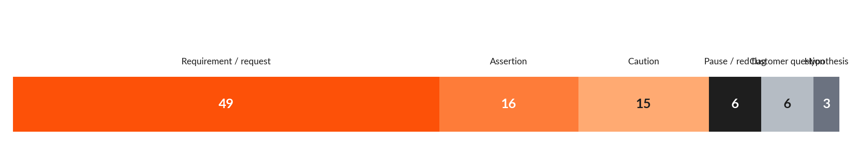
BACKUP
The evidence base: 95 statements, 8 stakeholders, no verified facts and no figures about the target
95
0
sentences, quote-checked
verified facts
Type | Meaning
REQ | Diligence requirement or evidence request (49)
CAU | Caution or warning against an assumption (15)
GATE | Pause, escalation or red-flag condition (6)
ASS | Stakeholder assertion about how healthcare works (opinion) (16)
HYP | Strategic hypothesis about the target (3)
Q | Question to put to customers (6)
What this means
The interviews tell us what to test, not what the target is.
The only numeral is "first 100 days", a planning horizon.
Competitor comparison is not established: no target or country was specified.
Source: Trainer's revised interview set; classification by us. Based on simulated (fictional) stakeholder interviews prepared for the hackathon; not real client evidence.
7

Slide 8
BACKUP
Sector scan (global): deal appetite is strong, valuations are high, targets are scarce
ID | Claim | Source | Date | Credibility
EC-01 | Pharma and life-sciences deal value passed US$65bn in Q1 2026, the strongest quarter since 2020, with 16 biopharma deals of US$1bn or more. | PwC US | 2026 | Medium-High
EC-02 | Loss of exclusivity is the main driver of pharma M&A; large pharma is trying to offset roughly US$300bn+ of branded revenue exposed this decade. | PwC US | 2026 | Medium-High
EC-03 | Medtech deal value reached US$36.5bn in H1 2026 after a decade-high 2025; health-services volume softened while value stayed resilient; AI has become a core diligence requirement. | PwC | 2026 | Medium-High
EC-04 | 67% of survey respondents expected more dealmaking in 2026; top obstacles were high valuations, uncertainty about targets' performance, and competition for a limited number of targets. | KPMG | January 2026 | Medium-High
EC-05 | Tuck-in and bolt-on acquisitions remain the preferred approach; private equity is likely to target mature brands, CDMO/API units and specialty portfolios. | Deloitte | 2026 | Medium-High
Source: Source IDs EC-01 to EC-05; links and dates in the working-group document, Appendix B
8

Slide 9
BACKUP
Sector scan (India): active deal market, wide market-size estimates, public payers matter
ID | Claim | Source | Date | Credibility
EC-06 | India pharma and healthcare recorded 87 deals worth US$4.3bn in Q3 2026, the highest quarterly volume in the series (volume +34% quarter on quarter, +23% year on year). | Grant Thornton Bharat Pharma and Healthcare Dealtracker | 29 October 2026 | Medium
EC-07 | In Q1 2026 India recorded 78 healthcare deals; volumes rose 8% but values fell 38% with no big-ticket deals ("many small, few large"). | Grant Thornton Bharat | Q1 2026 | Medium
EC-08 | Published estimates of India's healthcare market differ widely by definition: US$372bn for 2023 (IBEF), US$416bn for 2025 (MarkNtel Advisors), about US$400bn for FY26 of which the organised, investable segment is US$220-250bn (InsightRx). | IBEF Healthcare India; MarkNtel Advisors; InsightRx (compared by us) | 2026 | Low
EC-09 | FDI into drugs and pharmaceuticals was INR 2,10,940 crore (US$24.62bn) from April 2000 to June 2025; hospitals and diagnostics received INR 1,04,970 crore (US$12.25bn). | IBEF | To June 2025 | Medium-High
EC-10 | Union Budget 2026-27 allocated INR 1,06,530.42 crore to the Ministry of Health and Family Welfare (about 10% above the FY2025-26 revised estimate); 36,229 hospitals were empanelled under Ayushman Bharat by 28 Feb 2026. | IBEF Healthcare India | 28 Feb 2026 / Budget 2026-27 | Medium-High
EC-11 | India's medical-device market is projected to grow from US$15.2bn (2025) to US$50.1bn (2030); medical-device exports passed INR 33,908.56 crore (US$4.01bn) in FY25. | IBEF Medical Devices | 2025-26 | Low
Source: EC-06 to EC-11; each read through search summaries, pages not opened; credibility shown
9

Slide 10
BACKUP
We cannot compare competitors without a target, so we compare business models
Business model | Indian entry and rules | Typical value risks | Diligence must see
Pharmaceuticals | Greenfield 100% automatic; brownfield 74% automatic, above that approval (RC-05). Price ceilings on scheduled formulations (RC-12). Promotion code (RC-11). | Loss-of-exclusivity pipeline gaps (EC-02); price control; promotion and tender conduct; licence status after ownership change (RC-10, unverified). | Product quality findings, recalls, price-volume mix, channel margins, returns and rebates (INT-03, INT-06-A1-S3)
Medical devices / medtech | 100% automatic (RC-05). All devices licensed except Class A non-sterile non-measuring; foreign makers need an Indian authorised agent (RC-09). | Licence completeness; pending 2026 QMS-audit proposal; field actions; strong global deal appetite (EC-03). | Complaints, field actions, repeat defects, licence map (INT-03-A2-S1, INT-04-A1-S2)
Hospitals / care providers | 100% automatic (RC-05). Clinical Establishments Act registration by state (RC-13). ABDM if a participant (RC-16). Public payer exposure (EC-10). | Utilisation, staffing, payer mix and denials; continuity of care at change of ownership. | Payer mix, claims ageing, staffing, site-level profitability (INT-06-A1-S2, S4)
Diagnostics | Where products are medical devices, MDR 2017 applies (confirm per product) (RC-09). Hospitals and diagnostics attracted INR 1,04,970 crore FDI to June 2025 (EC-09). | Quality systems, data integrity, referral arrangements. | Quality incidents, referral and billing practices (INT-04-A3-S1)
Health-tech / digital health | DPDP Act and Rules (RC-14); CERT-In 6-hour reporting (RC-15); ABDM policy if applicable (RC-16). | Health-data governance, cyber history, interoperability, clinician adoption; AI claims treated as hypotheses (INT-05-A5-S2). | System and data-flow inventory, pen-test findings, breach history (INT-05-A3-S1)
Source: Working-group document, section 4.3. Competitor comparison: Not established in the case materials
10

Slide 11
BACKUP
Eight lenses, eight cautions: what each stakeholder wants proven first
Stakeholder | Lens | Key statement
CSO | Market-entry rationale, strategic fit, alternatives, success measures | "But we have not yet shown which of those advantages the target genuinely owns or whether we could achieve the same objective through a partnership." (INT-01-A1-S3)
Commercial | Demand, competitors, payer and provider purchasing, tender and reimbursement barriers | "Market growth does not automatically become revenue for one company." (INT-02-A2-S2)
CMO | Clinical value, patient safety, outcomes, complaints, quality evidence | "Marketing material and testimonials alone do not establish clinical benefit." (INT-03-A1-S3)
Regulatory | Licences, approvals, inspections, promotion and conduct exposure | "We must not assume one country's approval works everywhere." (INT-04-A1-S3)
CIO | Health-data governance, interoperability, cyber risk, technology integration | "A policy document alone does not prove controls work." (INT-05-A3-S2)
CFO | Revenue quality, payer mix, working capital, valuation, downside | "We need to quantify these where possible and disclose what is unknown." (INT-06-A3-S2)
COO | Capacity, critical suppliers, availability, service continuity, operating readiness | "A market forecast does not tell us whether the target can safely deliver the extra demand." (INT-07-A1-S2)
Regional | Local access, customer trust, local competitors, talent, execution | "Do not equate a large healthcare market with an accessible market." (INT-08-A5-S1)
Source: Quotes verbatim from the trainer's transcripts
11

Slide 12
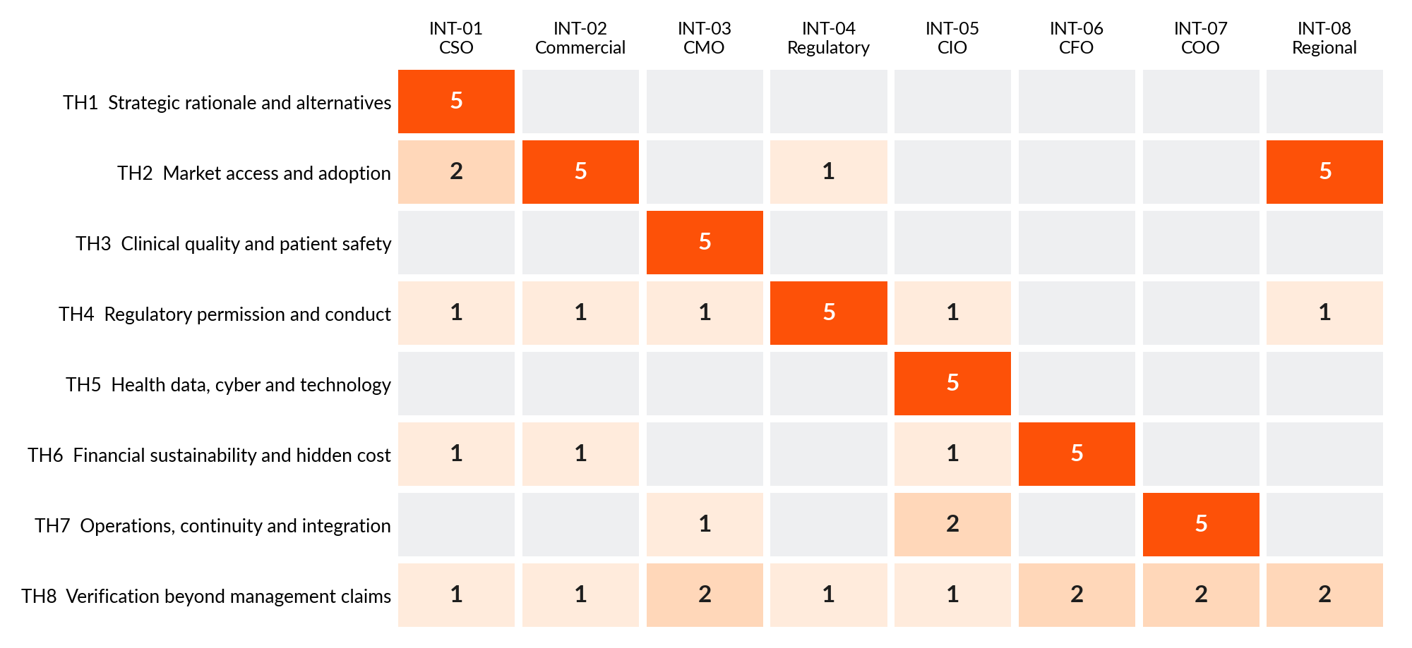
BACKUP
Themes: each stakeholder owns one theme; evidence discipline runs through all eight
Reading the map
TH8 is the only theme touched by all eight.
Each other theme is led by one function, so risk is siloed: nobody owns the cross-functional view yet.
That is the argument for gates with named owners and one integrated register.
Source: Number of each stakeholder's five answers touching each theme; counts show attention, not severity
12

Slide 13
BACKUP
Six tensions: none is a factual contradiction, none can be resolved without target data
ID | Tension | Our assessment | Evidence to resolve
X1 | Fast market entry vs local access barriers | Different assumptions, not a factual contradiction. The CSO frames speed as "might" and admits the advantages are unshown; Commercial and Regional warn that relationships and market size do not automatically transfer. | Country launch plan, approvals pathway, customer interviews, procurement or reimbursement route.
X2 | Growth forecast vs real adoption | Consistent caution across three functions; no stakeholder asserts a forecast. The tension is latent, between any future forecast and adoption evidence. | Customer-level pipeline, renewals, win/loss, adoption assumptions, competitor evidence.
X3 | Strategic capability vs clinical and quality evidence | Different priorities. The CSO lists capabilities as potential value; CMO and Regulatory say value is unproven until quality and compliance evidence exists. | Clinical or performance evidence, audit history, safety trends, regulatory status.
X4 | Synergy upside vs integration cost | Different scope, same direction: nobody quantifies either side. The CSO warns about double-counting synergies; CFO, CIO and COO list uncosted integration items. | Named synergy owners, costed integration plan, system assessment, downside sensitivity.
X5 | Expansion ambition vs operational capacity | Latent tension: demand growth is not shown to exceed supply, but the COO states a forecast does not show capacity. | Capacity and utilisation, supplier resilience, service-level data, workforce and investment plan.
X6 | Revenue reported vs cash realised | Consistent: both ask for reconciliation of contracts, claims and collections. No reported figures exist to compare. | Reconciliations, collections, claims and denials, contract terms, concentration.
Source: Trainer's six tensions assessed by us; evidence IDs in the working-group document, section 5.5
13

Slide 14
BACKUP
Insights: what stakeholders said, what outside evidence adds
# | Insight | Interview evidence | External evidence
1 | The deal thesis is a hypothesis: nobody has shown the target owns the advantages, or that a partnership could not deliver them. | INT-01-A1-S3, INT-01-A4-S2, INT-01-A2-S2, INT-02-A5-S1 | EC-04, EC-05
2 | A large market is not an accessible market: access, adoption and cash conversion must be proven country by country. | INT-08-A5-S1, INT-02-A2-S2, INT-08-A1-S1, INT-08-A2-S2 | EC-08, EC-10, RC-05, RC-12
3 | Permission to operate and clinical quality sit upstream of value: one licence, safety or conduct red flag can end the deal at any price. | INT-04-A5-S1, INT-03-A5-S1, INT-04-A1-S3, INT-04-A3-S1 | RC-09, RC-11, RC-17
4 | The headline price is not the cost: remediation, cyber, working capital, retention and integration are unquantified, so no valuation is defensible yet. | INT-06-A3-S1, INT-06-A5-S1, INT-05-A5-S1, INT-01-A3-S2 | EC-04, RC-14, RC-15
5 | Integration can create the risk it is meant to remove: continuity of care, supply and data integrity must be protected from Day 1. | INT-03-A3-S2, INT-07-A4-S1, INT-05-A4-S2, INT-07-A1-S2 | RC-15, EC-03
Source: Evidence IDs: INT = interview sentence; EC = sector source; RC = regulatory entry
14

Slide 15
BACKUP
Options: pause pending validation is the only one the evidence supports today
Criterion | A. Proceed now | B. Pause pending validation (time-boxed gated diligence) | C. Reconsider (stop the acquisition)
Evidence support today | Weak: no target fact is verified | Strong: addresses every stakeholder's evidence request | Not yet supported: no negative target evidence exists
Capital and reputation at risk | High: capital and reputation committed on hypotheses | Low: diligence spend only | None
Reversibility | Low once signed | High: can stop at any gate | High
Speed of learning | Low | Fast: first learning in weeks | None
Regulatory and conduct exposure | Highest: approvals and conduct unmapped | Controlled: clean-team protocol | None
Verdict | Not supported today | Recommended | Not yet; triggered by any uncured stop condition
Cost of pausing: a rival may acquire the target (KPMG, Jan 2026). Mitigation: fixed 12-week limit, rule agreed in advance, counsel advice on any limited exclusivity.
Source: Consultant judgement; qualitative, not scored
15

Slide 16
BACKUP
Five gates: each has an owner, a pass test and a stop condition taken from the stakeholders
Gate | Owner | Pass when | Stop when
G1 Thesis and alternatives | CSO | Each claimed advantage is evidenced from original documents; exclusivity and transfer tested; alternatives costed and acquisition shown superior; measurable outcomes defined with no double counting; business model and countries confirmed. | Advantage not exclusive or not transferable; approvals or access channels uncertain; cannot explain why acquisition beats partnership or organic entry (INT-01-A4).
G2 Market access and customers | Commercial; Regional | Decision chain mapped per country; customer references from an agreed, representative sample; contracts permit change of control; adoption assumptions backed by customer evidence; country launch plan includes approvals and procurement or reimbursement timing. | Relationships are personal or founder-dependent without credible retention; change-of-control blocks key contracts; access barriers have no route (INT-02-A5, INT-08-A2, INT-08-A5).
G3 Quality, regulatory and conduct | CMO; Regulatory | Complete licence map for every product and country; regulator history reconciled to original records; no unresolved material safety concern; remediation costed, owned and timed; anti-bribery and promotion controls tested. | Unclear licence status, undisclosed regulator correspondence, serious unresolved quality findings, improper conduct, or remediation with no owner, cost or timeline (INT-03-A5, INT-04-A5).
G4 Financial value and downside | CFO | Independent quality-of-earnings; revenue reconciled to contracts and cash; costed synergy register; downside cases show cash-flow and return impact; result meets investment thresholds set by the client. | Critical assumptions cannot be validated (decision paused or conditional) or value fails client thresholds (INT-06-A5).
G5 Operations, technology, data and Day 1 | COO; CIO | Capacity and supplier resilience evidenced; essential systems and data flows inventoried; cyber findings remediated or costed; validation and continuity plans exist; 100-day roadmap with named stop-authority. | Single points of failure in supply, service or systems with no credible mitigation; unremediated critical cyber findings (INT-05-A3, INT-07-A4).
Source: Stop conditions anchored in INT-01-A4, INT-02-A5, INT-03-A5, INT-04-A5, INT-05-A3, INT-06-A5, INT-07-A4
16

Slide 17
BACKUP
If we proceed: India approvals map for the deal itself
Regime | What it means for a deal
RC-01 Competition Act 2002, s.5: financial thresholds [V2] | Notifiable if parties exceed INR 2,500 crore assets or INR 7,500 crore turnover in India (group: INR 10,000 crore or INR 30,000 crore), as summarised after the March 2024 revision.
RC-02 Competition Act: de minimis (small-target) exemption [V2] | A target with Indian assets up to INR 450 crore or turnover up to INR 1,250 crore is exempt, unless the deal-value threshold applies.
RC-03 Competition Act: deal-value threshold [V1] | Deal value above INR 2,000 crore plus substantial Indian business operations needs prior CCI approval (in force since 10 September 2024).
RC-04 Standstill and gun-jumping (s.6(2A), s.43A) [V2] | No completion or integration before CCI approval or lapse of the waiting period (summarised as 150 days); penalty up to 1% of turnover or assets.
RC-05 FDI policy by sub-sector (Consolidated FDI Policy 2020 and later press notes) [V2] | Pharma: greenfield 100% automatic; brownfield 74% automatic, above that government approval with conditions. Medical devices and hospitals: 100% automatic.
RC-06 FDI Press Note 3 (2020) as eased by Press Note 2 (2026) [V1] | Land-border investors or beneficial owners need approval; non-controlling beneficial ownership up to 10% allowed on the automatic route since March 2026.
RC-07 FEMA NDI Rules 2019: pricing and reporting [V2] | Price not below fair value into India and not above fair value out; filings within 30 to 60 days as summarised.
RC-08 Companies Act 2013 (ss.230-233, s.186); SEBI takeover regulations [V2] | Scheme route needs approval of 75% in value; a listed Indian target triggers an open offer at 25% or on control, for at least 26%.
Source: RC-01 to RC-08; tiers V1 official-consistent, V2 commentary-consistent. Indian counsel must confirm against the Gazette
17

Slide 18
BACKUP
India also governs the target's permission to operate, conduct and data
Rule | Why it matters to this decision
RC-09 Medical Devices Rules 2017 (under the Drugs and Cosmetics Act 1940) [V1] | A medical-device target must show a complete licence map (INT-04-A1-S2). Pending changes can alter timelines (INT-04-A4-S1).
RC-10 Drugs and Cosmetics Rules 1945: licence status after change of ownership (drugs) [V3] | A direct deal-structure question for a pharma target.
RC-11 Uniform Code for Pharmaceutical Marketing Practices 2024 [V1] | Direct match to INT-04-A3-S1 (interactions with healthcare professionals, promotional claims).
RC-12 Drugs (Prices Control) Order 2013 (NPPA) [V1] | Caps revenue and margin for a pharma target's scheduled products; a quality-of-earnings item (INT-06-A1-S3).
RC-14 Digital Personal Data Protection Act 2023 and Rules 2025 [V1] | Health data held by the target (INT-05-A2-S1) will fall under these duties; remediation cost belongs in the model (INT-05-A5-S1).
RC-15 CERT-In Directions of 28 April 2022 (IT Act s.70B(6)) [V1] | Incident history and logging practice of the target are diligence items (INT-05-A3-S1) and a Day-1 duty.
RC-17 Prevention of Corruption Act (2018 amendment, s.9); FCPA and UK Bribery Act successor liability; ISO 37001:2025 [V2] | Direct match to INT-04-A3-S1 (tender conduct, distributors, anti-bribery controls).
RC-18 Consumer Protection Act 2019, s.21 (misleading advertisements) [V1] | Supports INT-03-A1-S3 (marketing material alone does not establish clinical benefit): claims need substantiation.
Source: RC-09 to RC-18. RC-10 is V3 (not verified, not relied on). Full text and links in working-group document, section 10
18

Slide 19
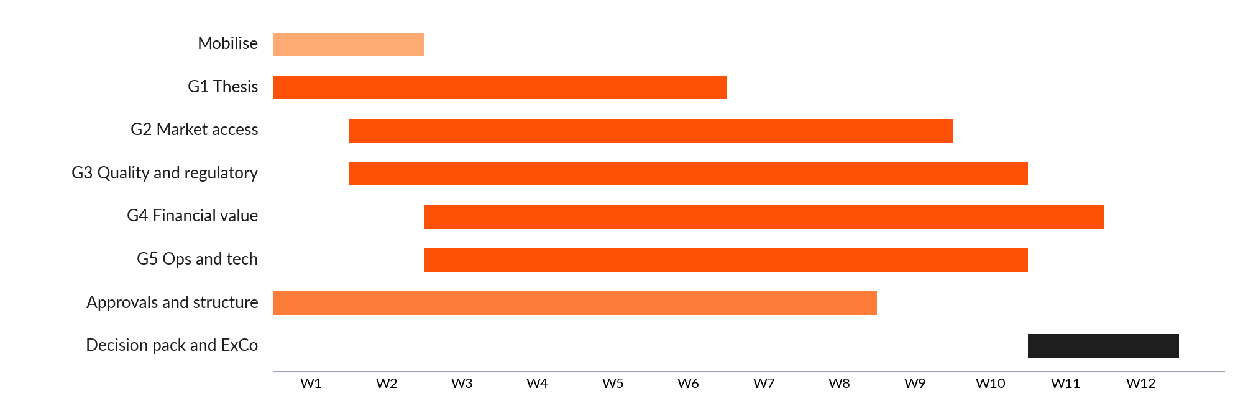
BACKUP
12-week plan: gates run in parallel, decision in week 12
Approvals and structure track
Approvals and structure track (Legal): merger control (India CCI and any other jurisdiction), FDI route and pricing, sector licences on change of ownership, clean-team protocol. Runs weeks 1-8 and feeds Gate 3 and Gate 4.
When | Phase | What happens
Weeks 1-2 | Mobilise | Confirm target business model, countries and thesis owner; agree gate criteria and thresholds with the CFO; agree clean-team and information-sharing protocol with counsel; issue data requests.
Weeks 2-10 | Validate | Run Gates 1-5 in parallel with named owners; weekly evidence-register review; log every claim as verified, unverified or contradicted.
Weeks 9-11 | Integrate | Combine findings in the integrated evidence map; test downside cases; prepare decision pack.
Week 12 | Decide | Executive Committee gate review: proceed to binding offer, continue pause, or reconsider.
Source: Indicative; kick-off early November 2026 gives a late-January 2027 decision. Dates to be confirmed
19

Slide 20
BACKUP
How far to trust this: what was verified, what was not, and who validates next
Verified by program
Not verified
Human validation pending
All 95 interview sentences and every quoted passage match the trainer's file exactly.
Counts, IDs and cross-references recomputed from one data model.
No competitor, price, share or target fact is stated.
Government sites could not be opened; Indian rules come from search-surfaced official and professional sources, tiered V1-V3.
1 entry is V3 and not relied on.
Interviews are simulated; competitor comparison not possible.
Engagement-team sign-off.
Indian counsel confirmation of the regulatory map.
Partner challenge session.
AI assisted throughout; recommendation is for the team to own and defend.
Source: Working-group document, sections 12-13
20

