Slide 1
Delegates
A delegate in C# is a type-safe function pointer
it’s an object that can hold a reference to a method (or multiple methods) with a specific signature (same return type and parameters).
Real-world Analogy
Imagine you have a TV remote 🎮
The remote (delegate) doesn’t care which TV (method) it controls.
As long as the TV supports the same signal (method signature), the remote can operate it.
So, if you replace the TV (method), the remote still works — because it just knows how to send commands, not what happens inside the TV.

Slide 2
Delegates
Why Do We Use Delegates in C#
Delegates exist mainly to make your code flexible, extensible, and loosely coupled.
They allow you to pass methods as parameters, change behavior at runtime, and build event-driven programs.
Passing behavior around: You can pass methods as arguments to other methods—like callbacks or event handlers.
Type safety: The method you reference must match the delegate's signature (easy to debug!).
Flexibility: Delegates enable code that chooses "what to do" later, not up front. This is super helpful in event-driven programming (like UI code), LINQ, and asynchronous code.

Slide 3
Delegates
To implement delegate in our application we need to declare delegates, instantiate delegates and call delegates.
We can declare delegates by using delegate keyword.
Declaration:
access-modifier delegate return-type delegate-name(parameter-list);
Ex: delegate void Mydelegate(string s);
Instantiation
delegate-name object-name=new delegate-name(method-name)
Or
delegate-name object-name=method-name
Invocation
object-name();
Note: The delegate can refer to the methods, which have the same signature and return type of the delegate .

Slide 4
Types of Delegates
Delegates are two types.
Single- cast Delegate
Multi cast Delegate

Slide 5
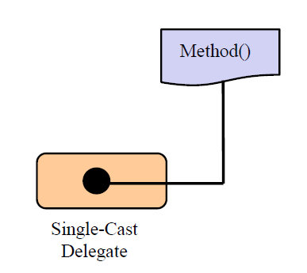
Types of Delegates[Contd.]
Single cast Delegate:
Single-cast delegate refer to one method at a time.
A single-cast delegate derived from System.Delegate class

Slide 6
Multicast Delegate
A Multicast delegate can invoke multiple methods at same time.
A Multicast delegate refers from the System.MulticastDelegate Class
When a multicast delegate is called ,it executes all the methods it wraps in the calling order.
The methods called by the multicast delegate should not have a return value.

Slide 7
Multicast Delegate
add a method to the delegate object , you simply make use of the overloaded += operator.
remove a method from the delegate object you make use of the overloaded operator -=
multicast delegates calls a sequence of methods in the specified order.
If one of the methods in the sequence throws an exception, the iteration stops there!

Slide 8
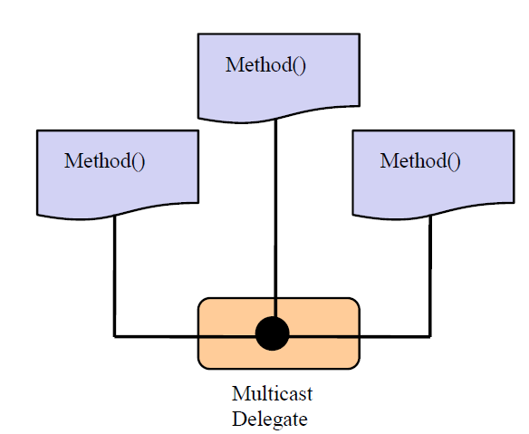
Multicast Delegate

Slide 9
Delegate
Summary — Why We Use Delegates
Reason | Description | Example Use Case
Pass methods as arguments | Behavior changes dynamically | Execute(calc.Add)
Loose coupling | Separate method caller and callee | Notification system
Callback methods | Notify when a task completes | Download completion
Event handling | Foundation for C# events | Button click, API events
Flexible business logic | Plug-ins, strategies, runtime switching | Discount, logging, validation

Slide 10
Events
An event in C# is a notification mechanism — it lets one class notify another class when something happens.
Example:
A Button clicks → triggers a Click event.
A FileDownloader finishes → triggers a DownloadCompleted event.
A Bank Account exceeds limit → triggers an InsufficientBalance event.
So, an event says:
“Hey, something just happened — whoever is interested, please react!”
Relationship Between Delegate and Event
A delegate defines what kind of method can handle the event.
An event uses that delegate to notify subscribers.
👉 Think of a delegate as the wiring and an event as the switch.

Slide 11
Anonymous function/method
An anonymous function is a function without a name.
Instead of declaring a separate named method, you can define the function inline (on the spot) — usually when you’re assigning it to a delegate or passing it as a parameter.
Think of it like a “temporary helper method” — used once, not reused.
Why Use Anonymous Functions?
Benefit | Explanation
Less code | No need to declare separate methods for small tasks
Better readability | Keeps logic close to where it’s used
Inline flexibility | Great for short callbacks, filtering, or events

Slide 12
Anonymous function/method
Ways to Create Anonymous Functions
C# supports two main ways:
Anonymous method → Introduced in C# 2.0
Lambda expression → Introduced in C# 3.0 (modern and preferred)

Slide 13
Lambda expression
Lambda expressions are a shorter, cleaner way to write anonymous functions.
using System;
class X
{
delegate int cube(int i);
static void Main(string[] args)
{
cube myDelegate = x => x*x*x;
int j = myDelegate(5);
Console.Write(j);
}
}
//Prints 125

Slide 14
Lambda expression Vs Anonymous Method
Type | Syntax | Return | Example
Anonymous Method | delegate(parameters) { ... } | Any | delegate(int x) { Console.WriteLine(x); }
Lambda Expression | (parameters) => expression | Any | (x, y) => x + y
Use With | Delegates, Events, LINQ, Callbacks | — | —

Slide 15
Built-in Delegates
C# provides predefined delegate types, so you don’t always have to declare your own.
Type | Description | Example Signature
Action | No return value | Action<int, string>
Func | Returns a value | Func<int, int, string>
Predicate | Returns bool | Predicate<int>

Slide 16
Built-in Delegates
Action Delegate
🧠 Concept
Action is used when you want to call a method that doesn’t return anything.
It can take zero or more parameters, but the return type must be void.
🧮 Syntax
Action<T1, T2, ...> actionName = methodName;

Slide 17
Built-in Delegates
Func Delegate
🧠 Concept
Func is used when you want to call a method that returns a value.
It can take 0 to 16 input parameters, but the last type is always the return type.
🧮 Syntax
Func<T1, T2, TResult> funcName = methodName;

Slide 18
Built-in Delegates
Predicate Delegate
🧠 Concept
Predicate<T> is a special type of Func that always:
Takes one parameter of type T
Returns bool
It is commonly used to check conditions (true/false).
🧮 Syntax
Predicate<T> predicateName = methodName;

Slide 19
Built-in Delegates
Delegate | Purpose | Takes Parameters | Returns | Example
Action | Perform an operation | Yes | void | Action<int, int> add = (x,y)=>{}
Func | Perform an operation & return a result | Yes | Any type | Func<int,int,int> multiply = (x,y)=>x*y;
Predicate | Test a condition | Exactly one | bool | Predicate<int> isEven = n => n%2==0;

