Slide 1
Angular Eager and Lazy Loading
In Angular, eager loading and lazy loading are strategies to load modules in your application.
They mainly affect performance and initial load time in larger applications.

Slide 2
Angular Eager and Lazy Loading
1. Eager Loading
Eager loading is the default strategy in Angular where all modules and dependencies are loaded before the application starts.
This approach is suitable for small applications since it ensures all features are immediately available, but can lead to slower initial load times for larger apps
This approach is suitable when certain modules are critical and always needed.
The benefit of eager loading is that once the app is loaded, navigation between different parts of the application is very fast since all the necessary code is already available in the browser.
However, this can result in a larger initial bundle size and a longer initial loading time, which can be a poor user experience, especially on slow networks or mobile devices.

Slide 3
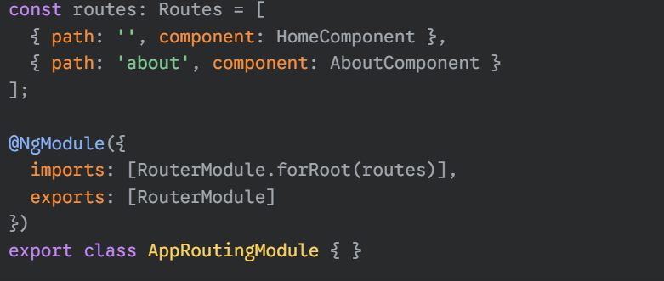
Angular Eager and Lazy Loading
In this simple example, the HomeComponent and AboutComponent are part of the main application bundle. When the application loads, both components' code is downloaded, making the navigation to /about almost instantaneous.

Slide 4
Angular Eager and Lazy Loading
2. Lazy Loading
Modules are loaded only when their routes are accessed.
Lazy loading useful In large apps where not all modules are required immediately, to reduce initial bundle size.
This technique is highly effective for improving load times and reducing memory footprint in large Angular applications.
When a user requests a route that corresponds to a lazy-loaded module, Angular downloads and loads the module's code in the background. This is a best practice for large-scale applications with many features.

Slide 5
Angular Eager vs Lazy Loading
Feature | Eager Loading | Lazy Loading
When modules are loaded | At application startup | On demand, when route is visited
Initial bundle size | Larger | Smaller
Best for | Small apps, always-used modules | Large apps, rarely-used modules
Performance | Slower startup | Faster startup, but extra request on demand

