Slide 1
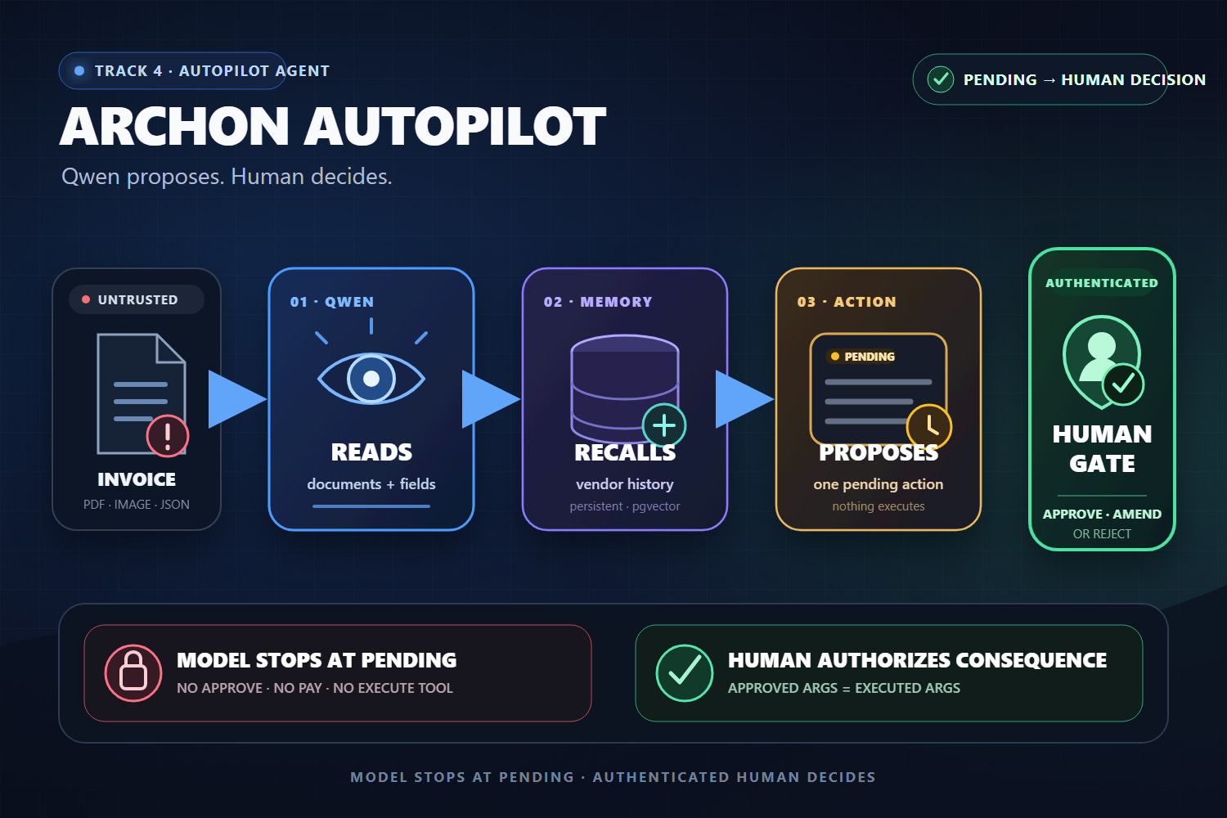
QWEN CLOUD HACKATHON · TRACK 4
Archon Autopilot
A Qwen AP agent that gathers evidence autonomously, but cannot move money on its own.
QWEN CLOUD · LIVE ALIBABA ECS · MIT
Qwen proposes. Human decides.
Notes:
Opening claim: Autonomy for evidence gathering, not financial authority. Track 4; deployed on Alibaba ECS; MIT-licensed. Repository asset: demo/thumbnail.png.

Slide 2
AP automation is valuable only if authority stays human.
Invoices are untrusted inputs, but payment consequences are real.
THE AP INBOX
ARCHON AUTOPILOT
Messy, untrusted invoices
Evidence autonomy, bounded consequence
• Duplicate and overbilling risk • Evidence scattered across history • Manual review and re-keying • A wrong action can move real money
• qwen-vl reads the document • A bounded Qwen loop recalls and checks • Exactly one PENDING proposal is created • A human approves the exact arguments
The model recommends. The authenticated human owns the consequence.
Source: repository workflow, model tool catalog and human-gate contract · build 030950e
2
Notes:
Problem/solution framing. No claim that the classifier detects every attack; the consequence boundary is enforced by tool separation and authenticated state transitions.

Slide 3
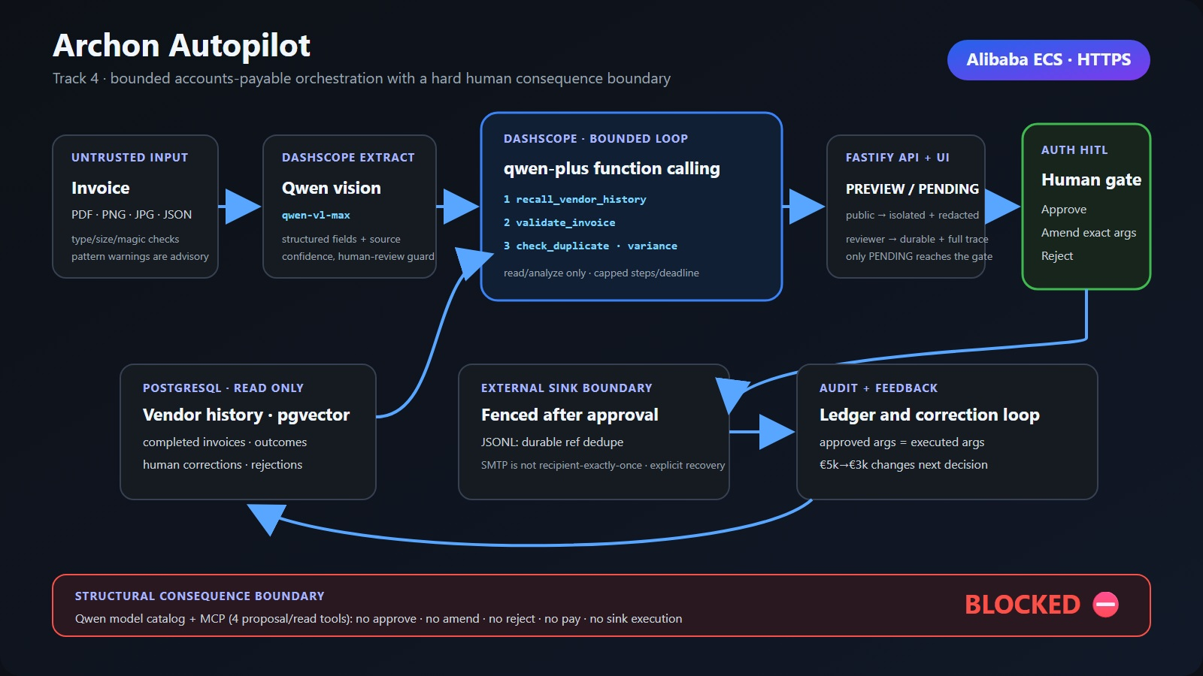
Agentic reasoning lives inside a deterministic approval workflow.
3
Notes:
Architecture provenance: demo/final-media/judge-architecture.jpg. The model catalog has proposal/read tools only; HTTP reviewer APIs own approve, amend and reject.

Slide 4
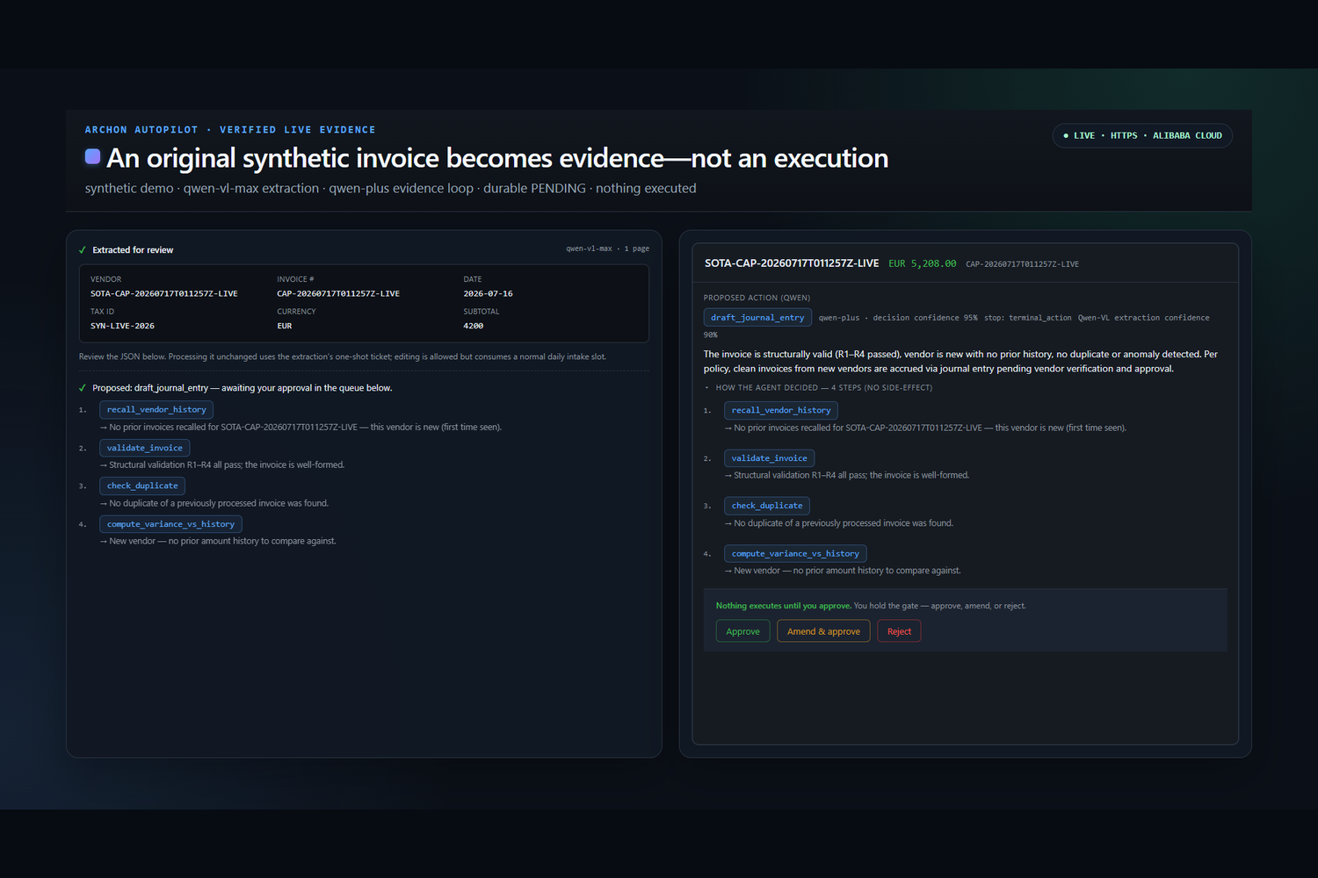
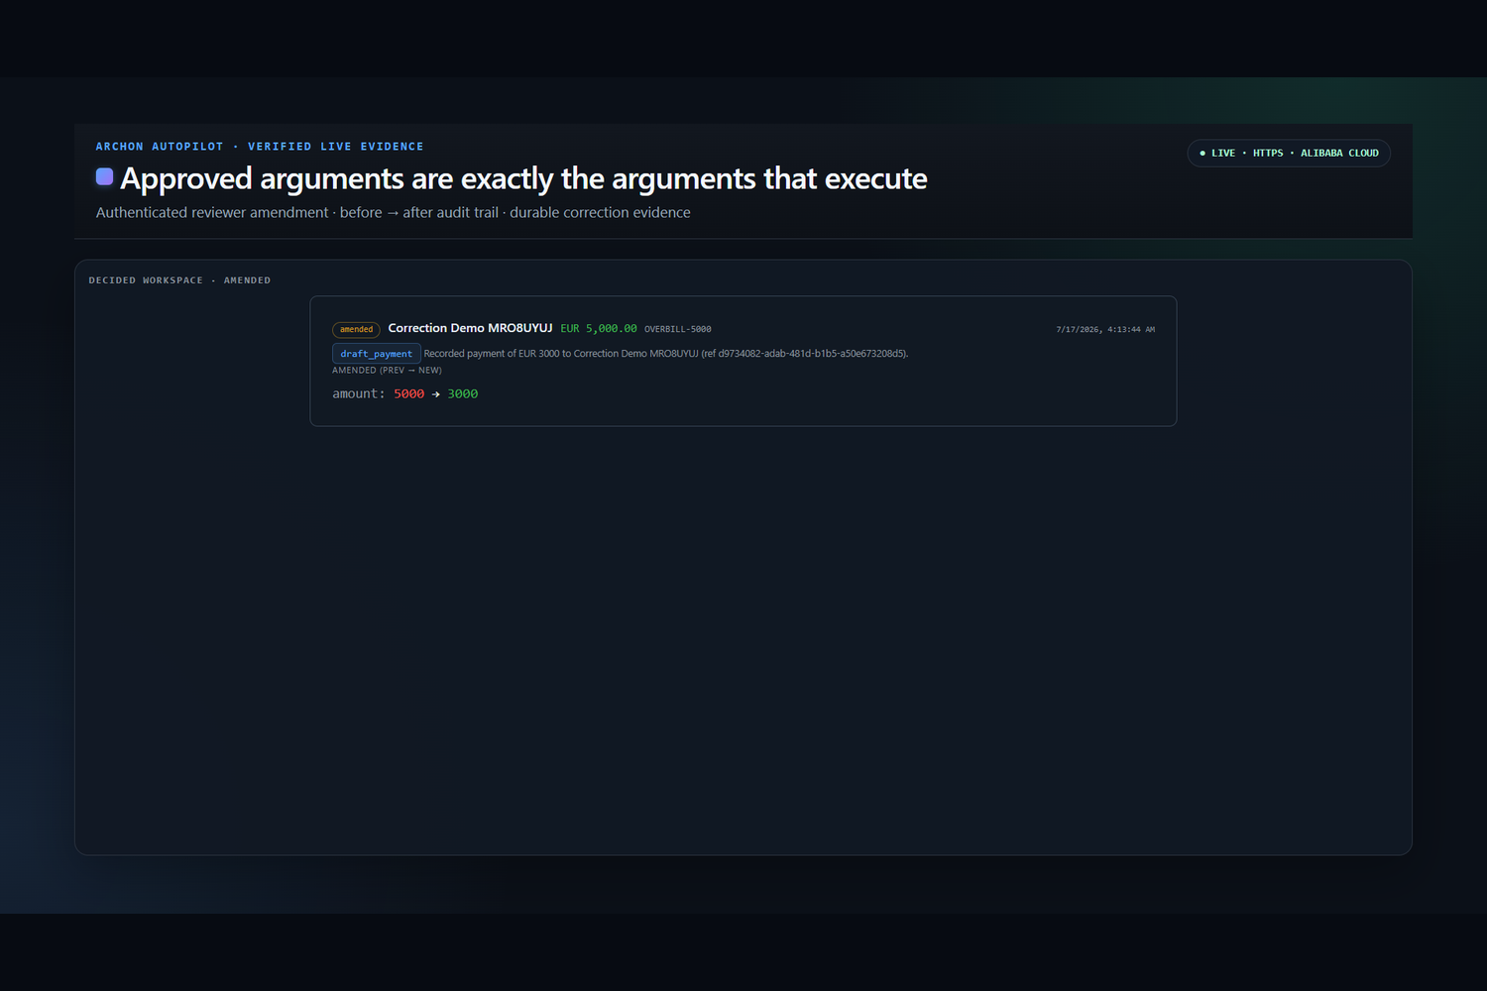
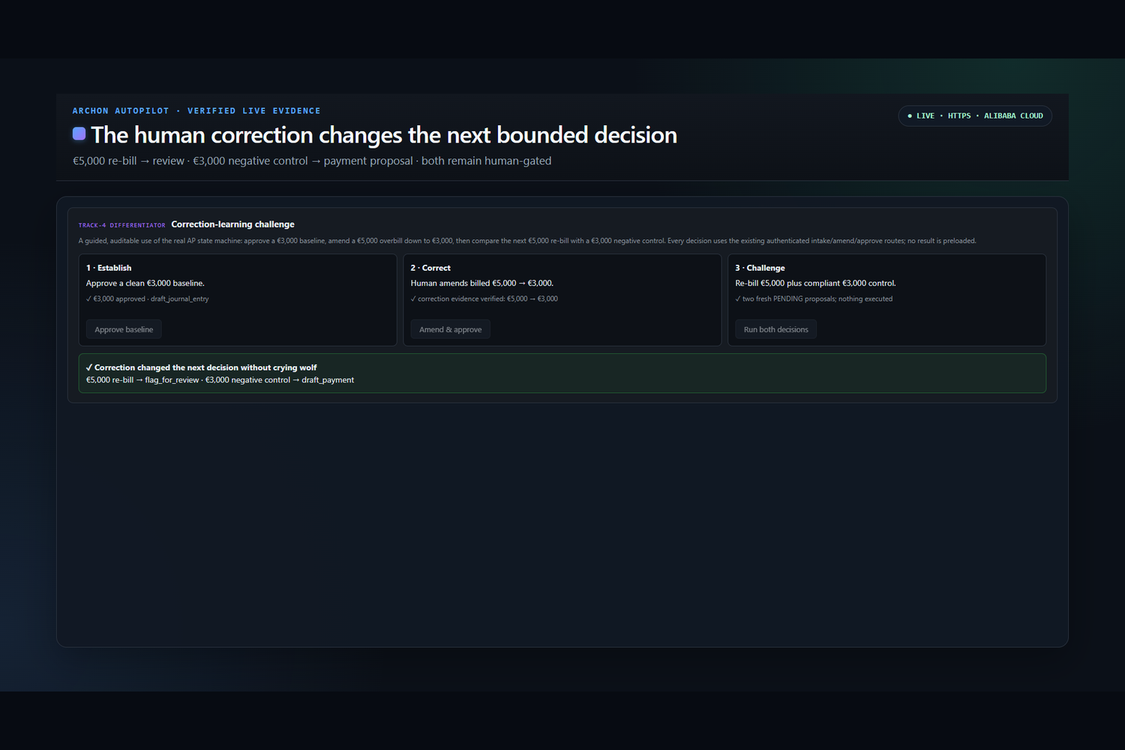
The agent earns autonomy - then stops.
One visible path from untrusted invoice to durable human decision.
01 · SEE + REASON
02 · STOP AT PENDING
03 · HUMAN DECIDES + MEMORY
Qwen reads, recalls and checks
A durable proposal waits
Amendment becomes future evidence
Live gallery evidence: intake → PENDING · exact-argument amend diff · correction affects later decision
4
Notes:
The canonical live captures show intake reaching PENDING, an authenticated exact-argument amendment, and a correction influencing a later decision.

Slide 5
Within the authored workflow model, active review falls from 100 to 36.5.
Indexed effort and checkpoints · manual baseline = 100
22/22
Tuned offline policy agreement
100.0
100.0
Developer-labelled deterministic regression; not live-Qwen accuracy.
75.0
58.0
2.4
Average autonomous evidence steps
50.0
53 total; all 22 scenarios required at least two steps.
36.5
25.0
0/12
Policy-label mismatches in each arm
0.0
0/12 manual vs 0/12 assisted; this does not establish error reduction.
Manual
Active review
Checkpoints
Caveat: 12 authored synthetic cases and public task assumptions; not a human study, ROI estimate, throughput result or field trial.
5
Notes:
Source: impact/RESULTS.md. Manual indexed baseline 100; assisted base active-review index 36.5 (63.5% lower); modeled human checkpoints index 58.0 (42% lower). The 12-case authored/synthetic boundary is shown on-slide.

Slide 6
Production readiness is enforced - not implied.
The model boundary, state machine, configured effects, security gates and hosted stress profile are independently inspectable.
BOUNDARY | ENFORCED BEHAVIOR | JUDGE-VERIFIABLE EVIDENCE
Model authority | The model catalog exposes proposal/read skills: no approve, reject, pay or terminal sink tool. | MCP catalog + adversarial tests
State transition | An authenticated reviewer atomically claims PENDING → EXECUTING before a decision can reach a sink. | Integration + Playwright E2E
Configured effects | SMTP transport acceptance and restart-safe JSONL are real; payment and specialist review remain simulated. | Sink/recovery tests + explicit scope
Quality & supply chain | Coverage 89.83 / 83.70 / 88.29 / 89.83, pen tests, CodeQL, immutable image, SBOM and Grype gate. | Hosted CI and release artifacts
Hosted ramp | 50 VUs · 13,204 requests · 0 failures · 19.37 ms p95 on the isolated application path. | Fake-Qwen + in-memory; not live inference
Coverage S/B/F/L 89.83/83.70/88.29/89.83 · latest submission-source gates · runtime 030950e · capture 51f73ae
6
Notes:
Hosted load source: load/RESULTS_2026-07-15.md. The on-slide row explicitly says Fake-Qwen/in-memory. Coverage, CodeQL and image/SBOM evidence are green on the latest submission-source gate. The deployed runtime remains 030950e9b1e2353ee64f422ad050feb9733745bc. The clean public capture-source HEAD is 51f73aebd7fcf25dce6afde472cdbcdfb7dbdcca; the later final submitted HEAD is linked separately after media/deck commits.

Slide 7
ARCHON AUTOPILOT
Autonomy where judgment helps. Human authority where money moves.
Archon turns an untrusted invoice into an auditable proposal, then stops.
autopilot.43.106.13.19.sslip.io
Qwen proposes · Human decides
github.com/upgradedev/archon-qwen-autopilot
Deployed runtime SHA · 030950e9b1e2
Notes:
The closing claim resolves the opening tension: Qwen has autonomy to gather evidence, while financial consequences remain under authenticated human authority.

