Slide 1
Intro to Windows Networking

Slide 2
Overview
What is a Server?
Server Hardware
Microsoft Licensing
Miscellaneous Terminology

Slide 3
Review: What is a Server?

Slide 4
Review: Server Types
Servers provide essential services across a network, either to private users inside an organization or to public users via the Internet. Server types that we will be discussing and working with throughout the course include:
File Server (SMB Server)
Web Server (IIS)
DNS Server (Windows Server)
Directory Server (AD)
DHCP Server
Proxy Server

Slide 5
Servers
We’ll use the term server quite broadly. In theory, any process that provides a resource to one or more client processes is a server.
For example, with file sharing: while the existence of files on a PC does not classify it as a server, the mechanism that shares these files to clients by the OS is the server.
Consider a web server. This web server software can be run on any capable computer.

Slide 6
Server Hardware

Slide 7
Server Hardware
In the hardware sense, the word server means hardware intended for hosting software applications under intense demand.
Most PCs can act as a server, but a dedicated server will contain features making it more suitable for production environments where performance and resilience are important.
In many ways server hardware really isn’t all that different from desktop PC hardware; Servers use the same basic components such as memory, CPUs, and power supplies.

Slide 8
Server Hardware
Examples of server hardware include:
More advanced CPUs (more cores, cache, etc.)
Server RAM (ECC)
Fast storage technologies (SCSI, RAID, SAN, etc.)
Servers also typically support fault tolerance
features like:
Redundant power supplies
Redundant storage (as in RAID)
Redundant network connections (as in NIC teams)

Slide 9
Server Hardware
To increase reliability, most servers use memory with error detection and correction, redundant disks, redundant power supplies and so on. Components tend to be hot swappable.
Since servers are usually administered by experienced system administrators, server OSes are usually tuned for stability and performance than for user friendliness and ease of use.

Slide 10
Server Hardware
Servers are noisy, power hungry, need good Internet access, and increased security, so they are usually stored in dedicated server centers (or data centers).
Server case themselves are usually flat and wide (typically measured in rack units - U or RU), and adapted to store many devices next to each other in a server rack (typically 42U high).
Servers can usually can be configured, powered up and down or rebooted remotely.

Slide 11
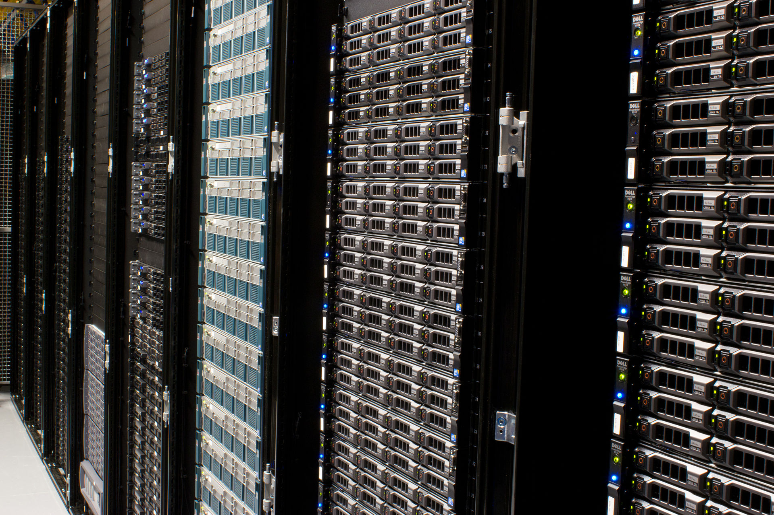

Slide 12
Why is remote administration via tools like IPMI so important?

Slide 13
Licensing

Slide 14
Client Access Licenses (“CAL”)
A Client Access License ("CAL") is a software license that allows clients to connect to its server software and use the software's services.
For example, server software, such as Windows Server or SQL Server require licenses for all clients that connect to these servers.

Slide 15
Client Access Licenses (“CAL”)
A CAL legally permits client computers to connect to Microsoft server software. They usually come in the form of a certificate of authenticity (CoA) and a license key. If more connections to the server are needed, additional CALs must be purchased.

Slide 16
Terminology

Slide 17
Terminology
Availability: The degree to which a system or equipment is in an operable state.
Client–Server model: A distributed application structure that partitions tasks between the providers of a resource or service (servers) and service requesters (clients).
Database server: A computer program that provides database services to other computer programs or computers, as defined by the client–server model.

Slide 18
Terminology
Enterprise class: Designed for the large-scale environments of modern enterprises. When comparing to consumer class, it has higher scalability, higher reliability, and better fault tolerance (along with a much higher initial price)
Fault tolerance: A design that enables a system to continue operation (possibly at a degraded level), rather than failing completely, when some part of the system fails.
File server: A computer attached to a network that provides a location for shared disk access by the workstations that are attached to the same network.

Slide 19
Terminology
Hypervisor: A piece of computer software that creates and runs virtual machines (Microsoft’s product is Hyper-V)
Internet Information Services (IIS): Microsoft’s web server
RAID (Redundant array of independent disks): Technology that combines many disks into a single logical unit.
Redundancy: The duplication of critical components with the intention of increasing reliability of the system.
Reliability: A system’s ability to perform its functions under stated conditions for a specified period of time.

Slide 20
Terminology
Scalability: The ability of a system, network, or process to handle a growing amount of work in a capable manner or its ability to be enlarged to accommodate that growth.
Service: A Windows service is a computer program that operates in the background (similar to a Linux daemon)
UPS (Uninterruptible power supply): A piece of electrical equipment providing emergency power when the input power source fails.

Slide 21
Terminology
Virtualization: The technologies for creating a virtual (rather than actual) version of something, such as a virtual hardware platform, operating system, storage device, or network resources.
Windows PowerShell: Microsoft's shell and scripting language built on .NET Framework.

