Slide 1
Intro to Windows PowerShell

Slide 2
Preamble

Slide 3
Life Without PowerShell
Windows users and administrators have always been happy clicking around in the graphical user interface (GUI) to accomplish their chores.

Slide 4
Life Without PowerShell
Unfortunately, GUIs have zero return on investment!
If it takes you five minutes to create a new user in Active Directory (and assuming you’re filling in a lot of the fields, that’s pretty reasonable), you’ll never get any faster than that. A hundred users will take five hundred minutes — there’s no way, short of learning to type and click a bit faster, to make the process go any quicker.

Slide 5
Life Without PowerShell
PowerShell attempts to bridge the gap between the point-and-click nature of a GUI and the need to automate repetitive tasks to increase productivity and reduce human error.

Slide 6
Life With PowerShell
The goal behind Windows PowerShell is that Microsoft builds 100% of a product’s administrative functionality in the shell.
While Microsoft continues to build GUI consoles, those consoles are executing PowerShell commands behind the scenes.
That approach forces them to make sure that every possible thing that you can do with the product is accessible through the shell.

Slide 7
Life With PowerShell
If you were in charge of a team of IT administrators, which ones would you want in your senior, high-paying positions?
The ones who need several minutes to click their way through a GUI each time they need to perform a task, or the ones who can perform tasks in a few seconds after automating them?
We already know the answer from almost every other part of the IT world. Ask a Cisco administrator or a Unix administrator.

Slide 8
Your choice is “learn PowerShell, or would you like fries with that?”

Slide 9
What is PowerShell?

Slide 10
What is PowerShell?
PowerShell, as its name implies, is a shell.
It’s similar to the cmd.exe command-line shell that you’ve probably used before which was an ancestor of the old MS-DOS shell that shipped with the first PCs back in the 1980’s.
PowerShell also has a strong resemblance to the Unix shells, like Bash.

Slide 11
What is PowerShell?
PowerShell isn’t a scripting language like VBScript or Python. With most languages, you sit down in front of a text editor (often built-in to an IDE) and type a series of keywords to form a script. You save the file, and then run it.
PowerShell can work like that, but that’s not necessarily the only usage pattern, especially when you’re getting started.

Slide 12
What is PowerShell?
With PowerShell, you type a command, add a few parameters to customize the command’s behavior, hit Return, and immediately see your results.
Eventually, you’ll get tired of typing the same command (and parameters) over and over again, so you’ll save it all into a text file. Give that file a .PS1 filename extension, and you suddenly have a PowerShell script.

Slide 13
What is PowerShell?
You can get as complex as you need to with PowerShell!
PowerShell gives you access to the full underlying power of the .NET Framework, and as such some PowerShell “scripts” are practically indistinguishable from a C# program written in Visual Studio.

Slide 14
Opening PowerShell

Slide 15
Opening PowerShell
This is a good time to get PowerShell up and running, if you haven’t done so already.
You should use the PowerShell ISE version (which provides an IDE to work in).
You’ll find the icons for PowerShell and the PowerShell ISE on the Start menu.

Slide 16
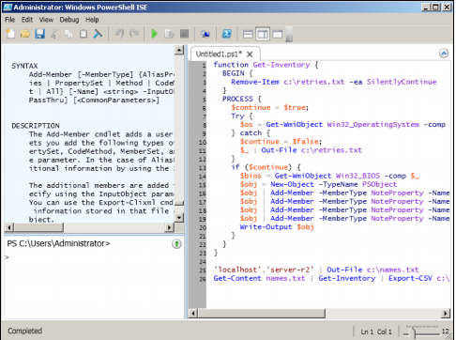
PowerShell ISE

Slide 17
Getting Help
The command for getting help is get-help. To display help for a particular command specify the command’s name after get-help.
For example, to display the help file entry for the get-help command, type:
PS> get-help get-help

Slide 18
Getting Help
The last thing you need to know about the help system is how you can use it to discover commands.
Since PowerShell accepts wildcards almost anywhere, using them along with the Get-Help command allows you to easily discover commands. For example, I am looking for commands that deal with Windows Services:
PS> Get-Help –Name *service*

Slide 19
Navigating the Filesystem

Slide 20
We Have to Start Somewhere…
Let’s run through some examples of how to manipulate files in the Windows filesystem with PowerShell.

Slide 21
Managing files and folders—you might know this!
How would you get a listing of files and folders from the current folder?
$ dir

Slide 22
Managing files and folders—you might know this!
Task | PowerShell Command
Copy a file to a different location | cp
Change directories | cd
Move a file to a new location | mv
Rename an existing file | mv
Create a new directory | mkdir
Remove an empty directory | rmdir
Delete a file | rm
Display the contents of a text file | cat

Slide 23
Command History

Slide 24
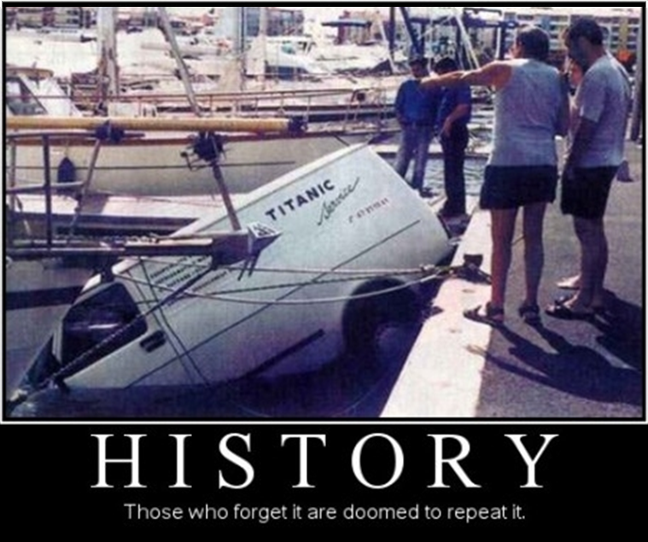

Slide 25
Those Who Forget History…
Similar to the history command in UNIX, PowerShell keeps a command history accessible by running get-history (or one of its aliases h, ghy, history, etc.).
(https://technet.microsoft.com/en-us/library/ee176849.aspx)

Slide 26
Those Who Forget History…
To re-run an item from your history, use the invoke-history command:
PS> invoke-history 34
Note that invoke-history also has an alias r:
PS> r 34
(http://blogs.technet.com/b/heyscriptingguy/archive/2011/01/18/use-powershell-history-to-speed-repetitive-commands.aspx)

Slide 27
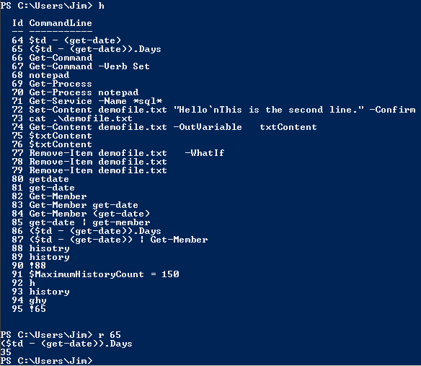
Those Who Forget History…

Slide 28
Writing Basic PowerShell Commands

Slide 29
Operators
Operator | Description
() {} | Grouping
++, -- | Increment, decrement, respectively
+, - | Unary operator
* or *= | Multiplication.
/ or /= | Division.
% or %= | Modulus
+ or += | Addition.
- or -= | Subtraction.
= | Assigns a value to a variable
NOTE: Standard order-of-operation applies

Slide 30
Data types
Type | Description
[int] | 32-bit signed integer
[string] | Fixed-length string of Unicode characters
[byte] | An 8-bit unsigned character
[bool] | Boolean True/False value
[single] | Single-precision 32-bit floating point number
[array] | An array of values
[hashtable] | A hashtable object
Note: These are the important ones for our class, there are tons more.

Slide 31
Exercise
Enter the following lines at the command prompt and observe the behavior:
#Key in this line and
#the rest below
PS> 54
PS> (54 * 3 ) – 2
PS> "Patrick is " + 54
PS> Get-Date

Slide 32
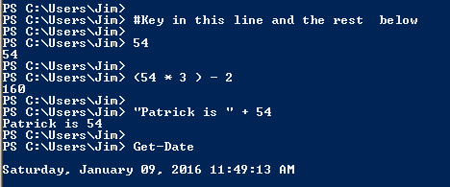
Experience Exercise
Why?
PowerShell is a loosely-typed language

Slide 33
Exploring Loose Typing
PS> 129 + "1"
PS> "1" + 129
PS> [int]"0129" + 1
PS> [datetime]"10/20/2009"
PS> "We are meeting on " + get-date
PS> "We are meeting on " + (get-date)

Slide 34
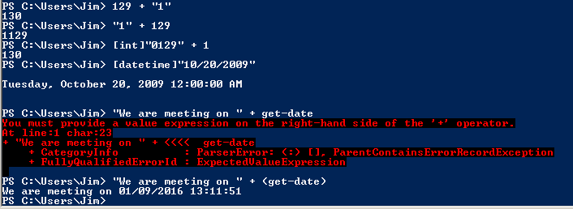
Exploring on your own

Slide 35
Redirecting Output
You can use the angle bracket to perform redirection.
dir > file.txt will redirect the output of the dir command into the text file file.txt.
You can even do the double-angle trick, where the content will be appended to the specified file:
dir >> file.txt

Slide 36
Programming Concepts

Slide 37
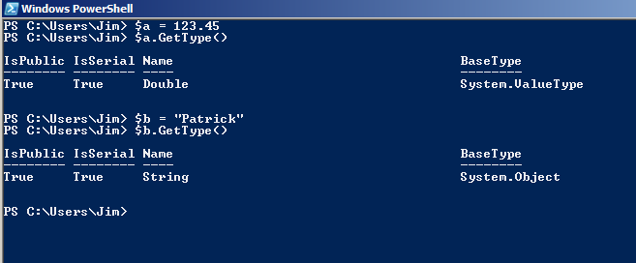
Variables in a Loosely-Typed Language
PS> $a = 123.45
PS> $a.GetType()
PS> $b ="Patrick"
PS> $b.GetType()

Slide 38
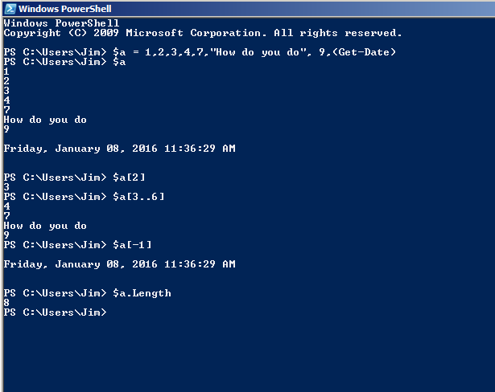
Arrays
Assigning:
PS> $a=1,2,3,4
Referencing a cell:
PS> $a[2] # 3
Length:
PS> $a.Length # 4
Ranges:
PS> $a[0..2] #1,2,3
Last Item:
PS> $a[-1] # 4

Slide 39
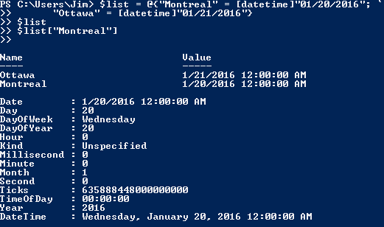
Hashtables
$list = @{"Montreal" = [datetime]"01/20/2016"; `
"Ottawa" = [datetime]"01/21/2016"}
$list
$list[“Montreal"]
Line continuation char

Slide 40
Cmdlets
Cmdlets are instances of .NET Framework classes; basically a compiled application for the PowerShell environment
Cmdlets process input objects from the pipeline rather than from streams of text, and cmdlets typically deliver objects as output to the pipeline.
Cmdlets are record-oriented, they process a single object at a time.
http://msdn.microsoft.com/en-us/library/ms714395%28VS.85%29.aspx

Slide 41
Cmdlet
verb-noun naming (e.g. get-childitem) Ref: http://technet.microsoft.com/en-us/library/dd315315.aspx

Slide 42
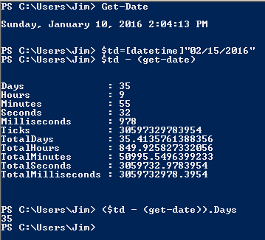
Exploring datetime Objects

Slide 43
Process Information
Enter each of these and observe:
Get-Command # list all commands available
Get-Command -Verb Set # list “set” commands
Notepad # launch the application
Get-Process # show running processes
Get-Process notepad # show notepad process
Get-Service -Name *sql* # services matching SQL
(http://technet.microsoft.com/en-us/library/dd315315.aspx )

Slide 44
Important Standard Parameters
-ErrorAction : The behavior when an error occurs. Values include SilentlyContinue, Continue (default), Stop
-Confirm : Before execution the command will ask user for continuation option. Mostly available with commands that alter resources.
-ErrorVariable : Variable to assign error object to.
-WhatIf : Describes the action that would be taken – does not execute command

Slide 45
Try these one at a time…
PS> Set-Content demofile.txt "Hello`nThis is the second line." –Confirm
PS> Get-Content demofile.txt -OutVariable txtContent
PS> $txtContent
PS> Remove-Item demofile.txt –WhatIf
PS> Remove-Item demofile.txt
PS> Remove-Item demofile.txt #yes this is a repeat
PS> Remove-Item demofile.txt -ErrorAction SilentlyContinue

Slide 46
Our First PowerShell Script

Slide 47
Background
Back in high school, I had a game to deal with super boring classes. Using my calculator, I would play a "Game of 3s". Here are the rules:
Mash in a random large number.
If the number is divisible by 3, divide it by 3 repeatedly (until the quotient is no longer divisible by 3), go to step #3.
Either add or subtract 1 (whichever gets you to evenly divisible by 3), then go back to step #2.
The game stops when you reach 1.
Today, the challenge is to create a program that "plays" the Game of Threes.

Slide 48
Challenge Description
The program input is a single number: the number at which the game starts.
Write a PowerShell script that plays the Threes game, outputting a the sequence of steps you need to take to get to 1.
Each step should output the number, followed by -1 or +1 (if you are adding/subtracting 1 before dividing), or 0 (if you are just dividing). The last line should simply be 1.

Slide 49
Learning Like the Pros
Once we understand the problem, we need to figure out how to translate to code.
First, let’s diagram…

Slide 50
Things We Need
Let’s identify what constructs we need.
What is the syntax for retrieving input from the command line?
What is the syntax for a loop?
What is the syntax for a conditional (if statement)?
How do we write to the console?
What do the comparison and arithmetic operators look like?
What are the search queries we should be sending to google?

Slide 51
Code It!

Slide 52
Test It!
\script1.ps1 2171894

Slide 53
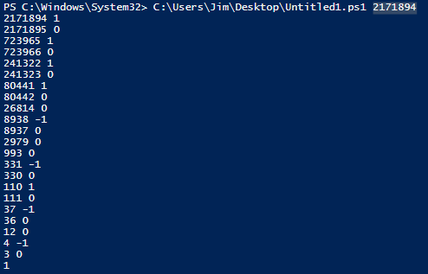

Slide 54
A Solution…
param([int]$start = 1)
while($start -ne 1){
$output = "$start ";
$diff=0;
if($start % 3 -eq 0){
$start /= 3;
}
else{
$diff = if($start % 3 -eq 1){-1} else {1}; # No PS support for conditionals like '? :'
$start+=$diff; # numeric context
}
$output+=$diff; # string context
# using Write-Host is tempting for -NoNewline, but write-Host should be avoided
# because it escapes piping (to be discussed later…)
Write-Output $output;
}
echo $start
NOTE: Better visibility next slide?

Slide 55
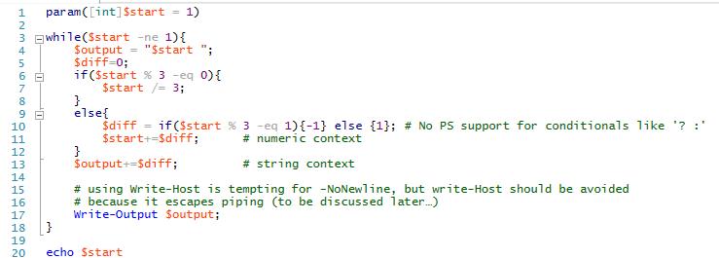
A Solution…

Slide 56
Review: Comparison Operators
Here are the comparison operators commonly used to compare numbers:
Purpose | Operator | Example | Returns
Greater than | -gt | 1 -gt 2 | $false
Less than | -lt | 1 -lt 2 | $true
Equals | -eq | 2 -eq (1+1) | $true
Not equals | -ne | 3 -ne (1+1) | $true
Greater than or equal to | -ge | 3 -ge (1+1) | $true
Less than or equal to | -le | 2 -le (1+1) | $true

Slide 57
Another Example

Slide 58
Description
Financial traders often use a technique called backtesting to evaluate trading performance.
Let's backtest a day trader’s performance – his goal is to buy low & sell high. Day traders want to get in and out of a stock before the day is done, while also timing trades to maximize gains.

Slide 59
Description
The market has a rule that a trader cannot buy and sell in a pair of ticks – at least one tick must go by between purchase and sale. Obviously no one can buy in the future and sell in the past!

Slide 60
Input
The only input is a list of stock prices (space separated) in chronological order:
Example:
\script.ps1 19.35 19.30 18.88 18.93 18.95 19.03 19.00 18.97 18.97 18.98

Slide 61
Output
The program should print the two trades (in chronological order) that maximize profits - what you think the trader should buy at and sell at.
Example:
\script.ps1 19.35 19.30 18.88 18.93 18.95 19.03 19.00 18.97 18.97 18.98
18.88 19.03

Slide 62
Learning Like the Pros
Once we understand the problem, we need to figure out how to translate to code.
First, let’s diagram…

Slide 63
Things We Need
Let’s identify what constructs we need.
What is the syntax for retrieving input from the command line in array form?
What’s the syntax for accessing elements of an array?
What is the syntax for a “c-style for” loop?
What is the syntax for a conditional (if statement)?
What are the search queries we should be sending to google?

Slide 64
Code It!

Slide 65
Test It!
9.95 8.03 10.02 8.08 8.14 8.10 8.31 8.28 8.35 8.34 8.39

Slide 66
Testing…

Slide 67
A Solution…
$prices = $args
#$prices | foreach-object { $_ } # short-hand for showing contents of an array
$lowIdx = 1; # index of the buy price (the "low" price
$highIdx = 3; # the index of the sell price (the "high" price)
$max = $prices[$highIdx] - $prices[$lowIdx]; # holds the largest price difference we've seen
<# This is a multi-line comment
$lowIdx, $highIdx, $max should be initialized to something, so take the first valid elements from the start of the array.
Setting $max to 0 would introduce a bug. #>
for($i=0; $i -lt $args.count; $i++){
for($j=$i + 2; $j -lt $args.count; $j++){ # plus 2 b/c of tick rule
if($prices[$j] - $prices[$i] -gt $max){
$max = $prices[$j] - $prices[$i];
$highIdx = $j;
$lowIdx = $i;
}
}
}
Write-Output "$($prices[$lowIdx]) $($prices[$highIdx])";
NOTE: Better visibility next slide?

Slide 68
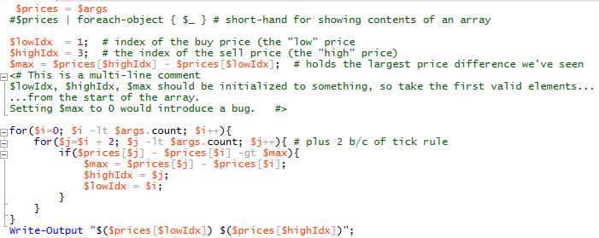
A Solution…

Slide 69
Pipeline / Piping

Slide 70
Objects
What sets PowerShell apart from a traditional Linux shell like Bash?
Traditional shells output text, which makes it difficult to do things like formatting and filtering. Of course, there are tools to help you get the job done (awk, sed, grep, etc), but to do any kind of heavy text parsing, you need to master regular expressions.
PowerShell takes advantage of the underlying .Net framework and takes a different approach, using objects instead of text.

Slide 71
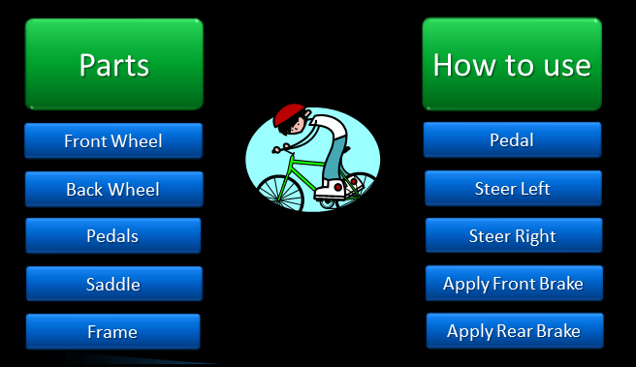
Objects (2)
Objects are just a representation of something. They are a collection of parts and actions to use them. Let’s take a look at the parts of a bicycle and how we might use them:

Slide 72
Objects (3)
If we wanted to represent a Windows Service as an object, we might decide that it is appropriate to describe it using three properties: Service Name, State and Description. We also need to interact with the service, so we might give the object a Start, a Stop and a Pause method.

Slide 73
Objects (4)
You can see an object’s properties and methods by passing it to the Get-Member cmdlet. The objects that a PowerShell cmdlet outputs are largely underlying types from the .Net framework, but you can create your own objects if you need to using C#.

Slide 74
Piping
PowerShell is object-based
Cmdlets appear to display their results in the console, however, most actually return an object that is processed by the console and then displayed. They do not write to the screen directly.
Instead of sending objects to the console, it is possible to send objects to other cmdlets with a technique known as piping.

Slide 75
Piping
PS> get-itemproperty c:\windows\regedit.exe
The result of this command is actually to return an object to the console
The object contains many more pieces of information than the default view shows.
By piping the object to format-list, other pieces of information are displayed:
PS> get-itemproperty c:\windows\regedit.exe | format-list

Slide 76
Filtering and the pipeline
Most cmdlets produce objects for their output. Literal values do the same.
Get-Member provides a listing of the public members of those objects (public members by default):
PS> get-date | get-member
(https://technet.microsoft.com/en-us/library/ee176854.aspx)

Slide 77
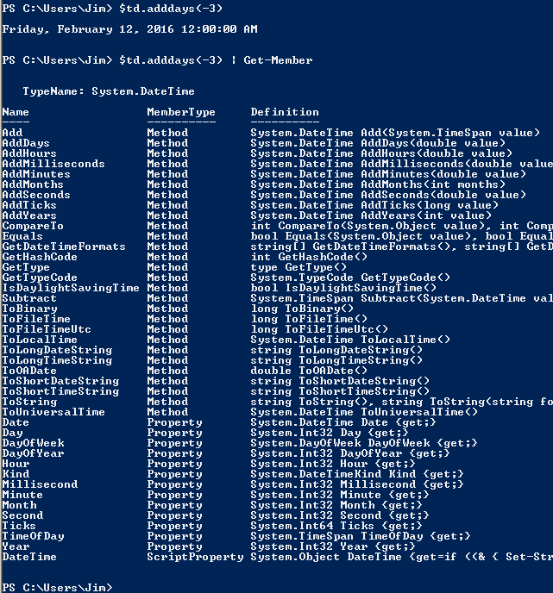

Slide 78
Expressions Are Objects!
Let’s explore this by entering the following:
PS>(120).GetType()
PS> "Patrick Bailey".GetType()
PS> "Patrick Bailey".ToUpper()
PS>“Pat has " + "Pat".Length + " letters."
PS>(Get-Date).AddYears(-5)

Slide 79
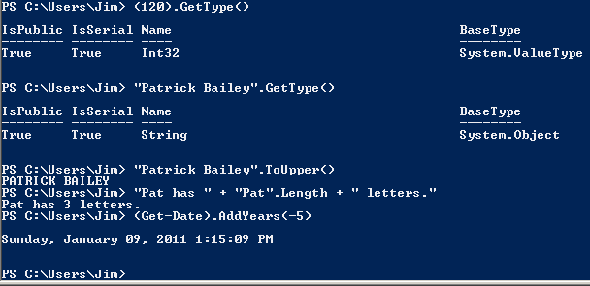
Expressions Are Objects!

Slide 80

The pipeline
Pipes are similar to traditional scripting languages, but they actually pass objects –Access to data is through methods and properties – not string parsing

Slide 81
A closer look
PS> notepad;notepad
PS> $plist = Get-Process notepad
PS> $p1 = $plist[0]
PS> $p1 | Get-Member
PS> $p1.HasExited # false
PS> Stop-Process -Id $p1.Id
PS> $p1.HasExited # true

Slide 82
Filtering in Action
PS> notepad;notepad;notepad
PS> Get-Process
| Where-Object { $_.Name -eq "notepad" }
| Select-Object Handles, Id, ProcessName
PS> Get-Process -Name notepad | ForEach-Object { Stop-Process $_.Id }

Slide 83
What Just Happened?
Script blocks – think of them as anonymous methods or short inline scripts, the ForEach objects run the script blocks for each item
$_ is similar to Perl’s use as the current value
PS> notepad;notepad;notepad
PS> Get-Process
| Where-Object { $_.Name -eq "notepad" }
| Select-Object Handles, Id, ProcessName
PS> Get-Process -Name notepad | ForEach-Object { Stop-Process $_.Id }

Slide 84
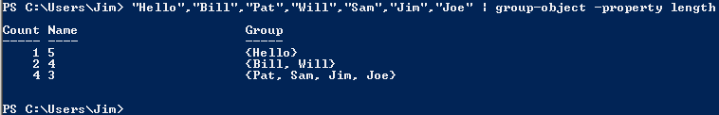
Group-Object
The Group-Object cmdlet sorts objects into buckets by property:

Slide 85
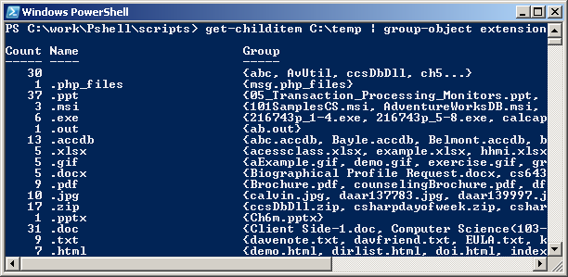
Grouping Objects
PS> get-childitem C:\temp | group-object extension

Slide 86
More Sample Scripts

Slide 87
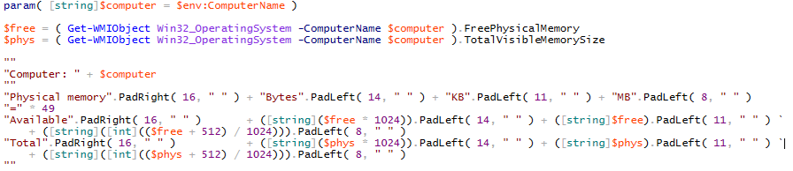
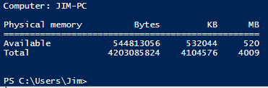
Example 1: Memory Use

Slide 88
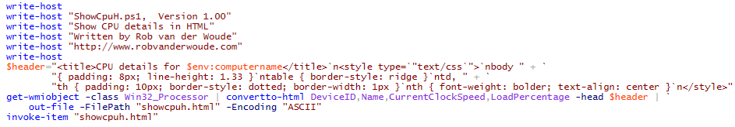
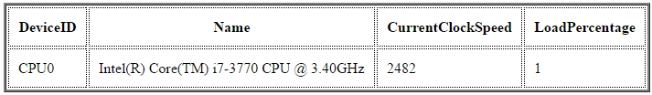
Example 2: CPU Info to Browser

