Slide 1
PowerShell [cont’d]

Slide 2
Review

Slide 3
Review
PowerShell script files have a .PS1 extension.
You should use the PowerShell ISE version (which provides an IDE to work in).
PowerShell is a loosely-typed language
Ex. "Patrick is " + 54
54 is automatically casted to string. PowerShell tries to guess at what you meant

Slide 4
C# in PowerShell
PowerShell gives you access to the full underlying power of the .NET Framework.
Some PowerShell “scripts” are practically indistinguishable from a C# program written in Visual Studio.

Slide 5
Redirecting Output
You can use the angle bracket to perform redirection.
dir > file.txt will redirect the output of the dir command into the text file file.txt.
You can even do the double-angle trick, where the content will be appended to the specified file:
dir >> file.txt

Slide 6
Data Types

Slide 7
Data types
Type | Description
[int] | 32-bit signed integer
[string] | Fixed-length string of Unicode characters
[byte] | An 8-bit unsigned character
[bool] | Boolean True/False value
[single] | Single-precision 32-bit floating point number
[array] | An array of values
[hashtable] | A hashtable object
Note: These are the important ones for our class, there are tons more.

Slide 8
Booleans
function test ($VALUE) { if ($VALUE) { Write-Host -ForegroundColor GREEN “TRUE” }
else { Write-Host -ForegroundColor RED “FALSE” } } test $TRUE TRUE test $FALSE FALSE test TRUE TRUE test FALSE TRUE # WHAT?!

Slide 9
‘Why is “FALSE” TRUE?’
Strings can be evaluated as Booleans.
If the length of a string is ZERO – it is false, otherwise it is TRUE.
“FALSE” has 5 characters so it is TRUE.

Slide 10
Booleans (cont’d)
test “SHORT STRING” TRUE test “” FALSE $x=(” ” -replace ” “) test $x FALSE

Slide 11
Booleans (cont’d)
test “0” TRUE # “0” is a string and it has a length of 1 test 0 FALSE # any number which evaluates to 0 is FALSE test 1 TRUE # any non-zero number is TRUE test 0.0 FALSE # floating point zero test 0x0 FALSE # a hexadecimal zero test 0.00000001 TRUE

Slide 12
Booleans (cont’d)
$x=@(1,2,3,4,5) test $x TRUE $x=@() # empty array test $x FALSE test (get-Process) TRUE test (get-Process |where {$_.name -eq “PowerShell”}) TRUE test (get-Process |where {$_.name -eq “NoSuchProcess”}) FALSE

Slide 13
Booleans (cont’d)
Here is your last example. If a variable is defined, we use its value to determine TRUE/FALSE but if the variable is not defined – it is FALSE.
$x=10 test $x TRUE $x=0 test $x FALSE test $NoSuchVariable FALSE set-psdebug -strict $NoSuchVariable The variable $NoSuchVariable cannot be retrieved because it has not been set yet. At line:1 char:15 + $NoSuchVariable <<<<

Slide 14
Using strict coding rules

Slide 15
strict Mode
set-strictmode -version 2.0
This command turns strict mode on and sets it to version 2.0. As a result:
Attempts to use uninitialized variables will fail.
Attempts to use method syntax (parentheses and commas) for a function call will fail.
Attempts to reference non-existent properties will fail.
https://msdn.microsoft.com/en-us/powershell/reference/4.0/microsoft.powershell.core/set-strictmode

Slide 16
Comparison and Logical Operators

Slide 17
Comparison Operators
Rather than using traditional comparison operators like < or >, PowerShell uses -lt or -gt to perform comparisons.

Slide 18
Comparison Operators
Here are the comparison operators commonly used to compare numbers:
Purpose | Operator | Example | Returns
Greater than | -gt | 1 -gt 2 | $false
Less than | -lt | 1 -lt 2 | $true
Equals | -eq | 2 -eq (1+1) | $true
Not equals | -ne | 3 -ne (1+1) | $true
Greater than or equal to | -ge | 3 -ge (1+1) | $true
Less than or equal to | -le | 2 -le (1+1) | $true

Slide 19
If Statements
if statements can be used with elseif and
else statements, which allow you to handle multiple scenarios.
if($num -eq 2){
return $true;
}
else{
return $false;
} # This code is stupid – how should it be written?

Slide 20
Comparison Operators (cont’d)
When comparing against text strings -eq can be used when an exact match is required.
The -match operator can be used when looking for a portion of a string

Slide 21
Comparison Operators (cont’d)
-like can be used to perform wildcard searches.
PowerShell can also be used to search for a particular value within an array by using -in, -notin, -contains, or -notcontains*
*: -in and –contains do the same thing with parameter order reveral

Slide 22
Review: Logical Operators
Logical Operator Example | Description
$a -and $b | True if $a and $b are True, otherwise False
$a -or $b | False if $a and $b are False, otherwise True
$a -xor $b | True if either $a or $b is True, otherwise False
-not($a) # alternatively !($a) | True if $a is False, otherwise False

Slide 23
Data Types

Slide 24
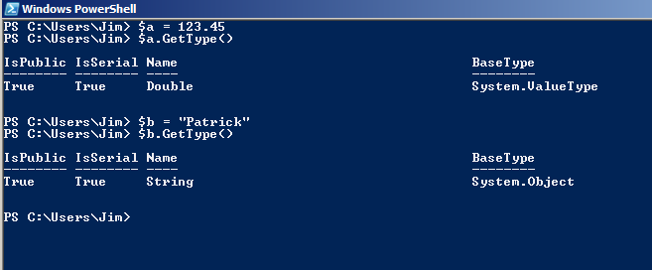
Variables in a Loosely-Typed Language
PS> $a = 123.45
PS> $a.GetType()
PS> $b ="Patrick"
PS> $b.GetType()

Slide 25
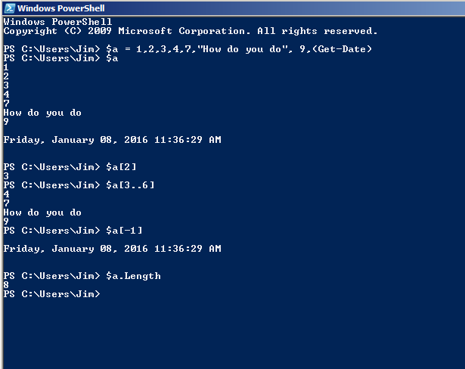
Arrays
Assigning:
PS> $a=1,2,3,4
Referencing a cell:
PS> $a[2] # 3
Length:
PS> $a.Length # 4
Ranges:
PS> $a[0..2] #1,2,3
Last Item:
PS> $a[-1] # 4

Slide 26
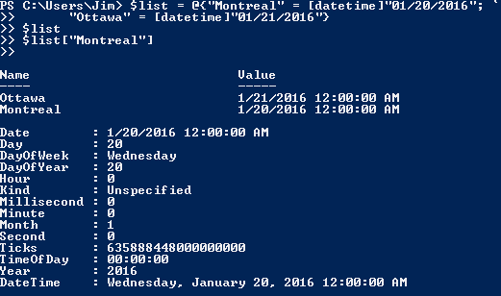
Hashtables
$list = @{"Montreal" = [datetime]"01/20/2016"; `
"Ottawa" = [datetime]"01/21/2016"}
$list
$list[“Montreal"]
Line continuation char

Slide 27
Functions

Slide 28
Script / Function Parameters
Param(
[int]$numThreads=4,
[int]$bufferSize=2000
);
Calling the script with --numThreads as an option will have the effect of defining an integer variable to hold the passed value. If nothing was passed, the default value is 4.
Note that the Param keyword must be the first line of code in a script. If it is not, the script will generate a runtime error.

Slide 29
What is a runtime error?

Slide 30
Functions
function Output-SalesTax { param( [int]$Price,
[int]$Tax
)
$Price + $Tax }
PS> Output-SalesTax -price 1000 -tax 38 1038
NOTE: in a block of code you need to define the function before you call it.
Don't add brackets around the function parameters:
$result = Add-Numbers (5, 10) -- Wrong!
$result = Add-Numbers 5 10 -- Right

Slide 31
Scope of Variables
All variables created in functions are local, they only exist within the function, though they are still visible if you call a second function from within the first one.
To persist a variable, so the function can be called repeatedly and the variable will retain it's last value, prepend $script: to the variable name, e.g. $script:myvar
To make a variable global prepend $global: to the variable name, e.g. $global:myvar

Slide 32
How does passing by reference differ from passing by value?

Slide 33
Passing by Reference
By default, PowerShell functions are pass by value:
function add5($num) { $num = $num + 5 } $testing = 2 $testing 2 add5 $testing $testing 2

Slide 34
Passing by Reference
A reference variable (defined with type: [ref]) is able to change the value of another variable that is passed to it.
This means that you can write a function that directly modifies one, (or more likely several) existing variables, rather than just returning a value.

Slide 35
Passing by Reference
function add5([ref]$num) { $num.value = $num.value + 5 } $testing = 2 $testing 2 add5 ([ref]$testing) $testing 7
If the parameter passed is not a reference variable, an InvalidArgument exception will be thrown. The parameters passed must also match the type required, integer, string etc.

Slide 36
Looping

Slide 37
Programming With Loops
PowerShell loops, at their most basic, simply repeat the same set of commands a set number of times.
PowerShell in particular features a number of cmdlets -- notably those that begin with the verb Get -- which return objects containing large numbers of similar data.
There are several types of loops available in PowerShell

Slide 38
while Loops
while($start -ne 1){
# some code…
}
echo $start

Slide 39
do … while Loops
$i=1 do { $i $i++ } while ($i -le 10)
echo $i
What is the output on the console?

Slide 40
How are while loops and do … while loops different?

Slide 41
do … until Loops
$i=1 do{ $i $i++ } until ($i -gt 10)
What is the output on the console?

Slide 42
How are do … while loops and do … until loops different?

Slide 43
foreach Loops
Concepts in the next example:
n..m defines a range of numbers returned in a list (or array).
PS> $a=8..11;
PS> $a
8
9
10
11

Slide 44
foreach Loops
Concepts in the next example:
| Where-Object {…} establishes a filter (where clause) similar to SQL:
PS> $a=8..15 | Where-Object { $_ % 2 –eq 0}
PS> $a
8
10
12
14

Slide 45
foreach Loops
$numArr = @(2..($num/3+1));
foreach($x in $numArr | Where-Object {$_ % 2 -ne 0}){
if($num % $x -eq 0){
return $FALSE;
}
}

Slide 46
for Loops
The following example shows a basic For loop used to create a multiplication table:
for ($i=0; $i -le 10; $i++) { "10 * $i = " + (10 * $i)
}
Show the colors in an array:
$colors = @("Orange","Yellow","Green","Blue","Indigo") for ($i=0; $i -lt $colors.Length; $i++){ $colors[$i] }

Slide 47
break
In some situations you may need to exit a loop early based on something other than the loops condition. In this case the Break keyword can be invoked in order to exit out of the loop. This example uses an infinite loop and the break keyword to exit out at the appropriate time:
$i=1 while ($true){ $i $i++ if ($i -gt 10){ break } }

Slide 48
continue
A continue statement returns the flow to the top of the innermost loop that is controlled by a while, for, or foreach statement. Probably the best way to understand this is to see it in action.
[array]$a = 1..6
foreach ($i in $a){
if($i -eq 3){continue}
$i
}

Slide 49
Exercise
Set up an array of the following musical instruments:
cello guitar violin double bass
Loop round and remove the vowels. Display the new words.

Slide 50
Writing to Console

Slide 51
Using Write-Host
write-host is a handy cmdlet with a very practical switch —nonewline. What nonewline provides is a simple way to join different lines together:
write-host –nonewline “Counting from 1 to 9 (seconds): “
foreach($element in 1..9){
Write-Host –NoNewLine “${element} “
Start-Sleep –Seconds 1
}
Write-Host “”

Slide 52
Using Write-Host
write-host is also useful for is adding color to output. This can be very useful when trying to make output stand out. On the next slide we’ll blend in some colors to the previous example.

Slide 53
Using Write-Host
Write-Host –NoNewLine “Counting from 1 to 9 (in seconds): “
foreach($i in 1..9){
$color = if($i % 3 -eq 0){ “green” }
elseif($i %3 -eq 1) { “Red” }
else {“Yellow”}
Write-Host –NoNewLine “${i} ” `
-BackgroundColor $color `
-ForegroundColor “Black”
Start-Sleep –Seconds 1
}

Slide 54

Exercise
Write code to create a checkerboard pattern with the letters “B" and “W" (colored appropriately).
Display to the console. When you have finished this exercise, it should look something like this:
Warning: The hardest part is getting the colors coded properly on different rows. Note that row 1 & 2 start with different colors!

Slide 55
“Evil” Solution
$boxes = @{ black = @{ char="B";fcolor="black";bcolor="white"};
white = @{ char="W";fcolor="white";bcolor="black"}
};
foreach($i in 1..64){
$color= if($i % 2 -eq ([math]::floor(($i - 1) / 8) % 2 -eq 0))
{ $boxes.Item("black") }
else { $boxes.Item("white") };
Write-Host –NoNewLine $color.Item("char") `
-BackgroundColor $color.Item("bcolor") `
-ForegroundColor $color.Item("fcolor")
if($i % 8 -eq 0){
Write-Host;
}
}
NOTE: Next slide, more visible?

Slide 56
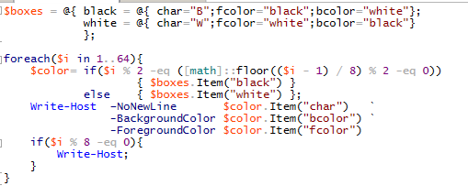
“Evil” Solution

Slide 57
Less “Evil” Solution
$boxes = @{ black = @{ char="B";fcolor="black";bcolor="white"};
white = @{ char="W";fcolor="white";bcolor="black"}
};
foreach($i in 1..64){
if([math]::floor(($i - 1) / 8) % 2 -eq 0){ # even numbered row
$color=if($i % 2 -eq 1){ $boxes.Item("black") } else { $boxes.Item("white") };
}
else{
$color=if($i % 2 -eq 1){ $boxes.Item("white") } else { $boxes.Item("black") };
}
Write-Host –NoNewLine $color.Item("char") `
-BackgroundColor $color.Item("bcolor") `
-ForegroundColor $color.Item("fcolor")
if($i % 8 -eq 0){
Write-Host;
}
}
NOTE: Next slide, more visible?

Slide 58
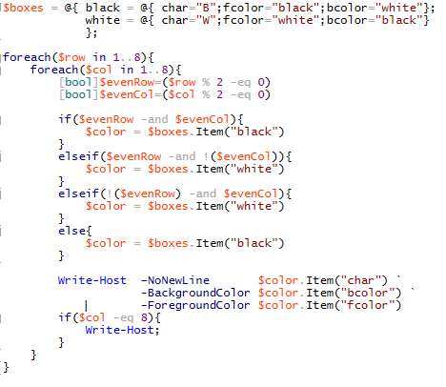
“Easy” Solution

