Slide 1
CUSTOMER
SEGMENTATION
FOR MARKETING
Business Intelligence • Power BI Dashboard Project
Presented by: Uplakshay Srivastava
BBA – Business Analytics
Illustrative banking customer dataset | Prepared for academic presentation

Slide 2
01 | Executive Summary
Using customer data to build more relevant and effective marketing
• Customer segmentation divides a broad customer base into smaller groups with similar characteristics or behaviours.
• This project demonstrates a Power BI-style dashboard using banking customer attributes such as age, income, tenure, product holding, transactions and preferred channel.
• The dashboard compares segment size, average monthly spend and channel preferences to help marketers understand different customer needs.
• The objective is to support targeted communication, stronger engagement and more informed campaign planning.
Note: figures are illustrative and generated for this presentation; replace with your actual Power BI export if available.
02 | CUSTOMER SEGMENTATION

Slide 3
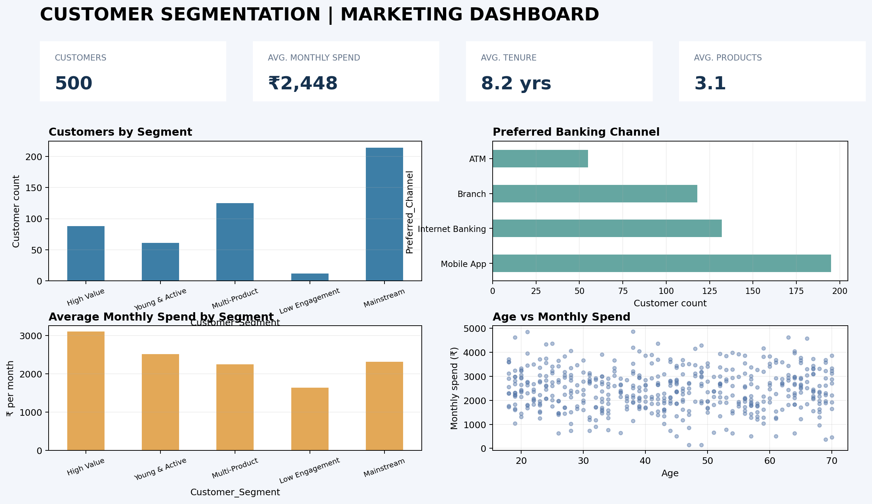
02 | Dashboard at a Glance
A single view of customer segments, spending and channel behaviour
Dashboard mock-up built from sample data; the accompanying CSV can be imported into Power BI.
03 | CUSTOMER SEGMENTATION

Slide 4
03 | How Customers Are Segmented
Simple, interpretable rules for the demonstration dataset
HIGH VALUE
YOUNG & ACTIVE
MULTI-PRODUCT
Higher income and higher monthly spend
Under 30 with frequent transactions
Customers holding four or more products
Marketing idea: Premium offers, loyalty benefits and relationship-building
Marketing idea: Mobile-first campaigns, app features and relevant onboarding
Marketing idea: Cross-sell carefully; highlight useful product bundles
LOW ENGAGEMENT
MAINSTREAM
Fewer than eight monthly transactions
Customers not matching the rules above
Marketing idea: Re-engagement messages and easy-to-use service reminders
Marketing idea: Relevant general offers and ongoing engagement
04 | CUSTOMER SEGMENTATION

Slide 5
04 | What the Dashboard Can Tell Us
Turn charts into questions and marketing actions
• Segment size: identify which customer groups make up the largest part of the sample.
• Spending patterns: compare average monthly spend across segments to understand relative value.
• Channel preference: see whether customers more often use the mobile app, internet banking, branch or ATM.
• Age and spend: explore whether spending patterns vary across age groups; avoid assuming age alone explains behaviour.
• These are descriptive findings from illustrative data—not verified findings about a real bank.
05 | CUSTOMER SEGMENTATION

Slide 6
05 | Methodology & Data Quality
A reliable segmentation dashboard starts with clear definitions
• Import the CSV into Power BI Desktop and check data types, missing values and duplicate customer IDs.
• Use Power Query to clean labels and verify that numeric fields are stored as numbers.
• Create measures for customer count, average monthly spend, average tenure and average products held.
• Build visuals: customers by segment, preferred channel, average spend by segment and age versus spend.
• Validate totals against the source file and clearly label the dataset as sample or real.
06 | CUSTOMER SEGMENTATION

Slide 7
06 | Marketing Recommendations
Use segmentation to make communication more relevant—not intrusive
• Personalise campaign messages around customer needs and product usage, rather than sending the same offer to everyone.
• Test one campaign per segment and compare response, conversion and retention using measurable KPIs.
• Use channel preferences to choose convenient communication routes, while respecting customer consent and privacy.
• Review segment definitions periodically; customer behaviour can change over time.
• Before business decisions, replace sample data with approved, anonymised bank data and validate results with stakeholders.
07 | CUSTOMER SEGMENTATION

Slide 8
CONCLUSION
Customer segmentation helps marketers understand differences between customer groups and plan more relevant campaigns.
A Power BI dashboard makes these patterns easier to explore through interactive filters, clear measures and visual comparisons.
THANK YOU
Questions & Discussion
Presented by: Uplakshay Srivastava

