Slide 1
Indian Railways Punctuality & Network Delay Dynamics
DATA WAREHOUSING AND MINING · PROJECT PRESENTATION
Data warehousing, OLAP, graph mining and next-station delay prediction on one year of operations (Feb 2025 – Feb 2026)
Uplakshya Vishwakarma
M.Tech CSE (Artificial Intelligence) · Roll No. 26072011
Indian Institute of Technology (BHU), Varanasi
06/11/2026
Data
ETL
Warehouse
Mining
Insight
Notes:
Introduce the project: a full knowledge-discovery pipeline on one year of Indian Railways delay data, from raw logs to a warehouse, OLAP analysis, network mining and delay prediction.

Slide 2



Delays do not stay local — they cascade along the route
PROBLEM DEFINITION
Indian Railways generates timetables, station masters and actual arrival/departure logs every day. A few minutes lost at one junction are carried — and often amplified — through every remaining stop, disrupting passengers and congesting shared corridors.
O1 · Punctuality & temporal patterns
O2 · Bottlenecks & high-risk routes
O3 · Delay prediction
When and for whom is the network late? Delay by month, weekday, time of day, route stage and train category.
Which stations and sections trigger or amplify delay, structurally and operationally?
Forecast the arrival delay at the next scheduled station from what is known now.
OLAP: roll-up, drill-down, slice, dice
Graph mining, centrality, 2σ / 3σ outlier bands
Regression: persistence, Ridge, RF, XGBoost
Notes:
Explain the motivation and the three objectives. Each objective maps to a data-mining task: descriptive OLAP, graph and outlier mining, and numeric prediction.

Slide 3
One year, four linked tables, 38.4 million delay records
DATASET
38.4 M
365
7,033
8,629
raw station-level delay records
days · 8 Feb 2025 – 7 Feb 2026
trains with delay logs (8,720 in master)
physical stations in the timetable
Table | Rows | Grain | Key attributes (type)
train_details.csv | 8,992 | train × type tag | train_no, train_name, type_code (nominal)
station_full_names.csv | 8,963 | station | station_name, full name, station_zone (nominal), address
combined_schedule.csv | 172,112 | train × scheduled stop | station_no (ordinal), distance (ratio), arrival/departure times (interval)
combined_delay.csv | 38,428,703 | date × train × stop | date, train_no, station_no, station_name, delay in minutes (ratio; < 0 = early)
8 service categories: Passenger, Express, Superfast, Rajdhani, Shatabdi, Vande Bharat (T18), Garib Rath and Premium/Special (PRM).
Notes:
Source is the Kaggle Indian Railways Delay Dataset scraped from etrain.info (an NTES mirror). Point out that the delay table dominates by volume and that station_no is a stop position, not a station.

Slide 4




A KDD pipeline from raw logs to forecasts
METHODOLOGY
Steps 1.1–1.3
Steps 2.1–2.5
Step 3.1–3.2
Steps 3.3–3.4
Step 4.1
Steps 4.2–5.4
Understand
Clean & integrate
Warehouse
OLAP
Graph mining
Predict & evaluate
Profiling, quality audit, key resolution
Imputation, noise, outliers, stop alignment
Star schema in DuckDB, analytical views
Cubes, cuboids, route & temporal patterns
Centrality, hubs, delay amplification
Features, 4 models, test set, audit
H&K Ch. 2–3
H&K Ch. 3
H&K Ch. 4
H&K Ch. 4–5
Freeman, Brandes
H&K Ch. 8
Stack DuckDB (out-of-core SQL over 38 M rows) · Parquet · pandas · NetworkX · scikit-learn · XGBoost · Streamlit · Plotly
Notes:
Walk through the pipeline left to right. Each stage maps to a chapter of Han, Kamber and Pei: preprocessing (Ch. 3), warehousing and OLAP (Ch. 4-5), prediction and evaluation (Ch. 8), outliers (Ch. 12).

Slide 5
Structured gaps, duplicate keys and impossible values
STEPS 1.1–1.3 · DATA UNDERSTANDING
4.88 %
What the audit found
of delays missing (1,874,271) — clustered by station and date, not random
Whole stations dark all year (AJLE, STLA 365/365 missing); some Feb 2025 days 12–14 % missing
Missing schedule times are structural: 8,673 arrivals only at origins, 8,673 departures only at termini
station_no is a stop position, not a station: 119 distinct values vs 8,629 station names
Impossible values: maximum delay 525,592 min (≈ 365 days), inflating SD to 229.9 min
Fact grain (date, train_no, station_no) verified unique over all 38.4 M rows in one DuckDB pass
Referential gaps: 1,687 master trains never appear in the delay logs
272
train numbers with two type codes (base type + PRM special tag)
64
stations in timetable/delay logs missing from the station master
Notes:
Emphasise that missingness is structured, not random, so zero-filling would be wrong. The duplicate train numbers turned out to be a premium-special overlay tag, which later became one of the strongest signals.

Slide 6
Each issue got a technique from the preprocessing toolbox
STEPS 2.1–2.3 · ETL & CLEANING
Issue | Technique (Han & Kamber, Ch. 3) | Result
272 duplicate train numbers | Entity identification — base type kept, PRM → is_premium_special flag | 8,720-train dimension
64 unknown stations | Unknown dimension members ("UNKNOWN") | 9,027 stations, 100 % FK integrity
Missing origin arrival / terminal departure | Logical imputation — zero-halt rule | 0 missing schedule times
Fully dark journeys | Ignore tuple at journey level (origin-date aware) | 39,616 journeys dropped
Missing origin delays | Class central tendency — per-train median, global fallback | 42,392 values imputed
Mid-route blackouts | Most probable value — LOCF within (origin_date, train) | 990,514 filled · is_imputed flag
Transmission errors | Noise removal — 1,440-min (24 h) domain cutoff | 14,982 rows removed · SD 229.9 → 66.0
Genuine extremes | Outlier analysis — positive-tail 2σ / 3σ bands | High-risk > 167.65 · critical > 233.68 min
Time attributes | Concept hierarchy generation | day → weekday → month → quarter → year
Final fact table: 36,614,824 rows — 97.18 % observed, 2.82 % imputed; 1,273,458 bottleneck rows (3.48 %) beyond 2σ.
Notes:
Map each row to Han & Kamber Chapter 3: global constant, logical imputation, class-wise central tendency, most-probable-value via LOCF, noise removal and outlier analysis. Every synthetic value carries the is_imputed flag.

Slide 7


Three semantic checks made the data trustworthy
STEPS 2.1, 2.4, 2.5 · VALIDATION
What does delay mean?
What does date mean?
Do stop numbers line up?
1.04 M non-zero delays at origins and 1.04 M at destinations: the field records departure delay at stop 1 and arrival delay everywhere else.
Origin delay on day D correlates most with terminal delay on D + 0 for 1- to 4-day trains (r = 0.47, 0.61, 0.53, 0.44).
18.0 % of rows carried a different station than the timetable at that station_no — extra halts shift later stops (62.7 % by exactly −1).
Rule: delay_type by stop position
date = journey start date
stop_alignment_map aligns 97.66 %
Notes:
These three checks are the difference between a correct and a wrong analysis. Delay meaning switches by position; date is the journey start; and 18 percent of stop numbers were shifted by unscheduled halts.

Slide 8
A star schema with a journey-date grain
STEP 3.1 · DATA WAREHOUSE
DIM_TRAIN
DIM_STATION
Design decisions
8,720 rows
train_name
primary_type_code
is_premium_special
9,027 rows
station_full_name
station_zone
station_address
Grain = journey start date × train × stop position
Schedule attributes joined only through the alignment map
Measures: count/sum distributive, mean algebraic, median/P90 holistic → ROLAP on demand
Materialised once as Parquet (432 MB)
8 automated checks — all passed
FACT_DELAY · 36.6 M
PK date_id, train_no, station_no
delay (min), delay_type
punctuality_band, severity
is_imputed, has_schedule
sched_station_no, distance,
scheduled halt & times
DIM_DATE
365 rows
year › quarter › month
day_name, is_weekend
Views: observed (35.58 M) · arrivals (33.77 M) · origins (1.81 M) · prediction-eligible (35.28 M)
Notes:
The fact grain is one delay per journey start date, train and stop position. Mention measure types from Han & Kamber Chapter 4: counts are distributive, means algebraic, medians and percentiles holistic, which is why the cube is computed ROLAP-style on demand in DuckDB.

Slide 9
Special trains are late five times more often than average
STEP 3.3 · CUBE 1 — TRAIN CATEGORY
76.2 %
of Shatabdi stops on time (≤ 15 min) — best of any category
96.3 min
mean delay of special (PRM) trains vs 35.7 min network-wide
Drill-down on is_premium_special: 28 special-tagged Express trains average 95.1 min (15.2 % bottleneck) against 36.8 min (3.7 %) for regular Express.
Notes:
Roll-up to train category on observed records. Shatabdi and Vande Bharat are the most punctual; special-tagged trains have a 17 percent bottleneck rate. The drill-down on the special flag inside Express shows 95 versus 37 minutes.

Slide 10
Extreme delay is a regional problem
STEP 3.3 · CUBE 2 — RAILWAY ZONE
Most stressed
SECR 7.74 % · SER 7.71 % · NER 6.43 % · ECR 5.94 %
SECR: mean 57.8 min, only 36 % of stops on time
Most punctual
SWR 0.58 % · SR 0.74 % · WR 0.89 % · NWR 1.02 %
WR: mean 14.5 min, 72.8 % of stops on time
Worst cuboid cell (zone × category)
Special trains in SER: mean 309.9 min, 50.3 % bottleneck
Regular: Superfast in SER 19.6 %, in SECR 17.9 %
Notes:
Zones on the eastern coal and mineral belt, SECR, SER and ECR, plus NER, have six to eight percent of stops beyond two standard deviations. The western and southern zones are an order of magnitude better. The dice on zone by category shows special trains in SER at 50 percent.

Slide 11
Winter is the worst season; weekday barely matters
STEP 3.3 · CUBE 4 — TEMPORAL HIERARCHY
44.97 min
Dec 2025 mean — worst month (bottleneck 5.41 %)
31.02 min
Aug 2025 mean — best month (bottleneck 2.56 %)
Weekday: 35.2–36.2 min mean, 15–16 min median
Early morning (04–08 h): 30.4 min, most punctual
Late night (00–04 h): 43.6 min, worst
Notes:
Monthly roll-up by journey start month. December peaks at 45 minutes mean and 5.4 percent bottleneck, consistent with fog and holiday traffic. Weekday means only vary between 35.2 and 36.2 minutes. Time of day: early morning best, late night worst.

Slide 12
Delay builds along the route — then the timetable hides it
STEP 3.4 · PATTERN DISCOVERY
31.6 %
of terminal arrivals are early — vs 0.00 % at intermediate stops
86.6 → 47.4 %
on time at origin vs at later stops
Distance effect: mean arrival delay rises from 25.6 min within 100 km of origin to 92.3 min beyond 1,500 km (bottleneck 17.6 %).
Notes:
Key discovery: delay grows monotonically with stop sequence to 70 minutes after stop 36, but at the final stop the mean falls to 28 and almost a third of arrivals are early, while intermediate stops record essentially no early arrivals. Recovery time is concentrated on the last segment.

Slide 13
The schedule network and its structural bridges
STEP 4.1 · GRAPH MINING
8,629
station nodes
31,514
directed edges (k → k+1)
99.64 %
of nodes in the largest weak component
C_B(v) = Σ σ_st(v) / σ_st (Freeman 1977; Brandes 2001)
Notes:
The graph is built from the static timetable only, and empirical statistics use the training period only, to avoid leakage. Betweenness is exact via Brandes' algorithm. DDU, BZA, NGP, CNB and NDLS are the bridges many shortest routes must cross.

Slide 14
Where structure meets stress: hubs and corridors
STEP 4.1 · BOTTLENECK RANKING
S = 0.35·PR(betweenness) + 0.15·PR(degree) + 0.25·PR(mean delay) + 0.25·PR(bottleneck rate) · PR = percentile rank among major hubs
Notes:
The composite score combines percentile ranks of betweenness, degree, mean delay and bottleneck rate among hubs with at least 20,000 training stops. Kharagpur ranks first. On the right, corridors that add the most delay per run; KGP to SRC adds almost 40 minutes, HWH to BWN amplifies on 95 percent of runs.

Slide 15
Once a train is badly late, it stays late
STEP 4.1 · DELAY PROPAGATION
r = 0.960
correlation between delays at consecutive stops (26.5 M pairs)
0.938 · 0.916
at lag 2 and lag 3 — slow decay
Zone boundaries: inter-zone transitions amplify by > 5 min on 29.2 % of runs vs 18.9 % within a zone, despite handover padding.
Notes:
Consecutive-stop delays correlate at 0.96 and decay slowly. Of trains in the bottleneck state, 99.7 percent are still more than 15 minutes late at the next stop. This is also why persistence is a strong baseline.

Slide 16
Predicting the next stop's delay without leaking the future
STEP 4.2 · FEATURE ENGINEERING
Train · 292 days · 26.53 M transitions
Val · 36 d
Test · 37 d
8 Feb 2025
26 Nov 2025
7 Feb 2026
Target mean: train 35.4 · validation 46.1 (+30 %) · test 41.2 min (+16 %) — winter fog shift
Feature | Meaning | r
curr_delay_min | delay at stop k | +0.960
prev_delay_min | delay at stop k−1 | +0.938
next_station_hist_arr_delay | smoothed station prior | +0.337
prev_delay_delta | upstream momentum | +0.172
transition_hist_delay_delta | smoothed edge amplification | +0.114
route_progress_ratio | position on the route | +0.106
Feature | Meaning | r
train_category_delay_prior | category / special prior | +0.095
segment_distance_km | scheduled distance | +0.073
segment_sched_running_min | scheduled running time | +0.062
is_terminal_arrival | next stop is the terminus | −0.036
next_sched_arrival_hour | scheduled hour | +0.033
next_station_betweenness | structural centrality | +0.027
Priors: x̃ = (n·x̄ + m·μ) / (n + m), m = 50, fitted on training data only · 33.16 M eligible observed transitions (imputed rows excluded)
Notes:
Target is the arrival delay at stop k+1 using only information at stops k and k-1. The split is chronological; validation and test both fall in winter so evaluation is under distribution shift. Network and category priors are fitted on training data only, with empirical-Bayes shrinkage m equals 50. Imputed rows are excluded from targets.

Slide 17
Random Forest is the best overall model
STEPS 4.3 & 5.1 · INDEPENDENT TEST SET
Model | MSE | RMSE | MAE | R² | ±15 min
Persistence | 408.14 | 20.20 | 8.21 | 0.9106 | 84.4 %
Ridge (α = 10) | 324.33 | 18.01 | 7.17 | 0.9290 | 88.2 %
Random Forest | 309.26 | 17.59 | 6.68 | 0.9323 | 89.5 %
XGBoost | 429.87 | 20.73 | 7.06 | 0.9058 | 89.6 %
−18.6 %
−24.2 %
MAE vs persistence
MSE vs persistence
RF: 80 trees, depth 14, min leaf 20 · tuned on the 36-day validation set · 63.6 % of forecasts within ±5 min
Notes:
Test set is untouched until the end: 3.35 million transitions from January and February 2026. Random Forest reduces MAE by 18.6 percent and MSE by 24.2 percent against persistence. XGBoost has good MAE but its MSE is worse than persistence because of the extreme tail.

Slide 18
Where each model wins — and where persistence fails
STEP 5.1 · STRATIFIED DIAGNOSTICS
Terminal destination stops
181,678 test transitions (5.4 %)
+12.7 → +0.1
mean bias: persistence → Random Forest (min)
20.5 → 12.1
terminal MAE: persistence → XGBoost (−41 %)
Learned from is_terminal_arrival, scheduled running time and the edge prior.
Notes:
XGBoost is best on the 96 percent of normal transitions; Ridge and RF are best in the critical tail where XGBoost collapses. At terminal stops persistence over-predicts by almost 13 minutes because it ignores the slack; the learned models remove that bias.

Slide 19
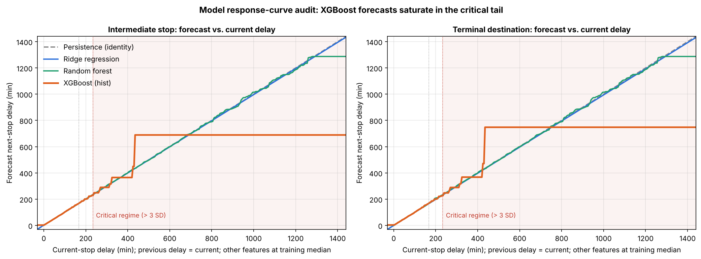
Why XGBoost fails on extreme delays
STEP 5.4 · MODEL RESPONSE-CURVE AUDIT
Why it happens
tree_method = hist buckets each feature into ≤ 256 quantile bins
Only ~2 % of rows lie above 233 min → a few wide bins
Trees output constants → a staircase, then a plateau
Fix: predict next − current, or raise max_bin
Current delay swept from −30 to 1,440 min; previous delay = current; other features at their training medians.
689 min
311 vs 3 min
constant XGBoost forecast for any current delay ≥ 435 min
error at 1,000 min: XGBoost vs Ridge (RF 15)
Notes:
New analysis: the saved models are probed by sweeping the current delay with other features at training medians. XGBoost's forecast is a staircase that goes flat at 689 minutes for any current delay above 435. Its histogram method has only a few quantile bins in the sparse tail. Fix: predict the residual next minus current.

Slide 20
Bottleneck patterns are stable, but not static
STEP 5.2 · PATTERN EVALUATION
Cohort | Stations | Mean delay r (train → test) | Bottleneck r (train → test) | Top-20 overlap
All eligible stations | 6,896 | 0.862 | 0.800 | —
Major transit hubs | 203 | 0.851 | 0.866 | 13 / 20
Effect of imputation
8 ×
fewer extreme origin delays in median-imputed rows (0.13 % vs 1.04 %)
SER, SECR, NER, ECR, WCR stay the most stressed zones in train, validation and test
Levels rise in winter — e.g. SECR bottleneck 7.5 % → 11.7 % → 8.7 %
Training-period priors are safe to use as features; refresh them periodically in production
8.0 vs 5.4 %
Dec 2025 bottleneck rate: LOCF-imputed vs observed arrivals
→ imputed rows keep lag continuity but never serve as targets
Notes:
Out-of-time check: station statistics in training versus test correlate at 0.86 for mean delay and 0.80 for bottleneck rate; 13 of the top 20 hubs persist. This corrects an earlier inflated number that compared training to the full year. Imputation effects justify excluding imputed rows from targets.

Slide 21
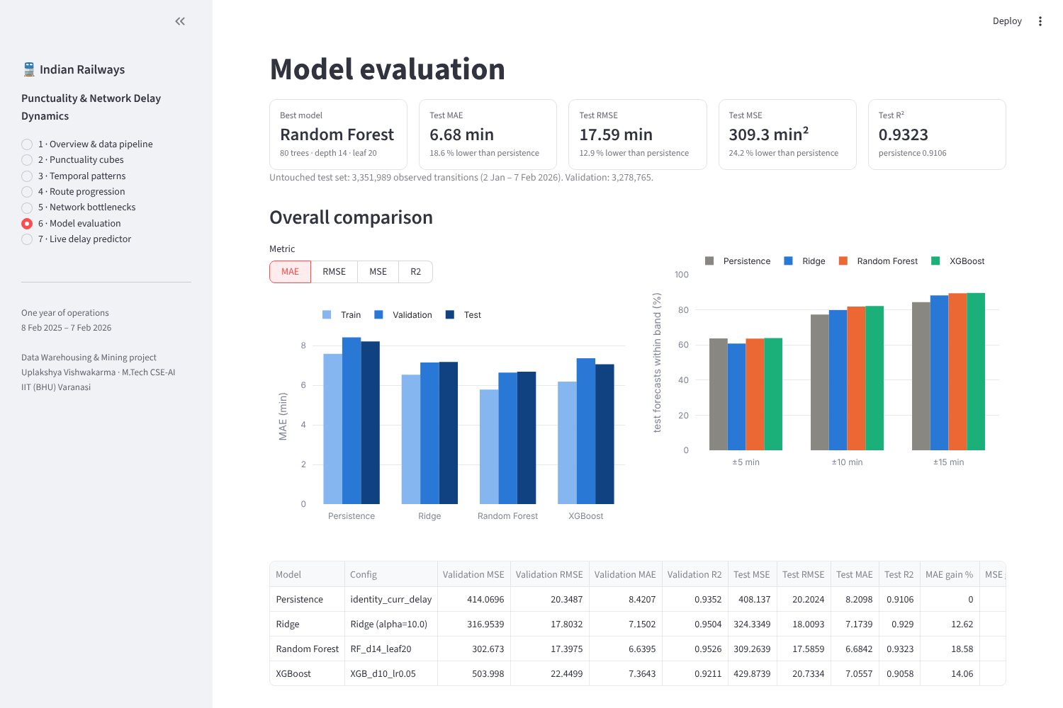
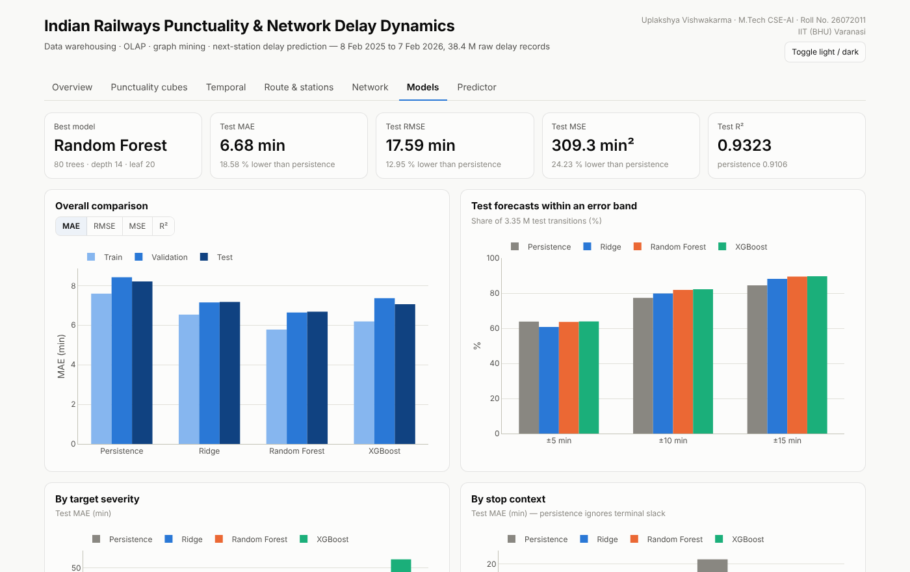
Two dashboards that work on a fresh clone
STEP 5.3 · KNOWLEDGE PRESENTATION
Streamlit — dashboard/app.py 7 pages · live predictor running Persistence, Ridge, RF and XGBoost
Standalone HTML tabbed, light/dark, sortable tables, in-browser Ridge predictor
streamlit run dashboard/app.py · python dashboard/build_dashboard_html.py [--inline]
Notes:
The Streamlit app has seven pages and a live predictor that runs the four saved models. The standalone HTML dashboard opens in any browser, has light and dark themes and an in-browser Ridge predictor. Both read only the committed JSON findings and model files.

Slide 22





What this means for operations
DISCUSSION
Target the line, not the origin
Fix a handful of corridors
Origin punctuality 86.6 % vs 47.4 % en route — monitor running sections and junction approaches.
KGP→SRC, NDLS→CNB, HWH→BWN, BLS→KGP amplify on 70–95 % of runs.
Measure punctuality en route
Plan for winter
Terminal padding makes destinations look 2× more punctual than stops 36+.
Dec–Jan adds ~10 min mean delay; build fog allowance into winter timetables.
Give special trains real paths
Alert early
Specials average 96 min — 2.6× regular Express; 50 % bottleneck in SER.
99.7 % of badly late trains stay late — forecast entry into the 60–170 min band.
Notes:
Six take-aways for operators. Emphasise that destination-only punctuality KPIs understate passenger-experienced delay, and that early alerts matter because late trains rarely recover.

Slide 23

What the data cannot tell us yet — and what comes next
LIMITATIONS & FUTURE WORK
Limitations
Future work
One annual cycle — validation and test both in winter
Scraped data; some hill lines report constant 0-min delays
No weather, freight, maintenance-block or crossing data
One-step horizon; recursive multi-stop use not evaluated
Models trained on 0.6–2.5 M sampled transitions
Residual target (next − current) for tree ensembles
Multi-horizon quantile forecasts (P10 / P50 / P90)
Add IMD fog/visibility and rainfall, festival calendars
Spatio-temporal graph neural networks on the schedule graph
Multi-year data with rolling-origin evaluation
Notes:
Be candid about limitations: one annual cycle, scraped data, no weather or freight inputs, one-step horizon and sub-sampled training. Future work follows directly: residual targets, quantile forecasts, weather data, graph neural networks and rolling-origin evaluation.

Slide 24
From 38.4 M raw logs to a forecaster that beats persistence by 18.6 %
CONCLUSION
36.6 M
31.6 %
KGP · TATA · NGP
6.68 min
validated fact rows in a DuckDB star schema
early arrivals at the terminus — schedule padding found by OLAP
top composite bottleneck hubs from graph mining
Random Forest test MAE on unseen winter data
Notes:
Summarise: careful data understanding fixed four hidden problems; the warehouse and OLAP quantified where and when the network is late and found terminal padding; graph mining named the bottlenecks; the Random Forest forecaster beats persistence and the audit explains XGBoost's failure mode.

Slide 25
References
REFERENCES
J. Han, M. Kamber, J. Pei. Data Mining: Concepts and Techniques, 3rd ed. Morgan Kaufmann, 2012.
R. Kimball, M. Ross. The Data Warehouse Toolkit, 3rd ed. Wiley, 2013.
W. H. Inmon. Building the Data Warehouse, 4th ed. Wiley, 2005.
J. Gray et al. Data Cube: A Relational Aggregation Operator. Data Mining & Knowledge Discovery 1(1), 1997.
S. Chaudhuri, U. Dayal. An Overview of Data Warehousing and OLAP Technology. SIGMOD Record 26(1), 1997.
U. Fayyad, G. Piatetsky-Shapiro, P. Smyth. From Data Mining to Knowledge Discovery in Databases. AI Magazine 17(3), 1996.
R. J. A. Little, D. B. Rubin. Statistical Analysis with Missing Data, 3rd ed. Wiley, 2019.
L. C. Freeman. A Set of Measures of Centrality Based on Betweenness. Sociometry 40(1), 1977.
U. Brandes. A Faster Algorithm for Betweenness Centrality. J. Mathematical Sociology 25(2), 2001.
A. E. Hoerl, R. W. Kennard. Ridge Regression. Technometrics 12(1), 1970.
L. Breiman. Random Forests. Machine Learning 45(1), 2001.
T. Chen, C. Guestrin. XGBoost: A Scalable Tree Boosting System. KDD 2016.
S. Kaufman et al. Leakage in Data Mining. ACM TKDD 6(4), 2012.
D. Micci-Barreca. A Preprocessing Scheme for High-Cardinality Categorical Attributes. SIGKDD Explorations 3(1), 2001.
R. J. Hyndman, G. Athanasopoulos. Forecasting: Principles and Practice, 3rd ed. OTexts, 2021.
T. Spanninger et al. A Review of Train Delay Prediction Approaches. J. Rail Transport Planning & Mgmt 22, 2022.
M. Raasveldt, H. Mühleisen. DuckDB: An Embeddable Analytical Database. SIGMOD 2019.
RXYDENXD. Indian Railways Delay Dataset (Feb 2025 – Feb 2026). Kaggle.
Notes:
Main textbook is Han, Kamber and Pei. Other standard references cover warehousing, OLAP cubes, centrality, the models and leakage.

Slide 26
Thank you
QUESTIONS & DISCUSSION
Uplakshya Vishwakarma · M.Tech CSE (AI) · Roll No. 26072011 · IIT (BHU) Varanasi
github.com/uplakshya07/indian_railway_delay
Notes:
Invite questions. Useful backups: the preprocessing table, the response-curve audit and the dashboards.

