Slide 1
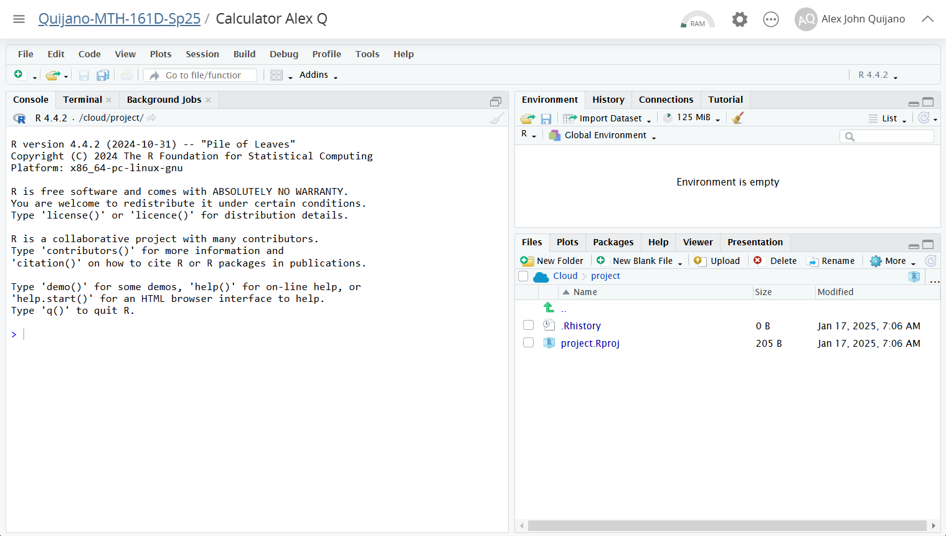
You can input R commands like a calculator on the console.
You can create documents in the file system.

