Slide 1
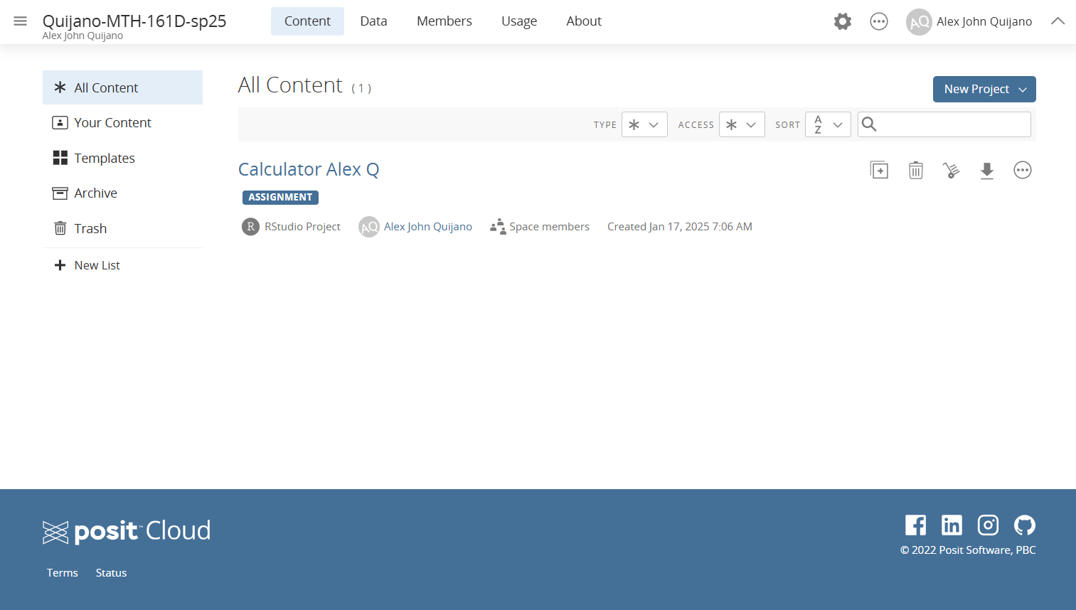
A R Studio “Project”
All R related assignments will show up as an R Studio “project” in this course’s workspace.
Workspace

