Slide 1
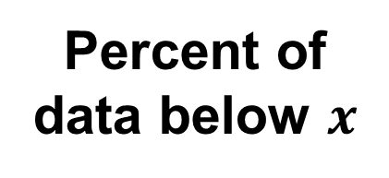

Percent of
data below $x$
Sorted Data
min
max
$$x$$
Percentile

