Slide 1












1
$$n=0$$
$$1=2^{0}$$
1
1
$$n=1$$
$$1+1=2^{1}$$
1
2
1
$$n=2$$
$$1+2+1=2^{2}$$
1
3
3
1
$$n=3$$
$$1+3+3+1=2^{3}$$
1
4
6
4
1
$$n=4$$
$$1+4+6+4+1=2^{4}$$
1
1
$$n$$
$$1+⋯+1=2^{n}$$

Slide 2

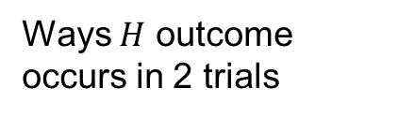






1
1
1
1
2
1
$$n=2$$
Ways $H$ outcome occurs in 2 trials
zero $H$
1
1
3
3
1
$$TT$$
one $H$
2
$$HT, TH$$
1
4
6
4
1
two $H$
1
$$HH$$
1
1

Slide 3

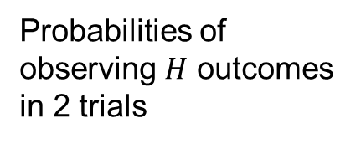
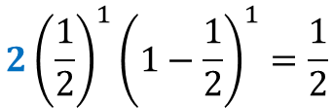

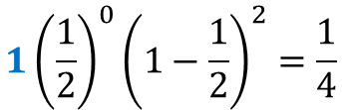


1
1
1
Probabilities of observing $H$ outcomes in 2 trials
1
2
1
$$n=2$$
1
3
3
1
$$1{\left(\frac{1}{2}\right)}^{0}{\left(1−\frac{1}{2}\right)}^{2}=\frac{1}{4}$$
$$P(zero H)$$
1
4
6
4
1
$$2{\left(\frac{1}{2}\right)}^{1}{\left(1−\frac{1}{2}\right)}^{1}=\frac{1}{2}$$
$$P(one H)$$
1
1
$$1{\left(\frac{1}{2}\right)}^{2}{\left(1−\frac{1}{2}\right)}^{0}=\frac{1}{4}$$
$$P(two H)$$

Slide 4


























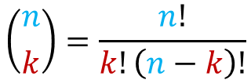

1
$$n=0$$
$$\left({0 \atop 0}\right)$$
k$=0$
1
1
$$n=1$$
$$\left({1 \atop 0}\right)$$
$$\left({1 \atop 1}\right)$$
k$=0, 1$
1
2
1
$$n=2$$
$$\left({2 \atop 0}\right)$$
$$\left({2 \atop 1}\right)$$
$$\left({2 \atop 2}\right)$$
k$=0, 1, 2$
1
3
3
1
$$n=3$$
$$\left({3 \atop 0}\right)$$
$$\left({3 \atop 1}\right)$$
$$\left({3 \atop 2}\right)$$
$$\left({3 \atop 3}\right)$$
k$=0, 1, 2, 3$
1
4
6
4
1
$$n=4$$
$$\left({4 \atop 0}\right)$$
$$\left({4 \atop 1}\right)$$
$$\left({4 \atop 2}\right)$$
$$\left({4 \atop 3}\right)$$
$$\left({4 \atop 4}\right)$$
k$=0,⋯,4$
1
1
$$n$$
$$\left({n \atop k}\right)=\frac{n!}{k!\left(n−k\right)!}$$
k

