Slide 1
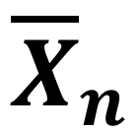
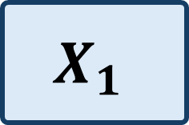
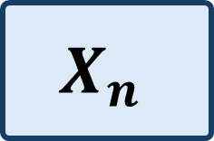

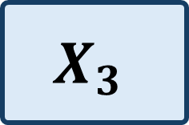
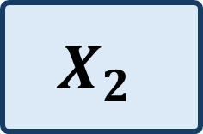
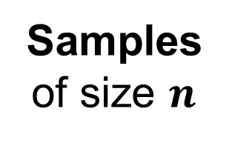

Samples
of size $n$
Population
with some unknown
underlying distribution
$$X_{1}$$
$$X$$
$$X_{2}$$
$${\overline{X}}_{n}$$
$$X_{3}$$
$$⋮$$
$$X_{n}$$

