Slide 1

Comprehensive Analysis of demographic data on members of the US Armed Forces, including gender, race and rank
Presented by:
Ella Skinkis, Anabel Hilerio, Mia Anderson

Slide 2

Motivation for Research
Notes:
Ella

Slide 3

Data Set
Notes:
Mia: Data taken from survey filled out by all members of the armed services collected by the department of defense from 2012. Including race, gender, rank, Hispanic, grade, branch. It is a population sampling and a prospective observational study.

Slide 4

Data & Biases
Data Collection Method: Reporting System
Some members may choose not to report
Some members may report incorrectly
May impact certain demographic groups more/less
Measure quantity ≠ true value
Notes:
Ella:

Slide 5
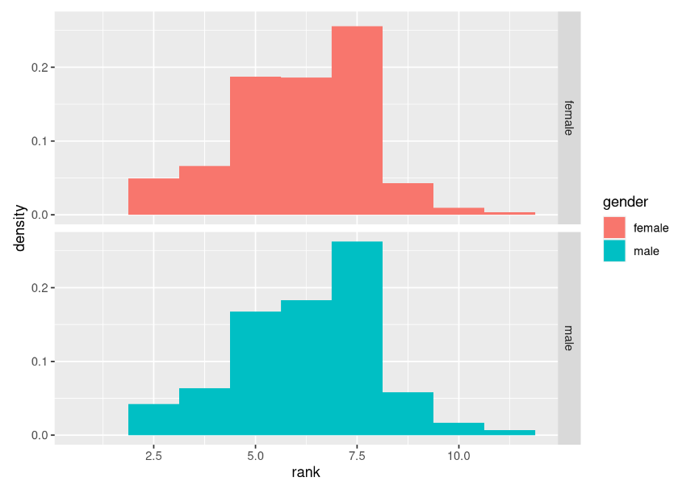
Density of Service Members in each Rank by Genders
Notes:
Anabel: Left skewed bell curve 7 is the most common rank.

Slide 6
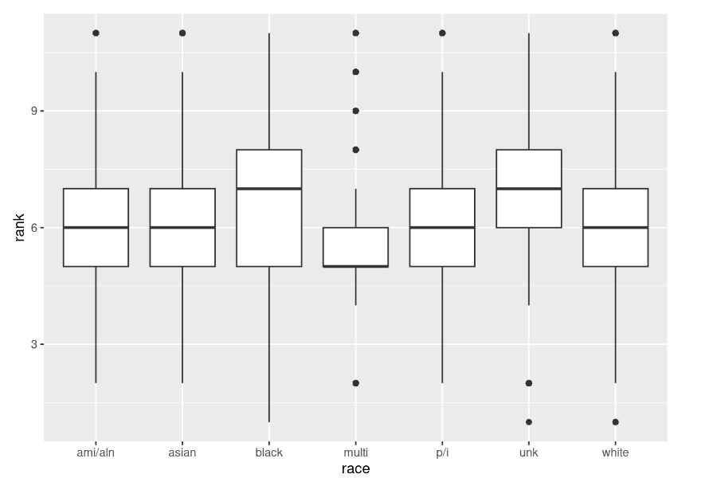
Race vs. Rank
Notes:
Anabel: Comparing these box plots allowed to see that there may be a statistical difference in the data. Many outliers in the multi race.

Slide 7
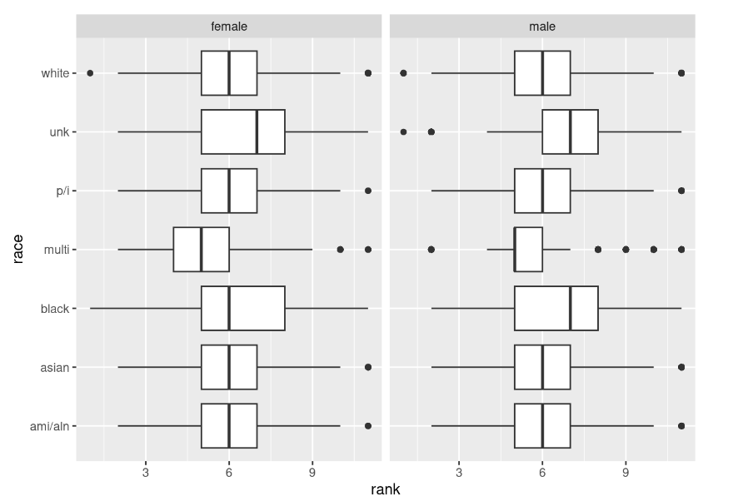
Rank vs. Race by Gender
Notes:
Anabel:

Slide 8

Race Hypotheses
Null Hypothesis:
There is no statistically significant difference between the probability of an Asian identifying military member making rank from rank 6 to rank 7 then that of a white identifying member.
Chi-Squared = df
Alternative Hypothesis:
There is a statistically significant difference between the probability of an Asian identifying military member making rank from rank 6 to rank 7 then that of a white identifying member.
Chi-Squared < df
Notes:
Mia: Decided rank 6-7 because based on the box plots we saw that that’s where the majority of the data lies. Making rank 7 is becoming a general officer which is a huge feat that not a lot of people make. We know that in society in general minority groups tend to not be considered as often white people for higher-up positions so we were wondering if this would apply to the military as well and we had suspicions that it would.

Slide 9
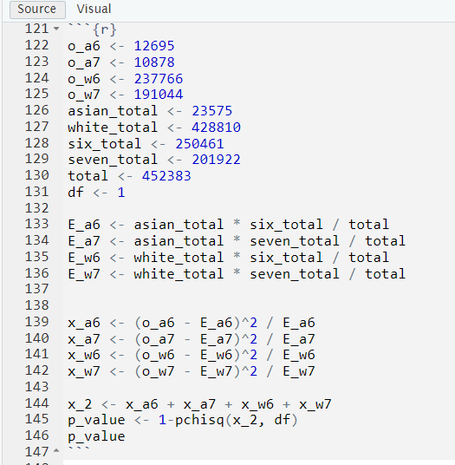

Chi-Squared for Two Way Table
Almost all requirements met:
Assuming independent random sample
Assuming the cell frequencies are at least 5
Notes:
Anabel:

Slide 10
We can conclude…
P-value = 1.646316e-06
Reject the null hypothesis!
There is a statistically significant difference
Discrimination
Lack of opportunities for minorities
Notes:
Ella: there is a statistically significant difference in the probability of an Asian identifying military member making rank from rank 6 to rank 7 compared to that of a white identifying member

Slide 11
Gender Hypothesis
Null Hypothesis:
There is no statistically significant difference between the probability of an female identifying military member making rank from rank 8 to rank 9 then that of a male identifying member. chi-squared = df
Alternative Hypothesis:
There is a statistically significant difference between the probability of an female identifying military member making rank from rank 8 to rank 9 then that of a male identifying member. chi-squared < df
Notes:
Mia:

Slide 12
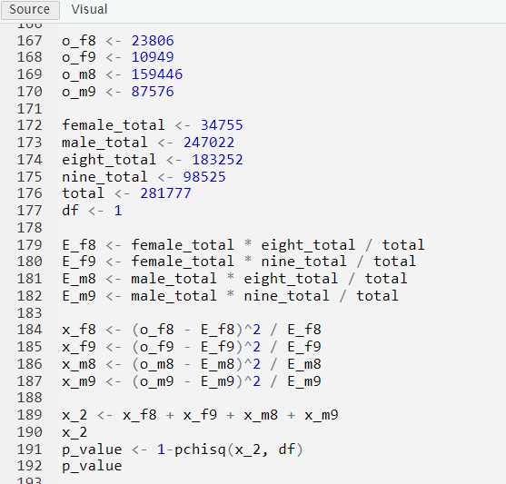
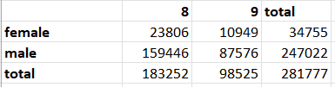
Chi-Squared for Two Way Table
Almost all requirements met:
Assuming independent random sample
Assuming the cell frequencies are at least 5
Notes:
Anabel:

Slide 13
We can conclude…
P-value < 0.05
Reject the null hypothesis
There is a statistically significant difference
Discrimination
Opportunity differences for females
Notes:
Ella:

Slide 14
Questions?

