Slide 1

Statistical Analysis of Duke Student’s GPA
By: Sophie Osborn

Slide 2

The GPA data set
Survey of voluntary students at Duke University
Observations include GPA, hours of sleep, hours of study, nights out, gender
Numeric vector, factor with two levels

Slide 3
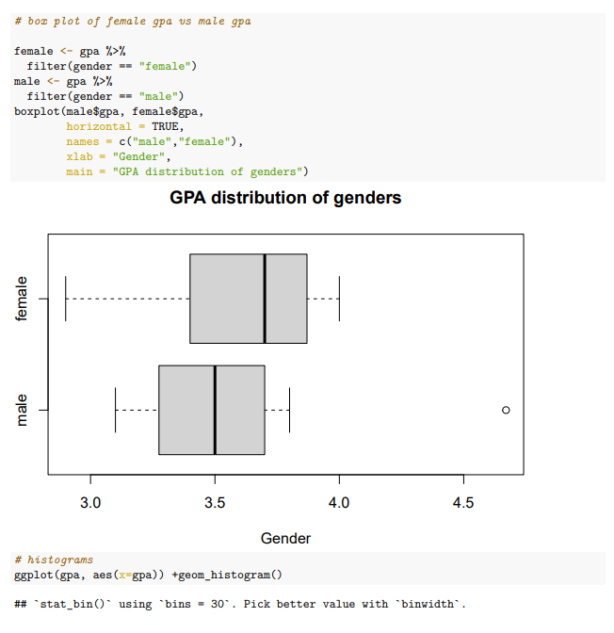
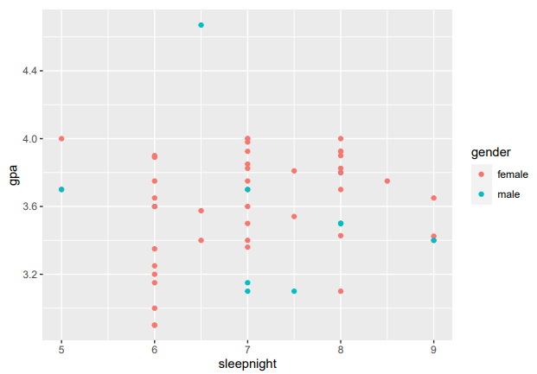
What are my research questions?
Do male students have a higher GPA on average than female students?
Does getting more sleep every night result in a higher GPA?

Slide 4

Why should you care?
College students
All hope to earn a high GPA
Statistics course, therefore some interest in statistical relationships

Slide 5
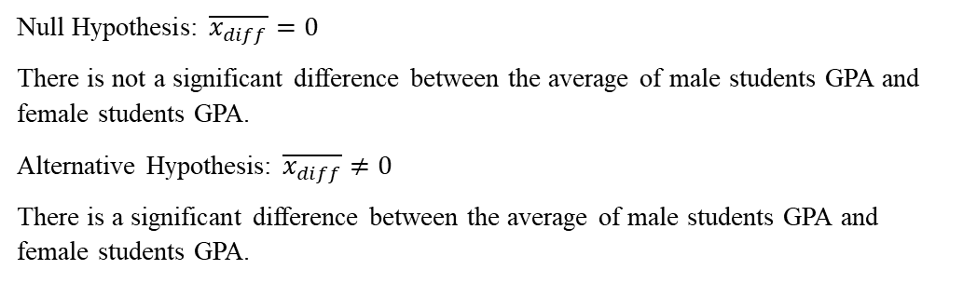
Do male students have a higher GPA on average than female students?
Inference for difference of two means using a t-test
Pro: well fit for question being asked
Con: sample sizes vastly different (43 female, 12 male)
Satisfies conditions for testing
No extreme outliers
Simple random sample
Null Hypothesis: $\overline{x_{diff}}=0$
There is not a significant difference between the average of male students GPA and female students GPA.
Alternative Hypothesis: $\overline{x_{diff}}≠0$
There is a significant difference between the average of male students GPA and female students GPA.

Slide 6
Results
CONCLUSIONS
High p-value: 0.7026, alpha = 0.05
Type 2 error, fail to reject the null
Confidence interval: -0.237->0.339
Null within confidence interval, no significant difference
Any variation likely by chance
Voluntary survey -> likely some bias
Small samples size of female to male, and in general
More variables are often at play when assessing GPA comparisons: major, year, high school credits or no

Slide 7
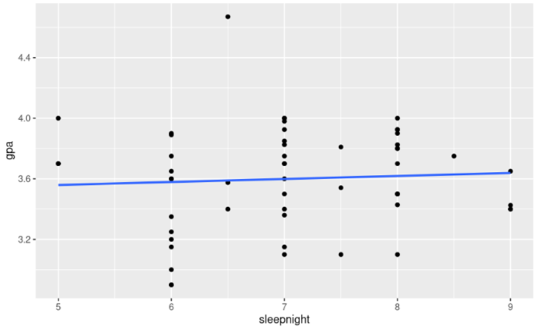
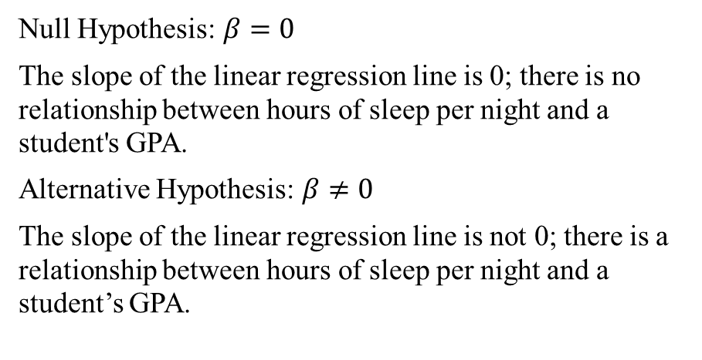
Does sleeping more every night guarantee a higher GPA?
Null Hypothesis: $β=0$
The slope of the linear regression line is 0; there is no relationship between hours of sleep per night and a student's GPA.
Alternative Hypothesis: $β≠0$
The slope of the linear regression line is not 0; there is a relationship between hours of sleep per night and a student’s GPA.
T-test, linear regression using OLS
Pro: well fight for numerical observations
Con: not clearly linear from initial scatter plot
Satisfies conditions for testing
Independent random samples
Residuals are normal and homoscedastic from initial plot
Explanatory variable appears independent from residuals

Slide 8
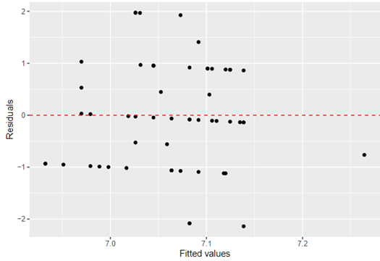
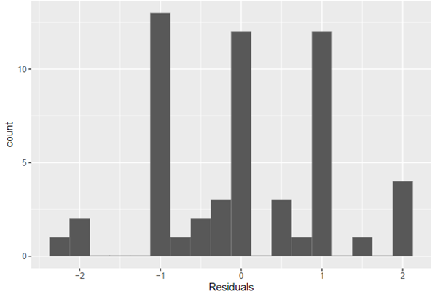
Results
Conclusions
P-value = 0.13, alpha = 0.05
Type 2 error, fail to reject the null
Confidence interval: -0.335->0.732
null value in interval so results not statistically significant
Residuals are not normally distributed, heteroscedastic -> linear regression does not explain all trends
Linear regression equation: y=2.199+0.198x
Very small positive slope
R squared = 0.372
Relatively low, not the lowest it could be
Again, small sample size with probable bias
Other research has been done showing positive correlation with more sleep and a higher GPA

Slide 9
Conclusions
DO MALE STUDENTS HAVE A HIGHER GPA ON AVERAGE THAN FEMALE STUDENTS?
Does sleeping more every night guarantee a higher GPA?
Type 2 error, failure to reject the null
Results not statistically significant, variation likely due to chance
Type 2 error, failure to reject the null
Results not statistically significant, variation likely due to chance
Linear Regression does not explain all trends
Solutions:
Larger sample size, closer number of responses for gender
Specific students from same major/year for testing
Multiple choice survey with specific responses

Slide 10

Questions???

