Slide 1
A Presentation on Problematic Pupil Prejudice and Partiality Pertaining to Professor Performance
Vincent Robinson – Alex Heller – Luke Knoblich

Slide 2
What is the problem?
If professor evaluations are significantly impacted by factors such as gender, ethnicity, and tenure status, then they are misleading and ineffective.

Slide 3
Why is this an interesting problem?
Gender/minority bias:
Would indicate that evaluations cannot be trusted
Hard to differentiate bias and actually good/bad professors
Tenure status:
Better professors may be put in harder courses
Larger, intro-level courses may have newer professors
If scores seem to be affected by course, evaluations are misleading

Slide 4
Where our data comes from
Sample of 463 classes taught by 94 professors from University of Texas
Data includes attributes such as:
Beauty Rating
Rank/Tenure Status
Gender
Ethnicity

Slide 5
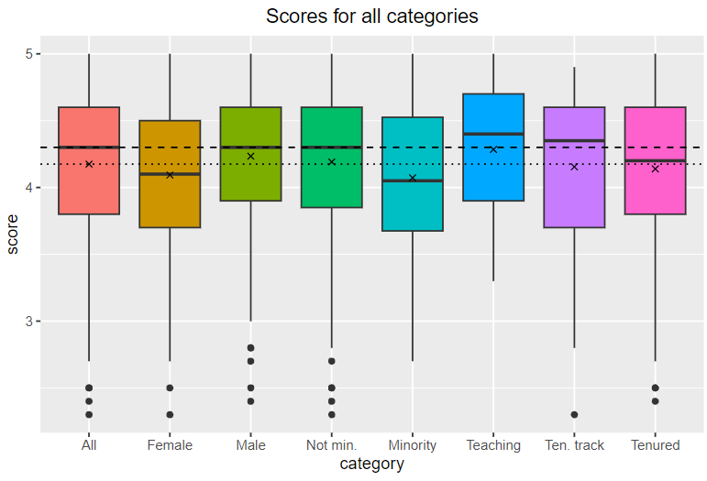
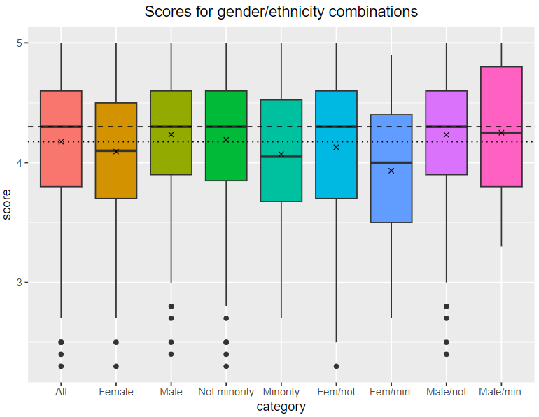
Statistical methodology
Difference of means
Compare each category's mean to the mean of the entire data
Can detect differences in each category independently

Slide 6
Results: Gender and ethnicity
Receive LOWER scores on average
Female
Female/minority
No significant difference
Male
Non-minority
Minority
Male minority

Slide 7
Results: Teaching, tenure track, tenured
Receive HIGHER scores on average
Teaching professors in general
Teaching/male (minority or not)
Receive LOWER scores on average
Teaching/female
Tenure/minority
No significant difference
Teaching/non-minority
All other tenure groups

Slide 8
Conclusions
Evaluations for female professors are disproportionately low
These evaluations cannot be fully trusted
Especially applies to minority female professors
Teaching professors have very high scores
Very odd result
Perhaps influenced by the classes they were assigned to?
Needs further research
Tenure track/tenured professors are almost entirely average
These evaluations seem the most reliable

Slide 9
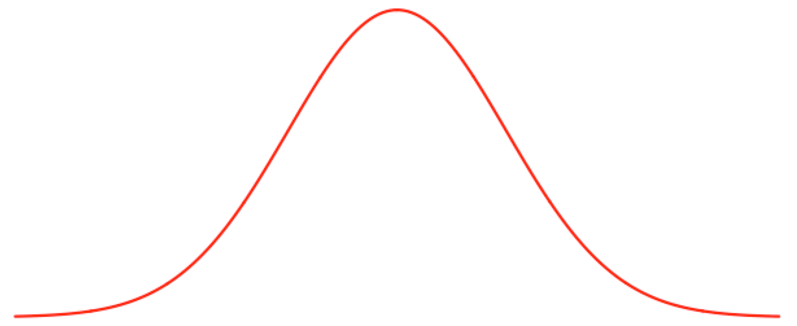
Questions?
Obligatory bad math joke:
The only condition is that they must be normal questions

