Slide 1

The Effect of Age On Housing Condition in Ames, Iowa
Applied Statistics Final Presentation
Alec Uyematsu, Caden Deutscher, Devam Patel

Slide 2
Overview
Motivation
Key Idea:
Test
Conditions Met?
Results

Slide 3

Problem
Does age effect house condition?
Can these effects be slowed/reversed with remodel?
How much should age be considered?
These are important decision for those of us who are going to be making these decisions going forward.
This Photo by Unknown author is licensed under CC BY.

Slide 4
Data Set
2930 observation
Explanatory variables - 23 nominal, 23 ordinal, 14 discrete, and 20 continuous
Pulled from sales of individual residential properties (2006-2010) in Ames, Iowa
Came directly from Ames City Assessors Office
Deleted variables that required special knowledge or outside information

Slide 5




Factors to Consider
Materials
Weather
Owners
Time

Slide 6
What are we testing?
Linear Regression
H0_YearBuild: Year built does not, on average, affect the general condition of the house
HA_YearBuilt: New houses, on average, have a better general condition than older houses.
Multiple Linear Regression
H0_RemodAdd: Year remolded/additions and year built does not, on average, affect the general condition of the house.
HA_RemodAdd: New remodels/additions to the house and more recently built houses, on average, have a better general condition than older houses.

Slide 7
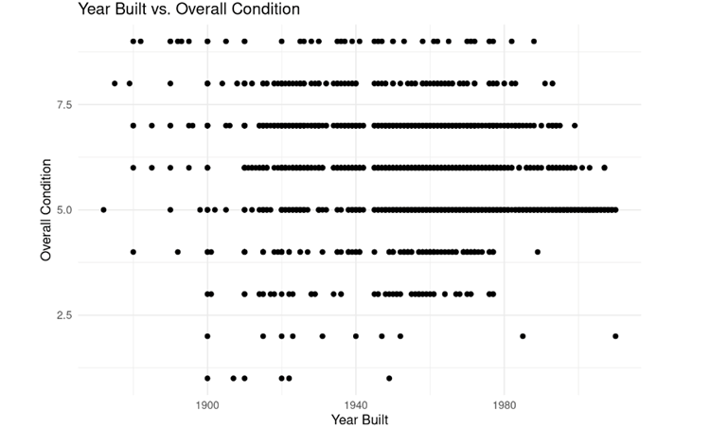
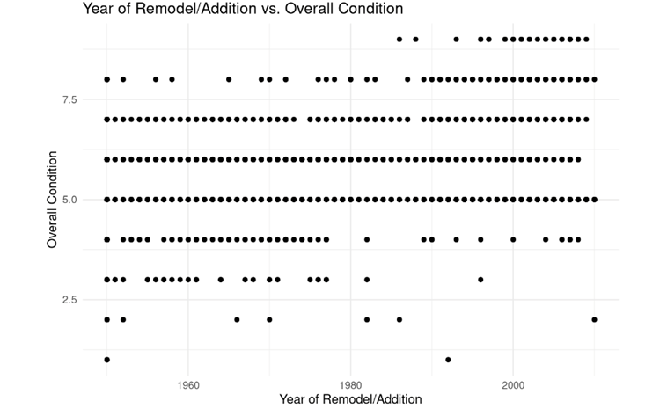
Initial Exploration

Slide 8
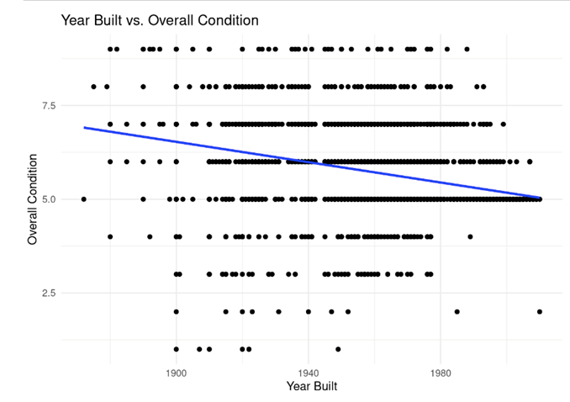
Simple Linear Regression
Condition = -0.013x + 32.280, where x is age of the home

Slide 9
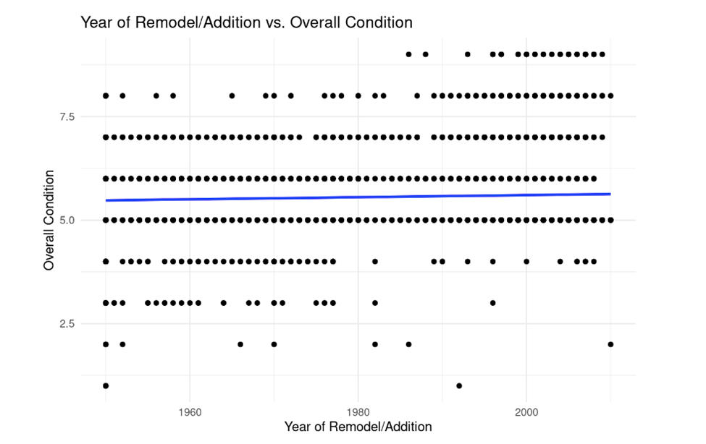
Multiple Linear Regression
Overall.Cond = 5.4417553 + 0.0232966 * Year.Remod.Add - 0.0233876 * Year.Built

Slide 10
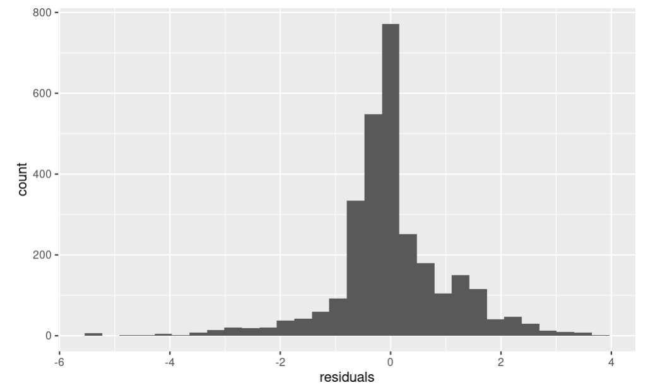
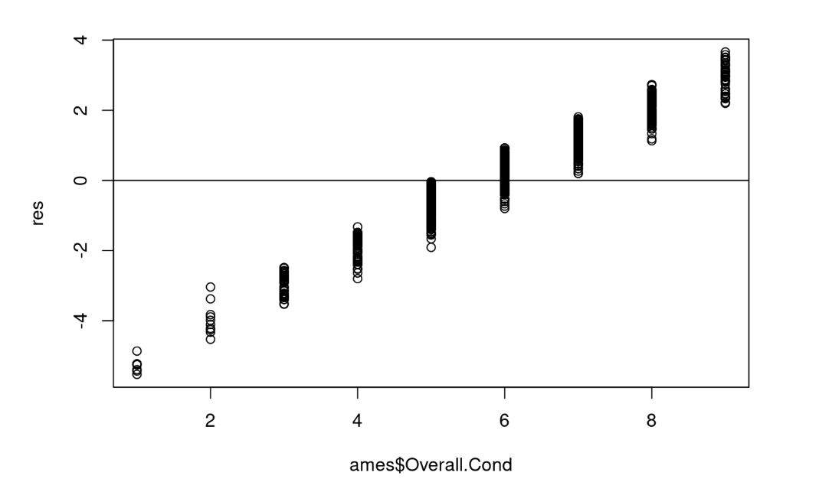
Conditions
Residual Histogram – Normal
Independent Random Sample - True
Residual Plot - Pattern in Residuals

Slide 11
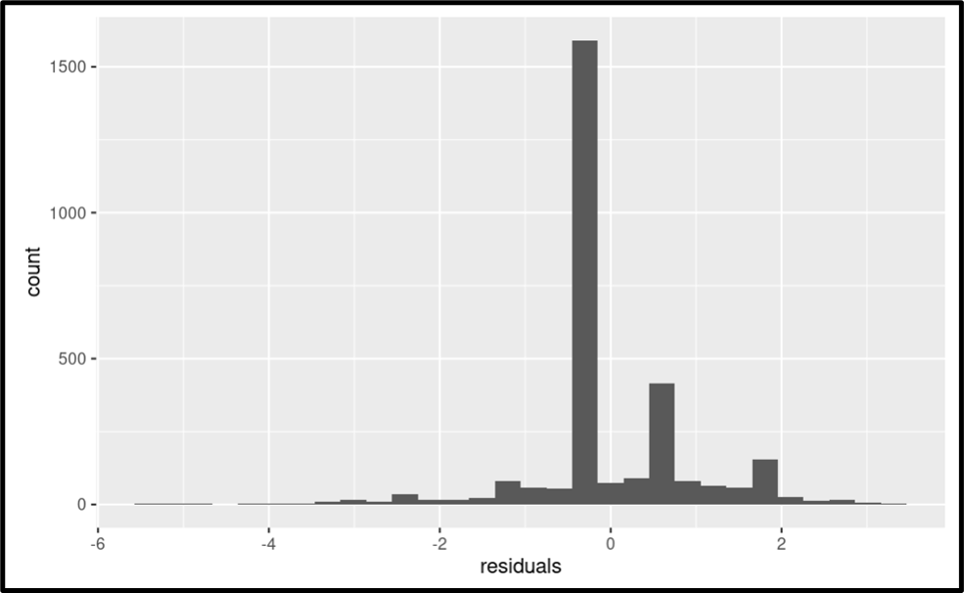
Conditions (Continued)

Slide 12
Results
Age Influences Conditions
Remodel influences condition
Very low p values
Results are opposite of what we expected for Age and same for Remodel
2008?

Slide 13
Key Conclusions
Application
Does this test work?
Other Considerations...
Does this match expectation?
Does not fit model enough to give conclusive result.
Many Lessons Learned

Slide 14
Summary
Motivation
Key Idea:
Test
Conditions Met?
Results

Slide 15


