Slide 1
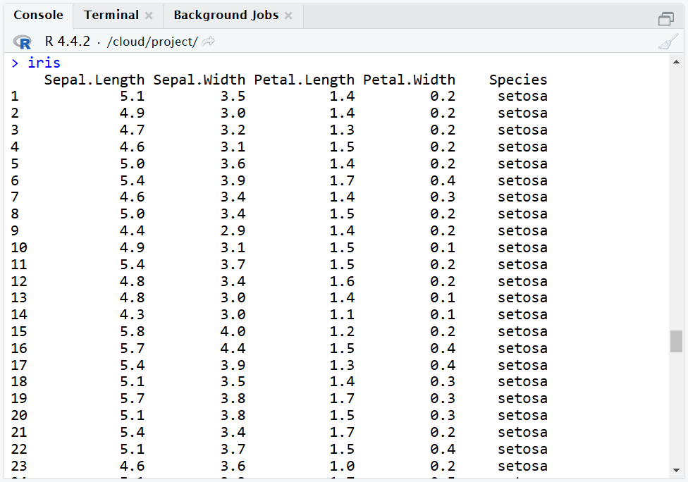
Shown Columns
or Variables
Shown Rows
or Observations
Row Indices or Labels

