Slide 1
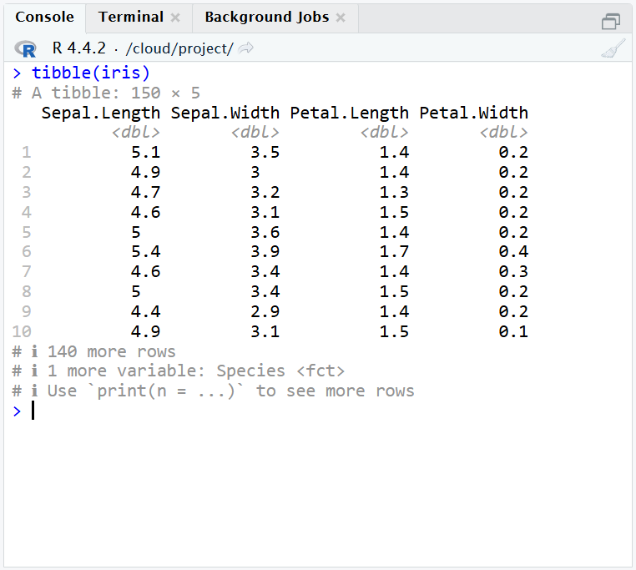
No. of Rows x Columns
Shown Columns
or Variables
Shown Rows
or Observations
More information about the no. of rows and columns

