Slide 1
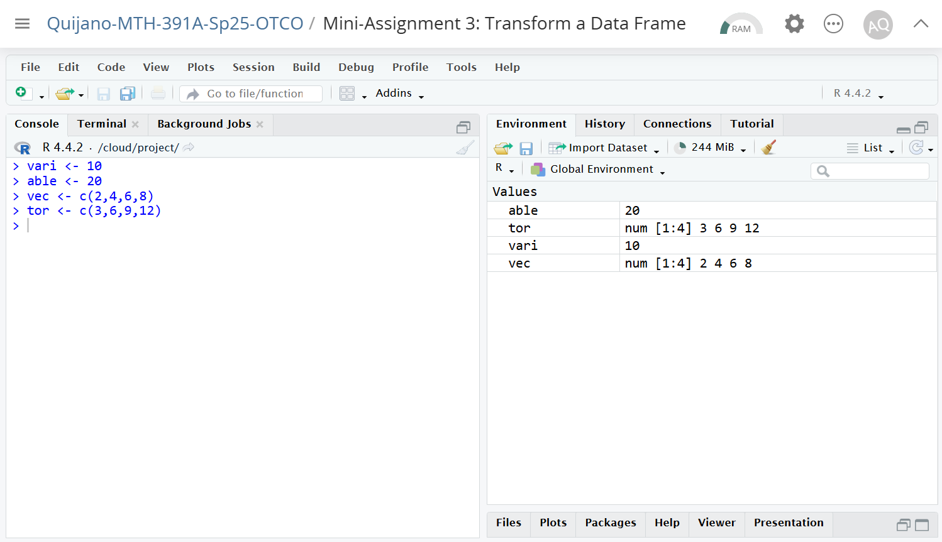
The “Environment” window shows all user-defined variables and functions.
Variables are defined using the “<-” syntax and stored in a temporary memory.
Here, “vari” the variable is defined as a single number.

