Slide 1
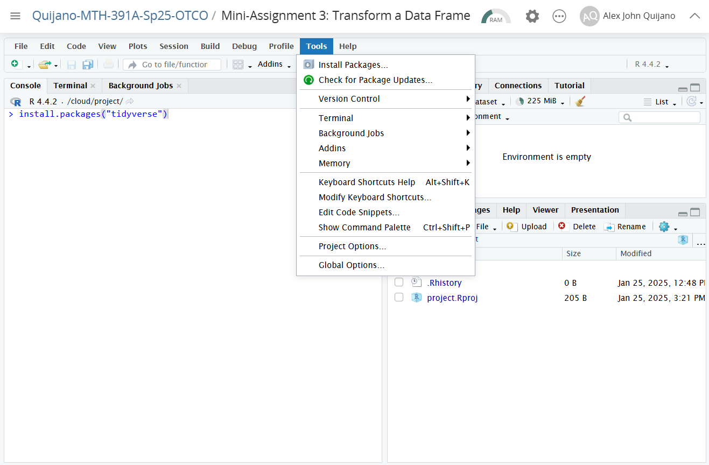
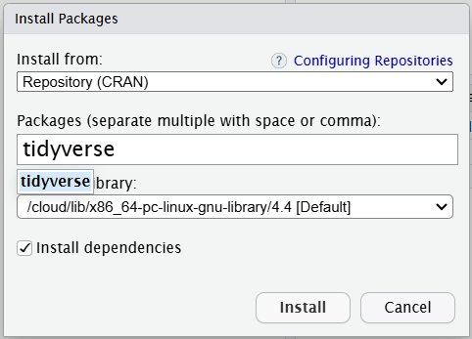
Installing packages using the “Tools” menu will send and run an R command to the console.
Clicking “Tools” and “Install Packages…” will open the install packages window.

