Slide 1
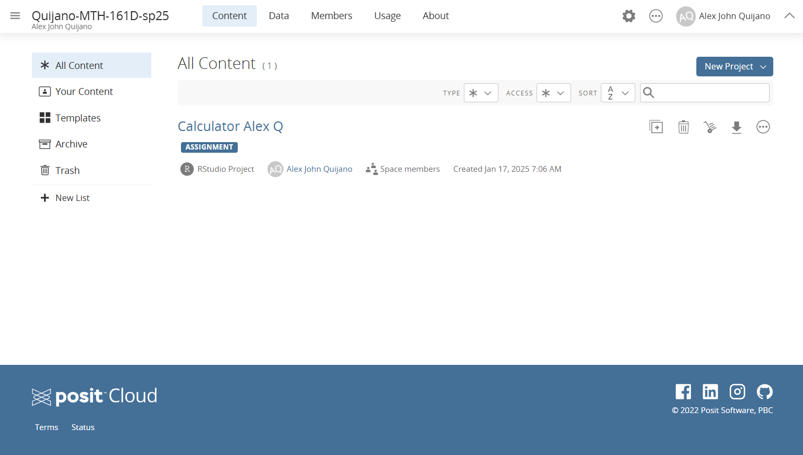
An RStudio “Project” labelled as an Assignment.
All R related assignments will show up as an RStudio Assignment in this course’s workspace.
Workspace

