Slide 1
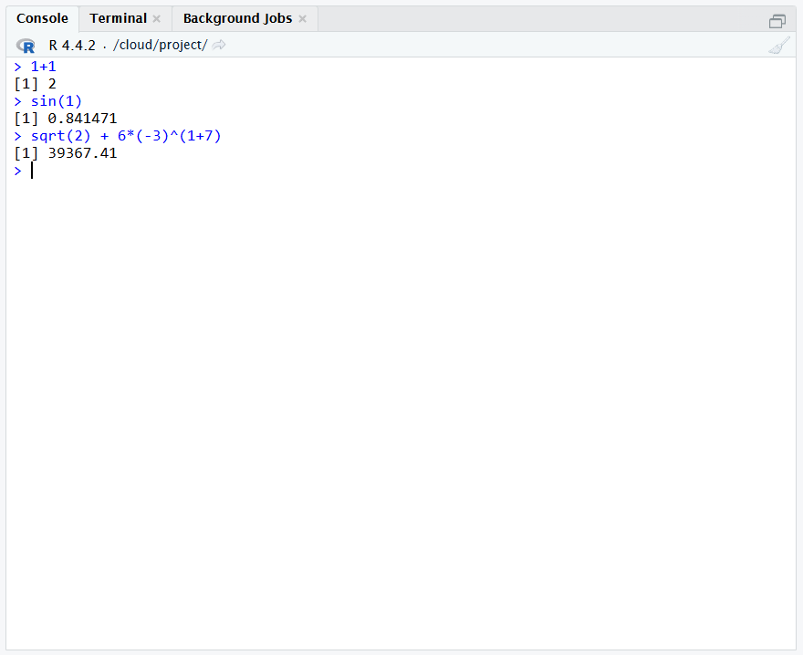
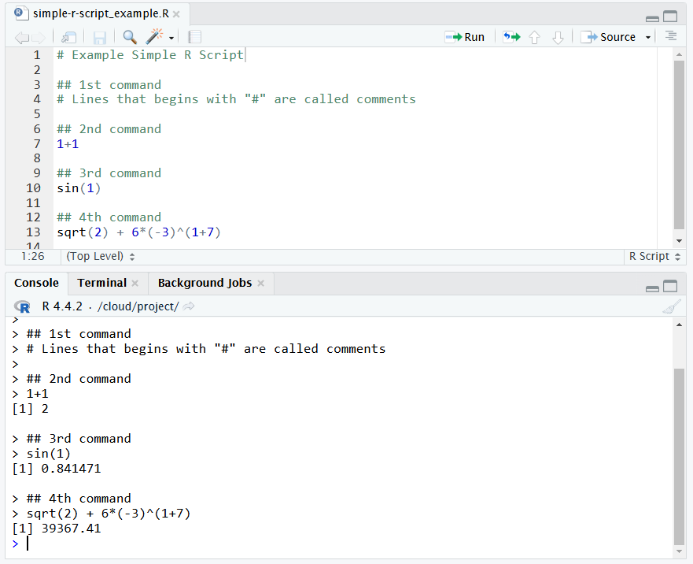
Console
R Scripting
Run the current R script to the console.
Running R directly on the console is useful if you need a quick result but the commands may not be saved.
Both methods are using the same system but in different pathways.
Writing R on a script file is useful if you need to run multiple commands.
Running R commands from an R script will send these commands to the console.

