Slide 1
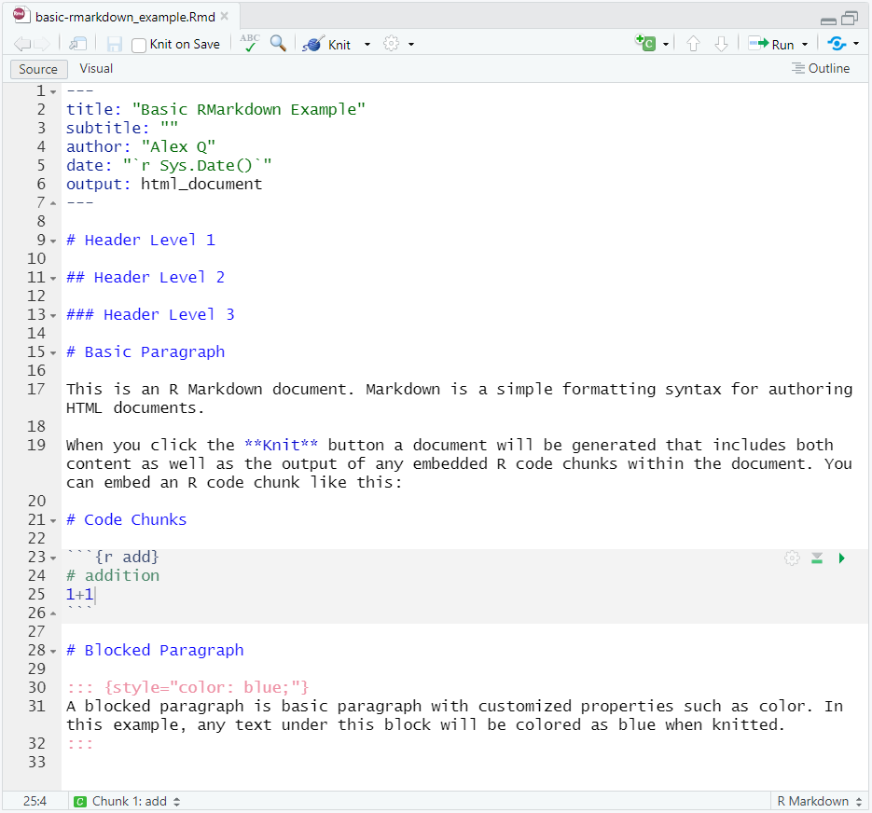
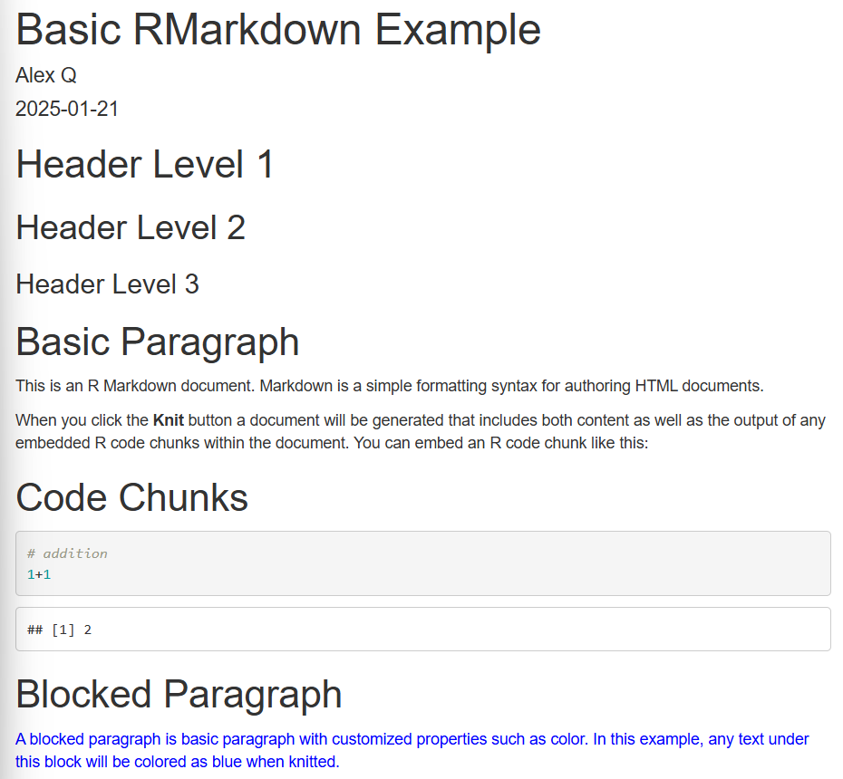
RMarkdown File
HTML Output
1
1
2
2
3
3

Slide 2
RMarkdown File
HTML Output
4
4
5
5

